Slide 1
Can we improve Yelp's services by precise user-business match-up?
Chang Du, Hanxing Li, Junru Lu, Shijia Gu

Slide 2
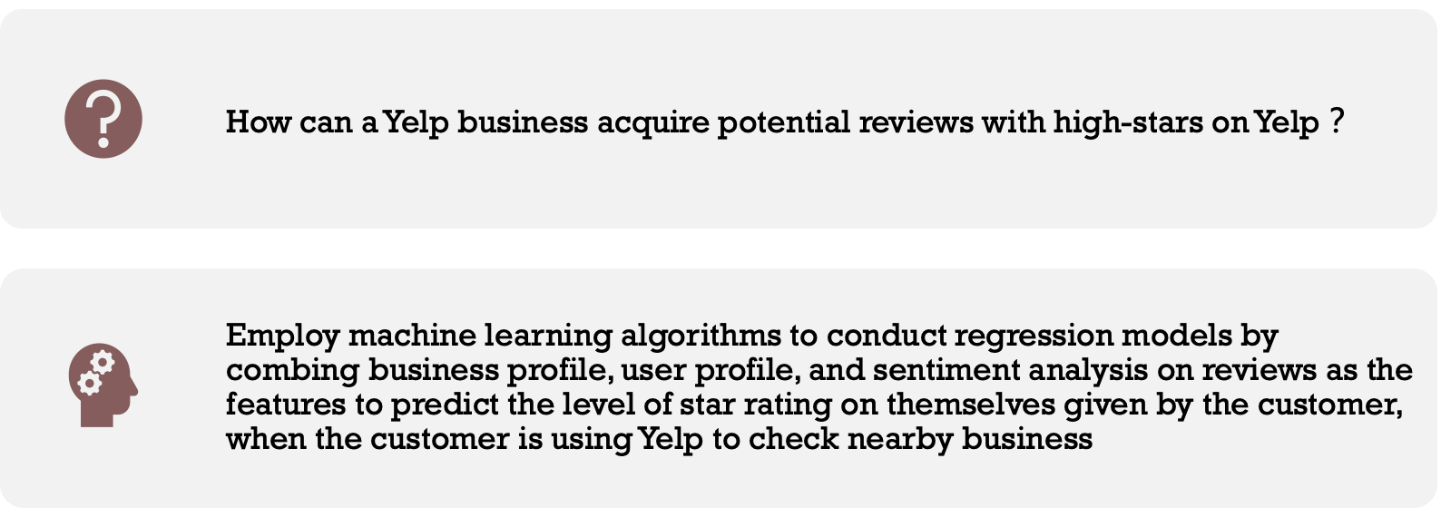
Problem Statement

Slide 3
Datasets

Slide 4
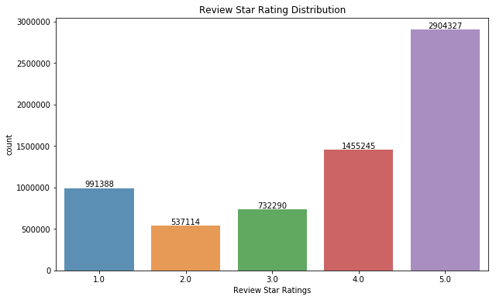
Review Dataset
 | Sample
Business id | kKo73YIOPoverMeL867hoOw
User id | KMAI8qT7LUKFrZCqEMqFfA
Review id | KPUFLYyHDsaQC8ks1ZQwxQ
Review star | 5.0
Text | This place is fantastic, Ordered a dozen tre...
Useful | 1
Cool | 0
Funny | 2
Figure 1: the Distribution of Star Ratings

Slide 5
Review Dataset
 | Sample
Business id | kKo73YIOPoverMeL867hoOw
User id | KMAI8qT7LUKFrZCqEMqFfA
Review id | KPUFLYyHDsaQC8ks1ZQwxQ
Review star | 5.0
Text | This place is fantastic, Ordered a dozen tre...
Useful | 1
Cool | 0
Funny | 2
Lexicon-based sentiment analysis to get three sentiment scores of reviews:
- TextBlob, VADER and AFINN Sentiment Scores:
- punctuation, capitalization, conjunctions
- emojis, slangs and acronyms
Review Length
Useful
Cool
Funny

Slide 6
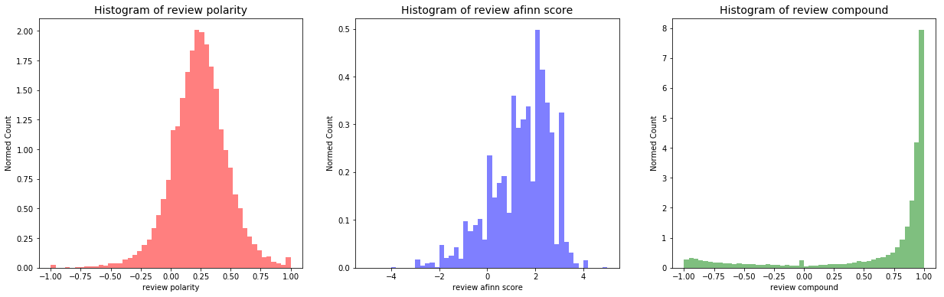
Review Dataset
Figure 2: Distribution of Reviews Sentiment Scores

Slide 7
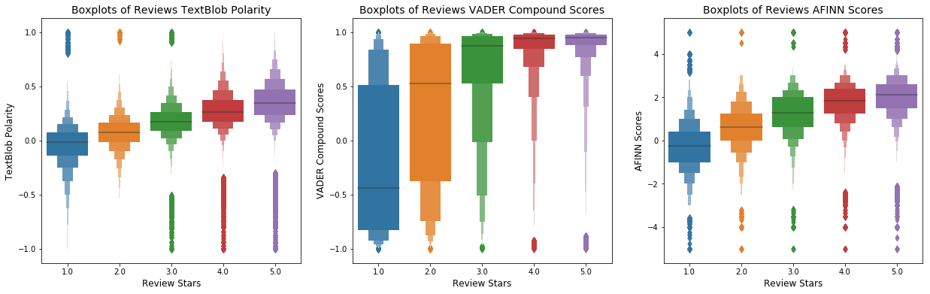
Review Dataset
Figure 3: Boxplots of Reviews Sentiment Scores over Review Stars

Slide 8
Tip Dataset
 | Business id | User id | Text | Compliment count | Date
0 | fknU3sWplCBn26b6HwJkQ | xmNjAckgX7vZFnfqTsR5YQ | Once you enter the parking lot… Turn around... | 0 | 2016-04-19 02:04:52
1 | oWh3TnsN5WrmPn7VgQNsWA | qCzx039NVrJkWnZEqQ1JKA | Positive experience every time! Thank you! | 0 | 2013-06-10 17:05:24
2 | gVgSI9anfzYn8dMdmmFNsg | B7NlilrOlwxxD_kiYMHT4g | This place is great! You gotta go! | 0 | 2014-03-29 06:57:23
3 | oz7PaA6zFtdi2nUxIYdlMg | ZF2fPwWrPRlqhlY8SxButQ | Spin class bikes fill up fast | 0 | 2010-07-06 16:10:41

Slide 9
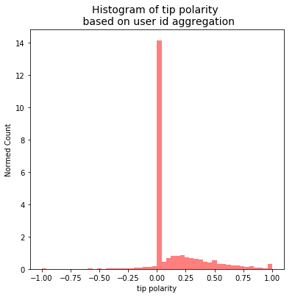
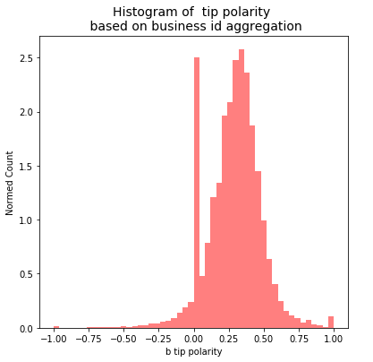
Tip Dataset
Figure 4: Distribution of Tips Sentiment Scores based on User id and Business id aggregation

Slide 10
User Dataset
User id | KMAI8qT7LUKFrZCqEMqFfA
User stars | 4.03
Elite | 2015, 2016, 2017, 2018
Compliments | Compliment cool | 0
User tags | Funny | 17
Fans | 5
Friends | c78V-rj8NQcQjOI8KP3UEA, aIRMgPcngYSCJ5raFRBz5g...
Review count | 95
Yelping since | 2013-10-06 23:11:33
The number of elite years
The number of friends
How many days with Yelp
Notes:
22 features
3 features need preprocessing
Transform the list of Elite years to .../ the list of friends to.../ yelping since is the date user registered Yelp, we transform it to ...

Slide 11
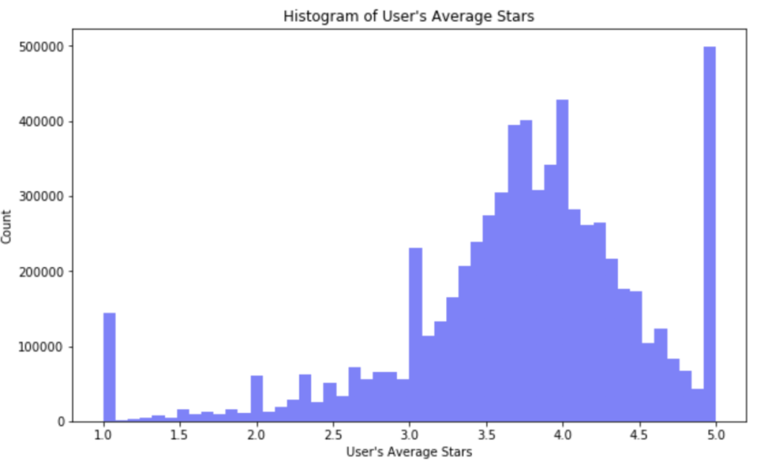
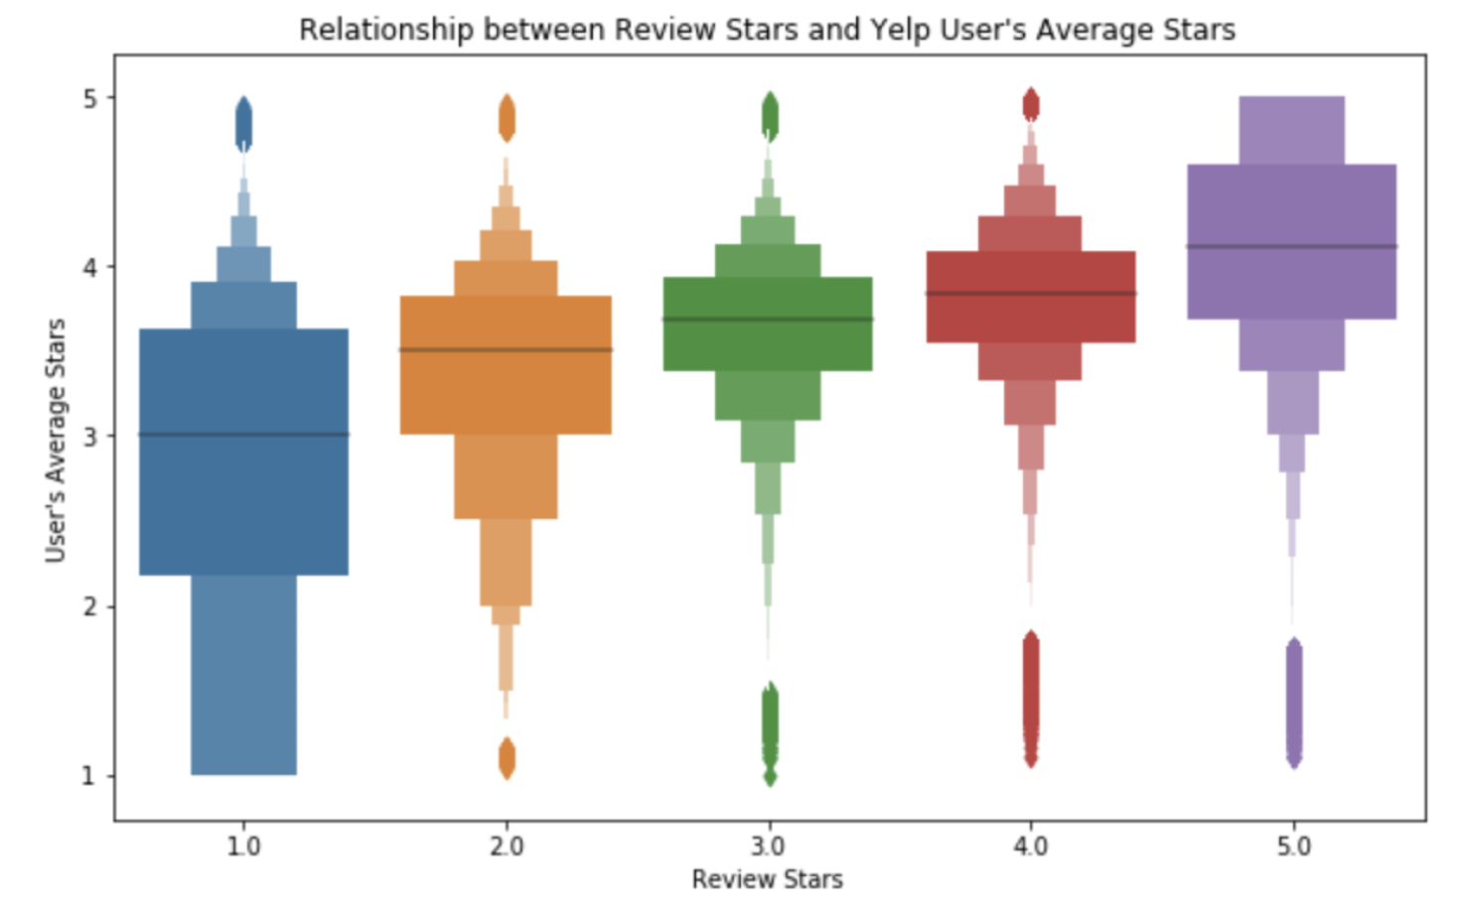
User Dataset
Figure 5: Histogram of User’s Average Stars
Figure 6: Boxplot of Review Stars and User Stars
Notes:
Distribution of User’s average stars, most reviews’ star are between 3.0-4.5, Peak: 5
The boxplot of review stars and user stars, a positive trend between user average stars and review stars

Slide 12
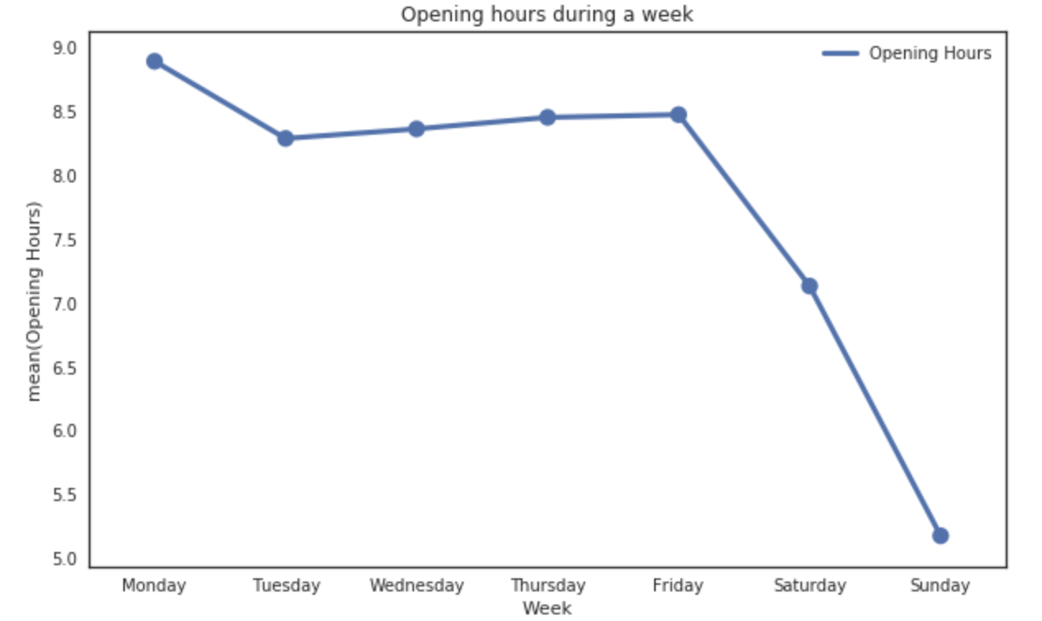
Business Dataset
 | Sample
Business id | ujmEBvifdJM6h6RLv4wQIg
Coordinates | [-115.248798, 36.215546]
Business ratings | 4.5
Number of reviews | 30
Categories | ["Mexican", "Gastropubs"]
Opening hours | {'Friday': '9:0-1:0', 'Sunday': '9:0-0:0', 'Tu…}
Figure 7: Opening hours during a typical week
Notes:
The business data including 6 most useful features. We transfer the category list into the number of categories, and map the opening hours into a seven-column feature matrix of opening duration within a typical week.

Slide 13
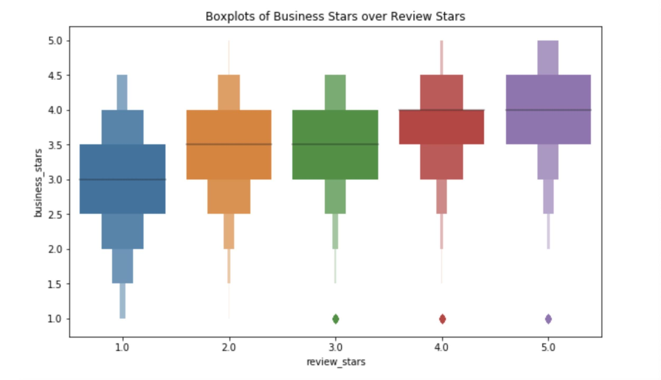
Business Dataset
 | Sample
Business id | ujmEBvifdJM6h6RLv4wQIg
Coordinates | [-115.248798, 36.215546]
Business ratings | 4.5
Number of reviews | 30
Categories | ["Mexican", "Gastropubs"]
Opening hours | {'Friday': '9:0-1:0', 'Sunday': '9:0-0:0', 'Tu…}
Figure 8: Business stars vs. review stars
Notes:
We check the correlation between business stars and review stars, which shows a positive trend.

Slide 14
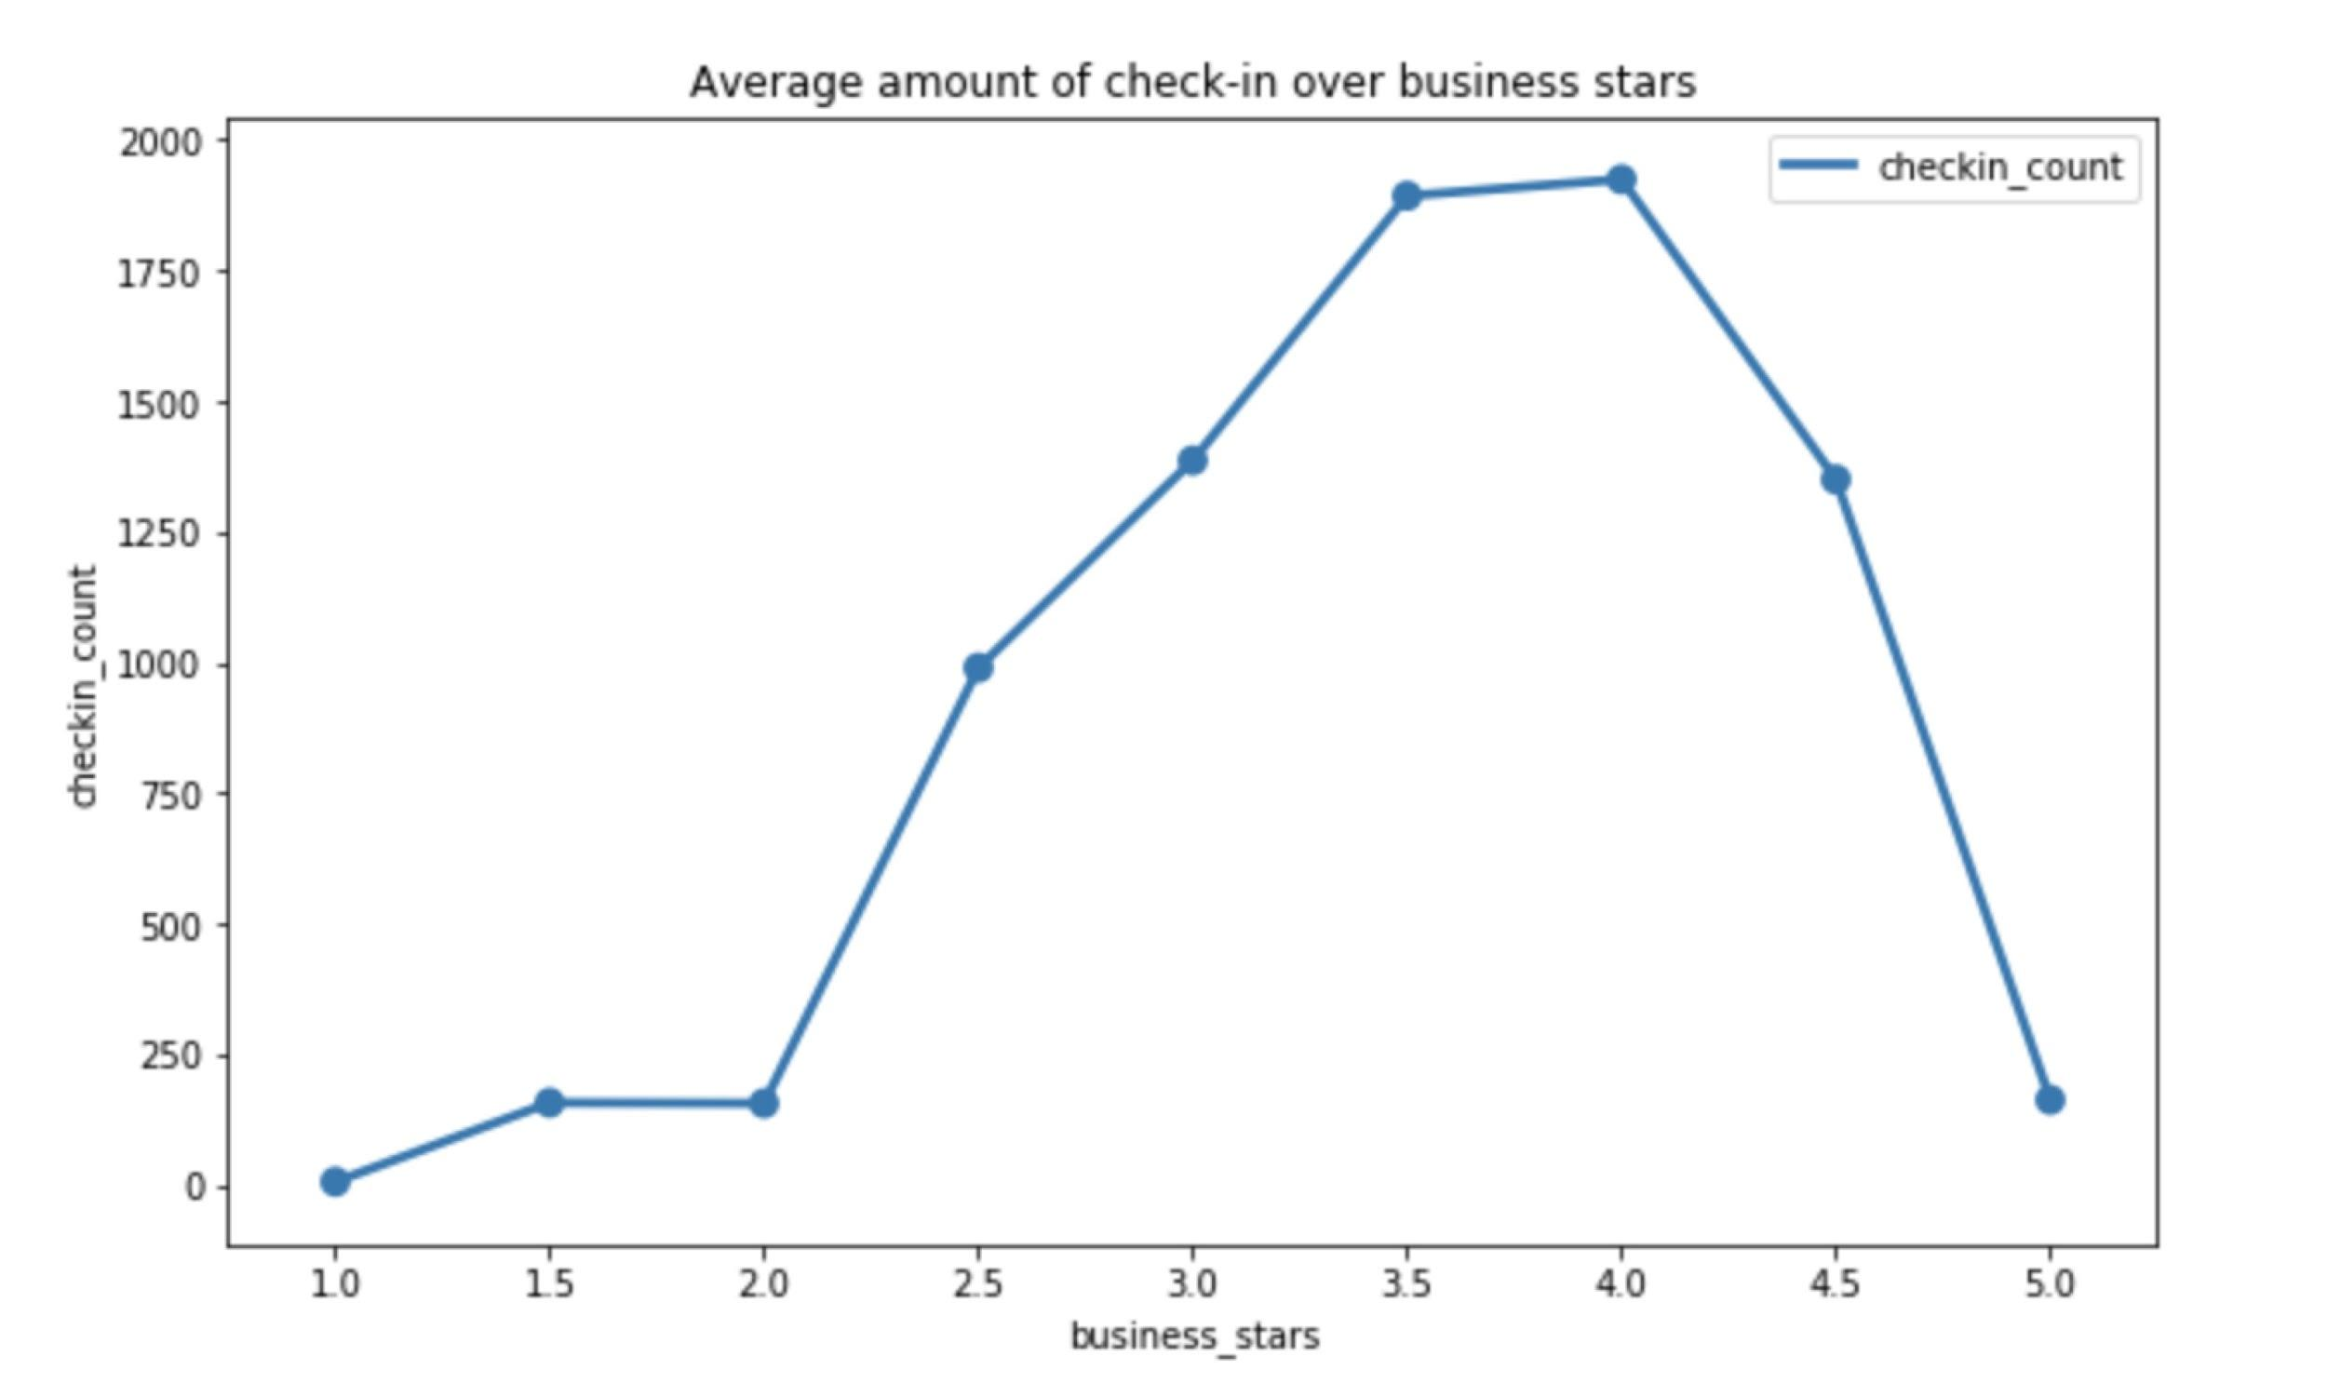
Checkin & Photo Dataset
 | Sample
Business id | ujmEBvifdJM6h6RLv4wQIg
Checkins | [2017-12-05, 2017-12-15]
Checkin Gaps | [10, 8, ...]
 | Sample
Business id | ujmEBvifdJM6h6RLv4wQIg
Labels | [food, food, inside...]
Figure 9: Amount of checkins vs. business stars
Notes:
For checkin and photo data, we calculate the gaps of every checkin dates, and based on that, give average and the variance of these gaps. For the photo data, there are five distinct labels, so we map them counts just as we map the opening hours before.

Slide 15
Modelling, Conclusion & Improvement

Slide 16
Features
 | Review Features |  | User Features | Business Features | User & Tip | Business & Tip | Checkin Features | Photo Features | Target Value
Sample Field | Review Score 1 | Review Score 2 | User Stars | Business Stars | Avg Tip Star | Avg Tip Star (B) | Checkin Counts | Labels Count | Review Stars
Sample | 0.80 | 0.78 | 3.6 | 4.5 | 4.2 | 3.8 | 29 | 20 | 4.0
66 numeric features in total
1 seemingly discrete but real-value target value
6,685,898 rows
8 GB
Notes:
After all these merging, we get 66 numeric features in total.
Also the target value. Review stars only have integer values in deed, but we cannot treat it as labels, since discrete labels will ignore the relative relations among them. So we treat them as real-values then round them into integers after prediction. We have such a massive dataset finally.

Slide 17
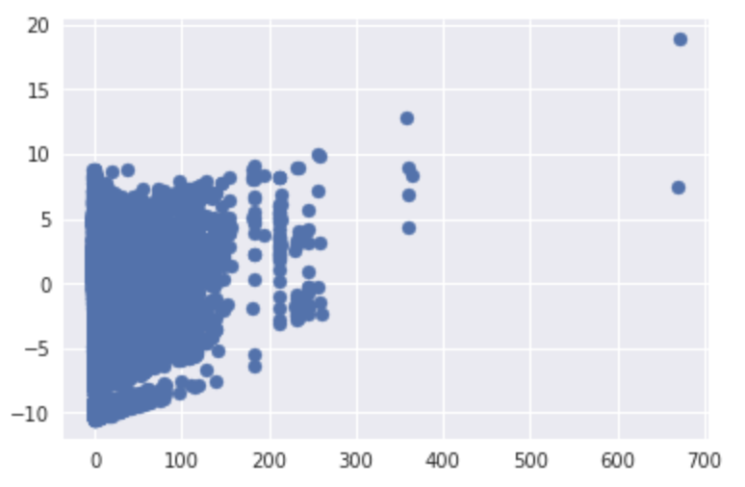
Noisy Data Detection
Figure 10: Using 2D PCA Components to show anomaly samples, only 7 outliers
Notes:
Before modelling, we shall check possible anomalies. Instead of time-consuming detection techs discussed in the class, we use a simple 2-D PCA tech to show anomaly samples, which shows only 7 outliers.

Slide 18
Parameter Setting
Train/test ratio: 7:3
Metrics：
1. Precise Accuracy: sum(prediction.round(0) == test) / test
2. Benefit Accuracy: sum(prediction.round(0) >= test) / test
Models: Random Forest & Light Gradient Boosting Machine
Notes:
For the modelling, we set some parameters. Except for traditional accuracy, we create a benefit accuracy for this case. Because for business owner, higher prediction means they can improve their reputation even more from customers.
We used two single models. One is RF, another is LGBM, which is an another tree-based gradient boosting framework. The LGBM using something called Leaf-wise algorithm, which can reduce more loss and training faster.

Slide 19
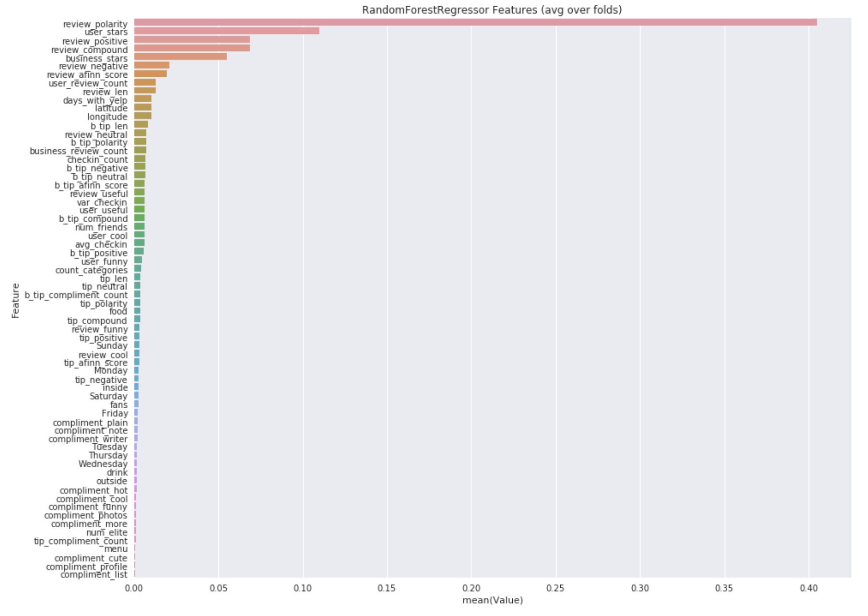
Regression
PA: 0.559
BA: 0.789
Notes:
The RF result gives a precise accuracy of 56% on test set, and around 80% benefit accuracy. This means on the this accuracy that a business can use the model to get a precise or higher rating expectation on any potential review.

Slide 20
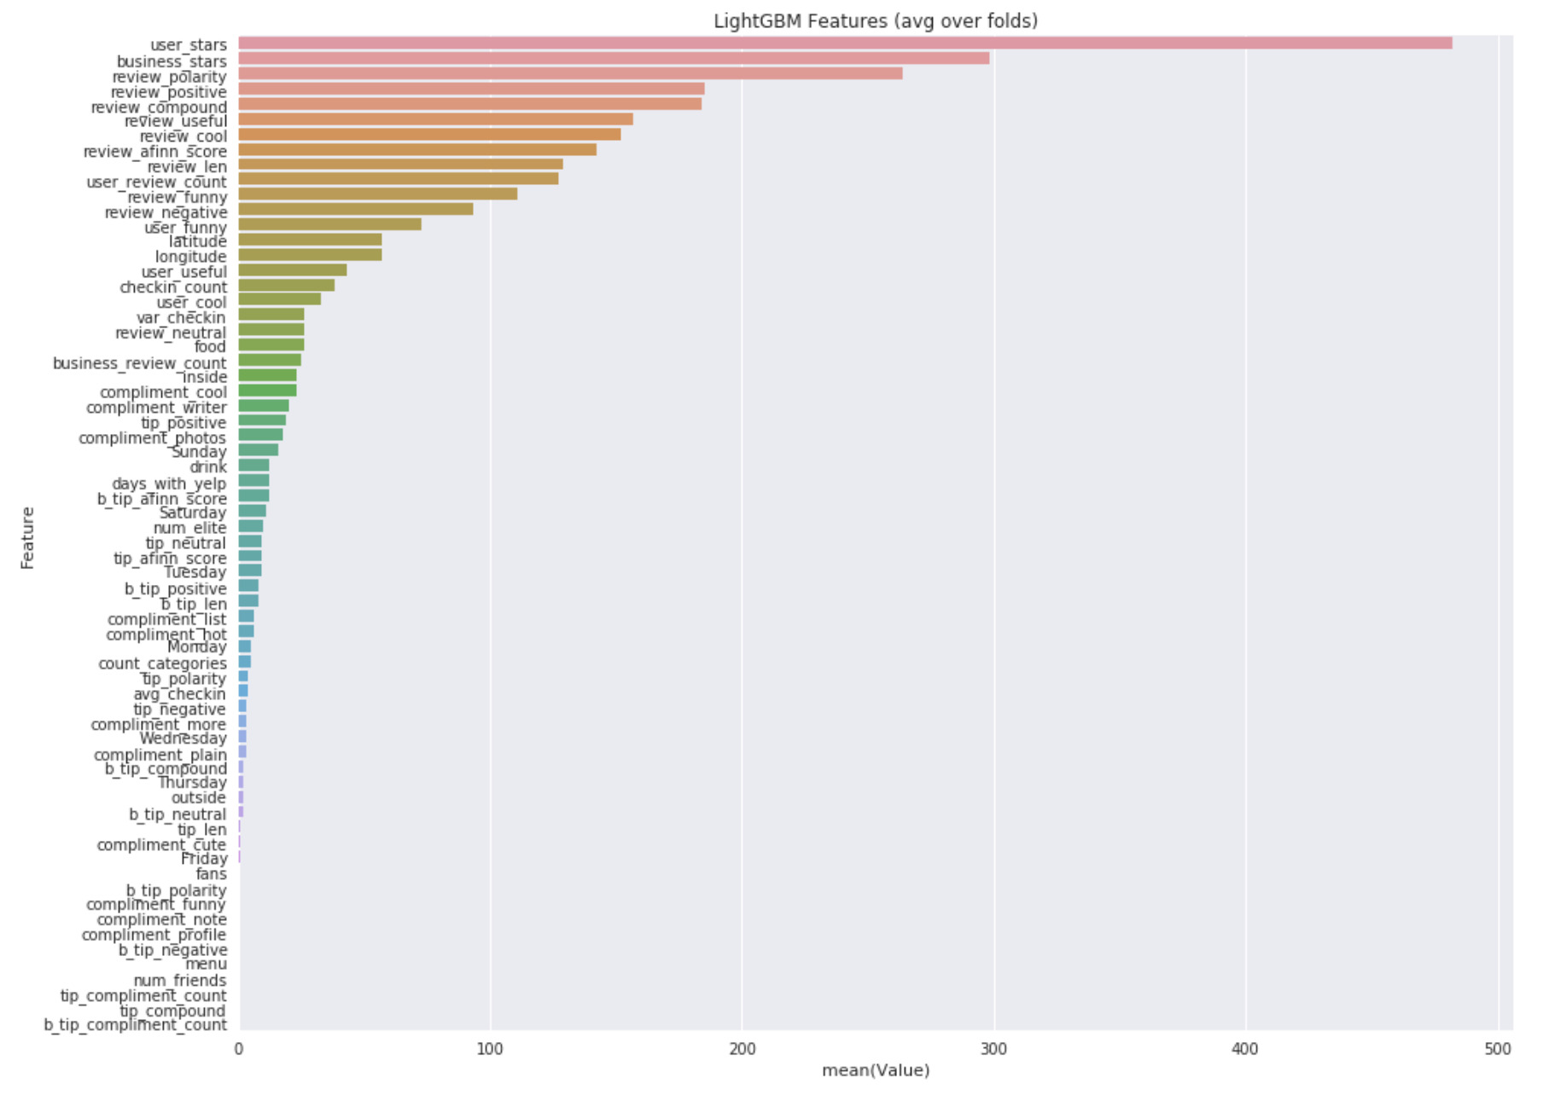
Regression
PA: 0.578
BA: 0.785
Notes:
The LGBM model gives even better results. What’s more, the contribution of top features are consistent with our intuition as well as the analysis we have done just before.

Slide 21
Improvement
Feature Engineering:
1. length of review
2. business categories
Parameter Optimum: grid search
Ensemble Learning: stacking while time complexity grows
Notes:
1. Improvement on feature engineering: change length of characters into words, and use specific infos in business categories
2. Using grid search to find the best combination of parameters. We currently only get some overfitting result

Slide 22
Can we improve Yelp's services by precise user-business match-up?
https://github.com/LuJunru/MLC2019_Final_Project
Notes:
Thank you for listening.

