Slide 1
Rotten Potatoes
Group Project for 372.01 Fall 2024
Bryn Slavin
Caleb Centy
Chang Vang
Nicholas Yang
Paul Trevizo

Slide 2
What’s ahead
Rotten Potatoes – An introduction (Paul)
An Overview of the App (Paul)
How Content is Fetched – A brief summary (Nicholas)
A demo
Login Screen (Caleb)
Home Page (Caleb)
Search Page (Nicholas)
Show Overview (Chang)
Season Overview (Chang)
Episode Overview (Bryn)

Slide 3




Rotten Potatoes – An introduction
All user reviews! Boil 'em, mash 'em, stick 'em in stew!
Need for better consistency in TV show reviews
Existing apps are subject to wild swings in fandom temperature causing the app’s objectivity to languish.
Rotten Potatoes – Logged in users can access different shows, submit reviews for specific seasons, and/or episodes.

Slide 4
An Overview of the App
The apps based on the following principles:
Data Integrity – Our database uses constraints to maintain accurate relationships between data.
Transparency – We implemented a simple review calculation methodology.
Quality – Our application is tested for performance, maintains high reliability and availability, and ensure a user-friendly and accessible interface.
We have six core functional requirements. Users must be able to:
Login to the app
Search for TV shows
Submit reviews
Goto Home via Home Button
See/review Individual Season Information
See/review Individual Episode Information

Slide 5

How Content is Fetched – A brief summary
Registered with The Movie Database (TMDB)
Utilized GET calls through their API to gather content for our app
Utilized in our code for real-time content without the need to:
Create a new content database
Maintain a content database.

Slide 6
Rotten Potatoes A demo

Slide 7
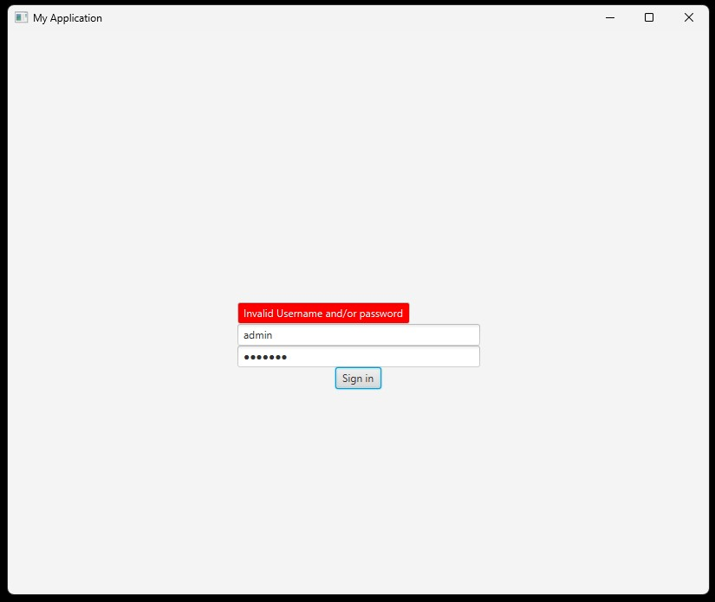
Login Screen
Users enter their username and password to login to the site
Will ping "Invalid Username/Password" if it isn't correct

Slide 8
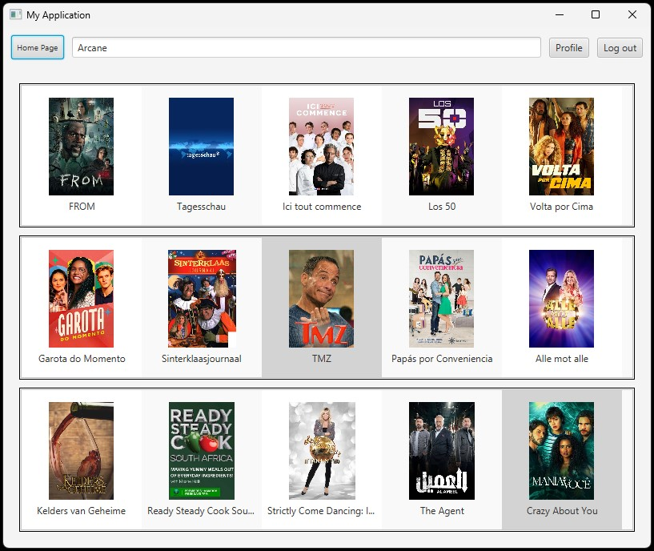
Home Page
Features:
Lists of suggested shows (TMDB API)
A fixed search bar located at the top of every page
A fixed home button to return to this page
A logout button

Slide 9
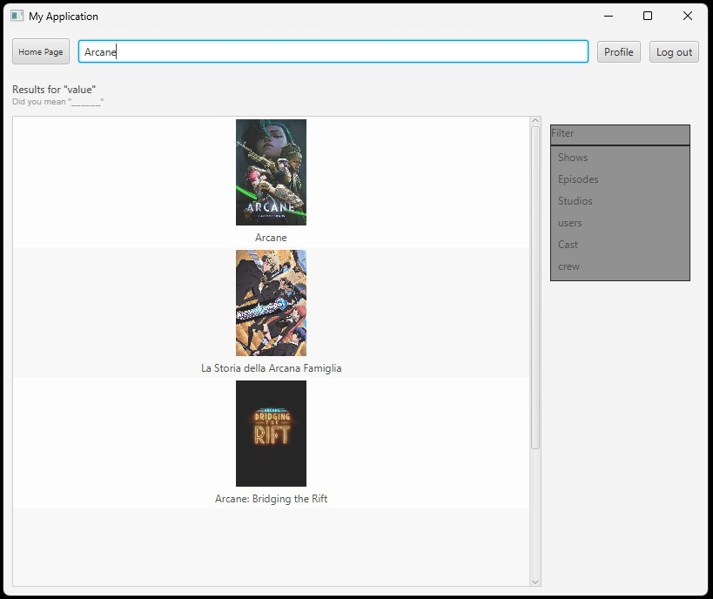
Search Page
Provides a list of options based on the search lexicon
Utilizes TMDB API
Users can click on the specific item they would like to open

Slide 10
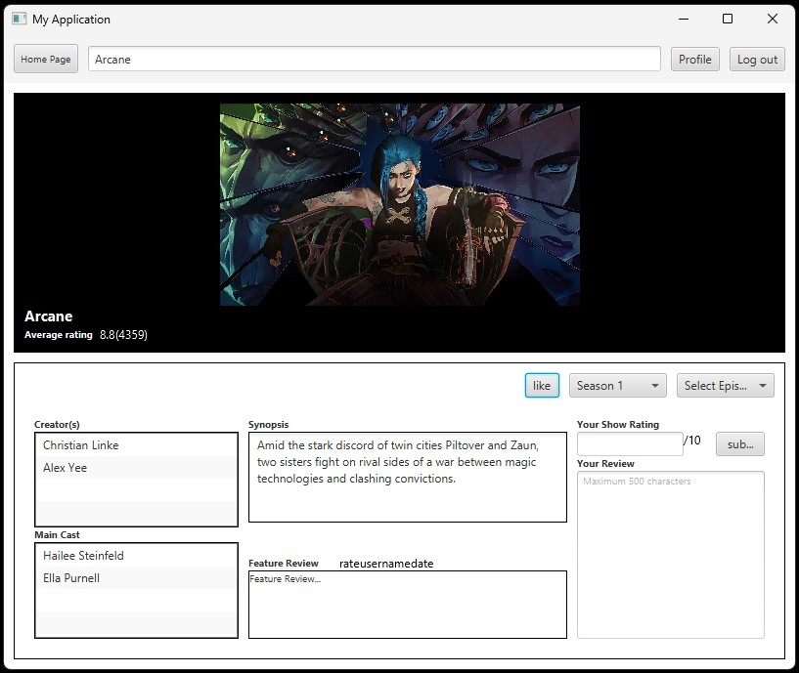
Show Overview
Features:
A bannered image from the show
A list of biographical information on the left side that includes items such as Main Cast
A synopsis of the show
A “Like” function
Featured reviews
Show-specific season and episode selectors
A text field to submit a review

Slide 11
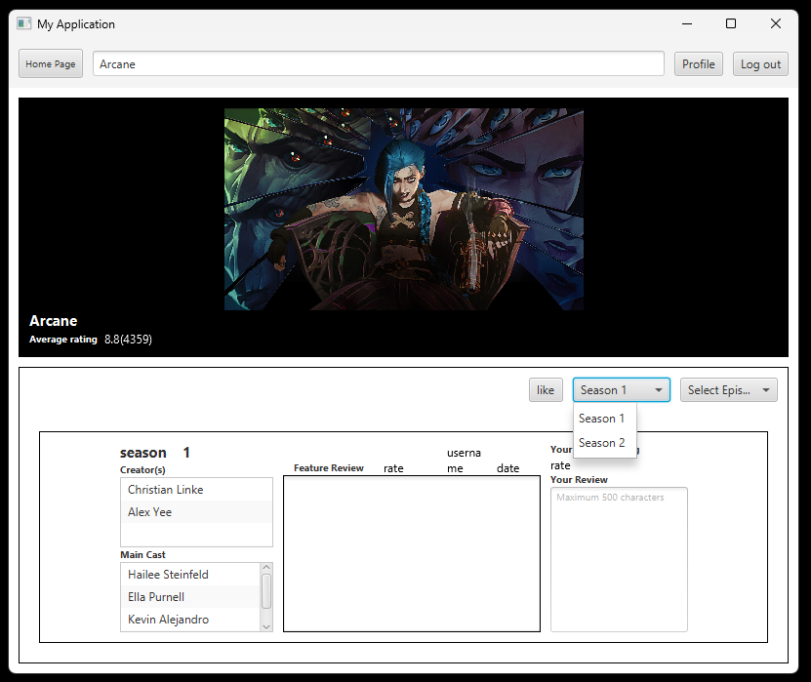
Season Overview
Features similar to Show Overview
Be able to write a review regarding an individual season
Get specific information regarding which Casts were in the season

Slide 12
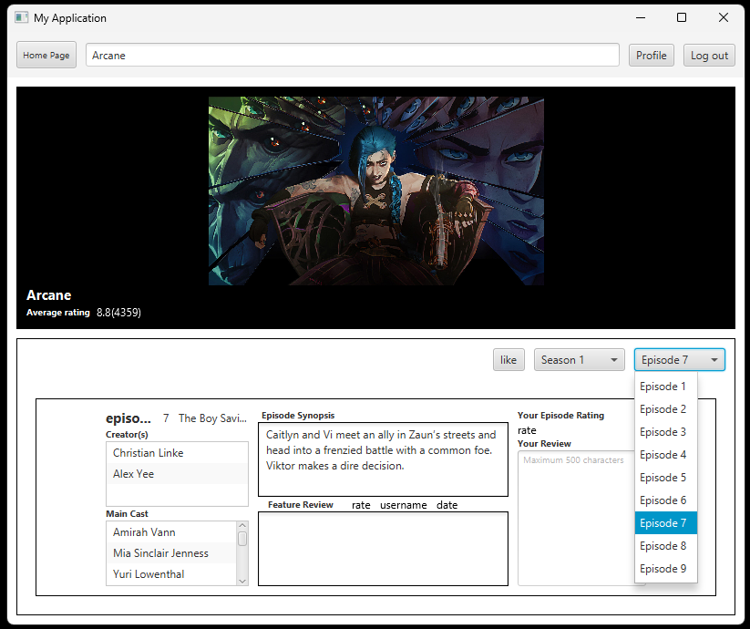
Episode Overview
Has features like Show and Season Overview
Be able to write a review on an individual episode
See specific information on each episode such as
Cast
Episode Synopsis

Slide 13
Conclusion
Any questions or comments?

