Slide 1
ConnectMVR: A Supervised Brain Connectivity Analysis Framework for Predicting Behavioral Outcomes
Present by
Aiying Zhang & Chang Li
@ the Design and Data Analysis (DADA) meeting
Nov 6, 2025

Slide 2
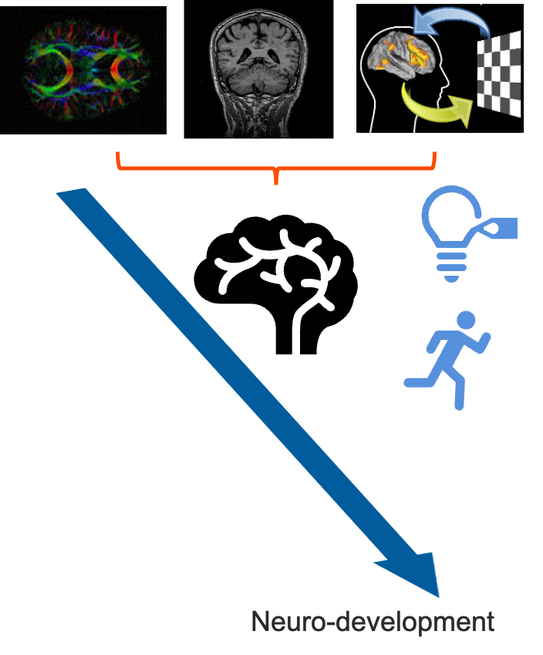
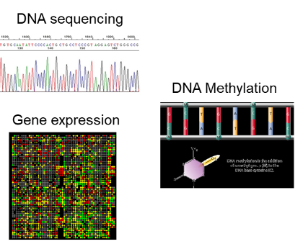
NeuroBioInformatics Lab (NBIL)
Aiying Zhang, Assistant Professor
Homepage: https://aiying0512.github.io/
Lab page: https://nbillab.github.io/nbillab.io/index.html
Research Interests:
Mental Health Data Science
Developing statistical and ML/AI approaches leveraging multi-modal imaging and multi-omics to understand typical and atypical brain development.
Network Analysis and Graphical Models
Multimodal Fusion
Causal Inference
Longitudinal Analysis

Slide 3
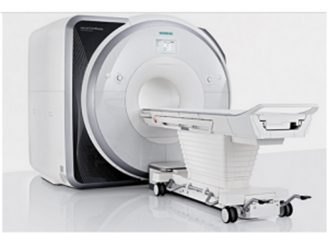
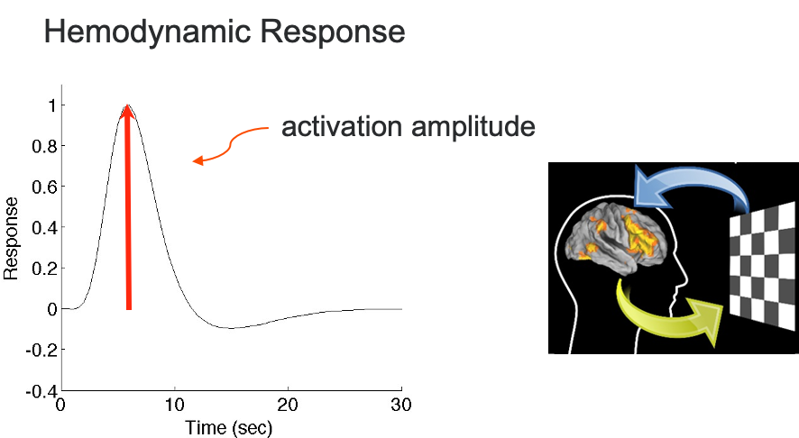
Functional magnetic resonance imaging (fMRI)
Paradigms of fMRI
Resting-state:
Measures intrinsic activity in the brain when not performing a specific task
Default Mode Network, Salience Network, Executive Control Network
Task-based: Explores how different brain regions coordinate during specific tasks
  Memory retrieval
  Emotion identification
  Etc..
Basics
Blood-Oxygen-Level-Dependent (BOLD) Signal
Temporal and Spatial Resolution:
  Temporal: 0.6 - 3 seconds.
  Spatial: Can localize activity to regions of a few millimeters.
Notes:
provides insights into brain activity and functional connectivity by detecting changes in blood flow and oxygenation associated with neuronal activity.
fMRI relies on the BOLD signal, which reflects changes in the ratio of oxygenated to deoxygenated hemoglobin in the blood.
Increased neural activity leads to increased blood flow to specific brain regions, which alters the BOLD signal.

Slide 4
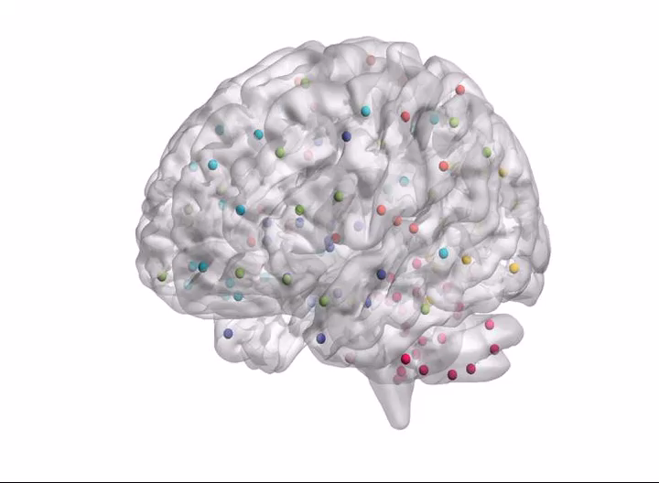
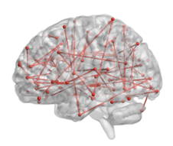
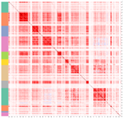
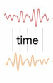
Functional Connectivity (FC)
Graph theory for studying brain networks
Brain Graph
Node: regions of interests (ROIs)
Edges: inter-connections
Functional Connectivity (FC):
Statistical dependencies between ROIs based on their activity patterns.
It provides insights into how brain regions interact and work together to support various cognitive and physiological processes.
Notes:
The complexity of brain computation mechanism implies that it is a product of combination of local synchronizations as well as longer ranged connections between neurons

Slide 5
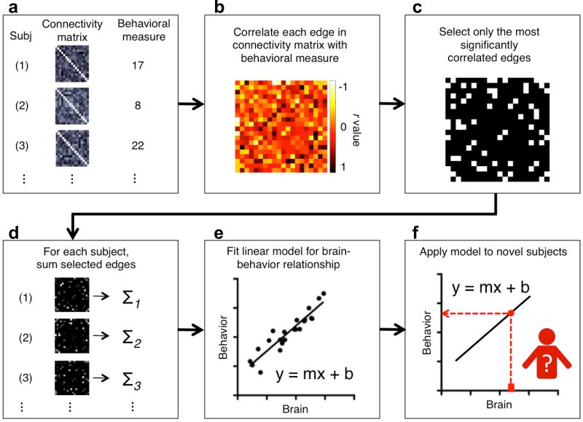
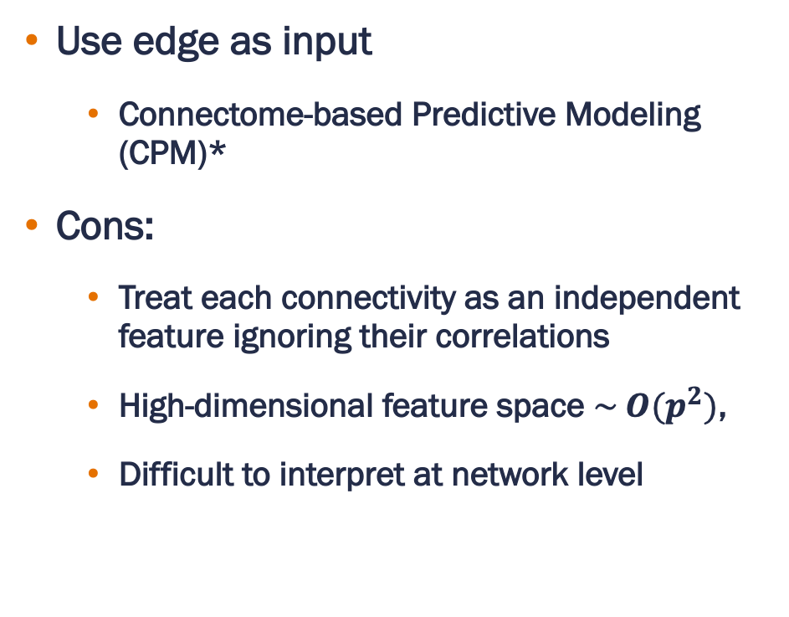
Link FC with Behaviors -- Statistical Methods
Use edge as input
  Connectome-based Predictive Modeling (CPM)*
Cons:
  Treat each connectivity as an independent feature ignoring their correlations
  High-dimensional feature space $\sim O(p^{2})$,
  Difficult to interpret at network level
* Shen, X., Finn, E.S., Scheinost, D., Rosenberg, M.D., Chun, M.M., Papademetris, X. and Constable, R.T., 2017. Using connectome-based predictive modeling to predict individual behavior from brain connectivity. nature protocols, 12(3), pp.506-518.

Slide 6
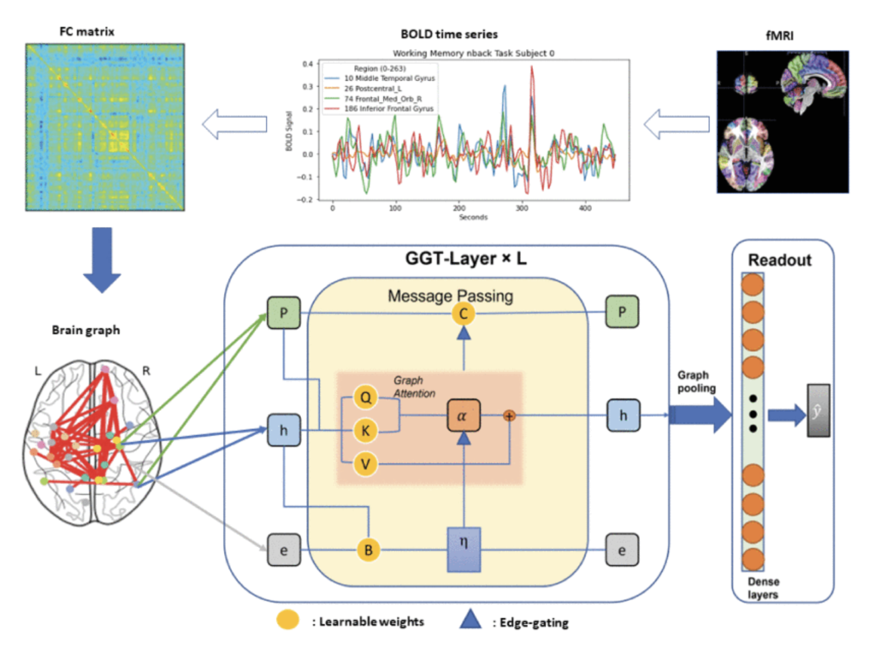
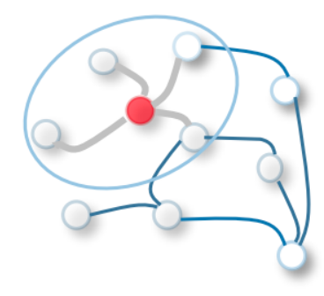

Link FC with Behaviors – DL Methods
Graph Neural Network (GNN)
  Graph convolutional network
  Graph attention network
  Graph Transformer
Cons:
  Limited statistical inference capability
  Challenging interpretability and transparency
Qu, G., Orlichenko, A., Wang, J., Zhang, G., Xiao, L., Zhang, K., Wilson, T.W., Stephen, J.M., Calhoun, V.D. and Wang, Y.P., 2023. Interpretable cognitive ability prediction: A comprehensive gated graph transformer framework for analyzing functional brain networks. IEEE transactions on medical imaging, 43(4), pp.1568-1578.
Graph Neural Network

Slide 7
Challenge 1 – Matrix Regression
Develop a graph-based predictive model that enables straightforward interpretation at both node and edge levels and allows valid statistical inference.

Slide 8
Multi-Graph -- Dynamic cases
Different FC estimation methods
Dynamic FC
  Capture time-varying patterns of brain connectivity
  More informative, reflects dynamic neural processes and cognitive flexibility
Effective connectivity
  Granger causality – Vector Autoregressive model (VAR)
  Temporal Lags – multiple (directed) graphs

Slide 9
Multi-Graph -- Multi-paradigm fMRI
Concept:
  Different fMRI paradigms (e.g., resting-state, emotional task, memory retrieval) capture distinct yet related brain connectivity patterns.
Advantages:
  Captures complementary neural processes across paradigms.
  Enables integration of multiple functional states for prediction.
  Models shared and unique network organization across tasks.
  Provides richer, more robust brain representations than single-paradigm analyses.

Slide 10
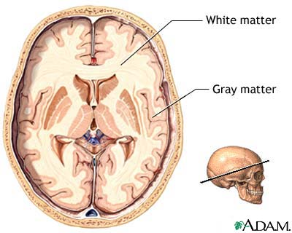
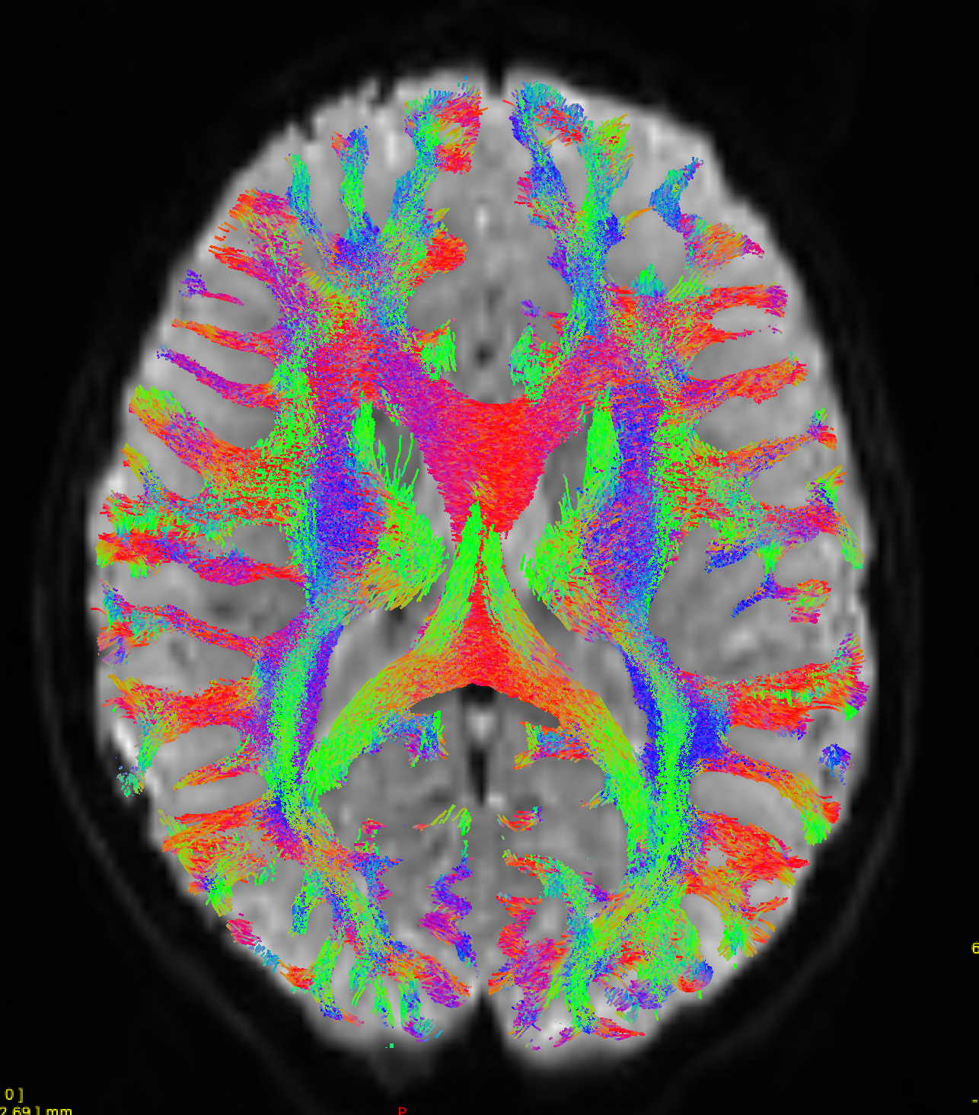
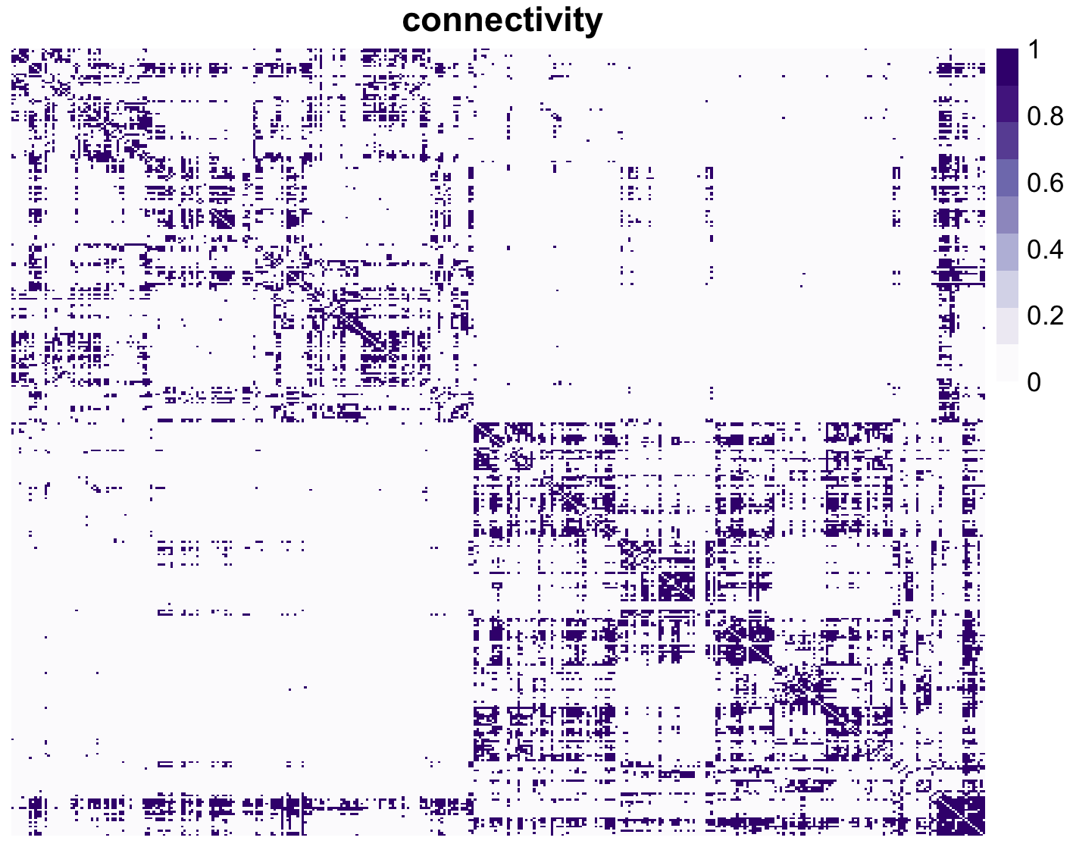
Multi-Graph -- Multi-modal MRI
Structural Connectivity (SC) as a Scaffold:
White matter tracts physically connect different brain regions, providing the pathways for neural communication.
Diffusion MRI: measures the diffusion of water molecules in the brain
  Water diffuses more easily along the direction of white matter fibers than perpendicular to them, allowing us to infer the structure of these tracts.
  Fiber Tractography: Reconstructs white matter pathways by following the principal diffusion directions across voxels
  SC: combining tractography with brain parcellation schemes, represents the strength of white matter connections between two ROIs.
Structural Connectivity

Slide 11
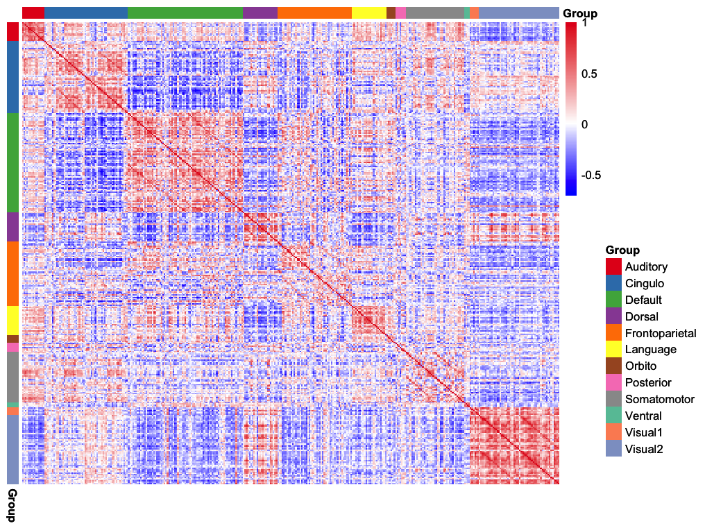
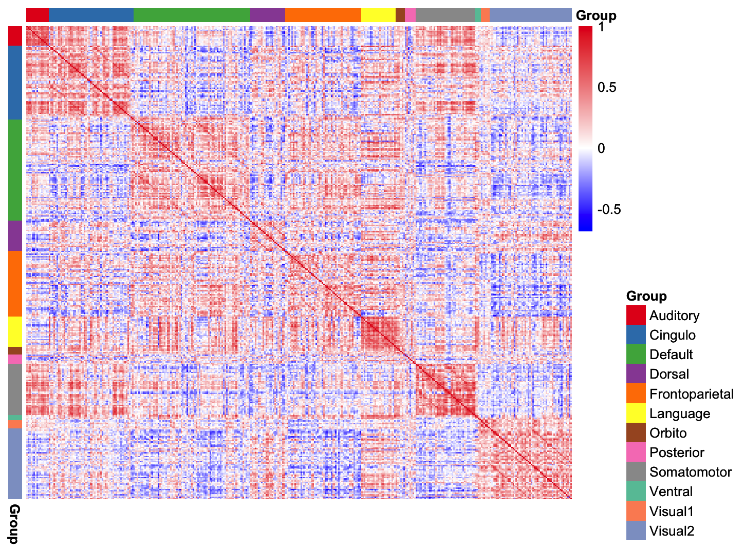
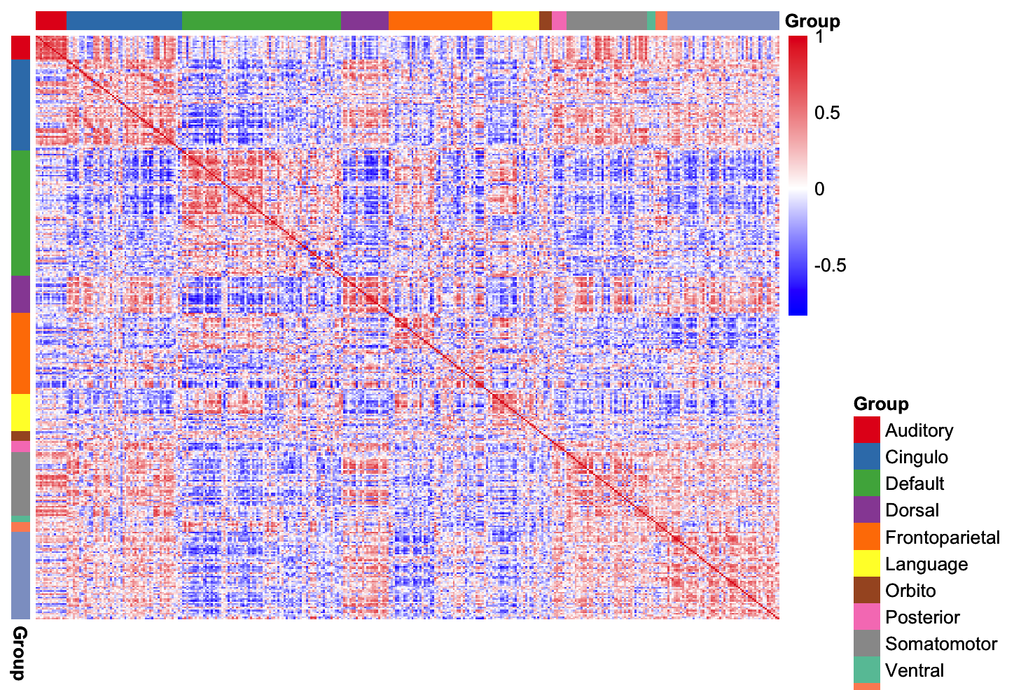
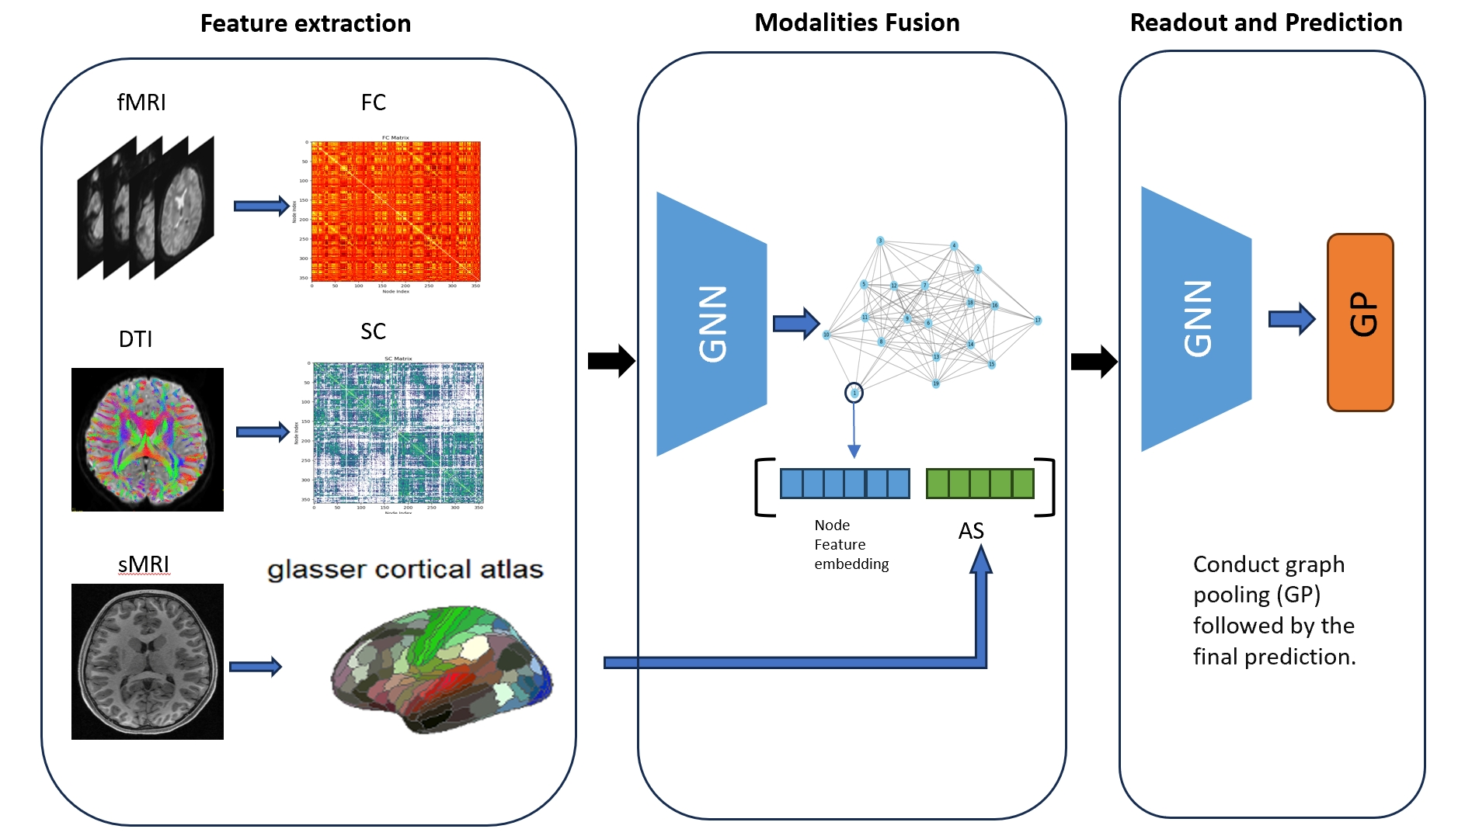
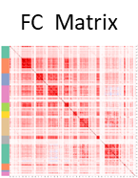









Challenge 2: Multi-graph Modelling
FC at rest
FC for task 1
FC for task 2
$$y =$$
$$u^{T}$$
$$u+v^{T}$$
$$v+w^{T}$$
$$w$$
SC Matrix
$$y =$$
$$u^{T}$$
$$u+v^{T}$$
$$v$$

Slide 12
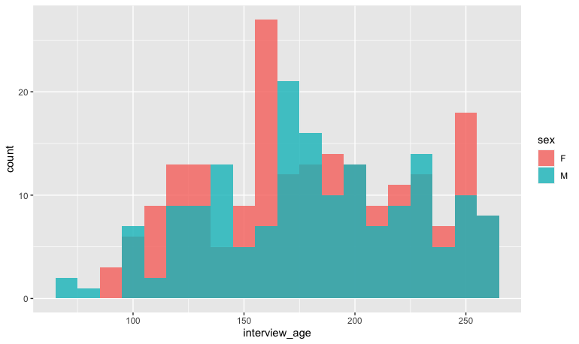
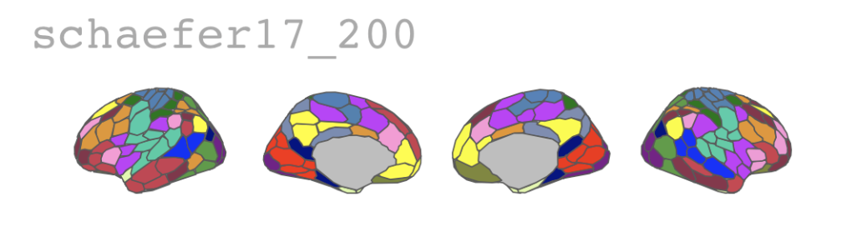
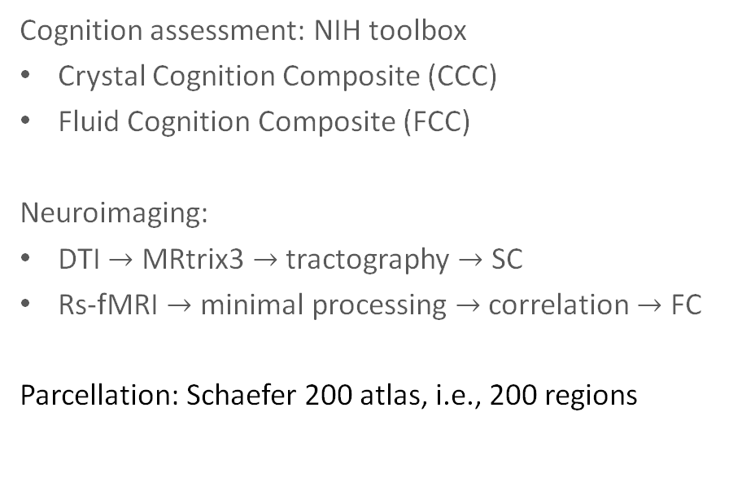
Data Showcase: TO Understand cognitive ABILITY
Human Connectome Project Development (HCP-D)
Participants:
Cognition assessment: NIH toolbox
Crystal Cognition Composite (CCC)
Fluid Cognition Composite (FCC)
Neuroimaging:
DTI $→$ MRtrix3 $→$ tractography $→$ SC
Rs-fMRI $→$ minimal processing $→$ correlation $→$ FC
Parcellation: Schaefer 200 atlas, i.e., 200 regions
Release:
650 subjects
Cognitive test
471 subjects
Neuroimage
372 subjects
Notes:
Fluid intelligence is characterized by the capacity to think logically and solve new problems, independent of previously acquired knowledge.
It is crucial for adapting to new situations and tackling novel challenges.
In contrast, crystallized intelligence involves the application of accumulated knowledge and experience to solve problems.

Slide 13

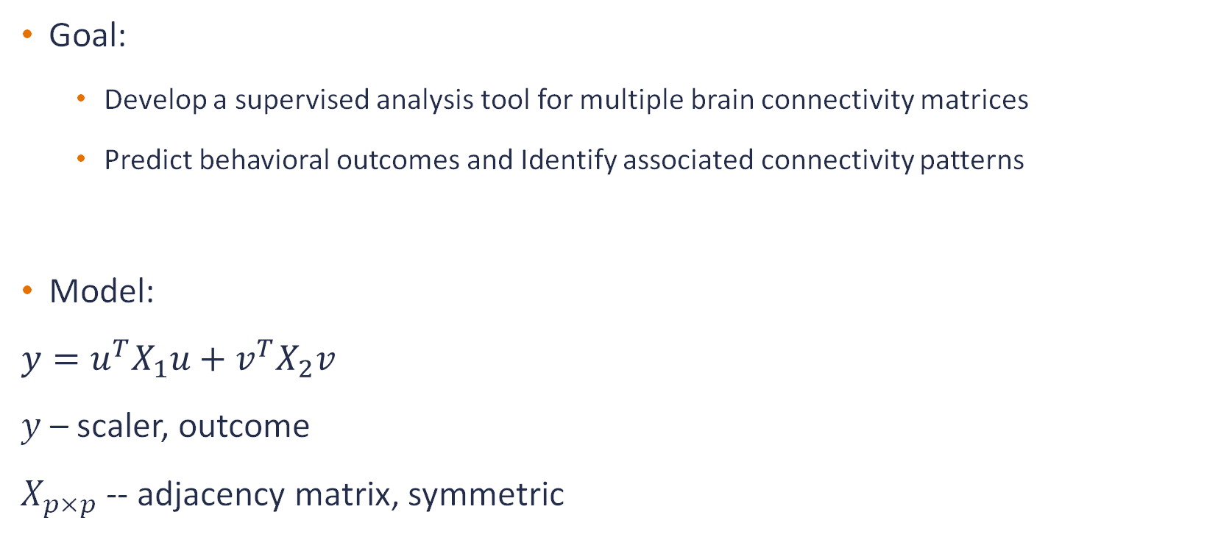
Matrix-Variate Regression – Bilinear Format
Goal:
  Develop a supervised analysis tool for multiple brain connectivity matrices
  Predict behavioral outcomes and Identify associated connectivity patterns
Model:
$$y=u^{T}X_{1}u+v^{T}X_{2}v$$
$y$ – scaler, outcome
$X_{p×p}$ -- adjacency matrix, symmetric
Interpretation:
$u_{p×1},v_{p×1}$ -- regression parameters indicating the effect of each node on the outcome
$u⊗u$ -- Kronecker product, representing edge-level effects derived from node contributions
Assumption:
Edge effects exist only if corresponding node effects are present
— analogous to regression models where interaction effects require main effects

Slide 14
Next Steps:
- Estimation procedure and optimization algorithm
- Computational implementation
- Simulation studies
Chang Li
PhD student in Statistics

Slide 15
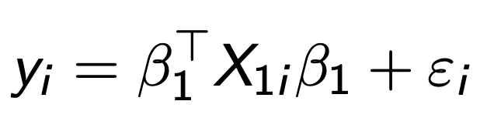

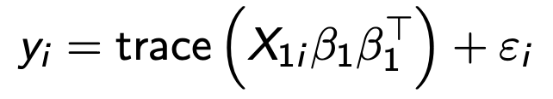
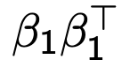
Bilinear regression on one matrix
Setup:
This bilinear regression can be converted to a trace regression
where we can substitute β1β with a rank one matrix B. For such a problem, a popular choice of estimator is a solution to the nuclear-norm regularized least-squares optimization problem.

Slide 16

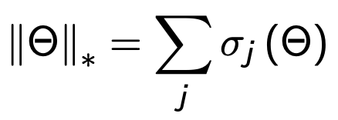
Nuclear norm
The nuclear norm of a matrix Θ ∈Rm1×m2 is given by
corresponding to the sum of its singular values. The nuclear norm enforces
low rank structure of the estimated matrix.

Slide 17
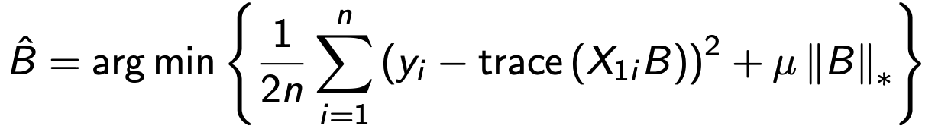

SVD decomposition
Given a collection of observations (yi ,Xi ),i = 1,2, we consider estimating the following optimization problem:
Next, decompose and get the eigenvector corresponding to the greatest eigenvalue
where

Slide 18
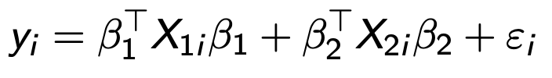
Bilinear regression on two matrices
Setup:
We will conduct Lasso regression which initializes at the value generated from the low rank matrix regression in (1)

Slide 19
Lasso regression
The objective function to be solved is as below:
where F(x) is the average of smooth convex functions and h(x) is a relatively simple convex function that can be non-differentiable.

Slide 20
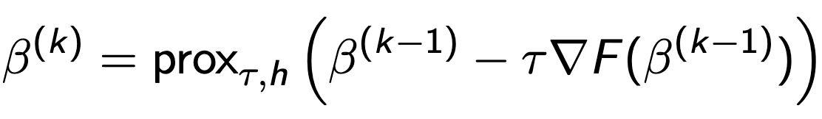

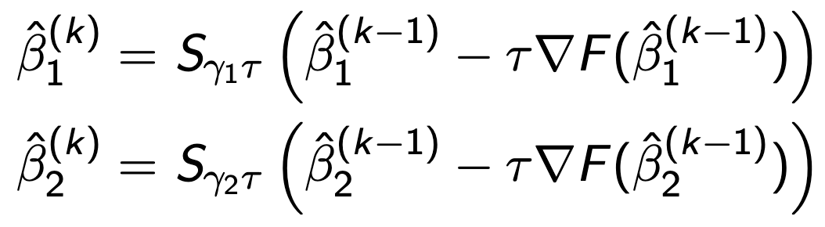
Proximal gradient descent (PGD)
To solve the optimization problem (2), one popular method is the proximal gradient descent (PGD) method, which can be described as the following update rules for k = 1, 2,:
Here we have h to be the l1-regularization. So, we can have the explicit form of the update rule with the soft-thresholding function

Slide 21
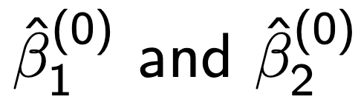
Challenges
Initial values
We experimented with initializing β( and β(0 from a uniform distribution on [−1, 1]. However, this initialization frequently caused the optimization to converge to local minima, and the gradients were sometimes unbounded, occasionally diverging to infinity during the iterations.

Slide 22
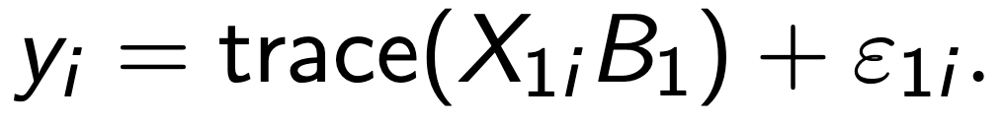
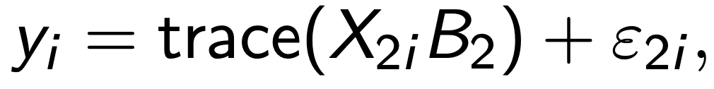
How to obtain a better initial value
We first regress y on X1 to obtain a low rank estimate. An initial value can then be derived by decomposing the low rank matrix.
Similarly, by regressing y on X2
We can get the corresponding initial value in the same manner.

Slide 23

Challenges
The choice of in low rank matrix regression
  Although there is existing literature on this topic, tuning is still a concern.
Choice of hyperparameters
  In the absence of prior information about the true coefficients, the most reliable way to select gamma_1 and gamma_2 is through cross-validation.

Slide 24
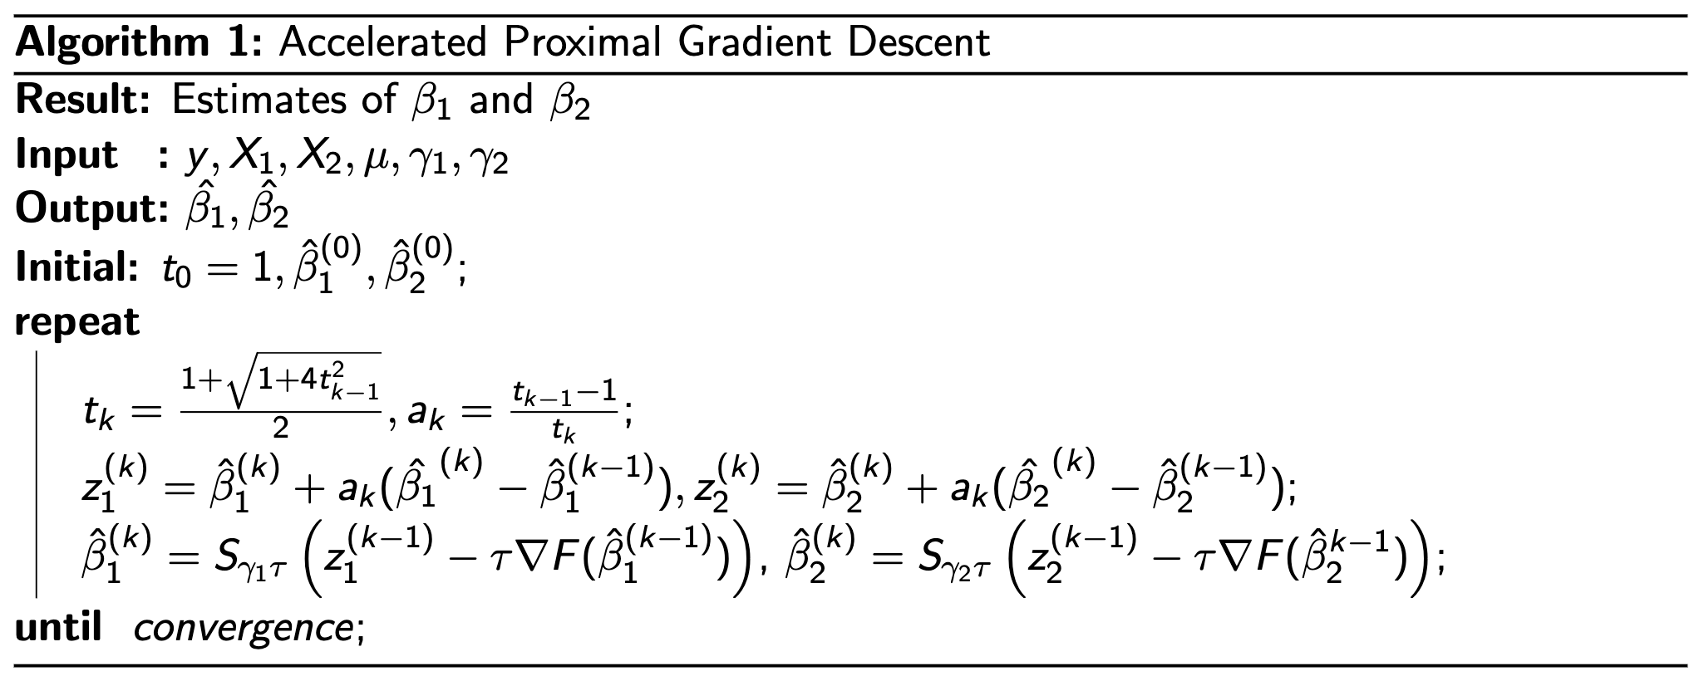
Our algorithm

Slide 25
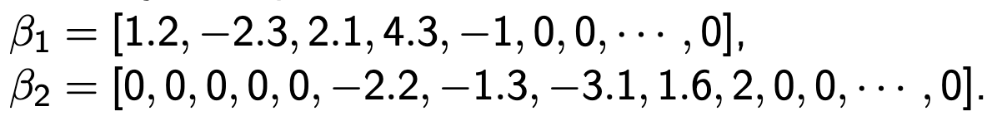
Simulations
Estimate two low rank matrices
  Suppose we run simulations on our real data X1 and X2 (properly scaled) and choose some arbitrary and sparse beta values to be

Slide 26
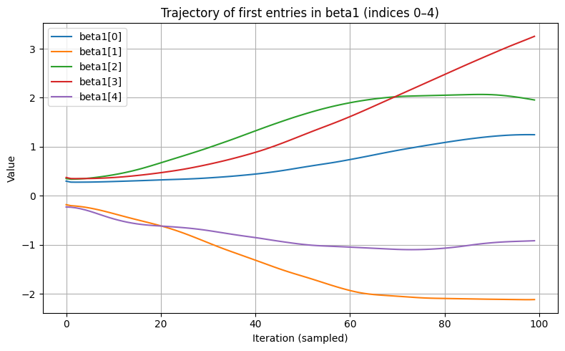
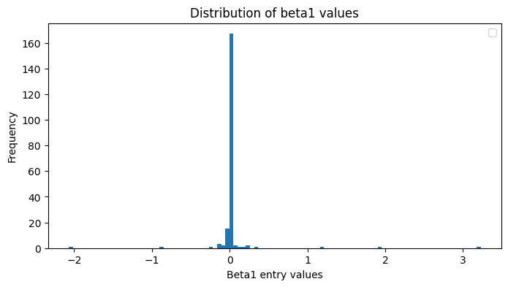
Simulations
Estimate two low rank matrices
  The trajectory of the first five entries in beta_1 during the optimization looks like the left figure below

Slide 27
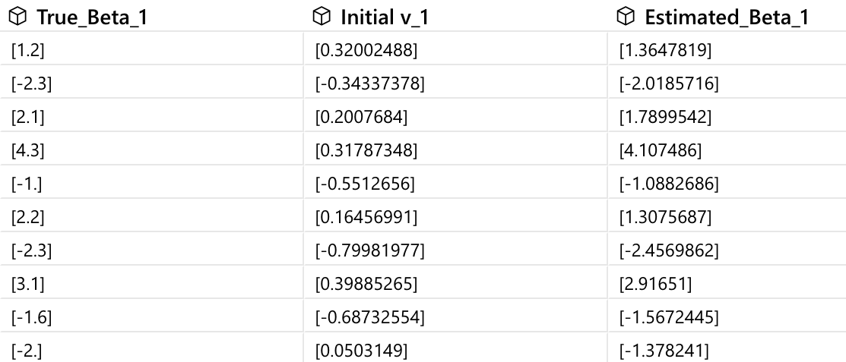
Simulations
Estimate two low rank matrices
  We can also have a look at the result when there are more nonzero entries in beta.

Slide 28
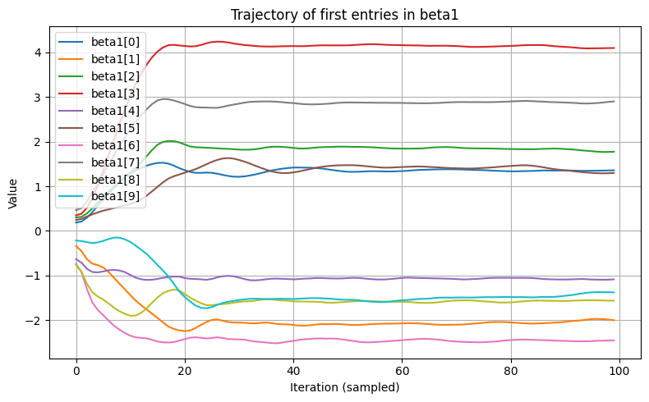
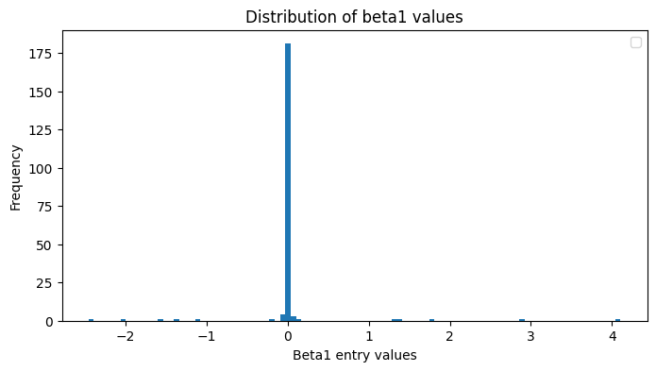
Simulations
Estimate two low rank matrices

Slide 29
Discussion
01.
02.
03.
04.
The sign and significance of the coefficients require further analysis.
A threshold may be needed to filter out near-zero values and ensure sparsity by retaining only the most significant terms.
Since X1 and X2 are highly correlated, it may be beneficial to include penalties that capture group structures within the objective function.
Test on more simulations and real datasets.

