Slide 1

Presentation on Road Accident
-Bimarsha Sherchan

Slide 2
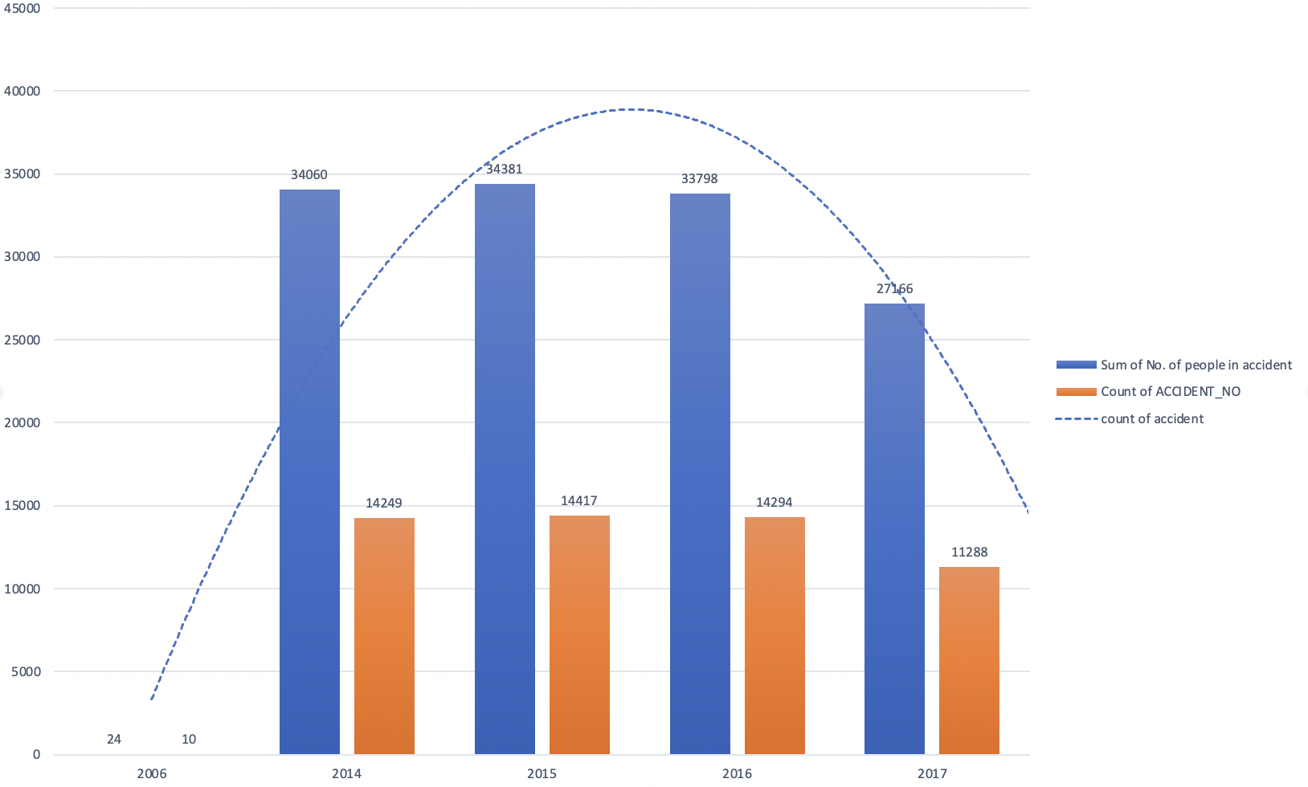
Fig: The number of accident and the number of people involved in each year
The trend is gradually decreasing towards 2017
Maximum being in the year 2015

Slide 3
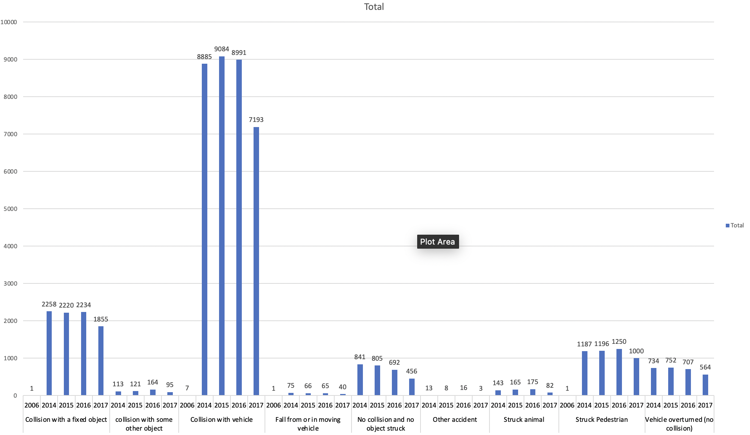
Fig: Number of accident by year and the reason of it
Collision with vehicle is the main reason in each year 2014-2017 which accounts 75% for the accident.
All the reason of accident are showing the trend of decrease going from 2014 to 2017.
Where strucking by animal had significantly decreased by more than 50% going from 2016 to 2017; reason being awareness to drivers, and indication of the hotspot area of animals.

Slide 4
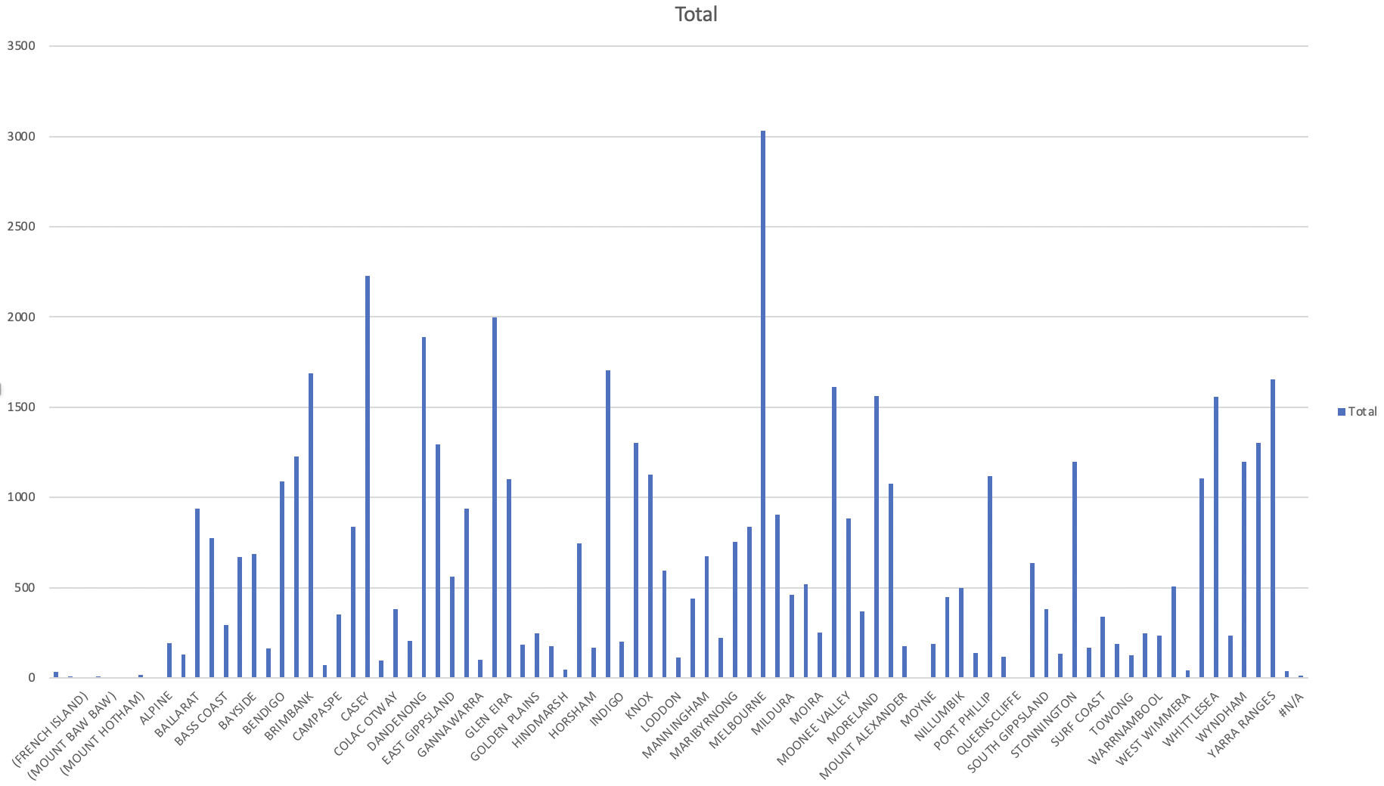
Fig: LGA with the total number of accident from year 2014 to 2017
Melbourne is the lga with the highest number of accident in 3-year duration, followed by Casey.

Slide 5
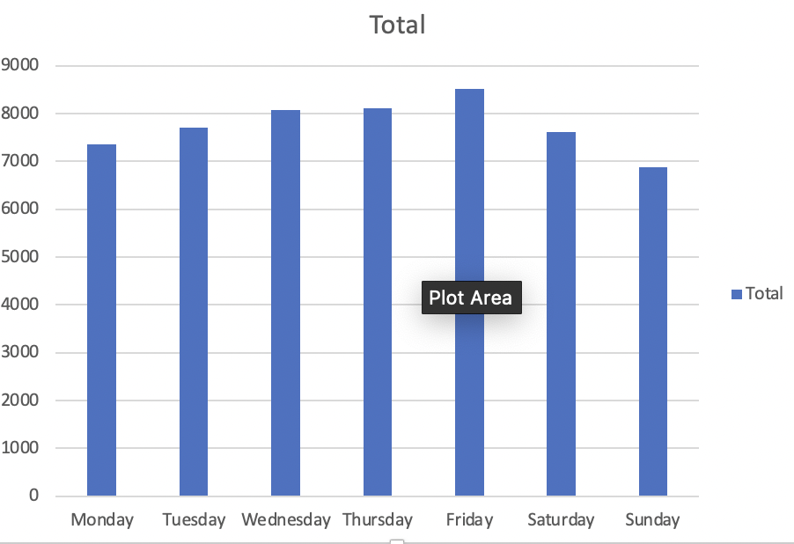
Fig: For LGA Melbourne, the accident during the days of a week.
From above graph, Melbourne has highest accident on Friday.

Slide 6
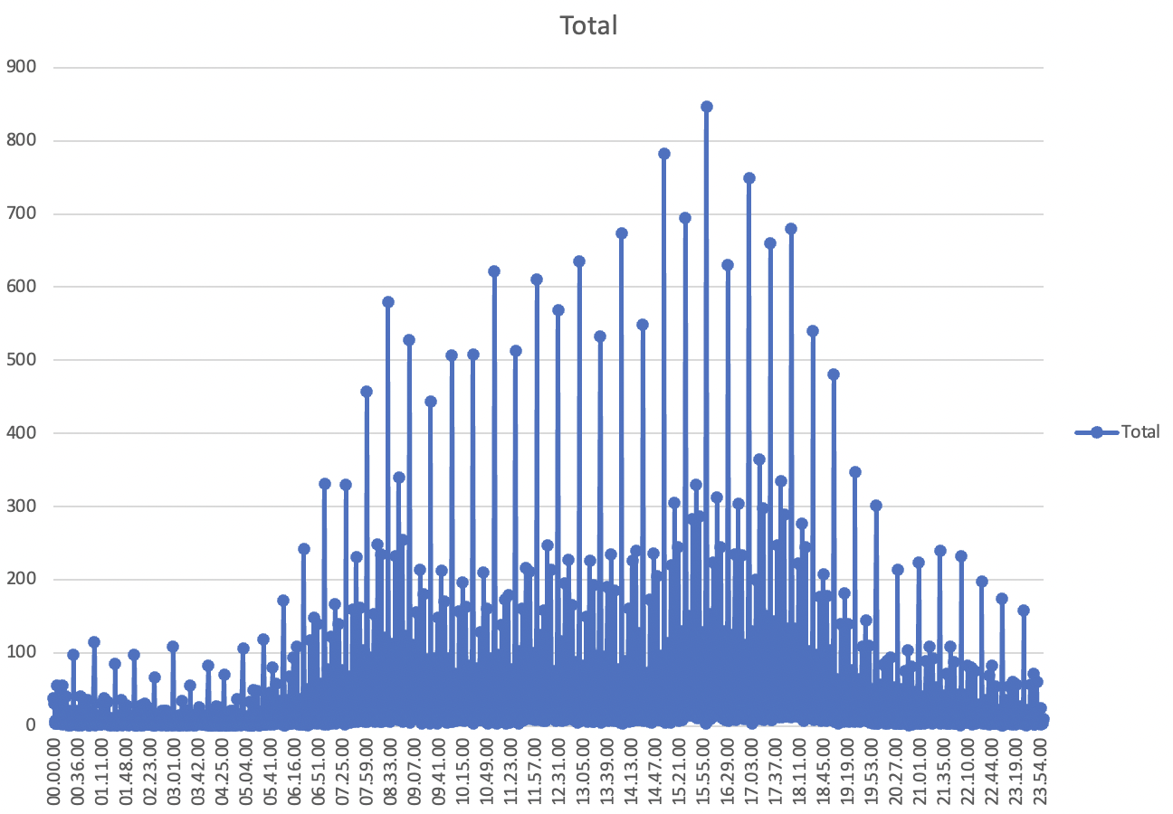
Fig: For Melbourne LGA, the number of accident during different time frame of a day.
For Melbourne LGA, 2-6PM is the most accident-prone time of a day.

Slide 7
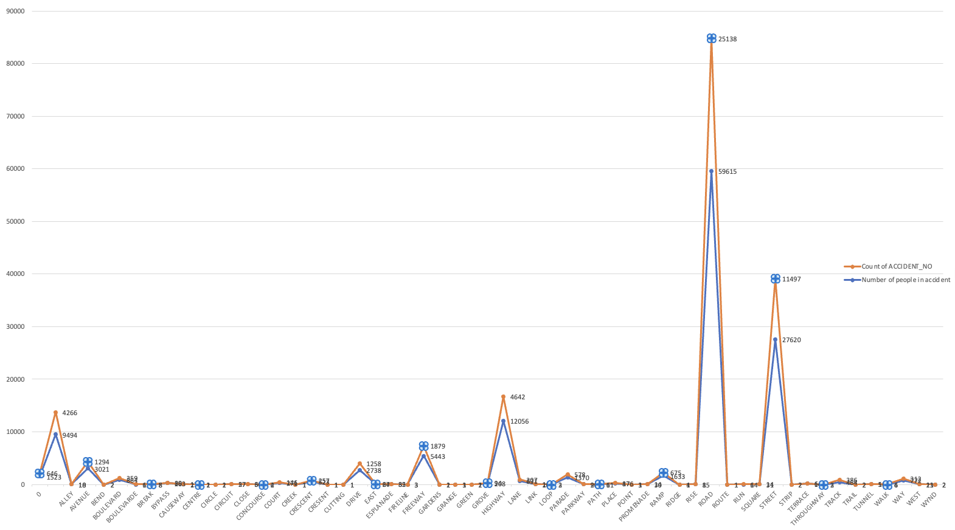
Fig: Different routes in Melbourne LGA
Road is the most accident-prone routes in Melbourne LGA accounting 25,138 accident within 3years range, followed by Street and Highway.

Slide 8



Conclusion
In all the LGA’s, Melbourne is the most accident happening LGA
Maximum accident happening in the year 2015.
Most accident happening in the time range of 2-6pm, mostly on Friday.
Most accident by colliding with the other vehicle in the road.
Melbourne LGA being one of the most populated and busiest LGA with population density of 11,897 and large volume of traffic every time.
Also, to that lot of tourist visit Melbourne every year which may result in the volume of traffic.
Speed Camera, Mobile police, speed restricted zone and bigger lane should be more introduced in the road.
During the peak hours, alternative transportation and route must be prioritized.

Slide 9
Thank You

