Slide 1












$$f_{4}$$
$$f_{1}$$
$$f$$
$$f_{3}$$
$${\vec{X}}_{B}$$
$${\vec{Y}}_{B}$$
$$f_{2}$$
$$R$$
$$x$$
$${\vec{Z}}_{B}$$
$${\vec{X}}_{E}$$
$${\vec{Y}}_{E}$$
$${\vec{Z}}_{E}$$

Slide 2







$$f_{6}$$
$$f_{1}$$
$$f_{5}$$
$$f$$
$${\vec{X}}_{B}$$
$$f_{2}$$
$${\vec{Y}}_{B}$$
$$f_{4}$$
$$R$$
$$f_{3}$$
$${\vec{Z}}_{B}$$
$$x$$
$${\vec{X}}_{E}$$
$${\vec{Y}}_{E}$$
$${\vec{Z}}_{E}$$

Slide 3








Translational controller
$$x_{d}$$
Mass
estimator
$${\hat{θ}}_{m}$$
Force
controller
$${\vec{Z}}_{B_{d}}$$
$$f$$
Multirotor
dynamics
$${\vec{X}}_{B_{d}}$$
$${\hat{θ}}_{J}$$
MoI
estimator
Moment
controller
$$M$$
Rotational controller
$$x, v, R, Ω$$

Slide 4
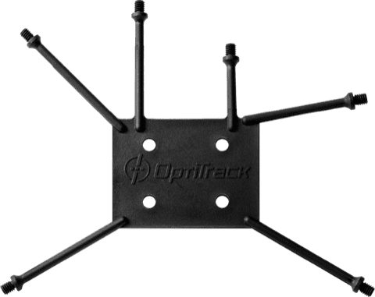
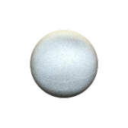

Slide 5
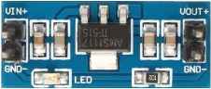
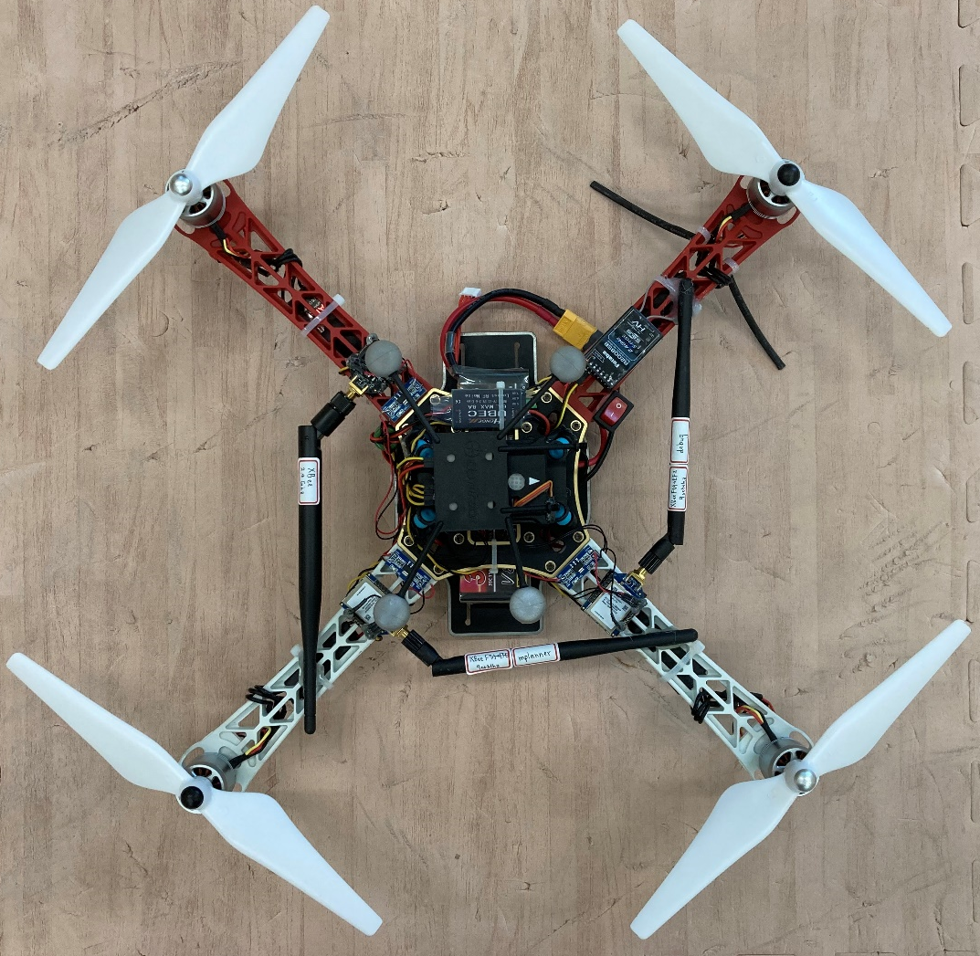
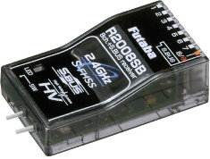
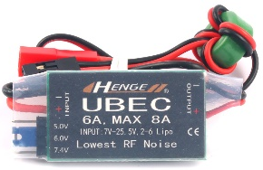
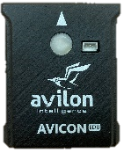

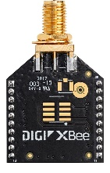
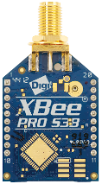




5V to 3V3 switching regulator
$$M_{2}$$
$$M_{1}$$
RC receiver
UBEC
Flight control board
$$M_{3}$$
$$M_{4}$$
OptiTrack marker
2.4 GHz, 900 MHz Xbee Module

Slide 6
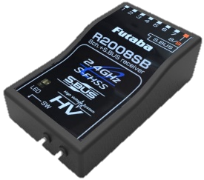
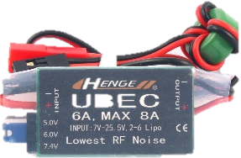
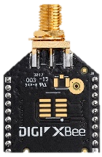
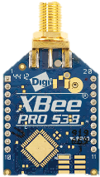





$$M_{2}$$
$$M_{1}$$
RC receiver
UBEC
5V to 3V3 regulator
Flight control board
Xbee Module
OptiTrack marker
$$M_{3}$$
$$M_{4}$$

