Slide 1




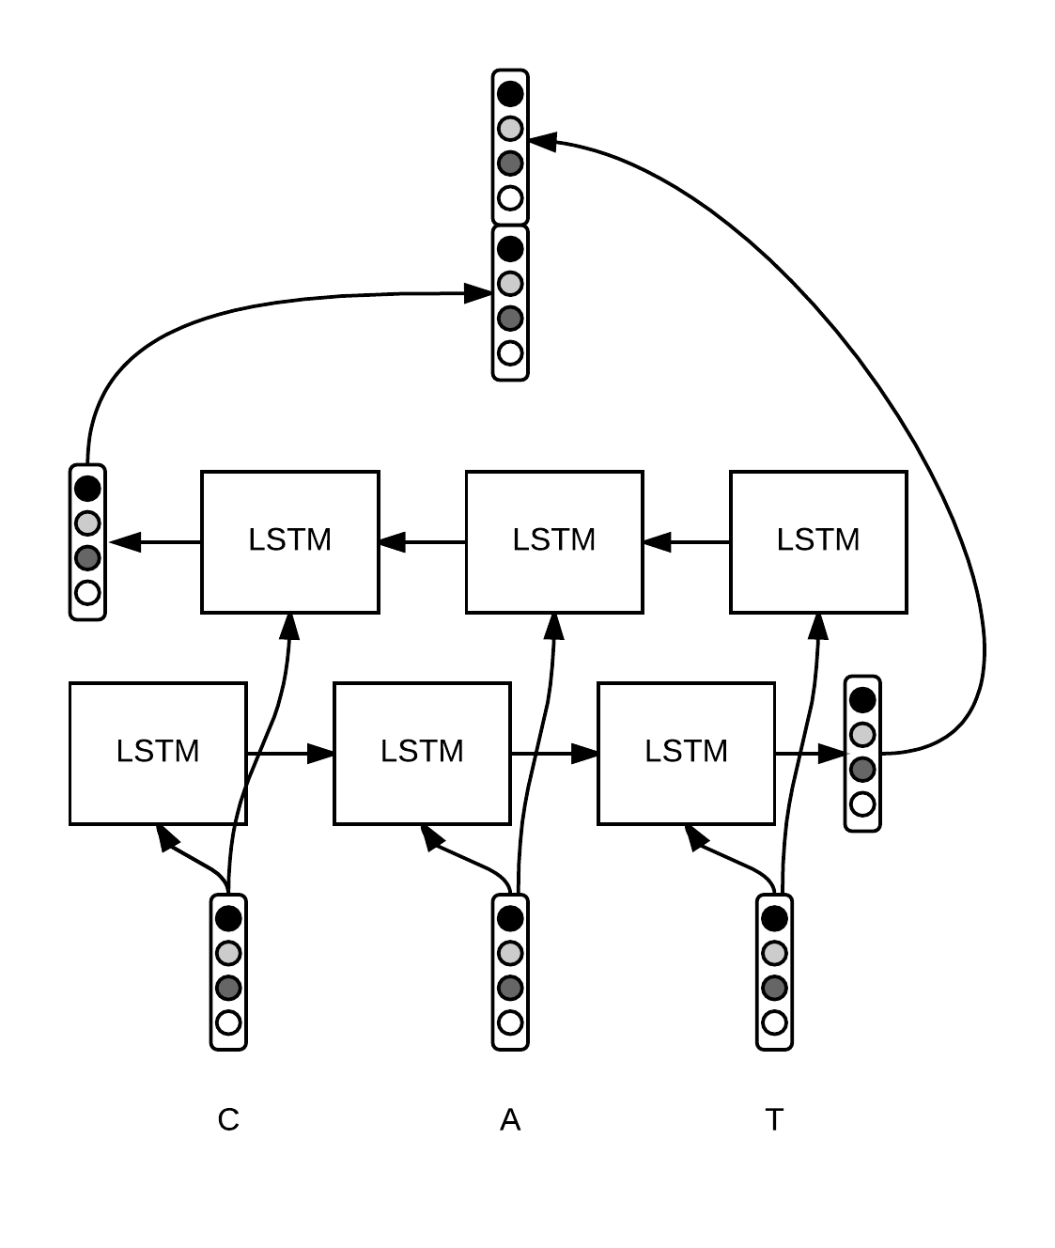
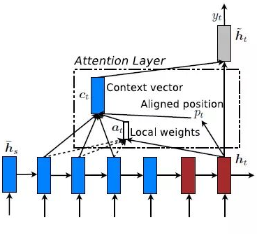

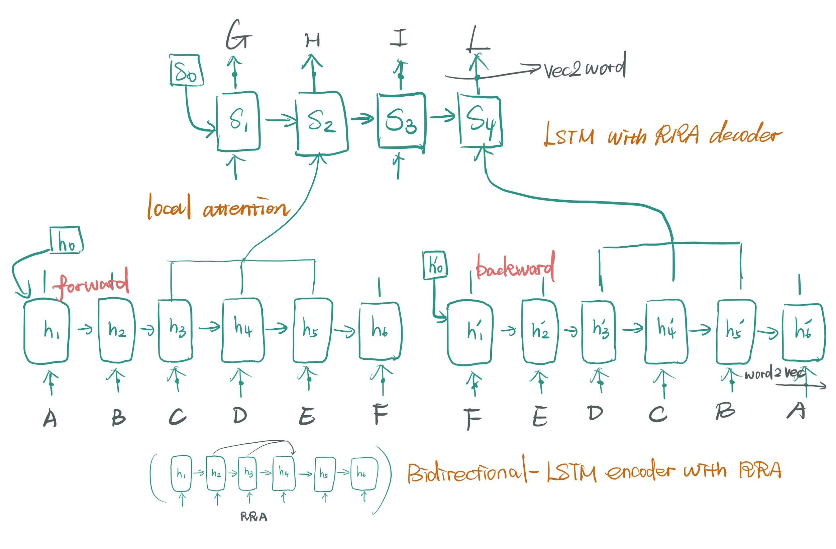

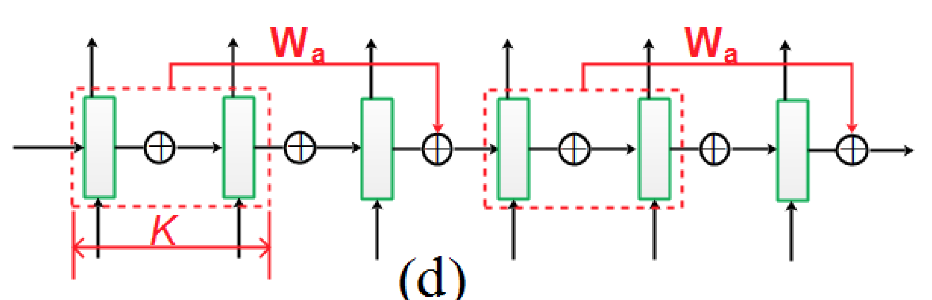
Abstractive Summarization on Amazon Review Using Attentive Bi-LSTM with RRA
Xinyue Ke;Chang Liu;Lu Pan
University College London
Introduction
Data Prepossessing
Results Visualisation
With the widespread use of e-commerce platform, buying commodities online has become the main way of shopping. More and more people and modern merchants has taken part in the conventional commercial activities. At the same time almost all online shopping websites allow and encourage people to leave reviews after buying commodities.
Removing inappropriate-length data
GloVe embedding & Limited vocabularies
REVIEW: The coffee tasted great and was at such a good price! I highly recommend this to everyone!
ACTUAL SUMMARY: great coffee with good price
PREDICTED SUMMARY: great coffee good
REVIEW: This is the worst cheese that I have ever bought! I will never buy it again and I hope you won’t either!
ACTUAL SUMMARY: worst cheese and never buy
PREDICTED SUMMARY: omg gross gross
less training time
better in semantic relatedness tasks
Model
Bi-LSTM
Bi-LSTM can preserves information both from the past and future.
Local attention
Using attention mechanism is an effective method to utilize all hidden states’ information in encode layers
RRA
It established connections between hidden states which are several steps apart. The attention over residual connection offers previous hidden states weight selectively ‘attend’ to future states.
the textual data expand dramatically
Aim:
Propose an encode-decoder architecture to do abstractive summarization on the multi-product reviews from Amazon so that people can easily make their own purchase decision
Evaluation
Pick a subset from test set, we do:
Result visualisation
To check the learning behaviour of this model
Manually Scoring
Scores contains three aspects based on whether having include the keypoint, grammar etc.
Dataset:
Obtained amazon reviews from SNAP.
randomly choose 30,000 from three topics
(Electronics, CDs & Vinyl, Home & Kitchen), split into 24,000 train and 6,000 test and add another 2,000 from topic Toy to test.
MODEL
encoder: Bidirectional-LSTM with RRA
decoder: LSTM with RRA

