Slide 1
Diving Into Maldives
Chang Lu

Slide 2
Introduction to Maldives
The Maldives, a jewel in the Indian Ocean, is an archipelago of 1,200 stunning islands scattered
like pearls across turquoise waters. Known for its pristine white sandy beaches, crystal-clear
lagoons, and vibrant coral reefs, the Maldives offers unparalleled natural beauty and tranquil
ity. This tropical paradise is home to luxury overwater bungalows, thriving marine ecosystems,
and a culture shaped by its maritime heritage.
However, beneath its serene beauty lies a challenge – the Maldives is one of the most climate
vulnerable island nations, facing rising sea levels and environmental pressures. Its resilience
and efforts toward sustainability and climate advocacy are as remarkable as its beauty

Slide 3
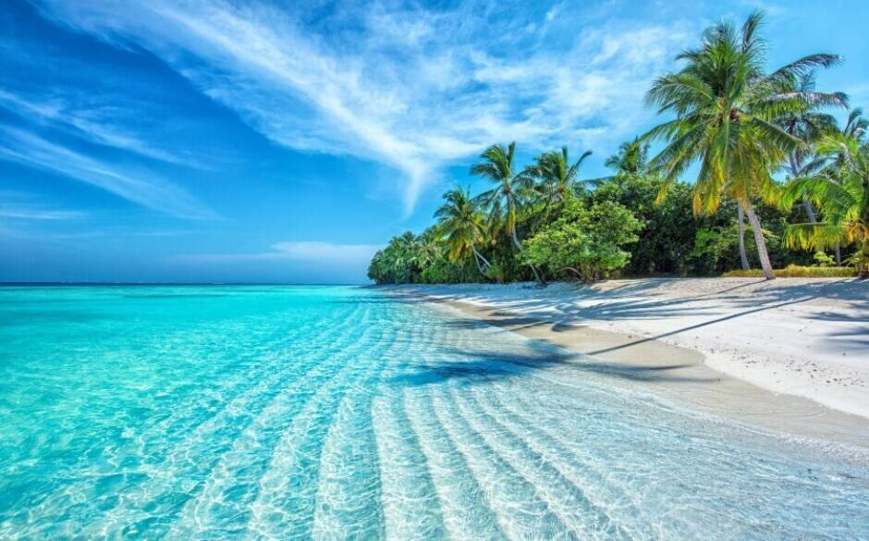

Slide 4
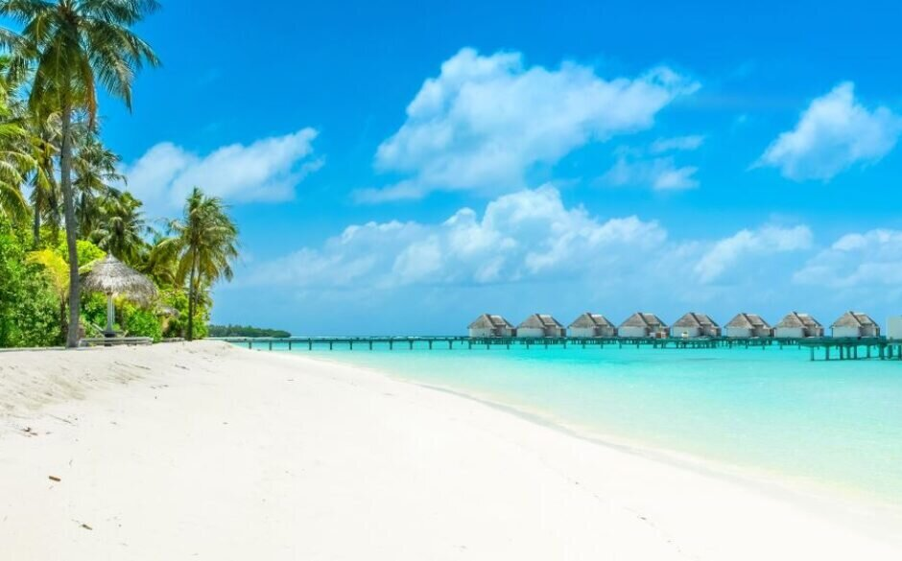

Slide 5
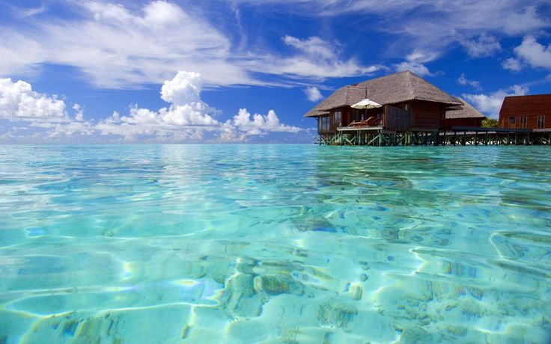

Slide 6
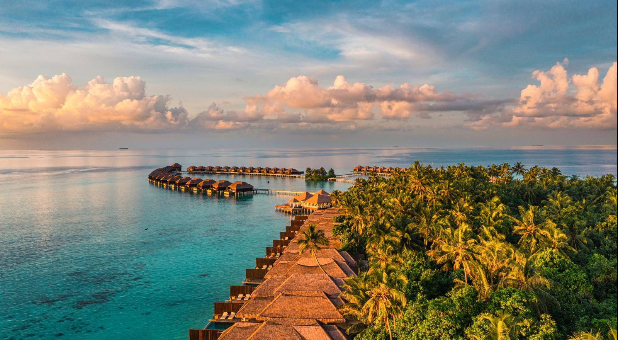

Slide 7
Analysis on GDP of Maldives

Slide 8
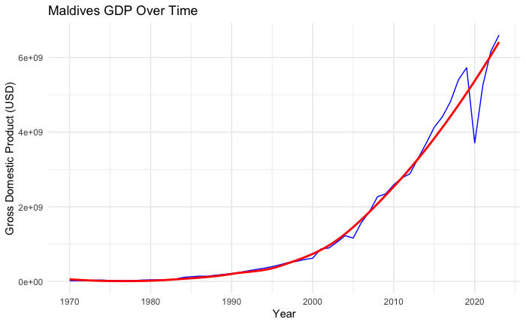
The graph shows how the Gross Domestic Product (GDP) of the Maldives has changed over time, with two components:
1. Blue Line: Represents the actual yearly GDP values for the Maldives.
2. Red Line: A LOESS smooth line, showing the general trend in GDP growth over time.

Slide 9
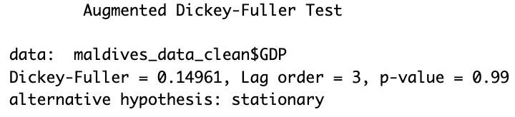
Null Hypothesis: The time series has a unit root and is non-stationary
The p-value(0.99) is very high (greater than common significance levels like 0.05), which means
we fail to reject the null hypothesis. In other words, the GDP time series is non-stationary.
We have to do some transformations to make it satisfy the assumption of time series model.

Slide 10

The p-value(0.147) is still larger than 0.05, indicating that we need more transformation.

Slide 11

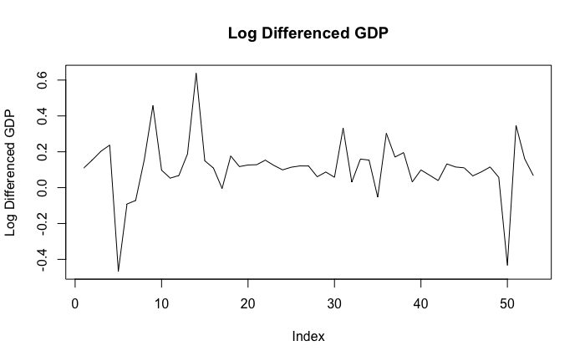
After the log-transformation, the result supports the conclusion that the series is stationary.

Slide 12
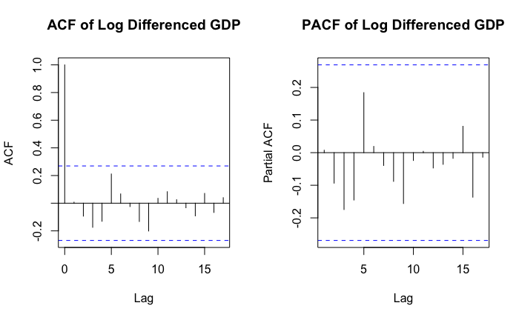
The combined pattern of the ACF and PACF suggests that the ARIMA(1,1,1) model is a good choice.

Slide 13
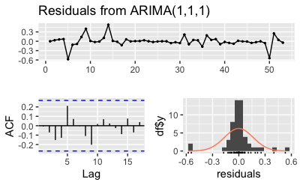

Slide 14
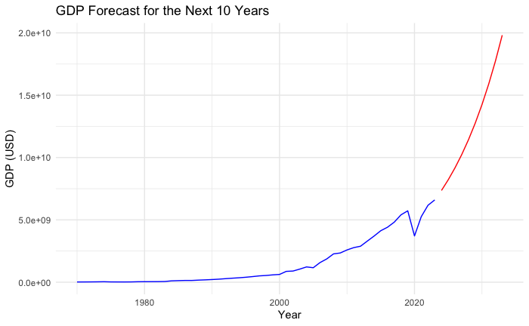
According to the forecast line, the GDP of Maldives will increase rapidly in the next 10 years.

Slide 15
Comparison with Sri Lanka

Slide 16
This part compares two South Asian island nations, Sri Lanka and the Maldives, focusing on four key indicators: GDP, population, life expectancy, and international homicide rates. Although both countries share geographic proximity as island nations in the Indian Ocean, they differ significantly in terms of population size, economic structure, and socio-economic development.
By examining GDP growth, overall population, life expectancy trends, and safety indicators (homicide rates), this comparison provides insight into their progress, challenges, and unique pathways of development over time.

Slide 17
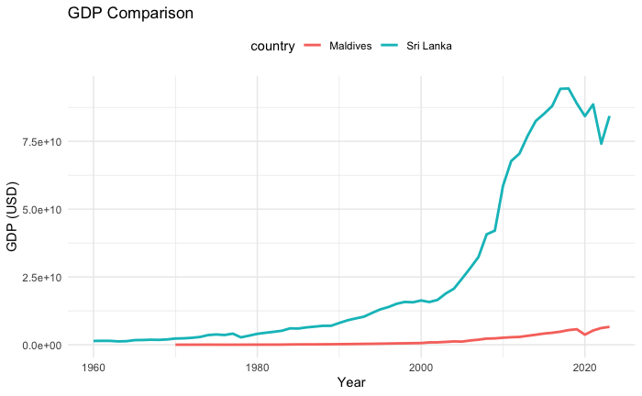
Sri Lanka has a larger and more established economy, showing exponential growth until recent disruptions.
Maldives, although starting smaller, has demonstrated steady and robust economic growth, driven by its tourism industry.

Slide 18
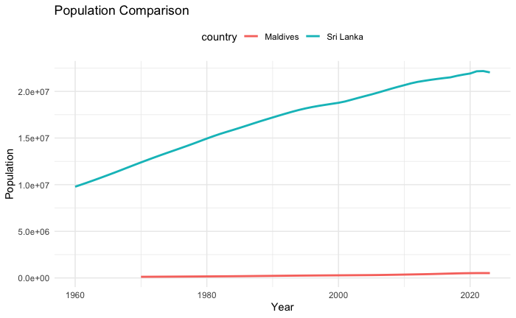
Sri Lanka’s Population is steady growing over the decades, reaching over 20 million by 2023.
The larger population supports a diversified economy but also poses challenges for resource management.
Maldives’ Population is consistently much smaller, with a gradual increase to just under 1 million. The smaller population aligns with its economic reliance on tourism and resource limitations as an archipelago.

Slide 19
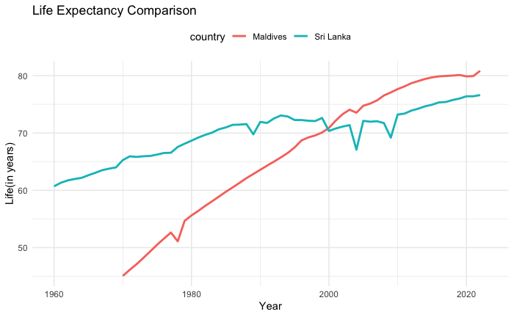
Sri Lanka has shown steady improvements, likely due to consistent investments in healthcare and education over decades.
Maldives has demonstrated exceptional progress, closing the life expectancy gap and ultimately exceeding Sri Lanka.

Slide 20
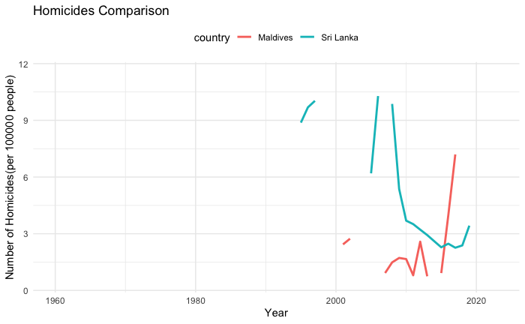
For Sri Lanka: The higher initial rates may have been influenced by political instability or conflict-related violence during the late 20th century and the sharp decline suggests improve
ments in governance, peace, and law enforcement over the years.
For Maldives: The low and stable homicide rates align with its small population and limited social unrest and the spike in recent years may warrant further investigation into potential
causes, such as economic stresses, organized crime, or social disruptions.

Slide 21
Current Challenges of Maldives

Slide 22
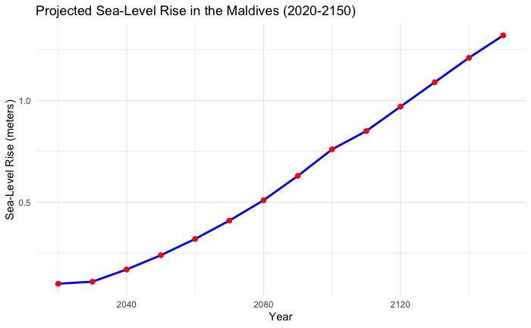
Sea-Level Rise and Land Loss
The Maldives, with over 80% of its land area less than 1 meter above sea level, is highly
vulnerable to sea-level rise.
Studies indicate that by 2150, sea levels could rise by approximately 1.32 meter, potentially submerging significant portions of the Maldives.

Slide 23
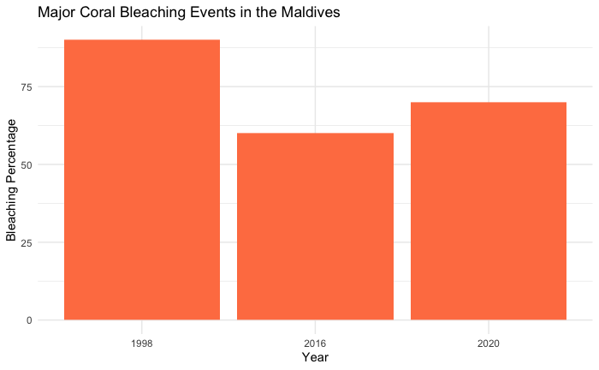
Coral Reef Bleaching
The Maldives has experienced significant coral bleaching events, notably in 1998, 2016, and 2020, leading to substantial coral mortality.
In 2016, over 60% of coral colonies were bleached, with some sites experiencing up to 90% bleaching.

