Slide 1
Dynamic Reconfigurable TCAM with Low Power Consumption
Haranadh Baba Singamsetti
Chang Min park

Slide 2
CAM: Content Addressable Memory
CAM is a extension of ordinary memory.
CAM = SRAM +A comparison circuit.
ADVANTAGES:
It is a search engine that completes the search of stored data in a single clock cycle.
Limitations:
Consumes excess power.
Applications:
Image coding
IP packets in network routers.

Slide 3
DIFFERENT TYPES OF CAM’s
Two types of CAM:
i) Binary CAM :
ii) Ternary CAM
Limitations of Binary CAM:
It can only do exact matches on ones and zeros.
A TCAM provides three results: 0, 1, and "don't care

Slide 4
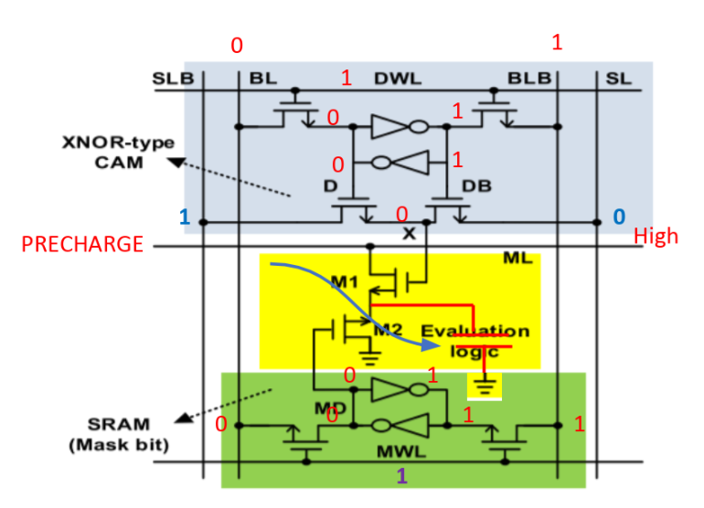
GENERALISED TCAM:
NOR TCAM:
BL act as data bit when DWL is high.
BL act as mask bit when MWL is high
SLB is search bit.
ML is high when match occurs.
LIMITATIONS:
Consumes more power.
power consumption is around 476 E-6.

Slide 5
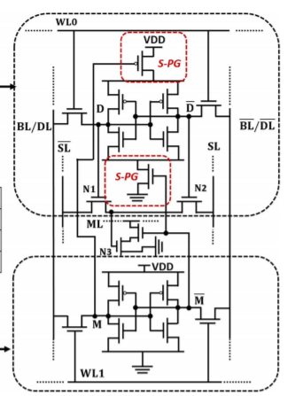
SELF POWER GENERATING TCAM
circuit diagram for S-PG TCAM.
It consumes less power compare to normal TCAM.
The two transistors in red box are used for self power
generating.
HOW IT CONSUMES LESS POWER?
when Mask bit is enabled, the top part of the circuit is turned off.
Power consumed when mask is enabled is 926.3 E-9.

Slide 6
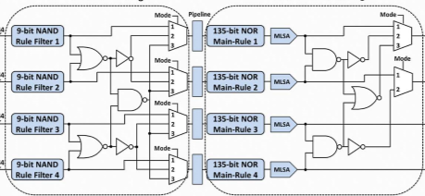
CIRCUIT DIAGRAM(PROTOTYPE):
PARTS:
NAND BASED FILTER
NOR BASED FILTER
MULTIPLEXER
PIPELINE CIRCUIT

Slide 7
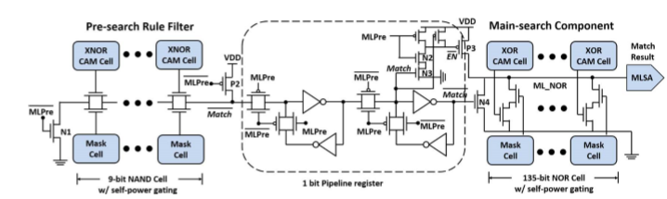
DETAILED CIRCUIT DIAGRAM:

Slide 8
WHAT IS DYNAMIC RECONFIGURABILITY?
This circuit consists of NAND BASED TCAM pipelined with NOR BASED TCAM.
NAND has better filtering output but consumes more power.
NOR has less power consumption
pipelining is for making the circuit to work faster.
DYNAMIC RECONFIGURABILITY:
This circuit operates in differents modes, depending on modes the number of search bits
changes. This is called dynamic reconfigurability.
In Mode 0 it searches 7 bits .
In Mode 1 it searches 14 bits.

Slide 9
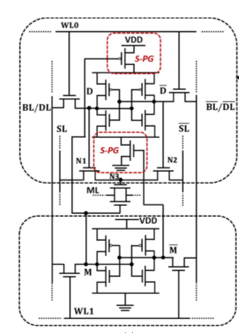
NOR TCAM:
NAND TCAM:
Note: neque digni and in aliquet nisl et a umis varius.

Slide 10
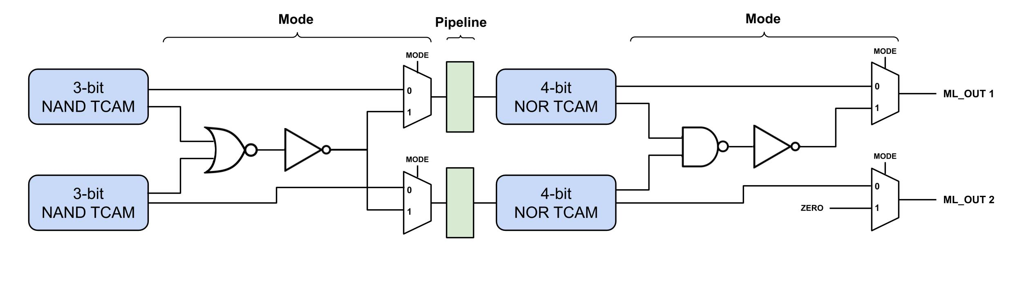
Mode Change
MODE = 0
MODE = 1
Figure. Overall Architecture
Mode: 0 = individual, 1 = combined
Dynamic configurable to change # of bits to search
(Mode 1 on our design, 6-bit NAND + 8-bit NOR TCAM)
We only used 2 rows with mode due to a limited space. (possible to have more modes)

Slide 11
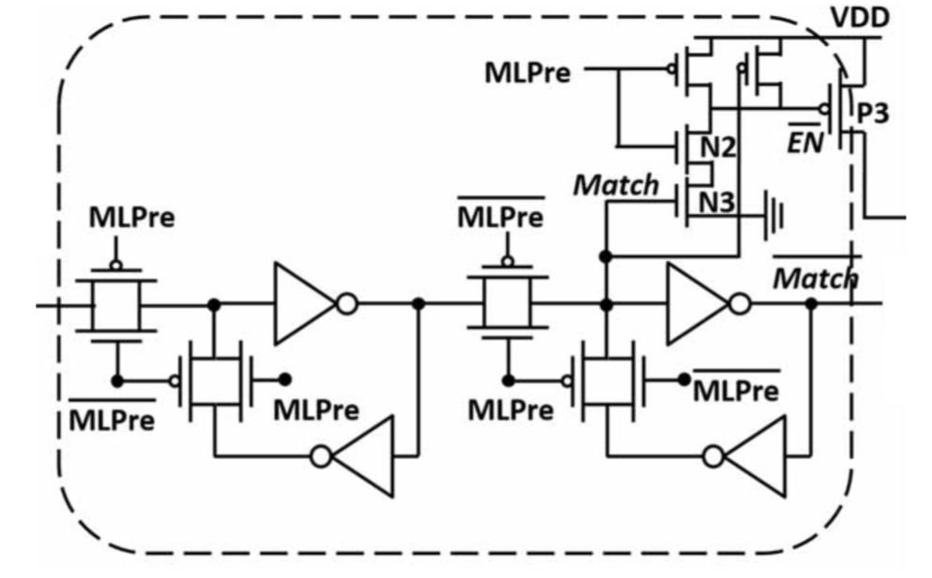
Pipeline
Uses D Flip-Flop (Transmission Gate)
Dividing search operation into 2 stages
(separate stages for NAND and NOR)
Pipeline technique almost doubles the throughput.
Figure. Overall Architecture
Figure. Pipeline

Slide 12
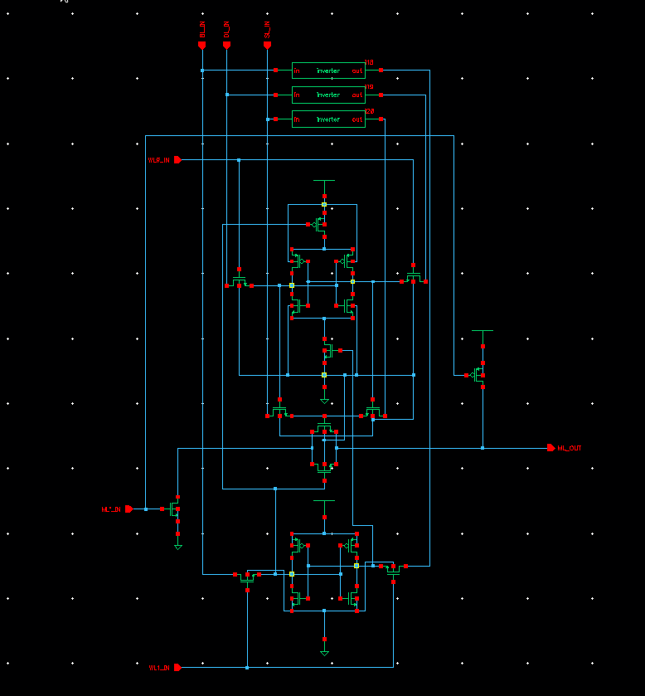
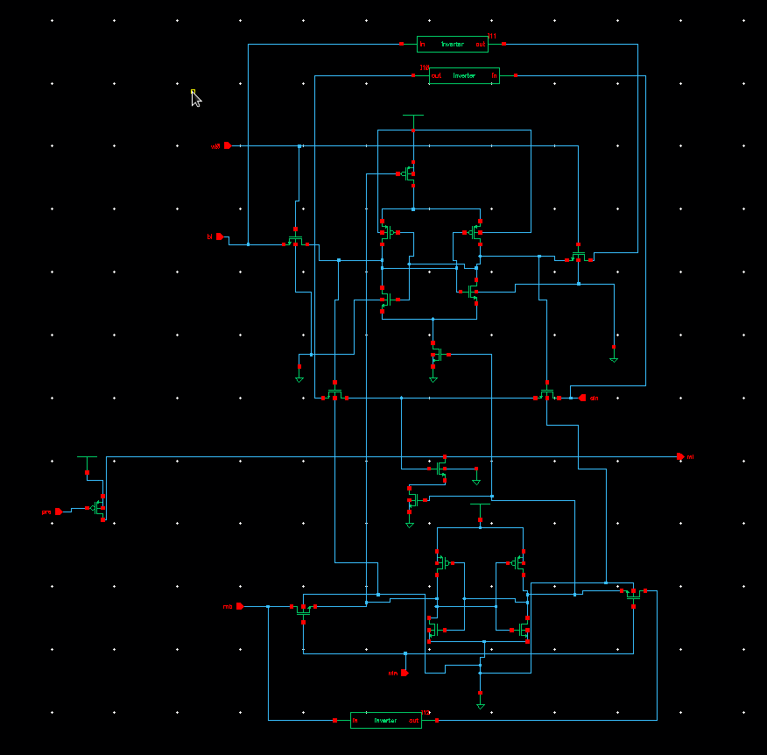
Screenshots (Schematic - NAND, NOR TCAM)
NAND TCAM
NOR TCAM

Slide 13
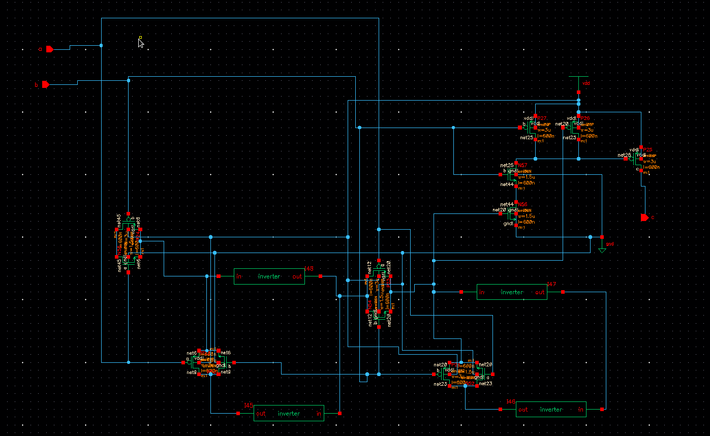
Screenshots (Schematic - Pipeline)

Slide 14
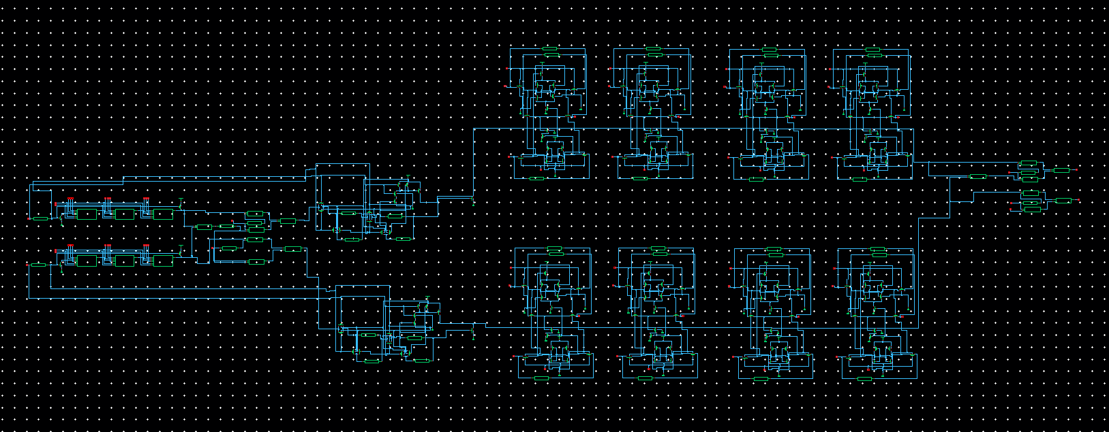
Screenshots (Schematic - Full Circuit)
NOR
MODE
NAND
MODE
Pipeline

Slide 15
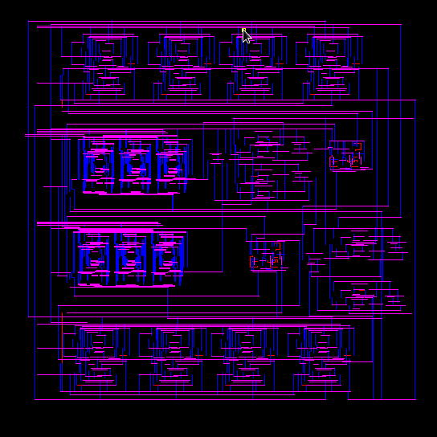
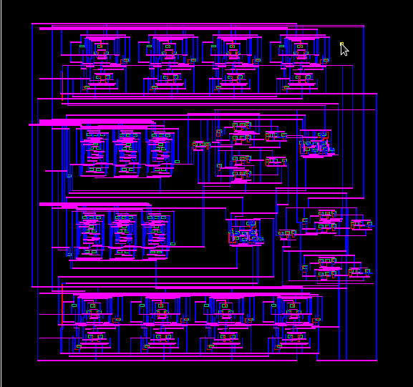
Screenshots (Layout, Extracted - Full Circuit)
Layout
Extracted

Slide 16
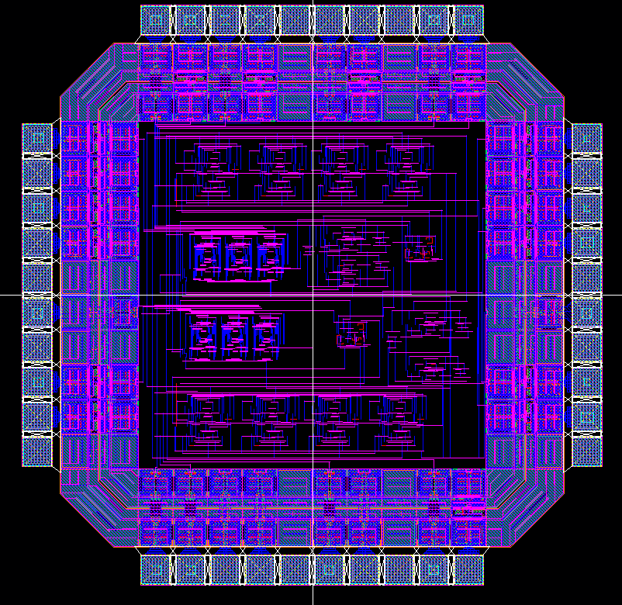
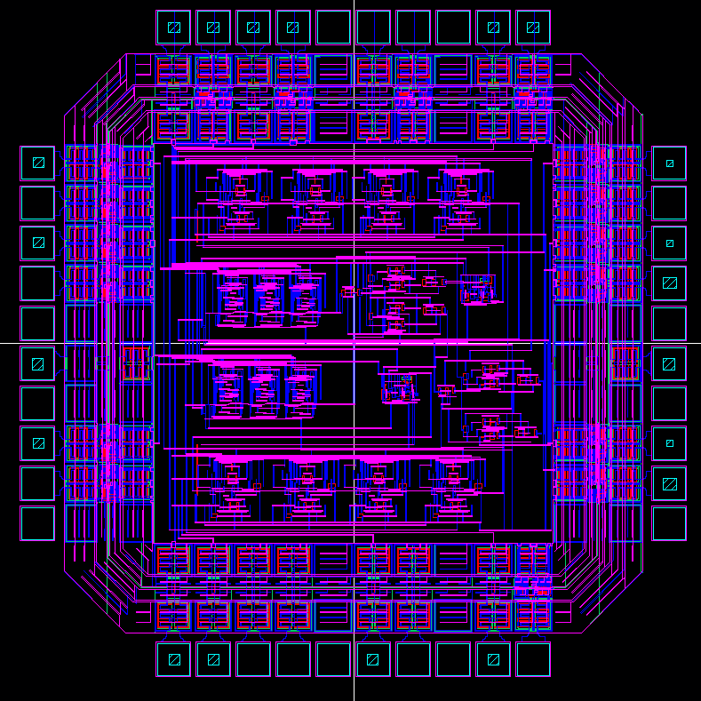
Screenshots (Full on Padframe)
Layout
Extracted

Slide 17
Simulation Result (match case - mode 0)
Figure. Overall Architecture
Mode = 0 (individual - upper / lower)
Data bit and search bit on NAND/NOR TCAM are all matched
Mask bit is disabled

Slide 18
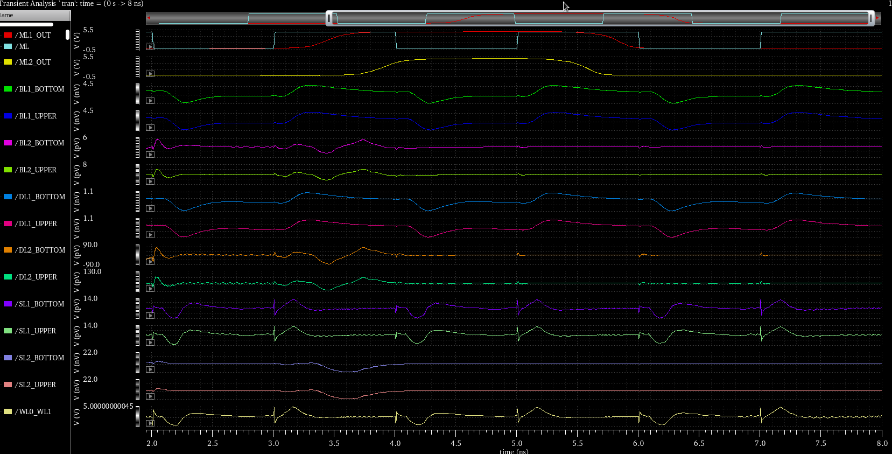
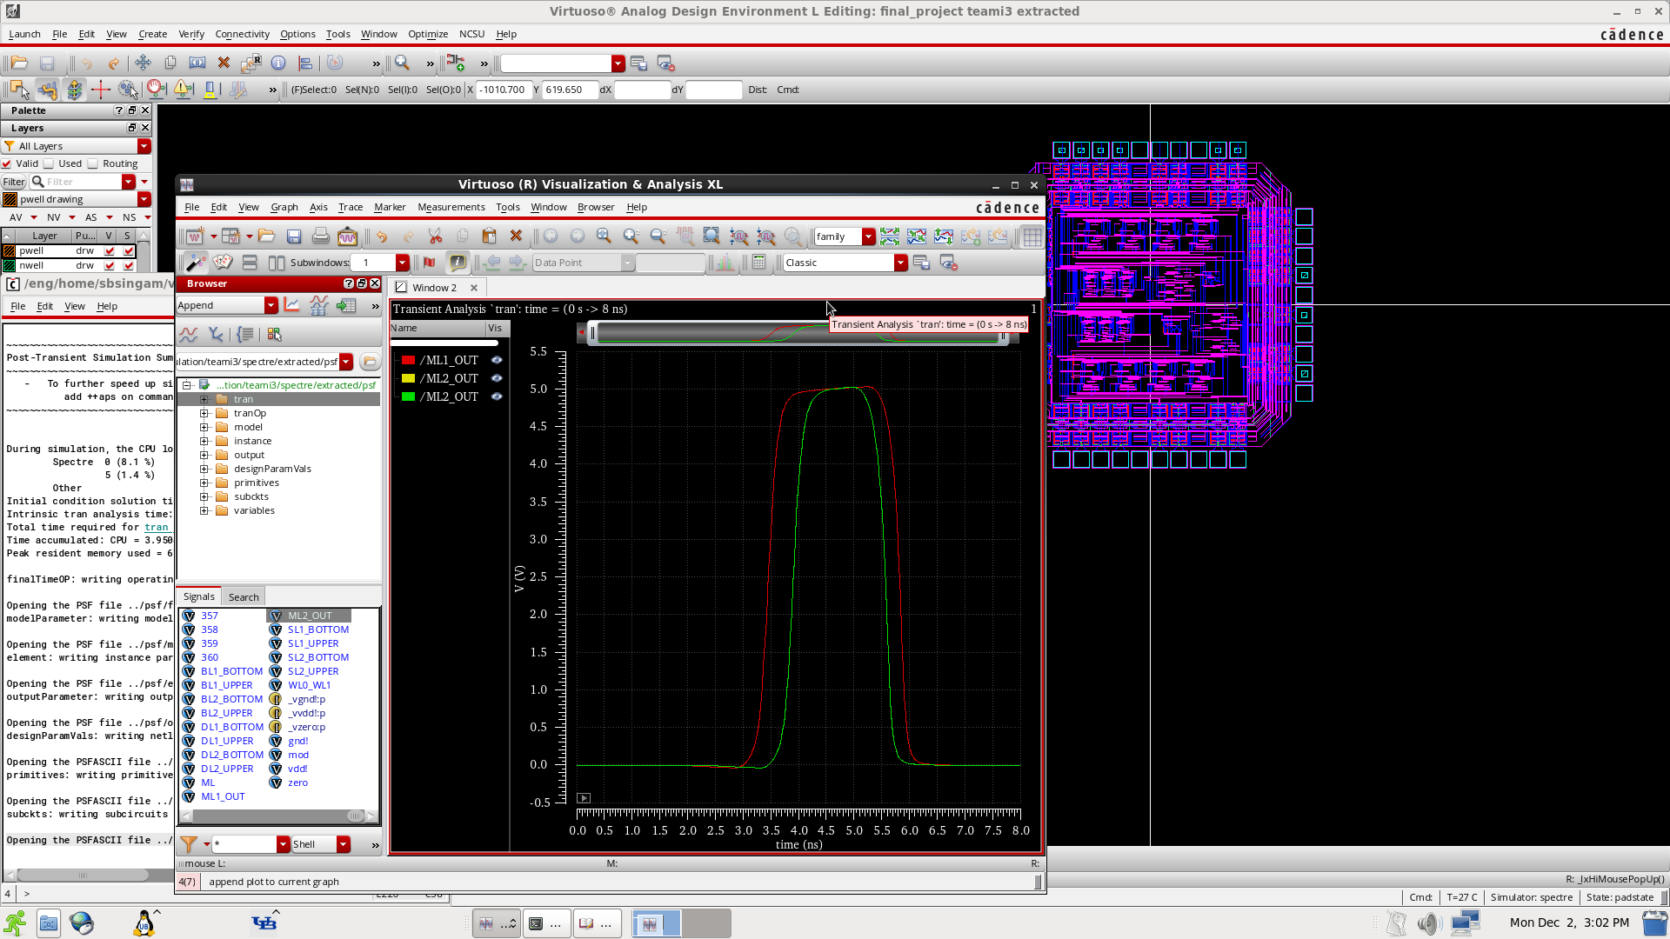
Simulation Result (match case - mode 0)

Slide 19
Work Distribution
Haranadh Baba Singamsetti
NOR TCAM
Multiplexer
Full design & Padframe
Chang Min Park
NAND TCAM
Pipeline
Full design & Padframe

Slide 20
Conclusion
Combined TCAM
Maximize performance with each advantage
NAND TCAM - better filtering output
NOR TCAM - less power consumption
Advanced Features
Mode
dynamic configurable for # of search bits
Pipeline
supports 2 staged search operation
almost doubles throughput

