Slide 1
IMMIX GC
Chang Min Park
Mrinalini Upadhya

Slide 2
CANONICAL TRACING GARBAGE COLLECTORS
Mark-Sweep
Mark-Compact
Semi-Space
Garbage Collectors make Time-Space trade off to achieve:
Better Space Efficiency
Fast Reclamation
Mutator Performance
The three canonical tracing garbage collectors all compromise one of the above performance objectives.

Slide 3
GC Fundamentals Algorithmic Components
Allocation
Identification
Reclamation
`
Sweep-to-Free
Tracing
(implicit)
Free List
Compact
Reference Counting
(explicit)
Bump Allocation
Evacuate
3
1
Notes:
A GC algorithm can be broken down into of three algorithmic components. How objects are allocated, how garbage is identified, and how space is reclaimed.

Slide 4
GC Fundamentals Canonical Garbage Collectors
Mark-Sweep [McCarthy 1960]
Free-list + trace + sweep-to-free
`
Sweep-to-Free
Mark-Compact [Styger 1967]
Bump allocation + trace + compact
Compact
Evacuate
Semi-Space [Cheney 1970]
Bump allocation + trace + evacuate

Slide 5
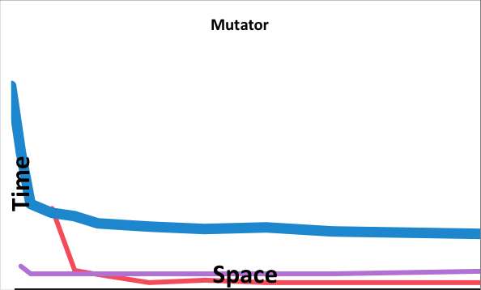
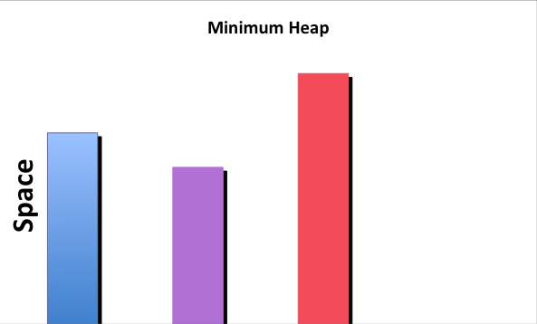
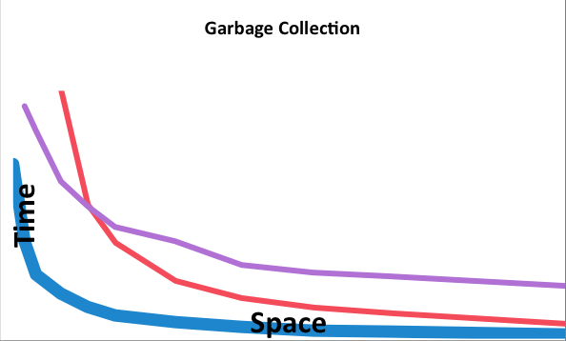
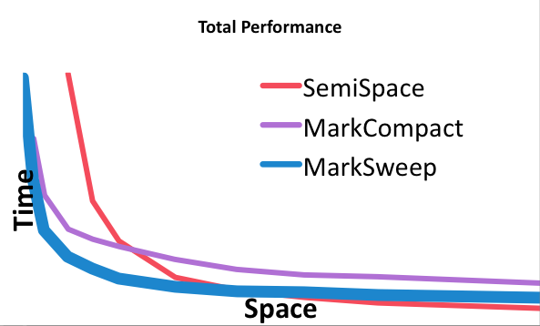
Mark-Sweep Free List Allocation + Trace + Sweep-to-Free
Space efficient
✓
Poor locality
Simple, very fast collection
✓
Actual data, taken from geomean of DaCapo, jvm98, and jbb2000 on 2.4GHz Core 2 Duo
Notes:
On this and the following slides, we contrast the three fundamental collectors, starting with mark-sweep. We do this by presenting four perspectives on collector performance: mutator, collector, minimum heap size, and total performance. Garbage collection people see the application as an adversary, hence the term “mutator” is used in the literature to characterize the application (in exclusion to the collector). It is often underappreciated that collection policies can affect mutator performance. The poor locality of the free list allocator gives mark-sweep poor mutator locality. However mark-sweep collection is fast and simple, and it is space efficient.

Slide 6
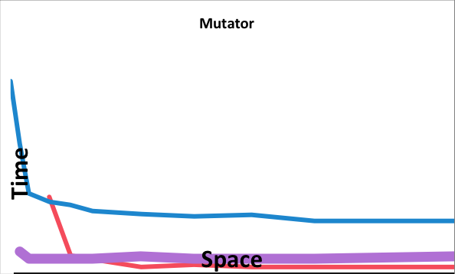
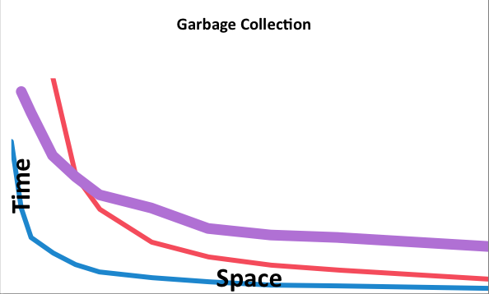
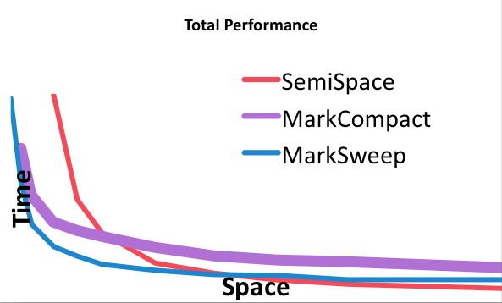
Mark-Compact Bump Allocation + Trace + Compact
Good
locality
Space efficient
✓
✓
Expensive multi-pass collection
Actual data, taken from geomean of DaCapo, jvm98, and jbb2000 on 2.4GHz Core 2 Duo
Notes:
On this and the following slides, we contrast the three fundamental collectors, starting with mark-sweep. We do this by presenting four perspectives on collector performance: mutator, collector, minimum heap size, and total performance. Garbage collection people see the application as an adversary, hence the term “mutator” is used in the literature to characterize the application (in exclusion to the collector). It is often underappreciated that collection policies can affect mutator performance. The poor locality of the free list allocator gives mark-sweep poor mutator locality. However mark-sweep collection is fast and simple, and it is space efficient.

Slide 7
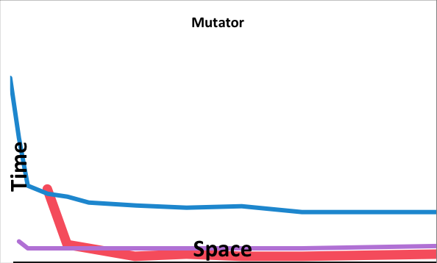
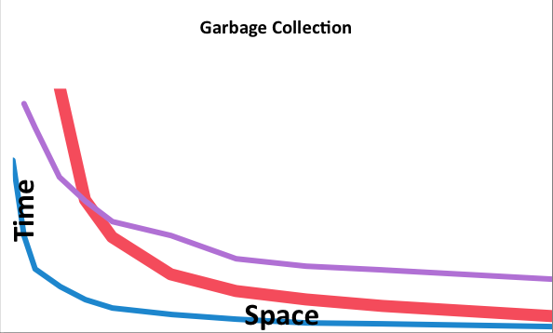
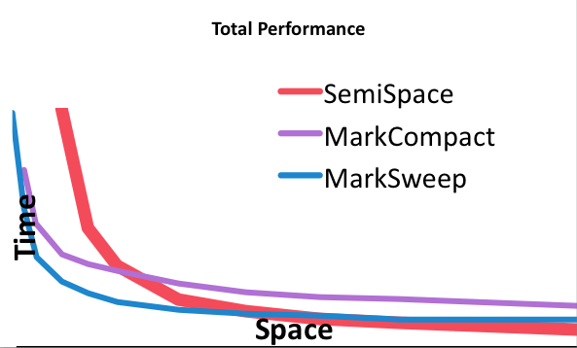
Semi-Space Bump Allocation + Trace + Evacuation
Space inefficient
Good locality
✓
Space inefficient
Actual data, taken from geomean of DaCapo, jvm98, and jbb2000 on 2.4GHz Core 2 Duo
Notes:
On this and the following slides, we contrast the three fundamental collectors, starting with mark-sweep. We do this by presenting four perspectives on collector performance: mutator, collector, minimum heap size, and total performance. Garbage collection people see the application as an adversary, hence the term “mutator” is used in the literature to characterize the application (in exclusion to the collector). It is often underappreciated that collection policies can affect mutator performance. The poor locality of the free list allocator gives mark-sweep poor mutator locality. However mark-sweep collection is fast and simple, and it is space efficient.

Slide 8
Mark-Region with Sweep-To-Region
Reclamation
Mark-Sweep
Free-list + trace + sweep-to-free
Sweep-to-Free
`
Compact
Mark-Compact
Bump allocation + trace + compact
Evacuate
Semi-Space
Bump allocation + trace + evacuate
Mark-Region
Bump + trace + sweep-to-region
Sweep-to-Region
Notes:
We do this by identifying a fourth reclamation strategy, sweep-to-region. It works by dividing the space into regions, and freeing any region with no live objects in it. Regions can then be used for contiguous bump allocation. Mark-region is a canonical collector combining contiguous bump allocation with tracing and sweep-to-region reclamation. Before we look more closely at mark-region let me give you a sneak preview of how it performs.

Slide 9
Naïve Mark-Region
0
Contiguous allocation into regions
Excellent locality
For simplicity, objects cannot span regions
Simple mark phase (like mark-sweep)
Mark objects and their containing region
Unmarked regions can be freed

Slide 10
Immix Efficient Mark-Region Garbage Collection
Notes:
Need text here

Slide 11
How Big Should the Region Be?
If any single object remains alive, the entire region is unavailable.
Large regions are space-inefficient since a single small object can withhold an entire region.
while small regions increase space efficiency but increase collection time.

Slide 12
Lines and Blocks
Large Regions
✓ More contiguous allocation
✗ Fragmentation (false marking)
Small Regions
✗ Increased metadata o/h
✗ Fragmentation (can’t fill blocks)
✗ Constrained object sizes
Page Size
Lines & Blocks
approx 1 cache line
Free
Recyclable
Free
Unavailable
0
• Line ≈ 1 Cache line
• Block > 4 X max object size
• Objects span lines
• Lines marked with objects
✓ Less fragmentation
✓ Fast common case
Notes:
Not to scale! 64K/128 (2^16/2^7) => 512 lines per block!! LOS used for large objects. Freed pages may be reused by other components, such as the LOS

Slide 13
Policies and Details
Allocation Policy
Recycling Policy
Opportunistic Defragmentation
Other Optimizations

Slide 14
Allocation Policy (Recycling)
Recycle partially marked blocks first
Minimizes fragmentation
Maximizes sharing of freed blocks
Recycle in address order
Allocate into free blocks last
Notes:
Block status
Free
Recyclable
Unavailable

Slide 15
Opportunistic Defragmentation
Opportunistically evacuate fragmented blocks
Lightweight, uses same allocation mechanism
No cost in common case (specialized GC)
0
Identify source and target blocks
(see paper for heuristics)
Evacuate objects in source blocks
Allocate into target blocks
Opportunistic
Leave in place if no space, or object pinned
Notes:
Need text here

Slide 16
Other Optimizations
Implicit Marking
• Small objects implicitly mark next line
✓ Most objects are small
Line mark
Implicit line mark
• Large objects mark lines exactly
✓ V. Fast common case
Overflow Allocation
• Multi-line objects may skip many small holes
✓
• Overflow allocation (used on failure)
✓ Large objects uncommon
✓ V. effective solution

Slide 17
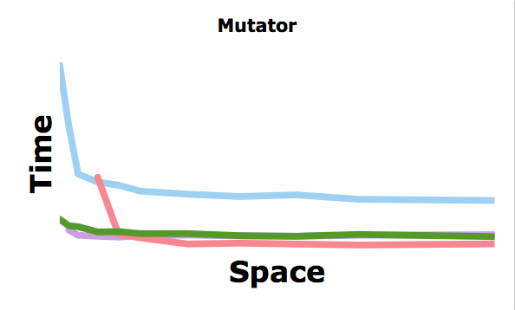
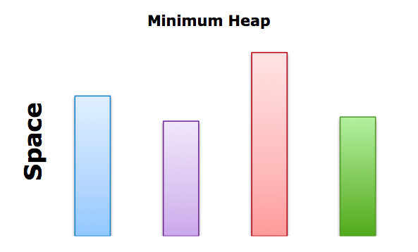
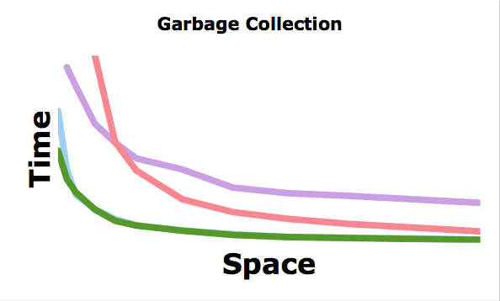
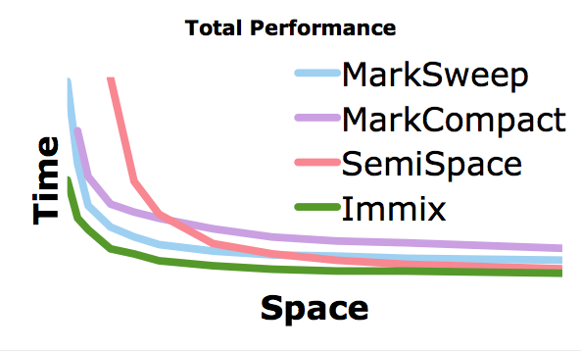
Immix Performance Bump Allocation + Trace + Sweep-to-Region
Good locality
Space efficient
✓
✓
Excellent
performance
✓
Simple, very fast collection
✓
Actual data, taken from geomean of DaCapo, jvm98, and jbb2000 on 2.4GHz Core 2 Duo
Notes:
Q. On here or at the end ?

Slide 18
Immix Summary
Design(Block & lines)
Less fragmentation, Fast collection time.
Recycling Policy
Allocate recyclable blocks first, and then free blocks.
Opportunistic Defragmentation
Evacuate from source block, and allocate it to target block
Implicit Marking
Handling small object differently.
Overflow Allocation

