Slide 1
삼성 DS-KAIST AI Expert 프로그램 해석가능한 딥러닝, 신뢰성 있는 딥러닝, 적대적 딥러닝
Jongheon Jeong (jongheonj@kaist.ac.kr)
KAIST ALIN Lab. (Prof. Jinwoo Shin)
Sept 30, 2019

Slide 2
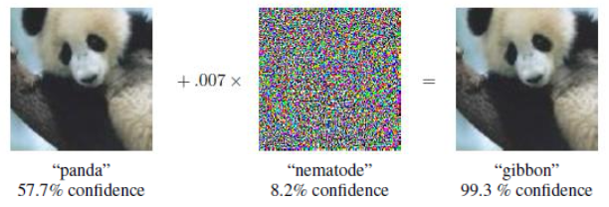

What is the adversarial example?
Problem: ML systems are vulnerable to a noise specifically designed by an adversary
In other words, answer of machine $≠$ answer of human
Even state-of-the-art-level neural networks make erroneous outputs
Example: GoogleNet trained on ImageNet dataset

Slide 3
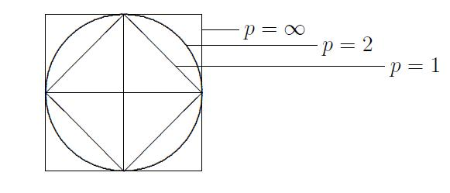
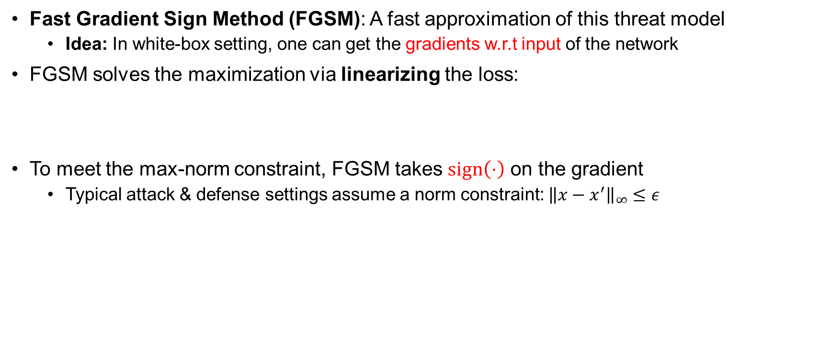
How can we find such a noise?
Fast Gradient Sign Method (FGSM): A fast approximation of this threat model
Idea: In white-box setting, one can get the gradients w.r.t input of the network
FGSM solves the maximization via linearizing the loss:
To meet the max-norm constraint, FGSM takes $sign\left(⋅\right)$ on the gradient
Typical attack & defense settings assume a norm constraint: ${\left\|x−x^{′}\right\|}_{∞}≤ε$

Slide 4
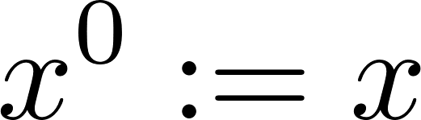
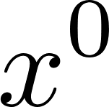
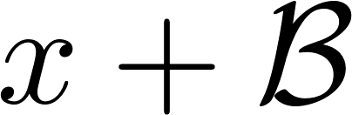
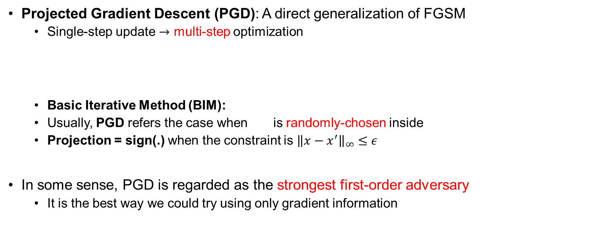
How can we find such a noise?
Projected Gradient Descent (PGD): A direct generalization of FGSM
Single-step update $→$ multi-step optimization
Basic Iterative Method (BIM):
Usually, PGD refers the case when is randomly-chosen inside
Projection = sign(.) when the constraint is ${\left\|x−x^{′}\right\|}_{∞}≤ε$
In some sense, PGD is regarded as the strongest first-order adversary
It is the best way we could try using only gradient information
projection

Slide 5
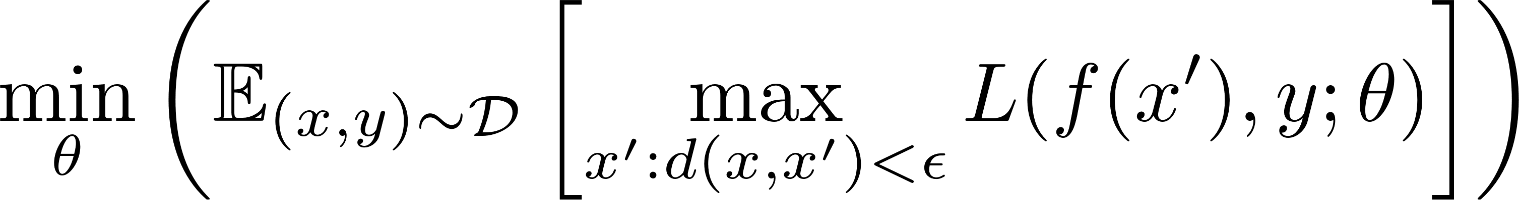
How can we defend from such noises?
Currently, adversarial training framework is known to be the best way
Challenge: Computing the inner-maximization is difficult
Idea: Use strong attack methods to approximate the inner-maximization
e.g. FGSM, PGD, DeepFool, …
In other words: data augmentation via adversarial examples
Training parameters

Slide 6
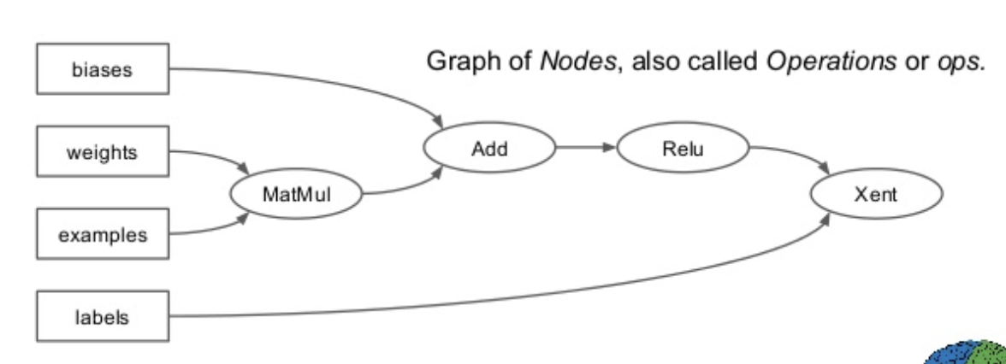
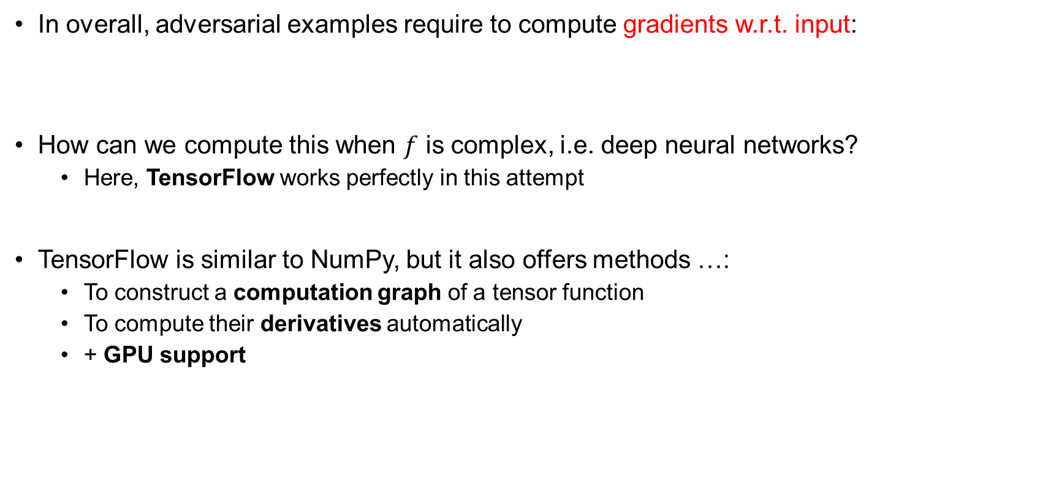
Gradient computation via TensorFlow
In overall, adversarial examples require to compute gradients w.r.t. input:
How can we compute this when $f$ is complex, i.e. deep neural networks?
Here, TensorFlow works perfectly in this attempt
TensorFlow is similar to NumPy, but it also offers methods …:
To construct a computation graph of a tensor function
To compute their derivatives automatically
+ GPU support
Nodes: Ops
Edges: Tensors

Slide 7
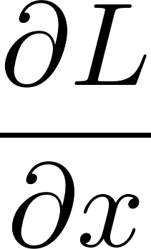
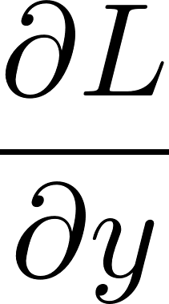
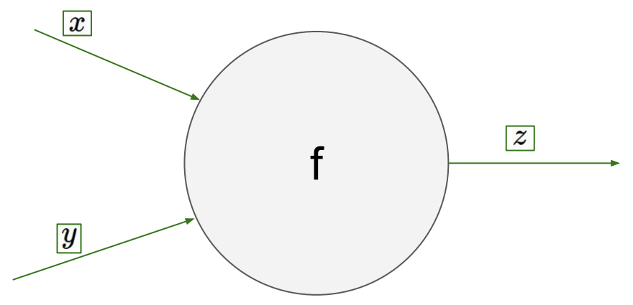
Backpropagation
Goal: Compute and
Notes:
To explain this, let’s focus on a single operation in a computation graph, assuming that the inputs are x and y, with output z.

Slide 8
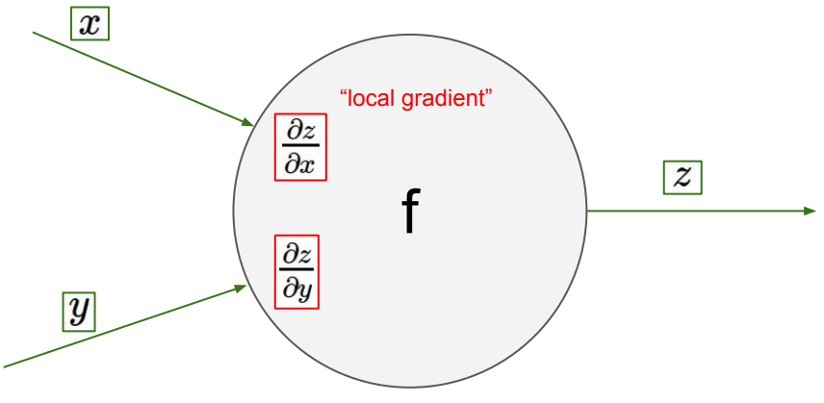
Backpropagation
Goal: Compute and
Implemented in TensorFlow
Notes:
In this setting, one key component of Tensorflow is that, it provides local gradients for the operation f w.r.t. their inputs, if f is a tensorflow primitive op, and its differentiable.

Slide 9
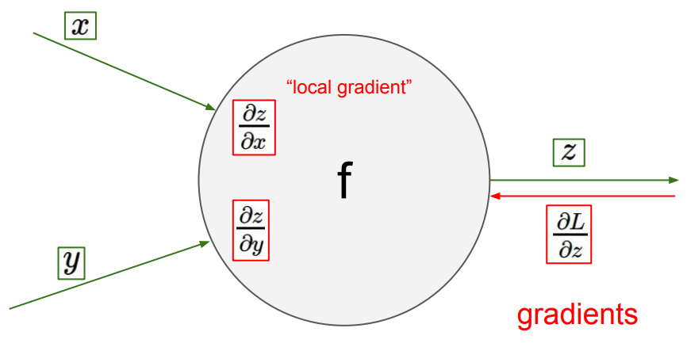
Backpropagation
Goal: Compute and
Notes:
Now, suppose that, for some reason, we’ve got the value of a gradient of loss w.r.t the output z, that is, round L over round z here.

Slide 10
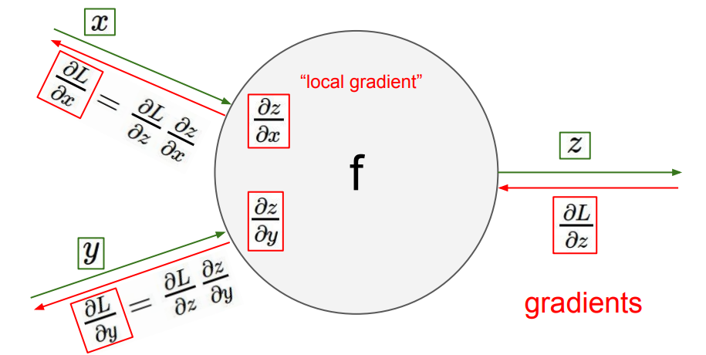
Backpropagation
Goal: Compute and
Notes:
Then by using the chain rule, we can calculate the value of gradient of loss w.r.t x and y as well. Note that these x or y can also be an output of another op.
Therefore, this procedure can be repeated as many times as we want in a differentiable computation graph, to obtain the values of gradients of loss w.r.t. certain variables.
This procedure is called the back-propagation algorithm, and until now this algorithm plays a key role to enable the gradient descent method on deep neural networks.

Slide 11
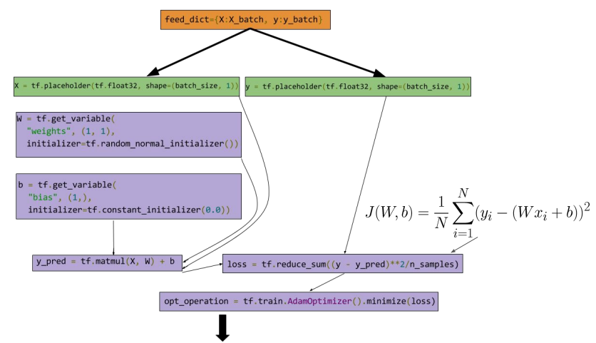


Example: Linear regression in TensorFlow
$$\frac{∂J}{∂W}$$
Computation graph
Op-wise derivatives
$$\frac{∂J}{∂b}$$
Notes:
Returning to our main computation graph, then, the backpropagation is now starts from the loss node, here, and it propagates a flow of gradients backward toward W and b. Once we get round j over round W and round j over round b, then we can do a single step of gradient descent.
In conclusion, now it is clear why TensorFlow maintains such computation graph and op-wise derivatives. By actively utilizing those two, TensorFlow enables a new functionality over Numpy: optimizing tensors with gradient based methods.

Slide 12
Project overview
This tutorial consists of 5 parts:
Part 1. TensorFlow를 활용한 역전파 알고리즘 수행
Part 2. 적대적 샘플 생성: ImageNet 분류기에 대한 FGSM 공격
Part 3. 적대적 공격 기법 설계하기
Part 4. 적대적 방어 기법 설계하기
Part 5. 모델 해석을 통해 적대적 샘플 이해하기

Slide 13
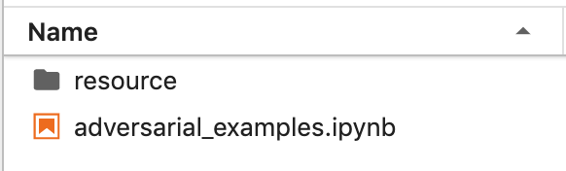
Overview
Please download the material in the following link:
bit.ly/2mAEVSh
The tutorial is mainly driven in jupyter-notebook
Make sure the material is accessible by Jupyter console
Please read & follow the instructions inside the project file
Main project

