Slide 1
CHAPTER 3 LEXICAL ANALYSIS
Section 0 Approaches to implement a lexical analyzer
1、Simple approach
  Construct a diagram that illustrates the structure of the tokens of the source language , and then to hand-translate the diagram into a program for finding tokens
  Notes: Efficient lexical analyzers can be produced in this manner

Slide 2
CHAPTER 3 LEXICAL ANALYSIS
Section 0 Approaches to implement a lexical analyzer
2、Pattern-directed programming approach
  Pattern Matching technique
  Specify and design program that execute actions triggered by patterns in strings
  Introduce a pattern-action language called Lex for specifying lexical analyzers
    Patterns are specified by regular expressions
    A compiler for Lex can generate an efficient finite automation recognizer for the regular expressions

Slide 3
CHAPTER 3 LEXICAL ANALYSIS
Section 1 The role of the lexical analyzer
First phase of a compiler
1、Main task
  To read the input characters
  To produce a sequence of tokens used by the parser for syntax analysis
  As an assistant of parser

Slide 4
CHAPTER 3 LEXICAL ANALYSIS
Section 1 The role of the lexical analyzer
2、Interaction of lexical analyzer with parser
token
Source program
Lexical analyzer
Parser
Get next token
Symbol table

Slide 5
CHAPTER 3 LEXICAL ANALYSIS
Section 1 The role of the lexical analyzer
3、Processes in lexical analyzers
  Scanning
    Pre-processing
      Strip out comments and white space
      Macro functions
  Correlating error messages from compiler with source program
    A line number can be associated with an error message
  Lexical analysis

Slide 6
CHAPTER 3 LEXICAL ANALYSIS
Section 1 The role of the lexical analyzer
4、Terms of the lexical analyzer
  Token
    Types of words in source program
    Keywords, operators, identifiers, constants, literal strings, punctuation symbols(such as commas,semicolons)
  Lexeme
    Actual words in source program
  Pattern
    A rule describing the set of lexemes that can represent a particular token in source program
    Relation {<.<=,>,>=,==,<>}

Slide 7
CHAPTER 3 LEXICAL ANALYSIS
Section 1 The role of the lexical analyzer
5、Attributes for Tokens
  A pointer to the symbol-table entry in which the information about the token is kept
  E.g E=M*C**2
  <id, pointer to symbol-table entry for E>
  <assign_op,>
  <id, pointer to symbol-table entry for M>
  <multi_op,>
  <id, pointer to symbol-table entry for C>
  <exp_op,>
  <num,integer value 2>

Slide 8
CHAPTER 3 LEXICAL ANALYSIS
Section 1 The role of the lexical analyzer
6、Lexical Errors
  Deleting an extraneous character
  Inserting a missing character
  Replacing an incorrect character by a correct character
  Transposing two adjacent characters(such as , fi=>if)
  Pre-scanning

Slide 9
CHAPTER 3 LEXICAL ANALYSIS
Section 1 The role of the lexical analyzer
7、Input Buffering
  Two-buffer input scheme to look ahead on the input and identify tokens
  Buffer pairs
  Sentinels(Guards)

Slide 10
CHAPTER 3 LEXICAL ANALYSIS
Section 2 Specification of Tokens
1、Regular Definition of Tokens
  Defined in regular expression
  e.g. Id → letter(letter|digit)
  letter →A|B|…|Z|a|b|…|z
  digit →0|1|2|…|9
  Notes: Regular expressions are an important notation for specifying patterns. Each pattern matches a set of strings, so regular expressions will serve as as names for sets of strings.

Slide 11
CHAPTER 3 LEXICAL ANALYSIS
Section 2 Specification of Tokens
2、Regular Expression & Regular language
  Regular Expression
    A notation that allows us to define a pattern in a high level language.
  Regular language
    Each regular expression r denotes a language L(r) (the set of sentences relating to the regular expression r)
  Notes: Each word in a program can be expressed in a regular expression

Slide 12
CHAPTER 3 LEXICAL ANALYSIS
Section 2 Specification of Tokens
3、The rule of regular expression over alphabet Σ
  ε is a regular expression that denote {ε}
    ε is regular expression
    {ε} is the related regular language
  2) If a is a symbol in Σ, then a is a regular expression that denotes {a}
    a is regular expression
    {a} is the related regular language

Slide 13
CHAPTER 3 LEXICAL ANALYSIS
Section 2 Specification of Tokens
3、The rule of regular expression over alphabet Σ
  3) Suppose α and β are regular expressions, then α|β, αβ, α* ,β * is also a regular expression
  Notes: Rules 1) and 2) form the basis of the definition; rule 3) provides the inductive step.

Slide 14
CHAPTER 3 LEXICAL ANALYSIS
Section 2 Specification of Tokens
4、Algebraic laws of regular expressions
1) α|β= β|α
  2) α|(β|γ)=(α|β)|γ α(βγ) =(α β)γ
  3) α(β|γ )= αβ | αγ (α|β)γ= αγ| βγ
  4) εα = αε = α
  5)(α*)*=α*
  6) α*=α＋|ε α＋ ＝ α α* = α*α
  7) (α|β)*= (α* |β *)*= (α* β*)*

Slide 15
CHAPTER 3 LEXICAL ANALYSIS
Section 2 Specification of Tokens
4、Algebraic laws of regular expressions
  8) If ε∉L(γ),then
  α= β| γ α α= γ* β
  α= β| α γ α= β γ*
  Notes: We assume that the precedence of * is the highest, the precedence of | is the lowest and they are left associative

Slide 16
CHAPTER 3 LEXICAL ANALYSIS
Section 2 Specification of Tokens
5、Notational Short-hands
  a)One or more instances
  ( r )⁺ digit⁺
  b)Zero or one instance
  r? is a shorthand for r|ε (E(+|-)?digits)?
  c)Character classes
  [a-z] denotes a|b|c|…|z
  [A-Za-z] [A-Za-z0-9]

Slide 17
CHAPTER 3 LEXICAL ANALYSIS
Section 3 Recognition of Tokens
1、Task of recognition of token in a lexical analyzer
  Isolate the lexeme for the next token in the input buffer
  Produce as output a pair consisting of the appropriate token and attribute-value, such as <id,pointer to table entry> , using the translation table given in the Fig in next page

Slide 18
CHAPTER 3 LEXICAL ANALYSIS
Section 3 Recognition of Tokens
1、Task of recognition of token in a lexical analyzer
Regular expression | Token | Attribute-value
if | if | -
id | id | Pointer to table entry
< | relop | LT

Slide 19
CHAPTER 3 LEXICAL ANALYSIS
Section 3 Recognition of Tokens
2、Methods to recognition of token
  Use Transition Diagram

Slide 20
CHAPTER 3 LEXICAL ANALYSIS
Section 3 Recognition of Tokens
3、Transition Diagram(Stylized flowchart)
  Depict the actions that take place when a lexical analyzer is called by the parser to get the next token
Accepting state
start
>
=
0
6
7
return(relop,GE)
Start state
other
*
8
return(relop,GT)
Notes: Here we use ‘*’ to indicate states on which input retraction must take place

Slide 21
CHAPTER 3 LEXICAL ANALYSIS
Section 3 Recognition of Tokens
4、Implementing a Transition Diagram
  Each state gets a segment of code
  If there are edges leaving a state, then its code reads a character and selects an edge to follow, if possible
  Use nextchar() to read next character from the input buffer

Slide 22
CHAPTER 3 LEXICAL ANALYSIS
Section 3 Recognition of Tokens
4、Implementing a Transition Diagram
while (1) {
switch(state) {
case 0: c=nextchar();
if (c==blank || c==tab || c==newline){
state=0;lexeme_beginning++}
else if (c== ‘<‘) state=1;
else if (c==‘=‘) state=5;
else if(c==‘>’) state=6 else state=fail();
break
case 9: c=nextchar();
if (isletter( c)) state=10;
else state=fail(); break
… }}}

Slide 23
CHAPTER 3 LEXICAL ANALYSIS
Section 3 Recognition of Tokens
5、A generalized transition diagram
Finite Automation
  Deterministic or non-deterministic FA
  Non-deterministic means that more than one transition out of a state may be possible on the the same input symbol

Slide 24
CHAPTER 3 LEXICAL ANALYSIS
Section 3 Recognition of Tokens
6、The model of recognition of tokens
i
f
d
2
=…
Input buffer
Lexeme_beginning
FA simulator

Slide 25
CHAPTER 3 LEXICAL ANALYSIS
Section 3 Recognition of Tokens
e.g：The FA simulator for Identifiers is:
  Which represent the rule: identifier=letter(letter|digit)*
letter
letter
1 2
digit

Slide 26
CHAPTER 3 LEXICAL ANALYSIS
Section 4 Finite automata
1、Usage of FA
  Precisely recognize the regular sets
  A regular set is a set of sentences relating to the regular expression
2、Sorts of FA
  Deterministic FA
  Non-deterministic FA

Slide 27
CHAPTER 3 LEXICAL ANALYSIS
Section 4 Finite automata
3、Deterministic FA (DFA)
  DFA is a quintuple, M(S,Σ,move,s₀,F）
  S: a set of states
  Σ: the input symbol alphabet
  move: a transition function, mapping from S× Σ to S, move(s,a)=s’
  s₀: the start state, s₀ ∈ S
  F: a set of states F distinguished as accepting states, F⊆S

Slide 28
CHAPTER 3 LEXICAL ANALYSIS
Section 4 Finite automata
  3、Deterministic FA (DFA)
  Note: 1) In a DFA, no state has an ε-transition;
  2)In a DFA, for each state s and input symbol a, there is at most one edge labeled a leaving s
  3)To describe a FA,we use the transition graph or transition table
  4)A DFA accepts an input string x if and only if there is some path in the transition graph from start state to some accepting state

Slide 29
e.g. DFA M=({0,1,2,3},{a,b},move,0,{3})
Move: move(0,a)=1 m(0,b)=2 m(1,a)＝3 m(1,b)＝2
  m(2,a)=1 m(2,b)=3 m(3,a)＝3 m(3,b)＝3
Transition table
input state | a | b
0 | 1 | 2
1 | 3 | 2
2 | 1 | 3
3 | 3 | 3
1
a
a
a
0
b a
3
b
b
b
2
Transition graph

Slide 30
e.g. Construct a DFA M，which can accept the strings which begin with a or b, or begin with c and contain at most one a。
b
b
0
c
a
2
3
a b
c
c
c a
1
b

Slide 31
So ,the DFA is
M=({0,1,2,3,},{a,b,c},move,0,{1,2,3})
  move：move(0,a)=1 move(0,b)=1
  move(0,c)=1 move(1,a)=1
  move(1,b)=1 move(1,c)=1
  move(2,a)=3 move(2,b)=2
  move(2,c)=2 move(3,b)=3
  move(3,c)=3

Slide 32
CHAPTER 3 LEXICAL ANALYSIS
Section 4 Finite automata
4、Non-deterministic FA (NFA)
  NFA is a quintuple, M(S,Σ,move,s₀,F）
  S: a set of states
  Σ: the input symbol alphabet
  move: a mapping from S× Σ to S, move(s,a)=2^{S}, 2^{S} ⊆S
  s₀: the start state, s₀ ∈ S
  F: a set of states F distinguished as accepting states, F⊆S

Slide 33
CHAPTER 3 LEXICAL ANALYSIS
Section 4 Finite automata
4、Non-deterministic FA (NFA)
  Note:1) In a NFA,the same character can label two or more transitions out of one state;
  2) In a NFA,ε is a legal input symbol.
  3) A DFA is a special case of a NFA
  4)A NFA accepts an input string x if and only if there is some path in the transition graph from start state to some accepting state. A path can be represented by a sequence of state transitions called moves.
  5)The language defined by a NFA is the set of input strings it accepts

Slide 34
e.g. An NFA M＝({q₀,q₁},{0,1},move,q₀,{q₁})
0
input State | 0 | 1
q₀ | q₀ | q₁
q₁ | q_{0，} q₁ | q₀
1
q₀
q₁
1
0
0
The language defined by the NFA is 0*10*|0*10*((1|0)0*10*)*

Slide 35
CHAPTER 3 LEXICAL ANALYSIS
Section 4 Finite automata
5、Conversion of an NFA into a DFA
a)Reasons to conversion
Avoiding ambiguity
b)The algorithm idea
Subset construction: The following state set of a state in a NFA is thought of as a following STATE of the state in the converted DFA

Slide 36
CHAPTER 3 LEXICAL ANALYSIS
Section 4 Finite automata
5、Conversion of an NFA into a DFA
c)The pre-process-- ε-closure(T)
Obtain ε-closure(T) T ⊆S
  ε-closure(T) definition
  A set of NFA states reachable from NFA state s in T on ε-transitions alone

Slide 37
CHAPTER 3 LEXICAL ANALYSIS
Section 4 Finite automata
5、Conversion of an NFA into a DFA
c)The pre-process--- ε-closure(T)
(2)ε-closure(T) algorithm
  push all states in T onto stack;
  initialize ε-closure(T) to T;
  while stack is not empty do {
  pop the top element of the stack into t;
  for each state u with an edge from t to u labeled ε do {
  if u is not in ε-closure(T) {
  add u to ε-closure(T)
  push u into stack}}}

Slide 38
CHAPTER 3 LEXICAL ANALYSIS
Section 4 Finite automata
5、 Conversion of an NFA into a DFA
d)Subset Construction algorithm
  Input. An NFA N=(S,Σ,move,S₀,Z)
  Output. A DFA D= (Q,Σ,δ,I₀,F), accepting the same language

Slide 39
CHAPTER 3 LEXICAL ANALYSIS
Section 4 Finite automata
5、 Conversion of an NFA into a DFA
d)Subset Construction algorithm
(1)I₀＝ ε-closure(S₀), I₀ ∈Q
(2)For each I_{i} , I_{i} ∈Q,
let I_{t}= ε-closure(move(I_{i},a))
if I_{t} ∉Q, then put I_{t} into Q
(3)Repeat step (2), until there is no new state to put into Q
(4)Let F={I | I ∈ Q,且I ∩ Z <>Φ}

Slide 40
e.g.
a
a
3
a
a
ε
ε
ε
ε
x
5
1
2
6
y
b
b
b
4
b
I
a
b
I₀={x,5,1}
I₁={5,3,1}
I₂={5,4,1}
I₁={5,3,1}
I₃={5,3,2,1,6,y}
I₂={5,4,1}
I₂={5,4,1}
I₁={5,3,1}
I₄={5,4,1,2,6,y}
I₃={5,3,2,1,6,y}
I₃={5,3,2,1,6,y}
I₅={5,1,4,6,y}
I₄={5,4,1,2,6,y}
I₆={5,3,1,6,y}
I₄={5,4,1,2,6,y}
I₅={5,1,4,6,y}
I₆={5,3,1,6,y}
I₄={5,4,1,2,6,y}
I₆={5,3,1,6,y}
I₃={5,3,2,1,6,y}
I₅={5,1,4,6,y}

Slide 41
I | a | b
I₀ | I₁ | I₂
I₁ | I₃ | I₂
I₂ | I₁ | I₄
I₃ | I₃ | I₅
I₄ | I₆ | I₄
I₅ | I₆ | I₄
I₆ | I₃ | I₅
DFA is
a
a
b
I₁
I₃
I₅
a
a
b a
a b
I₀
b
b
b
I₂
I₄
I₆
b

Slide 42
CHAPTER 3 LEXICAL ANALYSIS
Section 4 Finite automata
5、 Conversion of an NFA into a DFA
d)Subset Construction algorithm
Notes:
  1)Both DFA and NFA can recognize precisely the regular sets;
  2)DFA can lead to faster recognizers
  3)DFA can be much bigger than an equivalent NFA

Slide 43
CHAPTER 3 LEXICAL ANALYSIS
Section 4 Finite automata
6、 Minimizing the number of States of a DFA
a)Basic idea
Find all groups of states that can be distinguished by some input string. At beginning of the process, we assume two distinguished groups of states: the group of non-accepting states and the group of accepting states. Then we use the method of partition of equivalent class on input string to partition the existed groups into smaller groups .

Slide 44
CHAPTER 3 LEXICAL ANALYSIS
Section 4 Finite automata
6、 Minimizing the number of States of a DFA
b)Algorithm
  Input. A DFA M={S,Σ,move, s₀,F}
  Output. A DFA M’ accepting the same language as M and having as few states as possible.

Slide 45
CHAPTER 3 LEXICAL ANALYSIS
Section 4 Finite automata
6、 Minimizing the number of States of a DFA
b)Algorithm
  (1)Construct an initial partition ∏ of the set of states with two groups: the accepting states F and the non-accepting states S-F. ∏₀＝{I₀¹,I₀²}

Slide 46
CHAPTER 3 LEXICAL ANALYSIS
Section 4 Finite automata
6、 Minimizing the number of States of a DFA
b)Algorithm
  (2) For each group I of ∏_{i} ,partition I into subgroups such that two states s and t of I are in the same subgroup if and only if for all input symbols a, states s and t have transitions on a to states in the same group of ∏_{i} ; replace I in ∏_{i+1_}by the set of subgroups formed.

Slide 47
CHAPTER 3 LEXICAL ANALYSIS
Section 4 Finite automata
6、 Minimizing the number of States of a DFA
b)Algorithm
  (3) If ∏_{i+1} =∏_{i} ,let ∏_{final} =∏_{i+1} and continue with step (4). Otherwise,repeat step (2) with ∏_{i+1}
  (4) Choose one state in each group of the partition ∏_{final} as the representative for that group. The representatives will be the states of the reduced DFA M’. Let s and t be representative states for s’s and t’s group respectively, and suppose on input a there is a transition of M from s to t. Then M’ has a transition from s to t on a.

Slide 48
CHAPTER 3 LEXICAL ANALYSIS
Section 4 Finite automata
6、 Minimizing the number of States of a DFA
b)Algorithm
  (5) If M’ has a dead state(a state that is not accepting and that has transitions to itself on all input symbols),then remove it. Also remove any states not reachable from the start state.

Slide 49
CHAPTER 3 LEXICAL ANALYSIS
Section 4 Finite automata
6、 Minimizing the number of States of a DFA
b)Algorithm
  Notes: The meaning that string w distinguishes state s from state t is that by starting with the DFA M in state s and feeding it input w, we end up in an accepting state, but starting in state t and feeding it input w, we end up in a non-accepting state, or vice versa.

Slide 50
e.g. Minimize the following DFA.
a
a
b
1
3
4
a
b
a
0
b
a
a
b
b
b
a
2
5
6
b

Slide 51
1. Initialization: ∏₀＝{{0,1,2},{3,4,5,6}}
2.1 For Non-accepting states in ∏₀ :
  a: move({0,2},a)={1} ; move({1},a)={3} . 1,3 do not in the same subgroup of ∏₀.
  So ,∏₁`＝{{1}，{0,2}，{3,4,5,6}}
  b: move({0},b)={2}; move({2},b)={5}. 2,5 do not in the same subgroup of ∏₁‘.
  So, ∏₁``＝{{1}，{0}，{2}，{3,4,5,6}}

Slide 52
2.2 For accepting states in ∏₀ :
  a: move({3,4,5,6},a)={3,6}, which is the subset of {3,4,5,6} in ∏₁“
  b: move({3,4,5,6},b)={4,5}, which is the subset of {3,4,5,6} in ∏₁“
  So, ∏₁＝{{1}，{0}，{2}，{3,4,5,6}}.
3.Apply the step (2) again to ∏₁ ,and get ∏₂.
  ∏₂＝{{1},{0},{2},{3,4,5,6}}= ∏₁ ,
  So, ∏_{final} = ∏₁
4. Let state 3 represent the state group {3,4,5,6}

Slide 53
So, the minimized DFA is :
1
a
a
a
0
b
a
3
b
b
b
2

Slide 54
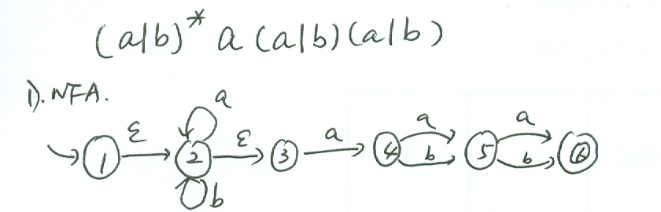

Slide 55
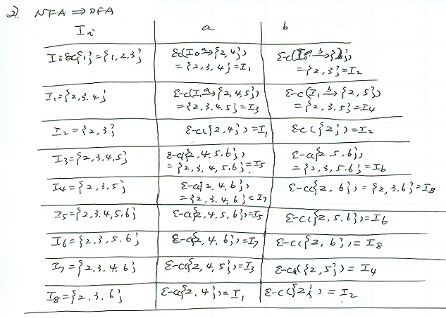

Slide 56
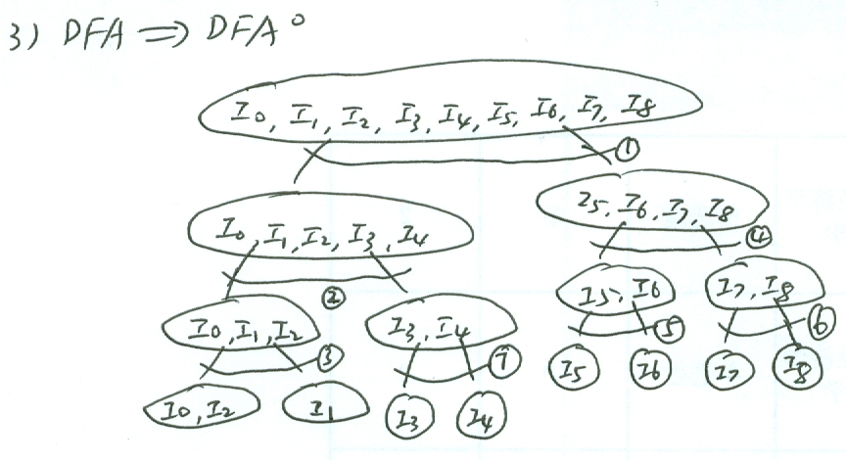

Slide 57
CHAPTER 3 LEXICAL ANALYSIS
Section 5 Regular expression to an NFA
1、The reasons about regular expression to a NFA
Strategy for building a recognizer from a regular expression is to construct an NFA from a regular expression and then to simulate the behavior of the NFA on an input string.

Slide 58
CHAPTER 3 LEXICAL ANALYSIS
Section 5 Regular expression to an NFA
2、Construction of an NFA from a regular expression
a)Basic idea
Syntax-directed in that it uses the syntactic structure of the regular expression to guide the construction process.

Slide 59
CHAPTER 3 LEXICAL ANALYSIS
Section 5 Regular expression to an NFA
2、Construction of an NFA from a regular expression
a)Algorithm
  Input. A regular expression r over an alphabet Σ
  Output. An NFA N accepting L( r)

Slide 60
CHAPTER 3 LEXICAL ANALYSIS
Section 5 Regular expression to an NFA
2、Construction of an NFA from a regular expression
a)Algorithm
  Method
  (1) Parse r into its constituent sub-expressions.
  (2) Use rules in the next pages to construct NFA’s for each of the basic symbols in r(those that are either ε or an alphabet symbol).
  (3)Use rules in the next and next page to combine these NFA’s inductively, and obtain the NFA for the entire expression.

Slide 61
Rules
1. For ε,
1
ε
2
1
a
2. For a in Σ,
2

Slide 62
Rules
3. Rules for complex regular expressions
1
αβ
2
1
α
1‘
β
2
α
α|β
1
1
2
β
2
β
^{β*}
1
2
ε
ε
1
1‘
2

Slide 63
e.g. Let us construct N( r) for the regular expression r=(a|b)*(aa|bb)(a|b)*
(a|b)*(aa|bb)(a|b)*
x y
(a|b)*
(aa|bb)
(a|b)*
x
1
2
y
a|b
a|b
ε
ε
aa
ε
ε
x
5
1
2
6
y
bb
a
a
3
a
a
ε
ε
ε
ε
x
5
1
2
6
y
b
b
b
4
b

Slide 64
CHAPTER 3 LEXICAL ANALYSIS
Section 6 A FA to Regular expression
1、Basic ideas
Reduce the number of states by merging states
2、Algorithm
  Input: An FA M
  Output: A regular expression r over an alphabet Σ recognize the same language as FA M

Slide 65
CHAPTER 3 LEXICAL ANALYSIS
Section 6 A FA to Regular expression
2、Algorithm
  Method:
    Extend the concept of FA, let the arrows can be marked by regular expressions.
    Add two nodes x,y to the FA M and get M’ that recognize the same regular language.
ε
ε
x
FA
y

Slide 66
CHAPTER 3 LEXICAL ANALYSIS
Section 6 A FA to Regular expression
2、Algorithm
  Method:
    Use the following rules to combine the regular expression in the FA’s inductively, and obtain the entire expression for the FA
1
α
2
β
αβ
3
1
3
α
α|β
1
β
2
1
2
α
αβ*
1
2
β
1
2

Slide 67
E.g. Construct the regular expression for the following DFA M.
x
ε
1
0
1
ε
1
y
0 0
0 0
1
2
3
1

Slide 68
x
ε
00|11
10|01
0 3
00|11
ε
01|10
(10|01)(00|11)*(01|10)
y
ε
ε
x 0 y
00|11
((10|01)(00|11)*(01|10)|(00|11))*
x y

Slide 69
CHAPTER 3 LEXICAL ANALYSIS
Section 7 Regular Grammar to an NFA
1、Basic properties
For each regular grammar G=(V_{N},V_{T},P,S), there is an FA M=(Q,Σ,f,q0,Z), and L(G)=L(M).
For each FA M, there is a right-linear grammar and a left-linear grammar recognize the same language. L(M)=L(G_{R})=L(G_{L})

Slide 70
CHAPTER 3 LEXICAL ANALYSIS
Section 7 Regular Grammar to an NFA
2、 Right-linear grammar to FA
  Input :G=(V_{N},V_{T},P,S)
  Output : FA M=(Q, Σ,move,q₀,Z)
  Method :
    Consider each non-terminal symbol in G as a state, and add a new state T as an accepting state.
    Let Q=V_{N}∪{T} , Σ ＝ V_{T} , q₀ ＝S; if there is the production S→ ε , then Z={S,T}, else Z={T} ;

Slide 71
CHAPTER 3 LEXICAL ANALYSIS
Section 7 Regular Grammar to an NFA
2、 Right-linear grammar to FA
  Method :
    For each production, construct the function move.
    a) For the productions similar as A₁ → aA₂，construct move(A₁,a)= A₂.
    b) For the productions similar as A₁ → a, construct move(A₁,a)= T.
    c) For each a in Σ, move(T,a)=Φ, that means the accepting states do not recognize any terminal symbol.

Slide 72
E.g. A regular grammar G=({S,A,B},{a,b,c},P,S) P: S →aS |aB
B→bB|bA
A →cA|c
Construct a FA for the grammar G.

Slide 73
Answer: let M=(Q,Σ,f,q₀,Z)
  1) Add a state T , So Q={S,B,A,T}; Σ ={a,b,c}; q₀=S; Z={T}.
  2) f：
f(S,a)=S f(S,a)=B
  f(B,a)=B f(B,b)=A
  f(A,c)=A f(A,c)=T
b
c
a
a
b
c
S
B
A
T

Slide 74
CHAPTER 3 LEXICAL ANALYSIS
Section 7 Regular Grammar to an NFA
3、FA to Right-linear grammar
  Input : M=(S ,Σ,f, s₀,Z)
  Output : Rg=(V_{N},V_{T},P,s₀)
  Method :
    If s₀∉Z, then the Productions are;
    a) For the mapping f(A_{i},a)=A_{j} in M, there is a production A_{i}→aA_{j};
    b) If A_{j}∈Z, then add a new production A_{i}→a，then we get A_{i}→a|aA_{j};

Slide 75
CHAPTER 3 LEXICAL ANALYSIS
Section 7 Regular Grammar to an NFA
3、FA to Right-linear grammar
  Method :
    If s₀∈Z, then we will get the following productions besides the productions we’ve gotten based on the former rule:
    For the mapping f(s₀,ε)=s₀, construct new productions, s₀’→ ε |s₀, and s₀’ is the new starting state.

Slide 76
e.g. construct a right-linear grammar for the following DFA M=({A,B,C,D},{0,1},f,A,{B})
B
0
1
0
A
0
C
1
1
D
0|1
  Answer:Rg=({A,B,C,D},{0,1},P,A)
  A → 0B | 1D | 0
  B → 1C | 0D
  C → 0B | 1D | 0
  D → 0D | 1D
  L(Rg)=L(M)=0(10)*

Slide 77
Regular-exp
Right-linear-Rg
FA

Slide 78
CHAPTER 3 LEXICAL ANALYSIS
Section 8 Design of a lexical analyzer generator
1、Lexical analyzer generator
A software tool that automatically constructs a lexical analyzer from related language specification
2、Typical lexical analyzer generator
Lex

Slide 79
CHAPTER 3 LEXICAL ANALYSIS
Section 8 Design of a lexical analyzer generator
3、Lex
a) Lexical analyzer generating tool
Lex compiler
b)Input specification
Lex language program

Slide 80
CHAPTER 3 LEXICAL ANALYSIS
Section 8 Design of a lexical analyzer generator
3、Lex
c) The process that creates a lexical analyzer with Lex
Lex source program lex.l
Lex compiler
Lex.yy.c
Lex.yy.c
C compiler
a.out
Input stream
Sequence of tokens
a.out

Slide 81
CHAPTER 3 LEXICAL ANALYSIS
Section 8 Design of a lexical analyzer generator
3、Lex
d) Lex specification
A Lex program consists of three parts:
declaration
%%
translation rules
%%
auxiliary procedures

Slide 82
CHAPTER 3 LEXICAL ANALYSIS
Section 8 Design of a lexical analyzer generator
3、Lex
d) Lex specification
(1)Declaration
Include declarations of variables, manifest constants and regular definitions
Notes: A manifest constant is an identifier that is declared to represent a constant

Slide 83
CHAPTER 3 LEXICAL ANALYSIS
Section 8 Design of a lexical analyzer generator
3、Lex
d) Lex specification
(1)Declaration
%{
/*definitions of manifest constants
LT,LE,EQ,GT,GE,IF,THEN,ELSE,ID*/
%}
/*regular expression*/
delim [\t\n]
ws {delim}+
letter [A-Za-z]
digit [0-9]
id {letter}({letter}|{digit})*

Slide 84
CHAPTER 3 LEXICAL ANALYSIS
Section 8 Design of a lexical analyzer generator
3、Lex
d) Lex specification
(2)Translation Rules
p₁ {action₁} /*p—pattern(Regular exp) */
…
p_{n} {action_{n}}
e.g {if} {return(IF);}
{id} {yylval=install_id();return(ID);}

Slide 85
CHAPTER 3 LEXICAL ANALYSIS
Section 8 Design of a lexical analyzer generator
3、Lex
d) Lex specification
(3)auxiliary procedures
install_id() {
/* procedure to install the lexeme, whose first character is pointed to by yytext and whose length is yyleng, into the symbol table and return a pointer thereto*/
}
Notes:The auxiliary procedures can be compiled separately and loaded with the lexical analyzer.

Slide 86
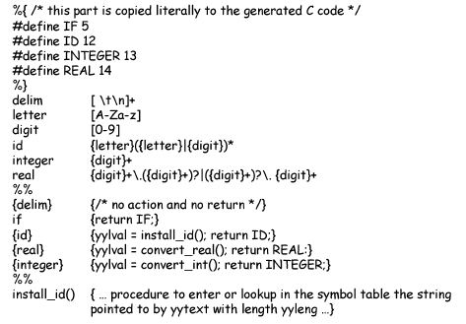

Slide 87
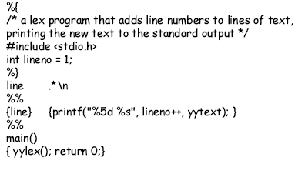

Slide 88
CHAPTER 3 LEXICAL ANALYSIS
Section 8 Design of a lexical analyzer generator
3、Lex
e) Model of Lex compiler
Lex specification
Transition table
Lex compiler
Lexeme
Input buffer
Look ahead pointer
FA simulator
Transition table
DFA transition table

