Slide 1
Computer Input/output System
2015
Instructors: Yang Quansheng
School of Computer Science and Engineering
College of Software Engineering
Southeast University

Slide 2
0.1 Purpose of this Course
To learn how to control the hardware directly by using 80x86 assembly language.
To learn how to analyze a computer I/O system.
To learn how to design a computer I/O interface.

Slide 3
0.2 Content of this Course
80x86 Assembly Language and Programming
The Basic of I/O System
Interrupt system
The Basic Interface in PC
  8254 Programmable Interval Timer
  82C55 Programmable Peripheral Interface
  16550 Programmable Communications Interface

Slide 4
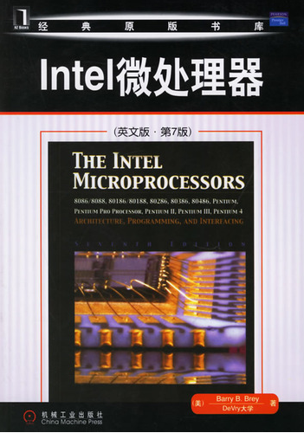
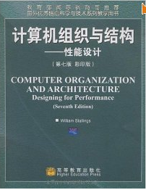
0.3 Reference
Barry B. Brey, The Intel Microprocessor-8086/8088, 80186/80188, 80286, 80386, 80486, Pentium, PentiumPro Processor, Pentium II, Pentium III, Pentium 4 Architecture, and Interfacing, 7th Edition, China Machine Press, 2006.
Stallings.W., Computer Organization and Architecture- Design for Performance, 7th Edition, Higher Education Press,2009

Slide 5
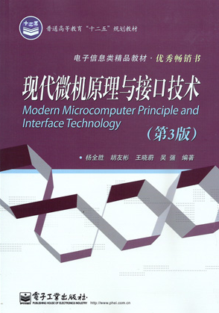
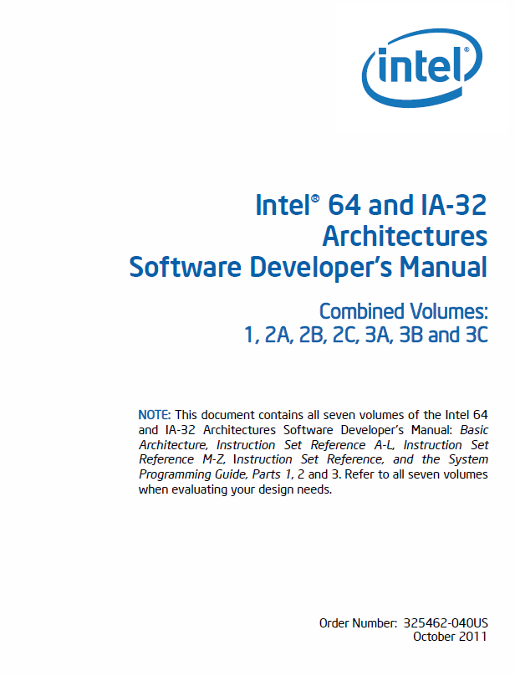
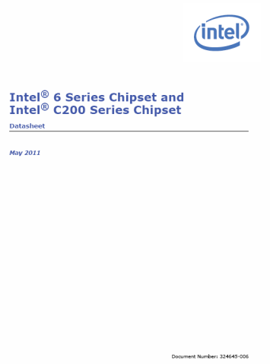
0.3 Reference
Yang Quansheng etc., The principle of Modern Microcomputer and Interface Technology, 3rd Edition, Publishing House of Electronics Industry, 2012 (杨全胜等, 现代微机原理与接口技术，第3版, 电子工业出版社, 2012)
Intel Corporation, Intel 64 and IA-32 Architectures Software Developer Manual, Intel Corporation Press, 2012
Intel Corporation, Intel® 6 Series Chipset and Intel® C200 Series Chipset Datasheet, Intel Corporation Press, 2011
Intel Corporation, Intel® 7 Series / C216 Chipset Family Platform Controller Hub (PCH) , Intel Corporation Press, 2012

Slide 6
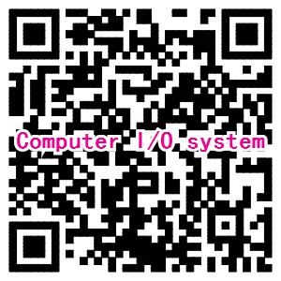
0.4 Teaching Informations
Instructor：
  Yang Quansheng
Office：
  Computer Building 524
Email：
  yangqs@seu.edu.cn
Website：
  http://223.3.65.249
    课程码：IO2015(3月20日失效）
QQ group for this course:
  91262141

