Slide 1
Computer Input/output System
2015
Instructors: Yang Quansheng
School of Computer Science and Engineering
College of Software Engineering
Southeast University

Slide 2
Chapter 4:
Interrupts

Slide 3
Outline
Basic Interrupt System
8259A PIC( Programmable Interrupt Controller)
Interrupt in x86 System
Interrupt process in Modern PC

Slide 4
4.1 Basic Interrupt System
What is interrupt
  Interrupts are events that indicate that a condition exists somewhere in the system, the processor, or within the currently executing program that requires the attention of a processor.
  Interrupts typically result in a forced transfer of execution from the currently running program to a special software routine called an interrupt handler.
  The action taken by a processor in response to an interrupt is referred to as servicing or handling the interrupt.
  When execution of the handler is complete, the processor resumes execution of the interrupted procedure or task.
Interrupt response
Interrupt service
resume
Interrupt request
Interrupt handler

Slide 5
4.1 Basic Interrupt System
Interrupt Source
  Interrupts occur at random times during the execution of a program, in response to signals from hardware.
    System hardware uses interrupts to handle events external to the processor, such as requests to service peripheral devices.
  Software can also generate interrupts by executing the INT n instruction.

Slide 6
4.1 Basic Interrupt System
Interrupt processing
  The device issues an interrupt signal to the processor.
  The processor finishes execution of the current instruction, then tests for an interrupt, determines that there is one, and sends an acknowledgment signal to the device that issued the interrupt.
  The acknowledgment allow the device to remove its interrupt signal.

Slide 7
4.1 Basic Interrupt System
Interrupt processing
  The processor now needs to prepare to transfer control to the interrupt routine. To begin, save information needed to resume the current program at the point of interrupt(Done automatically by the hardware).
    The status of the processor, which is contained in a register called the program status word(PWS).
    The location of the next instruction to be executed, which is contained in the program counter(PC or IP).
  The processor now loads the program counter with the entry location of the interrupt-handling program that will respond to this interrupt.

Slide 8
4.1 Basic Interrupt System
Interrupt processing
  In the interrupt-handling program, the contents of the processor registers need to be saved on the stack, because these registers may be used by the interrupt handler.
  The interrupt handler next processes the interrupt.
  When interrupt processing is complete, the saved register values are restored to the registers.
  The final act is to restore the PSW and program counter values from the stack. As the result. The next instruction to be executed will be from the previously interrupted program.

Slide 9
4.1 Basic Interrupt System
Interrupt Lines to Processor
  Single interrupt line
    Only one interrupt line between the processor and the I/O modules.
  Multiple interrupt lines
    Provide multiple interrupt lines between the processor and the I/O modules.
    It is impractical to dedicate more than a few bus lines or processor pins to interrupt lines.

Slide 10
4.1 Basic Interrupt System
Design Issues
  Two design issue in implementing interrupt I/O
    There are multiple I/O module, how does the processor determine which device issued the interrupt?
    If multiple interrupts have occurred, how does the processor decide which one to process?
  Three general categories of techniques are in common use:
    Software poll
    Daisy chain(hardware poll, vectored)
    Bus arbitration(vectored)

Slide 11
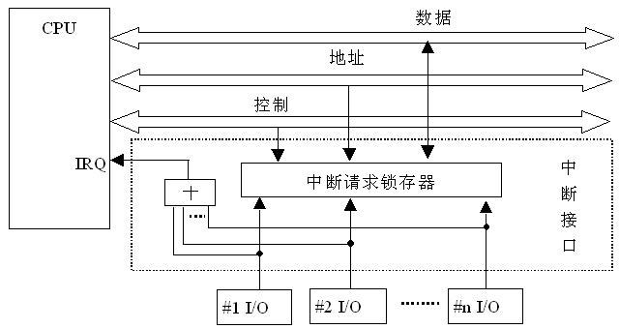
4.1 Basic Interrupt System
Design Issues
  Software Poll
    In interrupt-handle program, poll each I/O module to determine which module caused the interrupt.
    The disadvantage of the software poll is that it is time consuming.
    The order in which modules are polled determines their priority.

Slide 12
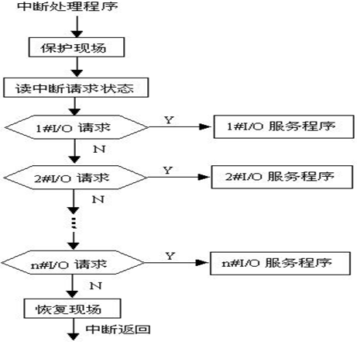
4.1 Basic Interrupt System
Design Issues
  Software Poll

Slide 13
4.1 Basic Interrupt System
Design Issues
  Daisy chain(hardware poll, vectored)
    All I/O modules share a common interrupt request line.
    The interrupt acknowledge line is daisy chained through the module.
    The acknowledge signal from CPU propagate through a series of I/O module until it gets to a requesting module
    The requesting module typically responds by placing a word on the data line. The word is referred to as a vector number that is:
      The address of I/O module.
      Some other unique identifier.
    The processor uses the vector as a pointer to the appropriate device-service routine.
    This technique is called a vectored interrupt.

Slide 14
4.1 Basic Interrupt System
Design Issues
  Daisy chain(hardware poll, vectored)
    The order of modules on a daisy chain determine their priority.
DATA BUS
INTA from CPU
INTR
Tri-state buffers
EN
Tri-state buffers
EN
Tri-state buffers
EN
Tri-state buffers
EN
……
≥1
&
&
&
&
&
Daisy chain
&
&
&
Q
Interrupt
trigger
Q
Interrupt
trigger
Q
Interrupt
trigger
Q
Interrupt
trigger
……
Device N
Device C
Device B
Device A

Slide 15
4.1 Basic Interrupt System
Design Issues
  Bus arbitration (vectored)
    Needs an interrupt arbitration or interrupt controller
    Only one module can raise the line at a time.
    When the processor detects the interrupt, it responds on the interrupt acknowledge line.
    The requesting module then places its vector number on the data lines.
    Bus arbitration can employ a priority scheme.
Interrupt
Controller
IR0
IR1
INTR
IR2
INTA
IR3

Slide 16
4.2 8259A PIC
General Description of the 8259A
  PIC: Programmable Interrupt controller
  Function
    Accept extern interrupt request;
    Manage the interrupt request (queued, priority, mask, nested);
    Sends the interrupt request signal(INTR) and interrupt vector number to the microprocessor;
    Processes the end of interrupt;
    Accept the command come from the processor and return the status.

Slide 17
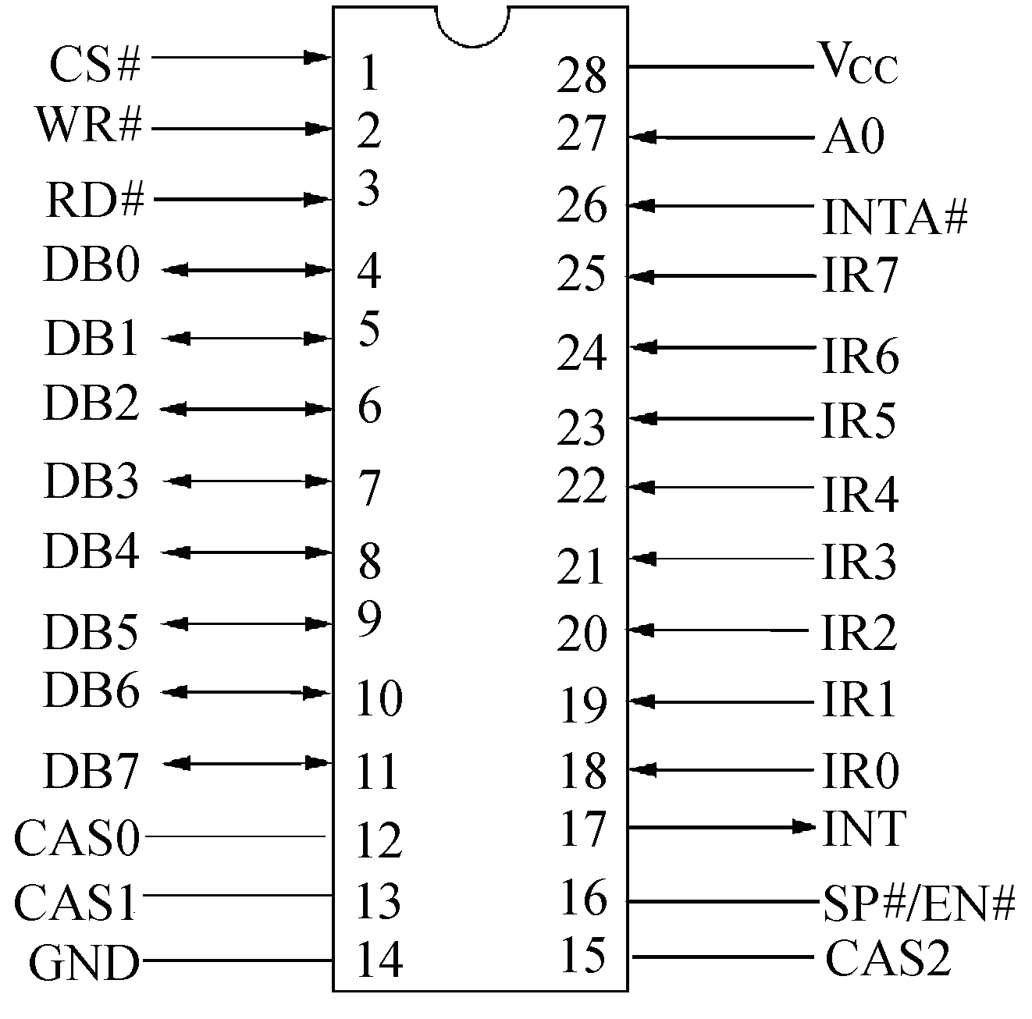
4.2 8259A PIC
General Description of the 8259A
  Pin-out of the 8259A
CPU side：
CS#；
DB₀~DB₇；
RD#、WR#、A₀；
INT、INTA#；
Peripheral side：
IR₀~IR₇；
Cascade：
SP#/EN#、 CAS₀~CAS₂
Notes:
SP#/EN#--Slave program / enable buffer，缓冲工作方式时，OUT引脚，用于控制数据总线收发器；非缓冲工作方式时，IN引脚，用于设置8259A为主片(SP#/EN#=1)或从片(SP#/EN#=0)

Slide 18
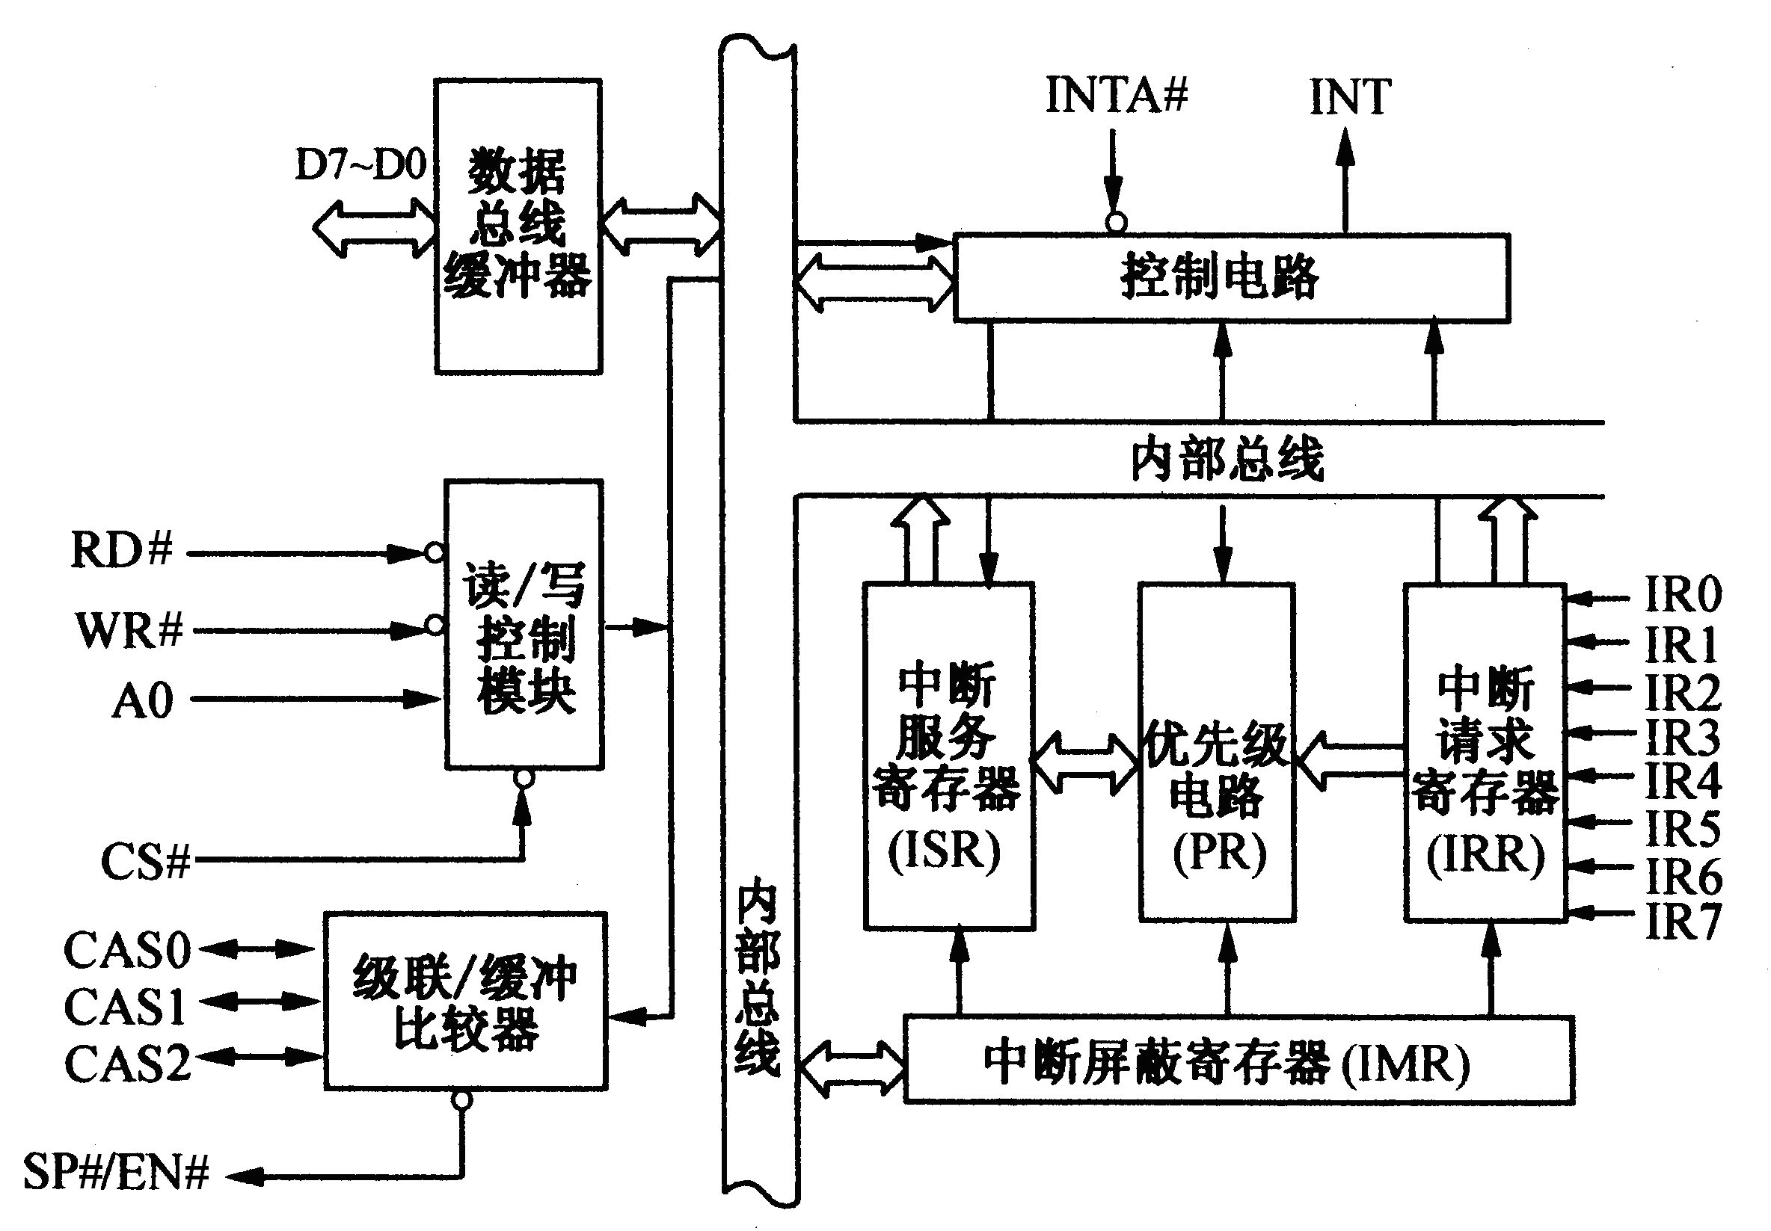
4.2 8259A PIC
General Description of the 8259A
  8259A Internal structure
DATA
BUS
BUFFER
Control Logic
Internal BUS
READ/ WRITELOGIC
In
Service
REG
Interrupt
request
REG
Internal BUS
Priority
Resolver
CASCADE BUFFER/ COMPARATOR
Interrupt mask REG (IMR)

Slide 19
4.2 8259A PIC
General Description of the 8259A
  8259A Internal structure
ISR
IMR
…
…
…
IS priority encoder
≥1
…
B₀
B₁
B₂
A₀
A>B or A₁
A≥B A₂
IR prioroty encoder
&
IRR
IR₀
comparator
INT
…
…
&
…
&
IR₇

Slide 20
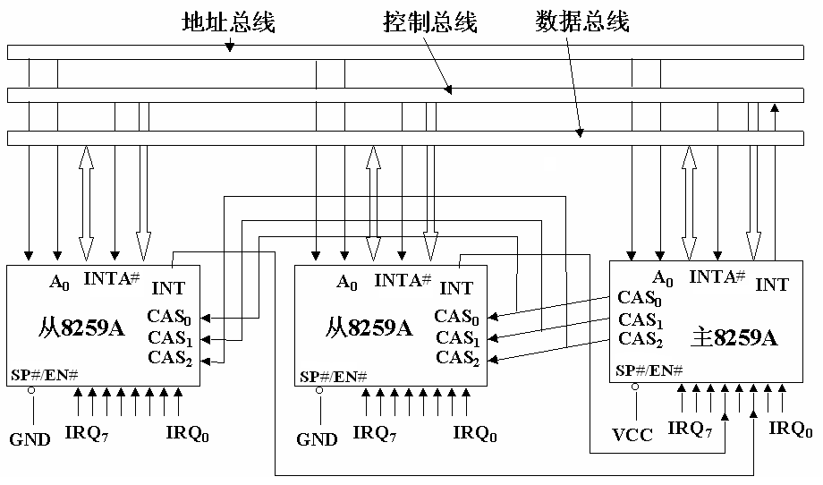
4.2 8259A PIC
级联1
General Description of the 8259A
  Cascading Multiple 8259As
级联2
Address BUS
Control BUS
Data BUS
8259A
SLAVE B
8259A
SLAVE A
8259A
MASTER

Slide 21
4.2 8259A PIC
General Description of the 8259A
  Response of the interrupt in 8259A
    When 8259 sent INT signal to processor, it will wait two INTA# pulse from processor for acknowledge.
    The PIC uses the first INTA# pulse to freeze the state of the interrupts for priority resolution. Additionally, the ISR for the interrupt is set, the IRR for the interrupt is cleared.
    On the second INTA# pulse, the PIC sends the interrupt vector number to the processor. The ISR bit be cleared when:
      if in AEOI mode, on the trailing edge of the second INTA#;
      if in Normally mode, the processor issues an EOI command immediately before returning from the service routine.

Slide 22
4.2 8259A PIC
Modes of Operation
  Edge and Level Triggered Mode
    Edge Triggered mode
      An interrupt request will be recognized by a low-to-high transition on the corresponding IRQ input.
    Level Triggered mode
      An interrupt request will be recognized by a high level on the corresponding IRQ input and there is no need for an edge detection.
    In both the edge and level triggered modes, the IRQ inputs must remain active until after the falling edge of the first internal INTA#. If the IRQ input goes inactive before this time, a default IRQ7 vector number is returned.

Slide 23
4.2 8259A PIC
Modes of Operation
  Poll Mode
    In this mode, the INT output function as it normally does, but the microprocessor should ignore this output. Service to devices is achieved by software using a Poll command.
  Nested Mode
    Full nested mode
      While the ISR bit is set, all further interrupts of the same or lower priority are inhibited.
    Special Fully-Nested Mode
      While the ISR bit is set, all further interrupts of the lower priority are inhibited.

Slide 24
4.2 8259A PIC
Modes of Operation
  Buffered Mode
    When the 8259A is used in a large system where bus driving buffers are required on the data bus, it will structure the 8259A to send an enable signal on SP#/EN# to enable the buffers.
    This modification forces the use of software programming to determine whether the 8259A is a master or a slave.
  Non-buffered Mode
    SP#/EN# = 1; 8259A is the master controller
    SP#/EN# = 0; 8259A is the slave controller

Slide 25
4.2 8259A PIC
Modes of Operation
  Mask Mode
    Normal Mask Mode
      Each bit in the IMR masks one interrupt channel if it is set (1). Bit 0 masks IR0, Bit 1 masks IR1 and so forth.
    Special Mask Mode
      When a mask bit is set in OCW1, it inhibits further interrupts at that level and enables interrupts from all other levels (lower as well as higher) that are not masked.

Slide 26
4.2 8259A PIC
Modes of Operation
  Priority Mode
    Fixed Priority
      The interrupt requests are ordered in priority from 0 through 7 (0 highest).
    Rotation Priority
    (The IR0 ~ IR7 priority as a circular queue.)
      Automatic Rotation
        In this mode a device, after being serviced, receives the lowest priority.
      Specific Rotation
        The programmer can change priorities by programming the bottom priority and thus fixing all other priorities; i.e., if IR4 is programmed as the bottom priority device, then IR5 will have the highest one.

Slide 27
4.2 8259A PIC
Modes of Operation
  End of Interrupt
    Normally Mode
      The ISR bit can be reset by an EOI command that must be issued to the 8259A before returning from a service routine
        When a Non-Specific EOI command is issued the 8259A will automatically reset the highest IS bit of those that are set.
        Specific EOI command includes the IS level to be reset as part of the command.
    Automatic End of Interrupt (AEOI) Mode
      The 8259A will automatically perform a non-specific EOI operation at the trailing edge of the last INTA#

Slide 28
4.2 8259A PIC
Operation and commands
  Port Address
    Only two port address.
  Command
    Initialization Command Words
      ICW1, ICW2, ICW3 and ICW4
    Operation Command Words
      OCW1, OCW2, OCW3
  Status can be read
    IRR, ISR, IMR, Status Word
  The way that use a few addresses to read/write more commands and status
    Data has free bits: Characteristic bit(CHB)
    Data has no free bits: Timing sequence(TS); R/W

Slide 29
4.2 8259A PIC
Operation and commands
PIC1 in x86 | PIC2 in x86 | R/W | Content | CHB | Time squence
 |  |  |  | D₄D₃D₂
20H | 0A0H | write | ICW1 | 1×× | -
 |  |  | OCW2 | 00×
 |  |  | OCW3 | 01×
21H | 0A1H | write | ICW2~ICW4 | 无 | After ICW1, ICW2→ICW4
 |  |  | OCW1 |  | In normal state
20H | 0A0H | read | IRR，ISR Status Word | 无 | Determine by OCW3
21H | 0A1H | read | IMR | - | -
Notes：ICWx only be used during the initialization.

Slide 30
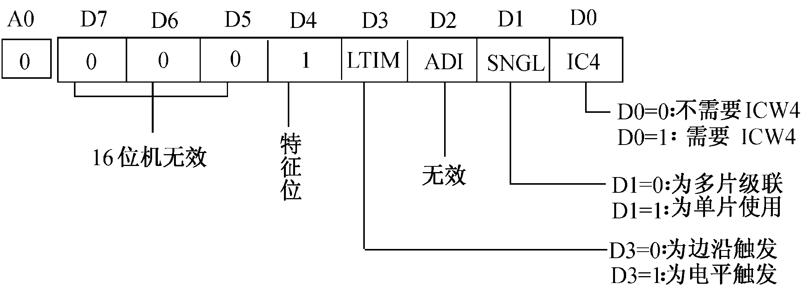
4.2 8259A PIC
Operation and commands
  Initialization Command Words 1(ICW1)
    If SNGL = 1, no ICW3 will be issued.
=0: No ICW4 needed
CHB
=1: ICW4 needed
Invalid
Invalid
=0: Cascade mode
=1: Single
=0: Edge triggered mode
=1: Level triggered mode

Slide 31
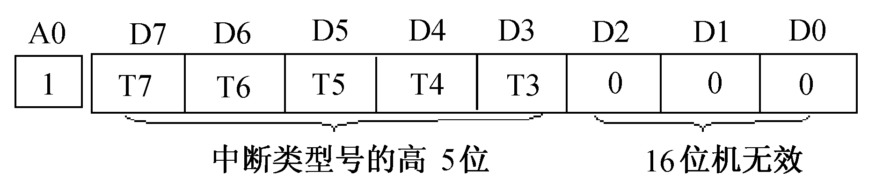


4.2 8259A PIC
Operation and commands
  Initialization Command Words 2(ICW2)
    Sequence: ICW1→ ICW2→[ICW3]→[ICW4]
    interrupt vector number of IR_{i} = [7:3] of ICW2 + i
Leftmost 5 bits of the interrupt vector number
Invalid
e.g. if ICW2 = 08H then
the interrupt vector number of IR₃ = 08H + 03H = 0BH
If an interrupt vector number is 16H, what is the value of ICW2? Which IR pin dose this interrupt request line connected?

Slide 32
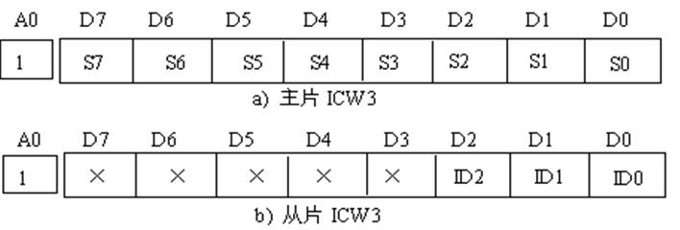
4.2 8259A PIC
Operation and commands
  Initialization Command Words 3(ICW3)
    For the master controller, ICW3 is used to indicate which IRQ input line is used to cascade the slave controller. The corresponding bit in ICW3 is set to a 1.
    For the slave controller, ICW3 is the slave identification code used during an interrupt acknowledge cycle.
转级联结构图
ICW3 of master controller
ICW3 of slave controller

Slide 33
4.2 8259A PIC
Operation and commands
  Initialization Command Words 3(ICW3)
ICW3 of master controller
ICW3 of slave controller
Master：MOV AL, 14H
OUT 21H，AL
Slave A：MOV AL, 04H
OUT 0A1H，AL
Slave B：MOV AL, 02H
OUT 0C1H，AL
转级联结构图

Slide 34
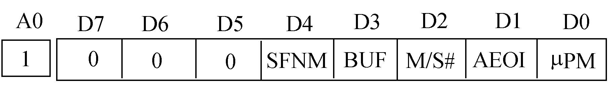
4.2 8259A PIC
Operation and commands
  Initialization Command Words 4(ICW4)
    D0: 1 = 8086/8088 MODE;
    0 = MCS-8080 MODE
    D1: 1 = AUTO EOI MODE;
    0 = NORMAL EOI
    D3D2: 0X = NON BUFFERED MODE;
    10 = BUFFERED MODE/SLAVE;
    11 = BUFFERED MODE/MASTER
    D4: 1 = SPECIAL FULLY NESTED MODE
    0 = FULL NESTED MODE

Slide 35
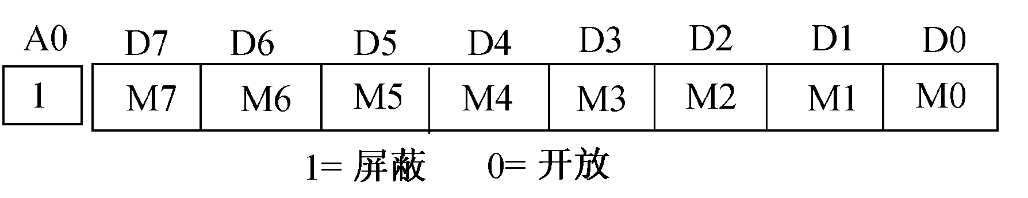
4.2 8259A PIC
Operation and commands
  Operation Control Word 1 (OCW1)
    OCW1 sets and clears the mask bits in the Interrupt Mask Register (IMR).
    M7~M0 represent the eight mask bits.
      M = 1 indicates the channel is masked (inhibited),
      M = 0 indicates the channel is enabled.
1=masked 0=enable

Slide 36
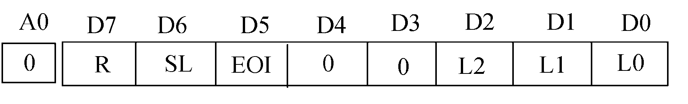
4.2 8259A PIC
Operation and commands
  Operation Control Word 2 (OCW2)
    CHB: D₄D₃=00
    R, SL, EOI - These three bits control the Rotate and End of Interrupt modes and combinations of the two.
    L2L1L0 - These bits determine the interrupt level acted upon when the SL bit is active.

Slide 37
4.2 8259A PIC
Operation and commands
  Operation Control Word 2 (OCW2)
R SL EOI 0 0 L2 L1 L0 | 功能
0 0 0 0 0 0 0 0 | AEOI; Fixed priority command
0 0 1 0 0 0 0 0 | Non specific EOI; Fixed priority command
0 1 1 0 0 L2 L1 L0 | Specific EOI; Fixed priority command
1 0 0 0 0 0 0 0 | AEOI; Rotate in automatic priority command
1 0 1 0 0 0 0 0 | Non specific EOI; Rotate in automatic priority command
1 1 1 0 0 L2 L1 L0 | Specific EOI; Rotate on specific priority command
1 1 0 0 0 L2 L1 L0 | AEOI; Rotate on specific priority command
e.g. MOV AL, 20H
OUT 20H，AL ; in X86, What’s mean?

Slide 38
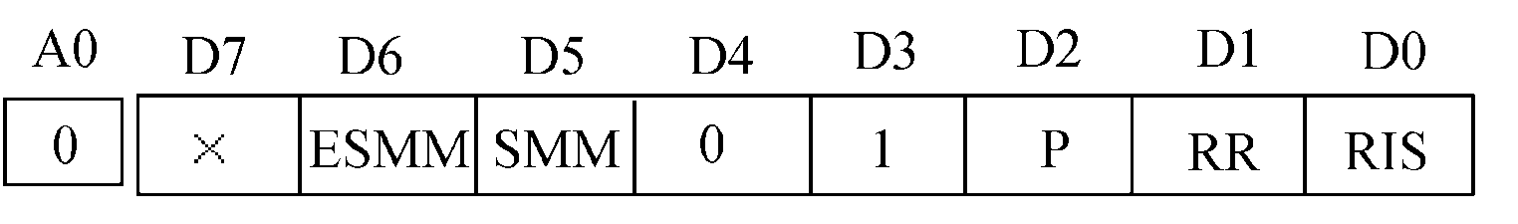
4.2 8259A PIC
Operation and commands
  Operation Control Word 3 (OCW3)
    CHB: D₄D₃=01
P RR RIS | Operation in next RD# pulse | Usage
1 × × | Read query word | MOV AL, 0CH OUT 20H, AL IN AL, 20H
0 1 0 | Read IRR | MOV AL, 0AH OUT 20H，AL IN AL，20H
0 1 1 | Read ISR | MOV AL, 0BH OUT 20H，AL IN AL，20H
0 0 × | -

Slide 39
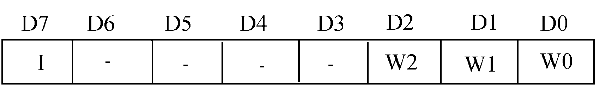
4.2 8259A PIC
Operation and commands
  Operation Control Word 3 (OCW3)
    The Query Word
      W2 – W0: Binary code of the highest priority level requesting service.
      I: Equal to ''1'' if there is an interrupt.

Slide 40
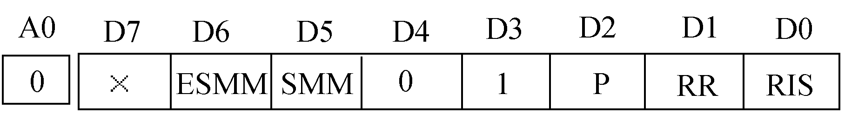
4.2 8259A PIC
Operation and commands
  Operation Control Word 3 (OCW3)
    SMM operation
ESMM SMM | Function
0 × | No Action
1 0 | Reset special mask
1 1 | Set special mask

Slide 41
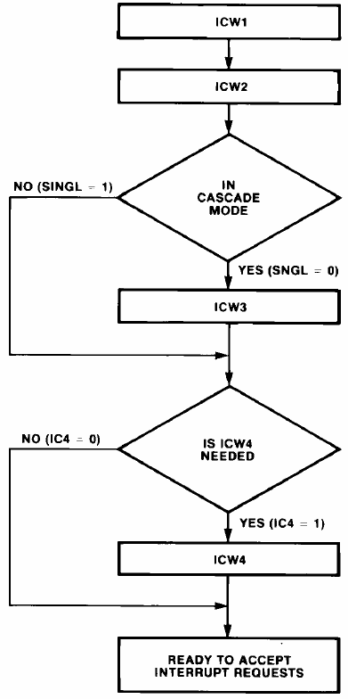
4.2 8259A PIC
ICW1
out 20h(a0h), al
Initial the 8259A
ICW2
out 21h(a1h), al
No (SNGL=1)
In cascade
mode?
Yes (SNGL=0)
ICW3
out 21h(a1h), al
No (IC4=0)
Is ICW4 needed?
Yes (IC4=1)
ICW4
out 21h(a1h), al
Ready to accept interrupt requests

Slide 42
4.2 8259A PIC
Initial the 8259A
INTM00 EQU 020H ;8259A port 0
INTM01 EQU 021H ;8259A port 1
……
MOV AL, 00010011B ;ICW1: edge trigger，ICW4 needed
; single mode，not need ICW3。
OUT INTM00, AL
JMP SHORT $+2 ; delay
MOV AL, 00001000B ;ICW2: interrupt vector number of IR0
; is 08H
OUT INTM01, AL
JMP SHORT $+2
MOV AL, 00000001B ;ICW4: Non buffered, full nested, EOI
OUT INTM01, AL
JMP SHORT $+2
……

Slide 43
4.2 8259A PIC
Initial the 8259A
MOV AL, 12H
OUT 20H, AL
MOV AL, 08H
OUT 21H, AL
MOV AL, 02H
OUT 21H, AL
MOV AL, 13H
OUT 20H, AL
MOV AL, 08H
OUT 21H, AL
MOV AL, 02H
OUT 21H, AL
Q：What command do the last statements in above two program send?

Slide 44
4.3 Interrupt in x86 System
Interrupt and Exception Classification
  External hardware interrupt
    From the peripheral devices, such as keyboard, mouse, COM, LPT
    Hardware, Maskable, and Vector interrupt
    Interrupt request: More than one request managed by 8259A in PCH. 8259A sent the INTR signal to CPU.
    interrupt vector number: Sent to the CPU via the data bus
    IMR in 8259A and the IF in EFLAGS register can mask the interrupt request.
interrupt vector
number
IRQx
SIO
LPC47B27X
SERIRQ
…
PCH
82G965
PIRQx
INTR
Pentium 4/Core 2 Duo

Slide 45
4.3 Interrupt in x86 System
Interrupt and Exception Classification
  Non-Maskable Interrupt(NMI)
    Hardware, non-maskable, and Vector interrupt
    Interrupt request signal sent to the NMI pin.
    interrupt vector number: 2
    No need interrupt recognition.
      When NMI signal transition from 0 to 1, then maintain high level at least four processor clock cycles, an NMI interrupt will be recognized.
      NMI transition from 1 to 0 and maintain low level at least four processor clock cycles , a new NMI interrupt can be identified.

Slide 46
4.3 Interrupt in x86 System
Interrupt and Exception Classification
  Software-Generated Interrupts
    Software, non-maskable, and Vector interrupt
    The INT n instruction permits interrupts to be generated from within software by supplying an interrupt vector number as an operand.
    interrupt vector number: Operand in INT n
    No need interrupt recognition.
      BIOS interrupt
        INT 10H, INT 13H, INT 16H, …
      DOS interrupt
        INT 20H, INT 21H, INT 24H,…

Slide 47
4.3 Interrupt in x86 System
Interrupt and Exception Classification
  Software-Generated Interrupts
    Interrupt instruction
function instruction operation
interrupt INT N SP<--(SP)-2
((SP)+1,(SP))<--(FLAGS)
SP<--(SP)-2
((SP)+1,(SP))<--(CS)
SP<--(SP)-2
((SP)+1,(SP))<--(IP)
IP<--(0000:OA) ；OA=4*N
CS<--(0000:OA+2)
return from IRET IP<--((SP)+1,(SP))
interrupt SP<--(SP)+2
CS<--((SP)+1,(SP))
SP<--(SP)+2
FLAGS<--((SP)+1,(SP))
SP<--(SP)+2

Slide 48
4.3 Interrupt in x86 System
Interrupt and Exception Classification
  Software-Generated Interrupts
    Common interrupt instruction
Vector number | function | Vector number | function
10H | Video service | 13H | Disk control
14H | COM | 15H | IO Peripheral
16H | keyboard | 17H | LPT
20H | Return to DOS | 21H | DOS system calls
23H | Ctrl+Break | 24H | DOS serious error
33H | Mouse | 2FH 31H | DOS Protected mode interface

Slide 49
4.3 Interrupt in x86 System
Interrupt and Exception Classification
  Exception
    Processor-detected program-error exceptions
      The processor generates one or more exceptions when it detects program errors during the execution in an application program or the operating system or executive.
      Intel 64 and IA-32 architectures define a vector number for each processor-detectable exception.

Slide 50
4.3 Interrupt in x86 System
Interrupt and Exception Classification
  Exception
    Processor-detected program-error exceptions
      Classification:
        Faults: The return address (saved contents of the CS and EIP registers) for the fault handler points to the faulting instruction, rather than to the instruction following the faulting instruction.
        Traps: The return address for the trap handler points to the instruction to be executed after the trapping instruction.
        Abort: Aborts are used to report severe errors, such as hardware errors. It does not allow a restart of the program or task that caused the exception.

Slide 51
4.3 Interrupt in x86 System
Interrupt and Exception Classification
  Exception
    Software-Generated Exceptions
      The INTO, INT 3, and BOUND instructions permit exceptions to be generated in software.
    Machine-Check Exceptions
      The P6 family and Pentium processors provide both internal and external machine-check mechanisms for checking the operation of the internal chip hardware and bus transactions.
      These mechanisms are implementation dependent.
      When a machine-check error is detected, the processor signals a machine-check exception (vector 18) and returns an error code.

Slide 52
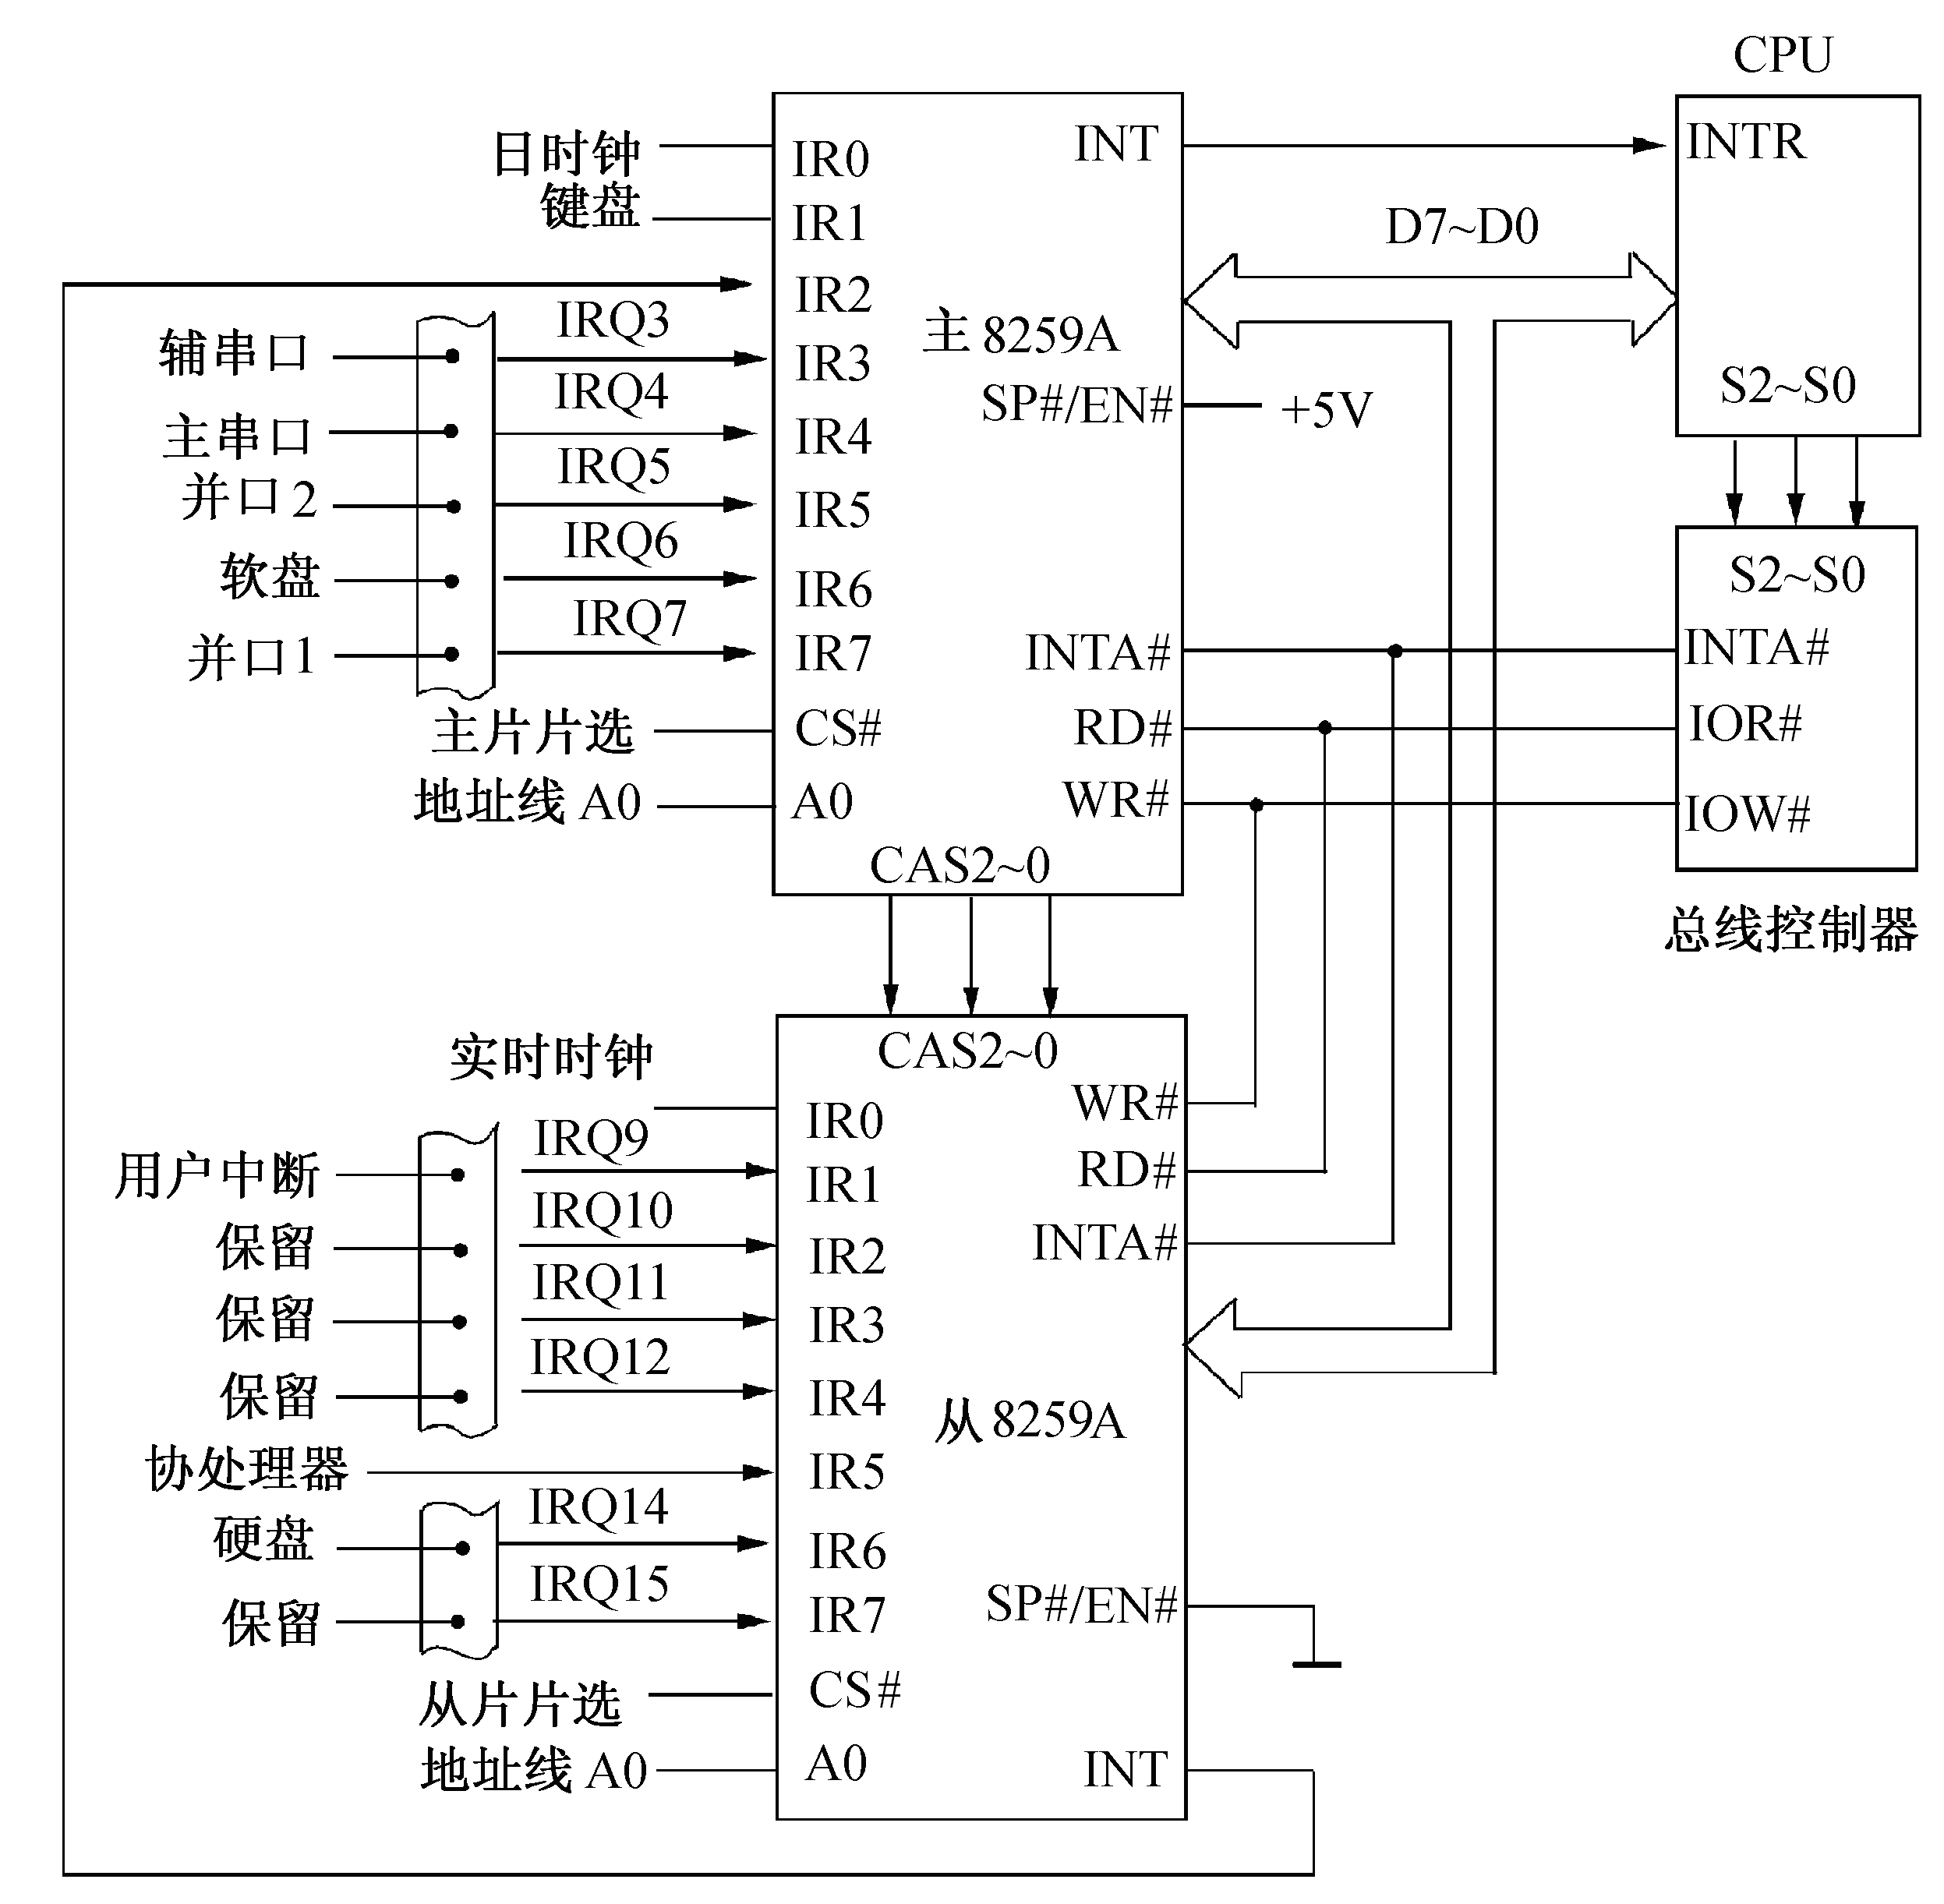
4.3 Interrupt in x86 System
8259A in PCH
  Two cascaded 8259A with 15 interrupts
Notes:
PCH--Platform Controller Hub

Slide 53
4.3 Interrupt in x86 System
8259A in PCH
  Two cascaded 8259A with 15 interrupts
    Initial the master controller
INTM00 EQU 020H ; Master 8259A port 0
INTM01 EQU 021H ; Master 8259A port 1
……
MOV AL, 00010001B;ICW1: edge trigger, ICW4 needed, cascaded, need ICW3
OUT INTM00, AL
JMP SHORT $+2 ;delay
MOV AL, 00001000B ;ICW2: interrupt vector number of IR0 is 08H
OUT INTM01, AL
JMP SHORT $+2
MOV AL, 00000100B ;ICW3: INT signal of slave connect on IR2 pin in master
OUT INTM01, AL
JMP SHORT $+2
MOV AL, 00010001B ;ICW4: Non buffered, special full nested, EOI
OUT INTM01, AL
JMP SHORT $+2
……

Slide 54
4.3 Interrupt in x86 System
8259A in PCH
  Two cascaded 8259A with 15 interrupts
    Initial the slave controller
INTS00 EQU 0A0H ; Slave 8259A port 0
INTS01 EQU 0A1H ; Slave 8259A port 1
……
MOV AL, 00010001B ;ICW1:edge trigger, ICW4 needed, cascaded, need ICW3
OUT INTS00, AL
JMP SHORT $+2
MOV AL, 01110000B ;ICW2: interrupt vector number of IR0 is 70H
OUT INTS01, AL
JMP SHORT $+2
MOV AL, 00000010B ;ICW3: INT signal of slave connect on IR2 pin in master
OUT INTS01, AL
JMP SHORT $+2
MOV AL, 00000001B ;ICW4: Non buffered, special full nested, EOI
OUT INTS01, AL
JMP SHORT $+2
……

Slide 55
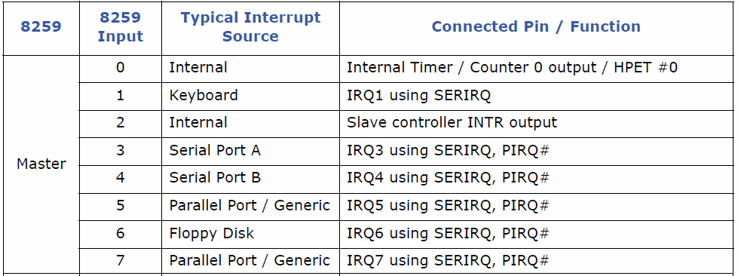
4.3 Interrupt in x86 System
8259A in PCH
  Interrupt Controller Core Connections
SIO
LPC47B27X
SERIRQ
INTR
IRQx
…
PCH
CPU
IRQ14,15

Slide 56
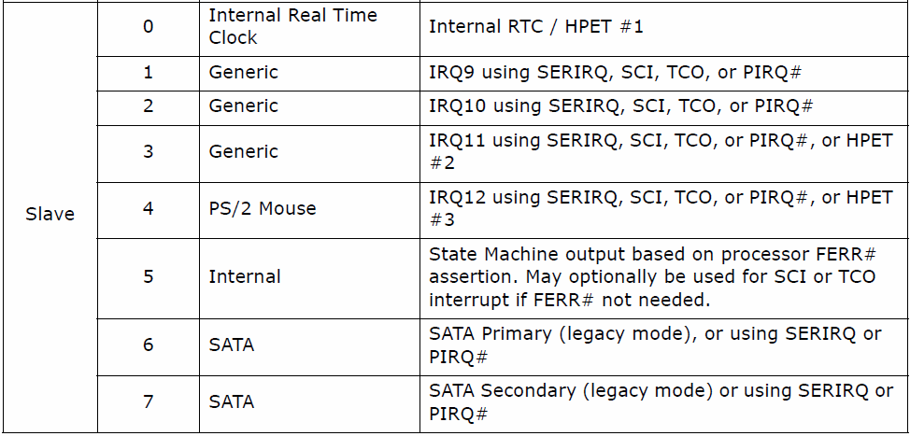
4.3 Interrupt in x86 System
8259A in PCH
  Interrupt Controller Core Connections

Slide 57
4.3 Interrupt in x86 System
8259A in PCH
  Set the interrupt request mode in Intel chipset
    In the PCH, bit3 in ICW1 is disabled and a new register for edge and level triggered mode selection.
ELCR1——For master controller（address 4D0H）
7 6 5 4 3 2 1 0
IRQ7 IRQ6 IRQ5 IRQ4 IRQ3 0 0 0
ELCR2——For slave controller（address 4D1H）
7 6 5 4 3 2 1 0
IRQ15 IRQ14 0 IRQ12 IRQ11 IRQ10 IRQ9 0
IRQx=0 ：IRQx is edge trigger mode
IRQx=1 ：IRQx is level trigger mode

Slide 58
4.4 Interrupt process in Modern PC
Interrupt response
  When the processor finishes execution of the current instruction, CPU response the interrupt, (maskable interrupt response according to whether the IF in EFLAGS is 1).
  Step of the respond
    Save the return address
      Clear the IF and TF in EFLAGS
      Push EFLAGS, CS and EIP in stack.
    Obtain the interrupt vector number
      For the external hardware interrupt, the number obtain from 8259A in PCH in the second INTA#.
      Other kind of interrupt do not need this step

Slide 59
4.4 Interrupt process in Modern PC
Interrupt response
  Step of the respond
    Obtain the entry location of interrupt-handling program
      Query the Interrupt Vector Table or Interrupt Descriptor Table with the vector number to get the address via the vector number.
    The processor now transfer control to the interrupt routine.
      loads the program counter with the entry location of interrupt-handling program
      processes the interrupt
    Return to the breakpoint
      Pop EIP, CS, EFLAGS

Slide 60
4.4 Interrupt process in Modern PC
Hardware/Software Interrupt Sequence
PCH
PCI INTA
Internal logic
82G965
2 INTA#
CPU BUS
Vector number
INTA#
S8259A
M8259A
INTR
Core i7
CPU
IRQ

Slide 61
4.4 Interrupt process in Modern PC
Hardware/Software Interrupt Sequence
  One or more of the Interrupt Request lines (IRQ) are raised high in edge mode, or seen high in level mode, setting the corresponding IRR bit.
  The PIC sends INTR active to the processor if an asserted interrupt is not masked.
  The processor acknowledges the INTR and responds with an interrupt acknowledge cycle. The cycle is translated into a PCI interrupt acknowledge cycle by the host bridge. This command is broadcast over PCI by the PCH.

Slide 62
4.4 Interrupt process in Modern PC
Hardware/Software Interrupt Sequence
  Upon observing its own interrupt acknowledge cycle on PCI, the PCH converts it into the two cycles that the internal 8259 pair can respond to. Each cycle appears as an interrupt acknowledge pulse on the internal INTA# pin of the cascaded interrupt controllers.
  Upon receiving the first internally generated INTA# pulse, the highest priority ISR bit is set and the corresponding IRR bit is reset. On the trailing edge of the first pulse, a slave identification code is broadcast by the master to the slave on a private, internal three bit wide bus. The slave controller uses these bits to determine if it must respond with an interrupt vector number during the second INTA# pulse.

Slide 63
4.4 Interrupt process in Modern PC
Hardware/Software Interrupt Sequence
  Upon receiving the second internally generated INTA# pulse, the PIC returns the interrupt vector number. If no interrupt request is present because the request was too short in duration, the PIC returns vector number 7 from the master controller.
  This completes the interrupt cycle. In AEOI mode the ISR bit is reset at the end of the second INTA# pulse. Otherwise, the ISR bit remains set until an appropriate EOI command is issued at the end of the interrupt subroutine.

Slide 64
4.4 Interrupt process in Modern PC
Interrupt Vector Table(IVT) in real mode
  Interrupt vector(IV)
    The address of interrupt-handling program corresponding to the vector number.
    Four bytes for each interrupt vector.
  Interrupt Vector Table(IVT)
    The storage area which store the interrupt vector in order of the interrupt vector number.
    Beginning from the address 0000: 0000,1KB range.
  Interrupt Vector Pointer(IVP)
    IVP = Vector × 4

Slide 65
4.4 Interrupt process in Modern PC
Interrupt Vector Table(IVT) in real mode
00000 IP
CS
00004 IP
CS
4*N IP
CS
IV for vector 0
IV for vector 1
IV for vector N

Slide 66
4.4 Interrupt process in Modern PC
Interrupt-handling routine programming
  Use the correct interrupt vector number
    E.g. The interrupt vector number of COM1 in IA-32 is 0CH. The interrupt vector number of internal Timer is 08h, but we must use 0CH, since 08H is used by BIOS(Basic I/O system.
  Set the address of the Interrupt-handling in the IVT
    Write this in main procedure
    There are two ways to do this.

Slide 67

4.4 Interrupt process in Modern PC
Interrupt-handling routine programming
1) Write the IVT directly.
CLI ; disable the maskable interrupt
MOV AX, 0
MOV ES, AX ; ES= 0000H(segment address of IVT)
MOV SI, 0CH*4 ; 4 bytes for each interrupt vector
MOV AX, OFFSET SERVICE ; EA of routine
MOV ES:[SI], AX
MOV AX, SEG SERVICE ; segment address of routine
MOV ES:[SI+2], AX
STI ; enable the interrupt
……
; interrupt-handling routine
SERVICE PROC FAR
……
2）use DOS system calls
MOV AX, SEG SERVICE
MOV DS，AX
MOV DX，OFFSET SERVICE
MOV AX，250CH
INT 21H

Slide 68
4.4 Interrupt process in Modern PC
Interrupt-handling routine programming
  Save the context
    The register will be used in interrupt-handling routine must be push in stack.
  Avoid DOS reentrant in the interrupt handler for non-software interrupt
    You can not use DOS system calls(int 21h) in the interrupt handler. But BIOS calls can be used.
  The interrupt handler must small and execute quickly.
    The execute time of interrupt handler must less than the minimum time interval of interrupts.
    You can’t use long loop and the human-computer interaction in interrupt handler.

Slide 69
4.4 Interrupt process in Modern PC
Interrupt-handling routine programming
  Set or clear the IF
    The IF was cleared when the interrupt be responded.
    You can set IF to allow the interrupt nested, but remember to clear the IF before return from interrupt handler.
  Process the EOI, and return
    If the interrupt is from 8259, and 8259 run in EOI mode, you must sent EOI command.
      MOV AL, 20H
      OUT 20H, AL ; sent EOI to master 8259
      OUT 0A0H, AL ; sent EOI to slave 8259
    Resume the register saved before.
    Execute the IRET instruction to return.

Slide 70
4.4 Interrupt process in Modern PC
Interrupt-handling routine programming
  Template of interrupt handler
  (suppose the vector number is 0CH)
; main procedure
OLD0C DWORD ？
……
CODE SEGMENT
……
MOV AX, 350CH ; Save the original 0CH interrupt vector
INT 21H
MOV WORD PTR OLD0C，BX
MOV WORD PTR OLD0C+2，ES
MOV AX, SEG SERVICE ; set new 0CH interrupt vector
MOV DS，AX
MOV DX，OFFSET SERVICE
MOV AX，250CH
INT 21H
…… ; others

Slide 71
4.4 Interrupt process in Modern PC
Interrupt-handling routine programming
  Template of interrupt handler
  (suppose the vector number is 0CH)
; interrupt handler
SERVICE PROC FAR
PUSHA ; push register
PUSH DS
STI ; set IF
…… ; main function in handler
CLI ; clear IF
MOV AL, 20H
OUT 20H, AL ; sent EOI
POP DS ; resume
POPA
IRET
SERVICE ENDP

