Slide 1
Computer Input/output System
2015
Instructors: Yang Quansheng
School of Computer Science and Engineering
College of Software Engineering
Southeast University

Slide 2
Chapter 5:
8254 Programmable Interval Timer

Slide 3
Outline
Basic of 8253/8254
Structure and pins of 8254
Applications
8254 in PCH

Slide 4
5.1 Basic of 8253/8254
Compatible with all Intel and most other microprocessors
Completely TTL Compatible
Three independent 16-bit counters(Timer)
Six Programmable Counter Modes
Binary or BCD counting
Status Read Back Command (8254 only)
The maximum allowable input frequency to any counter is 10MHz, in PCH is 14.31818MHz.(8254)

Slide 5
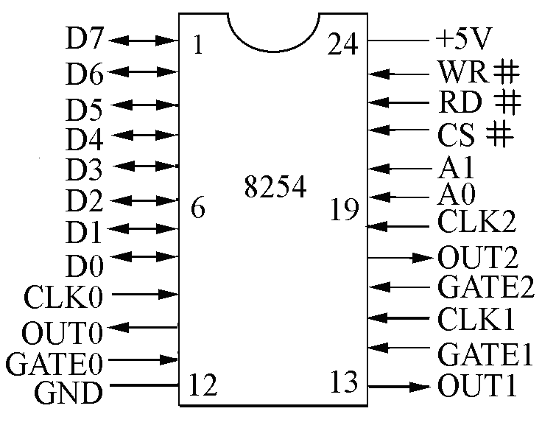
5.2 Structure and pins of 8254
82C54 Pinout
(1)Decoding: CS# and A₁A₀：
(2)read/write: RD#、WR#；

Slide 6
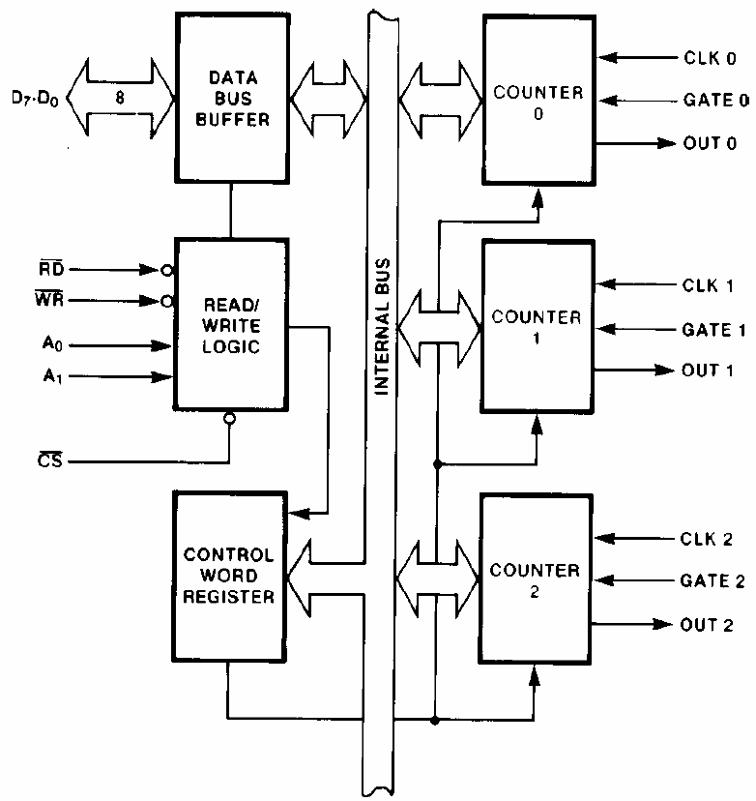
5.2 Structure and pins of 8254
82C54 Block Diagram
DATA
BUS
BUFFER
CLK 0
D7~D0
COUNTER
0
GATE 0
OUT 0
RD#
READ/
WRITE
LOGIC
CLK 1
WR#
COUNTER
1
A0
GATE 1
A1
OUT 1
CS#
CONTROL
WORD
REGISTER
CLK 1
COUNTER
2
GATE 1
OUT 1

Slide 7
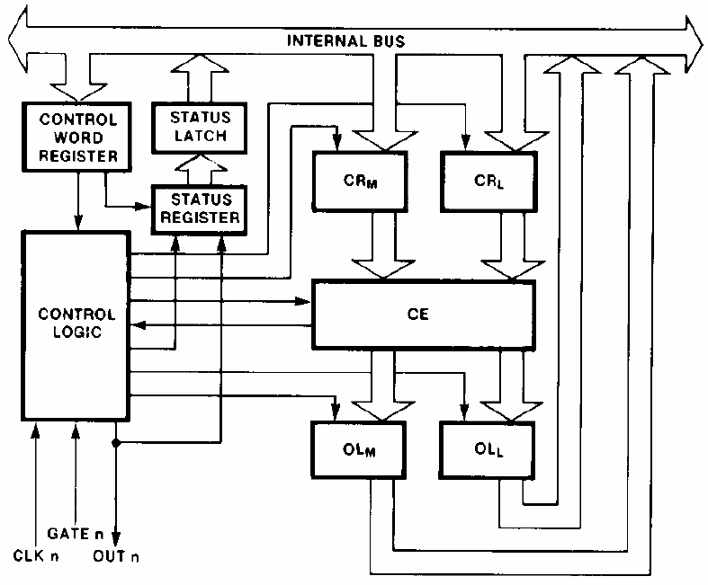



5.2 Structure and pins of 8254
Internal Block Diagram of a Counter
CR_{M} and CR_{L} are two 8-bit registers. Both are normally referred to as one unit and called just CR (Count Register) .
CR_{M}
CR_{L}
The actual counter is labeled CE (Counting Element). It is a 16-bit presettable synchronous down counter.
CONTROL
LOGIC
CE
OL_{M} and OL_{L} are two 8-bit latches. Both are normally referred to as one unit called just OL (“ Output Latch”).
OL_{M}
OL_{L}
GATEn
CLKn
OUTn

Slide 8
5.2 Structure and pins of 8254
Operation and Command
I/O port address: four port (address use A1A0)；
Command: initial—set mode, write initial count
operation—rewrite initial count,
command to read status
Status: current count, mode and current state
Initial count N=f_{CLKi} / f_{OUTi}

Slide 9
8254 command
 | operation | CHB | 时序
 |  | D₇D₆
0 1 0 0 0 | initial count → CNT0 | ** | 无
0 1 0 0 1 | initial count → CNT1 | ** | 无
0 1 0 1 0 | initial count → CNT2 | ** | 无
0 1 0 1 1 | Write control word | 00~10 | 无
 | Write “read back” command | 11 | 无
0 0 1 0 0 | Read CNT0 current count | - | See the explanation behind
 | Read status of CNT0 | -
0 0 1 0 1 | Read CNT1 current count | -
 | Read status of CNT1 | -
0 0 1 1 0 | Read CNT1 current count | -
 | Read status of CNT1 | -
0 0 1 1 1 | -
1 * * * * | Prohibit access
0 1 1 * * | -
CS#
RD#
WR#
A1 A0

Slide 10

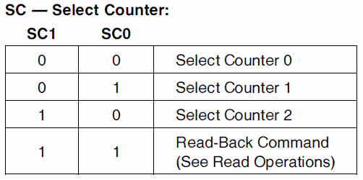
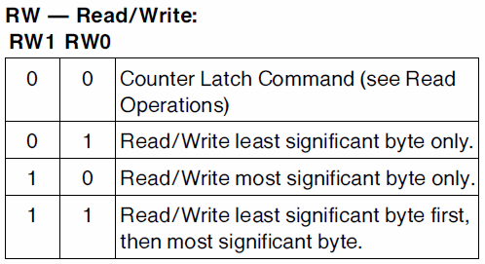
5.2 Structure and pins of 8254
Operation and Command
  Control Word Format

Slide 11
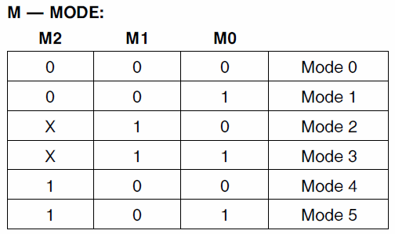
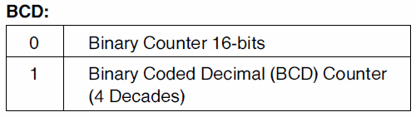
5.2 Structure and pins of 8254
Operation and Command
  Control Word Format
e.g.：MOV AL，01110100B ; T/C₁, least significant byte first
OUT 43H，AL ; mode 2, Binary

Slide 12
5.2 Structure and pins of 8254
Operation and Command
  Initial count
    The initial count for different counter must be write to different address.
    Write one byte by each time
    The range of initial count is:
A1A0 Timer/counter
0 0 T/C0
0 1 T/C1
1 0 T/C2
Binary: 65536(0000H)、65535(FFFFH)~1(0001H)。
BCD: 10000(0000H)、9999(9999H)~1(0001H)。

Slide 13
5.2 Structure and pins of 8254
Operation and Command
  Initial the Timer/count
    1) For each Counter, the Control Word must be written before the initial count is written.
    2) The initial count must follow the count format specified in the Control Word.
e.g. MOV AL, 01110101B; T/C1, least significant byte first, mode 2, BCD
OUT 43H, AL
MOV AX, 2000H ; initial count = 2000
OUT 41H, AL ;
MOV AL, AH
OUT 41H，AL ;
MOV AL，00010110B; T/C₀, least significant byte only,mode3, Binary
OUT 43H，AL
MOV AL, 50H ; ; initial count = 50H（80）
OUT 40H，AL

Slide 14
5.2 Structure and pins of 8254
Operation and Command
  Method of read data from T/C
    Counter Latch Command(A1A0=11)
      CHB: D7D6=00~01, D5D4=00
e.g.:
MOV AL, 01000101B ; T/C1, latch, least significant
; byte first,mode2,BCD
OUT 43H, AL
IN AL，41H
MOV AH，AL
IN AL，41H
XCHG AH，AL ; AX is initial count for T/C1

Slide 15
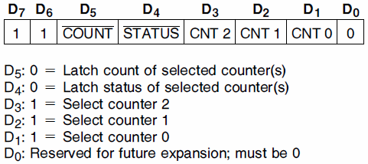
5.2 Structure and pins of 8254
Operation and Command
  Method of read data from T/C
    Read current data by Read-Back Command (A1A0=11)
Count latch command can only latch one counter
Read-back command can latch multiple counter at the same time

Slide 16
e.g.: MOV AL，11010100B ； T/C₁
OUT 43H，AL
IN AL，41H；
MOV AH，AL
IN AL，41H
XCHG AH，AL ；AX is current count of CT1
MOV AL，11011010B ； T/C₀ and T/C₂
OUT 43H，AL
IN AL，40H；
MOV AH，AL
IN AL，40H
XCHG AH，AL ； AX is current count of CT0
MOV BX，AX ；
IN AL，42H；
MOV AH，AL
IN AL，42H
XCHG AH，AL ； AX is current count of CT2

Slide 17
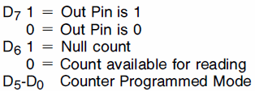

5.2 Structure and pins of 8254
Operation and Command
  Method of read data from T/C
    Read state by Read-Back Command(A1A0=11)
      Status word
MOV AL，11100100B ; T/C₁, latch the state
OUT 43H，AL
IN AL，41H ; Suppose AL=00110101，means T/C₁ in mode 2
; BCD， least significant byte first, out pin = 0
MOV AL，11100010B ; T/C₀, latch the state
OUT 43H，AL
IN AL，40 ; if AL=00010110，means T/C₀ in mode 3，Binary
; least significant byte only, out pin = 0

Slide 18
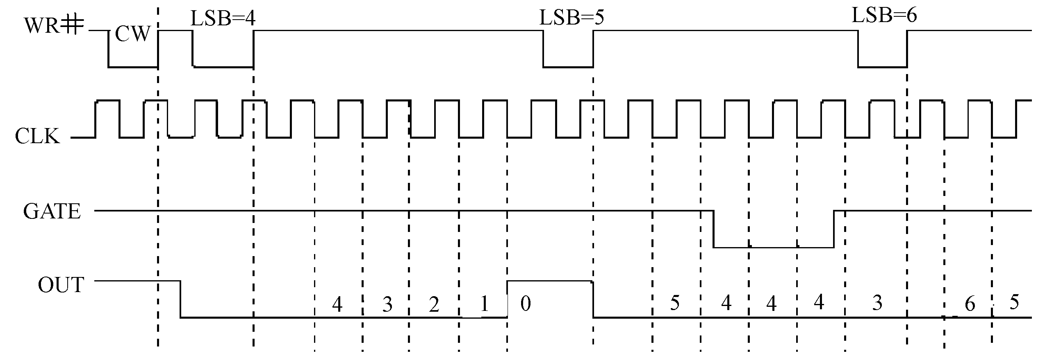
5.2 Structure and pins of 8254
Mode Definitions
  Mode 0: Interrupt on terminal count
characteristic ：count only once ；
GATE = 1 enables counting; GATE = 0 disables counting. GATE has no effect on OUT.
If a new count is written to the Counter, it will be loaded on the next CLK pulse and counting will continue from the new count.
After the Control Word is written, OUT is initially low, and will remain low until the Counter reaches zero. OUT then goes high and remains high until a new count or a new Mode 0 Control Word is written into the Counter

Slide 19
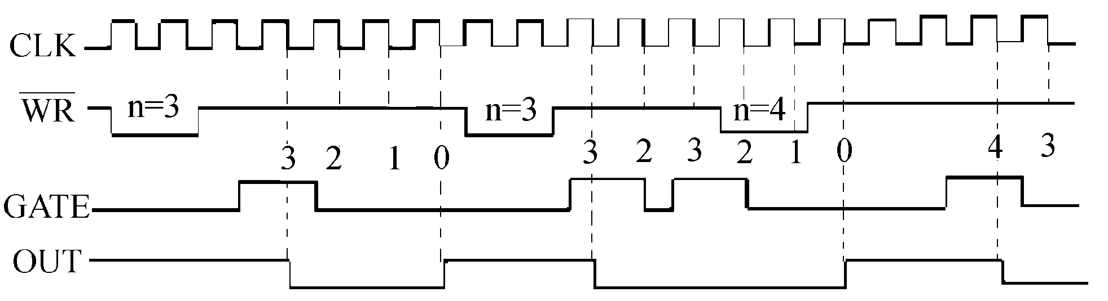
5.2 Structure and pins of 8254
Mode Definitions
  Mode 1: Hardware retriggerable one-shot
characteristic ：count only once ；
GATE = 1 and 0 are no affect. Rising edge of GATE will retrigger the counter and load the initial count. GATE has no effect on OUT.
If a new count is written to the Counter during a one-shot pulse, the current one-shot is not affected unless the Counter is retriggered by GATE.
OUT will be initially high. OUT will go low on the CLK pulse following a trigger to begin the one-shot pulse, and will remain low until the Counter reaches zero. OUT will then go high and remain high until the CLK pulse after the next trigger.

Slide 20
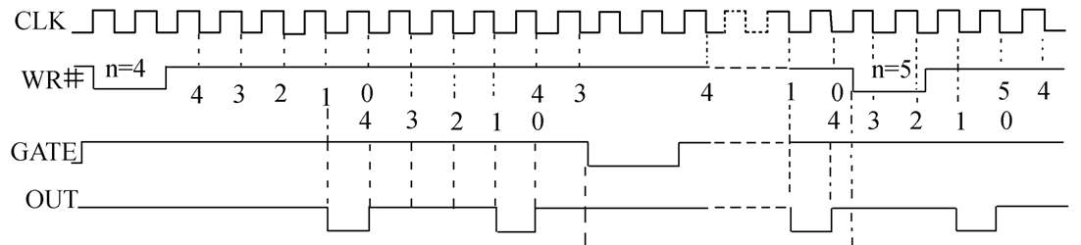
5.2 Structure and pins of 8254
Mode Definitions
  Mode 2: Rate Generator
characteristic ： periodic ；
GATE = 1 enables counting; GATE = 0 disables counting. Rising edge of GATE will retrigger the counter and load the initial count.
Writing a new count while counting does not affect the current counting sequence. The new count will be loaded at the end of the current counting cycle or the next CLK pulse when receive the rising edge of GATE.
OUT will initially be high. When the initial count has decremented to 1, OUT goes low for one CLK pulse. OUT then goes high again, the Counter reloads the initial count and the process is repeated.

Slide 21
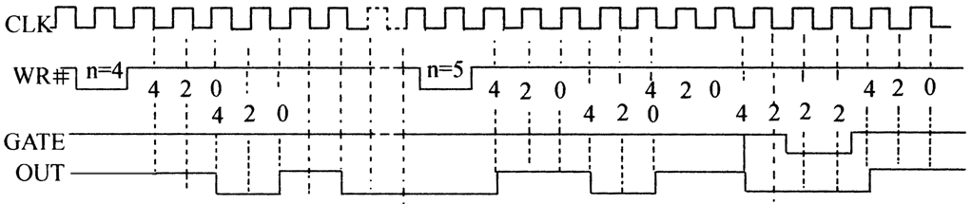
5.2 Structure and pins of 8254
Mode Definitions
  Mode 3: Square Wave mode
characteristic ： periodic ；
GATE = 1 enables counting; GATE = 0 disables counting. Rising edge of GATE will retrigger the counter and load the initial count.
Writing a new count will be loaded at the end of the current counting cycle.
Even counts: OUT is initially high. The initial count is loaded on one CLK pulse and then is decremented by two on succeeding CLK pulses. When the count expires OUT changes value and the Counter is reloaded with the initial count. The above process is repeated indefinitely.

Slide 22
5.2 Structure and pins of 8254
Mode Definitions
  Mode 3: Square Wave Mode
characteristic ： periodic ；
Odd counts: OUT is initially high. The initial count minus one (an even number) is loaded on one CLK pulse and then is decremented by two on succeeding CLK pulses. One CLK pulse after the count expires, OUT goes low and the Counter is reloaded with the initial count minus one. Succeeding CLK pulses decrement the count by two. When the count expires, OUT goes high again and the Counter is reloaded with the initial count minus one. The above process is repeated indefinitely. So for odd counts, OUT will be high for (N + 1)/2 counts and low for (N -1)/2 counts.

Slide 23
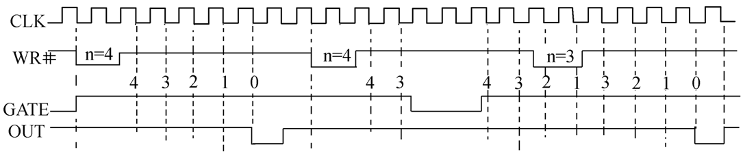
5.2 Structure and pins of 8254
Mode Definitions
  Mode 4: Software Triggered Strobe
characteristic ：count only once ；
GATE = 1 enables counting; GATE = 0 disables counting. Rising edge of GATE will retrigger the counter and load the initial count.
If a new count is written during counting, it will be loaded on the next CLK pulse and counting will continue from the new count.
OUT will be initially high. When the initial count expires, OUT will go low for one CLK pulse and then go high again. The counting sequence is “triggered” by writing the initial count.

Slide 24
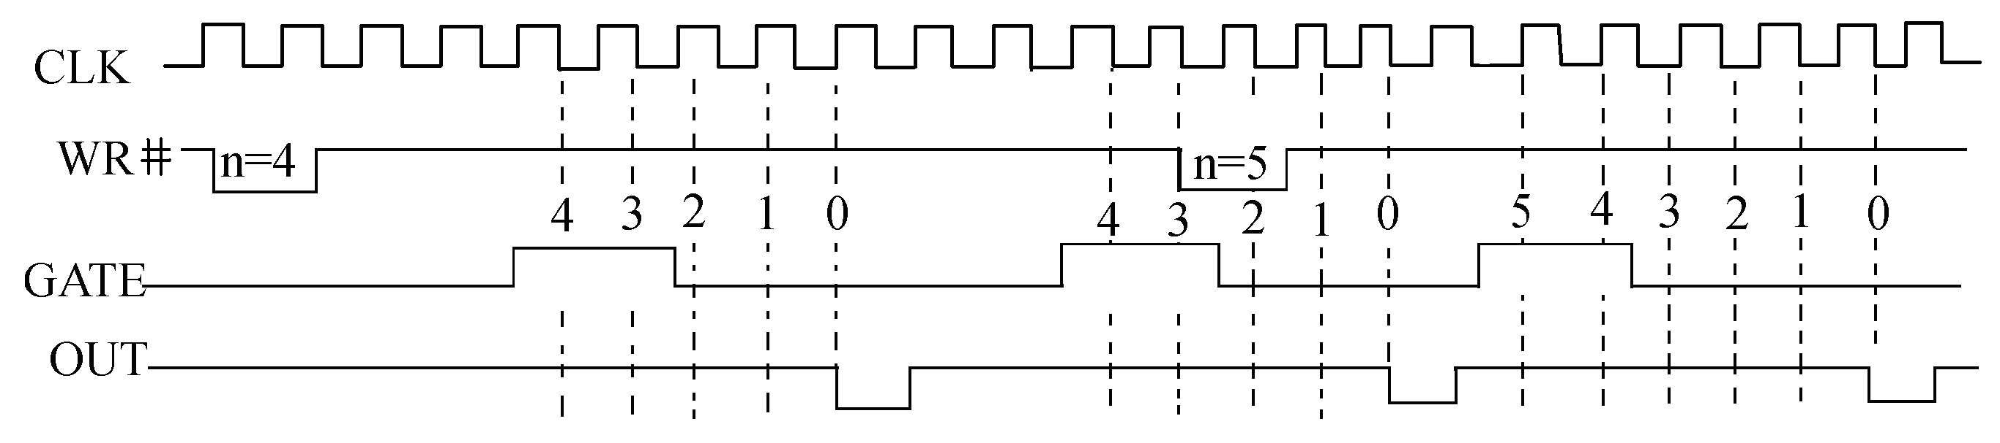
5.2 Structure and pins of 8254
Mode Definitions
  Mode 5: Hardware Triggered Strobe
characteristic ：count only once ；
GATE = 1 and 0 are no affect. Rising edge of GATE will retrigger the counter and load the initial count. GATE has no effect on OUT.
If a new count is written during counting, the current counting sequence will not be affected. If a trigger occurs, the Counter will be loaded with the new count on the next CLK pulse and counting will continue from there.
OUT will initially be high. Counting is triggered by a rising edge of GATE. When the initial count has expired, OUT will go low for one CLK pulse and then go high again.

Slide 25
5.2 Structure and pins of 8254
Mode Definitions
 |  | 方式0 | 方式1 | 方式2 | 方式3 | 方式4 | 方式5
OUT输出状态 |  | 写入控制字后变0，计数结束变1，并维持至重写控制字或计数初值 | 写入控制字后变1，GATE上升沿触发变0，开始计数，计数结束变1 | 写入控制字后变1，计数到1变0，维持一个Tclk变1 | 写入控制字后变1，装入初值且GATE=1则OUT变1，计数到变0，重装初值继续计数，计数到则反向 | 写入控制字后变1，计数结束变0，维持一个Tclk变1 | 写入控制字后变1，GATE上升沿触发开始计数，计数结束输出一个CLK的负脉冲
初值自动重装 |  | 无 | 无 | 计数到0重装 | 根据初值奇偶分别重装； | 无 | 无
计数过程中改变初值 |  | 立即有效 | GATE触发后有效 | 计数到1或GATE触发后有效 | 计数结束或GATE触发后有效 | 立即有效 | GATE触发后有效
GATE | 0 | 禁止计数 | 无影响 | 禁止计数 | 禁止计数 | 禁止计数 | 无影响
 | 下降沿 | 暂停计数 | 无影响 | 停止计数 | 停止计数 | 停止计数 | 无影响
 | 上升沿 | 继续计数 | 从初值开始重新计数 | 从初值开始重新计数 | 从初值开始重新计数 | 从初值开始重新计数 | 从初值开始重新计数
 | 1 | 允许计数 | 无影响 | 允许计数 | 允许计数 | 允许计数 | 无影响

Slide 26
5.3 Applications
Frequency Divider Design
Using 8254(address:40H~43H), Convert 5MHz pulse to 1Hz pulse
Initial count =f_{CLK}/f_{OUT}=5×10⁶＞65536，How to do it？
MOV AL，00110111B；T/C₀
OUT 43H，AL
MOV AX, 5000H
OUT 40H，AL
MOV AL, AH
OUT 40H，AL
MOV AL，01110101B；T/C₁
OUT 43H，AL
MOV AX, 1000H
OUT 41H，AL
MOV AL, AH
OUT 41H，AL
D0~D7
CLK0
5MHz
RD#
GATE0
OUT0
WR#
CLK1
CS#
GATE1
A1
OUT1
1Hz
CLK2
A0
GATE2
OUT2

Slide 27
5.3 Applications
Square Wave Generator that Duty cycle is 4:9
The frequency of the CLK0 in 8254 is 8KHz，then
1）What is the maximum period of OUT0？
2）Now wish the port address of 8254 is 90H, 92H, 94H and 96H, please design the decoding circuit by 74LS138 and some Gate.
3）Now want to generate the square wave which period is 9s and the duty cycle is 4:9. Please complete the above circuit the realize the decoder, and programming it.
Answer:
1）T_{CLK0}=1/f_{CLK0}=1/8000=0.125ms
Maximum period ＝65536×0.125ms=8.192 second
or：f_{CLK0}/f_{OUT}=65536＝>T_{max}=1/f_{OUT}=65536/ f_{clk0}
=65536/8000=8.192 second

Slide 28
5.3 Applications
Square Wave Generator that Duty cycle is 4:9
D7~D0
D7~D0
CLK0
8KHz
WR#
WR#
GATE0
RD#
RD#
OUT0
A1
A0
1Hz
5V
CLK1
A2
A1
GATE1
OUT1
square wave which period is 9s and the duty cycle is 4:9.
A5
C
8254
A4
B
A3
A
Y2#
CS#
CLK2
74LS138
GATE2
A7
G1
OUT2
A8
A9
≥1
G2A#
A6
≥1
G2B#
A0

Slide 29
5.3 Applications
Square Wave Generator that Duty cycle is 4:9
MOV AL，00110111B；T/C₀
OUT 96H，AL
MOV AX, 8000H
OUT 90H，AL
MOV AL, AH
OUT 90H，AL
MOV AL，01010111B；T/C₁
OUT 96H，AL
MOV AL, 9H
OUT 92H，AL

Slide 30
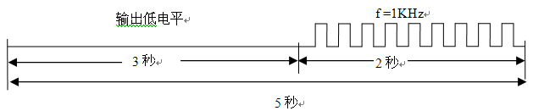
5.3 Applications
Square Wave Generator with two frequency
Suppose the frequency of the CLK0 in 8254 is 1 MHz. Now use this 8254 and some Gates to design a square wave generator that output the wave below.
Output low level
3s
2s
5s

Slide 31
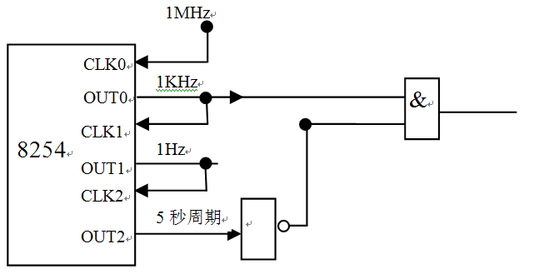
5.3 Applications
Square Wave Generator with two frequency
MOV AL，01110111B；T/C₁
OUT 43H，AL
MOV AX, 1000H
OUT 41H，AL
MOV AL, AH
OUT 41H, AL
MOV AL，10010111B；T/C₂
OUT 43H，AL
MOV AX, 5H
OUT 42H，AL
MOV AL，00110111B；T/C₀
OUT 43H，AL
MOV AX, 1000H
OUT 40H，AL
MOV AL, AH
OUT 40H, AL

Slide 32
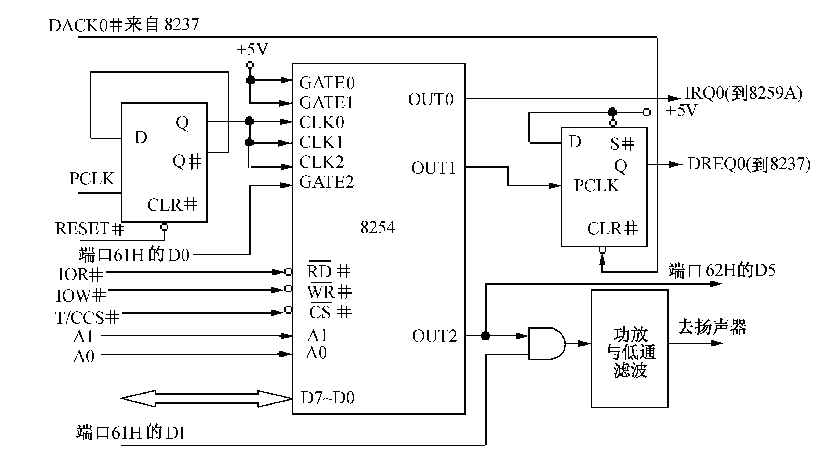
5.4 8254 in PCH
RD#
WR#

Slide 33
5.4 8254 in PCH
Counter 0, System Timer
  Frequency of CLK0 is 1.1931816MHz; Initial count is 65536
  This counter functions as the system timer by controlling the state of IRQ0 and is typically programmed for Mode 3 operation.
  OUT0 generate the square wave which frequency is 18.2Hz to IRQ0 in Master 8259A.
  The counter asserts IRQ0 when the count value reaches 0, reloads the initial count value, and repeats the cycle, alternately asserting and negating IRQ0.

Slide 34
5.4 8254 in PCH
Counter 1, Refresh Request Signal
  Frequency of CLK1 is 1.1931816MHz; initial count is 18.
  This counter provides the refresh request signal and is typically programmed for Mode 2 operation and only impacts the period of the REF_TOGGLE bit in Port 61.
  OUT1 connect DREQ0 in 8237, every 15.08μs have a width of 838ns pulse for RAM refresh.

Slide 35
5.4 8254 in PCH
Counter 2, Speaker Tone
  Frequency of CLK1 is 1.1931816MHz; initial count is sent in software .
  This counter provides the speaker tone and is typically programmed for Mode 3 operation.
  The counter provides a speaker frequency equal to the counter clock frequency (1.193 MHz) divided by the initial count value.
    Initial count = frequency of CLK2 / frequency of sound
  The speaker must be enabled by a write to port 61h

Slide 36
5.4 8254 in PCH
Counter 2, Speaker Tone
；function： issued 896Hz sound
；parameter：CX= time interval
；return：none
BEEP PROC FAR
IN AL，61H; read 8255 PB port
MOV AH，AL
PUSH AX
MOV AL，10110110B
OUT 43H，AL
MOV AX，0533H；=1.1931816MHz/896Hz
OUT 42H，AL
MOV AL，AH
OUT 42H，AL
POP AX

Slide 37
5.4 8254 in PCH
Counter 2, Speaker Tone
OR AL，03H ; 61H port D0,D1= 11; enable speaker
OUT 61H，AL
NOP
L1：LOOP L1 ; delay
AND AL，0FDH ; 61H port D1= 0，disable OUT2
OUT 61H，AL
MOV AL，AH
OUT 61H，AL
RET
BEEP ENDP

