Slide 1
Computer Input/output System
2015
Instructors: Yang Quansheng
School of Computer Science and Engineering
College of Software Engineering
Southeast University

Slide 2
Chapter 6:
16550 Programmable Communications Interface

Slide 3
Outline
Serial Communication
Asynchronous Serial Communication
RS-232 Standard
16550 UART
COM in IA-32

Slide 4
7.1 Serial Communication
Serial Communication
  Serial communication is the process of sending data one bit at a time, sequentially, over a communication channel or computer bus.
  Needs serializer and deserializer, or SerDes
  Serial communication is used for all long-haul communication and most computer networks, where the cost of cable and synchronization difficulties make parallel communication impractical.
Notes:
SerDes: A Serializer/Deserializer (SerDes pronounced sir-deez) is a pair of functional blocks commonly used in high speed communications to compensate for limited input/output. These blocks convert data between serial data and parallel interfaces in each direction.

Slide 5
7.1 Serial Communication
Serial Communication
  Serial computer buses are becoming more common even at shorter distances, as improved signal integrity and transmission speeds in newer serial technologies have begun to outweigh the parallel bus's advantage of simplicity (no need for serializer and deserializer, or SerDes) and to outstrip its disadvantages (clock skew, interconnect density).

Slide 6
7.1 Serial Communication
Serial versus parallel
  Serial links can be clocked considerably faster than parallel links in order to achieve a higher data rate, because:
    Clock skew between different channels is not an issue.
    A serial connection requires fewer interconnecting cables and hence occupies less space. The extra space allows for better isolation of the channel from its surroundings.
    Crosstalk is less of an issue, because there are fewer conductors in proximity.
  Serial is cheaper to implement.
Notes:
Crosstalk 串扰

Slide 7
7.1 Serial Communication
Serial versus parallel
  Data Transmission Mode
Simplex
T
R
T
T
Half-duplex
R
R
T
R
Full-duplex
R
T

Slide 8
7.1 Serial Communication
Baud Rate
  The number of information bits that can be transmitted in one second (bit/s or bps), also known as the data bit rate. It is an important indicator to measure the rate of serial communication.
Receiver/sender clock
  Directly determine the rate of data transmission on line.
  It is usually the 1, 16, 32 or 64 times baud rate.
  For asynchronous communication, it is 16 times baud rate

Slide 9
7.2 Asynchronous serial communication
Asynchronous serial communication
  Asynchronous serial communication describes an asynchronous, serial transmission protocol in which a start signal is sent prior to each byte, character or code word and a stop signal is sent after each code word.
  Data transmitted and received without a clock or timing signal.

Slide 10
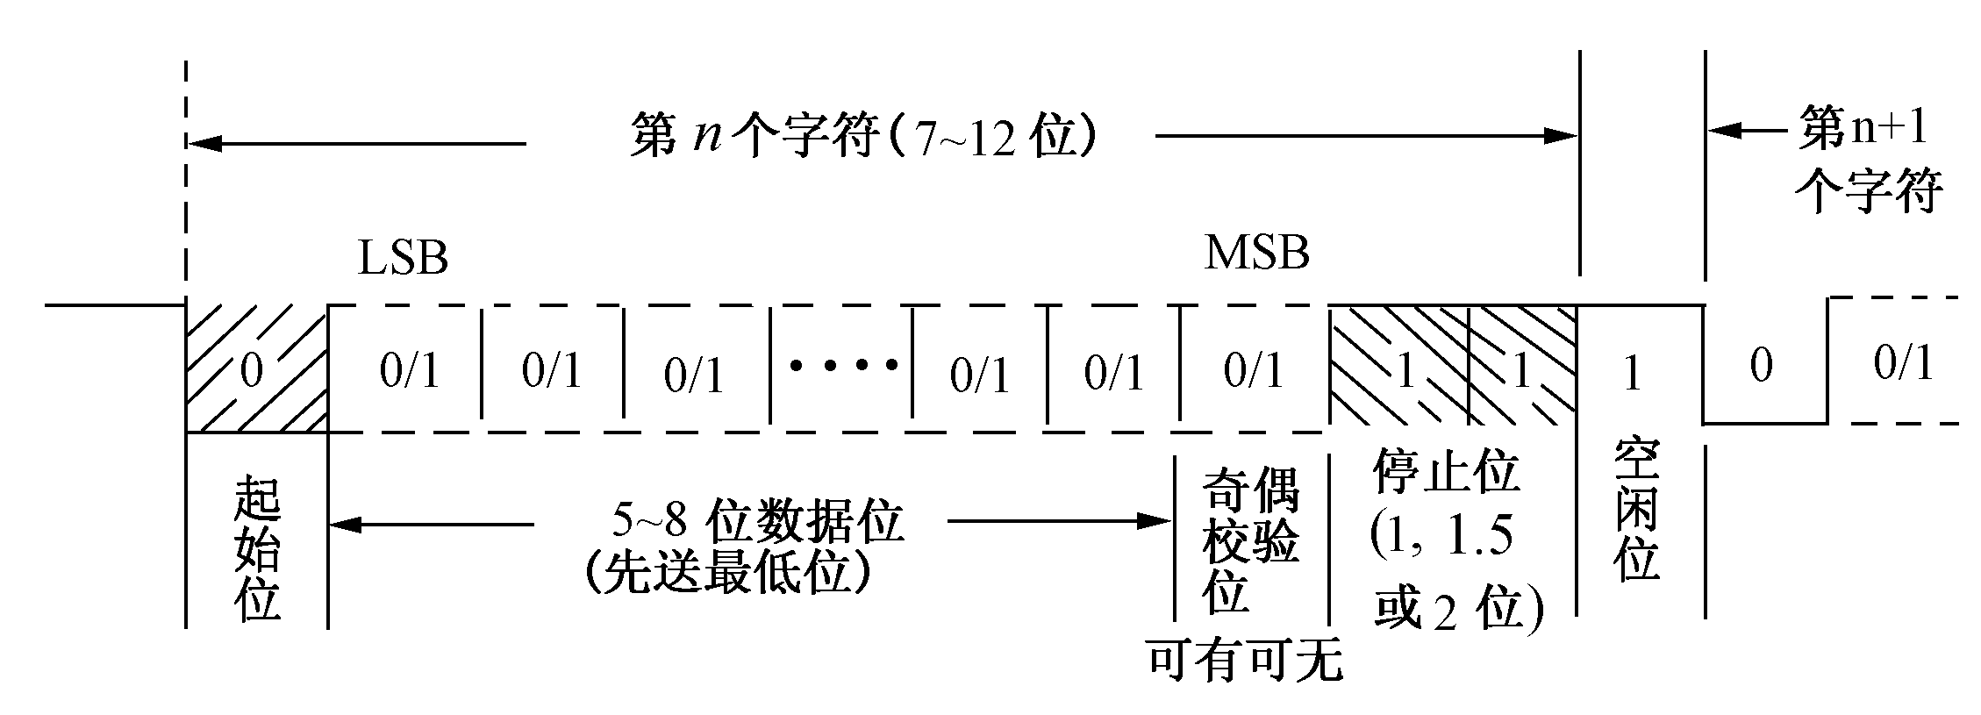
7.2 Asynchronous serial communication
Asynchronous serial communication
Frame
Stop
(1, 1.5 or 2 Bit)
Idle
Start
5~8 bits Data
Least Significant Bit first
Parity bit
Optional

Slide 11
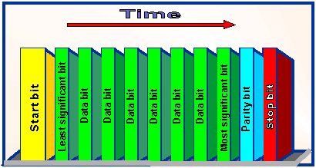
7.1 Asynchronous serial communication
Out
Asynchronous serial communication
0 1 0 0 0 0 0 1 0 0 1
Out first
D0
D7
last
For example, the ASCII ’A’, in binary is 0100 0001(8-bit)，the transfer between start and 1-bit stop, one bit parity bit is used.

Slide 12
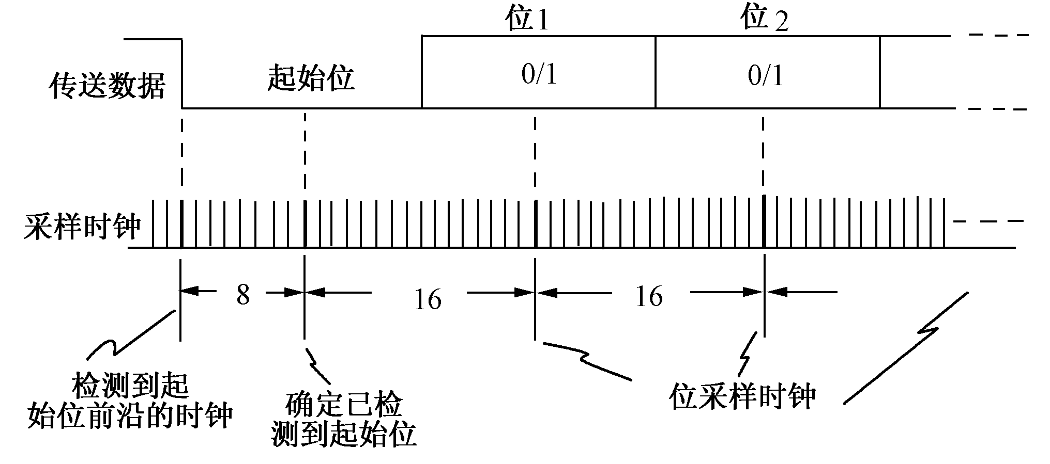
In order to ensure the transmission of asynchronous serial communication is correct:
1） Opposite polarity of the start bit and stop bit / idle bit to provide an accurate time base
2） Receiver using a higher frequency than the baud rate clock to control the sampling time to improve the sampling resolution and anti-jamming capability.
3） Receiver sample in the center of each bit to get the maximum of the transmit / receive clock frequency deviation tolerance.

Slide 13


7.2 Asynchronous serial communication
Exercise
Asynchronous serial data is 7-bit ASCII code， If you need a data transfer rate of 240 characters per sec ，1 bit parity and 1 bit stop is used, then：
1）What is baud rate?
2）How many data bits are valid in one second?
3）How about the transmit efficiency?
1）Baud rate is
(7-bit data+1 bit start+1 bit parity+1 bit stop)×240
=2400b/s
2）Valid data bits in one second is 7×240=1680 bits
3）Transmit efficiency is 1680/2400=70%

Slide 14
7.3 RS-232 Standard
RS-232 (Recommended Standard 232)
  In telecommunications, RS-232 is the traditional name for a series of standards for serial binary single-ended data and control signals connecting between a DTE and a DCE. It is commonly used in computer serial ports.
    DTE-Data Terminal Equipment
    DCE- Data Communication Equipment
    Some RS-232 devices are still found especially in industrial machines or scientific instruments.
    Many modern personal computers have no RS-232 ports and must use an external converter to connect to older peripherals.

Slide 15
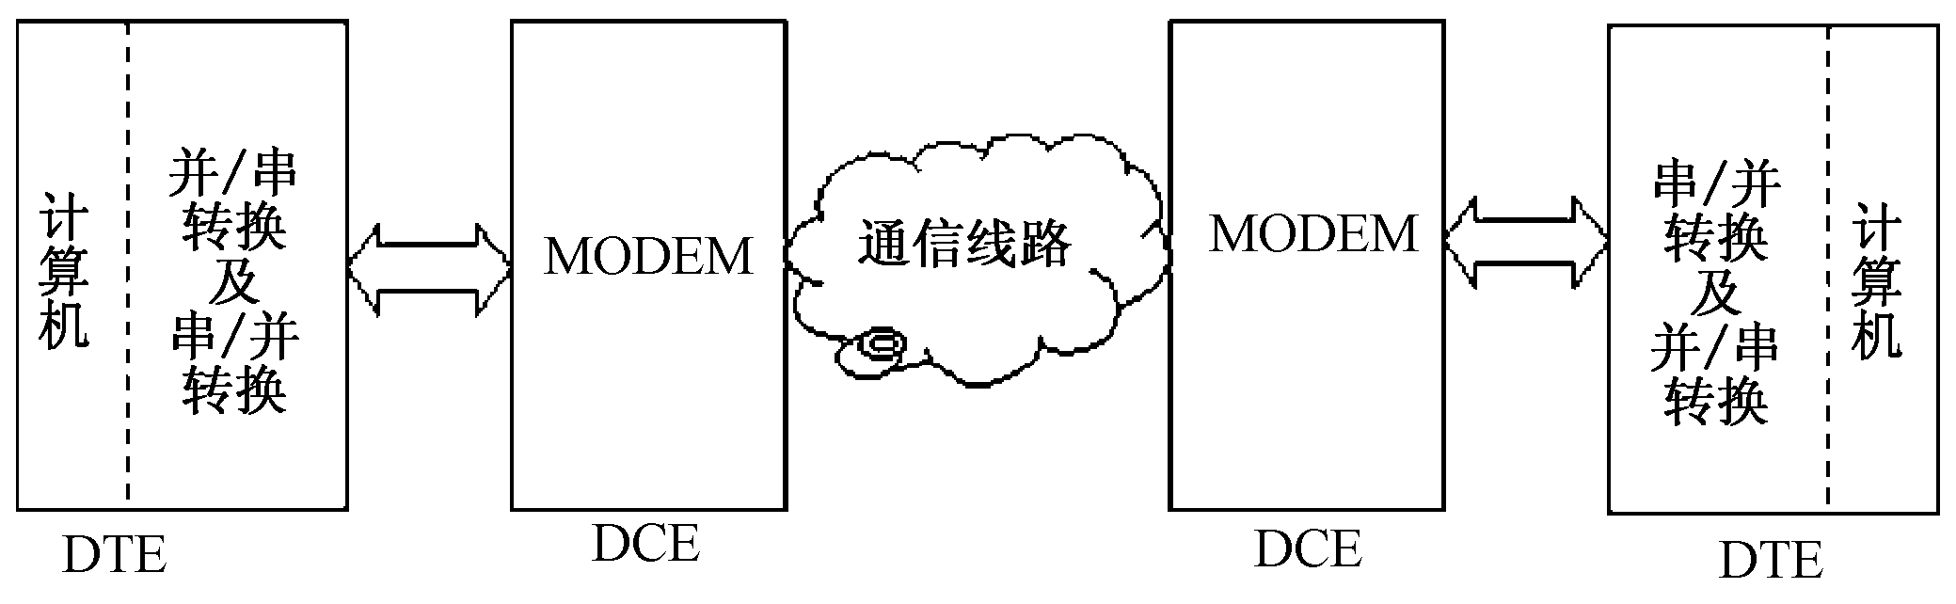
7.3 RS-232 Standard
RS-232 (Recommended Standard 232)
  Modem (modulator/demodulator)
    A device that converts TTL levels of serial data into audio tones that can pass through the telephone system
serializer and deserializer
serializer and deserializer
Computer
Computer

Slide 16
7.3 RS-232 Standard
RS-232 (Recommended Standard 232)
  Signals
DB-25pin | Abbreviation | Name | Direction
1 | PG | Protective Ground | Common
2 | TxD，SD | Transmitted Data | DTE→DCE
3 | RxD | Received Data | DCE→DTE
4 | RTS，RS | Request To Send | DTE→DCE
5 | CTS，CS | Clear To Send | DCE→DTE
6 | DSR，MR | Data Set Ready | DCE→DTE
7 | GND | Common Ground | Common
8 | RLSD，DCD | Data Carrier Detect | DCE→DTE
20 | DTR | Data Terminal Ready | DTE→DCE
22 | RI | Ring Indicator | DCE→DTE

Slide 17
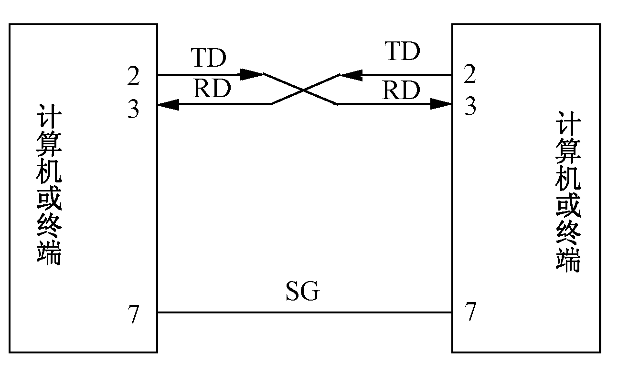
7.3 RS-232 Standard
RS-232 (Recommended Standard 232)
  “3 wire” RS-232 connection
    A minimal "3-wire" RS-232 connection consisting only of transmit data, receive data, and ground, is commonly used when the full facilities of RS-232 are not required.

Slide 18
7.3 RS-232 Standard
Electrical signal characteristics
  Voltage levels
    Valid signals are ±3 ~15 volts
    For data transmission lines
      Logic one is defined as a negative voltage (-3V~ - 15V), the signal condition is called marking.
      Logic zero is positive (+3V~+15V) and the signal condition is termed spacing.
    For Control signals
      When one of these signals is active, the voltage on the line will be between +3 to +15 volts.
      The inactive state for these signals is the opposite voltage condition, between −3 and −15 volts.

Slide 19
7.3 RS-232 Standard
Electrical signal characteristics
  Voltage levels
    Because the voltage levels are higher than logic levels typically used by integrated circuits, special intervening driver circuits are required to translate logic levels.
      MAX232, MAX232A, MC1488, MC1489

Slide 20
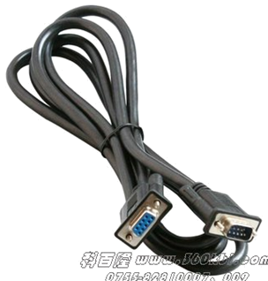
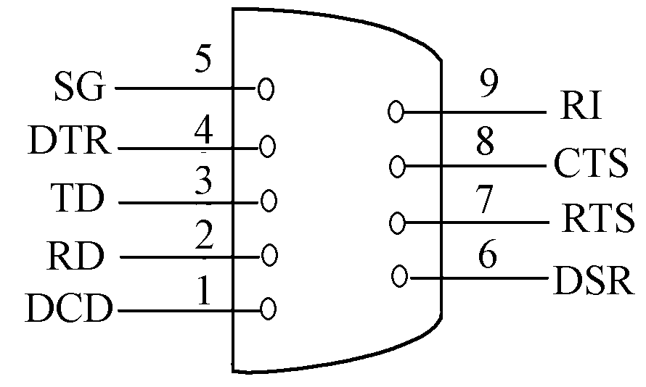
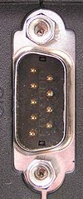

7.3 RS-232 Standard
Interface Mechanical Characteristics
  Connectors
    While the RS-232 standard originally specified a 25-pin D-type connector
    Many designers of personal computers chose to implement only a subset of the full standard which is DE-9 Connector.
      Terminals and computers have male connectors with DTE pin functions, and
      modems have female
      connectors with DCE pin
      functions.

Slide 21
7.4 16550 UART
16550 UART
  The 16550 UART (universal asynchronous receiver/transmitter) is an integrated circuit designed for implementing the interface for serial communications.
  It is frequently used to implement the serial port for IBM PC compatible personal computers.
  It is often connected to an RS-232 interface for modems, serial mice, printers, and similar peripherals.

Slide 22
7.4 16550 UART
Main features of the 16550
  The ability to convert data from serial to parallel, and from parallel to serial, using shift registers.
  An on-chip bit rate (baud rate) generator to control transmit and receive data rate.
  Handshake lines for control of an external modem, controllable by software.
  An interrupt function to the host microprocessor.
  An on-chip 16 byte FIFO buffer for both incoming and outgoing data; this gives the host system more time to respond to an interrupt generated by the UART, without loss of data.

Slide 23
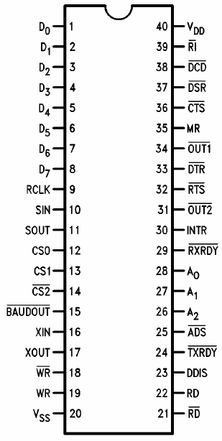
7.4 16550 UART
16550 UART Pins

Slide 24
7.4 16550 UART
16550 UART Pins
  Parallel data I/O and Control signal
    A0, A1, A2: Register Select
    CS0, CS1, CS2#: Chip Select
    D7~D0: Data Bus
    ADS#: Address Strobe
      Latches the Register Select and Chip Select
    DDIS: Driver Disable
      Disable or control the direction of a data bus transceiver between the CPU and the UART.
    RD, RD#: Read
    WR, WR#: Write
    TXRDY, RXRDY: Transmitter and Receiver DMA signal

Slide 25
7.4 16550 UART
16550 UART Pins
  Serial data I/O
    SIN: Serial Input
    SOUT: Serial Output
    XIN: External Crystal Input
    XOUT: External Crystal Output
    RCLK: Receiver Clock
    BAUDOUT#: Baud Out
      f_{Baud Out} =f_{XOUT}÷Divisor latch=Baud rate×16
      The BAUDOUT may also be used for the receiver section by tying this output to the RCLK input of the chip.

Slide 26
7.4 16550 UART
16550 UART Pins
  Handshake with MODEM
    CTS#: Clear to Send, in
    DCD#: Data Carrier Detect, in
    DSR#: Data Set Ready, in
    RI#: Ring Indicator, in
    DTR#: Data Terminal Ready, out
    RTS#: Request to Send, out
  Other
    INTR: Interrupt
    MR, Master Reset
    OUT1#, OUT2#: User defined output pins

Slide 27
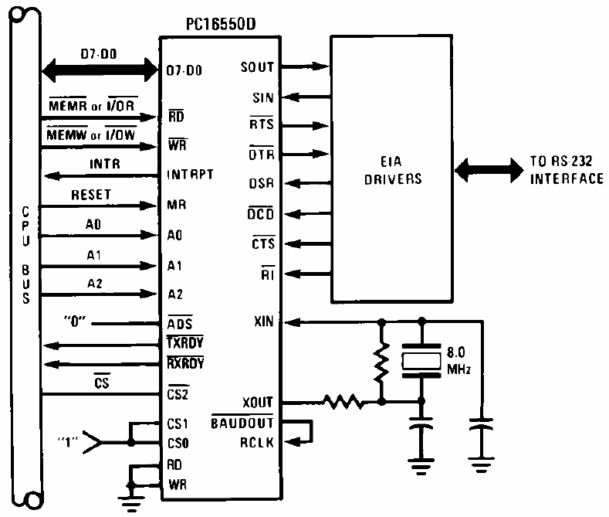
7.4 16550 UART
Basic Configuration

Slide 28
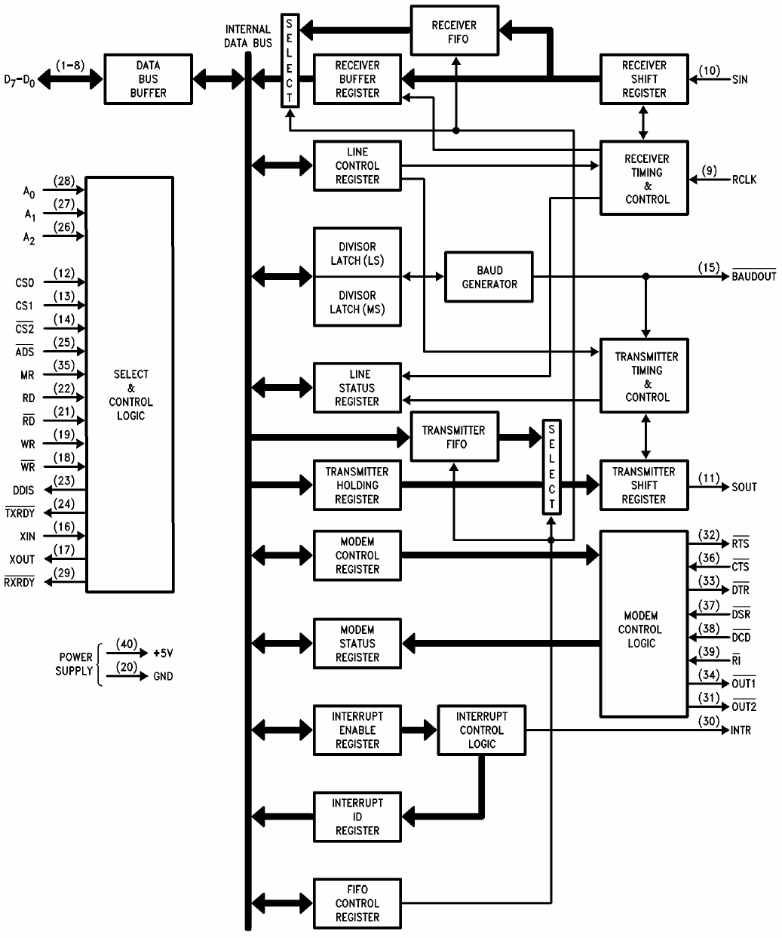
7.4 16550 UART
Block Diagram

Slide 29
7.4 16550 UART
Registers
DLAB | A₂A₁A₀ | Registers
0 | 000 | Receiver Buffer (R); Transmitter Holding Register (W)
0 | 001 | Interrupt Enable Register
1 | 000 | Divisor Latch (least significant byte)
1 | 001 | Divisor Latch (most significant byte)
X | 010 | Interrupt Identification Register(R); FIFO Control (W)
X | 011 | Line Control Register
X | 100 | MODEM Control Register
X | 101 | Line Status Register
X | 110 | MODEM Status Register
X | 111 | Scratch Register

Slide 30
7.4 16550 UART
Line Control Register(LCR)
A2A1A0=011
D7 D6 D5 D4 D3 D2 D1 D0
DLAB
SB
SP
EPS
PEN
STB
WLS1
WLS0
Send break
1—break
0—no break
Parity Type
Parity Enable
Data Length
00—5bit
01—6bit
10—7bit
11—8bit
11—even parity
01—odd parity
Enable Divisor Latch
0—disable
1—enable
Enable Stick bit
0—disable
1—enable
Stop bit
0—1bit
1—1.5bit(D1D0=00）
2bit(D1D0<>00)

Slide 31
7.4 16550 UART
Line Status Register(LSR)
A2A1A0=101
D7 D6 D5 D4 D3 D2 D1 D0
TSRE
THRE
BI
FE
PE
OE
DR
Transmitter Holding
Register Empty indicator
Break Interrupt
indicator
Data in FIFO error
Transmitter shifter
Empty indicator
Received character
have no valid Stop bit
Receiver Parity Error
Receiver Data Ready
Overrun Error

Slide 32
7.4 16550 UART
Receiver Buffer (RBR); Transmitter Holding Register (THR)
DLAB=0，A2A1A0=000
D7 D0
D7 D0
……
TSR
RSR
Shift out to SOUT pin, LSB first
Shift from SIN pin, LSB first
THR
RBR
8-bit data from CPU into THR in parallel
8-bit data to CPU in parallel
Sender
Receiver
Notes:
TSR: Transmitter Shift Register
RSR: Receiver Shift Register

Slide 33


7.4 16550 UART
Divisor Latch (DL)
DLAB=1, A2A1A0=001(MSB) or 000(LSB)
The UART contains a programmable Baud Generator that is capable of taking any clock input from DC to 24 MHz and dividing it by any divisor from 2 to 2¹⁶-1.
Value_{Divisor Latch}= (frequency_{XOUT}) ÷ (baud rate × 16)]
16550 use 18.432MHz crystal as a timing source in PC. if 240 is programmed into the Baud rate divisor. The Baud rate is (18.432MHz ÷16) ×240 = 4800 Baud
Transmit 7-bit ASCII code with 1 bit parity and 1 bit stop by using 16550, if the data transfer rate of 960 characters per sec, what is the value of divisor latch?
Notes:
Answer =78h

Slide 34
7.4 16550 UART
Interrupt Identification Register(IIR)
A2A1A0=010 (Read)
D7 D6 D5 D4 D3 D2 D1 D0
0
0
ID2
ID1
ID0
IP
0-an interrupt is pending
1- no interrupt is pending
01-Enable FIFO but no use
11-Enable FIFO
Identify the highest priority interrupt pending. ID2 used in FIFO mode only

Slide 35
7.4 16550 UART
Interrupt Identification Register(IIR)
ID2 | ID1 | ID0 | Interrupt source | Priority
0 | 1 | 1 | Receiver Line Status: Overrun Error or Parity Error or Framing Error or Break Interrupt | highest
0 | 1 | 0 | Receiver Data Available or Trigger Level Reached | second
1 | 1 | 0 | No Characters Have Been Removed From or Input to the RCVR FIFO During the Last 4 Char Times and There Is at Least 1 Char in It During This Time. | second
0 | 0 | 1 | Transmitter Holding Register Empty | third
0 | 0 | 0 | MODEM Status (CTS、DSR、RI和RLSD) changed | fourth

Slide 36
7.4 16550 UART
Interrupt Enable Register(IER)
DLAB=0，A2A1A0=001
D7 D6 D5 D4 D3 D2 D1 D0
0
0
I₀E
I₃E
I₁E
I₂E
1=enables the MODEM Status Interrupt
1=enables the THR Empty Interrupt
1=enables the Receiver Line Status Interrupt
1=enables the Received Data Available Interrupt

Slide 37
7.4 16550 UART
Modem Control Register(MCR)
A2A1A0=100
D7 D6 D5 D4 D3 D2 D1 D0
0
0
0
LOOP
OUT2
OUT1
RTS
DTR
provides a local loopback feature for diagnostic testing of the UART
control the out1# signal
control the DTR# output
control the out1# signal
control the RTS# output

Slide 38
7.4 16550 UART
Modem Status Register(MSR)
A2A1A0=110
D7 D6 D5 D4 D3 D2 D1 D0
DCD
RI
DSR
CTS
ΔDCD
TERI
ΔDSR
ΔCTS
Get the Ring
get CTS#
Trailing Edge of Ring come
CTS# changed
Get DCD#
DCD# changed
DSR# changed
Get DSR#

Slide 39
7.4 16550 UART
FIFO Control Register(FCR)
A2A1A0=010（写）
D7 D6 D5 D4 D3 D2 D1 D0
set the trigger level
(MSb)
clears all bytes in the sender FIFO
enable the FIFOs
reserve
set the trigger level
(LSb)
DMA mode select
clears all bytes in the receiver FIFO

Slide 40
7.4 16550 UART
FIFO Control Register(FCR)
The trigger level is indicative the number of bytes the buffer received before the UART sent.
D7 D6 | RCVR FIFO Trigger Level (Bytes)
0 0 | 1
0 1 | 4
1 0 | 8
1 1 | 14

Slide 41
7.5 COM in IA-32
What is COM in communication?
  COM is the original, yet still common, name of the serial port interface on IBM PC-compatible computers.
  It might not only refer to physical ports, but also to virtual ports, such as ports created by bluetooth or USB-to-Serial adapters.
  COM in IA-32
    COM1: I/O port 0x3F8, IRQ 4
    COM2: I/O port 0x2F8, IRQ 3
    COM3: I/O port 0x3E8, IRQ 4
    COM4: I/O port 0x2E8, IRQ 3

Slide 42
7.5 COM in IA-32
16550 initialize
  Write the divisor latch DL(port 0 and 1) to set baud rate.
  Write the line control register LCR(port 3) to set the format of the asynchronous data communications exchange.
  Write the MODEM control register MCR( port 4) to set the MODEM control word.
  Write Interrupt enable register IER(port 1) to set the interrupt enable word.

Slide 43
7.5 COM in IA-32
16550 initialize
mov dx,3fbh ；LCR
mov al,80h
out dx,al ；DLAB=1
mov dx,3f8h ；Divisor latch LSb
mov al,78h ；9600 Baud rate
out dx,al
mov al,00 ; Divisor latch MSb
inc dx
out dx,al

Slide 44
7.5 COM in IA-32
16550 initialize
mov al,00011011b ；even parity,
；1 stop, 8-bit data
mov dx,3fbh ；LCR
out dx,al
mov al,03h ；DTR, RTS
mov dx,3fch ；MCR
out dx,al
mov al,0 ；Disable interrupt
mov dx,3f9h ；IER
out dx,al

Slide 45
7.5 COM in IA-32
Sending Serial Data without interrupt
Initial 16550
Read LSR
N
D5=1？
Y
Send a char.
N
Finish？
Y
End

Slide 46
7.5 COM in IA-32
Initial 16550
Receiving Serial Data without interrupt
Read LSR
Y
Error ？
N
N
D0=1？
Error Handing
Y
Receive a char.
N
Finish？
Y
End

Slide 47
7.5 COM in IA-32
Programming Communication with interrupt
  Initialization
Modify the interrupt vector，According to COM1 or COM2, set the correct interrupt vector.
Determine the operation mode of 16550，set the IER and enable the interrupt ( set D3 in MCR = 1 at the same time)。
Set the baud rate and format of data (DL and LCR).
Enable the interrupt，Set the OCW1 of 8259A，enable IRQ4 or IRQ3. Set IF =1 in EFLAGS

Slide 48
7.5 COM in IA-32
Programming Communication with interrupt
  Interrupt handler
At first, read IIR，judge the interrupt source, then jump to the routine. Judge the interrupt source should be in accordance with the order of interrupt priority levels.
When D2D1 in IIR=11，means receive error，need to read LSR to know what’s wrong, and process it.
Maybe more than one interrupt are come. So, when a interrupt handler is complete, the IIR must be read again to check whether the D0 is “0”, when D0=0, you must to judge the interrupt source and process again.
The conditions for return from the interrupt routine is D0 of IIR is 1.

