Slide 1
Chapter 2
Process: A Generic View
(过程综述)
Software Engineering: A Practitioner’s Approach, 6th edition
by Roger S. Pressman

Slide 2
Chapter Overview
What? 过程是什么？当开发产品或构件系统时，遵循一系列可预测的步骤（即路线图）是非常重要的，它有助于及时交付高质量的产品。
Who? 相关人员？管理人员、软件工程师和客户均应该参与过程的定义、建立和测试。
Why?重要性？提高了软件开发活动的稳定性、可控性和有组织性；否则软件活动会失控并变得混乱。
Steps?有哪些步骤？ 具体步骤随着所构造的软件类型不同在细节方面有所变化，但对所有过程来讲有很多活动是相同的。
Work product?有哪些工作产品？ 是指过程中定义的一系列活动和任务的结果，包括Programs, documents, and data.
Correct process?什么是正确的过程？ Assessment, quality deliverable.

Slide 3
再看软件工程

Slide 4
SE: IEEE Definition
Software Engineering: (1) The application of a systematic, disciplined, quantifiable[系统的、规范的、可量化的] approach to the development, operation, and maintenance of software; that is, the application of engineering to software. (2) The study of approaches as in (1).
- IEEE Standard 610.12-1990

Slide 5
SE: A Layered Technology
Software Engineering
tools
SE工具：（半）自动化支持（CASE）
methods
SE方法：如何做；基本原则
process model
SE基础：过程
a “quality” focus
SE根基：质量关注点
软件工程基础是过程(process)！！！

Slide 6
2 什么是软件过程？
定义:软件过程是一个为建造高质量软件所需完成的任务的框架，即形成软件产品的一系列步骤。包括中间产品、资源、角色及过程中采取的方法、工具等范畴。

Slide 7
2.1 Software process model
Attempt to organize the software life cycle by
  defining activities involved in software production[软件生产]
  defining order of activities and their relationships
Goals of a software process
  standardization, predictability, productivity, high product quality, ability to plan time and budget requirements

Slide 8
早期做法： Code & Fix
The earliest approach
Write code
Fix it (修复) to eliminate any errors that have been detected, to enhance existing functionality, or to add new features
Source of difficulties and deficiencies
  impossible to predict
  impossible to manage

Slide 9
Symptoms of inadequacy: the software crisis
  scheduled time and cost exceeded
  user expectations not met
  poor quality
The size and economic value of software applications require appropriate "process models"

Slide 10
2.2 Process model goals (B. Boehm 1988)
determine the order of stages involved in software development and evolution, and to establish the transition criteria for progressing from one stage to the next. These include completion criteria for the current stage plus choice criteria and entrance criteria for the next stage. Thus a process model addresses the following software project questions:
  What shall we do next?
  How long shall we continue to do it?

Slide 11
3 怎么看软件过程？
3.1 黑盒观点
3.2 白盒观点

Slide 12
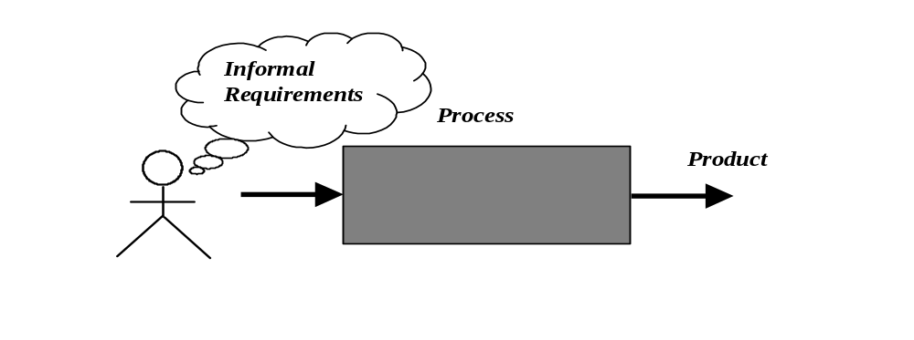
3.1 Process as a "black box"
Black-box
Quality?
Uncertain /
Incomplete
requirement
in the beginning
For Customer?

Slide 13
Problems
The assumption is that requirements can be fully understood prior to development
Interaction with the customer occurs only at the beginning (requirements) and end (after delivery)
Unfortunately the assumption almost never holds

Slide 14
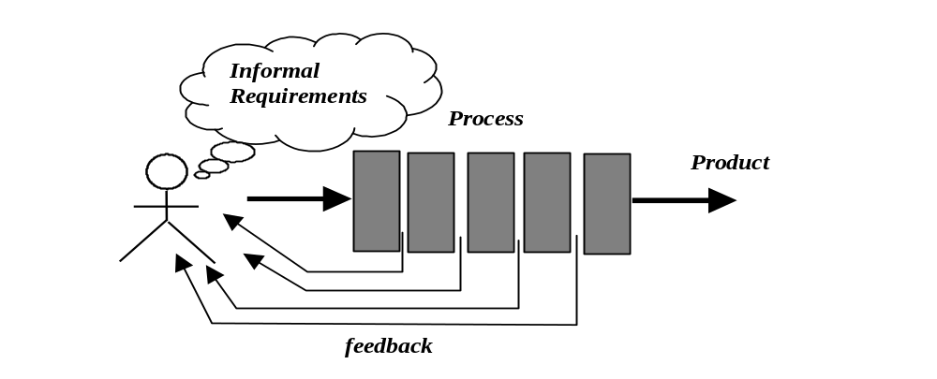
3.2 Process as a "white box"

Slide 15
Advantages
Reduce risks by improving visibility
Allow project changes as the project progresses
  based on feedback from the customer

Slide 16
4 过程框架

Slide 17
A Process Framework
Software process
Process framework
Umbrella activities
framework activity #1
framework activity #2
SE action #1.1
SE action #2.1
task sets | ⎧ ⎨ ⎩ | work tasks work products QA points milestones
task sets | ⎧ ⎨ ⎩ | work tasks work products QA points milestones
SE action #1.2
SE action #2.2
task sets | ⎧ ⎨ ⎩ | work tasks work products QA points milestones
task sets | ⎧ ⎨ ⎩ | work tasks work products QA points milestones

Slide 18
4.1 通用框架活动[阶段]
Communication[沟通]
Planning[策划]
Modeling[建模]
  Analysis of requirements
  Design
Construction[构建]
  Code generation
  Testing
Deployment[部署]
在通用的过程框架中,建模活动包括分析和设计两个动作(action)。
分析包括一组任务（如需求获取、细化、协商、规格说明和确认），最终产生需求分析模型（和/或需求规格说明书）。
设计也包括一组工作任务（如数据设计、体系结构设计、接口设计和构件层设计），最终产生设计（和/或设计规格说明书）。

Slide 19
4.2 普适性活动[Umbrella Activities]
Software project management
Formal technical reviews
Software quality assurance
Software configuration management
Work product preparation and production
Reusability management
Measurement
Risk management

Slide 20
通用框架的适用性(Adaptability)
The framework activities will always be applied on every project ... BUT
The tasks (and degree of rigor) for each activity will vary based on:
  the type of project
  characteristics of the project
  common sense[常识] judgment; concurrence of the project team

Slide 21
5 能力成熟度模型集成(CMMI)
这部分自学

Slide 22
CMMI简介
CMMI全称是Capability Maturity Model Integration, 即软件能力成熟度模型集成，是由美国国防部与卡内基-梅隆大学和美国国防工业协会共同开发和研制的，其目的是帮助软件企业对软件工程过程进行管理和改进，增强开发与改进能力，从而能按时地、不超预算地开发出高质量的软件。
其所依据的想法是：只要集中精力持续努力去建立有效的软件工程过程的基础结构，不断进行管理的实践和过程的改进，就可以克服软件开发中的困难。
CMMI为改进一个组织的各种过程提供了一个单一的集成化框架，新的集成模型框架消除了各个模型的不一致性，减少了模型间的重复，增加透明度和理解，建立了一个自动的、可扩展的框架。因而能够从总体上改进组织的质量和效率。CMMI主要关注点就是成本效益、明确重点、过程集中和灵活性四个方面。

Slide 23
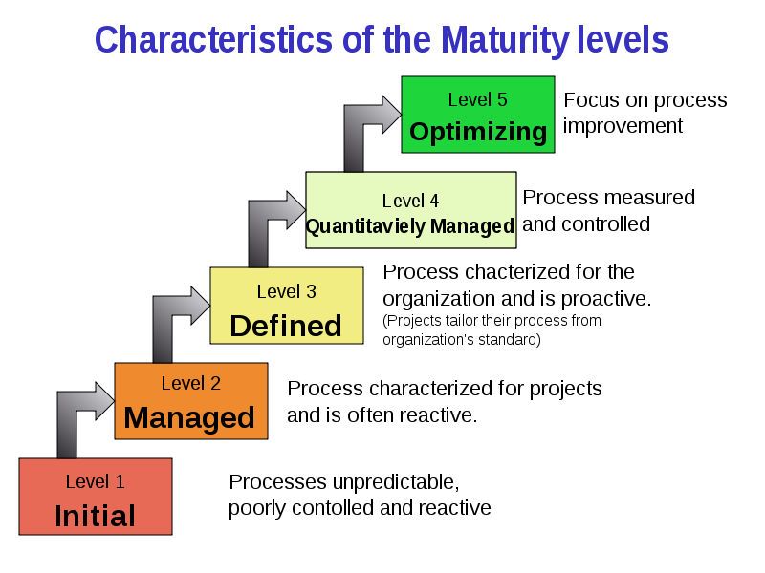
The CMMI
The CMMI defines each process area in terms of “specific goals” and the “specific practices” required to achieve these goals.
Specific goals establish the characteristics that must exist if the activities implied by a process area are to be effective.
Specific practices refine a goal into a set of process-related activities.

Slide 24
6 过程评估
评估软件过程以确认满足了成功软件工程所必需的基本过程标准(BASIC PROCESS CRITERIA)要求.

Slide 25
Process Assessment
The process should be assessed to ensure that it meets a set of basic process criteria that have been shown to be essential for a successful software engineering.
Many different assessment options are available:
  SCAMPI: Standard CMMI Assessment Method for Process Improvement
  CBA IPI: CMM-Based Appraisal for Internal Process Improvement
  SPICE: ISO/IEC 15504 Standard
  ISO 9001:2000 Standard

Slide 26
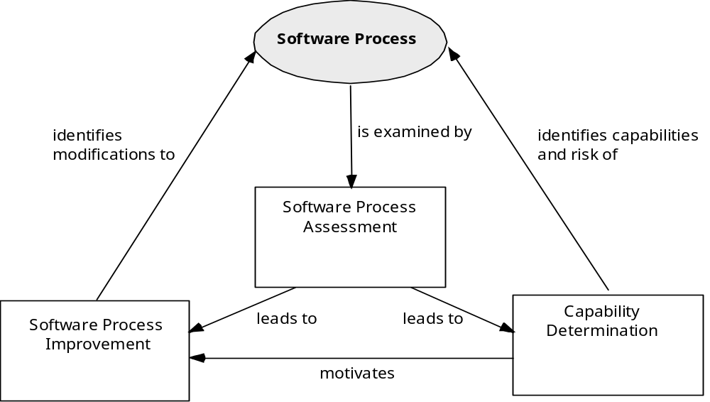
Assessment and Improvement

Slide 27
The Primary Goal of Any Software Process: High Quality
Remember:
High quality ⇒ project timeliness[项目的时效性]
Why?
Less rework!

