Slide 1
Chapter 9
Design Engineering
Software Engineering: A Practitioner’s Approach, 6th edition
by Roger S. Pressman

Slide 2
1 概述
与分析模型不同：设计模型提供了软件的数据结构(data structure)、体系结构(architecture)、接口(interface)和构件(component)的细节，而这些都是实现系统所必须的。
设计可以采用很多不同的方法描绘软件。首先，设计必须体现系统或产品的体系结构；其次，为各类接口建模；最后，设计用于构建系统的软件构件。
软件设计是建模活动的最后一个软件工程活动,接着便要进入构造阶段(生成代码和测试)。

Slide 3
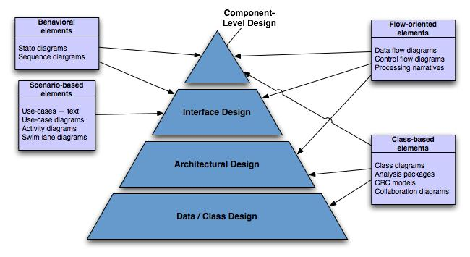
Analysis → Design

Slide 4
2 设计过程和设计质量
软件设计是一个迭代的过程，通过设计过程，需求被变换为用于构建软件的“蓝图”【体系结构设计/概要设计、接口设计】。
随着设计迭代的推进，后续的精化导致更低抽象层次的设计表示【构件级设计/详细设计、接口设计】。
正式的技术评审（technical review）和设计走查（walkthrough）可用于评估设计演化的质量。

Slide 5
3 Design Concepts
abstraction — data, procedure
architecture — the overall structure of the software
patterns — “conveys the essence” of a proven design solution
modularity — compartmentalization of data and function[数据和功能划分]
information hiding — controlled interfaces
functional independence — high cohesion and low coupling
refinement — elaboration of detail for all abstractions
refactoring — improve design without effecting behavior

Slide 6
3.1 Abstraction et al.
Abstraction
  process – extracting essential details
  entity – a model or focused representation
Information hiding
  the suppression of inessential information
Encapsulation
  process – enclosing items in a container
  entity – enclosure that holds the items

Slide 7
Data Abstraction
实数
对象
类
构件
……
door
manufacturer
model number
type
swing direction
数据抽象是描述数据对象的冠名数据集合.
例如,”门”的 数据抽象将包含一组描述门的属性: 门的类型/转动方向/开门机构,重量和尺寸等
inserts
lights
type
number
weight
opening mechanism
implemented as a data structure

Slide 8
Procedural Abstraction
过程抽象是指具有明确和有限功能的指令序列.
例如,”开”隐含了一长串的过程性步骤: 走到门前、伸手并抓住把手、转动把手并拉门、离开打开的门等
open
details of enter
algorithm
implemented with a "knowledge" of the
object that is associated with enter

Slide 9
3.2 Architecture
“The overall structure of the software and the ways in which that structure provides conceptual integrity for a system.” [软件的整体结构和这种结构为系统提供概念上完整性的方式][SHA95a]
简而言之, 体系结构是程序构件（模块）的结构或组织、这些构件交互的形式、以及构件所用的数据的结构。

Slide 10
Architecture…
Structural properties. This aspect of the architectural design representation defines the components of a system (e.g., modules, objects, filters) and the manner in which those components are packaged and interact with one another. For example, objects are packaged to encapsulate both data and the processing that manipulates the data and interact via the invocation of methods
Extra-functional properties. The architectural design description should address how the design architecture achieves requirements for performance, capacity, reliability, security, adaptability, and other system characteristics.
Families of related systems. The architectural design should draw upon repeatable patterns that are commonly encountered in the design of families of similar systems. In essence, the design should have the ability to reuse architectural building blocks.

Slide 11
3.3 Patterns
A pattern for software architecture describes a particular recurring design problem [某个再现的特定设计问题] that arises in specific design contexts, and presents a well-proven generic scheme for its solution. The solution scheme is specified by describing its constituent components, their responsibilities and relationships, and the ways in which they collaborate.

Slide 12
Some Kinds of Patterns
An architectural pattern expresses a fundamental structural organization schema for software systems. It provides a set of predefined subsystems, specifies their responsibilities, and includes rules and guidelines for organizing the relationships between them.
A design pattern provides a scheme for refining the subsystems or components of a software system, or the relationships between them. It describes a commonly-recurring structure of communicating components that solves a general design problem within a particular context.
An idiom is a low-level pattern specific to a programming language. An idiom describes how to implement particular aspects of components or the relationships between them using the features of the given language.

Slide 13
Design Patterns
Design Pattern Template
Pattern name—describes the essence of the pattern in a short but expressive name
Intent—describes the pattern and what it does
Also-known-as—lists any synonyms for the pattern
Motivation—provides an example of the problem
Applicability—notes specific design situations in which the pattern is applicable
Structure—describes the classes that are required to implement the pattern
Participants—describes the responsibilities of the classes that are required to implement the pattern
Collaborations—describes how the participants collaborate to carry out their responsibilities
Consequences—describes the “design forces” that affect the pattern and the potential trade-offs that must be considered when the pattern is implemented
Related patterns—cross-references related design patterns

Slide 14
Design Patterns
The best designers in any field have an uncanny ability [离奇的能力] to see patterns that characterize a problem and corresponding patterns that can be combined to create a solution
A description of a design pattern may also consider a set of design forces.
  Design forces [设计规范] describe non-functional requirements (e.g., ease of maintainability, portability) associated the software for which the pattern is to be applied.
The pattern characteristics (classes, responsibilities, and collaborations) indicate the attributes of the design that may be adjusted to enable the pattern to accommodate a variety of problems.

Slide 15
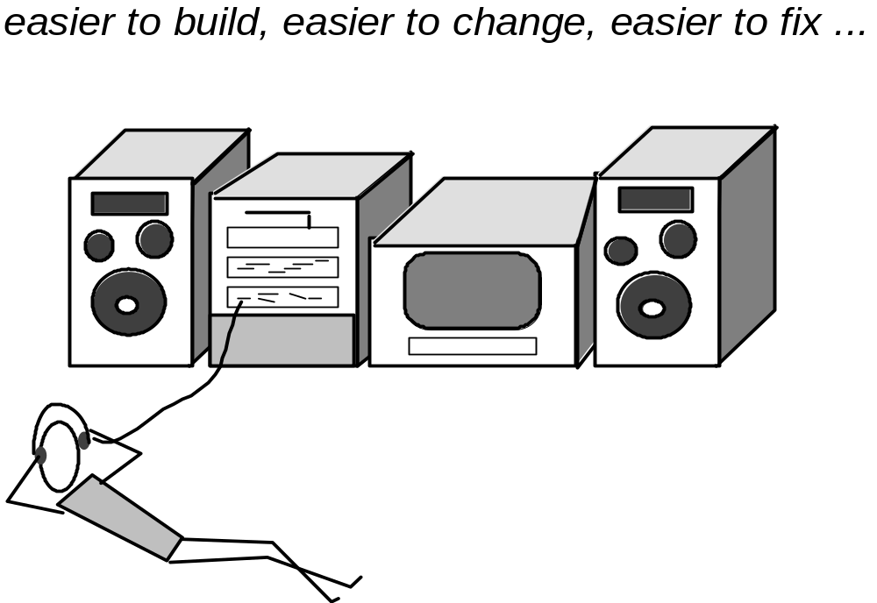
3.4 Modular Design

Slide 16
Modularity: Trade-offs
What is the "right" number of modules
for a specific software design?
module development cost
cost of
software
module
integration
cost
optimal number
number of modules
of modules

Slide 17
3.5 Information Hiding
module
• algorithm
controlled
interface
• data structure
• details of external interface
• resource allocation policy
clients
"secret"
a specific design decision

Slide 18
Why Information Hiding?
reduces the likelihood of “side effects”
limits the global impact of local design decisions
emphasizes communication through controlled interfaces
discourages the use of global data
leads to encapsulation—an attribute of high quality design
results in higher quality software

Slide 19
3.6 Stepwise Refinement
open
walk to door;
reach for knob;
open door;
repeat until door opens
turn knob clockwise;
walk through;
if knob doesn't turn, then
close door.
take key out;
find correct key;
insert in lock;
endif
pull/push door
move out of way;
end repeat

Slide 20
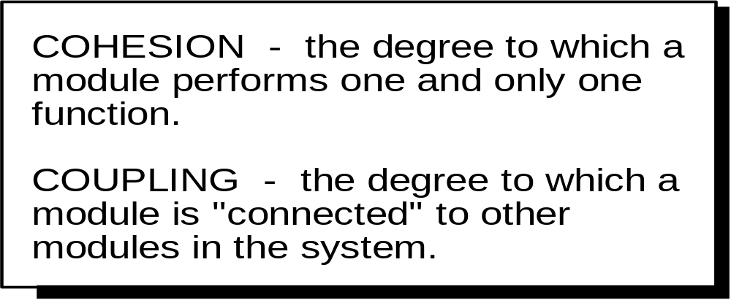
3.7 Functional Independence

Slide 21
3.8 Refactoring
Fowler [FOW99] defines refactoring in the following manner:
  "Refactoring is the process of changing a software system in such a way that it does not alter the external behavior of the code [design] yet improves its internal structure.”
When software is refactored, the existing design is examined for
  redundancy
  unused design elements
  inefficient or unnecessary algorithms
  poorly constructed or inappropriate data structures or any other design failure that can be corrected to yield a better design.

Slide 22
3.9 Design Classes
User interface classes – define abstractions necessary for HCI.
Business domain classes – refinements of analysis classes.
Process classes – lower-level business abstractions that manage business domain classes.
Persistent classes – data stores (databases) that persist beyond execution of the software.
System classes – management and control functions that enable the system to operate and communicate within its computing environment and with the outside world.

Slide 23
Well-formed Design Class
Complete and sufficient – class should be a complete and sufficient encapsulation of reasonable attributes and methods.
Primitiveness[原始性] – each method should be focused on one thing.
High cohesion – class should be focused on one kind of thing.
Low coupling – collaboration should be kept to an acceptable minimum.

Slide 24

4 The Design Model
过程维度表示设计模型的演化,设计工作作为软件过程的一部分被执行.
抽象维度表示过程的详细级别,分析模型的每个元素转化为一个等价的设计,然后迭代精化.

Slide 25
Design Model Elements
Data elements
  Architectural level → databases and files
  Component level → data structures
Architectural elements
  An architectural model is derived from:
    Application domain[应用领域信息]
    Analysis model[特定分析模型元素]
    Available styles and patterns[体系结构风格和模式]
Interface elements
  There are three parts to the interface design element:
    The user interface (UI)
    Interfaces to external systems
    Interfaces to components within the application
Component elements
Deployment elements

Slide 26
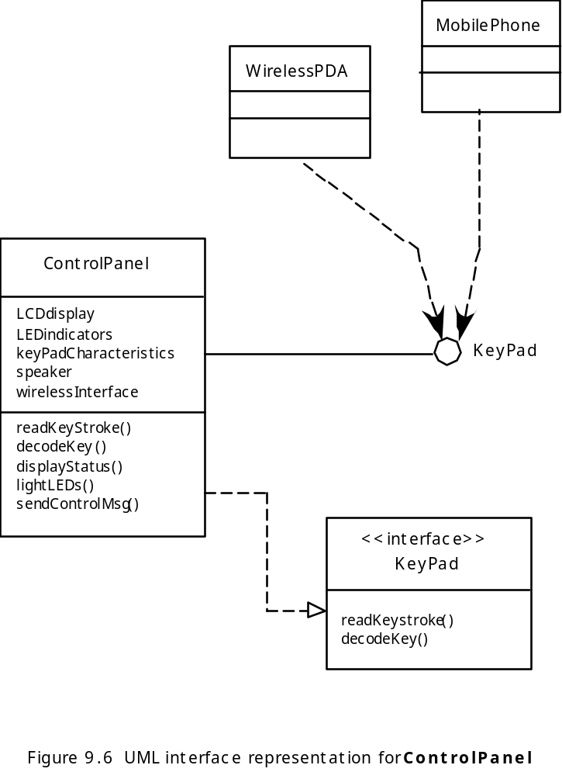
Interface Elements
软件的接口设计相当于一组房屋的门、窗和外部设施的详细绘图。

Slide 27
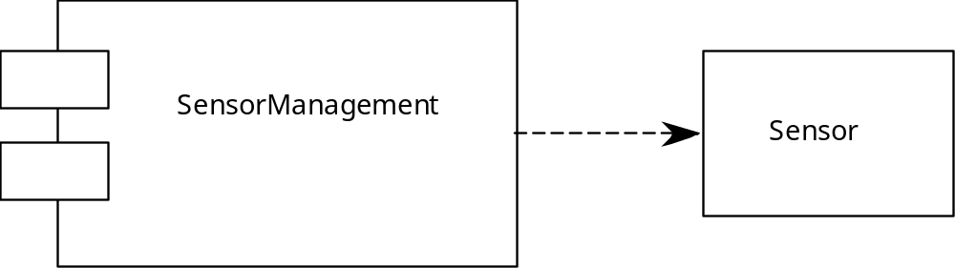
Component Elements
软件的构件级设计完全类似于某个房屋中每个房间的一组详细绘图。

Slide 28
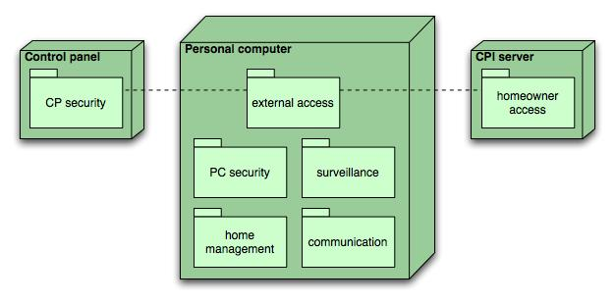
Deployment Diagram
部署级设计元素指明软件功能和子系统将如何在支持软件的物理计算环境内分布。
SafeHome控制面板
基于住宅的PC
CPI公司的服务器

Slide 29
5 Design Principles
The design process should not suffer from ‘tunnel vision[视野狭隘].’
The design should be traceable to the analysis model.
The design should not reinvent the wheel.
The design should “minimize the intellectual distance[理解差异]” between the software and the problem as it exists in the real world.
The design should exhibit uniformity and integration.
The design should be structured to accommodate change.
The design should be structured to degrade gently, even when aberrant data, events, or operating conditions are encountered.
Design is not coding, coding is not design.
The design should be assessed for quality as it is being created, not after the fact.
The design should be reviewed to minimize conceptual (semantic) errors.

Slide 30
6 Design and Quality
the design must implement all of the explicit requirements contained in the analysis model, and it must accommodate all of the implicit requirements desired by the customer.
the design must be a readable, understandable guide for those who generate code and for those who test and subsequently support the software.
the design should provide a complete picture of the software, addressing the data, functional, and behavioral domains from an implementation perspective.

Slide 31
Quality Guidelines
A design should exhibit an architecture that (1) has been created using recognizable architectural styles or patterns, (2) is composed of components that exhibit good design characteristics and (3) can be implemented in an evolutionary fashion
  For smaller systems, design can sometimes be developed linearly.
A design should be modular; that is, the software should be logically partitioned into elements or subsystems
A design should contain distinct representations of data, architecture, interfaces, and components.
A design should lead to data structures that are appropriate for the classes to be implemented and are drawn from recognizable data patterns.
A design should lead to components that exhibit independent functional characteristics.
A design should lead to interfaces that reduce the complexity of connections between components and with the external environment.
A design should be derived using a repeatable method that is driven by information obtained during software requirements analysis.
A design should be represented using a notation that effectively communicates its meaning.

