Slide 1
Chapter 10
Architectural Design
Software Engineering: A Practitioner’s Approach, 6th edition
by Roger S. Pressman

Slide 2
概述
人们不能在没有图纸的情况下建房子,同样也不能通过勾画出房子的管道布局而开始绘制房子的蓝图. 在开始考虑细节之前,需要关注整体视图---房子本身. 这就是体系结构设计需要做的事情---它为你提供整体的视图并保证得到正确的理解.

Slide 3
Software Architecture
The software architecture of a program or computing system is the structure or structures of the system, which comprise the software components, the externally visible properties of those components, and the relationships among them.
— Bass. et al.

Slide 4
Why Architecture?
Architecture is a representation of a system that enables the software engineer to:
  analyze the effectiveness of the design in meeting its stated requirements,
  consider architectural alternatives at a stage when making design changes is still relatively easy, and
  reduce the risks associated with the construction of the software.

Slide 5
Data Design
Architectural level → Database design
  data mining
  data warehousing
Component level → Data structure design

Slide 6
Architectural Styles
Each style describes a system category that encompasses:
  a set of components (e.g., a database, computational modules) that perform a function required by a system,
  a set of connectors that enable “communication, coordination, and cooperation” among components,
  constraints that define how components can be integrated to form the system, and
  semantic models that enable a designer to understand the overall properties of a system.

Slide 7
Specific Styles
Data-centered architecture
Data flow architecture
Call and return architecture
Object-oriented architecture
Layered architecture

Slide 8
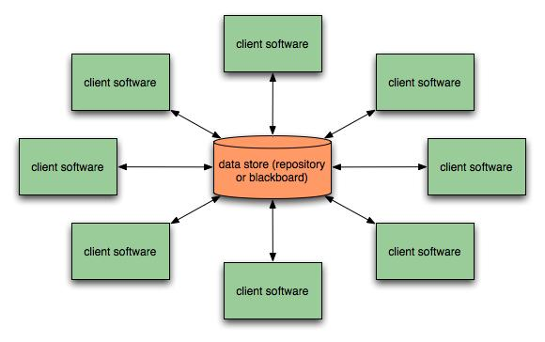
Data-Centered Architecture

Slide 9
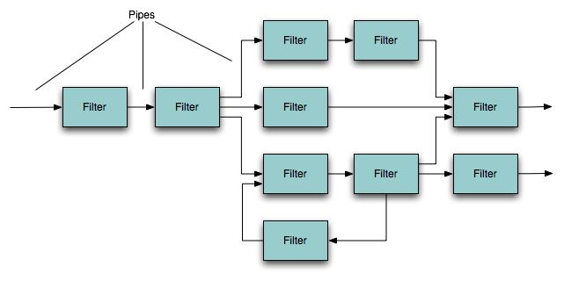
Data-Flow Architecture

Slide 10
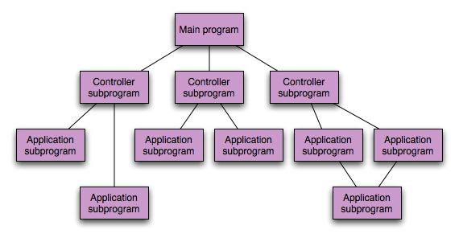
Call and Return Architecture

Slide 11
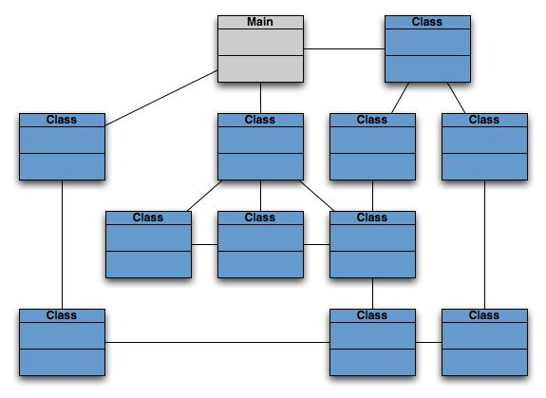
Object-Oriented Architecture

Slide 12
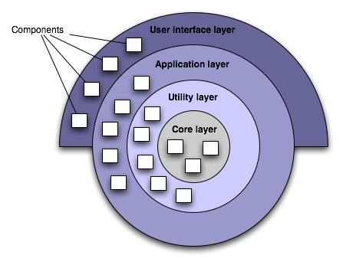
Layered Architecture

Slide 13
Architectural Patterns
Concurrency
  operating system process management
  task scheduler
Persistence
  database management system
  application level persistence
Distribution
  broker

Slide 14
Architectural Design
Architectural context diagrams model how software interacts with external entities
Archetypes are classes or patterns that represent an abstraction critical to the system
Architectural components are derived from the application domain, the infrastructure, and the interface.

Slide 15
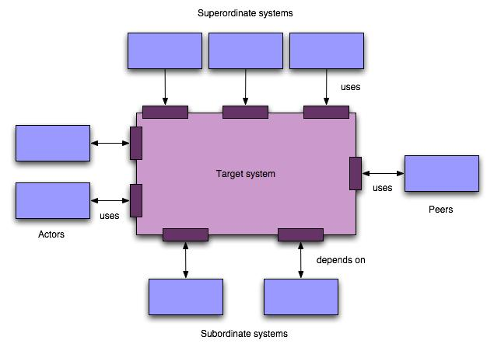
Arch. Context Diagram

Slide 16
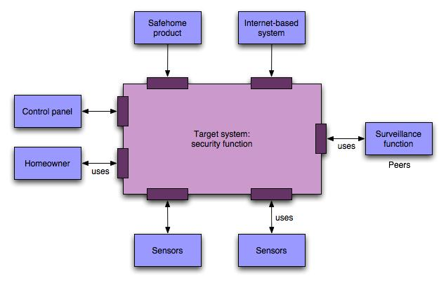
SafeHome ACD

Slide 17
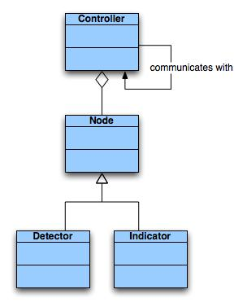
SafeHome Archetype

Slide 18
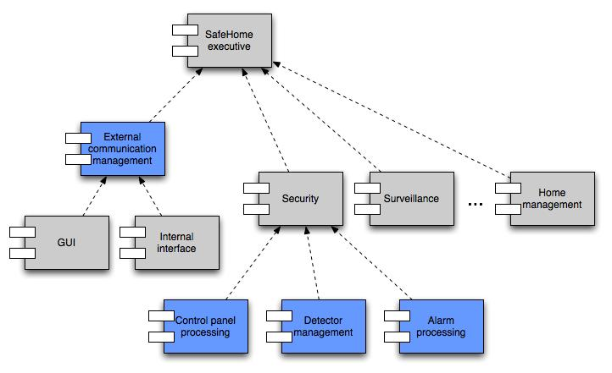
Component Structure

Slide 19
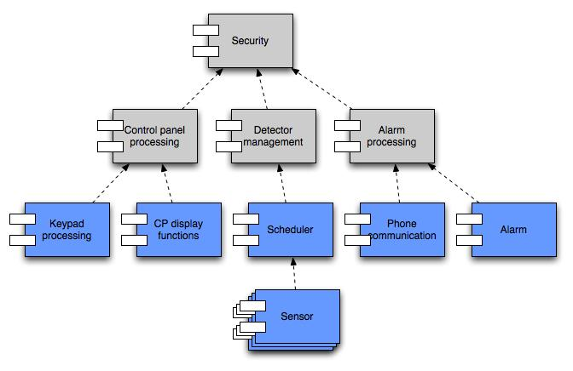
Component Elaboration

