Slide 1
Chapter 24
Project Scheduling and Tracking
Software Engineering: A Practitioner’s Approach, 6th edition
by Roger S. Pressman

Slide 2
Why Are Projects Late?
an unrealistic deadline established by someone outside the software development group
changing customer requirements that are not reflected in schedule changes;
an honest underestimate of the amount of effort and/or the number of resources that will be required to do the job;
predictable and/or unpredictable risks that were not considered when the project commenced;
technical difficulties that could not have been foreseen in advance;
human difficulties that could not have been foreseen in advance;
miscommunication among project staff that results in delays;
a failure by project management to recognize that the project is falling behind schedule and a lack of action to correct the problem

Slide 3
Scheduling Principles
compartmentalization—define distinct tasks
interdependency—indicate task interrelationship
effort validation—be sure resources are available
defined responsibilities—people must be assigned
defined outcomes—each task must have an output
defined milestones—review for quality

Slide 4
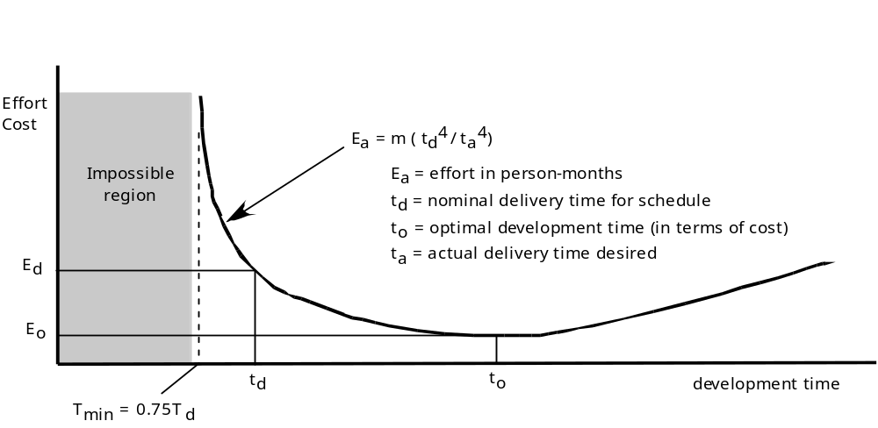
Effort and Delivery Time

Slide 5
Effort Allocation
40-50%
“front end” activities
  customer communication
  analysis
  design
  review and modification
construction activities
  coding or code generation
testing and installation
  unit, integration
  white-box, black box
  regression
15-20%
30-40%

Slide 6
Defining Task Sets
determine type of project
  concept development, new application development, application enhancement, application maintenance, and reengineering projects
assess the degree of rigor required
identify adaptation criteria
select appropriate software engineering tasks

Slide 7
Task Set Refinement
1.1Concept scoping determines the overall scope of the project.
Task definition: Task 1.1 Concept Scoping
1.1.1 Identify need, benefits and potential customers;
1.1.2 Define desired output/control and input events that drive the application;
Begin Task 1.1.2
1.1.2.1 FTR: Review written description of need
  FTR indicates that a formal technical review (Chapter 26) is to be conducted.
1.1.2.2 Derive a list of customer visible outputs/inputs
1.1.2.3 FTR: Review outputs/inputs with customer and revise as required;
endtask Task 1.1.2
1.1.3 Define the functionality/behavior for each major function;
Begin Task 1.1.3
1.1.3.1 FTR: Review output and input data objects derived in task 1.1.2;
1.1.3.2 Derive a model of functions/behaviors;
1.1.3.3 FTR: Review functions/behaviors with customer and revise as required;
endtask Task 1.1.3
1.1.4 Isolate those elements of the technology to be implemented in software;
1.1.5 Research availability of existing software;
1.1.6 Define technical feasibility;
1.1.7 Make quick estimate of size;
1.1.8 Create a Scope Definition;
endTask definition: Task 1.1
is refined to

Slide 8
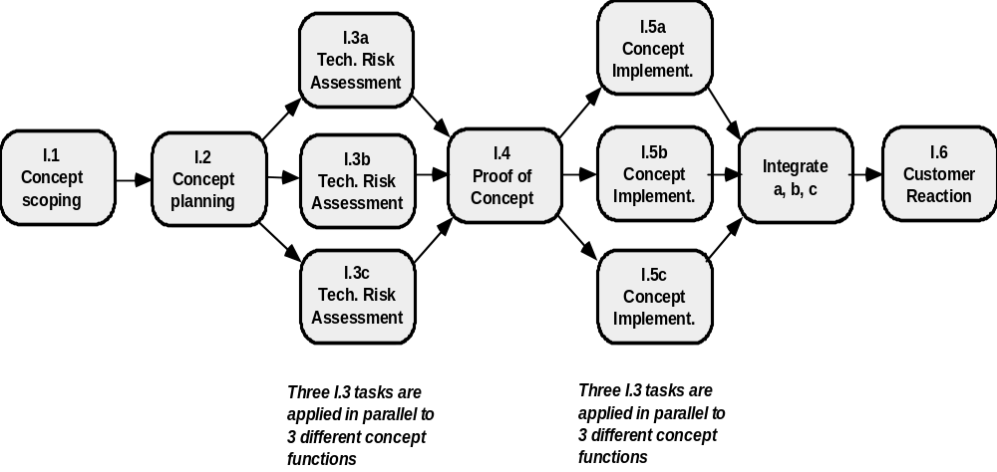
Define a Task Network

Slide 9
Timeline Charts
Tasks
Week 1
Week 2
Week 3
Week 4
Week n
Task 1
Task 2
Task 3
Task 4
Task 5
Task 6
Task 7
Task 8
Task 9
Task 10
Task 11
Task 12

Slide 10
Schedule Tracking
  conduct periodic project status meetings in which each team member reports progress and problems.
  evaluate the results of all reviews conducted throughout the software engineering process.
  determine whether formal project milestones have been accomplished by the scheduled date.
  compare actual start-date to planned start-date for each project task listed in the resource table
  meet informally with practitioners to obtain their subjective assessment of progress to date and problems on the horizon.
  use earned value analysis to assess progress quantitatively.

Slide 11
Progress on an OO Project
Technical milestone: OO analysis completed
  All classes and the class hierarchy have been defined and reviewed.
  Class attributes and operations associated with a class have been defined and reviewed.
  Class relationships (Chapter 8) have been established and reviewed.
  A behavioral model (Chapter 8) has been created and reviewed.
  Reusable classes have been noted.
Technical milestone: OO design completed
  The set of subsystems (Chapter 9) has been defined and reviewed.
  Classes are allocated to subsystems and reviewed.
  Task allocation has been established and reviewed.
  Responsibilities and collaborations (Chapter 9) have been identified.
  Attributes and operations have been designed and reviewed.
  The communication model has been created and reviewed.

Slide 12
Progress on an OO Project…
Technical milestone: OO programming completed
  Each new class has been implemented in code from the design model.
  Extracted classes (from a reuse library) have been implemented.
  Prototype or increment has been built.
Technical milestone: OO testing
  The correctness and completeness of OO analysis and design models has been reviewed.
  A class-responsibility-collaboration network (Chapter 8) has been developed and reviewed.
  Test cases are designed and class-level tests (Chapter 14) have been conducted for each class.
  Test cases are designed and cluster testing (Chapter 14) is completed and the classes are integrated.
  System level tests have been completed.

Slide 13
Earned Value Analysis (EVA)
Earned value
  is a measure of progress
  enables us to assess the “percent of completeness” of a project using quantitative analysis rather than rely on a gut feeling
  “provides accurate and reliable readings of performance from as early as 15 percent into the project.” [FLE98]

Slide 14
Computing Earned Value
The budgeted cost of work scheduled (BCWS) is determined for each work task represented in the schedule.
  BCWS_{i} is the effort planned for work task i.
  To determine progress at a given point along the project schedule, the value of BCWS is the sum of the BCWS_{i} values for all work tasks that should have been completed by that point in time on the project schedule.
The BCWS values for all work tasks are summed to derive the budget at completion, BAC. Hence,
BAC = ∑ (BCWS_{k}) for all tasks k

Slide 15
Computing Earned Value…
Next, the value for budgeted cost of work performed (BCWP) is computed.
  The value for BCWP is the sum of the BCWS values for all work tasks that have actually been completed by a point in time on the project schedule.
“the distinction between the BCWS and the BCWP is that the former represents the budget of the activities that were planned to be completed and the latter represents the budget of the activities that actually were completed.” [WIL99]
Given values for BCWS, BAC, and BCWP, important progress indicators can be computed:
    Schedule performance index, SPI = BCWP/BCWS
    Schedule variance, SV = BCWP – BCWS
    SPI is an indication of the efficiency with which the project is utilizing scheduled resources.

Slide 16
Computing Earned Value…
Percent scheduled for completion = BCWS/BAC
  provides an indication of the percentage of work that should have been completed by time t.
Percent complete = BCWP/BAC
  provides a quantitative indication of the percent of completeness of the project at a given point in time, t.
Actual cost of work performed, ACWP, is the sum of the effort actually expended on work tasks that have been completed by a point in time on the project schedule. It is then possible to compute
    Cost performance index, CPI = BCWP/ACWP
    Cost variance, CV = BCWP – ACWP

Slide 17
Chapter 25
Risk Management
Software Engineering: A Practitioner’s Approach, 6th edition
by Roger S. Pressman

Slide 18
Project Risks
风险的特性：
不确定性
损失
What can go wrong?
What is the likelihood?
What will the damage be?
What can we do about it?

Slide 19
Reactive Risk Management
project team reacts to risks when they occur
mitigation—plan for additional resources in anticipation of fire fighting
fix on failure—resource are found and applied when the risk strikes
crisis management—failure does not respond to applied resources and project is in jeopardy[危险]

Slide 20
Proactive Risk Management
formal risk analysis is performed
organization corrects the root causes of risk
  TQM concepts and statistical SQA
  examining risk sources that lie beyond the bounds of the software
  developing the skill to manage change

Slide 21
Risk Management Paradigm
control
track
RISK
identify
plan
analyze

Slide 22
Risk Identification
Product size—risks associated with the overall size of the software to be built or modified.
Business impact—risks associated with constraints imposed by management or the marketplace.
Customer characteristics—risks associated with the sophistication of the customer and the developer's ability to communicate with the customer in a timely manner.
Process definition—risks associated with the degree to which the software process has been defined and is followed by the development organization.
Development environment—risks associated with the availability and quality of the tools to be used to build the product.
Technology to be built—risks associated with the complexity of the system to be built and the "newness" of the technology that is packaged by the system.
Staff size and experience—risks associated with the overall technical and project experience of the software engineers who will do the work.

Slide 23
Assessing Project Risk
Have top software and customer managers formally committed to support the project?
Are end-users enthusiastically committed to the project and the system/product to be built?
Are requirements fully understood by the software engineering team and their customers?
Have customers been involved fully in the definition of requirements?
Do end-users have realistic expectations?

Slide 24
Assessing Project Risk…
Is project scope stable?
Does the software engineering team have the right mix of skills?
Are project requirements stable?
Does the project team have experience with the technology to be implemented?
Is the number of people on the project team adequate to do the job?
Do all customer/user constituencies agree on the importance of the project and on the requirements for the system/product to be built?

Slide 25
Risk Components
performance risk—the degree of uncertainty that the product will meet its requirements and be fit for its intended use.
cost risk—the degree of uncertainty that the project budget will be maintained.
support risk—the degree of uncertainty that the resultant software will be easy to correct, adapt, and enhance.
schedule risk—the degree of uncertainty that the project schedule will be maintained and that the product will be delivered on time.

Slide 26
Risk Mitigation, Monitoring, and Management
mitigation—how can we avoid the risk?
monitoring—what factors can we track that will enable us to determine if the risk is becoming more or less likely?
management—what contingency plans do we have if the risk becomes a reality?

Slide 27
Risk Due to Product Size
Attributes that affect risk:
• estimated size of the product in LOC or FP?
• estimated size of product in number of programs, files, transactions?
• percentage deviation in size of product from average for previous products?
• size of database created or used by the product?
• number of users of the product?
• number of projected changes to the requirements for the product?
before delivery? after delivery?
• amount of reused software?

Slide 28
Risk Due to Business Impact
Attributes that affect risk:
• affect of this product on company revenue?
• visibility of this product by senior management?
• reasonableness of delivery deadline?
• number of customers who will use this product
• interoperability constraints
• sophistication of end users?
• amount and quality of product documentation that
must be produced and delivered to the customer?
• governmental constraints
• costs associated with late delivery?
• costs associated with a defective product?

Slide 29
Risks Due to the Customer
Questions that must be answered:
• Have you worked with the customer in the past?
• Does the customer have a solid idea of requirements?
• Has the customer agreed to spend time with you?
• Is the customer willing to participate in reviews?
• Is the customer technically sophisticated?
• Is the customer willing to let your people do their
job—that is, will the customer resist looking over your
shoulder during technically detailed work?
• Does the customer understand the software
engineering process?

Slide 30
Risks Due to Process Maturity
Questions that must be answered:
• Have you established a common process framework?
• Is it followed by project teams?
• Do you have management support for
software engineering
• Do you have a proactive approach to SQA?
• Do you conduct formal technical reviews?
• Are CASE tools used for analysis, design and
testing?
• Are the tools integrated with one another?
• Have document formats been established?

Slide 31
Technology Risks
Questions that must be answered:
• Is the technology new to your organization?
• Are new algorithms, I/O technology required?
• Is new or unproven hardware involved?
• Does the application interface with new software?
• Is a specialized user interface required?
• Is the application radically different?
• Are you using new software engineering methods?
• Are you using unconventional software development
methods, such as formal methods, AI-based approaches,
artificial neural networks?
• Are there significant performance constraints?
• Is there doubt the functionality requested is "do-able?"

Slide 32
Staff/People Risks
Questions that must be answered:
• Are the best people available?
• Does staff have the right skills?
• Are enough people available?
• Are staff committed for entire duration?
• Will some people work part time?
• Do staff have the right expectations?
• Have staff received necessary training?
• Will turnover among staff be low?

Slide 33
Recording Risk Information
Project: Embedded software for XYZ system
Risk type: schedule risk
Priority (1 low ... 5 critical): 4
Risk factor: Project completion will depend on tests which require
hardware component under development. Hardware component
delivery may be delayed
Probability: 60 %
Impact: Project completion will be delayed for each day that
hardware is unavailable for use in software testing
Monitoring approach:
Scheduled milestone reviews with hardware group
Contingency plan:
Modification of testing strategy to accommodate delay using
software simulation
Estimated resources: 6 additional person months beginning 7-1-96

