Slide 1



Race Detection for Event-Driven
Node.js Applications
Xiaoning Chang, Wensheng Dou, Jun Wei, Tao Huang,
Jinhui Xie, Yuetang Deng, Jianbo Yang, Jiaheng Yang
Institute of Software,
Chinese Academy of Sciences
University of Chinese Academy of Sciences
Tencent Inc

Slide 2
JavaScript is the Most Popular Language
[1] https://www.benfrederickson.com/ranking-programming-languages-by-github-users/

Slide 3





JavaScript is Used in Various Applications
Server-side apps
Mobile apps
Web apps
IoT

Slide 4









Node.js
A server-side JavaScript event-driven framework
Introduced by Ryan Dahl in 2009
800,000+ modules in the npm repository [1]
Node.js is widely used in industry
[1] https://www.npmjs.com/

Slide 5



Event-Driven Architecture in Node.js
Looper thread
(Single thread)
1. offload writeFile
task queue
writeFile(log, req#1.username, cb);
w
req#1
2. return
Worker pool
(n threads)
3. execute task
w
log
pretty_print = req#1.pretty
event queue
4. done event

Slide 6

Races in Node.js
Looper thread
(Single thread)
task queue
writeFile(log, req#1.username, cb);
w
w
req#1
Worker pool
(n threads)
writeFile(log, req#2.username, cb);
req#2
A race on unordered events makes print format non-deterministic
w
w
log
pretty_print = req#1.pretty
event queue
A race on two concurrent file writing tasks makes the content of log file non-deterministic
pretty_print = req#2.pretty

Slide 7

Races in Node.js
Looper thread
(Single thread)
task queue
writeFile(log, req#1.username, cb);
w
w
req#1
I want to check the log
Worker pool
(n threads)
writeFile(log, req#2.username, cb);
req#2
A race on event and file writing task makes data read from file non-deterministic
w
data = readFileSync(log);
w
administrator
log
pretty_print = req#1.pretty
event queue
pretty_print = req#2.pretty

Slide 8
Races in Node.js
Races in Node.js cause severe failures, including
crashes, hangs, incorrect database/file states!
Looper thread
(Single thread)
task queue
writeFile(log, req#1.username, cb);
req#1
Worker pool
(n threads)
writeFile(log, req#2.username, cb);
req#2
Unordered events makes print format non-deterministic
log
pretty_print = req#1.pretty
event queue
Two concurrent file writing tasks makes the content of log file non-deterministic
pretty_print = req#2.pretty

Slide 9
Existing Work
Race detection on other event-driven architecture
Client-side JavaScript applications [1-3]
Android applications [4-6]
Race detection on Node.js applications
Fuzzing technique [7-8]
NOT consider async task and focus on different programming model features
Inefficient detection and miss race
[1] B. Petrov, etc. Race Detection for Web Applications, PLDI 2012.
[2] V. Raychev, etc. Effective Race Detection for Event-Driven Programs Applications, OOPSLA 2013.
[3] S. Hong, etc. Detecting Concurrency Errors in Client-Side JavaScript Web Applications, ICST 2014.
[4] C. Hsiao, etc. Race Detection for Event-Driven Mobile Applications, PLDI 2014.
[5] P. Bielik, etc. Scalable Race Detection for Android Applications, OOPSLA 2015.
[6] P. Maiya, etc. Race Detection for Android Applications, PLDI 2014.
[7] J. C. Davis, etc. Node.fz: Fuzzing the Server-Side Event-Driven Architecture, EuroSys 2017.
[8] A. Endo, etc. NodeRacer: Event Race Detection for Node.js Applications, ICST 2020.

Slide 10






Our approach
We design dynamic race detection tool NRace for Node.js
e₁
e₂
Application
e₃
e₄
e₅
Test Case
Trace Collection
Happens-before
Relation Construction
Race Filtering
Race Detection
Bug Report

Slide 11
Trace Collection
Trace Collection
Happens-before Relation Construction
Race Detection
Race Filtering
Trigger event
Start event
process.nextTick (() => {
x = compute(x);
fs.readFile(‘bar’, cb);
});
Read x
Lifecycle related operations
Write x
Resource access operations
Register cb
Read file bar
End event

Slide 12
Happens-before Relations
Trace Collection
Happens-before Relation Construction
Race Detection
Race Filtering
Apply 10 happens-before relations rules over events and async tasks
Event registration rule
foo
function foo () {
fs.readFile(‘bar’, cb);
};
cb

Slide 13
Happens-before Relations
Trace Collection
Happens-before Relation Construction
Race Detection
Race Filtering
Apply 10 happens-before relations rules over events and async tasks
Event registration rule
AsyncTask delegation rule
foo
function foo () {
fs.readFile(‘bar’, cb);
};
readFile
cb

Slide 14
Happens-before Relations
Trace Collection
Happens-before Relation Construction
Race Detection
Race Filtering
Apply 10 happens-before relations rules over events and async tasks
Event registration rule
AsyncTask delegation rule
AsyncTask completion rule
foo
function foo () {
fs.readFile(‘bar’, cb);
};
readFile
cb
Happens-before graph
Nodes: events ( ) and async tasks ( )
Edges: happens-before relations

Slide 15
Happens-before Relations
Trace Collection
Happens-before Relation Construction
Race Detection
Race Filtering
Apply 10 happens-before relations rules over events and async tasks
Event registration rule
AsyncTask delegation rule
AsyncTask completion rule
FIFO rule
Relation on foo and bar introduces relation on cb1 and cb2
function foo () {
process.nextTick (cb1);
};
foo
(register)
cb1
function bar () {
process.nextTick (cb2);
};
bar
(register)
cb2
same type

Slide 16
Happens-before Relations
Trace Collection
Happens-before Relation Construction
Race Detection
Race Filtering
Apply 10 happens-before relations rules over events and async tasks
Event registration rule
AsyncTask delegation rule
AsyncTask completion rule
FIFO rule
NextTick rule
…
Relation on foo, cb1 and cb2 introduces relation on cb1 and cb2
foo
(register)
function foo () {
setTimeout(cb1);
process.nextTick(cb2);
};
cb2
(register)
cb1

Slide 17

Happens-before Relations
Trace Collection
Happens-before Relation Construction
Race Detection
Race Filtering
Apply 10 happens-before relations rules over events and async tasks
Event registration rule
AsyncTask delegation rule
AsyncTask completion rule
FIFO rule
NextTick rule
…
Event#1
Event#2
Event#3
Event#4
Event#5
Complex rules: introduce new relation
Existing works repeatedly build relations until no more relation is found
…
Event#6
Event#7
Event#8
The newly added relation introduces other hb relations through complex rules

Slide 18
Incremental Graph Construction
Trace Collection
Happens-before Relation Construction
Race Detection
Race Filtering
We add nodes in the trace order
Benefit: build graph on a limited number of events
Given an event e, only events that occur before e in trace can happen before e
Event#1
Event#2
Event#3
Event#4
Event#5
Event#6
Event#7
Event#8
trace
Event#1
Event#2
Event#3
Event#4
Event#5
Event#6
Event#7
Event#8

Slide 19
Efficient Rule Matching
Trace Collection
Happens-before Relation Construction
Race Detection
Race Filtering
Find unordered nodes
Chain decomposition [1]
Unordered with event#8
Event#1
Event#2
Event#3
Event#4
Event#5
Event#6
Event#7
Event#8
trace
Event#1
Event#2
Event#3
Event#4
Event#5
chain1
chain2
Event#6
Event#7
Event#8
[1] V. Raychev, etc. Effective Race Detection for Event-Driven Programs, OOPSLA 2013.

Slide 20
Efficient Rule Matching
Trace Collection
Happens-before Relation Construction
Race Detection
Race Filtering
Find unordered nodes
Chain decomposition [1]
Evaluate unordered nodes in the chain order
Event#1
Event#2
Event#3
Event#4
Event#5
Event#6
Event#7
Event#8
trace
Event#1
Event#2
Event#3
Event#4
Event#5
chain1
chain2
Event#6
Event#7
Event#8
happens before?
[1] V. Raychev, etc. Effective Race Detection for Event-Driven Programs, OOPSLA 2013.

Slide 21
Efficient Rule Matching
Trace Collection
Happens-before Relation Construction
Race Detection
Race Filtering
Find unordered nodes
Chain decomposition [1]
Evaluate unordered nodes in the chain order
Event#1
Event#2
Event#3
Event#4
Event#5
Event#6
Event#7
Event#8
trace
Event#5 has concurrency relation with event#8
Event#1
Event#2
Event#3
Event#4
Event#5
chain1
chain2
Event#6
Event#7
Event#8
[1] V. Raychev, etc. Effective Race Detection for Event-Driven Programs, OOPSLA 2013.

Slide 22


Race Detection
Trace Collection
Happens-before Relation Construction
Race Detection
Race Filtering
Conflicting operations (op_{i}, op_{j})
Worker pool
(n threads)
Worker pool
(n threads)
writeFile
w
writeFile
w
s
r
statFile
readFile

Slide 23
Race Detection
Trace Collection
Happens-before Relation Construction
Race Detection
Race Filtering
Conflicting operations (op_{i}, op_{j})
Conflicting memory access operations: at least one of them is a write operation
Conflicting file access operations: design patterns based on equivalent influence
 | Create | Delete | Read | Write | Open | Close | Stat
Create | x | x | x | x | x | x | x
Delete | x | x | x | x | x | x | x
Read | x | x |  | x | x | x
Write | x | x | x | x | x | x
Open | x | x | x | x |  | x
Close | x | x | x | x | x | x
Stat | x | x

Slide 24
Race Detection
Trace Collection
Happens-before Relation Construction
Race Detection
Race Filtering
Conflicting operations (op_{i}, op_{j})
Conflicting memory access operations: at least one of them is a write operation
Conflicting file access operations: design patterns based on equivalent influence
Race on (op_{i}, op_{j}) if
They conflict
They have concurrency relation with each other

Slide 25
Race Filtering
Trace Collection
Happens-before Relation Construction
Race Detection
Race Filtering
We design commutative patterns to filter benign races
Sequentialize events/async tasks
var doing = false;
setImmediate(cb); //e₁
setTimeout(cb, 0); //e₂
function cb () {
if(!doing) {
doing = true;
fs.writeFile(…, function wrtCb () {
doing = false;
});
}
}
Crawler
doing = true
writeFile
if (doing) return
e₁
e₁
e₂
doing = false

Slide 26
Race Filtering
Trace Collection
Happens-before Relation Construction
Race Detection
Race Filtering
We design commutative patterns to filter benign races
Sequentialize events/async tasks
var doing = false;
setImmediate(cb); //e₁
setTimeout(cb, 0); //e₂
function cb () {
if(!doing) {
doing = true;
fs.writeFile(…, function wrtCb () {
doing = false;
});
}
}
conditional op
write op
happen before task
benign!
write op
happen after task

Slide 27

Race Filtering
Trace Collection
Happens-before Relation Construction
Race Detection
Race Filtering
We design commutative patterns to filter benign races
Sequentialize events/async tasks
Use counters
Write shared resource with the same value

Slide 28

Evaluation
RQ1: Can NRace detect known races in real-world Node.js applications, compared with NodeRacer [1]?
RQ2: Can NRace detect previously-unknown races in real-world Node.js applications?
RQ3: What is the runtime overhead of NRace, compared with NodeRacer [1]?
[1] A. Endo, etc. NodeRacer: Event Race Detection for Node.js Applications, ICST 2020.

Slide 29
Detect Known Races
We collect 10 races from NodeRacer
NRace detects all known races, NodeRacer detects 6
ID | Application | Issue ID | Detected | Detected (NodeRacer)
 |  |  | NRace | NodeRacer
1 | agentkeepalive | 23 | Y | N
2 | fiware-pep-steelskin | 269 | Y | Y
3 | ghost | 1,834 | Y | Y
4 | node-mkdirp | 2 | Y | Y
5 | nes | 18 | Y | Y
6 | node-logger-file | 1 | Y | N
7 | socket.io | 1,862 | Y | N
8 | del | 43 | Y | Y
9 | simplecrawler | 298 | Y | Y
10 | xlsx-extract | 71 | Y | N
NodeRacer runs out of time
NodeRacer misses it in its schedule space
NodeRacer does NOT fuzz async tasks
NodeRacer does NOT fuzz async tasks

Slide 30

Detect Unknown Races
10 Node.js applications
able to run Node.js 8.6
offer available test cases
Run test cases to collect traces

Slide 31
Detect Unknown Races
NRace detects 6 unknown races
ID | Application | #Star | #Harmful | #Benign
1 | nedb | 12,200 | 0 | 1(0)
2 | node-http-proxy | 11,800 | 0 | 0(0)
3 | baobab | 3,100 | 0 | 0(0)
4 | simplecrawler | 2,100 | 0 | 4(2)
5 | serve-static | 1,200 | 0 | 0(0)
6 | Nodejs-websocket | 646 | 0 | 2(1)
7 | ncp | 601 | 0 | 2(2)
8 | line-reader | 427 | 0 | 2(1)
9 | json-file-store | 184 | 1 | 0(0)
10 | fiware-pep-steelskin | 11 | 5 | 6(3)

Slide 32
Overhead
Use dataset of NodeRacer to compare overhead
ID | Application | Nrace (s) | NodeRacer (s) | Speedup (X)
1 | agentkeepalive | 1.3 | 3600.0 | 2,769
2 | fiware-pep-steelskin | 9.0 | 1665.5 | 185
3 | ghost | 0.7 | 1279.8 | 1,828
4 | node-mkdirp | 0.7 | 351.2 | 502
5 | nes | 1.6 | 743.6 | 465
6 | node-logger-file | 8.4 | 87.5 | 10
7 | socket.io | 1.0 | 945.3 | 945
8 | del | 0.8 | 282.6 | 353
9 | simplecrawler | 6.9 | 1203.6 | 174
10 | xlsx-extract | 15.8 | 465.5 | 29

Slide 33
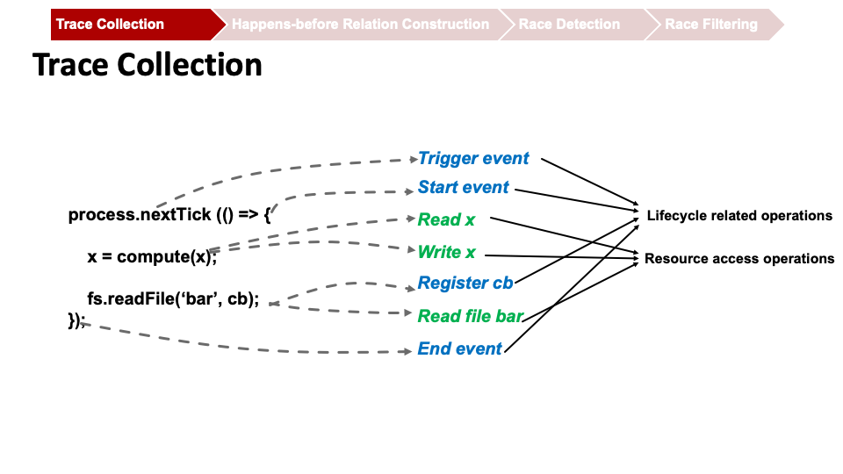
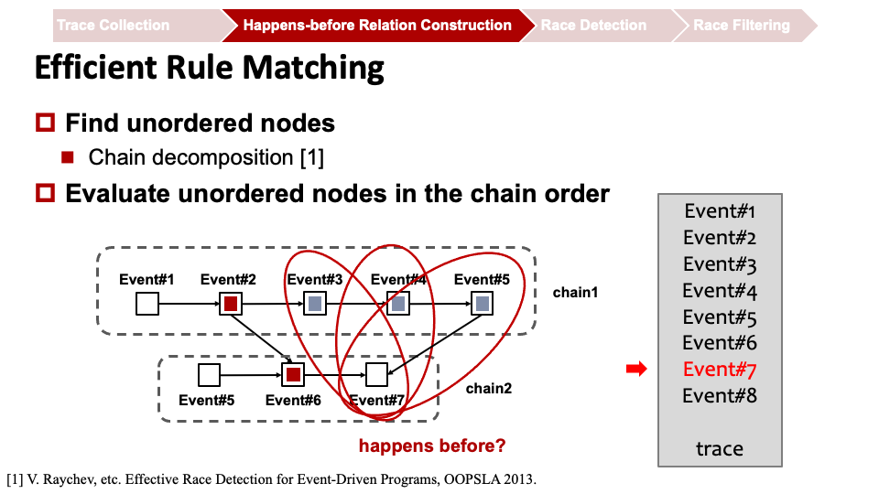
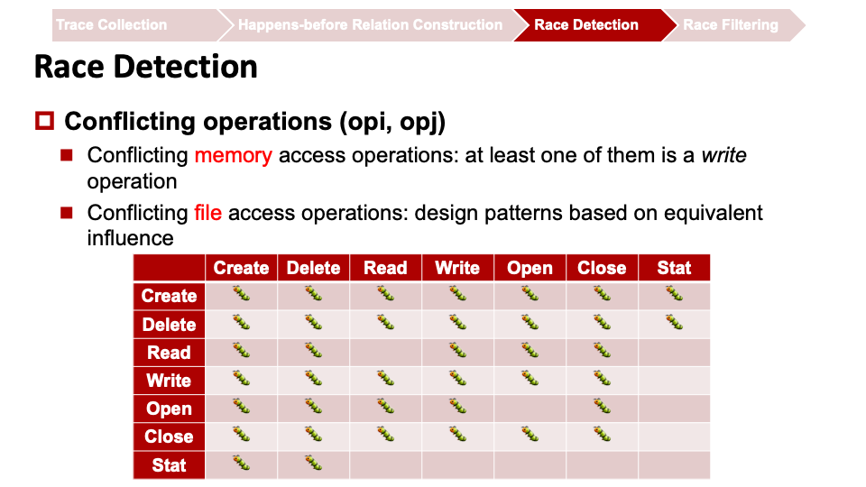
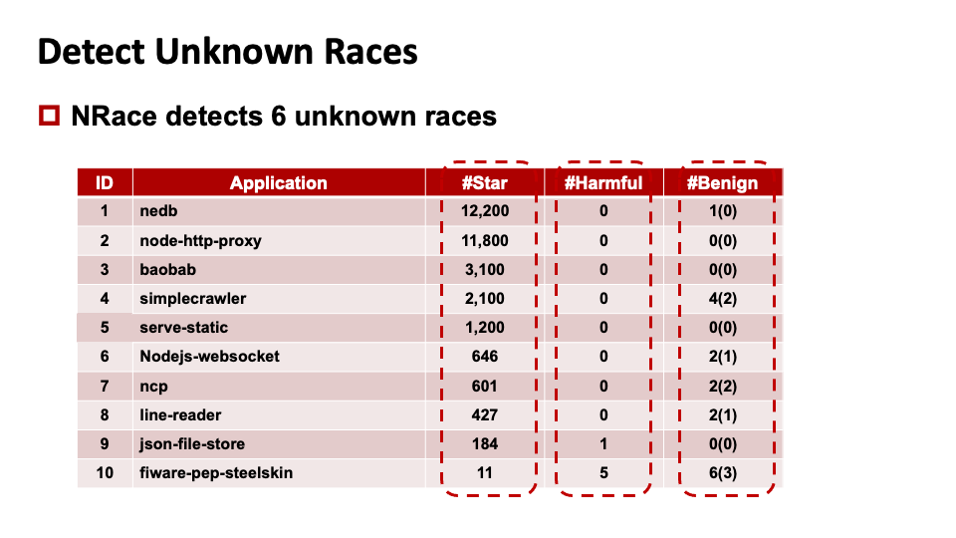
Summary

Slide 34

THANK YOU!

