Slide 1

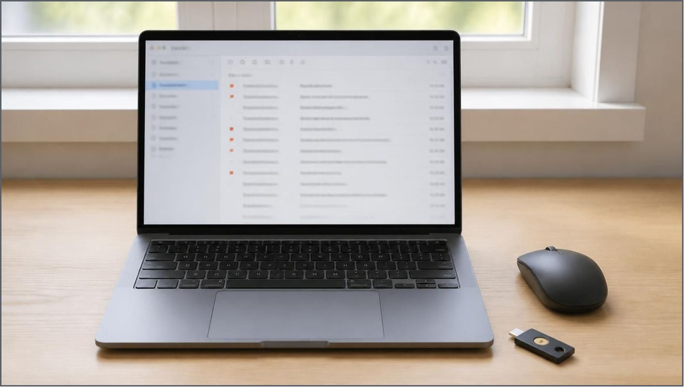
SECURITY BRIEFING
Phishing Awareness Training: Defending Against Cyber Deception
fig. 1 — workstation audit & threat mitigation log
Created by Mayuresh Changde | CodeAlpha Cybersecurity Internship

Slide 2

MODULE
01
Understanding the Threat
Phishing is a cyber attack where criminals impersonate trusted organizations to steal sensitive information like passwords or financial data.
How to Recognize It: Look for generic greetings, unexpected attachments, spelling errors, and mismatched sender email addresses.
specimen A · deceptive perimeter breach
!
02

Slide 3
VECTOR
ANALYSIS
How Attackers Manipulate You
Cybercriminals use psychological manipulation, known as social engineering, to trick users into making security mistakes.
TACTIC 01
TACTIC 02
TACTIC 03
Urgency & Fear: "Your account will be permanently deleted in 24 hours!"
Authority: Impersonating a manager or IT department asking for an urgent transfer.
Curiosity: "Click here to see a leaked photo."
mindset →
Analysis of social engineering vectors: emotional triggers bypass critical verification.
03

Slide 4
Spot the Red Flags
Fake Sender: Notice when an email address does not match the official domain (e.g., @netflix-billing-update.net).
Malicious Link: Hovering over buttons often reveals strange URLs that do not go to the official website.
04

Slide 5

DEFENSE
PROTOCOL
How to Protect Yourself
Verify the Source: Never click unverified links. Navigate to the official website directly via your browser.
01
Enable 2FA: Turn on Two-Factor Authentication on all important accounts for an extra layer of security.
02
Think Before You Click: Slow down and verify requests for sensitive data, even if it looks familiar.
protocol · verified authenticators
03
safe steps →
05

Slide 6
EXAM
Test Your Knowledge
CASE 01
You receive an urgent SMS from your bank saying your card is blocked, with a link to 'http://bank-secure-login.info/unblock'. What is your next step?
Option A: Click the link to unblock the card immediately.
Option B: Reply to the SMS asking for more details.
Option C: Ignore the link, open your banking app, and call the official support number.
✓
Answer: C! Never click links in unexpected security alerts. Always verify independently.
06

