Slide 1
SPSS 기초 활용법 강의
사회조사분석
Department of Sociology
Yonsei Univ.
Changdong Oh

Slide 2
Contents
SPSS – What is it?
Weakness of SPSS
Data Handling input data, n/a cases, keep/drop/recode variables
Descriptive Statistics, Cross Tabulation
Correlation Analysis

Slide 3

SPSS
Statistical Package for Social Sciences

Slide 4
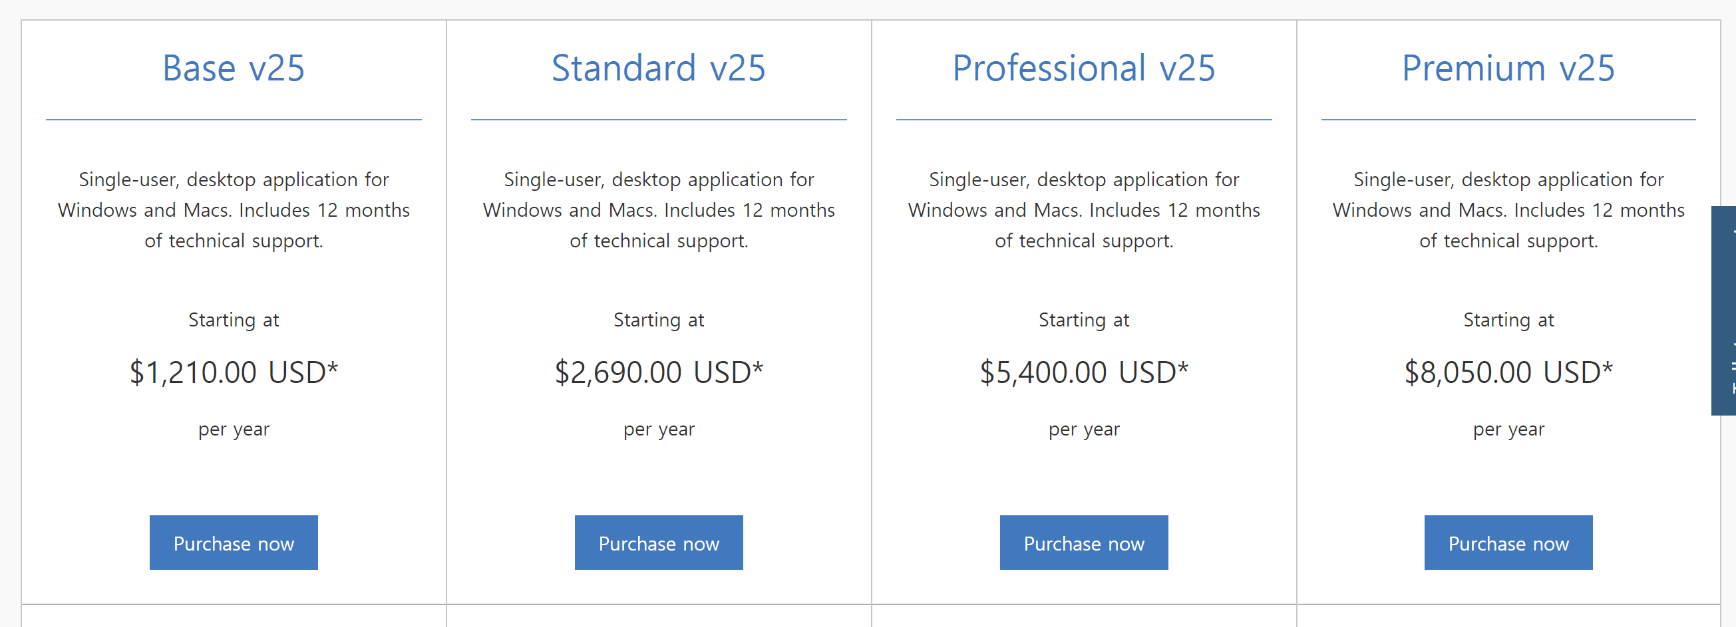
Weakness(or wickedness) of SPSS
Price

Slide 5
Weakness(or wickedness) of SPSS
Why do we need syntax-based statistical package?:
Replicability

Slide 6
Practice
Let’s start with practice data!

