Slide 1

(Rule based expert systems)

Slide 2
OUTLINE
ABSTRACT
EXPERT SYSTEM
CHARACTERISTICS OF EXPERT SYSTEM
SYSTEM ARCHITECTURE
MYCIN
RULE-BASED SYSTEM : MYCIN
FAILURE TO QUARRY
WHY EXPET SYSTEM
CAPABILITIES OF EXPERT SYSTEM
ADVANTAGES OF EXPERT SYSTEM
DISADVANTAGES OF EXPERT SYSTEM
APPLICATION OF EXPERT SYSTEM
CONCLUSION

Slide 3
ABSTRACT
Expert systems are a rapidly growing technology that use human expert knowledge to solve complex problems in many fields. They are computer programs that emulates the behavior of a human expert and represent knowledge as data or production rules. This paper gives an overview of this technology and discusses a survey on many papers done in health using expert system.

Slide 4
EXPERT SYSTEM
Knowledge based system
Part of artificial intelligence field
Computer programs that contain some subject-specific knowledge of one or more human experts
Made up of a set of rules that analyse user supplied information about a specific class of problems
System that utilise reasoning capabilities and draw conclusions.
:-DENDRAL(1967) determine molecule structure based on mass spectrograms
:-MYCIN(1976) diagnosis & therapy recommendation for blood disease
:-PROSPECTOR(1978) mineral exploration (found a $100M ore deposit)
:-XCON(1984) configure VAX and PDP-11 series computer systems (saved DEC $70M per year)

Slide 5
CHARACTERISTICS OF EXPERT SYSTEM
High Performance: The expert system provides high performance for solving any type of complex problem of a specific domain with high efficiency and accuracy.
Understandable: It responds in a way that can be easily understandable by the user. It can take input in human language and provides the output in the same way.
Reliable: It is much reliable for generating an efficient and accurate output.
Highly responsive: ES provides the result for any complex query within a very short period of time.

Slide 6
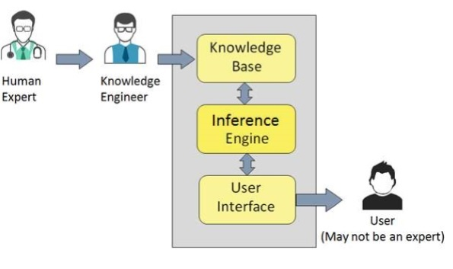
SYSTEM ARCHITECTURE
Usually expert system are rule based
-extract expert knowledge in the form of facts & rule
Fig1. System Architecture of Expert System

Slide 7
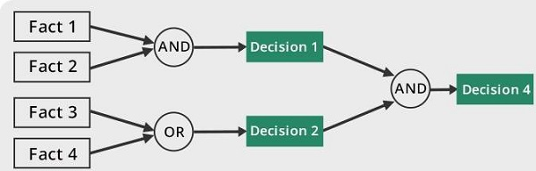
User interface
Inference Engine(Rule of Engines)
Two types
• Deterministic inference engine.
- The conclusions drawn from this type of inference engine are assumed to
be true .It is based on facts and rules.
• probabilistic Inference engine.
- This type of interface engine contains uncertainty in conclusions, and based
on the probability.
Interface engine used below modes to derive the solution.
‣ Forward Chaining: It starts from the known facts and rules, and applies the inference rules to add their conclusion to the known facts.
Fig2. forward Chaining

Slide 8
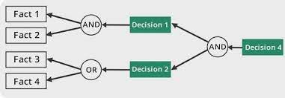
‣ Backward Chaining: It is a backward reasoning method that starts from the goal and works backward to prove the known facts.
Fig3. Backward Chaining
3.Knowledge base
Component of knowledge based
Factual Knowledge: The knowledge which is based on facts and accepted by
knowledge engineers comes under factual knowledge.
Heuristic Knowledge: This knowledge is based on practice, the ability to guess,
evaluation, and experiences.

Slide 9
MYCIN
•medical expert system for analysis of infection
•backward chaining rule-based expert system
-produces focused question
-easy to produce an user interface that needs only interpret
answer to specific question

Slide 10
RULE-BASED SYSTEM : MYCIN
IF: (1)the stain Of the organism is gram—positive, and
(2)the morphology of the organism is coccus, and
(3)the growth conformation of the organism is clumps,
THEN
there is suggestive evidence (0.7) that the identity of the organism is
Staphylococcus.
PREMISE :( SAND (SAME CNTXT GRAM GRAMPOS)
(SAME CNTXT MORPH COCCUS)
(SAME CNTXT CONFORM CLUMPS)
ACTION: (CONCLUDE CNTXT IDENT STAPHYLOCOCCUS TALLY .7)
MYCIN DAILOGUE

Slide 11
FAILURE TO QUARRY
‣The interpretation of failure as negation:
• i.e. Failure to prove query suggests it’s not true
• However, could also men the database was incomplete or inadequately maintained.
‣Under some circumstances, there is a possibility of infinity looping when attempting to retrieve missing information.
‣In these case:
•Necessary to apply terminating criteria that explicitly detect this and allow to fail gracefully

Slide 12
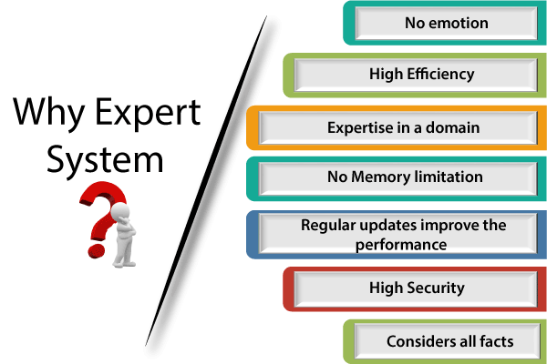

Slide 13
CAPABILITIES OF EXPERT SYSTEM
Advising
Provide decision-making capabilities
Demonstrate a device
Problem-solving
Explaining a problem
Interpreting the input
Predicting results
Diagnosis

Slide 14
ADVANTAGES OF EXPERT SYSTEM
These systems are highly reproducible.
They can be used for risky places where the human presence is not safe.
Error possibilities are less if the KB contains correct knowledge.
The performance of these systems remains steady as it is not affected by emotions, tension, or fatigue.
They provide a very high speed to respond to a particular query.

Slide 15
DISADVANTAGES OF EXPERT SYSTEM
The response of the expert system may get wrong if the knowledge base contains the wrong information.
Like a human being, it cannot produce a creative output for different scenarios.
Its maintenance and development costs are very high.
Knowledge acquisition for designing is much difficult.
For each domain, we require a specific ES, which is one of the big limitations.
It cannot learn from itself and hence requires manual updates.

Slide 16
APPLICATION OF EXPERT SYSTEM
In designing and manufacturing domain
In the knowledge
In the finance
In the diagnosis and troubleshooting of
Planning and Scheduling

Slide 17
CONCLUSION
We can summarize this discussion of certainty factors and rule-based systems as follows. The approach makes strong independence assumptions that make it relatively easy to use; at the same time assumptions create dangers if rules are not written carefully so that important dependencies are captured. The approach can serve as the basis of practical application programs. These systems use a knowledge base of medical information and algorithms to provide diagnoses, treatment recommendations, and other medical advice. They are particularly useful for routine tasks such as triaging patients, diagnosing common conditions, and monitoring vital signs. Rule-based expert systems have the potential to reduce errors, improve efficiency, and lower costs in healthcare. However, they are limited by their reliance on pre-determined rules and may not always be able to adapt to new information or unique patient situations.

Slide 18


