Slide 1
Project update
2026.1.31
Chang LIu

Slide 2
Main change
Optimizing Data Preprocessing
  New coastline source date update
  Centring → detrend → average transects value → Calculate mean for each coastline by month (remove monthly climatology) → Merge with SOI
  Better cross-correlation results, Choosing the lag time
Wavelet analysis / K-means
  Random linear noise interpolation
  Z-score
Add new climate index
  Pacific Decadal Oscillation(PDO), Indian Ocean Dipole(IOD)/ Dipole Mode Index (DMI), Southern Annular Mode (SAM), ZW3(Zonal Wave 3)

Slide 3
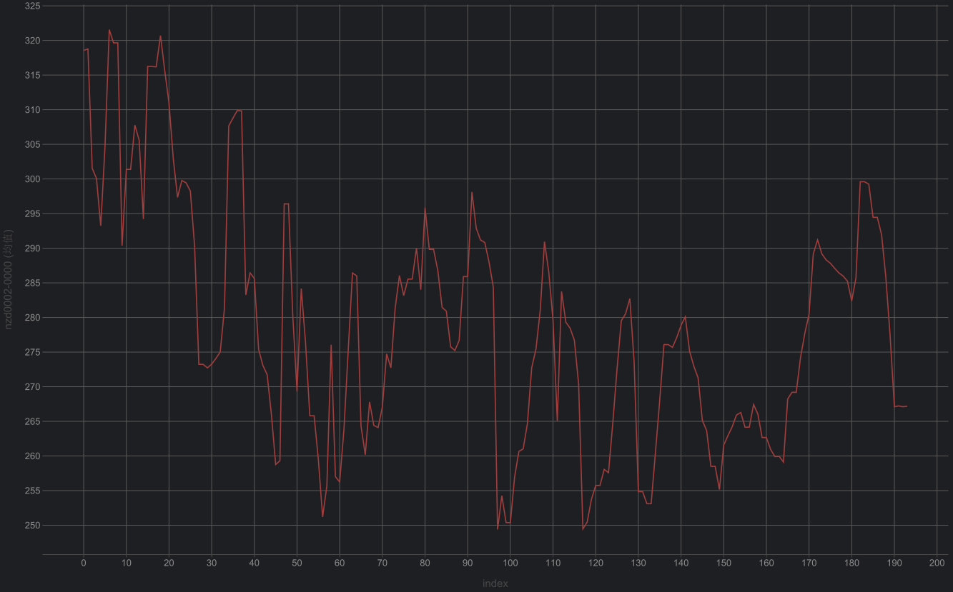
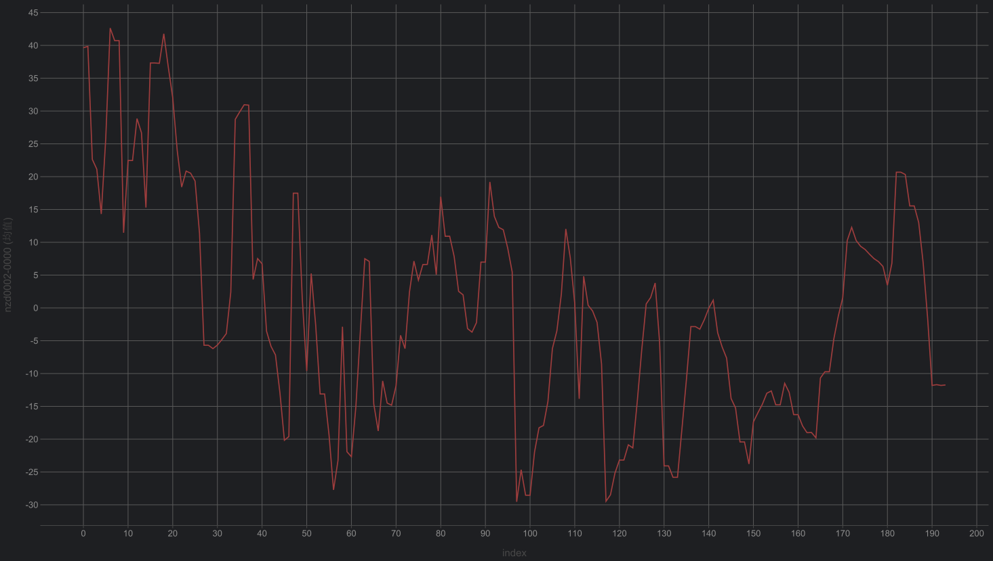
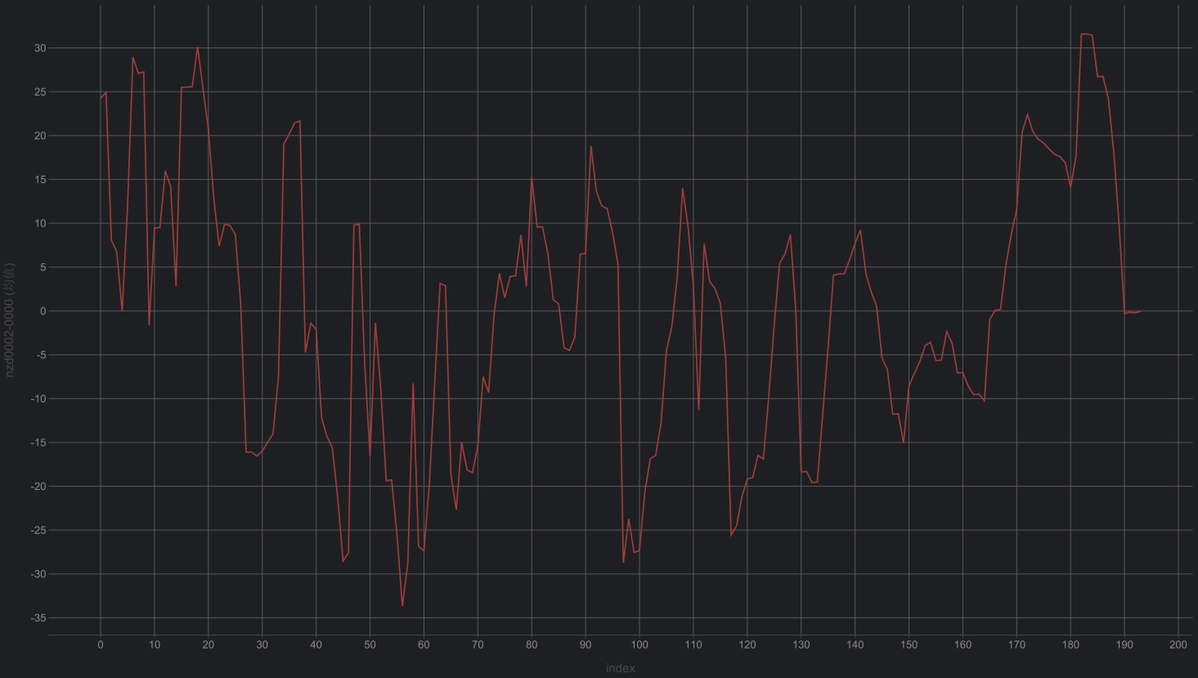
Optimizing Data Preprocessing
Raw
detrend
Centring
Subtract the long-term over full period (2000-2025)
Coastline change data:
Transect time series tidally corrected smoothed
For example: nzd0002
Subtract the trend by year

Slide 4
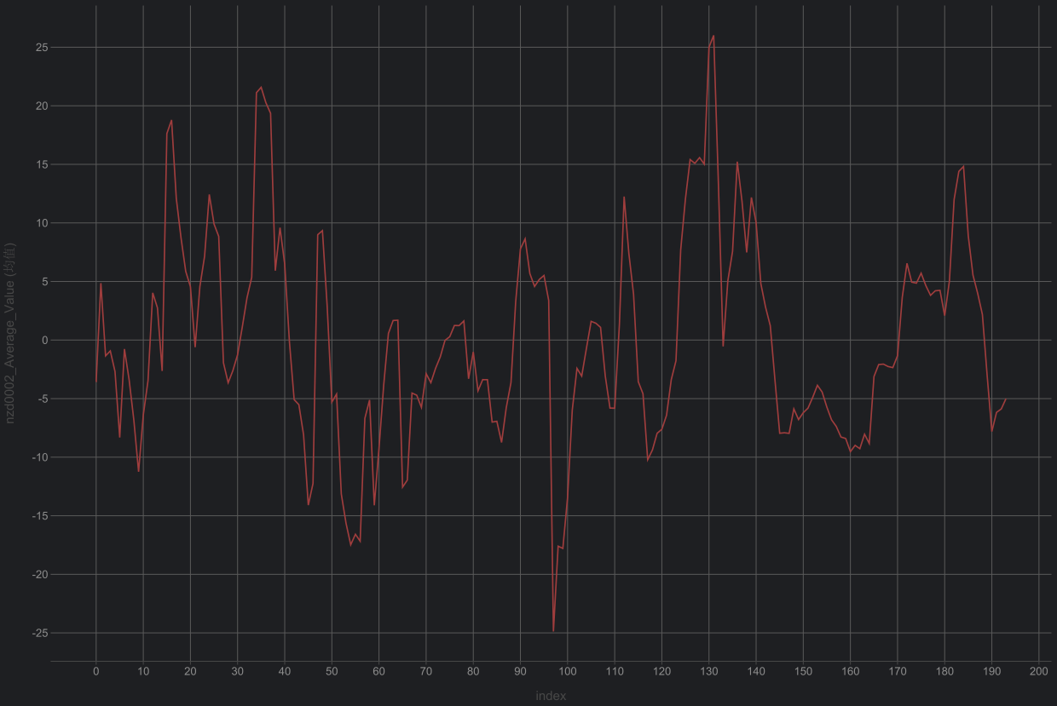
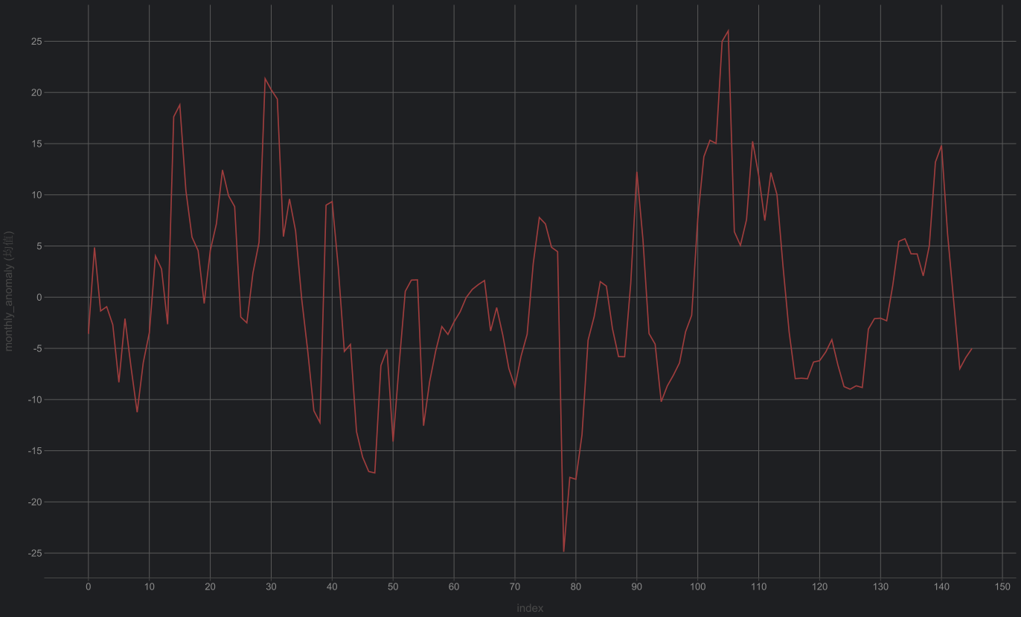
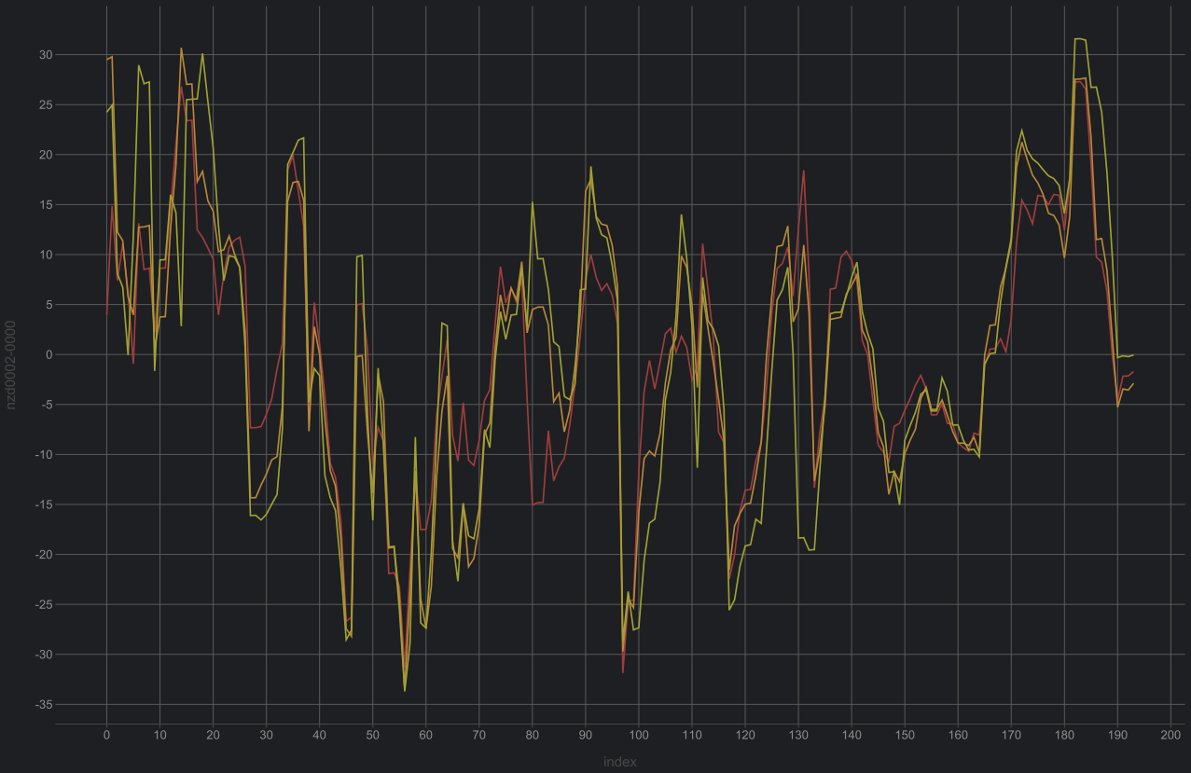
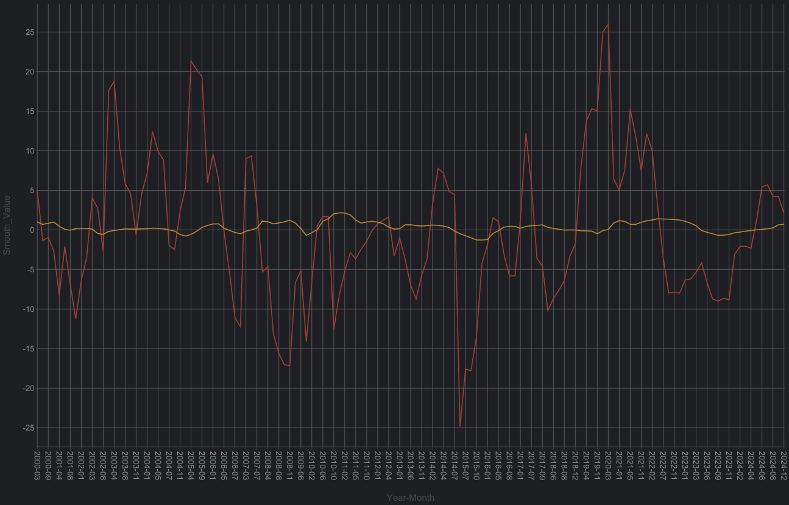
Optimizing Data Preprocessing
Average
transects
Merge
Mean by month
Average all transects for each coastline
Coastline change data:
Transect time series tidally corrected smoothed
For example: nzd0002
Get monthly data
no longer perform the climatology anomaly (de-seasonalization) step
three transects for nzd0002 coastline

Slide 5
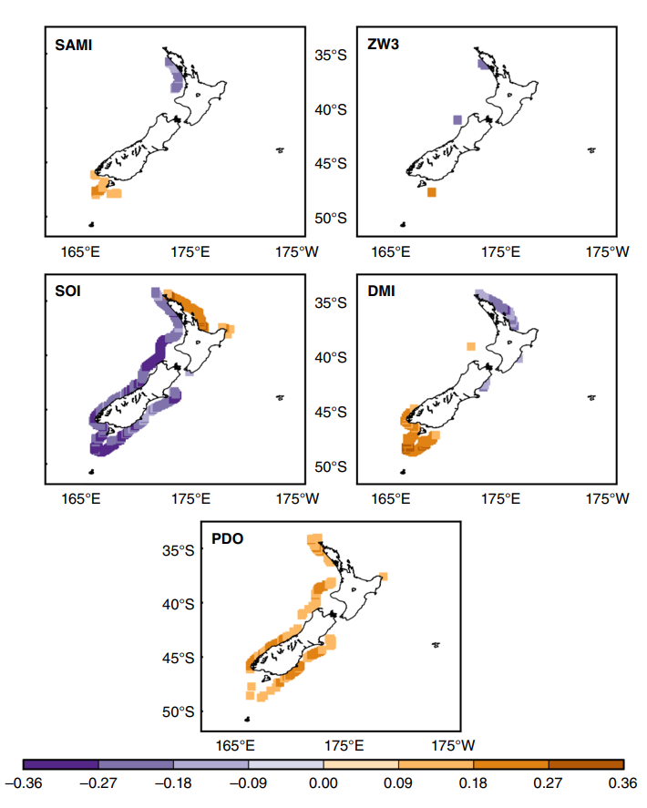
Cross-Correlation
This enhancement relative to non-lagged correlation is due to the time that teleconnected phenomena take to respond to the warming and cooling of the Indian and Pacific Oceans’ tropical waters. An example of this delayed response is the warming in the tropical Indian Ocean caused by the ENSO-related fluctuations, which takes approximately 3–6 months to occur
Cross-correlation
Reference:
Storm wave clustering around New Zealand and its connection to climatic patterns

Slide 6
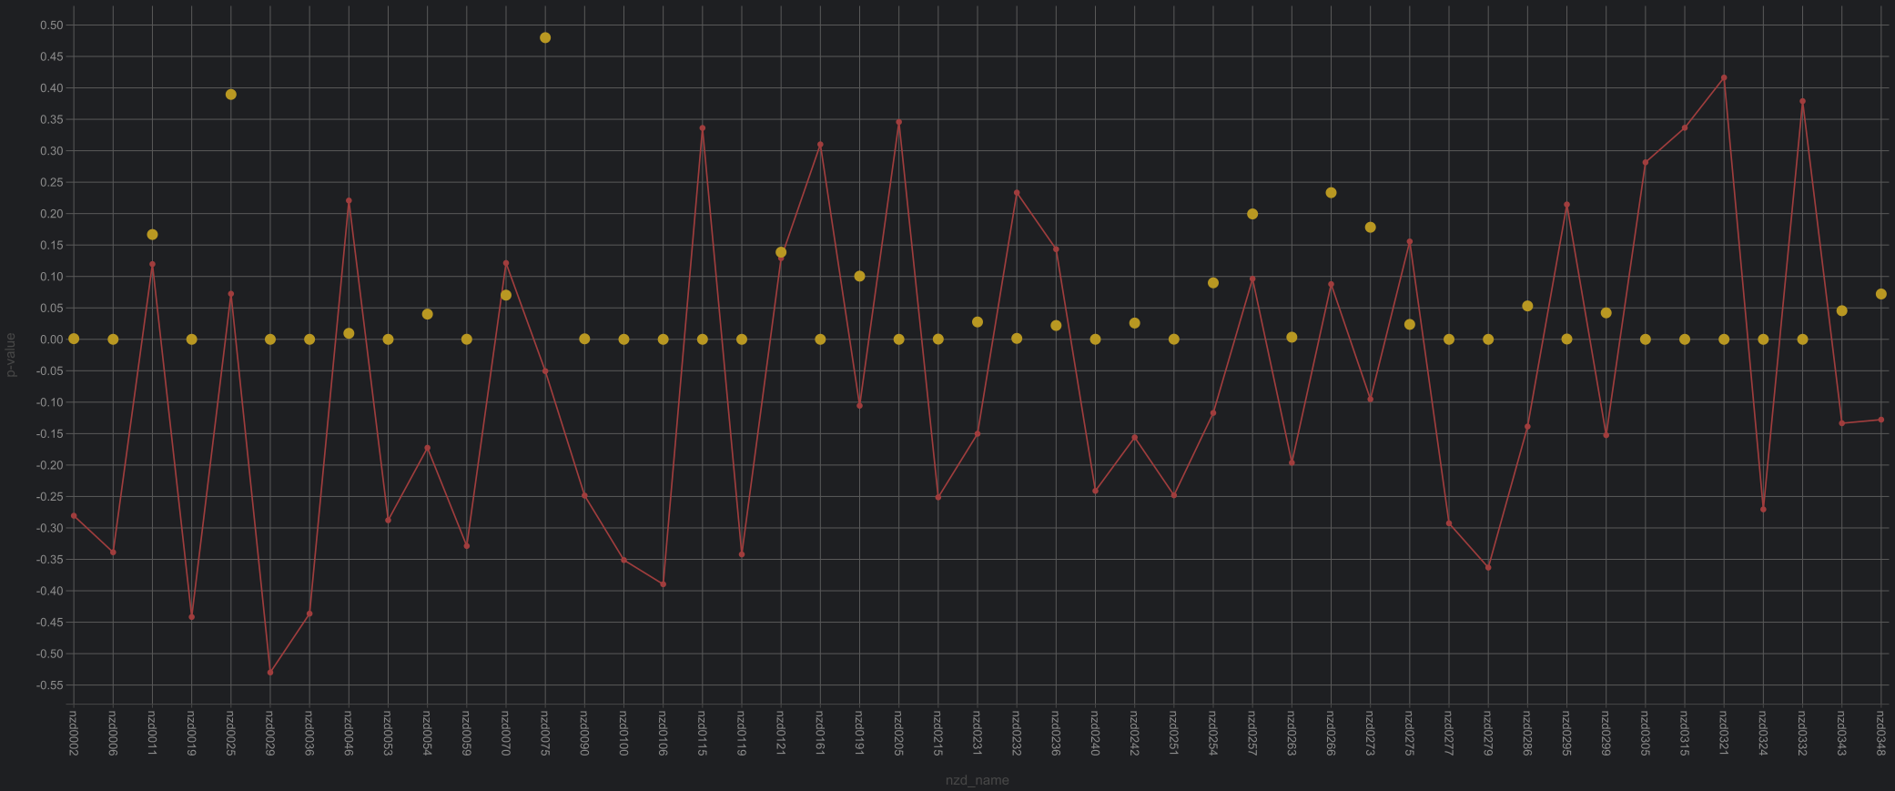
Cross-Correlation
Cross-correlation
Time lag: [2,6]
X: monthly coastal line
Y: smoothed soi value
Time period: 2000-2025
Results
Reference:
Storm wave clustering around New Zealand and its connection to climatic patterns
2000-2025

Slide 7
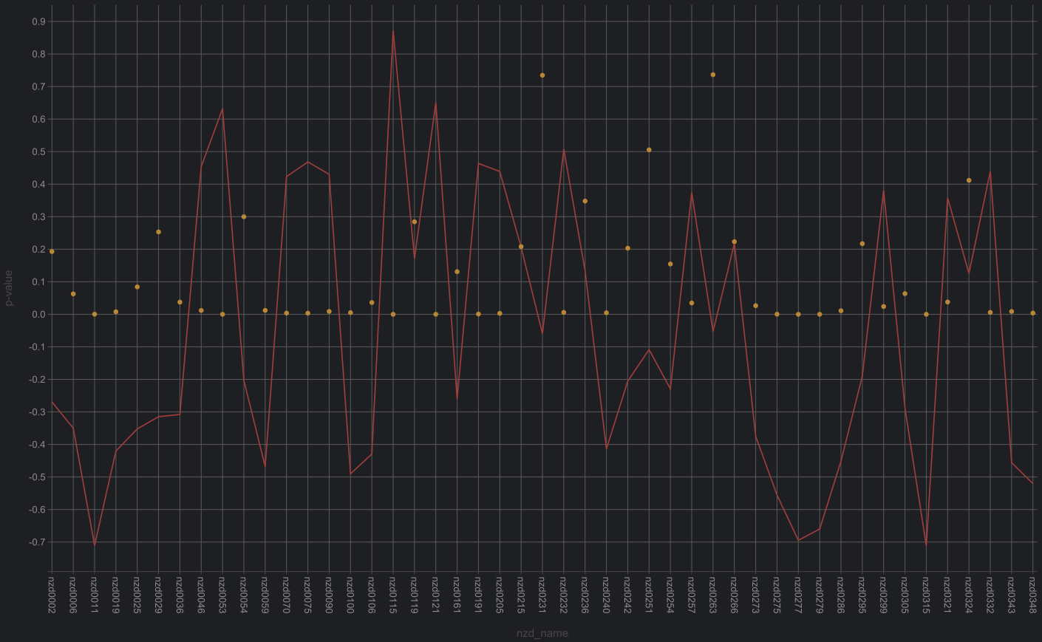
Cross-Correlation
Cross-correlation
Time lag: [2,6]
X: monthly coastal line
Y: smoothed soi value
Time period: 2010-2014 (La Nina)
Results
Reference:
Storm wave clustering around New Zealand and its connection to climatic patterns
2010-2014

Slide 8
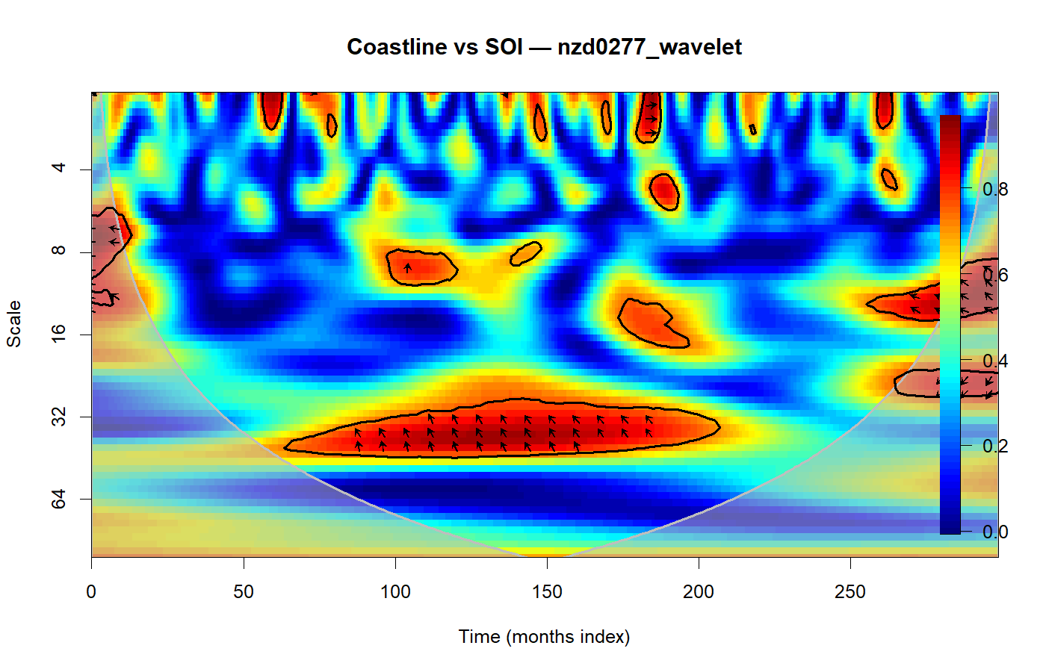
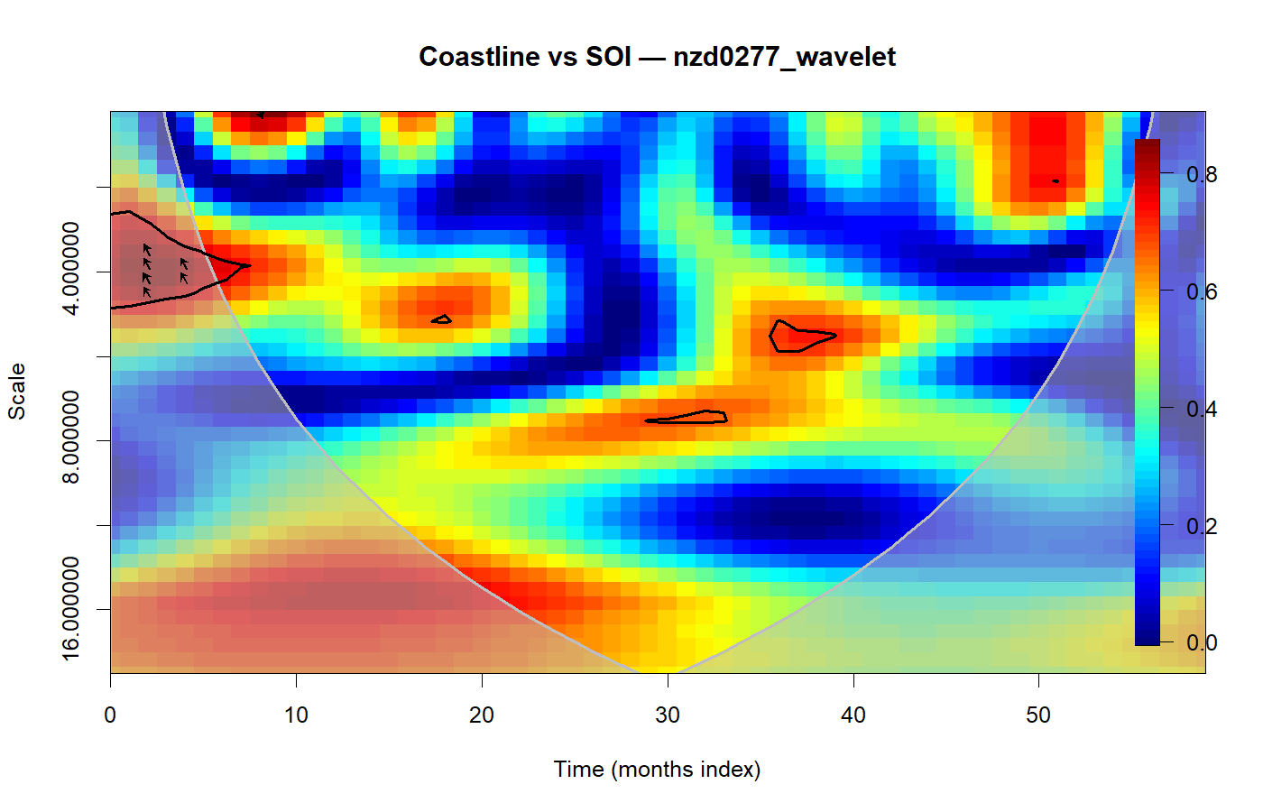
K-means /
Wavelet analysis
Wavelet
Analysis （R）
Z-score
Interpolation
(random linear noise)
K-means
Key-step: Z-score/Interpolation
SOI value without smoothing when wavelet analysis
Source data for analysis
Result (2000-2025)
Result (2010-2014)
Only consider the Rising and falling mode, neglect the amplitude of variation
2000-2025
2010-2014

Slide 9
Climate index
SOI (Southern Oscillation Index)：the sea-level pressure difference between Tahiti and Darwin to track ENSO’s atmospheric state—negative values typically indicate El Niño and positive values indicate La Niña. Eastern Pacific pressure. Western Pacific pressure (Restandardized)
PDO: A decadal-scale “warm vs. cool” sea-surface temperature pattern in the North Pacific that shifts climate and rainfall patterns.
IOD/DMI: Measures the west–east sea-surface temperature contrast in the Indian Ocean (quantified by DMI), shaping monsoon strength and rainfall. SST′(Western Indian Ocean) − SST′(Southeastern/Eastern Indian Ocean)
SAM: Tracks how the Southern Hemisphere westerly wind belt strengthens and shifts north–south, affecting storm tracks and weather/ocean conditions.
ZW3: A Southern Ocean/Antarctic circulation pattern with three repeating ridges and troughs around the hemisphere, influencing winds and regional climate.
Data source:
SOI: https://www.ncei.noaa.gov/access/monitoring/enso/soi
PDO: https://www.data.jma.go.jp/tcc/tcc/products/elnino/decadal/pdo_month.html
IOD (DMI): https://www.jamstec.go.jp/aplinfo/sintexf/iod/dipole_mode_index.html
SAM:
http://www.nerc-bas.ac.uk/icd/gjma/sam.html
ZW3: https://data.mendeley.com/datasets/382gmc8937/1

Slide 10
Climate index
SOI (Southern Oscillation Index)：
the sea-level pressure difference between Tahiti and Darwin to track ENSO’s atmospheric state—negative values typically indicate El Niño and positive values indicate La Niña. Eastern Pacific pressure. Western Pacific pressure (Restandardized)
PDO (Pacific Decadal Oscillation):
A decadal-scale “warm vs. cool” sea-surface temperature pattern in the North Pacific that shifts climate and rainfall patterns.
IOD/DMI (Indian Ocean Dipole):
Measures the west–east sea-surface temperature contrast in the Indian Ocean (quantified by DMI), shaping monsoon strength and rainfall. SST′(Western Indian Ocean) − SST′(Southeastern/Eastern Indian Ocean)
SAM (Southern Annular Mode):
Tracks how the Southern Hemisphere westerly wind belt strengthens and shifts north–south, affecting storm tracks and weather/ocean conditions.
ZW3 (Zonal Wave 3):
A Southern Ocean/Antarctic circulation pattern with three repeating ridges and troughs around the hemisphere, influencing winds and regional climate.
Data source:
SOI: https://www.ncei.noaa.gov/access/monitoring/enso/soi
PDO: https://www.data.jma.go.jp/tcc/tcc/products/elnino/decadal/pdo_month.html
IOD (DMI): https://www.jamstec.go.jp/aplinfo/sintexf/iod/dipole_mode_index.html
SAM:
http://www.nerc-bas.ac.uk/icd/gjma/sam.html
ZW3: https://data.mendeley.com/datasets/382gmc8937/1

