Slide 1
Project update
2026.1.31
Chang LIu

Slide 2
Main change
Optimizing Data Preprocessing
  New coastline source date update
  Centring → detrend → average transects value → Calculate mean for each coastline by month (remove monthly climatology) → Merge with SOI
  Better cross-correlation results, Choosing the lag time
Wavelet analysis / K-means
  Random linear noise interpolation
  Z-score
Add new climate index
  Pacific Decadal Oscillation(PDO), Indian Ocean Dipole(IOD)/ Dipole Mode Index (DMI), Southern Annular Mode (SAM), ZW3(Zonal Wave 3)

Slide 3
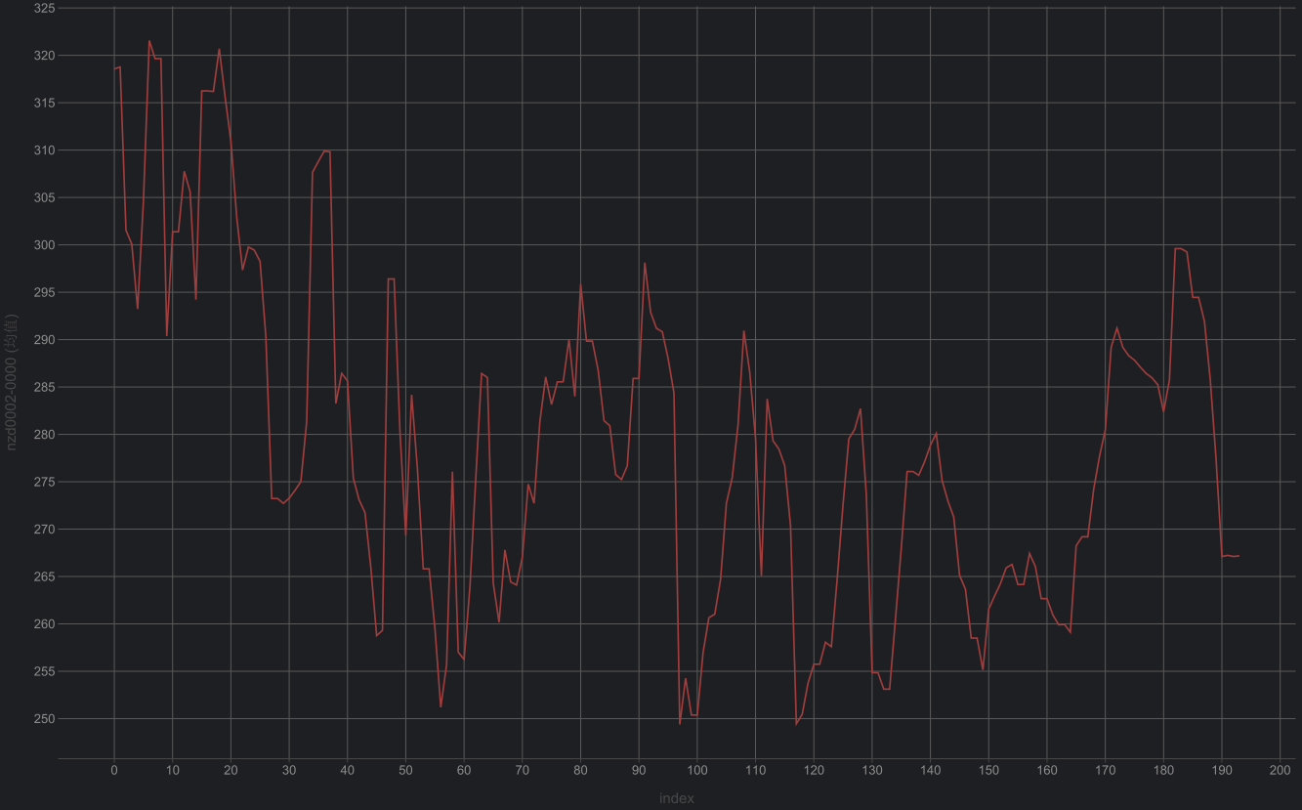
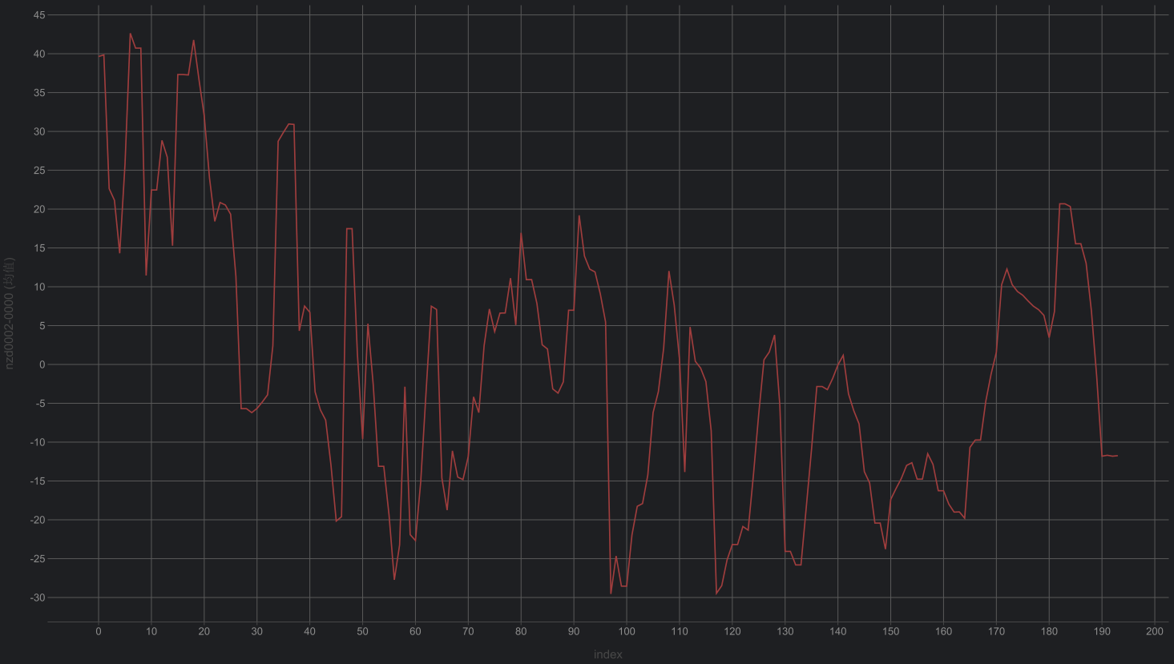
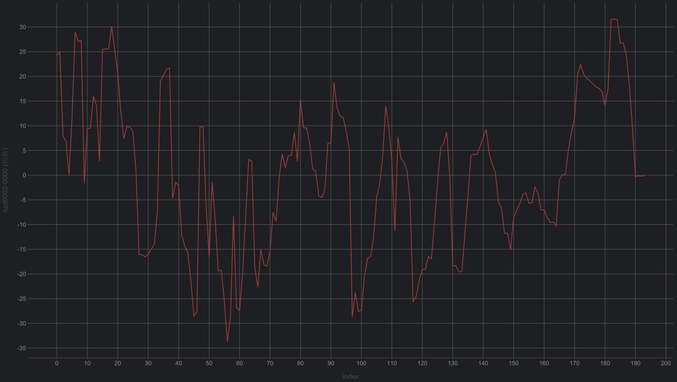
Optimizing Data Preprocessing
Raw
detrend
Centring
Subtract the long-term over full period (2000-2025)
Coastline change data:
Transect time series tidally corrected smoothed
For example: nzd0002
Subtract the trend by year

Slide 4
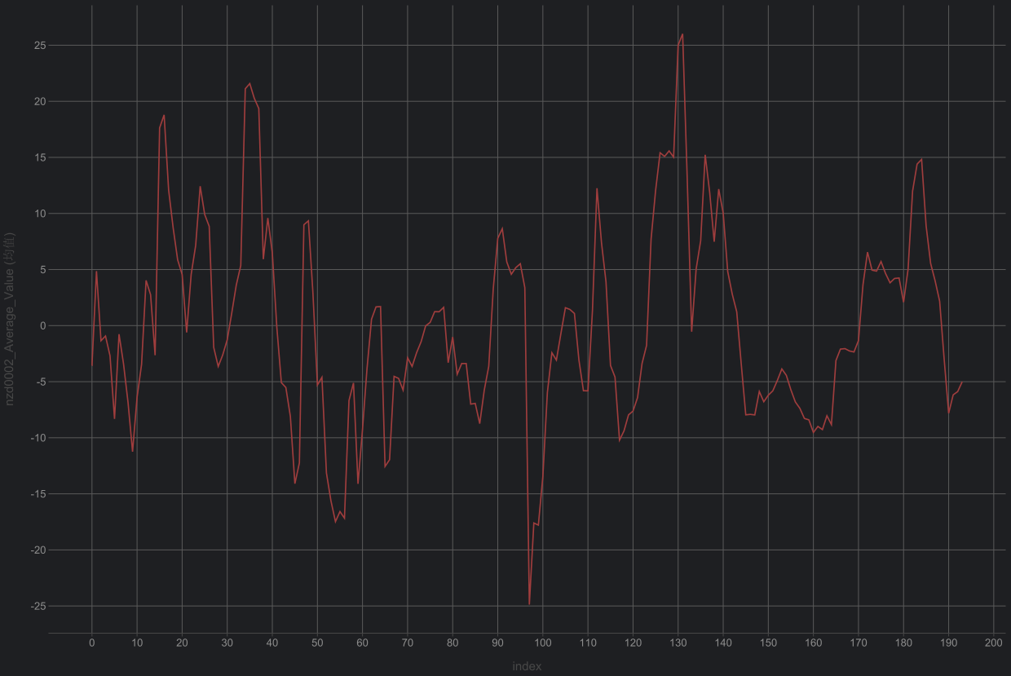
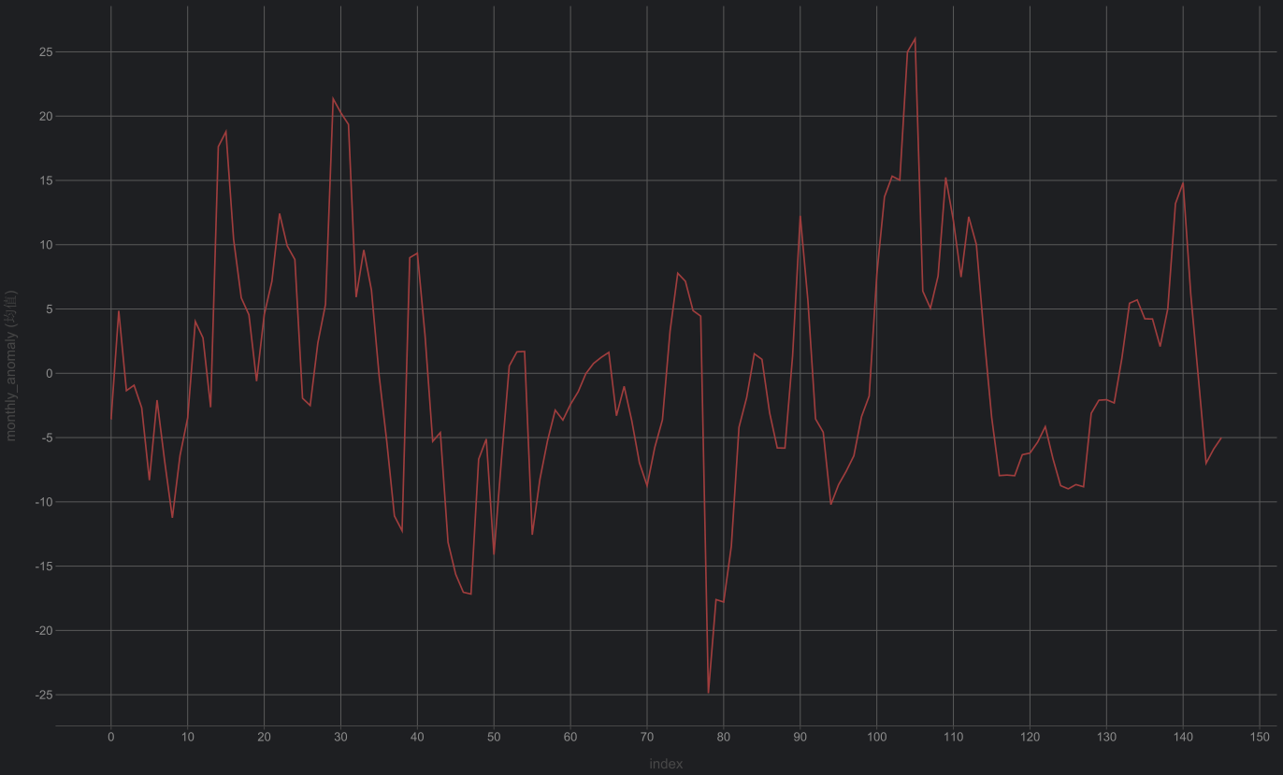
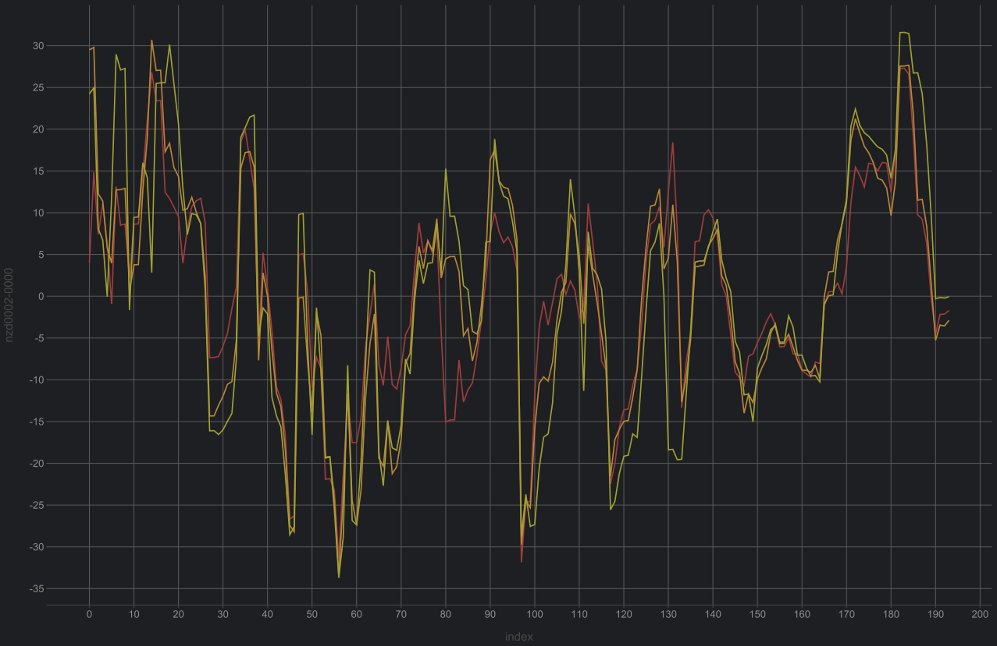
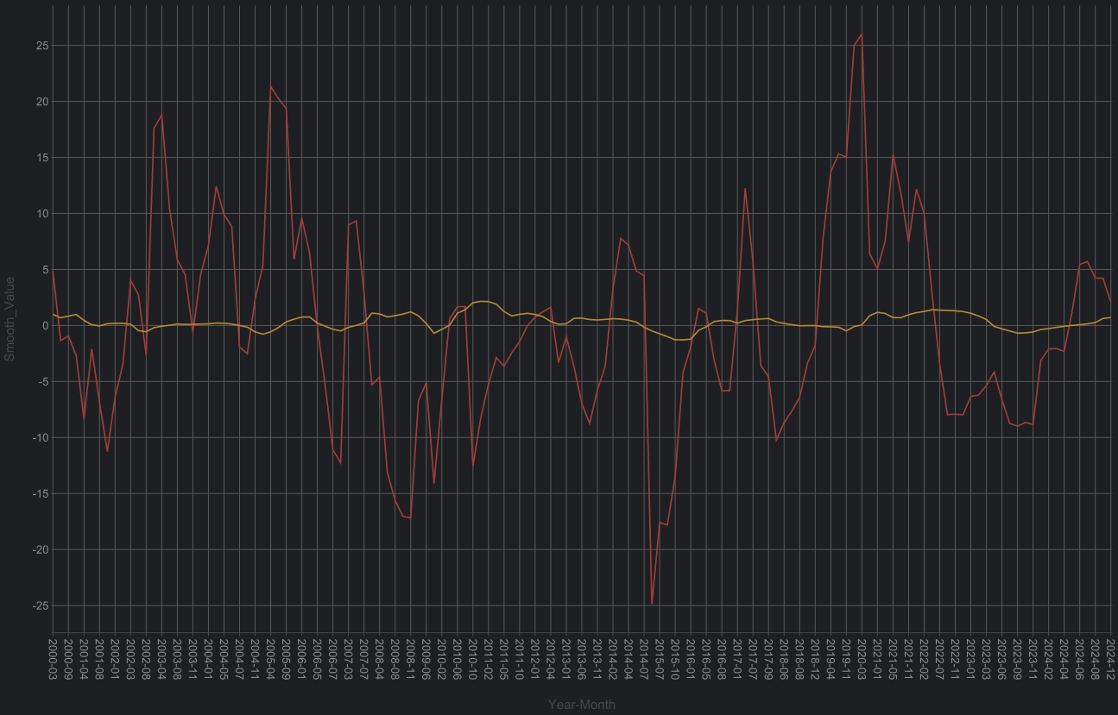
Optimizing Data Preprocessing
Average
transects
Merge
Mean by month
Average all transects for each coastline
Coastline change data:
Transect time series tidally corrected smoothed
For example: nzd0002
Get monthly data
no longer perform the climatology anomaly (de-seasonalization) step
three transects for nzd0002 coastline

Slide 5
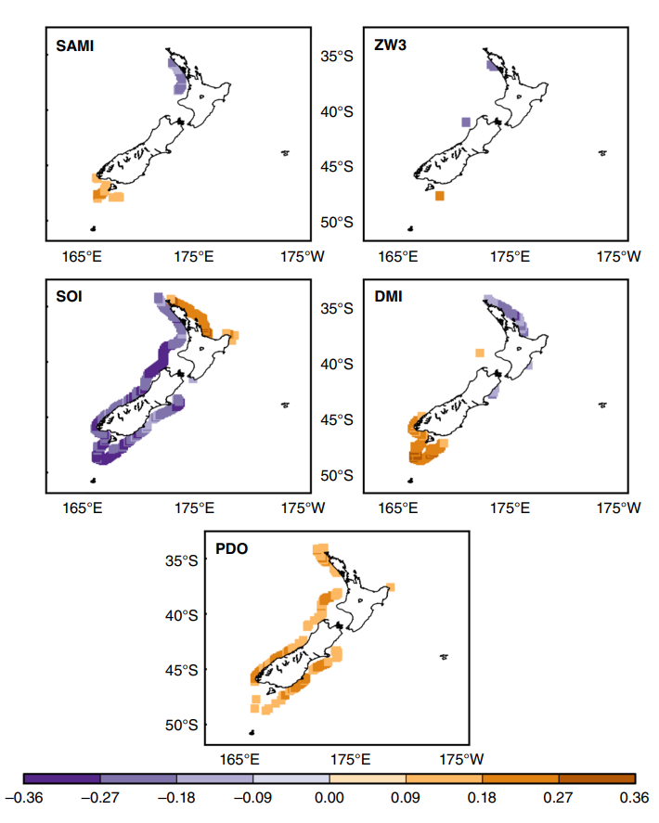
Cross-Correlation
This enhancement relative to non-lagged correlation is due to the time that teleconnected phenomena take to respond to the warming and cooling of the Indian and Pacific Oceans’ tropical waters. An example of this delayed response is the warming in the tropical Indian Ocean caused by the ENSO-related fluctuations, which takes approximately 3–6 months to occur
Cross-correlation
Reference:
Storm wave clustering around New Zealand and its connection to climatic patterns

Slide 6
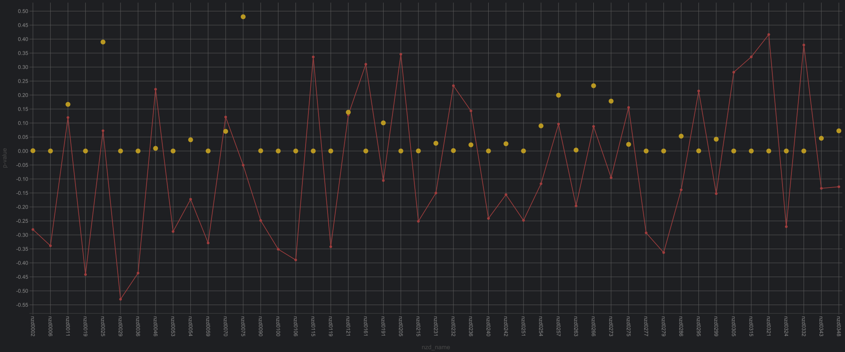
Cross-Correlation
Cross-correlation
Time lag: [2,6]
X: monthly coastal line
Y: smoothed soi value
Time period: 2000-2025/ 2010-2014(La nina)
Reference:
Storm wave clustering around New Zealand and its connection to climatic patterns
2000-2025

Slide 7
Cross-Correlation
Wavelet
K-means
Reference:
Storm wave clustering around New Zealand and its connection to climatic patterns

