Slide 1
Circuit Analysis and Design Academic year 2017/2018 – Semester 1 – tutorial 1
Qammer H. Abbasi, Francesco Fioranelli, Petros Karadimas, Majid Butt {qammer.abbasi, francesco.fioranelli, petros.karadimas, majid.butt}@glasgow.ac.uk
“A good student never steal or cheat”

Slide 2
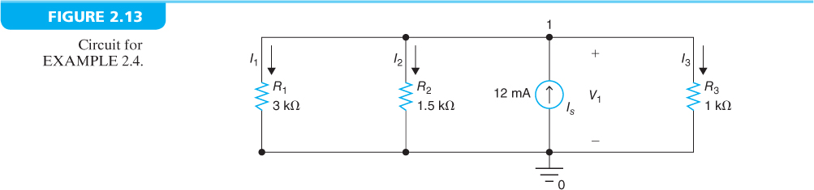
EXAMPLE 2.4
Find V₁, I₁, I₂, and I₃ in the circuit shown in Figure 2.13.
KCL: I_{s} = I₁ + I₂ + I₃ = V₁/R₁ + V₁/R₂ + V₁/R₃ = V₁(1/R₁ + 1/R₂ + 1/R₃)
I₁ = V₁/R₁ = 2 mA, I₂ = V₁/R₂ = 4 mA, I₃ = V₁/R₃ = 6 mA

Slide 3
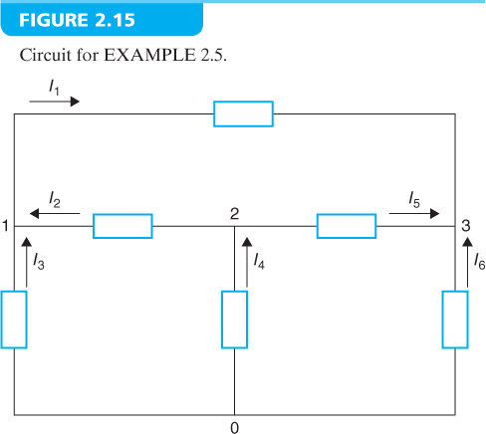
EXAMPLE 2.5
Given I₁ = 3 A, I₃ = 10 A, and I₆ = – 8 A, find I₂, I₄, and I₅ in the circuit shown in Figure 2.15.
KCL at node 1: I₂ + I₃ = I₁
I₂ = I₁ – I₃ = 3 A – 10 A = – 7 A
KCL at node 3: I₁ + I₅ + I₆ = 0
I₅ = – I₁ – I₆ = – 3 A – (– 8 A) = 5 A
KCL at node 2: I₄ = I₂ + I₅
I₄ = I₂ + I₅ = – 7 A + 5 A = – 2 A

Slide 4
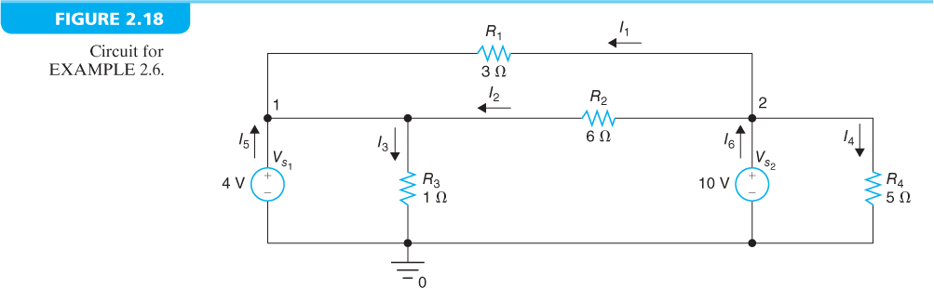
EXAMPLE 2.6
Find I₁, I₂, I₃, I₄, I₅, and I₆ in the circuit shown in Figure 2.18.
Ohm’s law: I₁ = (V_{s2} – V_{s1})/R₁ = 6 V/3 Ω = 2 A, I₂ = (V_{s2} – V_{s1})/R₂ = 6 V/6 Ω = 1 A,
I₃ = V_{s1}/R₃ = 4 V/1 Ω = 4 A, I₄ = V_{s2}/R₄ = 10 V/5 Ω = 2 A
KCL at node 1: I₅ = – I₁ – I₂ + I₃ = – 2 A – 1 A + 4 A = 1 A
KCL at node 2: I₆ = I₁ + I₂ + I₄ = 2 A + 1 A + 2 A = 5 A

Slide 5
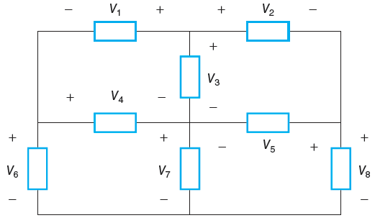
EXAMPLE 2.8
Given V₁ = 6 V, V₅ = 5 V, V₆ = 3 V, and V₇ = 7 V, find V₂, V₃, V₄, and V₈ in the circuit shown in Figure 2.23.
KVL around the mesh in the lower left:
– V₆ + V₄ + V₇ = 0, V₄ = V₆ – V₇ = 3 V – 7 V = – 4 V
KVL around the mesh in the lower right:
– V₇ – V₅ + V₈ = 0,
V₈ = V₅ + V₇ = 5 V + 7 V = 12 V
KVL around the mesh in the upper left:
– V₁ + V₃ – V₄ = 0, V₃ = V₁ + V₄ = 6 V – 4 V = 2 V
KVL around the mesh in the upper right:
– V₃ + V₂ + V₅ = 0
V₂ = V₃ – V₅ = 2 V – 5 V = – 3 V

Slide 6
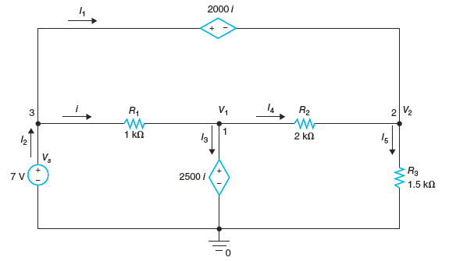
EXAMPLE 2.9
Find i, V₁, V₂, I₂, I₃, I₄, I₅ in the circuit shown in Figure 2.25.
KVL around the mesh in the lower left: – V_{s} + R₁i + 2500i = 0 or – 7 + 1000i + 2500i = 0
i = 7/3500 A = 1/500 A = 2 mA, V₁ = 2500i = 2500 × 0.002 V = 5 V
KVL around the outside loop:
– V_{s} + 2000i + V₂ = 0
V₂ = V_{s} – 2000i = 7 – 2000 × 0.002 = 3 V
Ohm’s law:
I₄ = (V₁ – V₂)/R₂ = 2 V/2000 Ω = 1 mA
I₅ = V₂/R₃ = 3 V/1500 Ω = 2 mA
KCL at node 1: I₃ = i – I₄ = 1 mA
KCL at node 2: I₁ = I₅ – I₄ = 1 mA
KCL at node 3: I₂ = I₁ + i = 3 mA

Slide 7
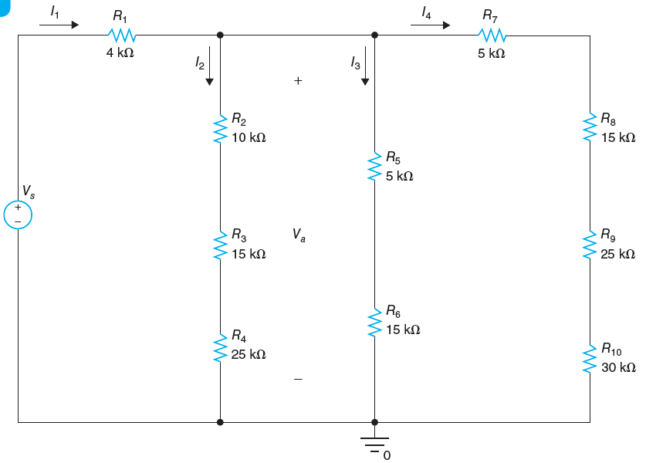
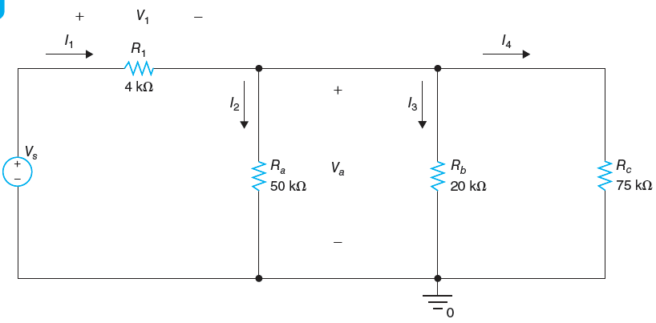
EXAMPLE 2.10
Given I₃ = 750 μA, find V_{a}, I₂, I₄, I₁, V_{s} in the circuit shown in Figure 2.31.
R_{a} = R₂ + R₃ + R₄ = 50 kΩ, R_{b} = R₅ + R₆ = 20 kΩ, R_{c} = R₇ + R₈ + R₉ + R₁₀ = 75 kΩ
V_{a} = R_{b}I₃ = 15 V, I₂ = V_{a}/R_{a} = 0.3 mA, I₄ = V_{a}/R_{c} = 0.2 mA, I₁ = I₂ + I₃ + I₄ = 1.25 mA
V₁ = R₁I₁ = 5 V, V_{s} = V₁ + V_{a} = 20 V
Figure 2.32 shows simplified circuit.

