Slide 1
第二章 时域中的离散时间信号
离散时间信号的时域表示－－序列
离散时间信号的计算－－移位，翻褶，加法，乘法，差分，卷积
典型的离散时间信号－－δ[n]，μ[n], sinω₀n，e^{jω0n}（后两种序列的周期性确定）

Slide 2
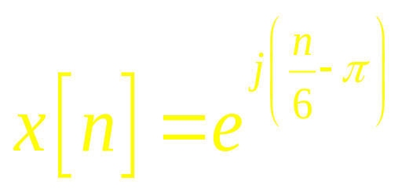
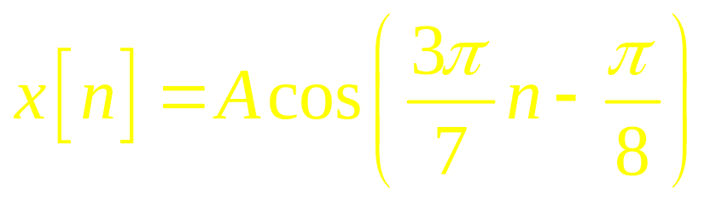
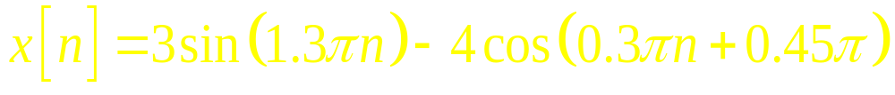
第一类题：序列周期的确定
Are the following sequences periodic? If the answer is positive, determine the fundamental period for each sequence.
a) b)
c)

Slide 3
第三章 DTFT
DTFT的定义－－坐标为e^{jωn}的幂级数
DTFT的性质：对称性和一般性质
典型序列的DTFT的计算，常见变换对
采样及恢复
带通采样

Slide 4
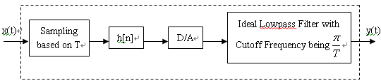
第二类题：信号采样
In practice，digital filters are often used to process analog signal. The processing procedure is shown as following figure, where T denotes sampling interval，and satisfies Nyquist Theorem. And we can regard it as an equivalent analog filter.
If the digital filter h[n] is a bandpass filter with the cutoff frequencies ω_{c1}=π/6,ω_{c2}=π/3, 1/T=15kHz，give the cutoff frequency f_{c1} and f_{c2} of the equivalent analog filter.

Slide 5
第四章 离散时间系统
离散时间滤波器的分类：线性，时不变，因果，稳定
冲激响应：简单的系统互联关系等
LTI离散时间系统的时域特点：输入输出关系，稳定要求等
有限维LTI离散时间系统：求解方案
LTI离散时间系统的频域表示：频率响应
相位延迟及群延迟

Slide 6
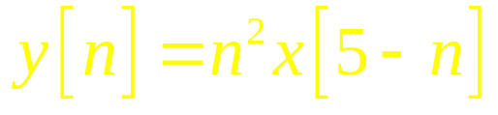
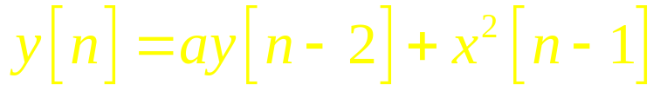
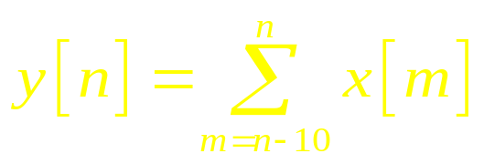
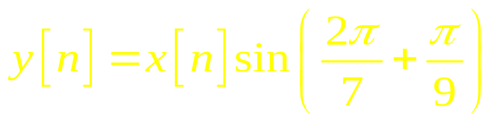
第三类题：系统性能的判定
For each of the following discrete-time systems, where y[n] and x[n] are, respectively, the output and the input sequences, determine whether or not each system is (1)linear, (2)causal, (3)stable, (4)shift-invariant:
a) b)
c) d)

Slide 7
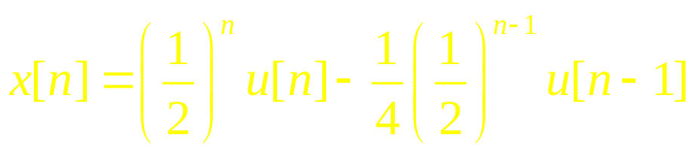
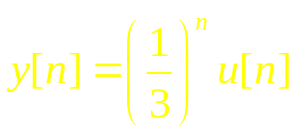
第四类题：系统响应计算
If a discrete-time LTI system’s input is
The output is
Try to find out the impulse response and frequency response of the system，and give its input-output relation (difference equation).

Slide 8
第五章 DFT和FFT
DFT的定义－－与DFS对应理解
DFT的性质
线性卷积和圆周卷积的关系
DFT的工程计算－－实序列DFT计算
FFT的思想－－DIT FFT和DIF FFT

Slide 9
第五类题：DTFT，DFT计算
Let x[n] = δ[n] + δ[n+1],
a) Determine the DTFT of x[n].
b) Determine and sketch the magnitude and phase spectrum of x[n].
c) Calculate the 4-point DFT of x[n].

Slide 10
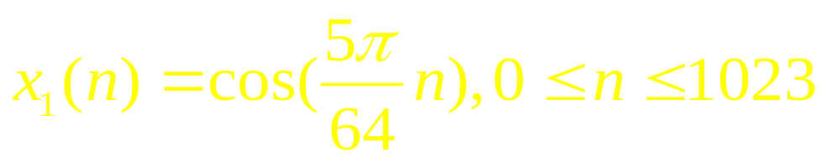
第六类题：DTFT，DFT计算
Give the DTFT of the following sequences:
x₁[n] = 3 – (1/3)^{n}, |n| ≤ 3;
x₂[n] = a^{n}[μ[n] – μ[n-N]];
Known ， its 1024-
point DFT is wanted.

Slide 11
第七类题：DTFT、DFT的性质
A 498-point DFT X[k] of a real sequence x[n] has the following samples: X[0]=2, X[11]=7+j3, X[k1]=-2-j, X[112]=3-j0.7, X[k2]=-4+jα, X[249]=3, X[309] = -4 - j2, X[386]=3+j0.7, X[412]=-2+jβ, and X[487]=7-j3. The values of remaining DFT samples are assumed to be zero.
a) Determine the values of the indices k1 and k2.
b) Determine the values of α and β.
c) Determine and x[249].
d) Determine the energy of x[n].

Slide 12
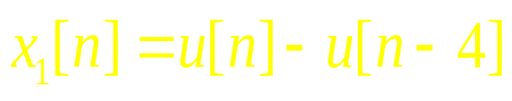
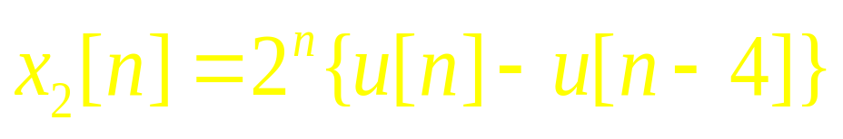

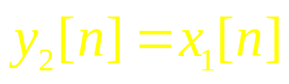
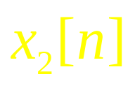
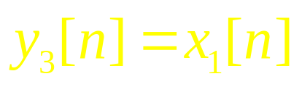
第八类题：圆周卷积和线性卷积
For the following two sequences:
,
Let (linear convolution),
4 (circle convolution), sketch y₁[n], y₂[n].
For L , determine the value of L to guarantee y₁[n]=y₃[n].

