Slide 1
Queue
Dr. Seung Chul Han
Dept. Computer Engineering
Myongji University

Slide 2

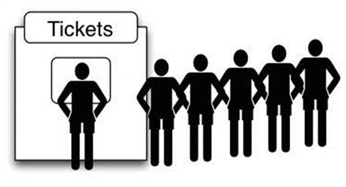
Queue
0개 이상 원소를 save/retrieve
FIFO(First In First Out)

Slide 3
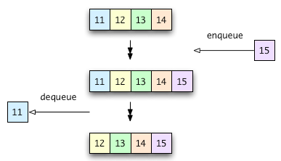
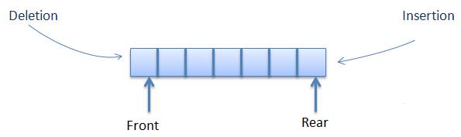
Queue Functions
Functions
Queue queueCreate( )
Boolean enqueue(queue, item)
Element dequeue(queue)
Boolean IsFull(queue)
Boolean IsEmpty(queue)

Slide 4
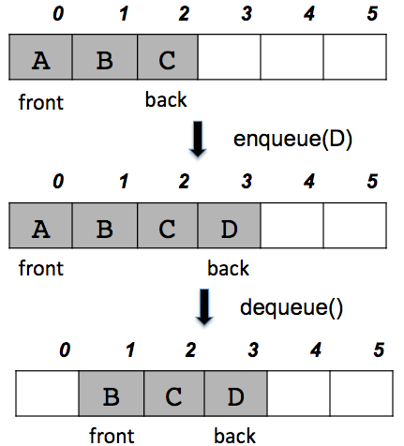
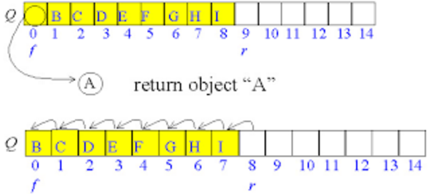
Queue Implementation 1 : ARRAY
Array로 구현해 볼까
Memory 문제점 발생!

Slide 5
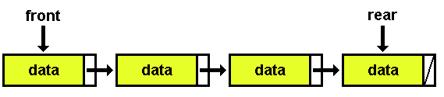
Queue Implementation 2 : Linked List
다음 queue functions을 구현해보자
Boolean enqueue(queue, item)
Element dequeue(queue)
Boolean IsFull(queue)
Boolean IsEmpty(queue)

Slide 6
Queue Implementation 3 : Double Linked List
Deque (double-ended queue)
양방향으로 enqueue/dequeue 가능
enqueueFront(queue, item), dequeueFront(queue), enqueueRear(queue, item), dequeueRear(queue)

Slide 7
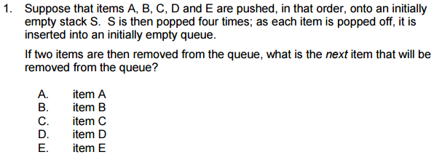
Quiz. http://www.fas.harvard.edu/~cscie119

Slide 8
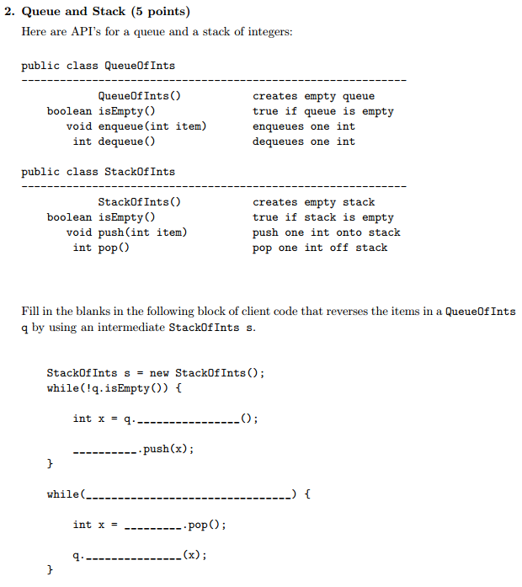
Quiz. http://www.cs.princeton.edu/courses

Slide 9
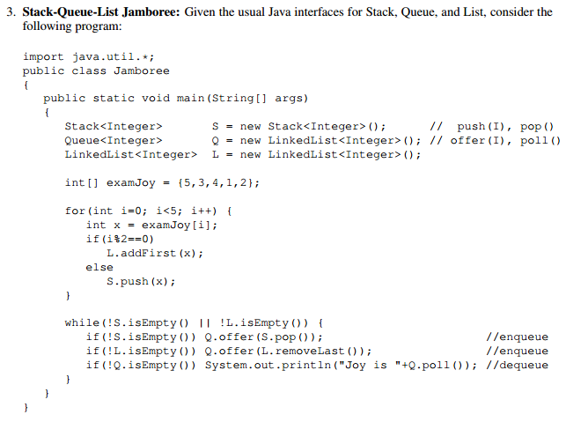
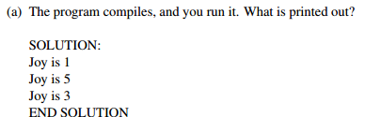
Quiz. http://www.cs.cornell.edu/courses/cs2110

Slide 10
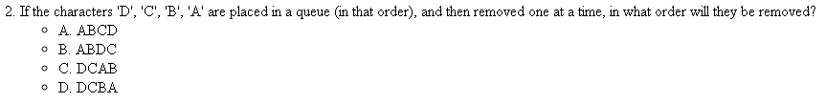
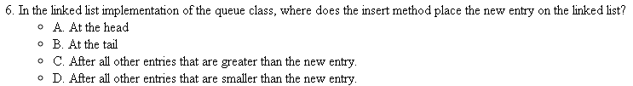
Quiz. https://www.cs.colorado.edu

