Slide 1
Tree
Dr. Seung Chul Han
Dept. Computer Engineering
Myongji University

Slide 2
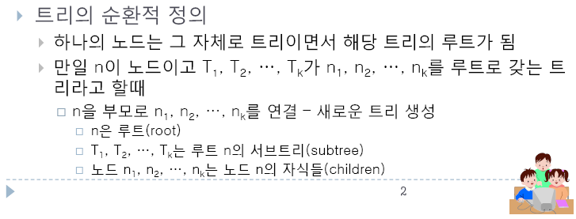
Tree
계층형 자료구조 (hierarchical data structure)
용어
- Node/Edge, Root, Parent/Child, Siblings, Ancestor/Descendant, Leaf/Internal node, Level, Height/Depth, Degree (차수), Subtree

Slide 3
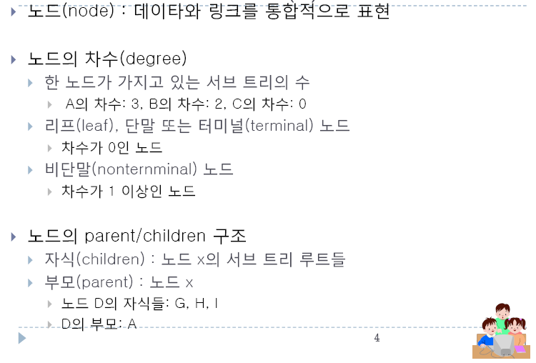
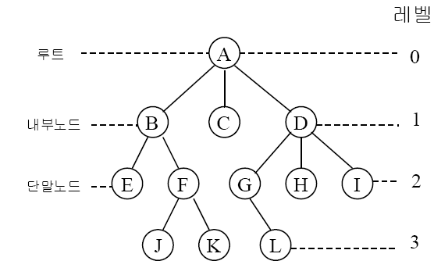
용어

Slide 4
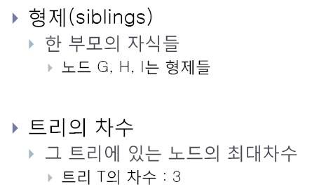
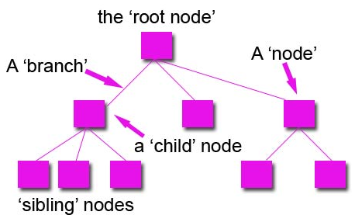
용어

Slide 5
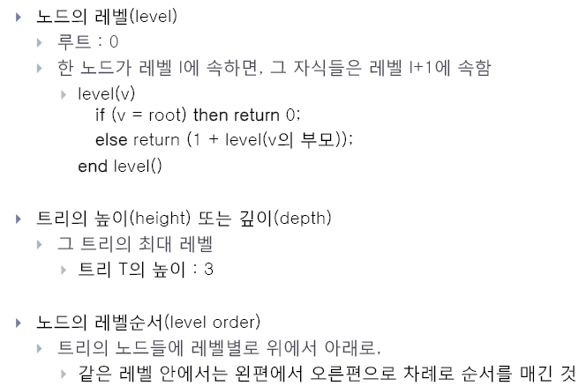
용어

Slide 6
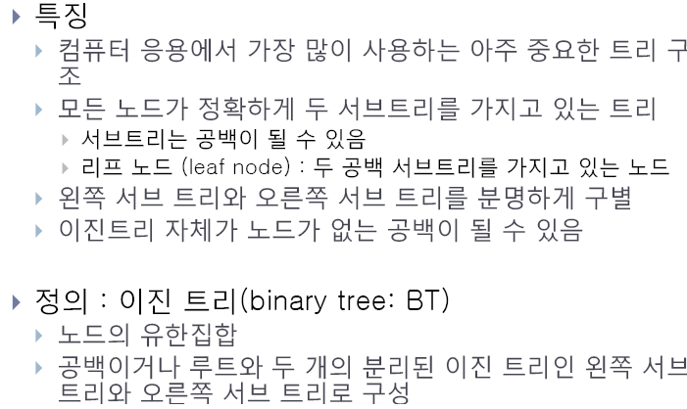

Binary Tree(이진트리)
내가 이진

Slide 7
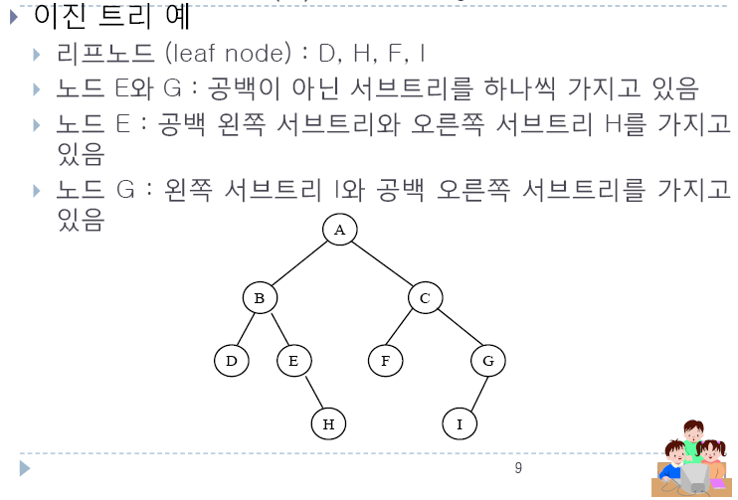

Slide 8
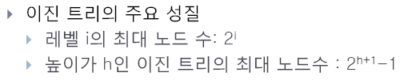
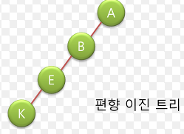
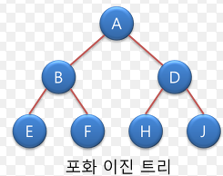
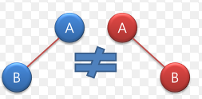

Slide 9
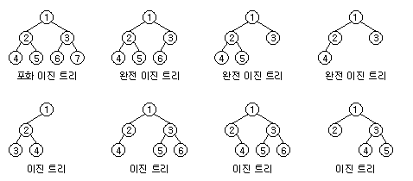
완전이진트리
- 리프노드를 제외한 모든 노드가 자식을 2개씩 갖고, 마지막 레벨의 노드들은 왼쪽부터 채워져 있음

Slide 10
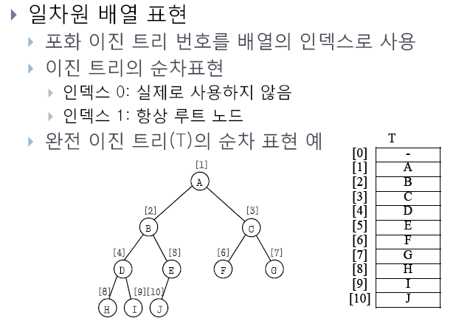
Tree Implementation 1: ARRAY

Slide 11
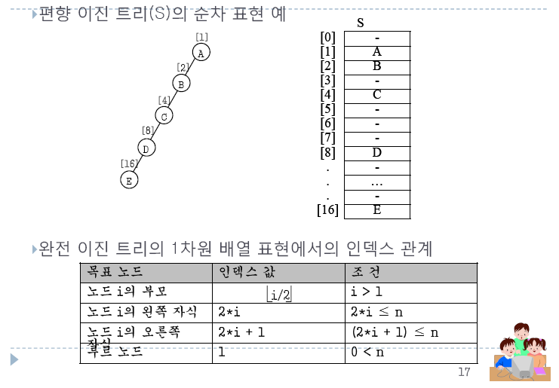

Slide 12
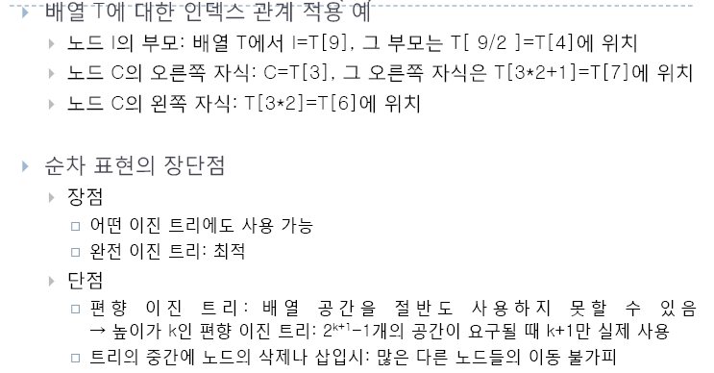

Slide 13
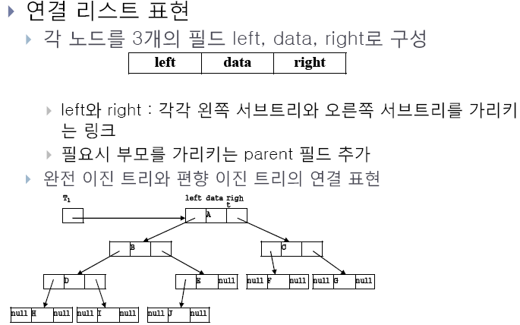
Tree Implementation 2: LIST

Slide 14
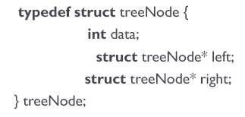
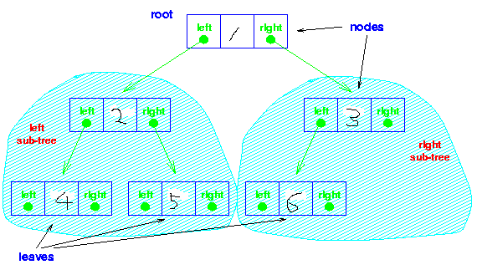
Tree Implementation 2: LIST
다음 tree를 코딩해 보자

Slide 15
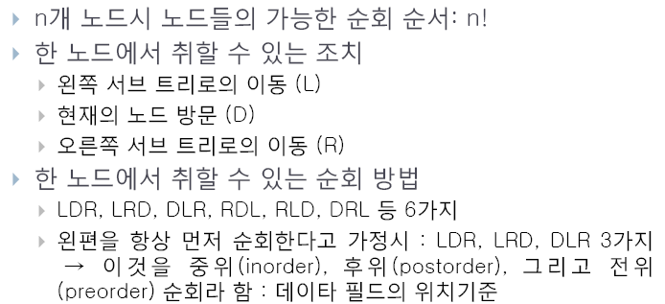
Tree Traverse (트리순회)
Tree내의 노드들을 모두 방문

Slide 16
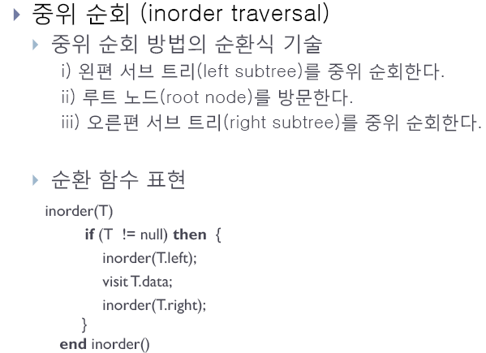

Slide 17
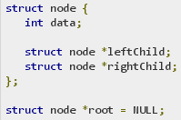
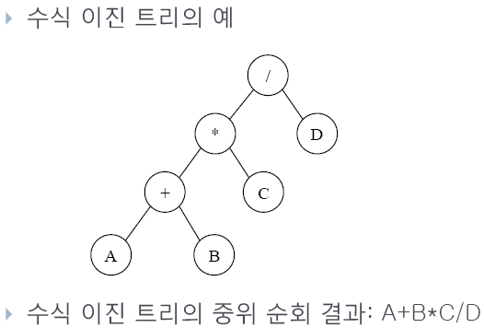
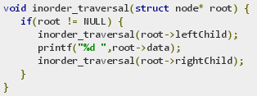

Slide 18
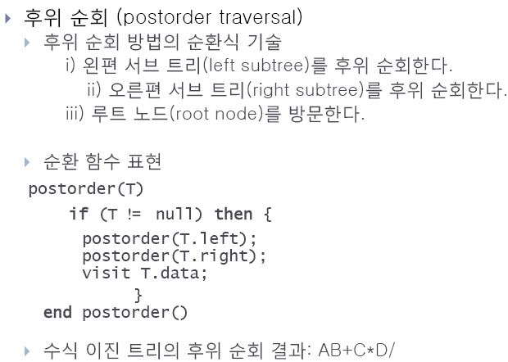
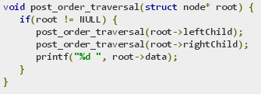

Slide 19
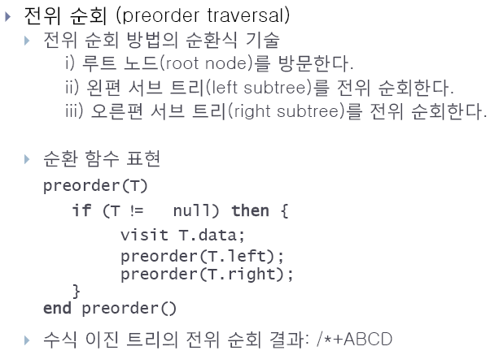
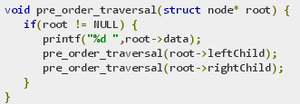

Slide 20
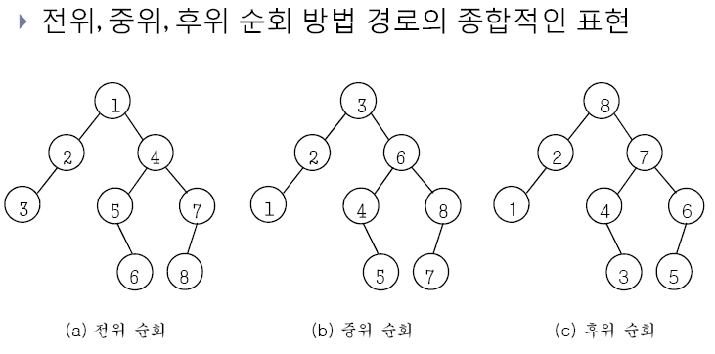

Slide 21
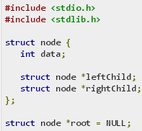
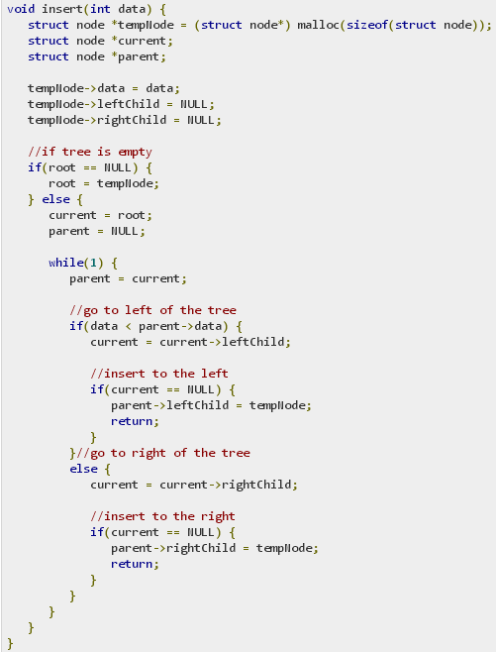
https://www.tutorialspoint.com/data_structures_algorithms/tree_traversal_in_c.htm

Slide 22
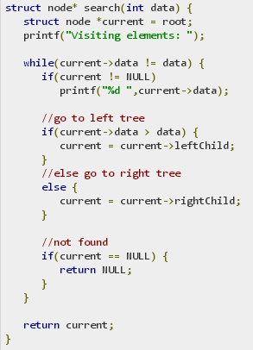
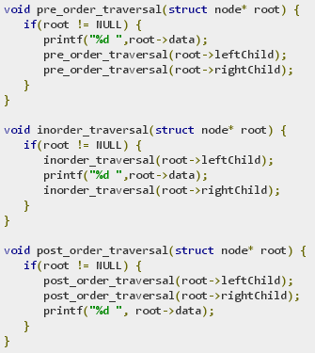

Slide 23
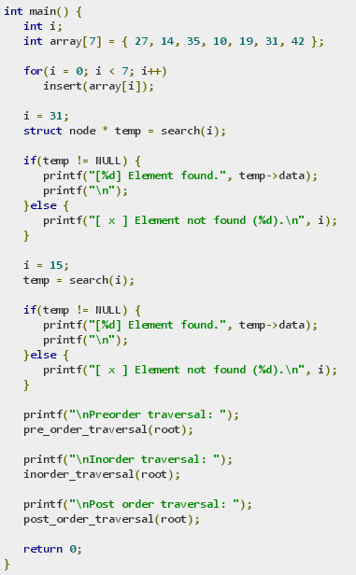

Slide 24
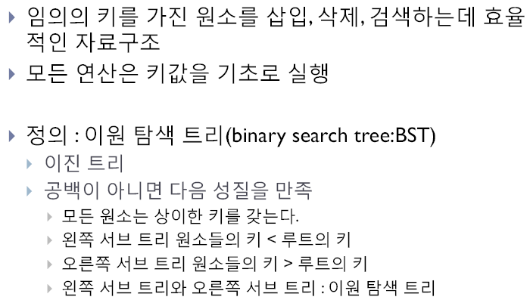
Binary Search Tree (이진탐색트리)

Slide 25
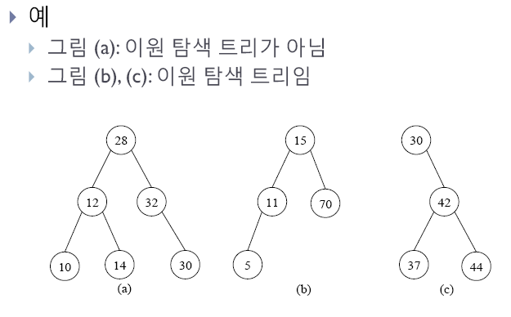

Slide 26
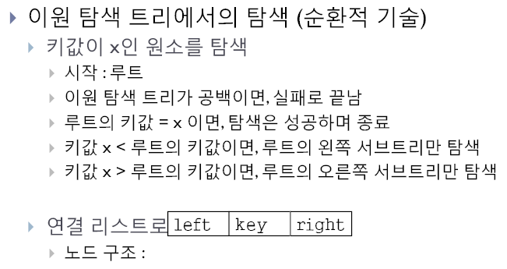
Search in BST

Slide 27
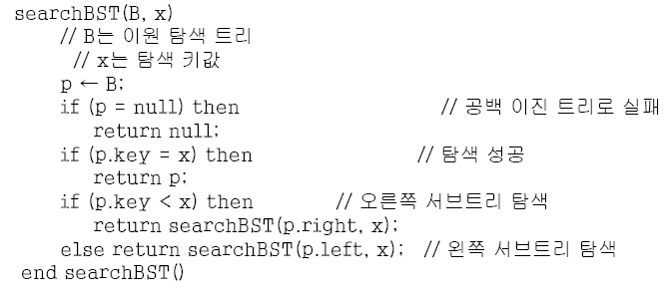
Search Algorithm

Slide 28
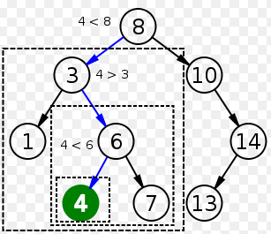
Example

Slide 29
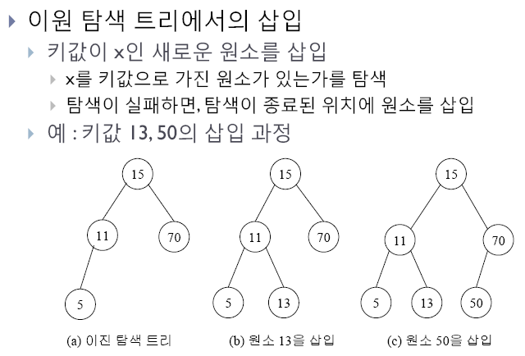
Insert in BST

Slide 30
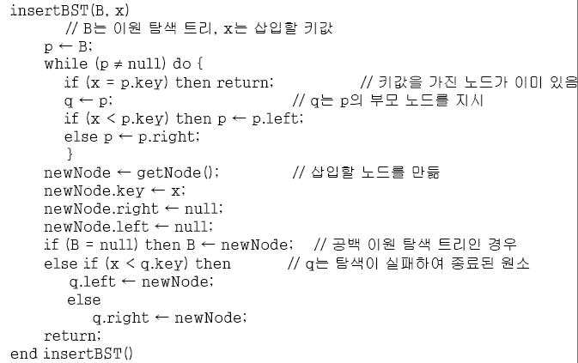
Insert Algorithm

Slide 31
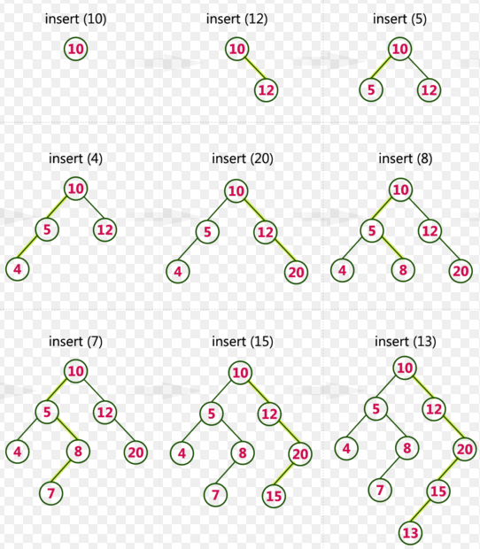
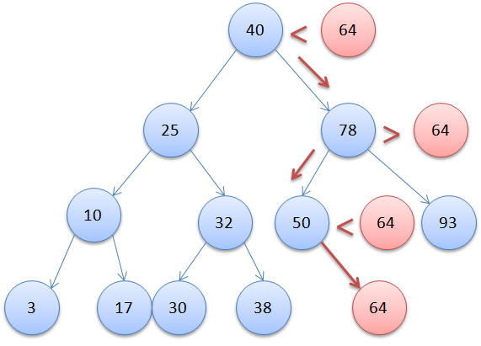
Example

Slide 32
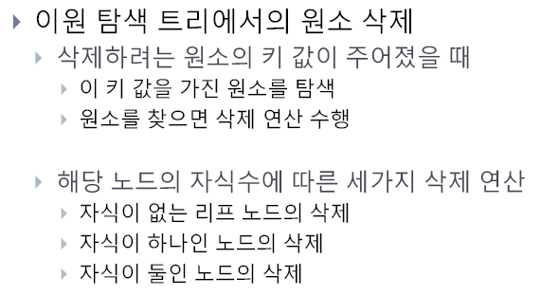
Delete in BST

Slide 33
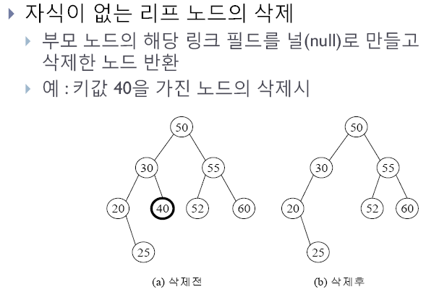

Slide 34
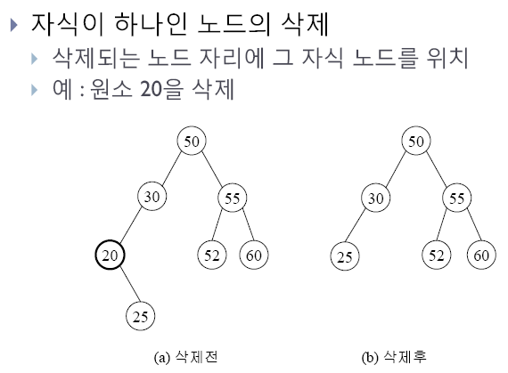

Slide 35
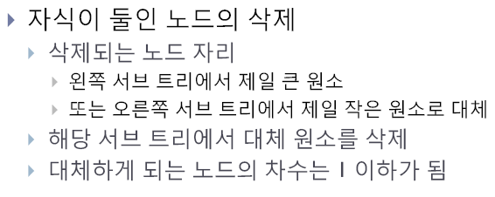

Slide 36
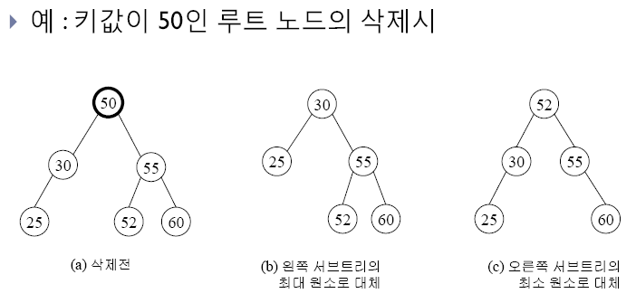

Slide 37
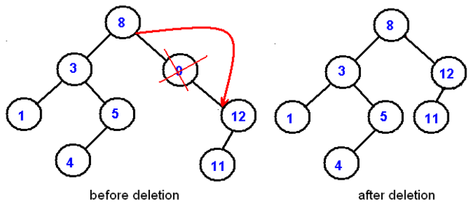
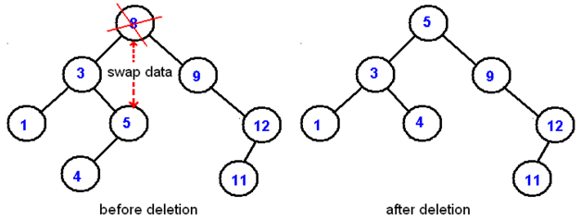

Slide 38


Slide 39

Delete Algorithm

Slide 40

C implementation

Slide 41


Slide 42


Slide 43


Slide 44


Slide 45

Merge Binary Search Trees

Slide 46


Slide 47


Slide 48


Slide 49


Slide 50

Split in BST

Slide 51


Slide 52


Slide 53

Tree Search
Depth-First Search / Breadth-First-Search

Slide 54

Quiz. http://www.fas.harvard.edu/~cscie119/

Slide 55


Slide 56


Quiz. http://www.cs.cornell.edu/courses/cs2110/2011fa/

Slide 57

Quiz. http://www.cs.cornell.edu/courses/cs2110/2011fa/

Slide 58

Quiz. http://www.cs.toronto.edu/~hojjat/148s07

Slide 59

Quiz. http://cs.nyu.edu/courses/fall11/

Slide 60


Slide 61


Quiz. http://courses.cs.washington.edu/courses/cse143/

Slide 62


Slide 63

Quiz. chara.cs.illinois.edu/cs225/

