Slide 1
TREE (part 2)
Dr. Seung Chul Han
Dept. Computer Engineering
Myongji University

Slide 2
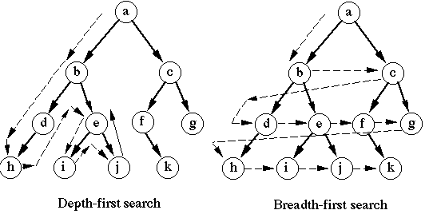
Tree Search
Depth-First Search / Breadth-First-Search

Slide 3
Example: DFS
Visited Array
F
C
A
B
C
D
E
F
G
H
A
B
D
H
G
E
Task: Conduct a depth-first search of the graph starting with node D

Slide 4
Walk-Through
Visited Array
F
C
A
B
C
D | √
E
F
G
H
D
A
B
D
H
G
E
The order nodes are visited:
D
Visit D

Slide 5
Walk-Through
Visited Array
F
C
A
B
C
D | √
E
F
G
H
D
A
B
D
H
G
E
The order nodes are visited:
D
Consider nodes adjacent to D, decide to visit C first (Rule: visit adjacent nodes in alphabetical order)

Slide 6
Walk-Through
Visited Array
F
C
A
B
C | √
D | √
E
F
G
H
C
D
A
B
D
H
G
E
The order nodes are visited:
D, C
Visit C

Slide 7
Walk-Through
Visited Array
F
C
A
B
C | √
D | √
E
F
G
H
C
D
A
B
D
H
G
E
The order nodes are visited:
D, C
No nodes adjacent to C; cannot continue ➔ backtrack, i.e., pop stack and restore previous state

Slide 8
Walk-Through
Visited Array
F
C
A
B
C | √
D | √
E
F
G
H
D
A
B
D
H
G
E
The order nodes are visited:
D, C
Back to D – C has been visited, decide to visit E next

Slide 9
Walk-Through
Visited Array
F
C
A
B
C | √
D | √
E | √
F
G
H
E
D
A
B
D
H
G
E
The order nodes are visited:
D, C, E
Back to D – C has been visited, decide to visit E next

Slide 10
Walk-Through
Visited Array
F
C
A
B
C | √
D | √
E | √
F
G
H
E
D
A
B
D
H
G
E
The order nodes are visited:
D, C, E
Only G is adjacent to E

Slide 11
Walk-Through
Visited Array
F
C
A
B
C | √
D | √
E | √
F
G | √
H
G
E
D
A
B
D
H
G
E
The order nodes are visited:
D, C, E, G
Visit G

Slide 12
Walk-Through
Visited Array
F
C
A
B
C | √
D | √
E | √
F
G | √
H
G
E
D
A
B
D
H
G
E
The order nodes are visited:
D, C, E, G
Nodes D and H are adjacent to G. D has already been visited. Decide to visit H.

Slide 13
Walk-Through
Visited Array
F
C
A
B
C | √
D | √
E | √
F
G | √
H | √
H
G
E
D
A
B
D
H
G
E
The order nodes are visited:
D, C, E, G, H
Visit H

Slide 14
Walk-Through
Visited Array
F
C
A
B
C | √
D | √
E | √
F
G | √
H | √
H
G
E
D
A
B
D
H
G
E
The order nodes are visited:
D, C, E, G, H
Nodes A and B are adjacent to F. Decide to visit A next.

Slide 15
Walk-Through
Visited Array
F
C
A | √
B
C | √
D | √
E | √
F
G | √
H | √
A
H
G
E
D
A
B
D
H
G
E
The order nodes are visited:
D, C, E, G, H, A
Visit A

Slide 16
Walk-Through
Visited Array
F
C
A | √
B
C | √
D | √
E | √
F
G | √
H | √
A
H
G
E
D
A
B
D
H
G
E
The order nodes are visited:
D, C, E, G, H, A
Only Node B is adjacent to A. Decide to visit B next.

Slide 17
Walk-Through
Visited Array
F
C
A | √
B | √
C | √
D | √
E | √
F
G | √
H | √
B
A
H
G
E
D
A
B
D
H
G
E
The order nodes are visited:
D, C, E, G, H, A, B
Visit B

Slide 18
Walk-Through
Visited Array
F
C
A | √
B | √
C | √
D | √
E | √
F
G | √
H | √
A
H
G
E
D
A
B
D
H
G
E
The order nodes are visited:
D, C, E, G, H, A, B
No unvisited nodes adjacent to B. Backtrack (pop the stack).

Slide 19
Walk-Through
Visited Array
F
C
A | √
B | √
C | √
D | √
E | √
F
G | √
H | √
H
G
E
D
A
B
D
H
G
E
The order nodes are visited:
D, C, E, G, H, A, B
No unvisited nodes adjacent to A. Backtrack (pop the stack).

Slide 20
Walk-Through
Visited Array
F
C
A | √
B | √
C | √
D | √
E | √
F
G | √
H | √
G
E
D
A
B
D
H
G
E
The order nodes are visited:
D, C, E, G, H, A, B
No unvisited nodes adjacent to H. Backtrack (pop the stack).

Slide 21
Walk-Through
Visited Array
F
C
A | √
B | √
C | √
D | √
E | √
F
G | √
H | √
E
D
A
B
D
H
G
E
The order nodes are visited:
D, C, E, G, H, A, B
No unvisited nodes adjacent to G. Backtrack (pop the stack).

Slide 22
Walk-Through
Visited Array
F
C
A | √
B | √
C | √
D | √
E | √
F
G | √
H | √
D
A
B
D
H
G
E
The order nodes are visited:
D, C, E, G, H, A, B
No unvisited nodes adjacent to E. Backtrack (pop the stack).

Slide 23
Walk-Through
Visited Array
F
C
A | √
B | √
C | √
D | √
E | √
F
G | √
H | √
D
A
B
D
H
G
E
The order nodes are visited:
D, C, E, G, H, A, B
F is unvisited and is adjacent to D. Decide to visit F next.

Slide 24
Walk-Through
Visited Array
F
C
A | √
B | √
C | √
D | √
E | √
F | √
G | √
H | √
F
D
A
B
D
H
G
E
The order nodes are visited:
D, C, E, G, H, A, B, F
Visit F

Slide 25
Walk-Through
Visited Array
F
C
A | √
B | √
C | √
D | √
E | √
F | √
G | √
H | √
D
A
B
D
H
G
E
The order nodes are visited:
D, C, E, G, H, A, B, F
No unvisited nodes adjacent to F. Backtrack.

Slide 26
Walk-Through
Visited Array
F
C
A | √
B | √
C | √
D | √
E | √
F | √
G | √
H | √
A
B
D
H
G
E
The order nodes are visited:
D, C, E, G, H, A, B, F
No unvisited nodes adjacent to D. Backtrack.

Slide 27
Walk-Through
Visited Array
F
C
A | √
B | √
C | √
D | √
E | √
F | √
G | √
H | √
A
B
D
H
G
E
The order nodes are visited:
D, C, E, G, H, A, B, F
Stack is empty. Depth-first traversal is done.

Slide 28
Analysis of DFS
Setting/getting a vertex/edge label takes O(1) time
Each vertex is labeled twice
once as UNEXPLORED
once as VISITED
Each edge is labeled twice
once as UNEXPLORED
once as DISCOVERY or BACK
Method incidentEdges is called once for each vertex
DFS runs in O(n + m) time provided the graph is represented by the adjacency list structure
Recall that Σ_{v} deg(v) = 2m

Slide 29
Path Finding
We can specialize the DFS algorithm to find a path between two given vertices u and z using the template method pattern
We call DFS(G, u) with u as the start vertex
We use a stack S to keep track of the path between the start vertex and the current vertex
As soon as destination vertex z is encountered, we return the path as the contents of the stack
Algorithm pathDFS(G, v, z)
setLabel(v, VISITED)
S.push(v)
if v = z
return S.elements()
for all e ∈ G.incidentEdges(v)
if getLabel(e) = UNEXPLORED
w ← opposite(v,e)
if getLabel(w) = UNEXPLORED
setLabel(e, DISCOVERY)
S.push(e)
pathDFS(G, w, z)
S.pop(e)
else
setLabel(e, BACK)
S.pop(v)

Slide 30
Cycle Finding
We can specialize the DFS algorithm to find a simple cycle using the template method pattern
We use a stack S to keep track of the path between the start vertex and the current vertex
As soon as a back edge (v, w) is encountered, we return the cycle as the portion of the stack from the top to vertex w
Algorithm cycleDFS(G, v, z)
setLabel(v, VISITED)
S.push(v)
for all e ∈ G.incidentEdges(v)
if getLabel(e) = UNEXPLORED
w ← opposite(v,e)
S.push(e)
if getLabel(w) = UNEXPLORED
setLabel(e, DISCOVERY)
pathDFS(G, w, z)
S.pop(e)
else
T ← new empty stack
repeat
o ← S.pop()
T.push(o)
until o = w
return T.elements()
S.pop(v)

Slide 31
Breadth First Search
2
4
8
s
5
7
3
6
9

Slide 32
Breadth First Search
Shortest path from s
1
2
2
4
8
0
s
5
7
3
6
9
Undiscovered
Discovered
Queue: s
Top of queue
Finished

Slide 33
Breadth First Search
1
2
4
8
0
s
5
7
3
3
6
9
1
Undiscovered
Discovered
Queue: s 2
Top of queue
Finished

Slide 34
Breadth First Search
1
2
4
8
0
s
5
5
7
1
3
6
9
1
Undiscovered
Discovered
Queue: s 2 3
Top of queue
Finished

Slide 35
Breadth First Search
1
2
4
8
0
s
5
7
1
3
6
9
1
Undiscovered
Discovered
Queue: 2 3 5
Top of queue
Finished

Slide 36
Breadth First Search
1
2
2
4
4
8
0
s
5
7
1
3
6
9
1
Undiscovered
Discovered
Queue: 2 3 5
Top of queue
Finished

Slide 37
Breadth First Search
1
2
2
4
8
5 already discovered: don't enqueue
0
s
5
7
1
3
6
9
1
Undiscovered
Discovered
Queue: 2 3 5 4
Top of queue
Finished

Slide 38
Breadth First Search
1
2
2
4
8
0
s
5
7
1
3
6
9
1
Undiscovered
Discovered
Queue: 2 3 5 4
Top of queue
Finished

Slide 39
Breadth First Search
1
2
2
4
8
0
s
5
7
1
3
6
9
1
Undiscovered
Discovered
Queue: 3 5 4
Top of queue
Finished

Slide 40
Breadth First Search
1
2
2
4
8
0
s
5
7
1
3
6
6
9
1
2
Undiscovered
Discovered
Queue: 3 5 4
Top of queue
Finished

Slide 41
Breadth First Search
1
2
2
4
8
0
s
5
7
1
3
6
9
1
2
Undiscovered
Discovered
Queue: 3 5 4 6
Top of queue
Finished

Slide 42
Breadth First Search
1
2
2
4
8
0
s
5
7
1
3
6
9
1
2
Undiscovered
Discovered
Queue: 5 4 6
Top of queue
Finished

Slide 43
Breadth First Search
1
2
2
4
8
0
s
5
7
1
3
6
9
1
2
Undiscovered
Discovered
Queue: 5 4 6
Top of queue
Finished

Slide 44
Breadth First Search
1
2
2
4
8
0
s
5
7
1
3
6
9
1
2
Undiscovered
Discovered
Queue: 4 6
Top of queue
Finished

Slide 45
Breadth First Search
1
2
3
2
4
8
8
0
s
5
7
1
3
6
9
1
2
Undiscovered
Discovered
Queue: 4 6
Top of queue
Finished

Slide 46
Breadth First Search
1
2
3
2
4
8
0
s
5
7
1
3
6
9
1
2
Undiscovered
Discovered
Queue: 4 6 8
Top of queue
Finished

Slide 47
Breadth First Search
1
2
3
2
4
8
0
s
5
7
7
1
3
3
6
9
1
2
Undiscovered
Discovered
Queue: 6 8
Top of queue
Finished

Slide 48
Breadth First Search
1
2
3
2
4
8
0
s
5
7
1
3
3
6
9
9
1
2
3
Undiscovered
Discovered
Queue: 6 8 7
Top of queue
Finished

Slide 49
Breadth First Search
1
2
3
2
4
8
0
s
5
7
1
3
3
6
9
1
2
3
Undiscovered
Discovered
Queue: 6 8 7 9
Top of queue
Finished

Slide 50
Breadth First Search
1
2
3
2
4
8
0
s
5
7
1
3
3
6
9
1
2
3
Undiscovered
Discovered
Queue: 8 7 9
Top of queue
Finished

Slide 51
Breadth First Search
1
2
3
2
4
8
0
s
5
7
1
3
3
6
9
1
2
3
Undiscovered
Discovered
Queue: 7 9
Top of queue
Finished

Slide 52
Breadth First Search
1
2
3
2
4
8
0
s
5
7
1
3
3
6
9
1
2
3
Undiscovered
Discovered
Queue: 7 9
Top of queue
Finished

Slide 53
Breadth First Search
1
2
3
2
4
8
0
s
5
7
1
3
3
6
9
1
2
3
Undiscovered
Discovered
Queue: 7 9
Top of queue
Finished

Slide 54
Breadth First Search
1
2
3
2
4
8
0
s
5
7
1
3
3
6
9
1
2
3
Undiscovered
Discovered
Queue: 7 9
Top of queue
Finished

Slide 55
Breadth First Search
1
2
3
2
4
8
0
s
5
7
1
3
3
6
9
1
2
3
Undiscovered
Discovered
Queue: 9
Top of queue
Finished

Slide 56
Breadth First Search
1
2
3
2
4
8
0
s
5
7
1
3
3
6
9
1
2
3
Undiscovered
Discovered
Queue: 9
Top of queue
Finished

Slide 57
Breadth First Search
1
2
3
2
4
8
0
s
5
7
1
3
3
6
9
1
2
3
Undiscovered
Discovered
Queue: 9
Top of queue
Finished

Slide 58
Breadth First Search
1
2
3
2
4
8
0
s
5
7
1
3
3
6
9
1
2
3
Undiscovered
Discovered
Queue:
Top of queue
Finished

Slide 59
Breadth First Search
1
2
3
2
4
8
0
s
5
7
1
3
3
6
9
1
2
3
Level Graph

Slide 60
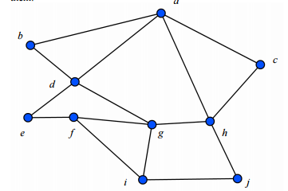
Psu.edu
Do DFS and BFS starting with ‘a’

Slide 61
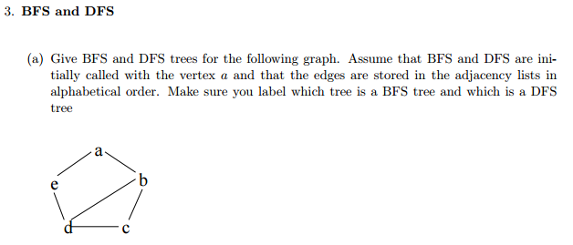
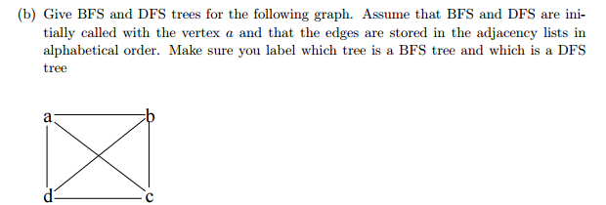
www.cs.unm.edu

Slide 63
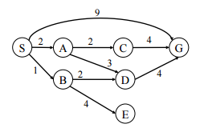
Eecs.Berkeley.edu
Do DFS and BFS starting with s

Slide 64
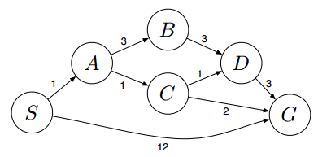
Do DFS and BFS starting with s

Slide 65
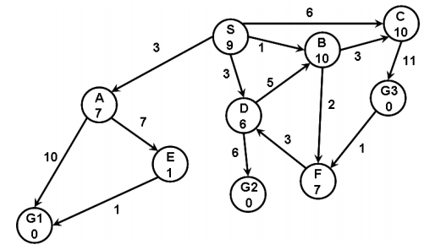
www.cs.cmu.edu
Do DFS and BFS starting with s

Slide 66
