Slide 1
Heap
Dr. Seung Chul Han
Dept. Computer Engineering
Myongji University

Slide 2
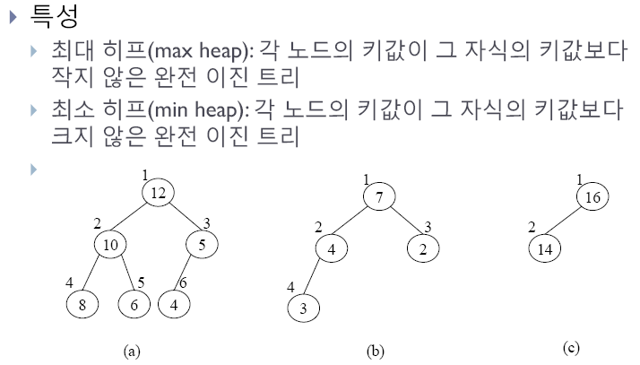
Heap
완전 이진트리

Slide 3
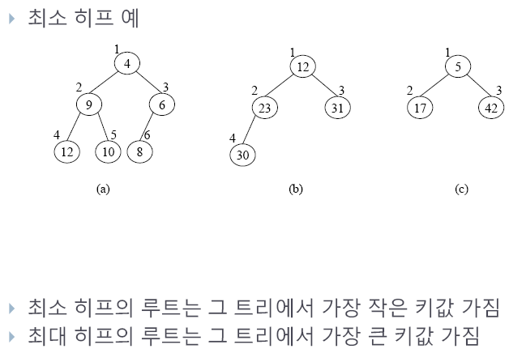

Slide 4
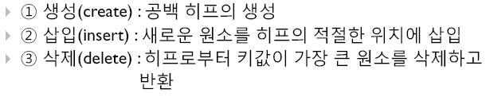
Functions

Slide 5
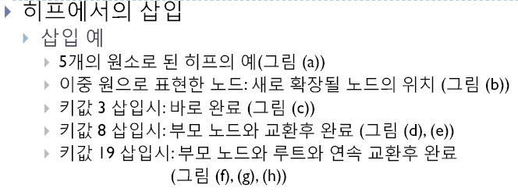

Slide 6
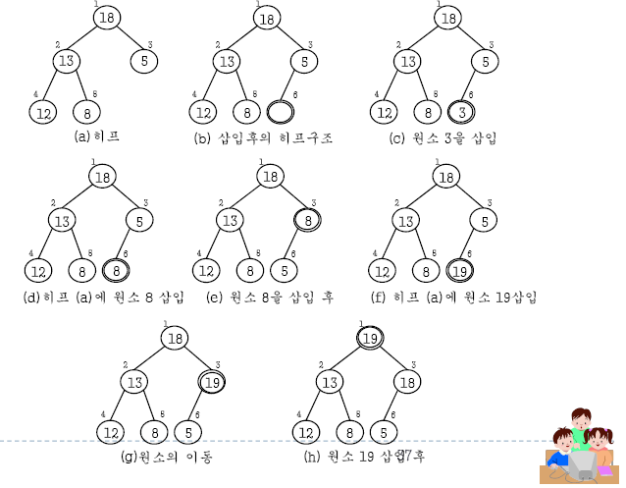

Slide 7
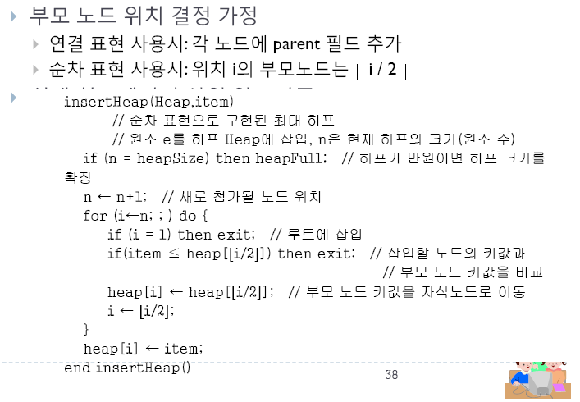

Slide 8
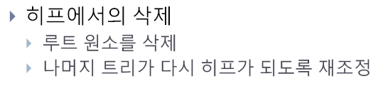

Slide 9
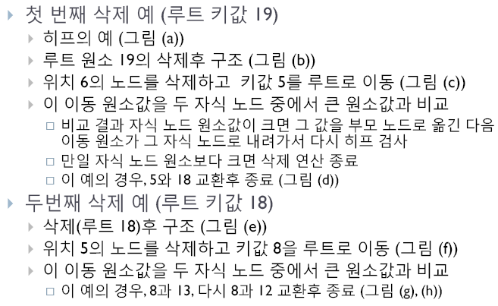

Slide 10
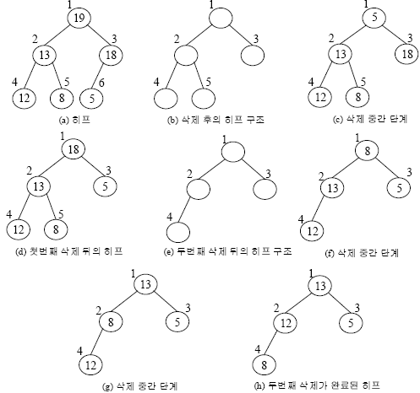

Slide 11
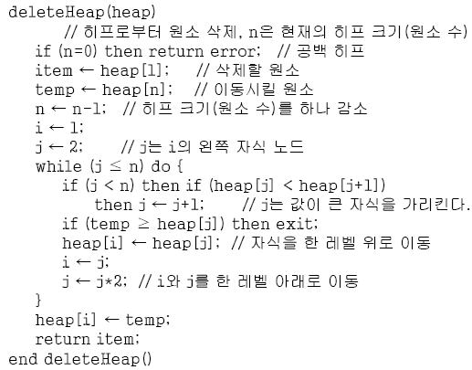

Slide 12
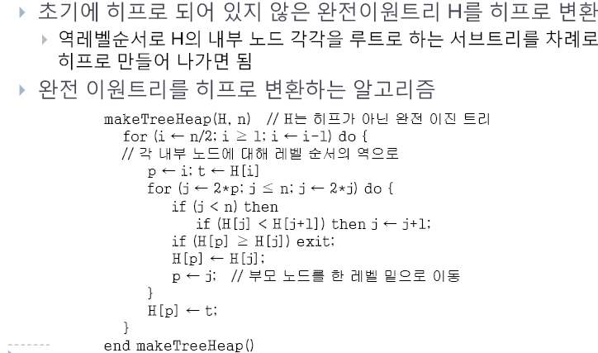
Binary Tree -> Heap

Slide 13
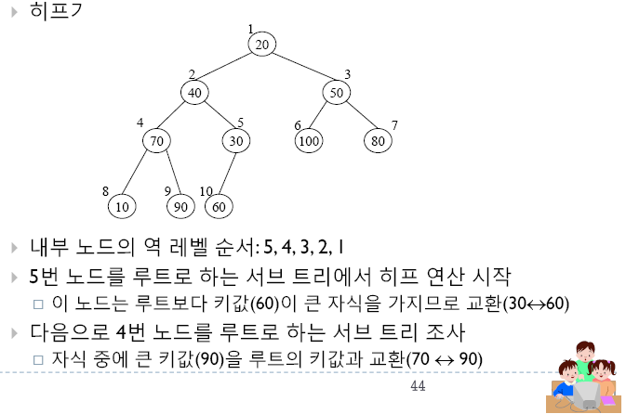

Slide 14
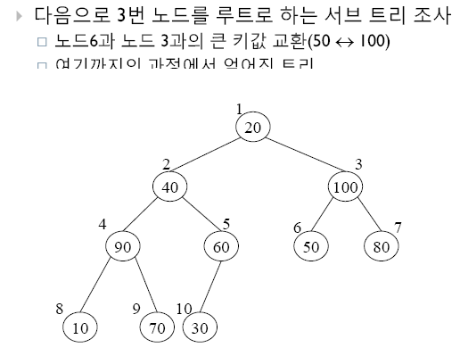

Slide 15
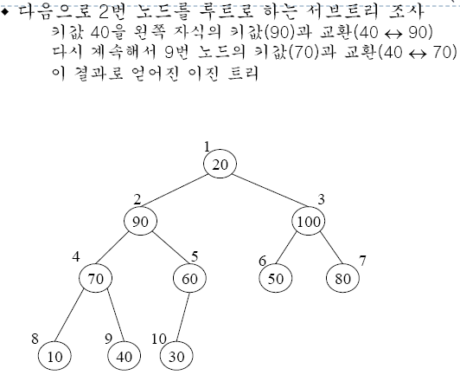

Slide 16
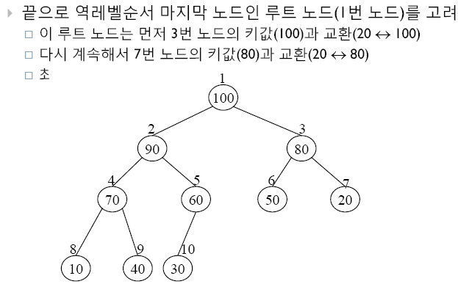

Slide 17
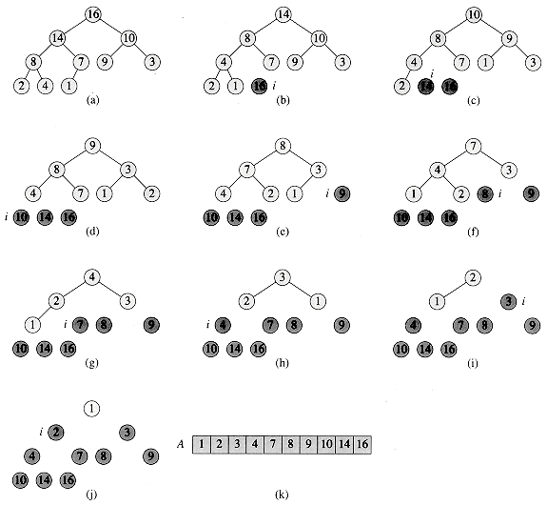
Heap Sort

Slide 18

Quiz. people.eecs.berkeley.edu/~jrs/61b/

Slide 19
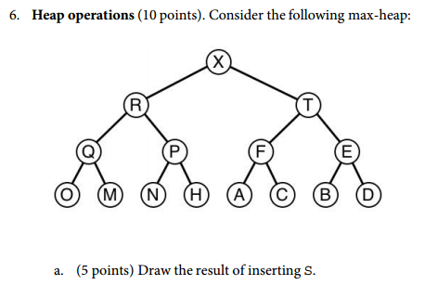
Quiz. www.cs.princeton.edu/courses/archive

Slide 20

Quiz. www.ics.uci.edu/~eppstein/161

Slide 21
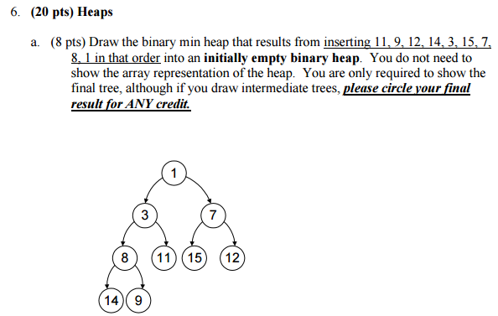
Quiz. courses.cs.washington.edu/courses/cse373/

Slide 22

