Slide 1
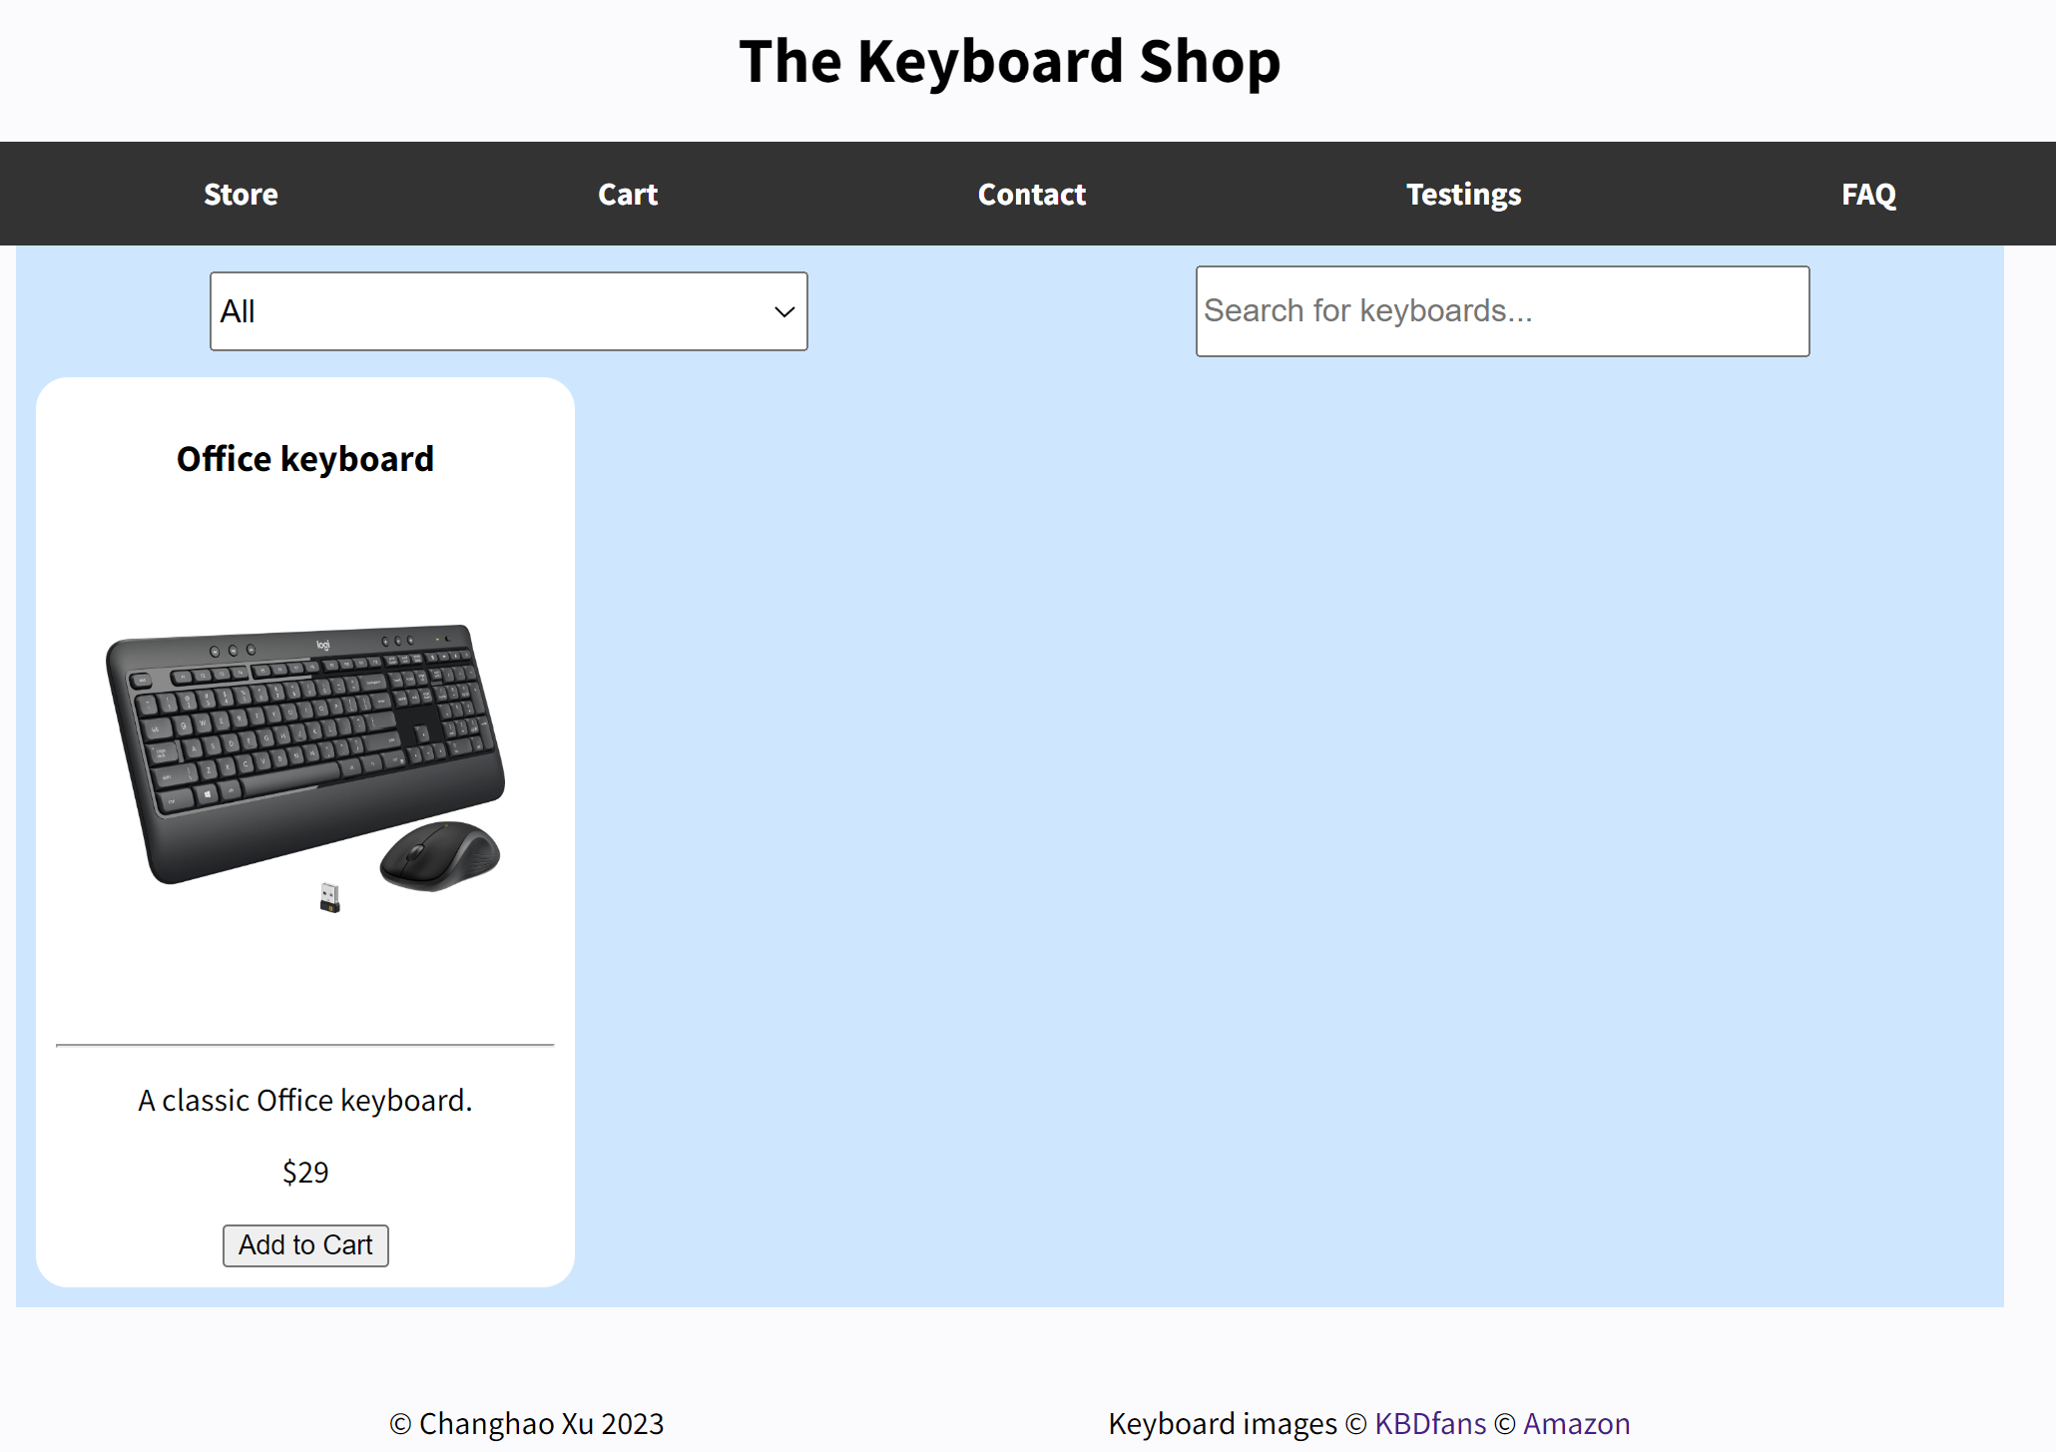
Nav bar, toggle between different html pages
Header
Radio button for selecting different categories of keyboards
Search a specific keyboard by typing keywords
Flex containers, similar with coffee shop – will implement JS to populate this board. For illustration, I just hard coded one keyboard example.
Click the image for details (will implement more JS)
Footer for notes and copyrights

Slide 2
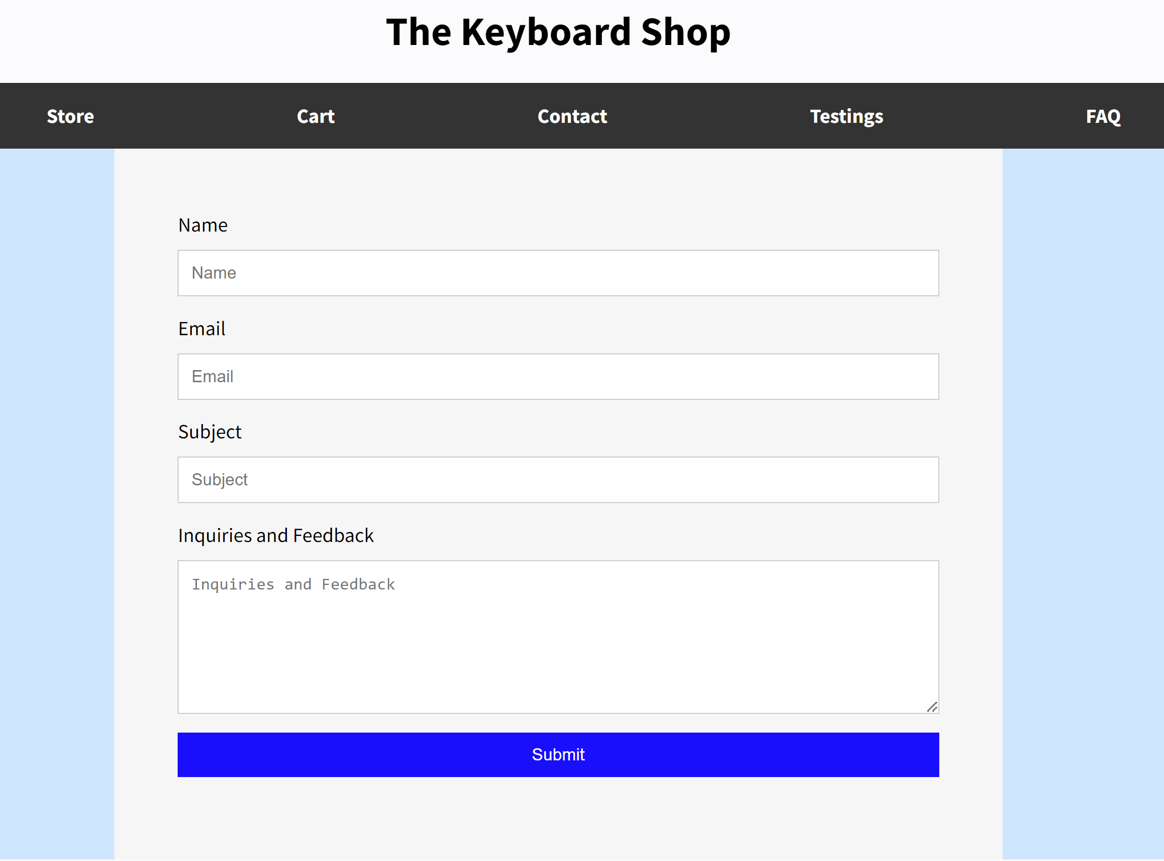
Nav bar, toggle between different html pages
Header
For name, email and subject input
For longer text input of inquiries and feedback
POST to API

