Slide 1
Decarbonising Wastewater Treatment

Slide 2
Background
There are six weather stations in the large WSP sewage treatment plant in Melbourne. to collect the necessary local weather data for GHG flux estimations, which will ultimately lead to proposing solutions to help decarbonise the treatment process, as well as provide opportunities for resource recovery.
The software will
Support cloud-based storage of sensor data from multiple sources in a large-scale, WSP-based wastewater treatment plant.
Offer web-based interactive visualisations of the data
Allow researcher or industry users to download data or visualisations for further analysis

Slide 3
Identify and understand your business and market Needs
Business need: A network of six weather stations to collect necessary local weather data that can aid in day-to-day operations and planning for future assets
market needs: Researchers or industry users can download data or visualizations for further analysis, which makes their work more convenient.

Slide 4
Map out user journey
When the customers first open the app, they will see a UI interface.
case1: The user clicks the search box in the upper right corner of the page and enters the single condition he wants to query, and the 200 lines of the corresponding data will be displayed on the right.
case2: The user clicks the visualization type on the left side of the page, and the corresponding visualization image will be displayed on the right side.
case3: The user clicks the download button in the lower right corner of the page to download the data or visual image

Slide 5
Pains and Gains
Pains | gains
Difficult viewing the data; Trouble downloading data availability or spend long time; Show all unfiltered data. | View the data and choose visualization type; Download data file conveniently; Optional data query range to obtain the desired data.

Slide 6
Features to build
Visualise data in a meaningful way – （possibly via PowerBI）
Support users to query data by conditions
Interactive data is automatically and regularly updated
Data storage in the cloud
(Downloadability of data visualisation) - optional

Slide 7
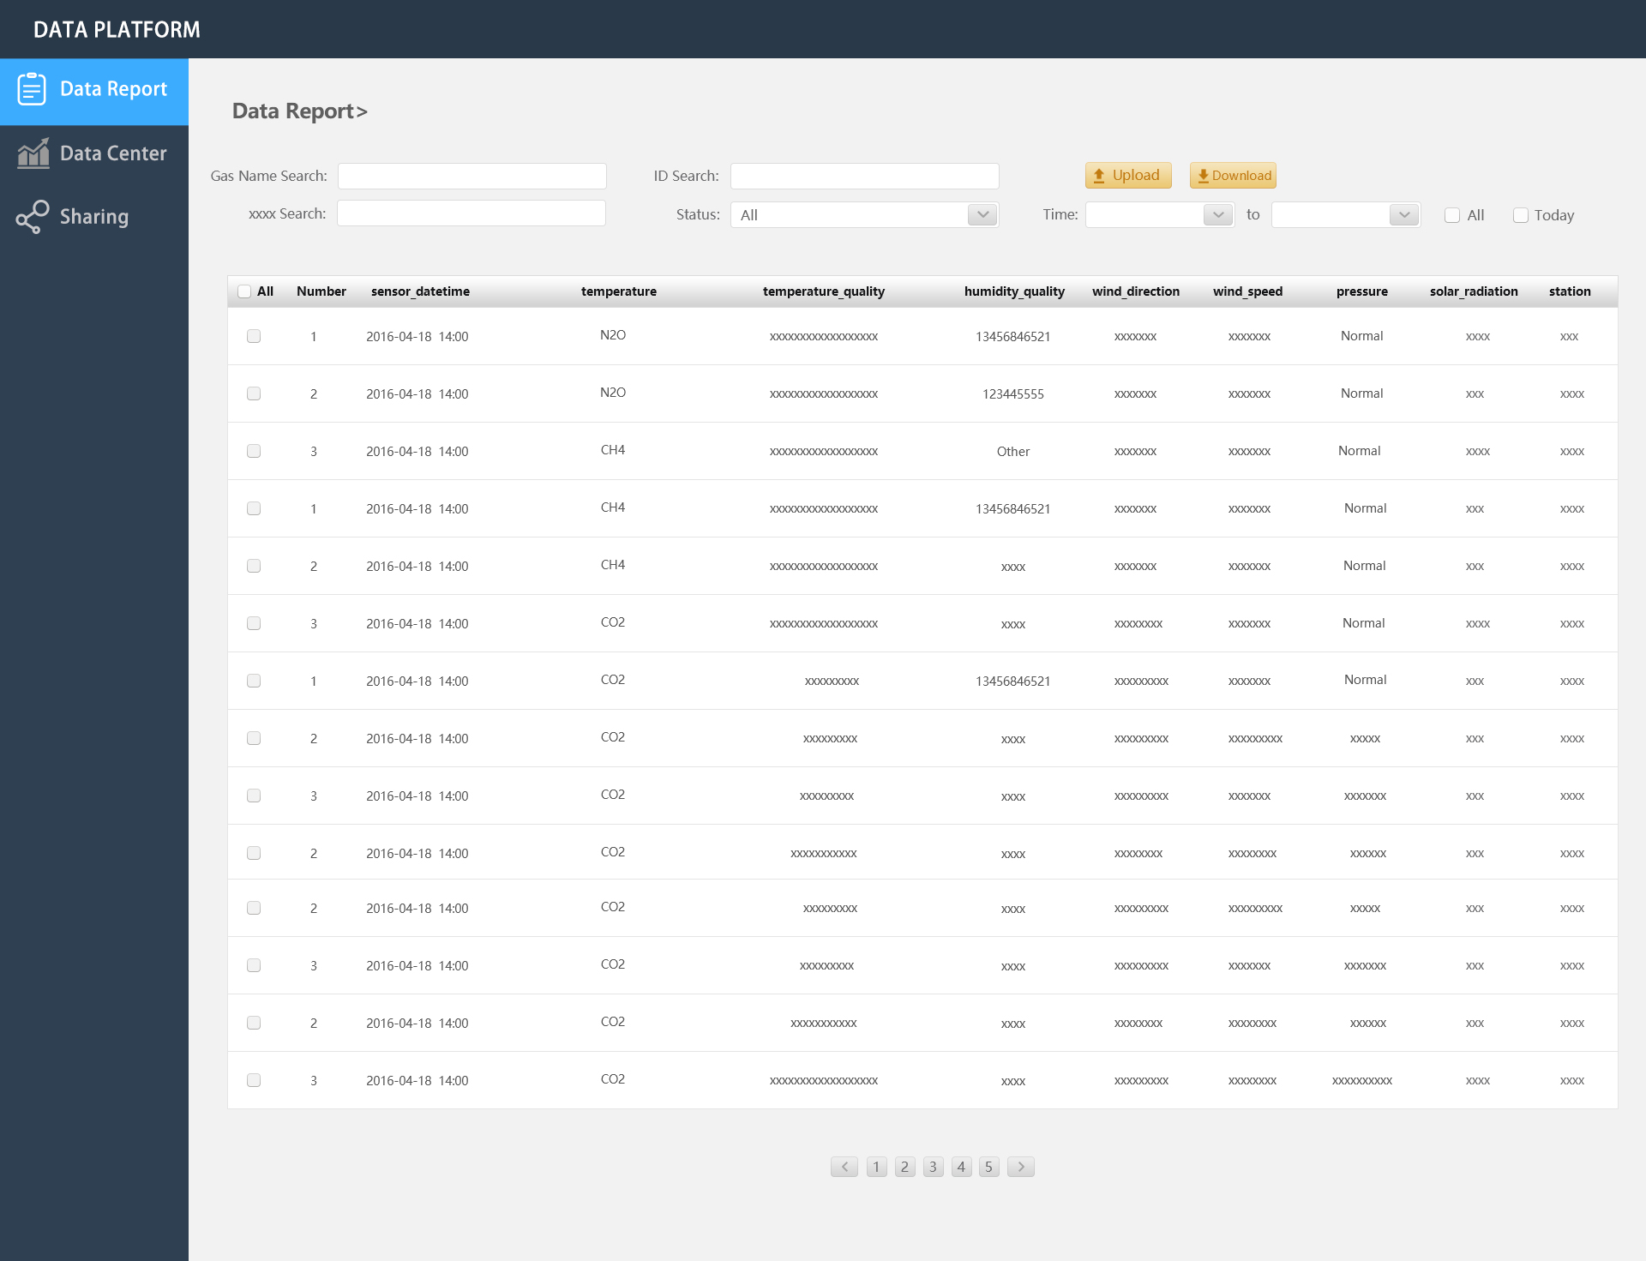
Prototype

Slide 8
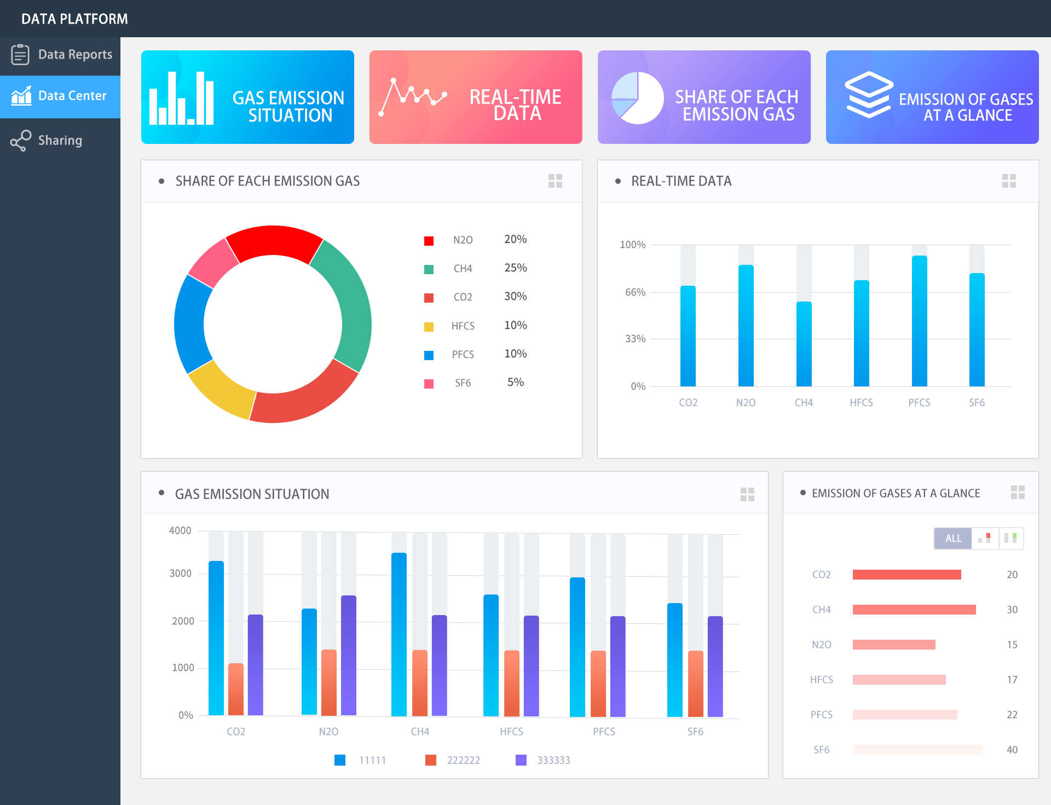

Slide 9
End

