Slide 1
C++11新特性
李长河
changhe.lw@gmail.com

Slide 2
C++11
1. Declarations: auto, decltype,using =,nullptr
2. Smart pointers
3. Class changes
4. Range-based for loop
5. The rvalue reference
6. Move semantics
7. Lambda functions

Slide 3
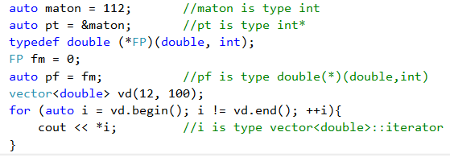
C++11
1. auto

Slide 4
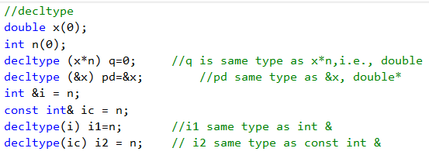
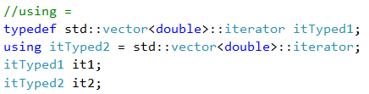
C++11
2. decltype
3. using=

Slide 5
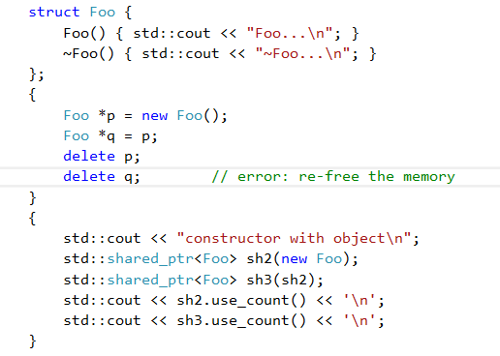
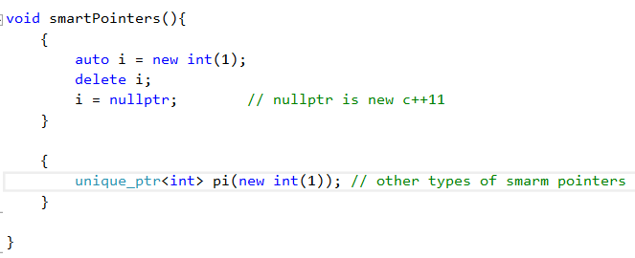
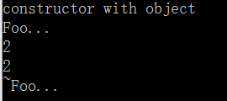
C++11
smart pointers

Slide 6
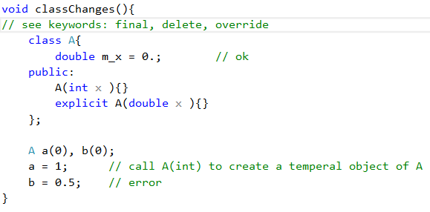
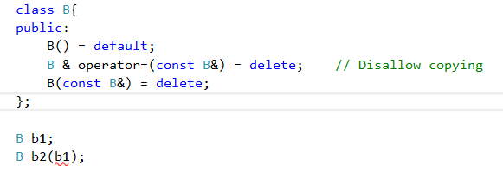
C++11
class changes

Slide 7
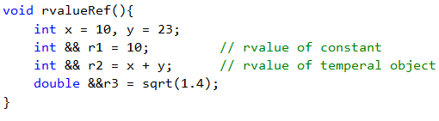
C++11
rvalue reference

Slide 8
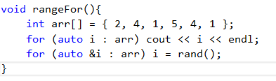
C++11
range-based for loop

Slide 9
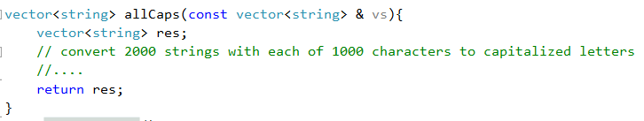
C++11
move Semantic

Slide 10
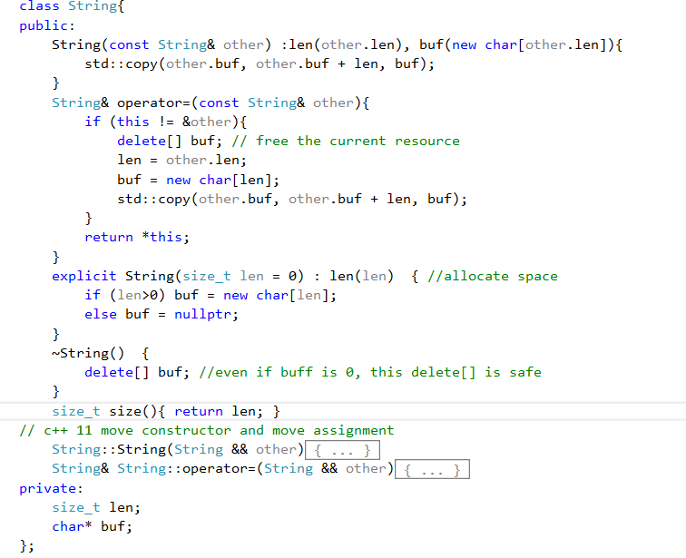
C++11

Slide 11
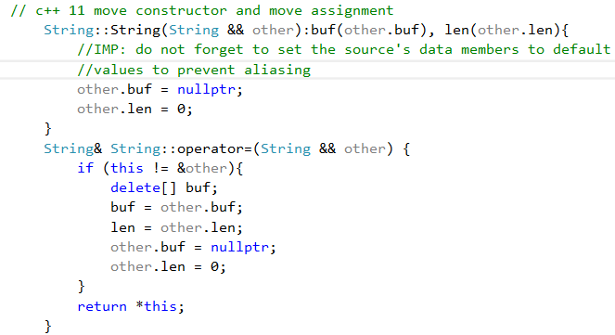
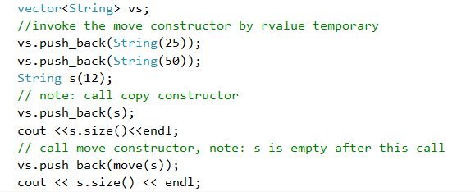

C++11

Slide 12

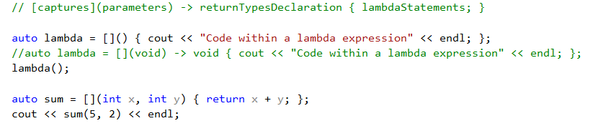

C++11
lambda exp.
[captures](parameters) -> returnType { Statements; }

Slide 13
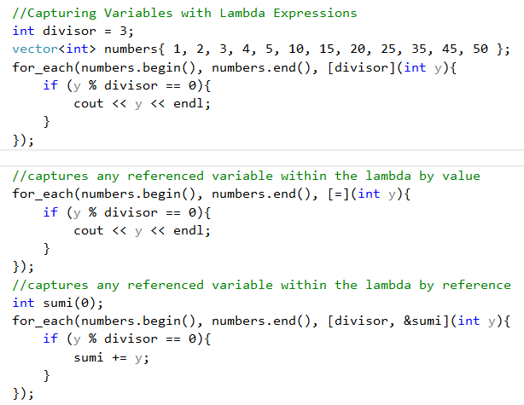
C++11

Slide 14
More C++ 11 Features
并行程序设计
thread_local, thread, mutex,condition_variable, future
可变参数模板
template<typename T, typename... Args>
void foo(cosnt T& t, const Args& ... rest );
新的STL模板库： tuple 类模板
随机数库
Visual Studio Community 2015:
https://www.visualstudio.com/products/visual-studio-community-vs

