Slide 1
智能优化与最优化方法
李长河
lichanghe@cug.edu.cn
自动化学院

Slide 2

课程考核
考核方式：课程论文
选题：
以优化为主题，结合研究方向，题目自选，要求论文后面附上源代码
评分标准：
优秀：提出新（改进）想法且有实验结果支撑
良：一般性实验分析和讨论
中：具有学术意义的综述报告
及格：符合学术论文规范
不及格：缺勤达4次，无课程论文或者课程论文特别差

Slide 3
EC领域主流期刊和会议
主流期刊
1. IEEE Transactions on Evolutionary Computation, T1 A类 2. Evolutionary Computation, T2 A类 3. IEEE Transactions on Cybernetics,T1 A类 4. Swarm and Evolutionary Computation, T2 5. Soft Computing, T3 6. Applied Soft Computing, T2 7. Information Sciences, T1 8. IEEE Computational Intelligence Magazine, T2 9. Journal of Global Optimization, T3
10. Artificial Intelligence, T2
11. Swarm Intelligence, T2
主流会议
1. The Genetic and Evolutionary Computation Conference, GECCO 2. IEEE Congress on Evolutionary Computation, IEEE CEC 3. International Conference on Parallel Problem Solving from Nature, PPSN 4. IEEE Symposium Series on Computational Intelligence, IEEE SSCI 5. International Conference on Simulated Evolution and Learning, SEAL 6. International Conference on Evolutionary Multi-Criterion Optimization, EMO

Slide 4
最优化方法
最优化问题
梯度下降法
其他迭代算法
模拟退火算法

Slide 5
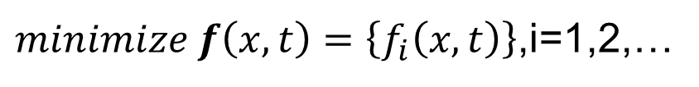
最优化问题
最优化问题的一般数学模型（最小化优化）：
x 为问题的一个解，是一个 n 维向量
f(x) 为目标函数，此处求使目标函数最小的解
h_{i}(x) 为等式约束函数， g_{i}(x) 为不等式约束函数
$minimize f\left(x,t\right)=\left\{f_{i}\left(x,t\right)\right\}$,i=1,2,…
$$subject to g_{i}\left(x\right)≤0,h_{i}\left(x\right)=0,i=1,2,…$$

Slide 6
Terminologies
Solution (search/decision) space：all possible solutions comprises the solution (search/decision) space and corresponding objective values comprises the objective space (e.g.,TSP)
Global optimum is a solution that has the best fitness value in the search space.
Fitness landscape：a mapping from every possible genotype, which represents a candidate solution (phenotype), into a fitness value.

Slide 7
Terminologies
A local optimum is a solution that has the best fitness value within its neighbourhood in the search space.
Basin of attraction is the region of all its neighbourhood solutions whose fitness values monotonically changes as they move close to the optimum
A function is unimodal if there is only one optimum in the fitness landscape and it is multi-modal if there exist more than one optimum in the fitness landscape.
Bias indicates whether evenly distributed solutions in the search space map evenly distributed objective values in the objective space.

Slide 8
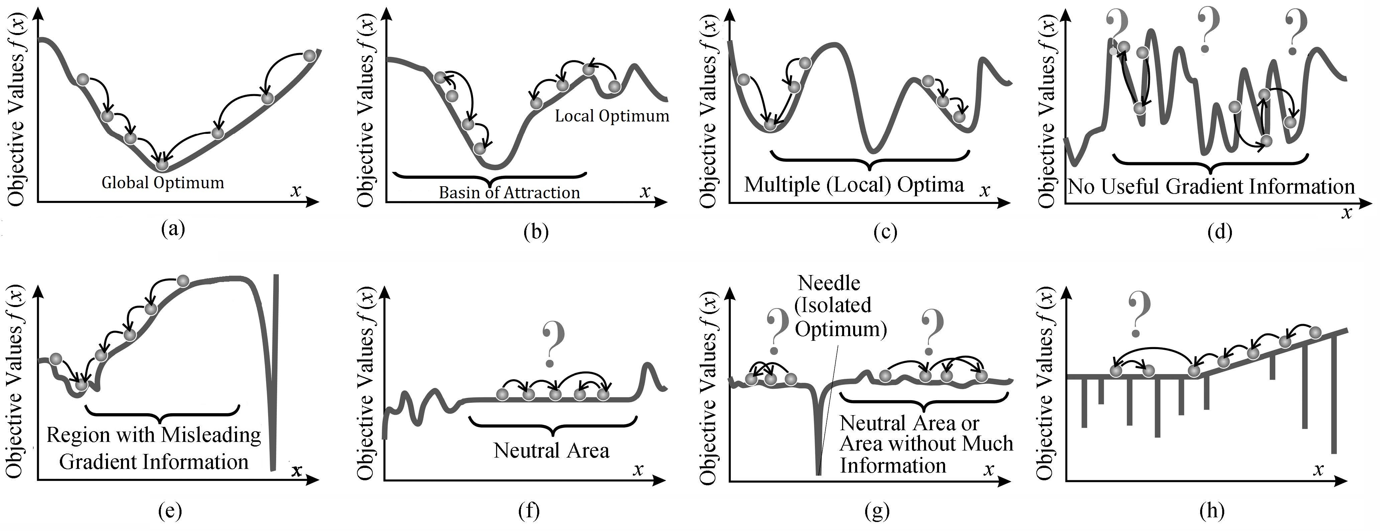
Terminologies
Fitness landscape

Slide 9
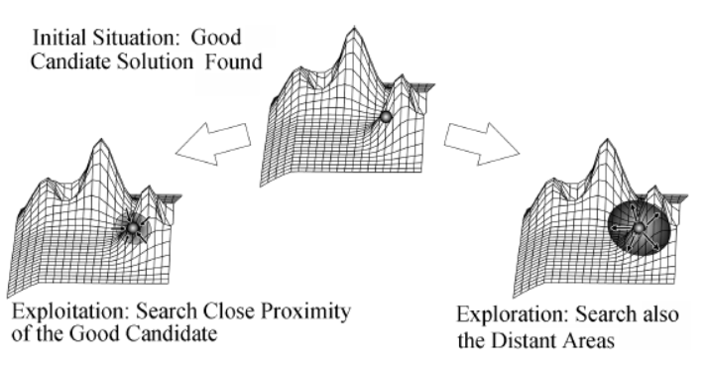
Terminologies
Exploration: The process of finding points in new areas of the search space that are rather distant from the currently investigated candidate solutions
Exploitation: The process of improving and combining the traits of the (best) currently known solutions

Slide 10
Terminologies
Convergence: Approach to a stationary system state, where the variation rate of the considered state variables goes to zero.
Premature convergence: The convergence to local optimal states.
Diversity: Measure(s) of the genotypic difference of individuals

Slide 11
Terminologies
Computational complexity:1) the time it takes to produce the desired outcome and 2) the storage space it needs for internal data, i.e., its time and space complexity.
P-problem: the set of all problem classes that can be solved on a computer within polynomial time.
NP problem: the set of problem classes that allows solution verification in polynomial time, e.g., TSP

Slide 12
Terminologies
A problem A is hard for a complexity class if every other problem in this class can be reduced to it.
Reducibility: A problem A can be reduced to problem B means the method for problem B can be also for solving problem A, e.g. methods for linear equation in one variable and two variables, the former can be reduced to the later.
Exactly solving any NP-hard problem is difficult as it may require super-polynomial, exponential time.

Slide 13
Terminologies
No Free Lunch (NFL) theorem: any two optimization algorithms are equivalent when their performance is averaged across all possible problems, i.e.,when you're considering all search spaces, hill-climbing is just a bad (or as good) as any other algorithm.
Wolpert, D.H., Macready, W.G. No Free Lunch Theorems for Optimization, IEEE Transactions on Evolutionary Computation, 1997, 1(1): 67-82.

Slide 14
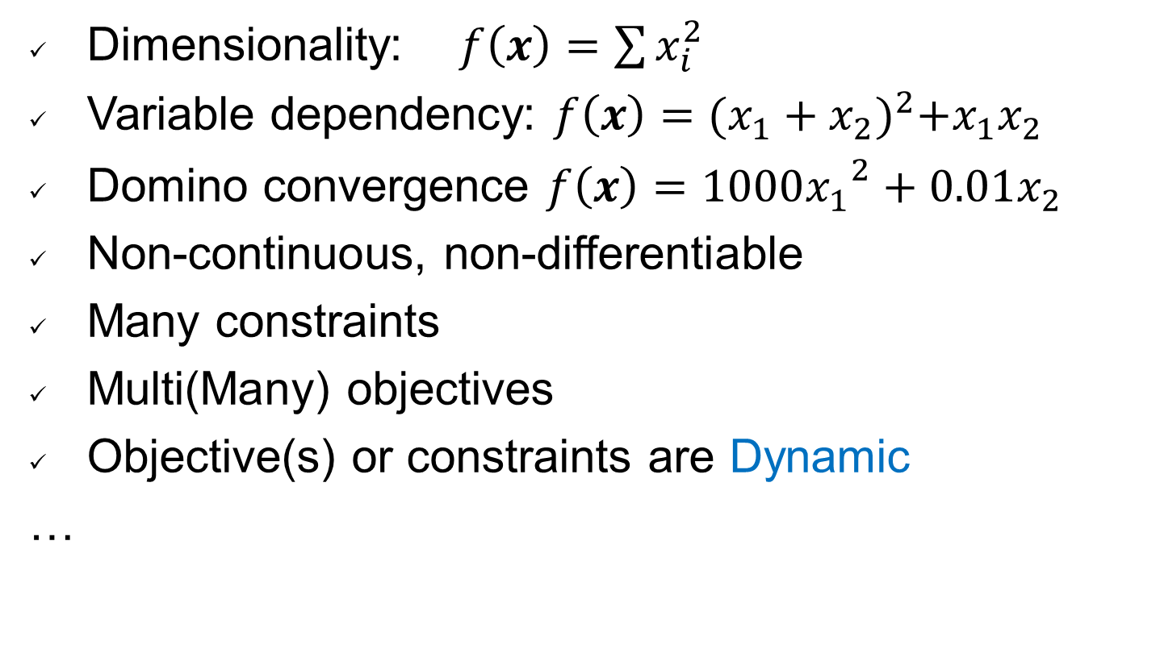
Difficulties
Dimensionality: $f\left(x\right)=\sum{x_{i}^{2}}$
Variable dependency: $f\left(x\right)={(x_{1}+x_{2})}^{2}+x_{1}x_{2}$
Domino convergence $f\left(x\right)={1000x_{1}}^{2}+0.01x_{2}$
Non-continuous, non-differentiable
Many constraints
Multi(Many) objectives
Objective(s) or constraints are Dynamic
…

Slide 15
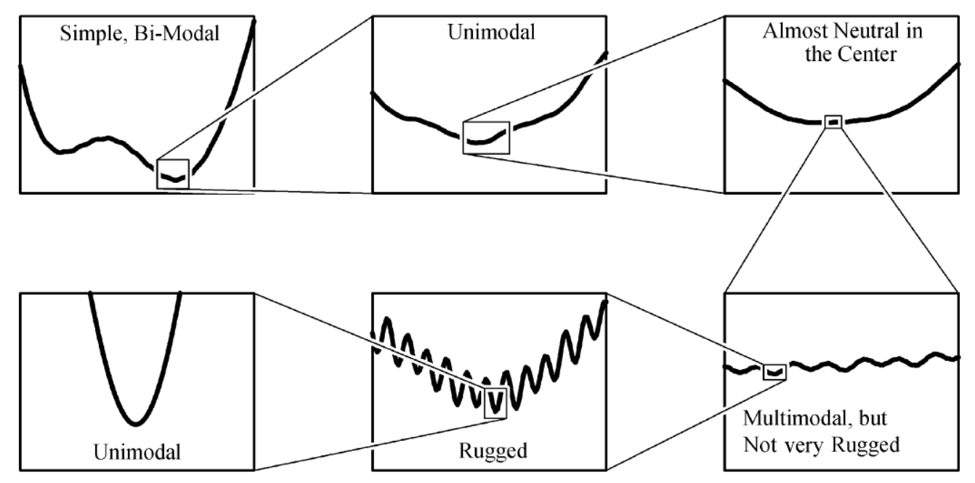
Difficulties

Slide 16
Classes of Search Techniques

Slide 17
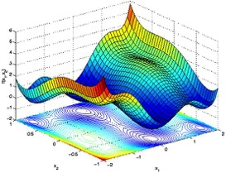
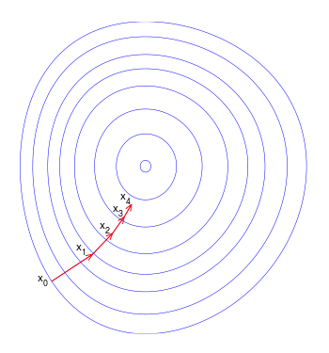
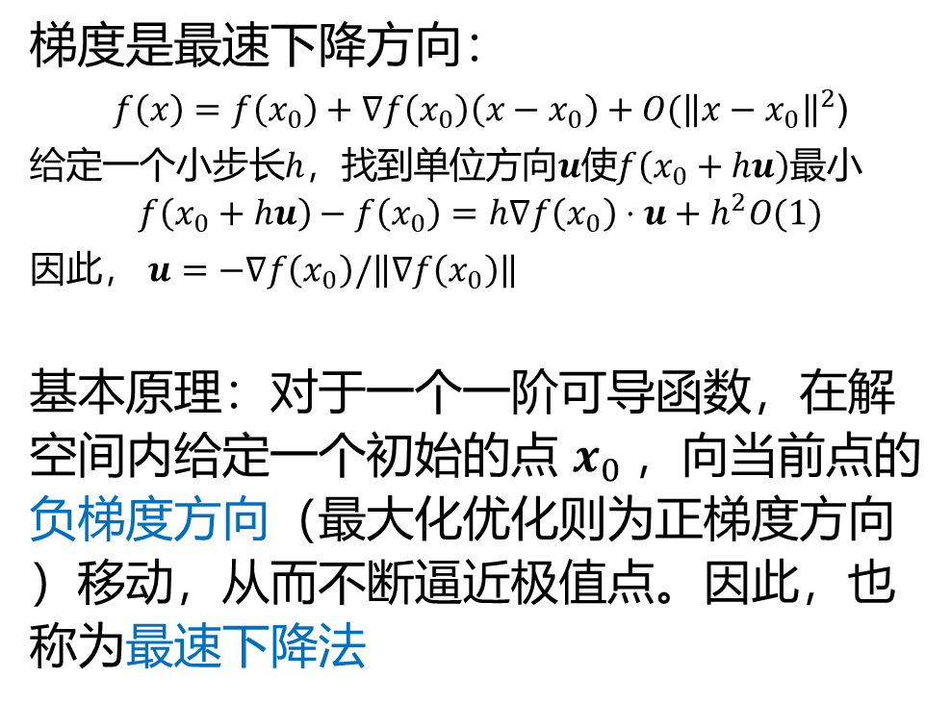
梯度下降(Gradient descend)法
梯度是最速下降方向：
$f\left(x\right)=f\left(x_{0}\right)+∇f\left(x_{0}\right)\left(x−x_{0}\right)+O({\left\|x−x_{0}\right\|}^{2}$)
给定一个小步长$h$，找到单位方向$u$使$f\left(x_{0}+hu\right)$最小
$$f\left(x_{0}+hu\right)−f\left(x_{0}\right)=h∇f\left(x_{0}\right)⋅u+h^{2}O(1)$$
因此， $u=−∇f\left(x_{0}\right)/\left\|∇f\left(x_{0}\right)\right\|$
基本原理：对于一个一阶可导函数，在解空间内给定一个初始的点 $x_{0}$，向当前点的负梯度方向（最大化优化则为正梯度方向）移动，从而不断逼近极值点。因此，也称为最速下降法
一个二元函数的目标值等值线图

Slide 18
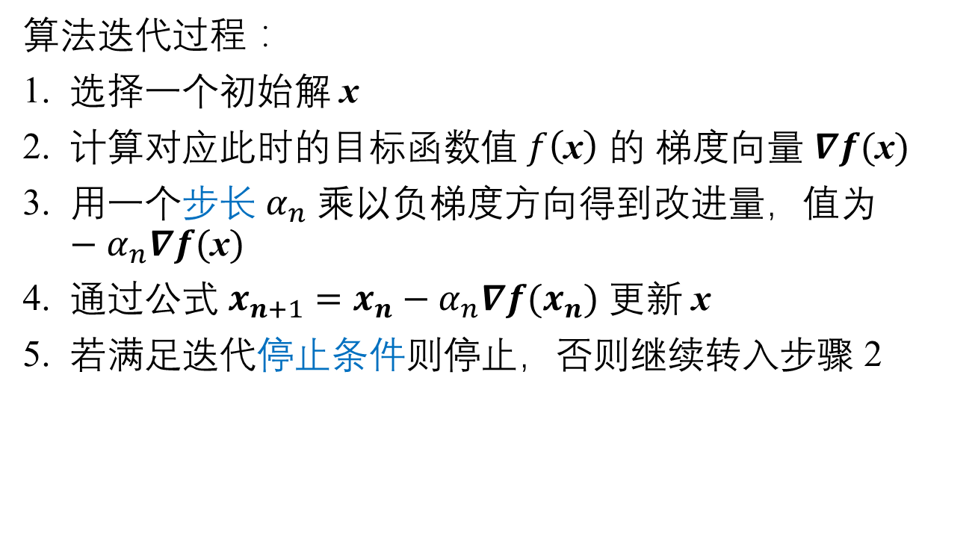
梯度下降法
算法迭代过程：
选择一个初始解 x
计算对应此时的目标函数值 $f\left(\text{x}\right)$ 的 梯度向量 $∇f(\text{x})$
用一个步长 $α_{n}$ 乘以负梯度方向得到改进量，值为 $−α_{n}∇f(\text{x})$
通过公式 $x_{n+1}=x_{n}−α_{n}∇f(x_{n})$ 更新 x
若满足迭代停止条件则停止，否则继续转入步骤 2

Slide 19
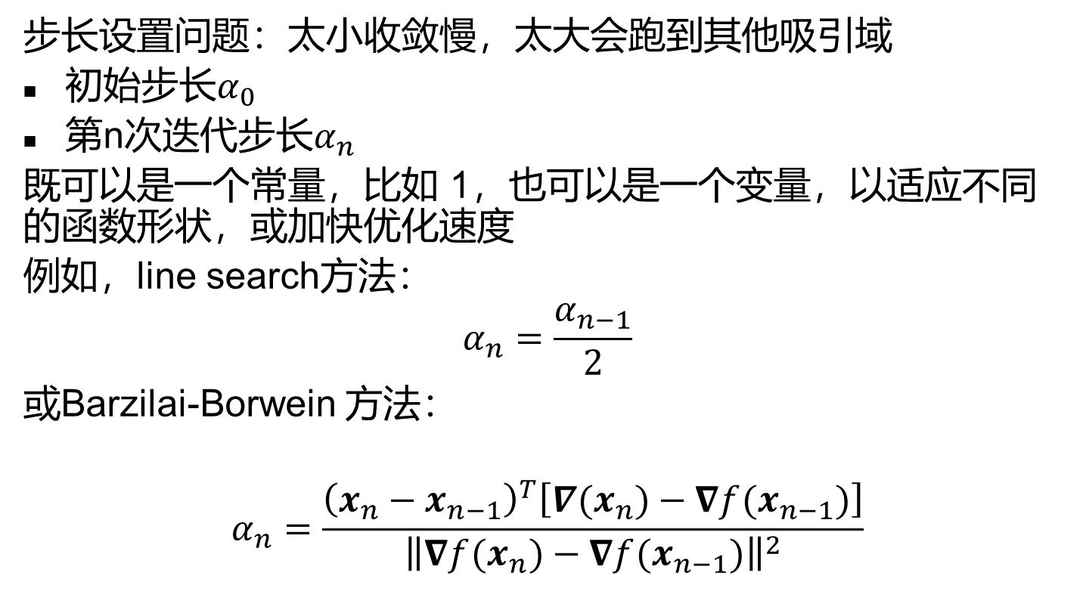
梯度下降法
步长设置问题：太小收敛慢，太大会跑到其他吸引域
初始步长$α_{0}$
第n次迭代步长$α_{n}$
既可以是一个常量，比如 1，也可以是一个变量，以适应不同的函数形状，或加快优化速度
例如，line search方法：
$$α_{n}=\frac{α_{n−1}}{2}$$
或Barzilai-Borwein 方法：
$$α_{n}=\frac{{\left(x_{n}−x_{n−1}\right)}^{T}\left[∇(x_{n})−∇f(x_{n−1})\right]}{{\left\|∇f(x_{n})−∇f(x_{n−1})\right\|}^{2}}$$

Slide 20
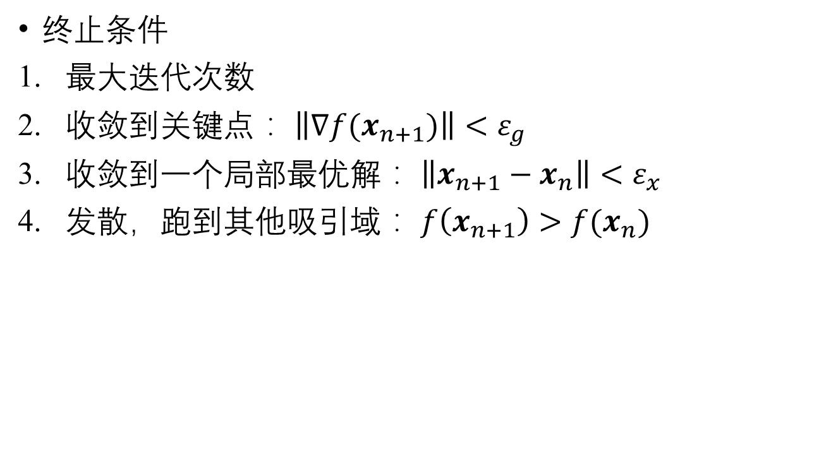
梯度下降法
终止条件
最大迭代次数
收敛到关键点： $\left\|∇f(x_{n+1})\right\|<ε_{g}$
收敛到一个局部最优解： $\left\|x_{n+1}−x_{n}\right\|<ε_{x}$
发散，跑到其他吸引域： $f\left(x_{n+1}\right)>f(x_{n})$

Slide 21
梯度下降法
应用实例：
求Rosenbrock函数的极值点
解决线性回归问题

Slide 22
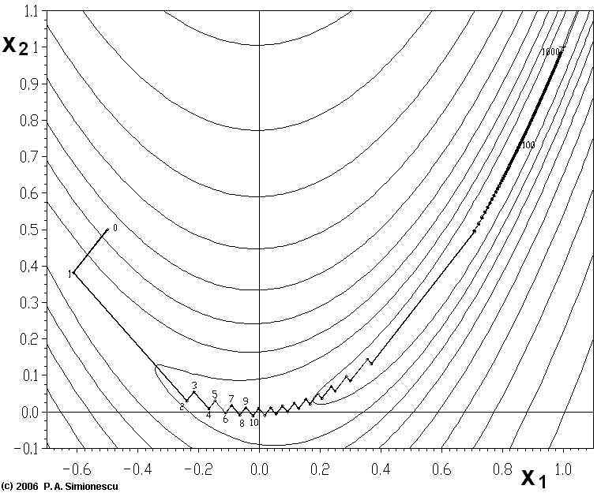
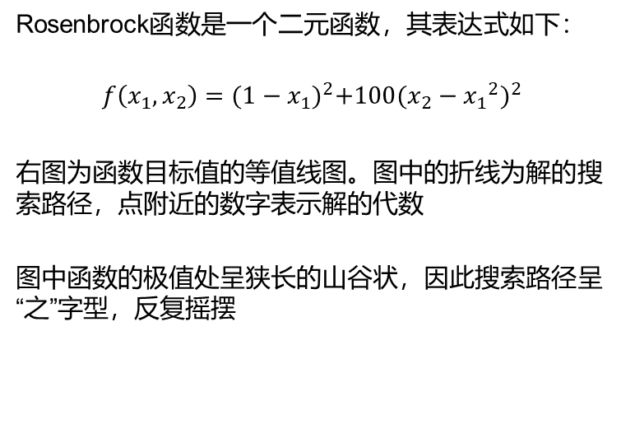
求Rosenbrock函数的极小值点
Rosenbrock函数是一个二元函数，其表达式如下：
$$f\left(x_{1},x_{2}\right)={(1−x_{1})}^{2}+100{({{x_{2}−x}_{1}}^{2})}^{2}$$
右图为函数目标值的等值线图。图中的折线为解的搜索路径，点附近的数字表示解的代数
图中函数的极值处呈狭长的山谷状，因此搜索路径呈“之”字型，反复摇摆

Slide 23
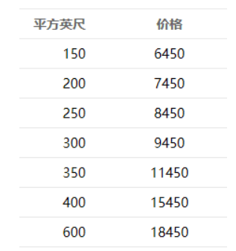
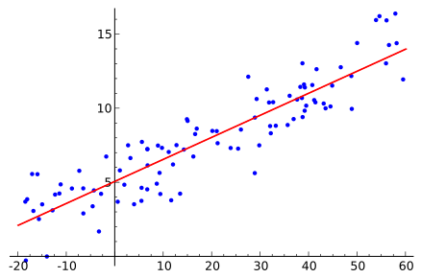
线性回归模型的参数估计
线性回归（Linear Regression）：拟合一批数据的自变量和因变量之间的线性关系，预测未知数据的值。
例如右图中的蓝色点为一批样本数据，横坐标表示自变量，纵坐标表示因变量。图中的红线就是我们要求的线性关系。
右图中数据的自变量是一个标量（特征），这种情况称为简单线性回归问题。而在多重线性回归问题中，数据的自变量是一个多维向量。

Slide 24
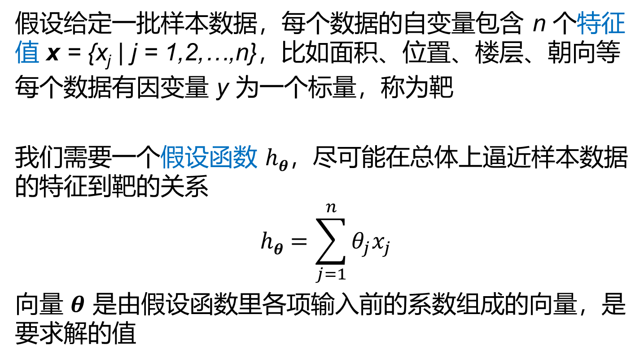
线性回归模型的参数估计
假设给定一批样本数据，每个数据的自变量包含 n 个特征值 x = {x_{j} | j = 1,2,…,n}，比如面积、位置、楼层、朝向等
每个数据有因变量 y 为一个标量，称为靶
我们需要一个假设函数 $hθ$，尽可能在总体上逼近样本数据的特征到靶的关系
$$hθ=\sum_{j=1}^{n}{θ_{j}x_{j}}$$
向量 $θ$ 是由假设函数里各项输入前的系数组成的向量，是要求解的值

Slide 25
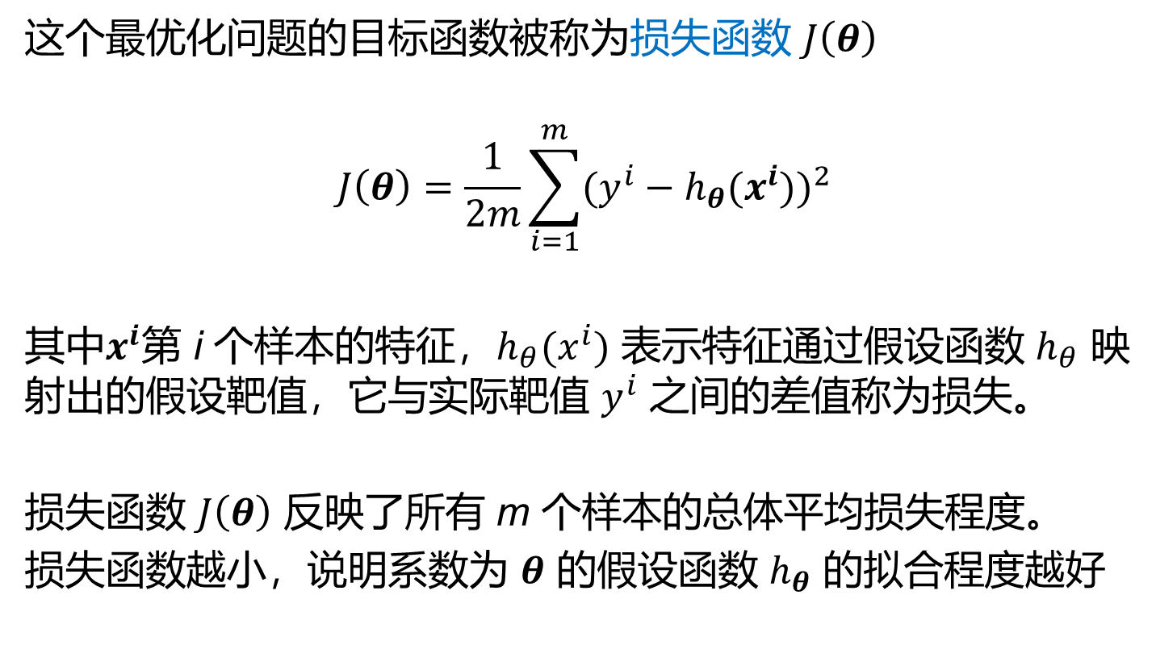
线性回归模型的参数估计
这个最优化问题的目标函数被称为损失函数 $J\left(θ\right)$
$$J\left(θ\right)=\frac{1}{2m}\sum_{i=1}^{m}{{(y^{i}−h_{θ}(x^{i}))}^{2}}$$
其中$x^{i}$第 i 个样本的特征，$h_{θ}(x^{i})$ 表示特征通过假设函数 $h_{θ}$ 映射出的假设靶值，它与实际靶值 $y^{i}$ 之间的差值称为损失。
损失函数 $J\left(θ\right)$ 反映了所有 m 个样本的总体平均损失程度。
损失函数越小，说明系数为 $θ$ 的假设函数 $h_{θ}$ 的拟合程度越好

Slide 26
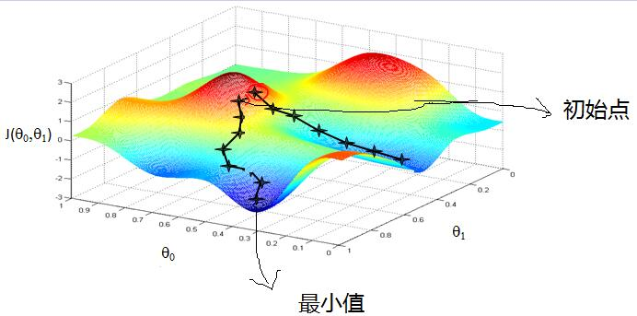
梯度下降法优缺点
梯度下降法在凸函数上能保证收敛到极值点。
为了尽可能逼近极值点，迭代过程中步长一般设计为逐渐变小，但这也导致靠近极值点时收敛速度减慢
沿最速方向是当前的最好选择，但整体上会呈现“之”字型的反复摇摆，导致收敛速度很慢
为了提高优化的收敛速度，提出了牛顿法

Slide 27
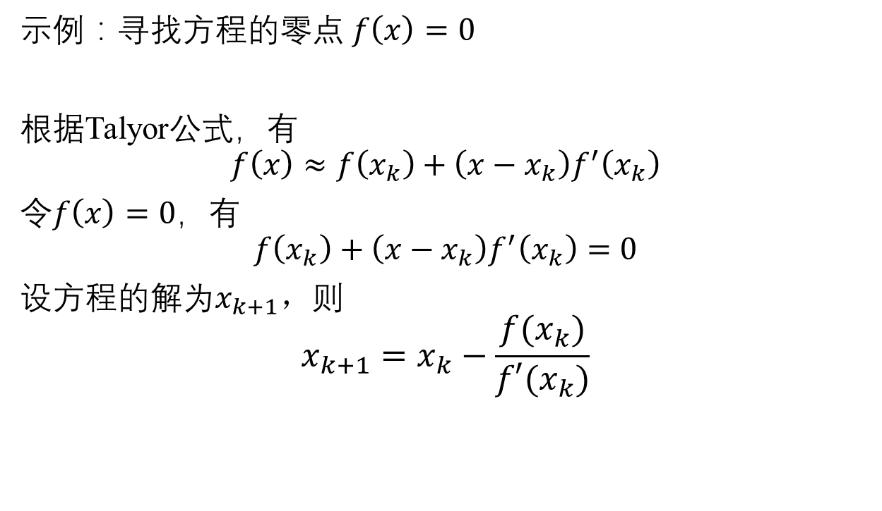
牛顿法(Newton’s method)
示例：寻找方程的零点 $f\left(x\right)=0$
根据Talyor公式，有
$$f\left(x\right)≈f\left(x_{k}\right)+\left(x−x_{k}\right)f^{′}\left(x_{k}\right)$$
令$f\left(x\right)=0$，有
$$f\left(x_{k}\right)+\left(x−x_{k}\right)f^{′}\left(x_{k}\right)=0$$
设方程的解为$x_{k+1}，$则
$$x_{k+1}=x_{k}−\frac{f(x_{k})}{f′(x_{k})}$$

Slide 28
牛顿法
过程如下：
选择一个初始点
计算该点的斜率，从而可以画出经过该点的切线
该切线与x轴的交点即为改进点
重复迭代此过程即可无限逼近实际零点
牛顿法迭代过程示意图

Slide 29
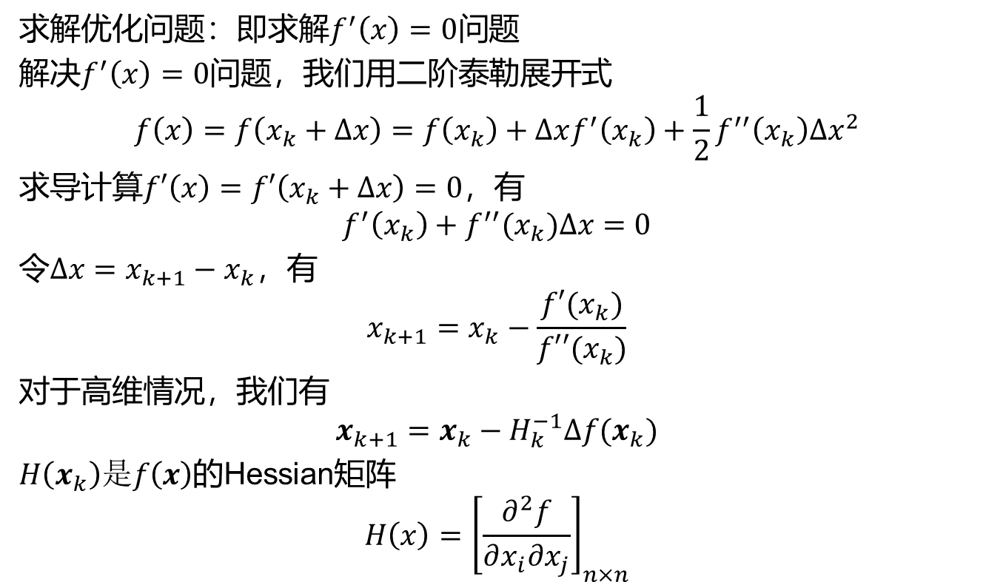
牛顿法
求解优化问题：即求解$f^{′}\left(x\right)=0$问题
解决$f^{′}\left(x\right)=0$问题，我们用二阶泰勒展开式
$$f\left(x\right)=f\left(x_{k}+∆x\right)=f\left(x_{k}\right)+∆xf^{′}\left(x_{k}\right)+\frac{1}{2}f^{′′}\left(x_{k}\right){∆x}^{2}$$
求导计算$f′\left(x\right)=f′\left(x_{k}+∆x\right)=0$，有
$$f^{′}\left(x_{k}\right)+f^{′′}(x_{k})∆x=0$$
令$∆x=x_{k+1}−x_{k}$，有
$$x_{k+1}=x_{k}−\frac{f′(x_{k})}{f′′(x_{k})}$$
对于高维情况，我们有
$$x_{k+1}=x_{k}−H_{k}^{−1}∆f(x_{k})$$
$H\left(x_{k}\right)是f\left(x\right)$的Hessian矩阵
$$H\left(x\right)={\left[\frac{∂^{2}f}{∂x_{i}∂x_{j}}\right]}_{n×n}$$

Slide 30

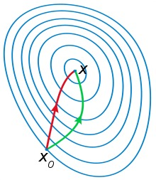
牛顿法
牛顿法是二阶收敛，梯度下降是一阶收敛，所以牛顿法更快。但牛顿法的使用条件更为严格，需要已知极值，函数导数不能为零，且尽在函数导数连续的情况下保证算法收敛。
除了严格的使用条件以外，牛顿法的每一步都需要计算目标函数的Hessian矩阵的逆矩阵，计算量很大。
为了改善这个缺陷，提出了拟牛顿法。它使用正定矩阵来近似Hessian矩阵的逆矩阵，从而简化计算复杂度。

Slide 31
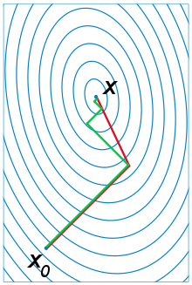
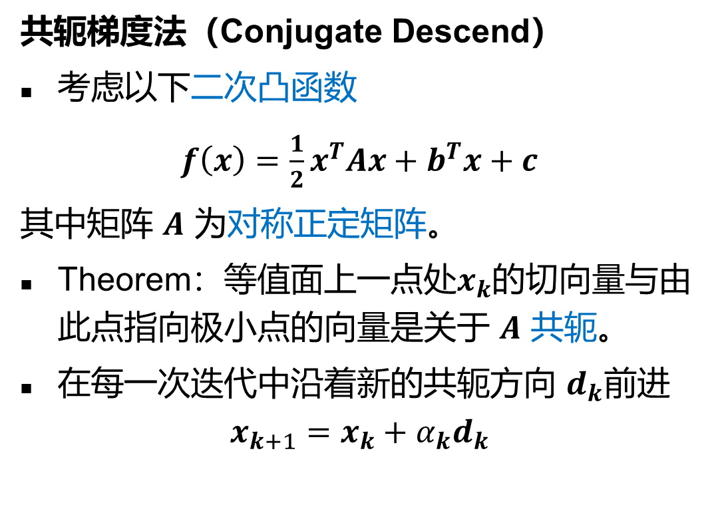
其他迭代算法
共轭梯度法（Conjugate Descend）
考虑以下二次凸函数
$f\left(x\right)=\frac{1}{2}x^{T}Ax+b^{T}x+c$
其中矩阵 $A$ 为对称正定矩阵。
Theorem：等值面上一点处$x_{k}$的切向量与由此点指向极小点的向量是关于 $A$ 共轭。
在每一次迭代中沿着新的共轭方向 $d_{k}$前进
$$x_{k+1}=x_{k}+α_{k}d_{k}$$
梯度下降法（绿）与共轭梯度法（红）对比
其中步长$α_{k}$通过当前的梯度方向和上一代的共轭方向求得

Slide 32
其他迭代算法
共轭梯度法
共轭梯度法是介于最速下降法与牛顿法之间的一个方法，它仅需利用一阶导数信息，但克服了最速下降法收敛慢的缺点，又避免了牛顿法需要存储和计算Hesse矩阵并求逆的缺点
共轭梯度法不仅是解决大型线性方程组最有用的方法之一，也是解大型非线性最优化最有效的算法之一
依然对初始点敏感，对于非线性问题，无法避免局部最优

Slide 33
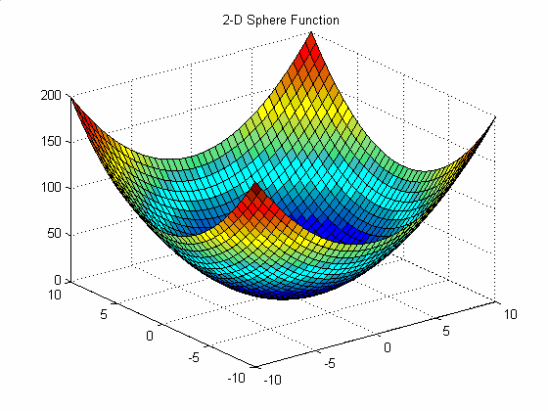




A single agent by following gradient descent
Direction Of negative gradient

Slide 34
Difficulty in Searching Global Optima
barrier to local search
starting
point
descend
direction
local minima
global minima
Notes:
Local search techniques, such as steepest descend method, are very good in finding local optima. However, difficulties arise when the global optima is different from the local optima. Since all the immediate neighboring points around a local optima is worse than it in the performance value, local search can not proceed once trapped in a local optima point. We need some mechanism that can help us escape the trap of local optima. And the simulated annealing is one of such methods.

Slide 35
Intuition of Simulated Annealing
Origin:
The annealing process of heated solids.
Intuition:
By allowing occasional ascent in the search process, we might be able to escape the trap of local minima.
Notes:
The name of simulated annealing origins from the simulation of annealing process of heated solids. “In condensed matter physics, annealing denotes a physical process in which a solid in a heat bath is heated up by increasing the temperature of the heat bath to a maximum value at which all particles of the solid randomly arrange themselves in the liquid phase, followed by cooling through slowly lowering the temperature of the heat bath. In this way, all particles arrange themselves in the low energy ground state of a corresponding lattice.” (quoted from Simulated Annealing: Theory and Applications)
In solving combinatorial optimization problems, we make an analogy to the aforementioned process. The basic idea is that by allowing the search process to proceed in an unfavorable direction occasionally, we might be able to escape the trap of local optima and reach the global optima.

Slide 36
Simulated Annealing
desired effect
Help escaping the
local optima.
adverse effect
Might pass global optima
after reaching it
Notes:
However, like swords have two edges, there are two consequences of allowing occasional ascent steps. On one hand, it fulfills our desire to let the algorithm proceed beyond local optima. On the other hand, we might miss the global optima by allowing the search process to pass through it. To maintain the desired effect and reduce the adverse effect, we need a sophisticated scheme to control the acceptance of occasional ascents, which is the heart of simulated annealing.

Slide 37
Simulated Annealing
Global-Maximum
Local-Maximum
Valley

Slide 38

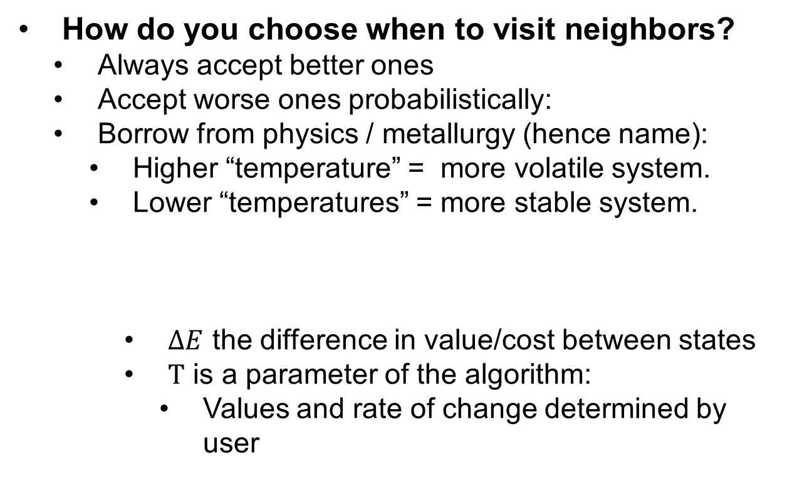
Simulated Annealing
How do you choose when to visit neighbors?
Always accept better ones
Accept worse ones probabilistically:
Borrow from physics / metallurgy (hence name):
Higher “temperature” = more volatile system.
Lower “temperatures” = more stable system.
$ΔE$ the difference in value/cost between states
$T$ is a parameter of the algorithm:
Values and rate of change determined by user
$$P=exp\left(\frac{ΔE}{T}\right)$$

Slide 39
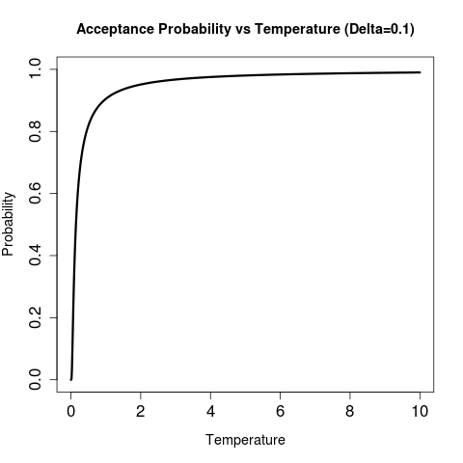
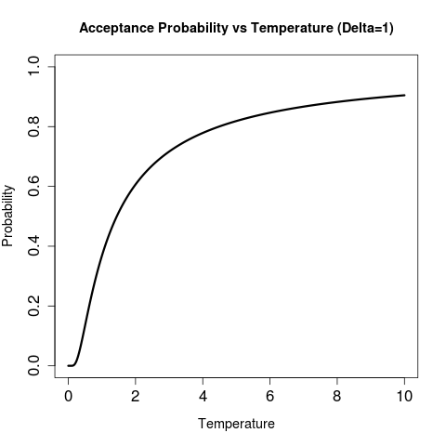
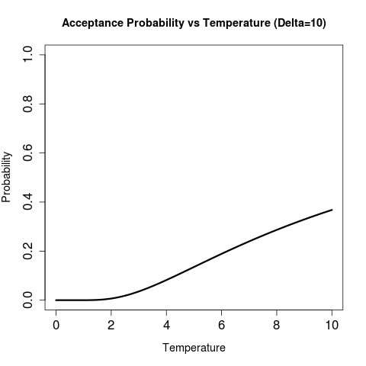
Simulated Annealing
Acceptance of new state is a function of temperature and how good/bad the state is compared to current one:
Relatively good states (low-delta) are almost always accepted

Slide 40
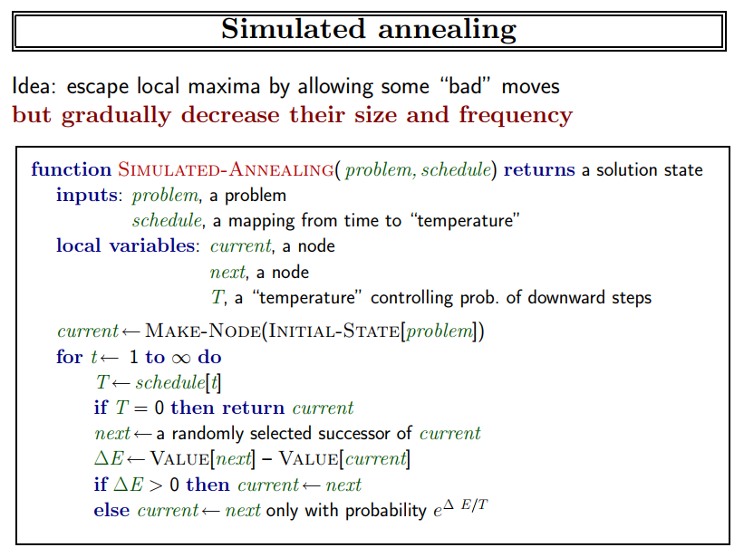
maximization

Slide 41
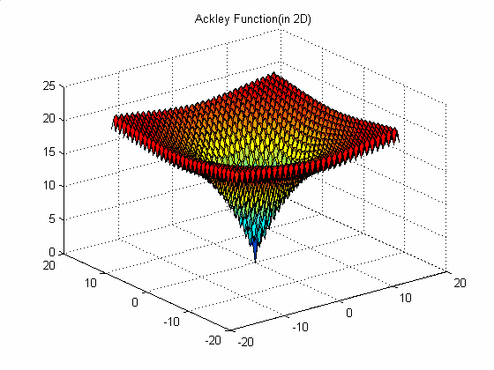
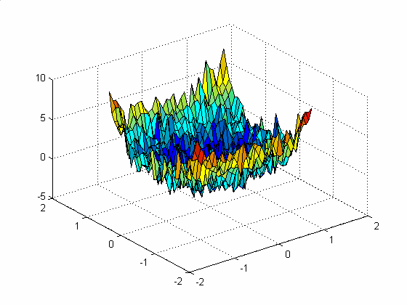
What about these multi-modal, noisy and even discontinuous functions?

Slide 42
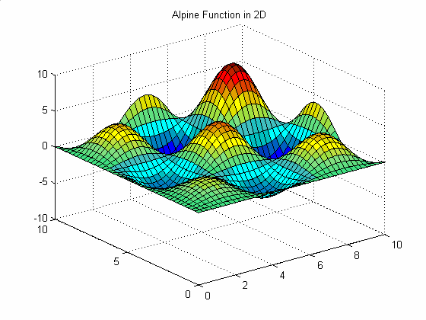
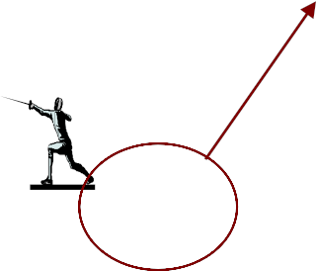








Multi-Agent Optimization in Continuous Space
Agents
Randomly Initialized Agents

Slide 43

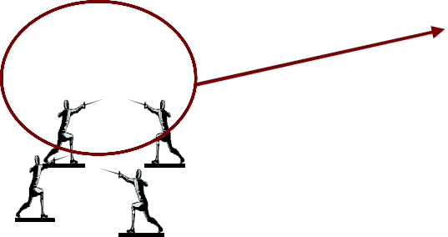

After Convergence

Slide 44
总结
基于梯度的最优化方法在满足某些严格条件下能保证收敛全局最优
不适合求解非线性、多模态的最优化问题
无法求解非连续、不可导、病态的问题
无法求解离散空间内的优化问题，e.g.，背包问题、TSP等
无法求解多目标优化问题

