Slide 1
Differential Evolution
From Differential Evolution: Foundations, Perspectives, and Applications, by Swagatam Das, SSCI

Slide 2
Outlines
Introduction of DE
Steps of the basic DE family of algorithms
Control parameters of DE
Some significant DE-variants
Application demons

Slide 3


Differential Evolution
A stochastic population-based algorithm for continuous function optimization
History
Developed by Kenneth Price and Rainer Storn,1995
Chebychev Polynomial fitting Problem
DE Homepage
http://www1.icsi.berkeley.edu/~storn/code.html
Kenneth Price
Rainer Storn
R. Storn and K. Price, "Differential Evolution: A Simple and Efficient Adaptive Scheme for Global Optimization over Continuous Spaces", Technical Report TR-95-012, International Computer Science Institute, Berkeley, CA, 1995.
R. Storn and K. Price, "Minimizing the real functions of the ICEC'96 contest by differential evolution", in Proceedings of IEEE International Conference on Evolutionary Computation, 1996.

Slide 4
Differential Evolution
Outperformed GA and PSO on a 34-function test suite (Vesterstrom & Thomsen, 2004)
Remarkable performance in competitions on different kinds of optimization problems like dynamic, multi-objective, constrained, and multi-modal problems held under IEEE congress on Evolutionary Computation (CEC) conference series.

Slide 5
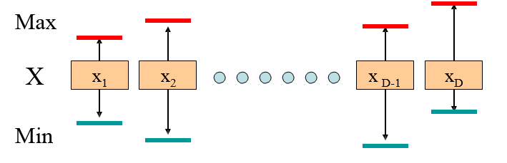
Representation
Solutions are represented as vectors of size D with each value taken from some domain.
May wish to constrain the values taken in each domain above and below.

Slide 6
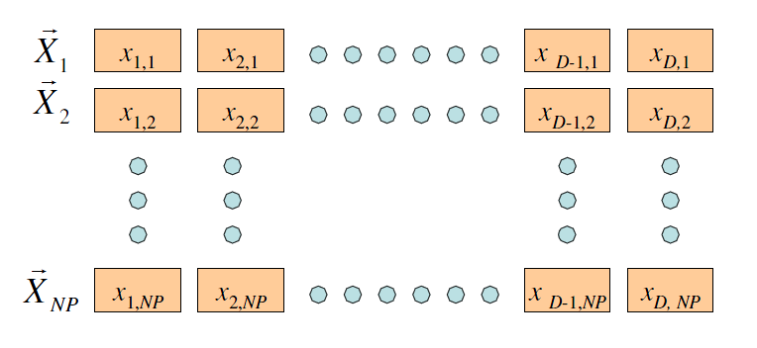
Population
A population of size NP

Slide 7
Steps of the basic DE families
DE is an Evolutionary Algorithm
Basic steps of an Evolutionary Algorithm
Initialization
Mutation
Recombination
Selection

Slide 8
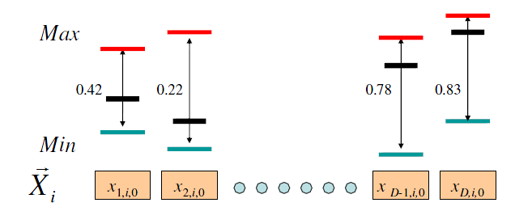
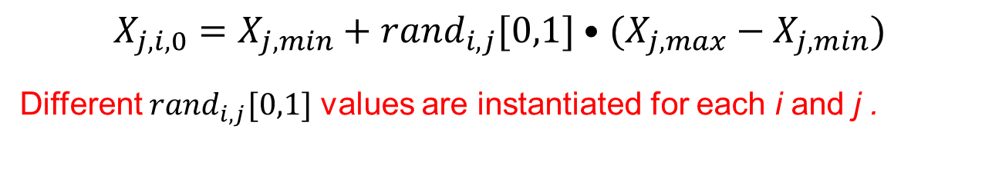
Initialization
Mutation
Recombination
Selection
$$X_{j,i,0}=X_{j,min}+{rand}_{i,j}[0,1]•(X_{j,max}−X_{j,min})$$
Different ${rand}_{i,j}[0,1]$ values are instantiated for each i and j .

Slide 9
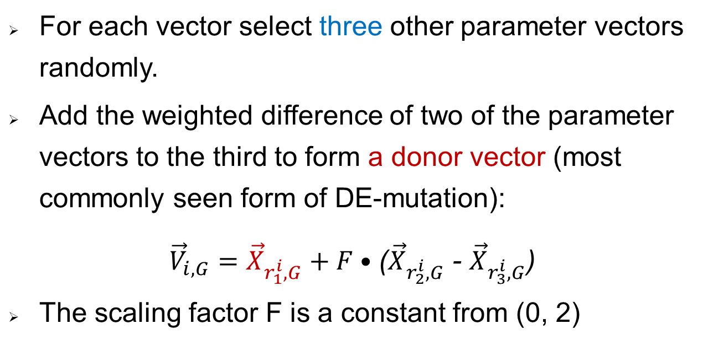
Initialization
Mutation
Recombination
Selection
For each vector select three other parameter vectors randomly.
Add the weighted difference of two of the parameter vectors to the third to form a donor vector (most commonly seen form of DE-mutation):
${\vec{V}}_{i,G}=$ ${\vec{X}}_{r_{1}^{i},G}+F•$(${\vec{X}}_{r_{2}^{i},G}$ - ${\vec{X}}_{r_{3}^{i},G}$)
The scaling factor F is a constant from (0, 2)

Slide 10
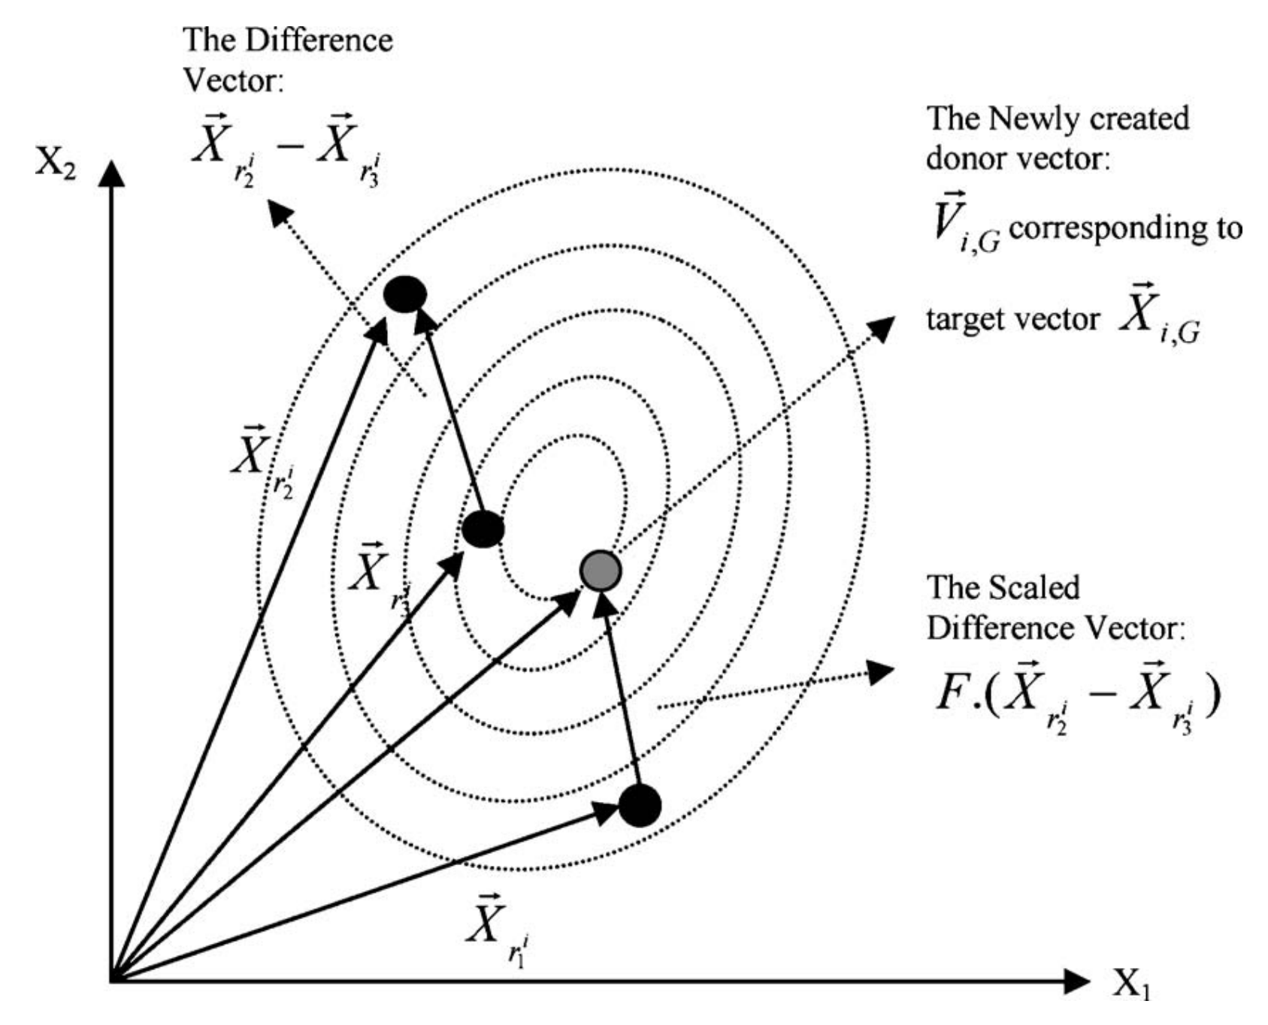
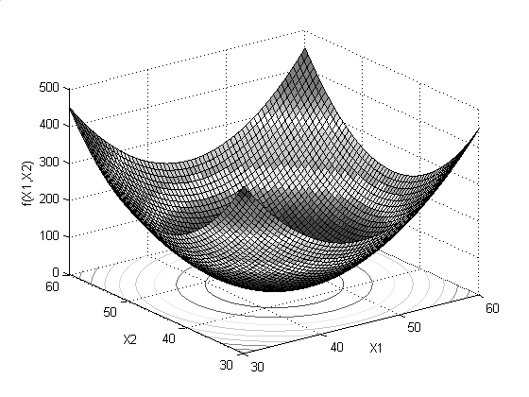
Example of formation of donor vector

Slide 11
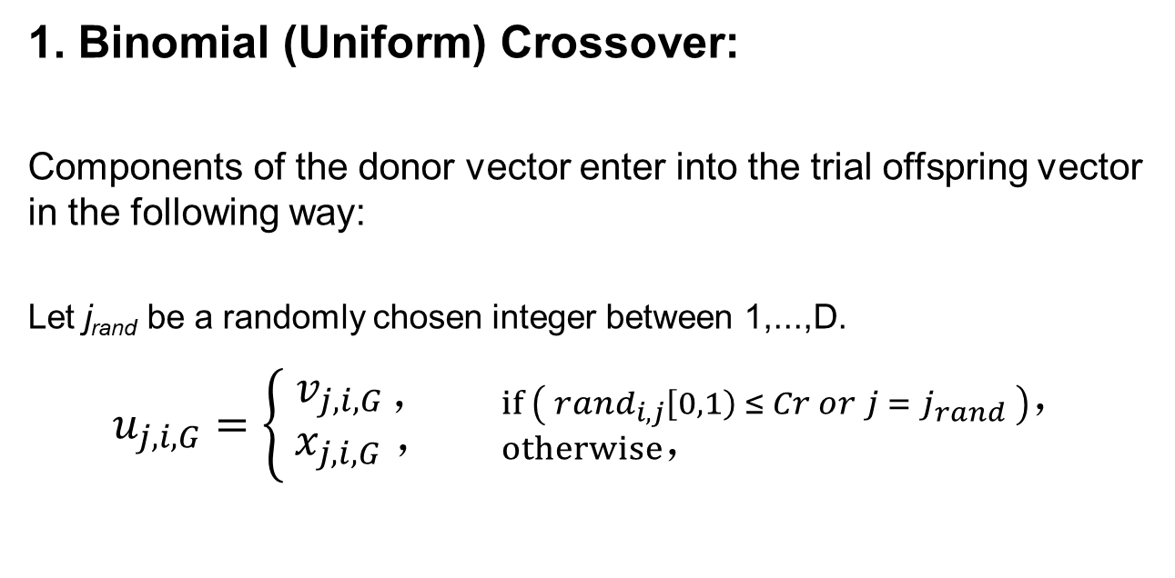
Initialization
Mutation
Recombination
Selection
1. Binomial (Uniform) Crossover:
Components of the donor vector enter into the trial offspring vector in the following way:
Let j_{rand} be a randomly chosen integer between 1,...,D.
$u_{j,i,G}=\left\{\begin{aligned}{ v}_{j,i,G ，} \\ { x}_{j,i,G} ，\end{aligned}\right.$ ${if \left({ rand}_{i,j}\left[0,1\right) ≤ Cr or j ={ j}_{rand} \right)， \atop otherwise， }$

Slide 12
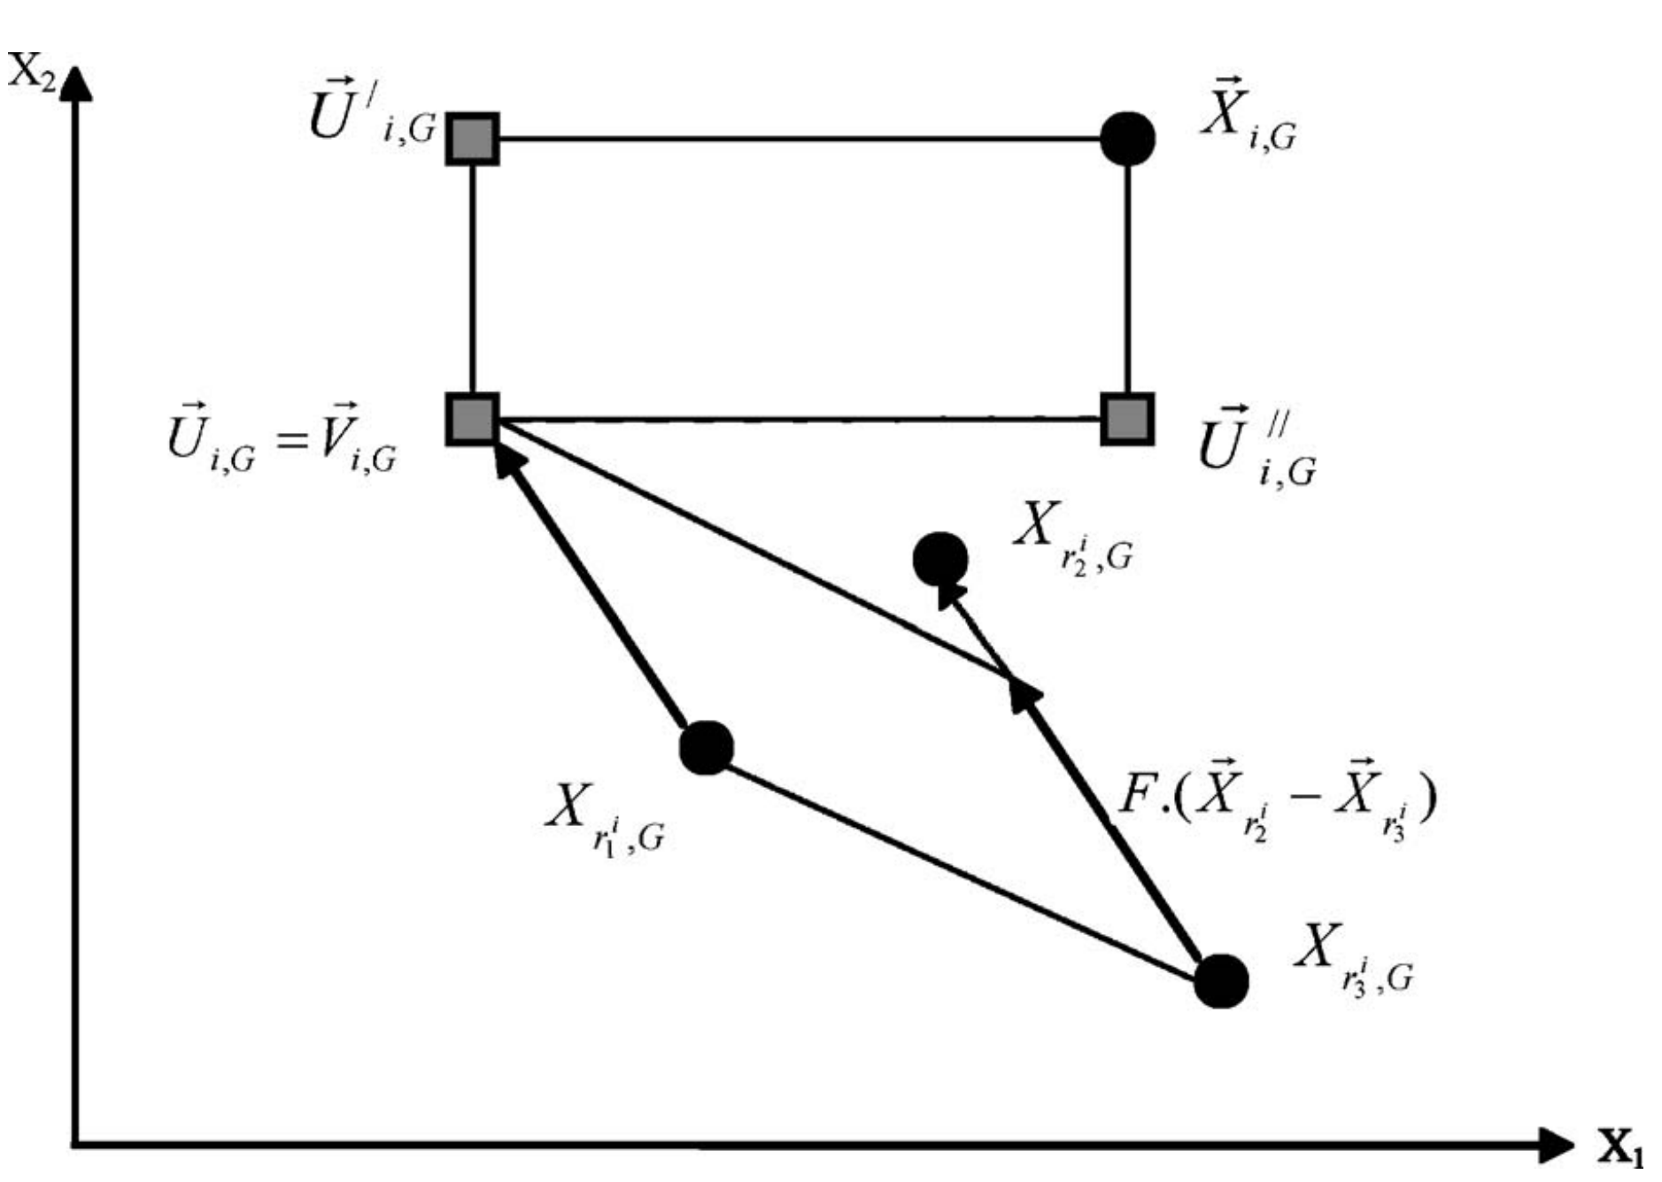
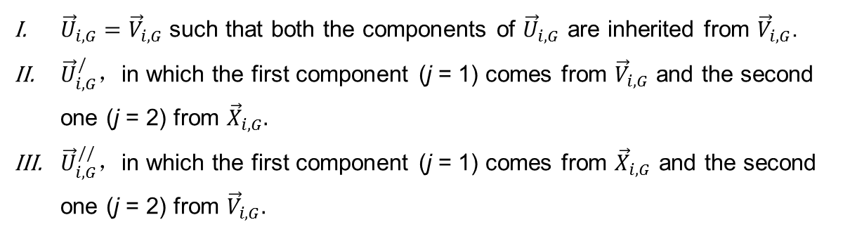
An Illustration of Binomial Crossover in 2-D Parametric Space:
${\vec{U}}_{i,G}={\vec{V}}_{i,G}$ such that both the components of ${\vec{U}}_{i,G}$ are inherited from ${\vec{V}}_{i,G}$.
${\vec{U}}_{i,G}^{/}，$in which the first component (j = 1) comes from ${\vec{V}}_{i,G}$ and the second one (j = 2) from ${\vec{X}}_{i,G}.$
${\vec{U}}_{i,G}^{//}，$in which the first component (j = 1) comes from ${\vec{X}}_{i,G}$ and the second one (j = 2) from ${\vec{V}}_{i,G}.$

Slide 13

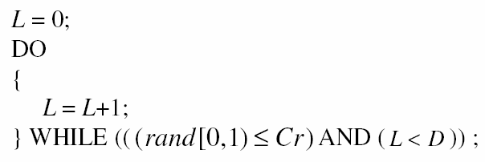
2. Exponential (two-point modulo) Crossover
First choose integers n (as starting point) and L (number of components the donor actually contributes to the offspring) from the interval [1,D]
Pseudo-code for choosing L:

Slide 14
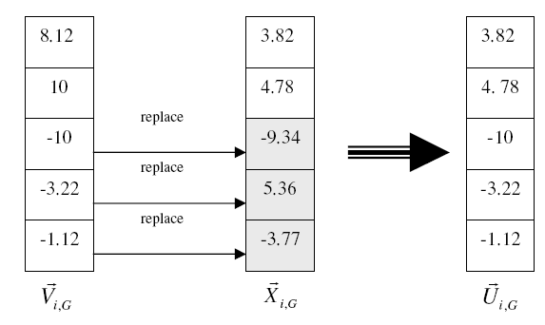
Suppose n = 3 and L= 3 for this specific example. Then the exponential crossover process can be shown as:

Slide 15
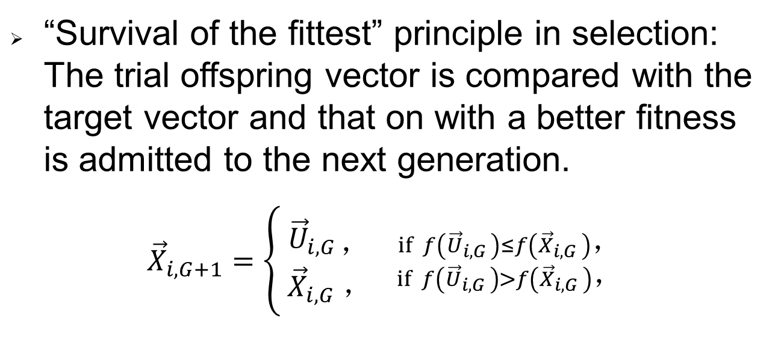
Initialization
Mutation
Recombination
Selection
“Survival of the fittest” principle in selection: The trial offspring vector is compared with the target vector and that on with a better fitness is admitted to the next generation.
${\vec{X}}_{i,G+1}=\left\{\begin{aligned}{ \vec{U}}_{i,G ，} \\ { \vec{X}}_{i,G} ，\end{aligned}\right.$ ${if f\left({\vec{U}}_{i,G }\right)≤f\left({\vec{X}}_{i,G }\right)， \atop if f\left({\vec{U}}_{i,G }\right)>f\left({\vec{X}}_{i,G }\right)，}$

Slide 16
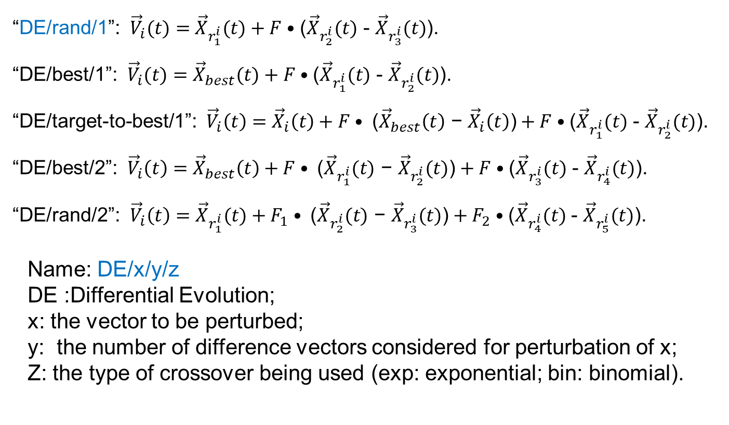
Five most frequently used DE mutation schemes
“DE/rand/1”: ${\vec{V}}_{i}(t)=$ ${\vec{X}}_{r_{1}^{i}}(t)+F•$(${\vec{X}}_{r_{2}^{i}}(t)$ - ${\vec{X}}_{r_{3}^{i}}(t)$).
“DE/best/1”: ${\vec{V}}_{i}(t)=$ ${\vec{X}}_{best}(t)+F•$(${\vec{X}}_{r_{1}^{i}}(t)$ - ${\vec{X}}_{r_{2}^{i}}(t)$).
“DE/target-to-best/1”: ${\vec{V}}_{i}\left(t\right)={\vec{X}}_{i}\left(t\right)+F• \text{(}{\vec{X}}_{best}\left(t\right)\text{ −} {\vec{X}}_{i}\left(t\right)\text{)}+F•$(${\vec{X}}_{r_{1}^{i}}(t)$ - ${\vec{X}}_{r_{2}^{i}}(t)$).
“DE/best/2”: ${\vec{V}}_{i}\left(t\right)={\vec{X}}_{best}\left(t\right)+F• \text{(}{\vec{X}}_{r_{1}^{i}}(t)\text{ − }{\vec{X}}_{r_{2}^{i}}(t)\text{)}+F•$(${\vec{X}}_{r_{3}^{i}}(t)$ - ${\vec{X}}_{r_{4}^{i}}(t)$).
“DE/rand/2”: ${\vec{V}}_{i}\left(t\right)={\vec{X}}_{r_{1}^{i}}(t)+F_{1}• \text{(}{\vec{X}}_{r_{2}^{i}}(t)\text{ − }{\vec{X}}_{r_{3}^{i}}(t)\text{)}+F_{2}•$(${\vec{X}}_{r_{4}^{i}}(t)$ - ${\vec{X}}_{r_{5}^{i}}(t)$).
Name: DE/x/y/z
DE :Differential Evolution;
x: the vector to be perturbed;
y: the number of difference vectors considered for perturbation of x;
Z: the type of crossover being used (exp: exponential; bin: binomial).

Slide 17
Control parameters of DE
The Scale Factor F:
1) Much more sensitive to F than Cr .
2) The upper limit of the scale factor F is empirically taken as 1(F > 1 is ok, however, until date, no benchmark function that was successfully optimized with F > 1.
3) Zaharie derived a lower limit of F and the study revealed that if F is sufficiently small, the population can converge even in the absence of selection pressure.

Slide 18
1) Typically 0.4 < F < 0.95 with F = 0.9 can serve as a good first choice
2) Randomizing F may yield good results over a variety of functions
3) Time-varying scale factor where the value of F is linearly decreased from1 to 0.5 with a view of promoting exploration of diverse regions of the search volume during earlier stages of search while favoring exploitation during the final stages.

Slide 19
The Crossover Rate Cr:
1) Cr controls how many parameters in expectation, are changed in a population member.
2) Low value of Cr, a small number of parameters are changed in each generation and the stepwise movement tends to be orthogonal to the current coordinate axes.
3) High values of Cr (near 1) cause most of the directions of the mutant vector to be inherited prohibiting the generation of axis orthogonal steps.

Slide 20
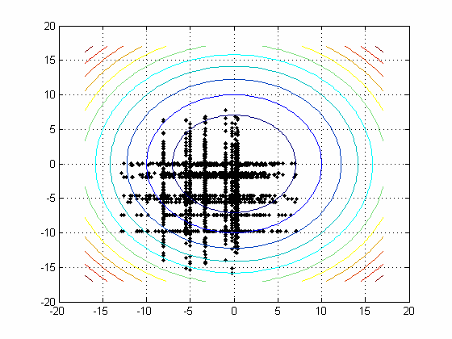
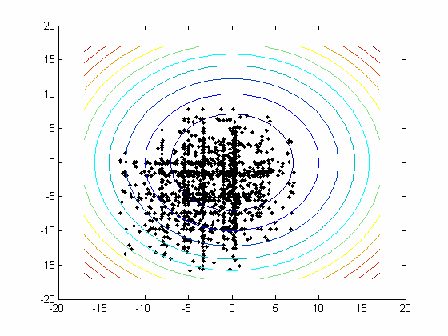
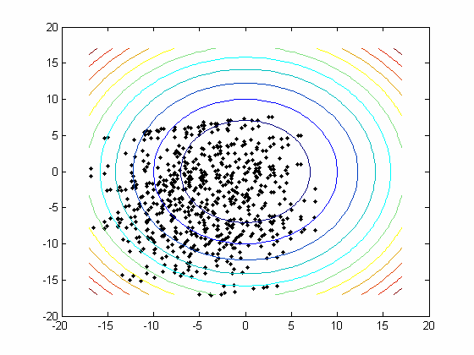

The Crossover Rate Cr (Contd.):
For schemes like DE/rand/1/bin the performance is rotationally invariant only when Cr = 1.
At that setting, crossover is a vector-level operation that makes the trial vector a pure mutant i.e.
${\vec{U}}_{i,G}=$ ${\vec{X}}_{r_{1}^{i},G}+F•$(${\vec{X}}_{r_{2}^{i},G}$ - ${\vec{X}}_{r_{3}^{i},G}$)
A low Cr value (e.g. 0 or 0.1) results in a search that changes each direction (or a small subset of directions) separately.
This is an effective strategy for functions that are separable or decomposable i.e. $f$($\vec{X}$) = $\sum_{i=1}^{D}{f_{i}(x_{i})}$.
(a) Cr = 0 (b) Cr = 0.5 (c) Cr = 1.0

Slide 21
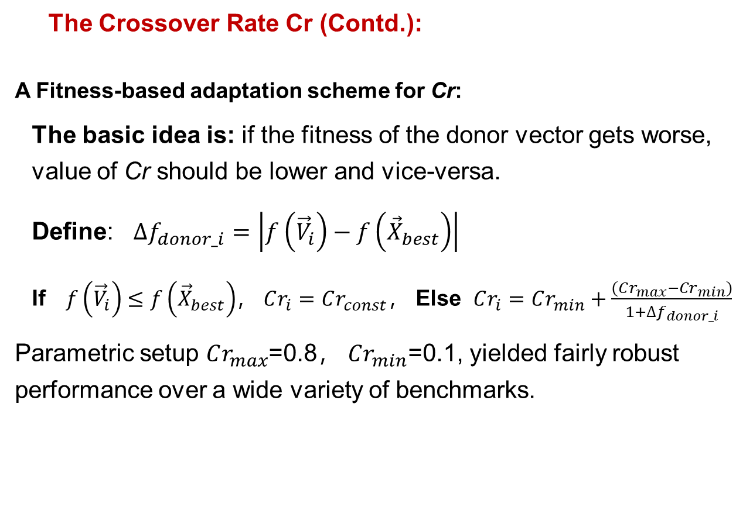
The Crossover Rate Cr (Contd.):
A Fitness-based adaptation scheme for Cr:
The basic idea is: if the fitness of the donor vector gets worse, value of Cr should be lower and vice-versa.
Define: $∆f_{donor_i}=\left|f\left({\vec{V}}_{i}\right)−f\left({\vec{X}}_{best}\right)\right|$
If$f\left({\vec{V}}_{i}\right)≤f\left({\vec{X}}_{best}\right)$， $Cr_{i}=Cr_{const}$， Else $Cr_{i}=Cr_{min}+\frac{(Cr_{max}−Cr_{min})}{1+∆f_{donor_i}}$
Parametric setup $Cr_{max}$=0.8， $Cr_{min}$=0.1, yielded fairly robust performance over a wide variety of benchmarks.

Slide 22
The population size NP：
1) The influence of NP on the performance of DE is yet to be extensively studied and fully understood.
2) Storn and Price have indicated that a reasonable value for NP could be chosen between 5D and 10D (D being the dimensionality of the problem).
3) Brest and Maučec presented a method for gradually reducing population size of DE. The method improves the efficiency and robustness of the algorithm and can be applied to any variant of a DE algorithm.

Slide 23
Some Significant DE-variants
The ‘jDE’ Algorithm
Self-Adaptive DE (SaDE)
Opposition-based DE (ODE)
JADE
DE with Neighborhood-based Mutation
AEPD

Slide 24
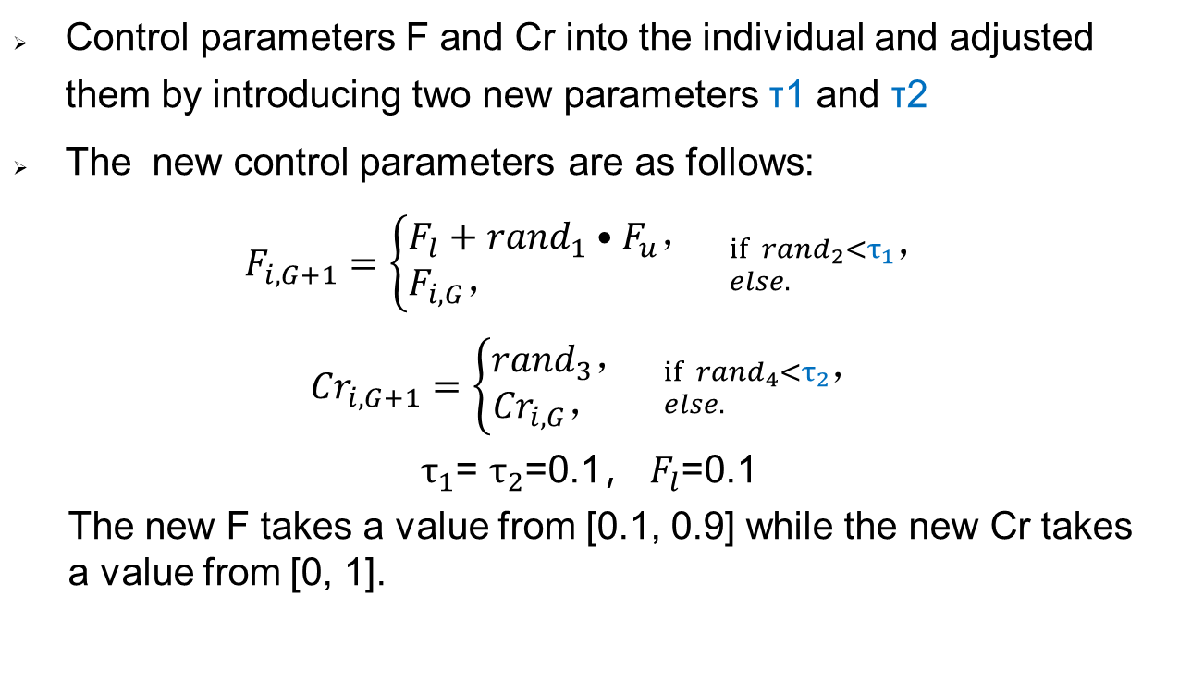
The ‘jDE’ Algorithm (Brest et al., 2006)
Control parameters F and Cr into the individual and adjusted them by introducing two new parameters τ1 and τ2
The new control parameters are as follows:
$F_{i,G+1}=\left\{\begin{aligned}F_{l}+{rand}_{1}•F_{u}， \\ F_{i,G}， \end{aligned}\right.$ ${if {rand}_{2}<τ_{1}， \atop else. }$
${Cr}_{i,G+1}=\left\{\begin{aligned}{rand}_{3}， \\ {Cr}_{i,G}， \end{aligned}\right.$ ${if {rand}_{4}<τ_{2}， \atop else. }$
$τ_{1}$= $τ_{2}$=0.1， $F_{l}$=0.1
The new F takes a value from [0.1, 0.9] while the new Cr takes a value from [0, 1].
J. Brest, S. Greiner, B. Boskovic, M. Mernik, V. Zumer. Self-Adapting Control Parameters in Differential Evolution: A Comparative Study on Numerical Benchmark Problems. IEEE Transactions on Evolutionary Computation, 2006

Slide 25
Self-Adaptive DE (SaDE)
Includes both control parameter adaptation and strategy adaptation
Strategy Adaptation:
Four effective trial vector generation strategies: DE/rand/1/bin, DE/rand-to-best/2/bin, DE/rand/2/bin and DE/current-to-rand/1.
For each target vector in the current population, one trial vector generation strategy is selected based on its success rate in generating improved solutions within a certain number of previous generations.
K. Qin, V. Huang, P. Suganthan, Differential Evolution Algorithm With Strategy Adaptation for Global Numerical Optimization. Evolutionary Computation, IEEE Transactions on. 2009,13. 398 - 417.

Slide 26
SaDE (Contd.)
Control Parameter Adaptation:
NP is left as a user defined parameter.
A set of F values from a normal distribution N(0.5, 0.3).
Cr obeys a normal distribution with mean value Crm and standard deviation Std =0.1, denoted by N (Crm,Std) where Crm is initialized as 0.5.
Crm: mean Cr values for trial vectors successfully entering the next generation.

Slide 27
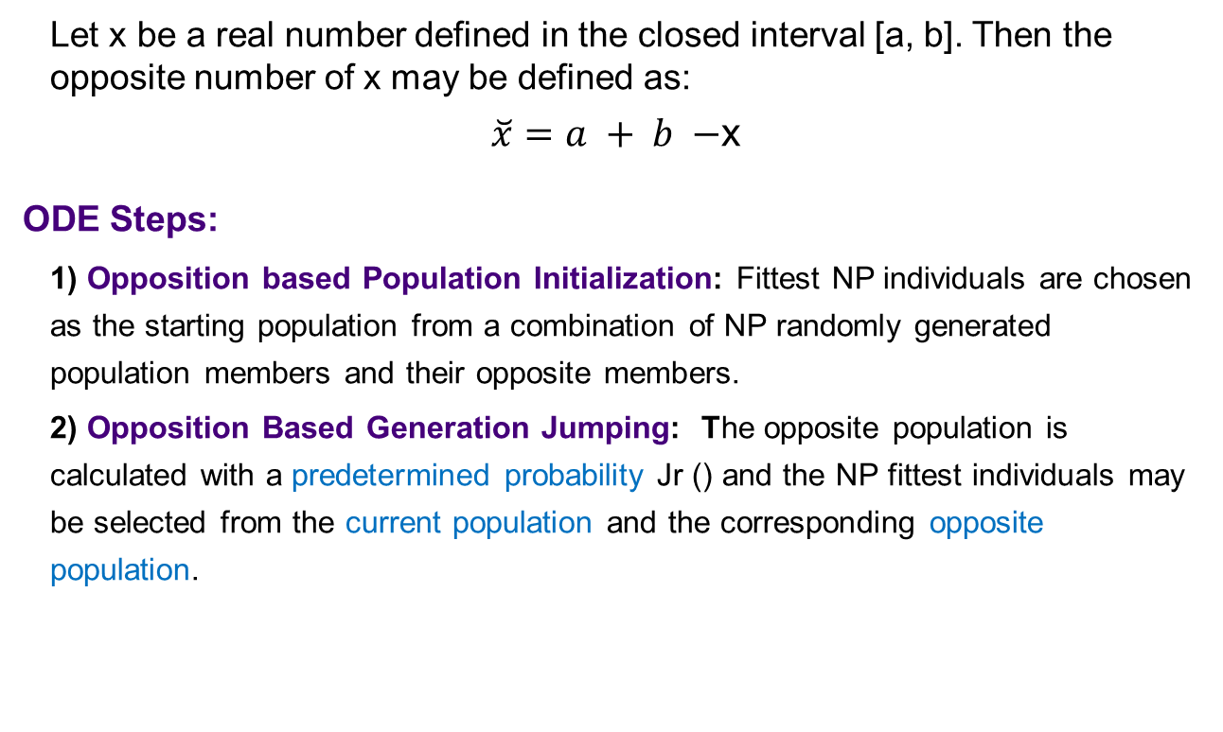
Opposition-based DE (ODE)
Let x be a real number defined in the closed interval [a, b]. Then the opposite number of x may be defined as:
$\breve{x}=a + b −$x
ODE Steps:
1) Opposition based Population Initialization: Fittest NP individuals are chosen as the starting population from a combination of NP randomly generated population members and their opposite members.
2) Opposition Based Generation Jumping: The opposite population is calculated with a predetermined probability Jr () and the NP fittest individuals may be selected from the current population and the corresponding opposite population.
S. Rahnamayan, H. R. Tizhoosh and M. M. A. Salama, "Opposition-Based Differential Evolution," in IEEE Transactions on Evolutionary Computation, vol. 12, no. 1, pp. 64-79, Feb. 2008.

Slide 28
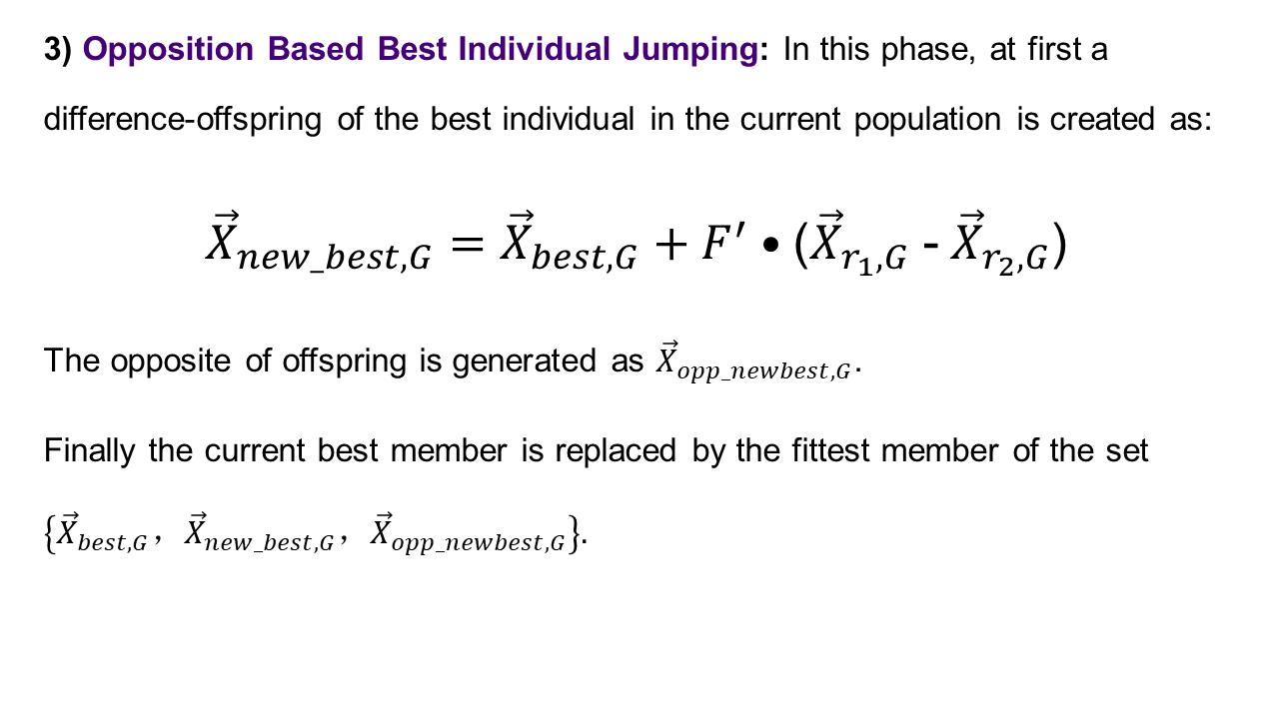
ODE (Contd.)
3) Opposition Based Best Individual Jumping: In this phase, at first a difference-offspring of the best individual in the current population is created as:
${\vec{X}}_{new_best,G}={\vec{X}}_{best,G}+F^{′}•$(${\vec{X}}_{r_{1},G}$ -${ \vec{X}}_{r_{2},G}$)
The opposite of offspring is generated as ${\vec{X}}_{opp_newbest,G}$.
Finally the current best member is replaced by the fittest member of the set $\left\{{\vec{X}}_{best,G}，{\vec{X}}_{new_best,G}，{\vec{X}}_{opp_newbest,G}\right\}.$

Slide 29
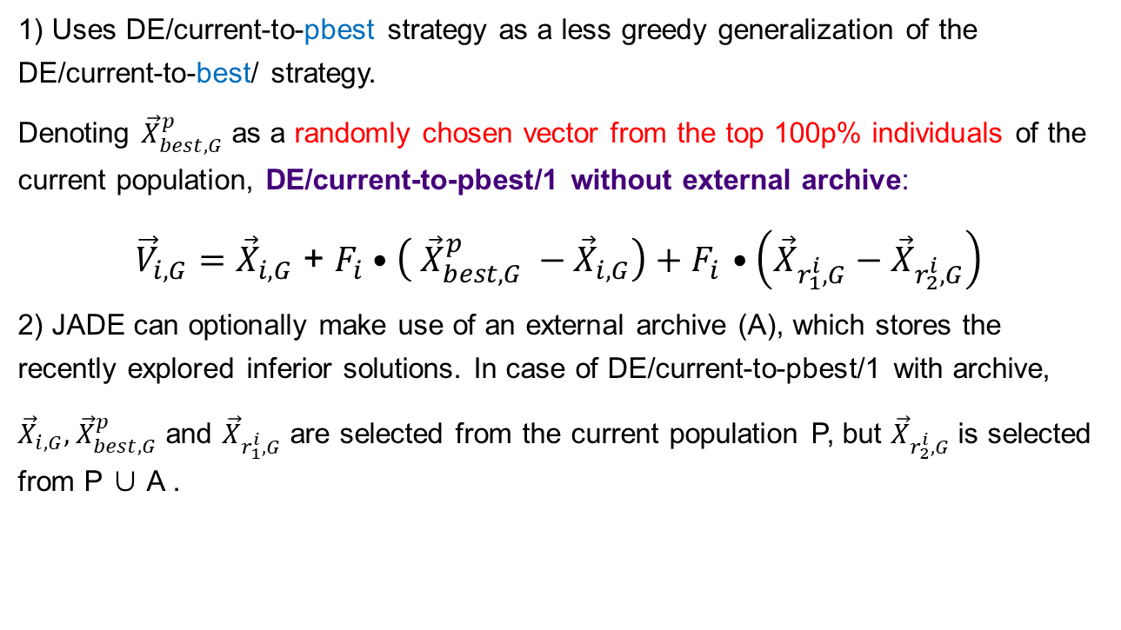
Adaptive Differential Evolution With Optional External Archive (JADE)
1) Uses DE/current-to-pbest strategy as a less greedy generalization of the DE/current-to-best/ strategy.
Denoting ${\vec{X}}_{best,G}^{p}$ as a randomly chosen vector from the top 100p% individuals of the current population, DE/current-to-pbest/1 without external archive:
${\vec{V}}_{i,G}={\vec{X}}_{i,G}$ + $F_{i}•\left( {\vec{X}}_{best,G}^{p} −{\vec{X}}_{i,G}\right)+F_{i}$ $•\left({\vec{X}}_{r_{1}^{i},G}−{\vec{X}}_{r_{2}^{i},G}\right)$
2) JADE can optionally make use of an external archive (A), which stores the recently explored inferior solutions. In case of DE/current-to-pbest/1 with archive,
${\vec{X}}_{i,G}, { \vec{X}}_{best,G}^{p}$ and ${\vec{X}}_{r_{1}^{i},G}$ are selected from the current population P, but ${\vec{X}}_{r_{2}^{i},G}$ is selected from P ∪ A .
J. Zhang and A. C. Sanderson, "JADE: Adaptive Differential Evolution With Optional External Archive," in IEEE Transactions on Evolutionary Computation, 2009,13(5): 945-958.

Slide 30
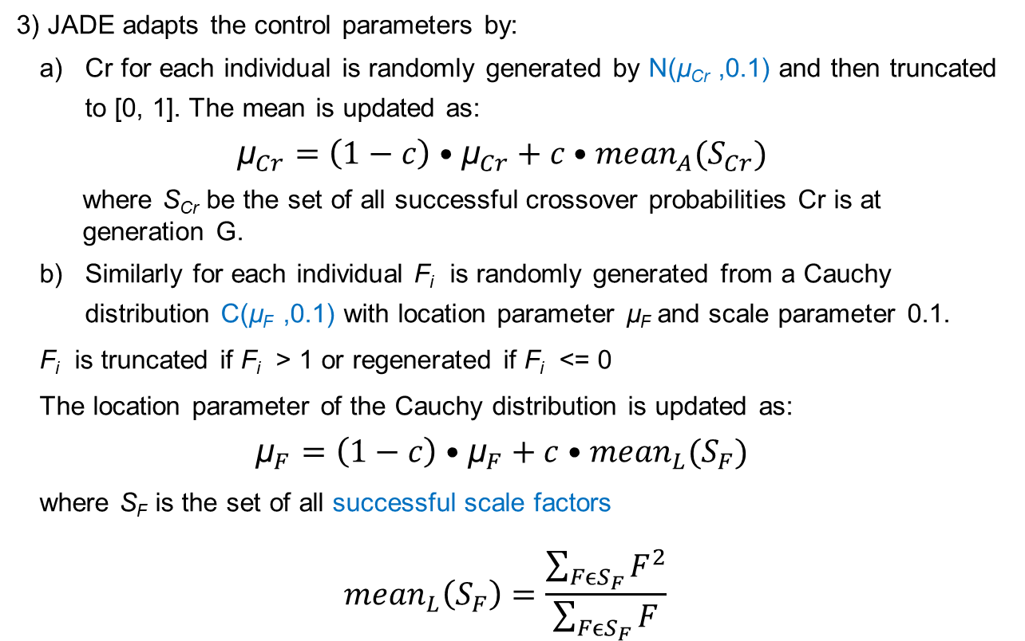
JADE (Contd.)
3) JADE adapts the control parameters by:
Cr for each individual is randomly generated by N(µ_{Cr} ,0.1) and then truncated to [0, 1]. The mean is updated as:
$${\text{µ}}_{Cr}=\left(1−c\right)•{\text{µ}}_{Cr}+c•{mean}_{A}(S_{Cr})$$
where S_{Cr} be the set of all successful crossover probabilities Cr is at generation G.
Similarly for each individual F_{i} is randomly generated from a Cauchy distribution C(µ_{F} ,0.1) with location parameter µ_{F} and scale parameter 0.1.
F_{i} is truncated if F_{i} > 1 or regenerated if F_{i} <= 0
The location parameter of the Cauchy distribution is updated as:
$${\text{µ}}_{F}=\left(1−c\right)•{\text{µ}}_{F}+c•{mean}_{L}(S_{F})$$
where S_{F} is the set of all successful scale factors
$${mean}_{L}\left(S_{F}\right)=\frac{\sum_{FϵS_{F}}{F^{2}}}{\sum_{FϵS_{F}}{F}}$$

Slide 31
Differential Evolution with Neighborhood-based Mutation
S. Das, A. Abraham, U. K. Chakraborty and A. Konar, "Differential Evolution Using a Neighborhood-Based Mutation Operator," in IEEE Transactions on Evolutionary Computation, vol. 13, no. 3, pp. 526-553, June 2009.

Slide 32
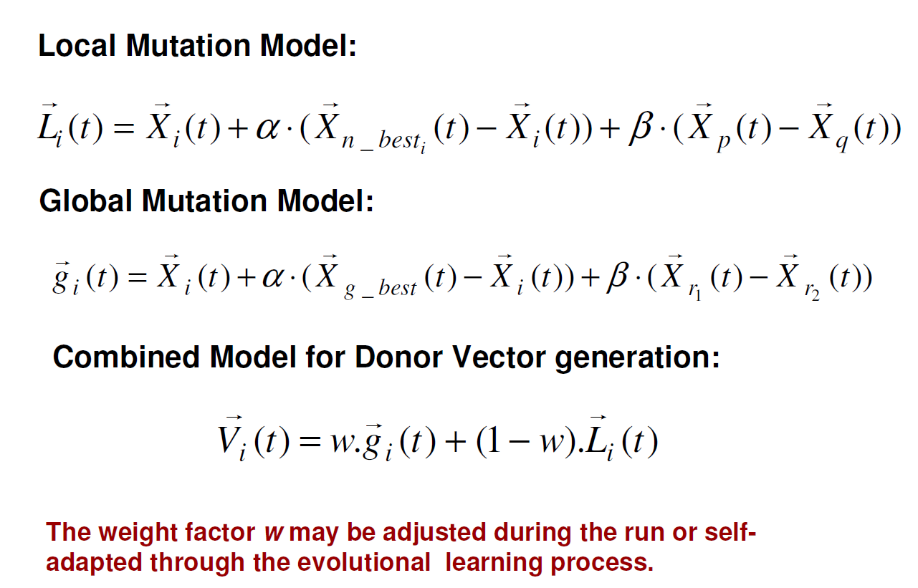
Differential Evolution with Neighborhood-based Mutation (Contd.)

Slide 33
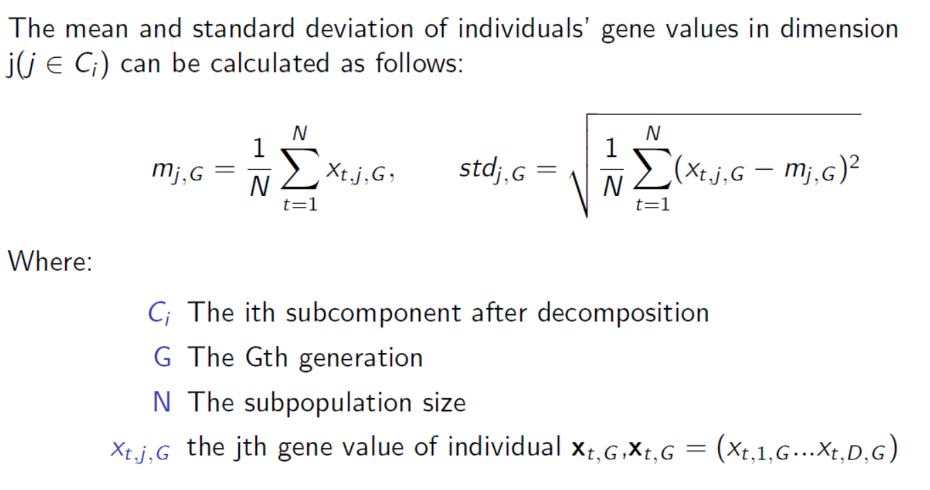
DE with Auto-enhanced Diversity
M. Yang, C. Li, Z. Cai and J. Guan. Diferential evolution with auto-enhanced population diversity". IEEE Trans. Cybernetics, 2015

Slide 34
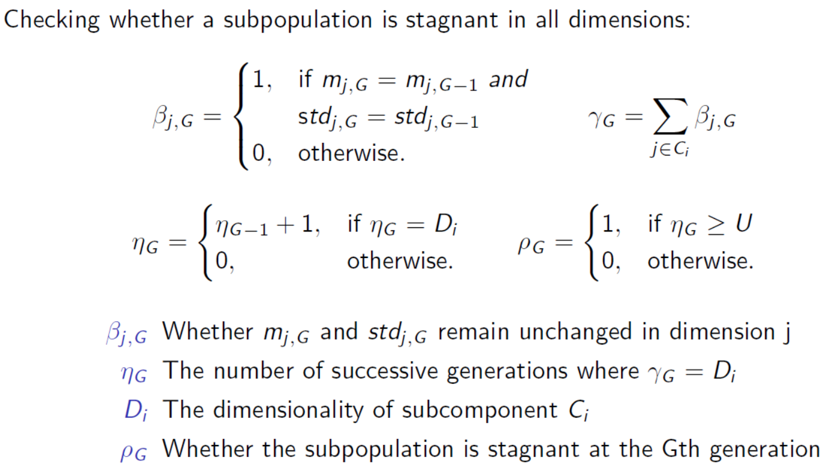
DE with Auto-enhanced Diversity

Slide 35
Future work
1. Theoretical work: dynamic behavior, convergence
2. New variants: parameter adaptation, operator adaptation, novel operators
3. Applications

