Slide 1
Artificial Intelligence A-Z
Session 12~18

Slide 2
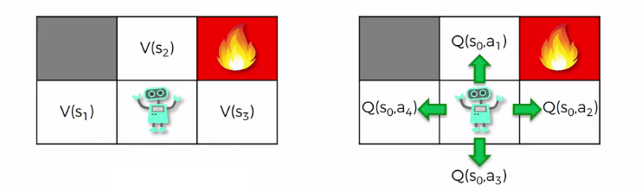
Q-Learning
Value of state
Value of each action

Slide 3
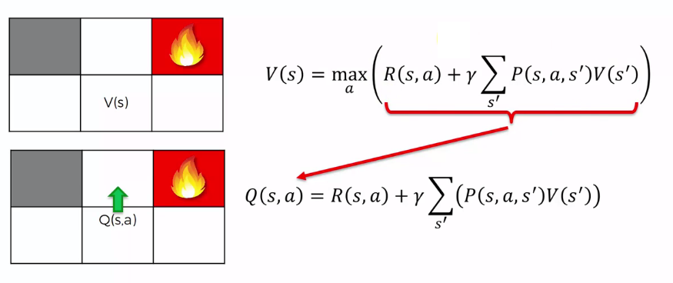

Q-Learning
Recursive function

Slide 4
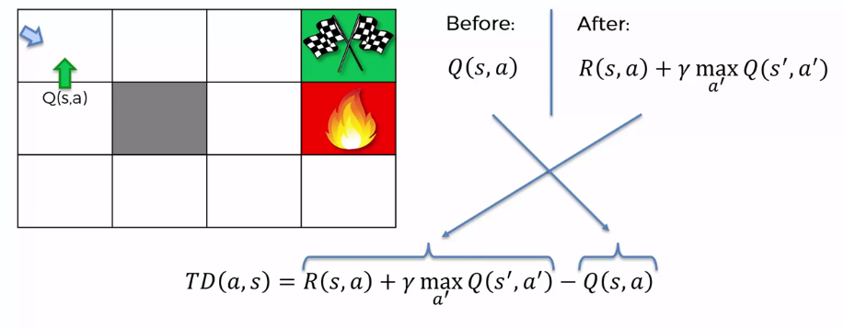
Temporal Difference
Difference is time.
There should be a shift in time. (Current – Previously)

Slide 5
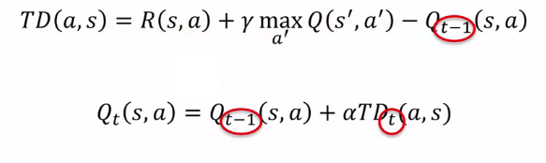
Temporal Difference
α is the learning rate
Q value is update step by step
α = 1 => agent ignore the previous Q value, and use the calculated one
α = 0 => agent keep the previous Q value
Learning to update the Q value step by step
Hopefully TD is 0, which means Q is converged for agent solving the environment
We have randomness event leads the TD meaningful

Slide 6
Visualization
GridWorld.py
GridWorld.py –m (probabilities to different direction)
GridWorld.py –k 10 –a q (q learning agent )
GridWorld.py –k 100 –a q –s 100 (q learning agent )
GridWorld.py –k 100 –a q –s 1000 -r -0.04 –d 0.5 (reward, discount)
Press “P” to get the policy

Slide 7
Part 1 - Self-Driving Car (Deep Q-Learning)

Slide 8
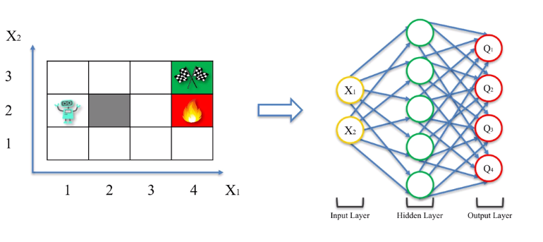
Deep Q-Learning
e.g. Add two axes and feed into input layer of Neural Network
Basic Q learning is not sufficient enough for complicated situation (self driving car etc.)

Slide 9
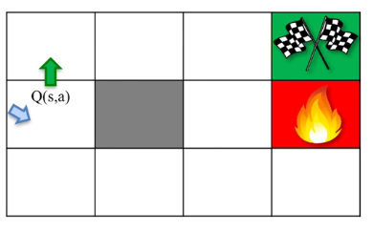
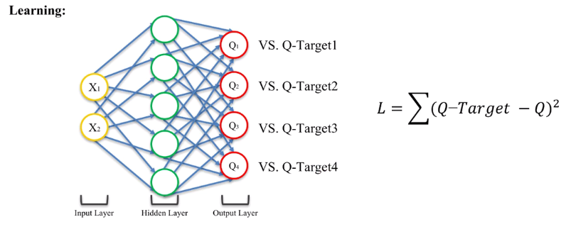
Deep Q-Learning
Current: Q value is predicted using the Neural Network
Compare to the previously calculated Q value - target (might long time ago)

Slide 10
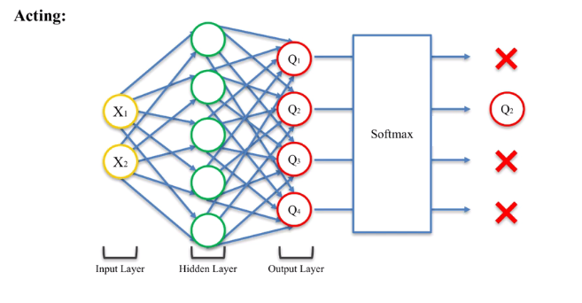
Deep Q-Learning
Learning and acting phase happens every time when agent in a new single state

