Slide 1
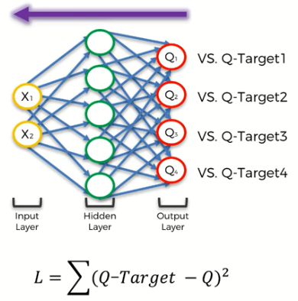
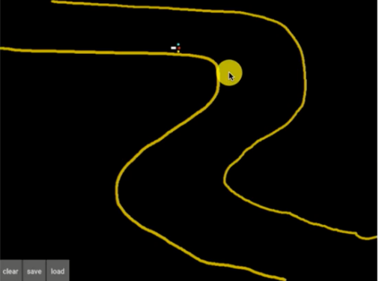
Experience Replay

Slide 2
Prioritized Experience Replay
\\CNPDGWDRND4WKP3\CSL_DataSharing\Documents\AI for AD\Seminar\Prioritized Experience Replay.pdf

Slide 3
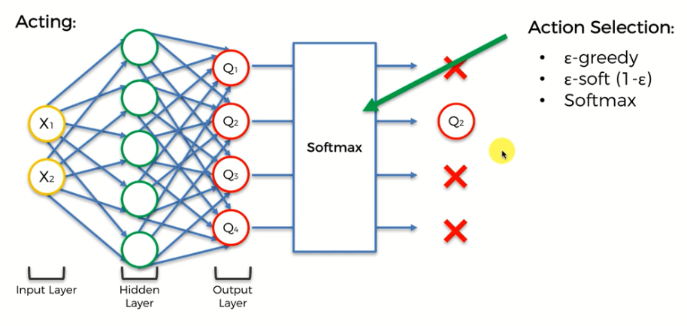
Action Selection Policies
Prevent from getting stuck in local maximum.
Notes:
Greedy: might has 10% change to select the not highest q-value
Soft(1-e): just reverse of greedy
Softmax:

Slide 4
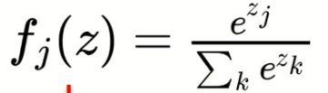
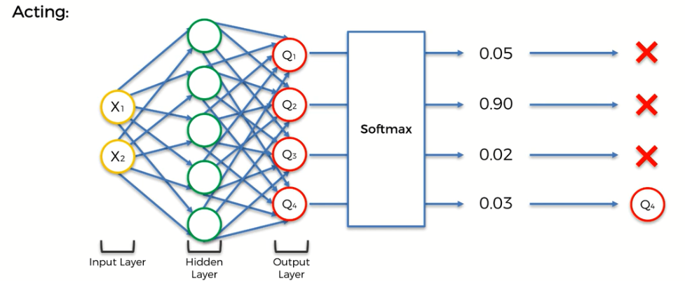
SoftMax
0-1 range
Shows each possibilities

Slide 5
Software environment
Anaconda and Kivy are installed in //CNPDGWDRND8WN9Z

