Slide 1
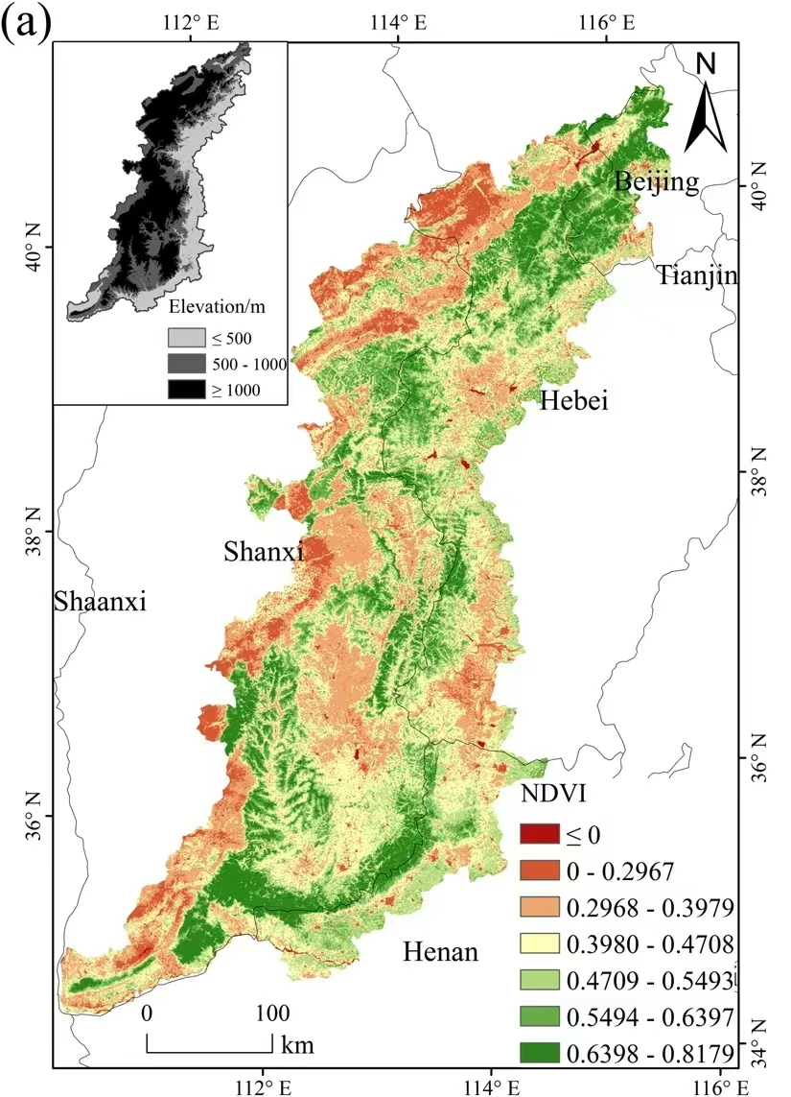
A0251B
CB6040
E2A979
FFFFBE
B7D884
77AA53
478032

Slide 2
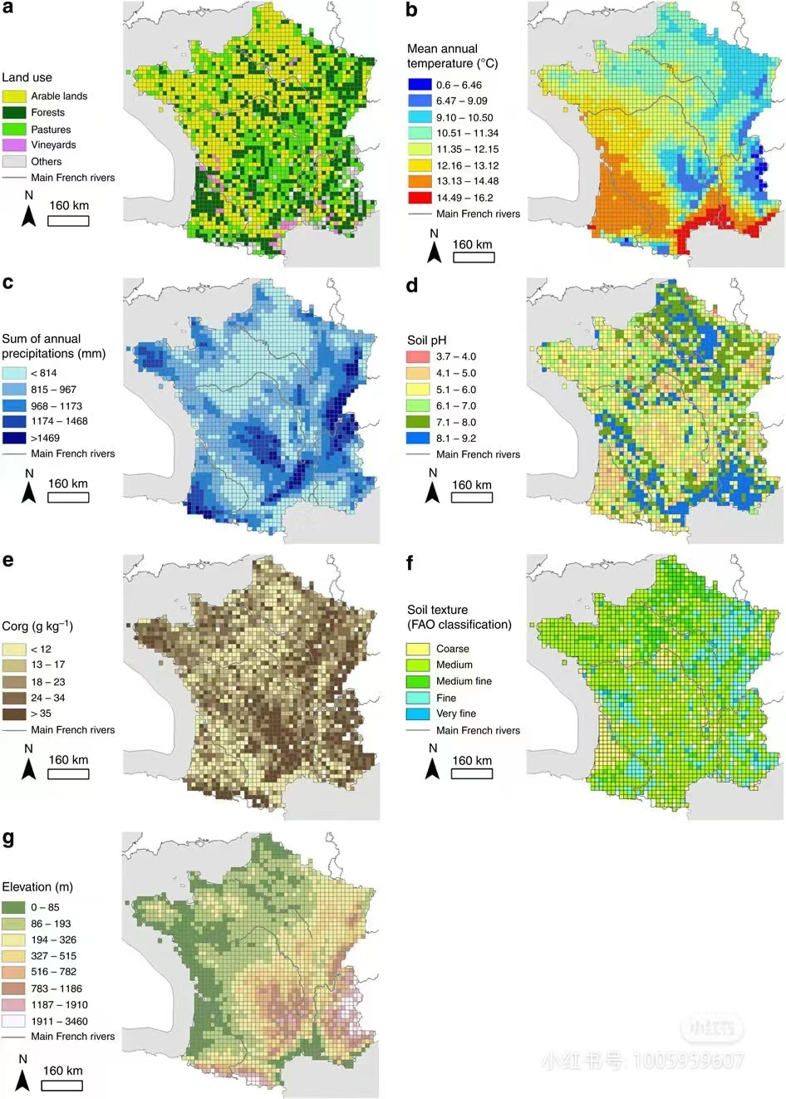
001BE4
4873F4
69D7F4
A6FAC5
E2FC7A
F3DE4B
E98D35
E73223

Slide 3
C1EAED
82AFE0
4185D8
2448AD
0B1073

Slide 4
EC8A84
F4D490
FBFC8B
B9F888
82A436
2E6FF1

Slide 5
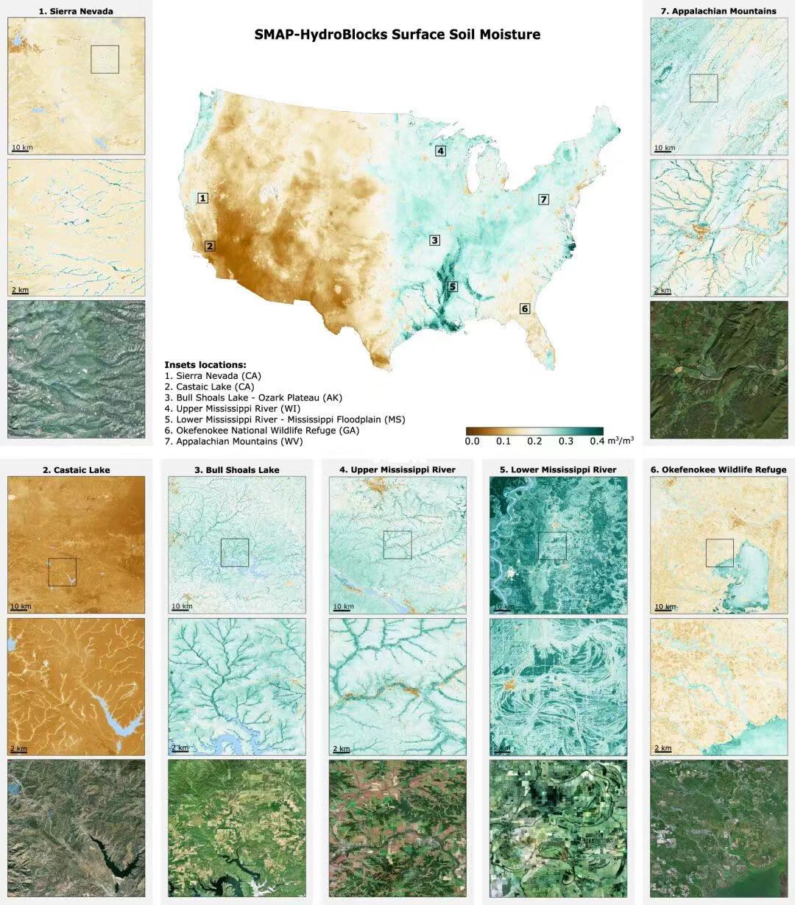
493B25
CCA569
F9F8F4
6BA9A1
1C362D

Slide 6
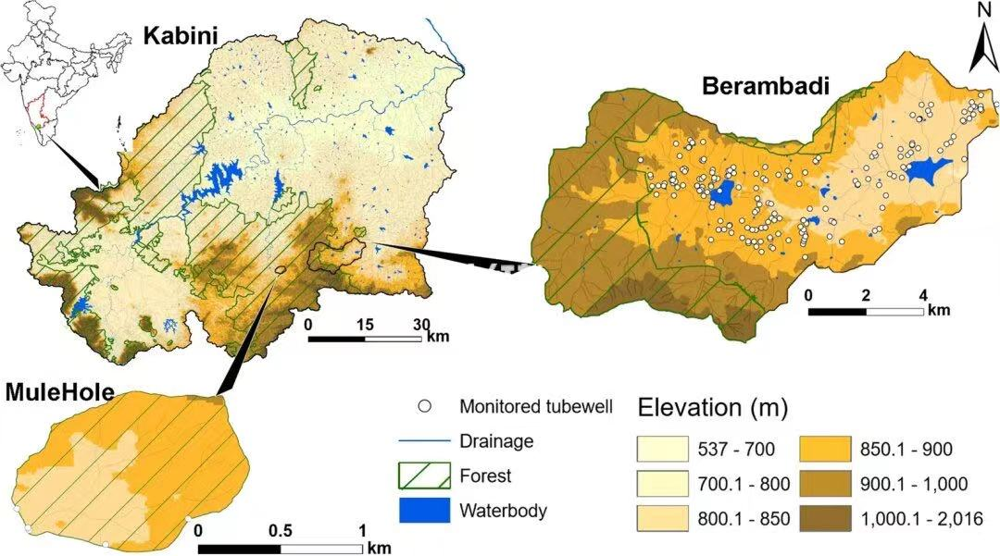
FFFED8
FEFCCC
FBE4A5
F4C452
B58F40
8E703B

