Slide 1
Transaction
(ACID properties)

Slide 2
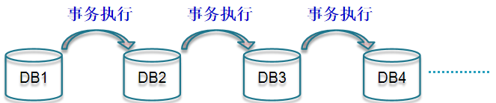
Transactions
Many enterprises use databases to store information about their state
When an event occurs in the real world that changes the state of the enterprise, a program is executed to change the database state in a corresponding way
Such a program is called a transaction

Slide 3
Transaction Concept
A transaction is a unit of program execution that accesses and possibly updates various data items.
A transaction is a means to package together a number of database operations performed by a process, so the database system can provide several guarantees, called the ACID properties.
A transaction symbolizes a unit of work performed within a database management system against a database, and treated in a coherent and reliable way independent of other transactions.
Notes:
定义
▪ 一个数据库操作序列，▪ 一个不可分割的工作单位，▪ 恢复和并发控制的基本单位
事务和程序比较
▪ 在关系数据库中，一个事务可以是一条或多条SQL语句,也可以包含一个或多个程序。
▪ 一个程序通常包含多个事务
设想网上购物的一次交易，其付款过程至少包括以下几步数据库操作： · 更新客户所购商品的库存信息 · 保存客户付款信息--可能包括与银行系统的交互 · 生成订单并且保存到数据库中 · 更新用户相关信息，例如购物数量等等 正常的情况下，这些操作将顺利进行，最终交易成功，与交易相关的所有数据库信息也成功地更新。但是，如果在这一系列过程中任何一个环节出了差错，例如在 更新商品库存信息时发生异常、该顾客银行帐户存款不足等，都将导致交易失败。一旦交易失败，数据库中所有信息都必须保持交易前的状态不变，比如最后一步更 新用户信息时失败而导致交易失败，那么必须保证这笔失败的交易不影响数据库的状态--库存信息没有被更新、用户也没有付款，订单也没有生成。否则，数据库 的信息将会一片混乱而不可预测。

Slide 4
Transaction Concept
two main purposes
To provide reliable units of work that allow correct recovery from failures and keep a database consistent even in cases of system failure, when execution stops (completely or partially) and many operations upon a database remain uncompleted, with unclear status.
To provide isolation between programs accessing a database concurrently. If this isolation is not provided, the programs' outcomes are possibly erroneous.
Notes:
定义
▪ 一个数据库操作序列，▪ 一个不可分割的工作单位，▪ 恢复和并发控制的基本单位
事务和程序比较
▪ 在关系数据库中，一个事务可以是一条或多条SQL语句,也可以包含一个或多个程序。
▪ 一个程序通常包含多个事务
设想网上购物的一次交易，其付款过程至少包括以下几步数据库操作： · 更新客户所购商品的库存信息 · 保存客户付款信息--可能包括与银行系统的交互 · 生成订单并且保存到数据库中 · 更新用户相关信息，例如购物数量等等 正常的情况下，这些操作将顺利进行，最终交易成功，与交易相关的所有数据库信息也成功地更新。但是，如果在这一系列过程中任何一个环节出了差错，例如在 更新商品库存信息时发生异常、该顾客银行帐户存款不足等，都将导致交易失败。一旦交易失败，数据库中所有信息都必须保持交易前的状态不变，比如最后一步更 新用户信息时失败而导致交易失败，那么必须保证这笔失败的交易不影响数据库的状态--库存信息没有被更新、用户也没有付款，订单也没有生成。否则，数据库 的信息将会一片混乱而不可预测。

Slide 5
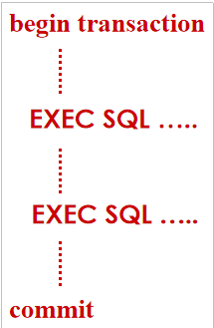
Flat Transaction
Consists of:
Computation on local variables
not seen by DBMS; hence will be ignored in most future discussion
Access to DBMS using call or statement level interface
This is transaction schedule; commit applies to these operations
No internal structure
Accesses a single DBMS
Adequate for simple applications

Slide 6
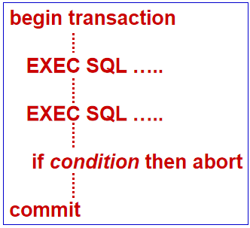
Flat Transaction
Abort causes the execution of a program that restores the variables updated by the transaction to the state they had when the transaction first accessed them.

Slide 7
Limitations of Flat Transactions
Only total rollback (abort) is possible
Partial rollback not possible
All work lost in case of crash
Limited to accessing a single DBMS
Entire transaction takes place at a single point in time

Slide 8
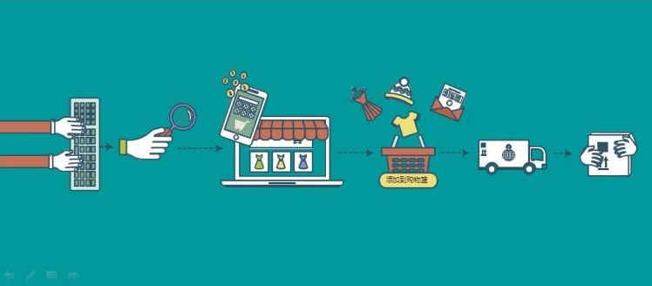
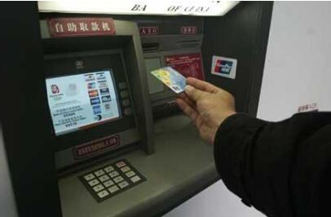
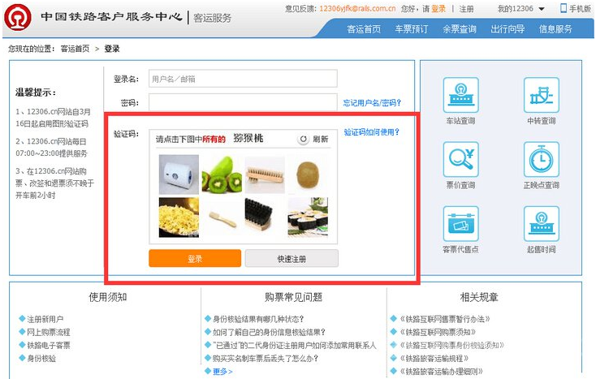

What Does a Transaction Do?
Return information from the database
Update the database to reflect the occurrence of a real world event
Cause the occurrence of a real world event
Notes:
事务的作用：返回查询结果，或者修改数据库以反映现实世界中的实际变化情况

Slide 9
What Does a Transaction Do?
Return information from the database (ReadOnly)
RequestBalance transaction: Read customer’s balance in database and output it
Update the database to reflect the occurrence of a real world event (ReadWrite)
Deposit transaction: Update customer’s balance in database

Slide 10
Transactions
The execution of each transaction must maintain the relationship between the database state and the enterprise state
Example: banking applications with file system
problems
Creating an inconsistent result
Errors of concurrent execution
Uncertainty as to when changes become permanent

Slide 11
Problems(1)
Creating an inconsistent result
Our application is transferring money from one account to another (different pages).
One account balance gets out to disk (run out of buffer space)
and then the computer crashes.

Slide 12
problems(2)
Errors of concurrent execution
Teller 1 transfers money from Acct A to Acct B of the same customer, while Teller 2 is performing a credit check by adding balances of A and B.
Teller 2 can see A after transfer subtracted, B before transfer added.

Slide 13
problems
Uncertainty as to when changes become permanent
At the very least, we want to know when it is safe to hand out money: don't want to forget we did it if system crashes, then only data on disk is safe.

Slide 14
Transactions
Therefore additional requirements are placed on the execution of transactions beyond those placed on ordinary programs:
Atomicity
Consistency
Isolation
Durability
ACID properties

Slide 15
Atomicity （原子性）
The set of record updates that are part of a transaction are indivisible (either they all happen or none happen).
This is true even in presence of a crash.
Consistency （一致性）
If all the individual processes follow certain rules (money is neither created nor destroyed) and use transactions right,
then the rules won't be broken by any set of transactions acting together.

Slide 16
Isolation （隔离性）
Means that operations of different transactions seem not to be interleaved in time.
as if ALL operations of one T_{x} before or after ALL operations of any other T_{y}.
Durability （持久性）
When the system returns to the logic after a Commit Work statement, it guarantees that all T_{x} Updates are on disk.
Now ATM machine can hand out money.

Slide 17
ACID properties of Transactions

Slide 18
1、Consistency
database consistency
transaction consistency

Slide 19
Database Consistency
Any data written to the database must be valid according to all defined rules, including constraints, cascades, triggers, and any combination thereof.
constraints (or data integrity) is the assurance of the accuracy and consistency of data over its entire life-cycle. (static constraints: domain, primary key/foreign key, check, assertion)
cascades (rollback is an operation which returns the database to some previous state.)
trigger (dynamic constraints)

Slide 20
Database Consistency
Enterprise (Business) Rules limit the occurrence of certain real-world events
Student cannot register for a course if the current number of registrants equals the maximum allowed
Correspondingly, allowable database states are restricted
cur_reg <= max_reg
These limitations are called (static) integrity constraints: assertions that must be satisfied by all database states (state invariants).

Slide 21
Database Consistency (state invariants)
Other static consistency requirements are related to the fact that the database might store the same information in different ways
cur_reg = |list_of_registered_students|
Such limitations are also expressed as integrity constraints
Database is consistent if all static integrity constraints are satisfied

Slide 22
Transaction Consistency
A consistent database state does not necessarily model the actual state of the enterprise
A deposit transaction that increments the balance by the wrong amount maintains the integrity constraint balance ≥ 0, but does not maintain the relation between the enterprise and database states
A consistent transaction maintains database consistency and the correspondence between the database state and the enterprise state (implements its specification)
Specification of deposit transaction includes balance′ = balance + amt_deposit , (balance′ is the next value of balance)

Slide 23
Dynamic Integrity Constraints (transition invariants)
Some constraints restrict allowable state transitions
A transaction might transform the database from one consistent state to another, but the transition might not be permissible
Example: A letter grade in a course (A, B, C, D, F) cannot be changed to an incomplete ( I )
Dynamic constraints cannot be checked by examining the database state

Slide 24
Transaction Consistency (定义)
Consistent transaction: if DB is in consistent state initially, when the transaction completes:
All static integrity constraints are satisfied (but constraints might be violated in intermediate states)
Can be checked by examining snapshot of database
New state satisfies specifications of transaction
Cannot be checked from database snapshot
No dynamic constraints have been violated
Cannot be checked from database snapshot

Slide 25
Checking Integrity Constraints
Automatic: Embed constraint in schema.
CHECK, ASSERTION for static constraints
TRIGGER for dynamic constraints
Increases confidence in correctness and decreases maintenance costs
Not always desirable since unnecessary checking (overhead) might result
Deposit transaction modifies balance but cannot violate constraint balance ≥ 0
Manual: Perform check in application code.
Only necessary checks are performed
Scatters references to constraint throughout application
Difficult to maintain as transactions are modified/added

Slide 26
2、Atomicity
A real-world event either happens or does not happen
Student either registers or does not register
Similarly, the system must ensure that either the corresponding transaction runs to completion or, if not, it has no effect at all
Not true of ordinary programs. A crash could leave files partially updated on recovery

Slide 27
Commit and Abort
If the transaction successfully completes it is said to commit
The system is responsible for ensuring that all changes to the database have been saved
If the transaction does not successfully complete, it is said to abort
The system is responsible for undoing, or rolling back, all changes the transaction has made

Slide 28
Reasons for Abort
System crash
Transaction aborted by system
Execution cannot be made atomic (a site is down)
Execution did not maintain database consistency (integrity constraint is violated)
Execution was not isolated
Resources not available (deadlock)
Transaction requests to roll back

Slide 29
API for Transactions
DBMS and TP monitor provide commands for setting transaction boundaries.
begin transaction
commit
rollback
The commit command is a request
The system might commit the transaction, or it might abort it for one of the reasons on the previous slide
The rollback command is always satisfied

Slide 30
3、Durability
The system must ensure that once a transaction commits, its effect on the database state is not lost in spite of subsequent failures
Not true of ordinary programs.
A media failure after a program successfully terminates could cause the file system to be restored to a state that preceded the program’s execution

Slide 31
Implementing Durability
Database stored redundantly on mass storage devices to protect against media failure
Architecture of mass storage devices affects type of media failures that can be tolerated
Related to Availability: extent to which a (possibly distributed) system can provide service despite failure
Non-stop DBMS (mirrored disks)
Recovery based DBMS (log)

Slide 32
4、Isolation
Serial Execution: transactions execute in sequence
Each one starts after the previous one completes.
Execution of one transaction is not affected by the operations of another since they do not overlap in time
The execution of each transaction is isolated from all others.
If the initial database state and all transactions are consistent, then the final database state will be consistent and will accurately reflect the real-world state, but
Serial execution is inadequate from a performance perspective

Slide 33
Isolation
Concurrent execution offers performance benefits:
A computer system has multiple resources capable of executing independently (e.g., cpu’s, I/O devices), but
A transaction typically uses only one resource at a time
Hence, only concurrently executing transactions can make effective use of the system
Concurrently executing transactions yield interleaved schedules

Slide 34
Concurrent Execution
begin trans
..
op_{1,1}
..
op_{1,2}
..
commit
sequence of db
operations output by T₁
T₁
op_{1,1} op_{1.2}
local computation
DBMS

Slide 35
Concurrent Execution
begin trans
..
op_{1,1}
..
op_{1,2}
..
commit
interleaved sequence of db
operations input to DBMS
T₁
op_{1,1} op_{1.2}
local computation
DBMS
op_{1,1} op_{2,1} op_{2.2} op_{1.2}
begin trans
..
op_{2,1}
..
op_{2,2}
..
commit
T₂
op_{2,1} op_{2.2}
在每一个事务内部，其操作的发送顺序是固定的。
但来自于不同事务之间的操作，他们到达DBMS的顺序是不确定的。
local variables

Slide 36
Isolation
Interleaved execution of a set of consistent transactions offers performance benefits, but might not be correct
Example: course registration; cur_reg is number of current registrants
local computation
not seen by DBMS
T1: r(cur_reg : 29)…………
T2: r(cur_reg : 29)……….…
time →
w(cur_reg : 30) commit
w(cur_reg : 30) commit
Result: Database state no longer corresponds to
real-world state, integrity constraint violated
cur_reg <> |list_of_registered_students|

Slide 37
Interaction of Atomicity and Isolation
T₁: r(bal:10); w(bal:1000010); abort;
T₂: r(bal:1000010); w(yes!!!); commit;
time
T1 deposits $1000000
T2 grants credit and commits before T1 completes
T1 aborts and rolls balance back to $10
T1 has had an effect even though it aborted!

Slide 38
Isolation
An interleaved schedule of transactions is isolated if its effect is the same as if the transactions had executed serially in some order (serializable)
It follows that serializable schedules are always correct (for any application)
Serializable is better than serial from a performance point of view
DBMS uses locking to ensure that concurrent schedules are serializable
T1: r(x) w(x)
T2: r(y) w(y)

Slide 39
Isolation in the Real World
SQL supports SERIALIZABLE isolation level, which guarantees serializability and hence correctness for all applications
Performance of applications running at SERIALIZABLE is often not adequate
SQL also supports weaker levels of isolation with better performance characteristics
But beware! -- a particular application might not run correctly at a weaker level

Slide 40
Summary
Application programmer is responsible for creating consistent transactions and choosing appropriate isolation level
The system is responsible for creating the abstractions of atomicity, durability, and isolation
Greatly simplifies programmer’s task since she does not have to be concerned with failures or concurrency

