Slide 1
Isolation in Relational Databases (3)

Slide 2
Isolation in Relational Databases
Locking in Relational Databases
SQL Isolation Levels
Granular Locks
Index Locking
Multiversion Controls (MVCs)
SNAPSHOT Isolation

Slide 3
Granular Locks (粒度锁)
Transactions access data at different levels of granularity
Many DBMSs provide both fine and coarse granularity locks
DBMS attempts to automatically choose appropriate granularity
A particular application might be able to force a particular granularity

Slide 4
Granular Locks
Problem:
T₁ holds a (fine grained) lock on field F₁ in record R₁
T₂ requests a conflicting (coarse grained) lock on R₁
Lock requested by T₂
Record R₁ :
Field F₁ | Field F₂ | ……
Locked by T₁
How does the concurrency control detect the conflict
since it sees F₁ and R₁ as different items?

Slide 5
Granular Locks (GL)
Solution:
Organize locks hierarchically by containment
Require that a transaction to get a fine grained lock it
must first get a coarse grained lock on the containing item.
Record R₁ :
Field F₁ | Field F₂ | ……
Hence, T₁ must:
First get a lock on R₁ Before getting a lock on F₁
When T₂ requests a conflicting lock on R₁
The conflict with T₁ is detected at R₁

Slide 6
Intention Locking
Performance improvement: if lock on parent is weak
Intention shared (IS): to get an S lock on an item, T must first get IS locks on all containing items (↑root)
Intention exclusive (IX): to get an X lock on an item, T must first get IX locks on all containing items (↑root)
Shared Intention Exclusive (SIX): Equivalent to an S lock and an IX lock on an item
Intention lock indicates transaction’s intention to
acquire conventional lock on a contained item

Slide 7
Conflict Table
T₁ Granted
NOTE:
× - denied
√ - granted
mode | IS | IX | S | X | SIX
IS
IX
S
X
SIX
×
×
×
×
T₂ Requested
×
×
×
×
×
×
×
×
×
×
×
×
×
Example 1: T₂ denied an IX lock (intends to update some contained items) since T₁ is reading all contained items

Slide 8
Conflict Table
T₁ Granted
NOTE:
× - denied
√ - granted
mode | IS | IX | S | X | SIX
IS
IX
S
X
SIX
√
√
√
×
√
√
√
×
×
×
T₂ Requested
√
×
×
√
×
×
×
×
×
×
×
√
×
×
×
×
Example 2: T₂ granted IS lock even though T₁ holds IX lock (since they may be accessing different subsets of contained items)

Slide 9
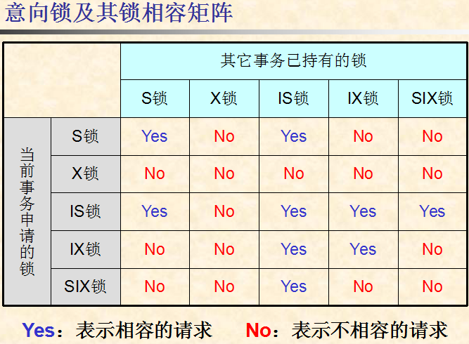

Slide 10
多粒度封锁
多粒度树
可以根据数据库被访问的数据对象之间的包含关系构造出一棵 ‘多粒度树’，树中的结点代表可以被访问的数据对象（也是被封锁的对象）。
如果数据对象A‘包含’数据对象B，则“A是B的父结点，B是A的子结点”，依次类推。
多粒度锁
显式封锁：一个事务经申请而获得的某个结点上封锁（包括意向锁）
隐式封锁：如果一个事务T持有结点N上封锁lock，则事务T隐含持有结点N的所有后裔结点上的封锁lock（即隐式封锁）
需要对所有的显式封锁和隐式封锁进行锁冲突检查。引入意向锁及多粒度封锁协议的目的就是为了“在提高并发度的同时，尽量降低锁冲突检查的开销”。

Slide 11
