Slide 1
Isolation in Relational Databases (5)

Slide 2
Isolation in Relational Databases
Locking in Relational Databases
SQL Isolation Levels
Granular Locks
Index Locking
Multiversion Controls (MVCs)
SNAPSHOT Isolation

Slide 3
Multiversion Controls (MVCs)
Version: a snapshot of the database containing the updates of all and only committed transactions
A multi-version DBMS maintains all versions created in the (recent) past
Major goal of a multi-version DBMS: avoid the need for read locks
w₁(x) w₂(y) c₁ w₃(x) w₂(z) c₂ ......
create version 1
(contains updates
of T₁, but not T₂)
create version 2
(contains updates of
T₁ and T₂, but not T₃)

Slide 4
Multiversion Controls

Slide 5
Read-Consistency
All DBMSs guarantee that statements are isolated:
Each statement sees state produced by the complete execution of other statements, but state might not be committed
A MVC guarantees that each statement sees a committed state:
Statement executed in a state whose value is a version
Referred to as statement-level read consistency
A MVC can also guarantee that all statements of a transaction see the same committed state:
All statements of a transaction access same version
Referred to as transaction-level read consistency

Slide 6
Read-Only MVC
Distinguishes in advance read-only (R/O) transactions from read/write (R/W) transactions.
R/W transactions use a (conventional) immediate-update, pessimistic control. Hence, transactions access the most current version of the database.
All the reads of a particular R/O transaction T_{RO} are satisfied using the most recent version that existed when T_{RO} requested its first read.

Slide 7
Read-Only MVC
Assuming R/W transactions are executed at SERIALIZABLE, all schedules are serializable:
R/W transactions are serialized in commit order.
Each R/O transaction is serialized after the transaction that created the version it read.
Equivalent serial order is not commit order.
All transactions see transaction-level read consistency.

Slide 8
Example
T₁ and T₂ are read/write, T₃ is read/only
初试版本v₀
新版本v₁
新版本v₂
_{readonly事务的提交，不需要创建新版本}
x₀
y₀
x₀
y₁
x₂
y₂
r₁(x) w₁(y) r₂(x) c₁ w₂(x) r₃(x) w₂(y) c₂ r₃(y) c₃
T₃ sees the version produced by T₁
The equivalent serial order is T₁ T₃ T₂

Slide 9
Implementation
DBMS maintains a version counter (VC).
Incremented each time a R/W transaction commits.
The new version of a data item created by a R/W transaction is tagged with the value of VC at the time the transaction commits.
When a R/O transaction makes its 1st read request, the value of VC becomes its counter value.
Each request to read an item is satisfied by the version of the item having the largest version number less than or equal to the transaction’s counter value.

Slide 10
Multiversion Database
x
y
z
u
v1
v2
v1
v4
17
a
.223
.223
v1
38
38
v4
v2
v3
v5
22
ab
ab
v3
.24
v3
v6
123
123
v3
abf
Values read by a R/O transaction with counter value 4

Slide 11
Read-Only Multiversion Control
R/O transactions do not use read locks.
They never wait.
They never cause R/W transactions to wait.

Slide 12
Read-Consistency MVC
R/O transactions:
get transaction-level read consistency.
R/W transactions:
Write statements acquire long-duration write locks (delay other write statements)
Read statements use most recent (committed) version at time of read
Not delayed by write locks, since read locks are not requested.
Notes:
对于R/W事务
1、在执行write操作时需要申请write lock，防止两个并发事务同时修改同一个数据，避免了lost-update/dirty-wirte错误
2、在执行read操作时，读取的是当前最近版本值（该值一定是之前最后一个被提交的事务的修改结果），和当前其他正在运行的并发事务并不产生影响，因而不需要申请read lock.

Slide 13
Example
v₀
v₁
v₂
x₀
y₀
x₁
y₁
x₂
y₂
w₁(x) w₁(y) r₂(x) c₁ w₂(x) r₃(x) r₂(y) w₂(y) c₂ r₃(y) c₃
T₁ and T₂ are R/W, T₃ is R/O.
T₃ uses v₁.
T₂ takes the value of x₀ from v₀, y₁ from v₁.
There is no equivalent serial order.

Slide 14
Read-Consistency MVC
Satisfies ANSI definition of READ COMMITTED isolation level, but in addition ...
Provides transaction-level read consistency for R/O transactions
No read locks: reads do not wait for writes and writes do not wait for reads
Version of READ COMMITTED supported by Oracle.

Slide 15
SNAPSHOT Isolation
Does not distinguish between R/W and R/O transactions
A transaction reads the most recent version that
existed at the time of its first read request
Guarantees transaction-level read consistency
The write sets of any two concurrently executing transactions must be disjoint
Two implementations of this specification
First Committer Wins
Locking implementation

Slide 16
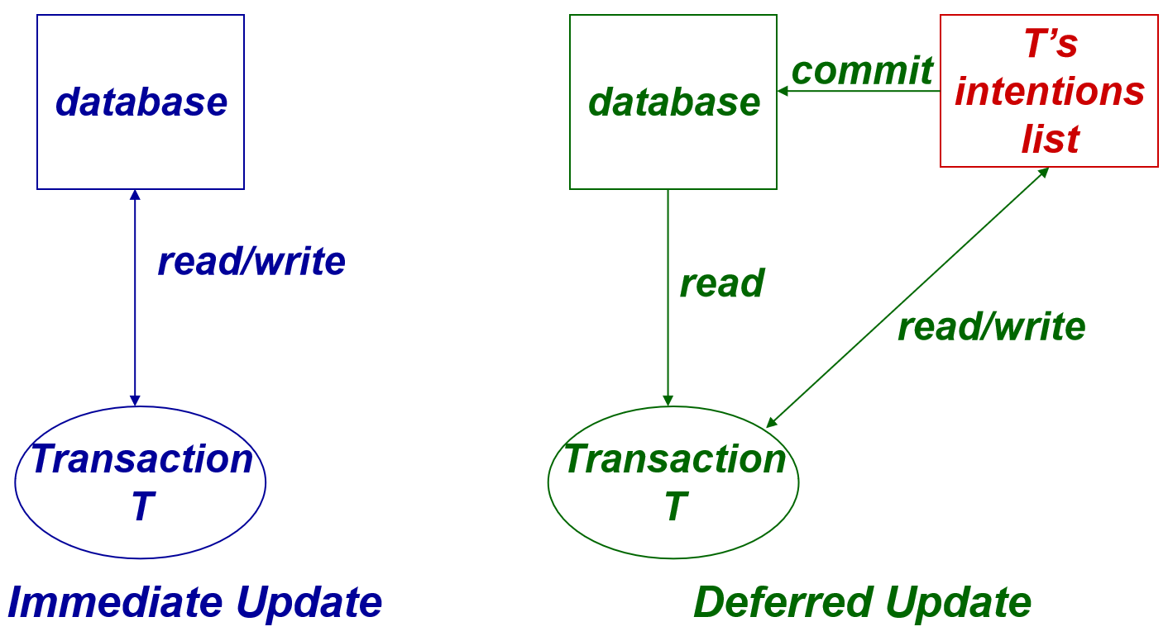
First Committer Wins Implementation
Writes use deferred-update (intentions list).
T is allowed to commit only if no concurrent transaction:
committed before T and updated a data item that T also updated.

Slide 17
First Committer Wins
to intentions list
T₁: r(x_{n}) w(x) request_commit
T_{2:} r(x_{n}) w(x) request_commit
counter value = n
commit and create w(x_{n+1})
abort
Control is optimistic:
It can be implemented without any locks
Deadlock not possible
Validation (write set intersection) is required for R/W transactions and abort is possible
Schedules might not be serializable
Notes:
也不需要申请 write lock
当一个事务执行commit操作，需要提交对数据项 x 的修改结果时，将比较数据库中 x 的最新版本号 与 自己所读取到的版本号的大小，并根据比较结果来判断是否有其他事务提前提交了对 x 的修改结果 （已完成提交的事务生成了 x 的新版本值）

Slide 18
Locking Implementation of SNAPSHOT Isolation
Immediate update pessimistic control
Reads do not get any locks and execute as in the previous implementation

Slide 19
Locking Implementation of SNAPSHOT Isolation
A transaction T that wants to perform a write on some item I must request a write lock
If the version number of I is greater than that of T, T is aborted (first committer wins)
Otherwise, if another transaction T’ has a write lock on that item, T waits until that T’ completes
If T’ commits, T is aborted (first committer wins)
If T’ aborts, T is given the write lock and allowed to write

Slide 20
Anomalies at SNAPSHOT Isolation
Many anomalies are impossible:
Dirty read, dirty write, non-repeatable read, lost update
However, schedules might not be serializable.
Example:
Constraint a+b≥0 violated
Referred to as write skew
T₁: r(a=10) r(b=10) w(a = -5) commit
T₂: r(a=10) r(b=10) w(b = -5) commit

Slide 21
Phantoms at SNAPSHOT Isolation
Audit:
SELECT SUM (balance)
FROM Accounts
WHERE name = ‘Mary’
SELECT totbal
FROM Depositors
WHERE name = ‘Mary’
NewAccnt:
INSERT INTO Accounts
VALUES (‘123’,‘Mary’,100)
UPDATE Depositors
SET totbal = totbal + 100
WHERE name = ‘Mary’
Both transactions commit.
All reads of a transaction satisfied from the same version.
Hence Audit works correctly! why?
Notes:
答案：多版本！Audit 读取的是旧版本的数据，不是NewAccnt写入的新版本值。

Slide 22
Phantoms at SNAPSHOT Isolation
After a transaction executes SELECT, a concurrent transaction might insert a phantom
If the SELECT is repeated, the phantom will not be in the result set
Therefore, apparently, phantoms cannot occur at SNAPSHOT isolation
But …

Slide 23
Phantoms at SNAPSHOT Isolation
Non-serializable schedules due to phantoms are possible
Example: concurrent transactions each execute SEL(P) and then insert a row satisfying P
Neither sees the row inserted by the other.
The schedule is not serializable.
This would be considered a phantom if it occurred at REPEATABLE READ.
Can be considered write skew

Slide 24
Correct Execution at SNAPSHOT Isolation
Many applications execute correctly at SNAPSHOT isolation, even though schedules are not serializable
Example: reserving seats for a concert
Integrity constraint: a seat cannot be reserved by more than one person

Slide 25
Reserving Seats for a Concert
A reservation transaction checks the status of two seats and then reserves one that is free
Schedule below is non-serializable, but is correct and preserves the constraint
T₁: r(s1:Free) r(s2:Free) w(s1:Res) ......
T₂: r(s1:Free) r(s2:Free) w(s2:Res) ......
commit
commit
Alternatively, if both transactions had tried to reserve the same seat, then ...
T₁: r(s1:Free) r(s2:Free) w(s1:Res) ......
T₂: r(s1:Free) r(s2:Free) w(s1:Res) ......
abort
commit
Notes:
当两个人预订了同一个座位时，首先提交commit请求的事务赢得‘提交’权！

