Slide 1
Implementing Isolation （1）

Slide 2
The Issue
Maintaining database correctness when:
Many transactions are accessing the database concurrently
Assuming each transaction maintains database correctness when executed in isolation
Contents
Isolation
Concurrency Control
Locking

Slide 3
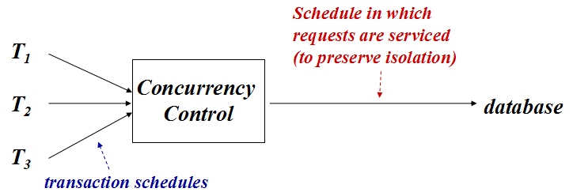
1. Isolation
Serial execution & Concurrent execution
Schedule (调度)
equivalence of schedules
serial schedule & serializable schedule
view serializable & conflict serializable
Isolation level
Strict Schedules

Slide 4
1.1 Serial & Concurrent Execution
Serial execution: trans. execute in sequence
Since each transaction is consistent and isolated from all others, schedule is guaranteed to be correct for all applications
Inadequate performance: Since system has multiple asynchronous resources and transaction uses only one at a time
Concurrent execution: Interleaved execution of a set of consistent trans.
Improved performance (multiprogramming)
Some interleavings produce incorrect result
Concurrent schedules that are equivalent to serial schedules are referred to as serializable schedules.

Slide 5
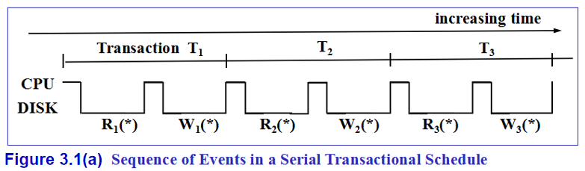
If a serial history is always consistent, why don't we just enforce serial histories?
Figure 3.1(a):
T_{x} has relatively small CPU bursts and then I/O during which CPU has nothing to do.
Notes:
为什么要并发？
穿行调度无法利用CPU、硬盘等计算机资源的并行处理能力

Slide 6
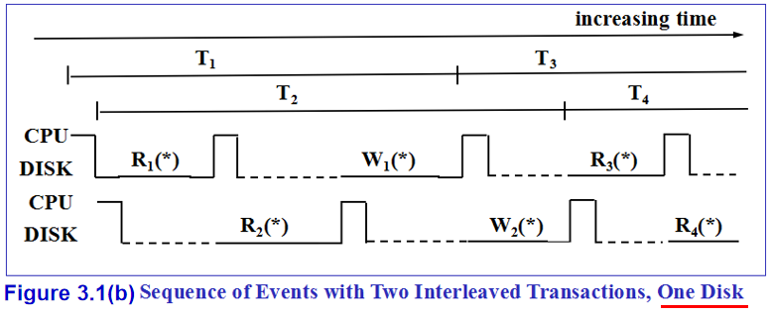
What do we want to do?
Figure 3.1(b):
Let another T_{y} run during slack CPU time.
Notes:
事务的并发运行，可以充分利用多CPU、多磁盘以及CPU与磁盘之间的并行处理能力，进而降低每个事务的响应等待时间，提高计算机资源的使用效率

Slide 7
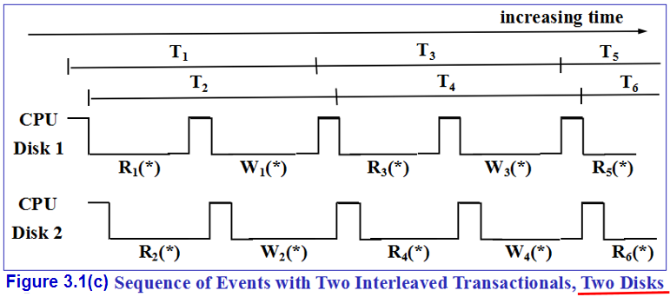
Figure 3.1(c)
If we have many disks in use, we can keep the CPU 100% occupied.
When one thread does an I/O, want to find another thread with completed I/O ready to run again.

Slide 8
1.2 Transaction Schedule
T₁: begin_transaction();
….
p_{1,1;}
….
p_{1,2;}
….
p_{1,3};
commit();
Transaction schedule
(commit applies to this)
p_{1,1} p_{1,2} p_{1,3}
To DB
server
local
variables
Consistent: performs correctly when executed in isolation starting in a consistent database state
Preserves database consistency
Moves database to a new state that corresponds to new real-world state

Slide 9
Schedule
Schedule in which
requests are serviced
(to preserve isolation)
Arriving schedule
(merge of transaction
schedules)
T1
T2
T3
Concurrency
Control
database
transaction
schedules
Database server

Slide 10
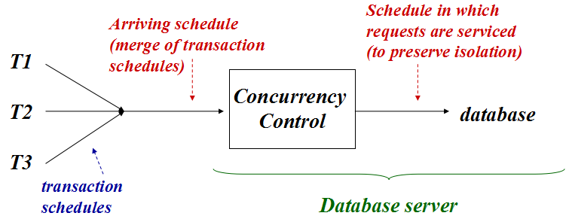
Transforms arriving interleaved schedule into a correct interleaved schedule to be submitted to the DBMS
Delays servicing a request - causes a transaction to wait
Refuses to service a request - causes transaction to abort
Actions taken by concurrency control have performance costs
Goal is to avoid delaying or refusing to service a request

Slide 11
Transaction T₁ & T₂
多用户事务执行示例
begin trans
..
op_{1,1}
..
op_{1,2}
..
commit
T₁
local computation
begin trans
..
op_{2,1}
..
op_{2,2}
..
commit
T₂
local variables

Slide 12
Transaction Execution
begin trans
..
op_{1,1}
..
op_{1,2}
..
commit
sequence of db
operations output by T₁
T₁
op_{1,1} op_{1.2} c₁
local computation
begin trans
..
op_{2,1}
..
op_{2,2}
..
commit
sequence of db
operations output by T₂
T₂
op_{2,1} op_{2.2} c₂
local variables

Slide 13
Sequence of DB op. input to DBMS
begin trans
..
op_{1,1}
..
op_{1,2}
..
commit
T₁
op_{1,1} op_{1.2} c₁
DBMS
op_{1,1} op_{2,1} op_{2.2} c₂ op_{1.2} c₁
begin trans
..
op_{2,1}
..
op_{2,2}
..
commit
T₂
op_{2,1} op_{2.2} c₂
interleaved sequence of db
operations input to DBMS

Slide 14
Execution sequence of DB op. in DBMS
多个事务的数据库访问操作，在DBMS中的实际执行序列，就构成这些事务之间的一个调度 (Schedule 或 History)
T₁
op_{1,1} op_{1.2} c₁
DBMS
op_{1,1} op_{2,1} op_{2.2} c₂ op_{1.2} c₁
op_{1,1} op_{2,1} op_{1.2} c₁ op_{2.2} c₂
T₂
op_{2,1} op_{2.2} c₂
interleaved sequence of db
operations input to DBMS
execution sequence of db
operations in DBMS
受并发控制的影响，来自不同事务的数据库访问请求在DBMS内部的执行顺序，与它们到达DBMS的顺序不完全一样！
但就单个事务而言，其操作的执行顺序是不变的！

Slide 15
Serial Execution in DBMS
T₁
op_{1,1} op_{1.2} c₁
DBMS
op_{1,1} op_{2,1} op_{2.2} c₂ op_{1.2} c₁
op_{1,1} op_{1.2} c₁ op_{2,1} op_{2.2} c₂
T₂
op_{2,1} op_{2.2} c₂
interleaved sequence of db
operations input to DBMS
Serial Execution in DBMS
T₁ & T₂
如果最终产生的执行顺序如上图所示，就构成这两个事务之间的一个串行调度（先T1后T2）。
串行调度的执行结果总是正确的！！

Slide 16
Concurrent Execution in DBMS
T₁
op_{1,1} op_{1.2} c₁
DBMS
op_{1,1} op_{2,1} op_{2.2} c₂ op_{1.2} c₁
op_{1,1} op_{2,1} op_{1.2} c₁ op_{2.2} c₂
T₂
op_{2,1} op_{2.2} c₂
concurrent sequence of db
operations in DBMS
如果如上图所示，则最终产生的是这两个事务之间的一个并发调度。
‘可串行化调度’是一种并发调度方法，不满足‘可串行化调度’要求的并发调度可能导致错误的并发执行结果。
DMBS并发控制的目标，是实现并发事务的可串行化调度！

Slide 17
调度 & 串行调度 & 可串行化调度
调度
一个或多个事务中的数据库访问操作，按照这些操作在DBMS中被执行的时间先后，排序所形成的一个操作序列
给定一组并发事务T₁, T₂, T₃,...,T_{k}，它们之间的调度H必须满足以下两个要求：
必须包括所有事务的所有操作，包括每一个事务的结束命令 （commit 或 abort ）
单个事务内部的操作顺序必须保持不变

Slide 18
调度 & 串行调度 & 可串行化调度
串行调度
如果一个调度的操作组成方式如下：首先是一个事务的所有操作，然后是另一个事务的所有操作，依此类推，则我们称该调度是串行的，或称为‘串行调度’
在每一个事务中，所有操作都是按照预定的顺序依次执行
串行调度的性质：任何一个串行调度均具有以下性质
在该调度中任意取两个事务X和Y，如果X的某个操作在Y的某个操作之前，则X的所有操作都在Y的所有操作之前
不存在不同事务之间的交叉执行现象
并发事务的串行调度执行方式不会破坏数据库状态的一致性

Slide 19
调度 & 串行调度 & 可串行化调度
可串行化调度
每个串行调度都将保持数据库状态的一致性。但也存在其它的调度（非串行调度）能够保证数据库状态的一致性
如果一个调度的执行结果（每一个事务的执行结果，及其对数据库状态的影响）和某个串行调度的结果相同，则我们称该调度是可串行化的，或称为 ‘可串行化调度’
‘可串行化’ 是用来衡量一个调度是否正确的评价标准，但缺乏 ‘可操作性’ (可串行化是一个‘事后’的结果评价标准)，DBMS必须确保经运行产生的调度满足‘可串行化’要求。
‘可串行化’也是一个过于严苛的标准，对某些应用来说，可通过选择合适的隔离级别 (Isolation level) 来提高系统的并发度。

Slide 20
Scheduler（调度器）
若干个事务的访问操作，混杂在一起形成的一个执行序列
come in
history
Scheduler
operations
operations
隶属于同一个事务的访问操作，其到达顺序是固定的；
来自于不同事务的访问操作，它们到达的先后次序是不确定的。

Slide 21
come in
history
Scheduler
operations
operations
Scheduler（调度器）
Scheduler assures that the sequence of operations in history is equivalent in effect to some serial schedule.
maybe
delaying some operations
some transactions be aborted

Slide 22
next
Correct Schedules
Commutativity (可交换性) of Read and Write Operations
Equivalence of Schedules (调度等价)
Serializable (可串行化) Schedules

Slide 23
Schedule
每个事务的操作单独占一行
p_{i} 表示该行事务的第 i 个操作
【Representation 1】
T₁: p₁ p₂ p₃ p₄
T₂: p₁ p₂
time
水平方向是执行时间轴（从左向右）
【Representation 2】
p_{1,1} p_{1,2} p_{2,1} p_{1,3} p_{2,2} p_{1,4}
time →
所有的事务操作都放在同一行中
p_{i,j} 表示事务T_{i}的第j个操作

Slide 24
Correct Schedules
Interleaved schedules equivalent to schedules are the only ones guaranteed to be correct for all applications
Equivalence: based on commutativity of operations
[Define] Commute
DB operations p₁ and p₂ commute if, for all initial database states, they
(1) return the same results and
(2) leave the database in the same final state
when executed in either order: p₁ p₂ or p₂ p₁
Notes:
在研究两个op的可交换性时，通常我们是指它们“来自不同的事务而且是一对相邻的op”
不允许跨越其他的数据库访问操作去调换两个op的执行顺序。

Slide 25
Conventional Operations
Read Operation: r(x, M)
copy the value of database variable x to local variable M
Write Operation: w(x, M)
copy the value of local variable M to database variable x
We use r₁(x) and w₁(x) to mean a read or write of x by transaction T₁
Notes:
r和w表示操作的类型（read/write），括号中的x表示要访问的数据库对象的标识符；下标1是该请求的访问者的标识（即发出该调用请求的事务的标识符）。
大写的X表示的是应用程序的局部变量，在研究事务调度时可以忽略不计。

Slide 26

Commutativity of Read and Write Operations
p₁ commutes with p₂ if
They operate on different data items
Or both are reads (on same data item)
其中：p₁和 p₂是来自不同事务的两个操作
If two transactions never access the same data items, so
We can commute operations in the history of requests permitted by the scheduler until all operations of one T_{x} are together (serial history).
The operations don't affect each other, and order doesn't matter.

Slide 27



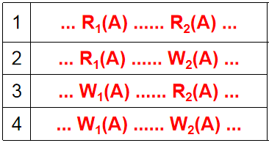
Commutativity of Read and Write Operations
Operations that do not commute conflict if
They operate on same data item, and at least one is write
or they come from the same transaction.
If we have operations by two different transactions that do affect the same data item, There are only four possibilities

Slide 28


If we have operations by two different transactions that do affect the same data item ^{(注)}
1 | ... R₁(A) ...... R₂(A) ...
2 | ... R₁(A) ...... W₂(A) ...
3 | ... W₁(A) ...... R₂(A) ...
4 | ... W₁(A) ...... W₂(A) ...
注:
在这两个操作之间，不存在其他对于数据项A的访问操作（不管是来自这两个事务本身，还是来自其他事务）；
每一次交换操作，只允许交换相邻的一对动作的执行顺序；
如果想交换两个不相邻操作的执行顺序，只能通过②中的方法，通过若干次相邻操作的交换来实现(当然，需要保证过程中的每一步都是可交换的)。
Notes:
如果两个事务需要访问同一个数据项，那么需要根据它们各自的访问模式来决定，其执行顺序是否会影响到某一个事务或者最终数据库中数据的执行结果。

Slide 29
归纳如下
来自两个不同事务 | 访问不同数据(A≠B) | op₁(A); op₂(B) | can be commuted
 | 访问同一个 数据对象 | R₁(A); R₂(A)
 |  | R₁(A); W₂(A) | can't be commuted
 |  | W₁(A); R₂(A)
 |  | W₁(A); W₂(A)
来自同一个事务 |  | op(A); op(B)
其中：
R 表示 Read 操作，W 表示 Write 操作
op 是指任意的一种操作 (Read或Write)

Slide 30
【Define】Conflicting Operations（冲突动作）
Two operations X_{i}(A) and Y_{j}(B) in a history are said to conflict (i.e., the order matters) if and only if the following three conditions hold:
A ≡ B
i ≠ j
at least one of the two operations X or Y is a write (W).
备注：这里没有讨论来自于同一个事务的相邻操作，是因为来自同一个事务的所有操作的执行顺序（相对顺序）是不可改变的，也可以认为：任何来自同一个事务的一对相邻操作也是一对“冲突动作”
Notes:
这里没有讨论来自于同一个事务的相邻操作，是因为来自同一个事务的所有操作的执行顺序（相对顺序）是不可改变的，也可以认为：任何来自同一个事务的一对相邻操作也是一对“冲突动作”

Slide 31
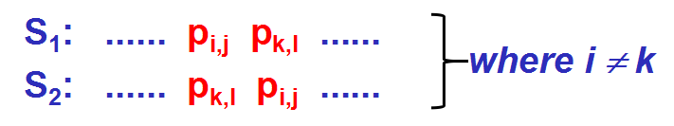
Equivalence of Schedules
An interchange of adjacent operations of different transactions in a schedule creates an equivalent schedule if the operations commute:
更准确地说，上文给的是两个调度的 ‘冲突等价’ (conflict equivalence)的定义。
Equivalence is transitive!

Slide 32
Example of Equivalence
conflict
S₁: r₁(x) r₂(x) w₂(x) r₁(y) w₁(y)
S₂: r₁(x) r₂(x) r₁(y) w₂(x) w₁(y)
S₃: r₁(x) r₁(y) r₂(x) w₂(x) w₁(y)
S₄: r₁(x) r₁(y) r₂(x) w₁(y) w₂(x)
S₅: r₁(x) r₁(y) w₁(y) r₂(x) w₂(x)
conflict
all conflicting operations ordered in same way
∵ S₁ is equivalent to S₅ , S₅ is the serial schedule (T₁,T₂)
∴ S₁ is serializable
but, S₁ is not equivalent to the serial schedule (T₂,T₁)

Slide 33
Example of Equivalence
T₁: begin transaction
read (x, X);
X = X+4;
write (x, X);
commit;
T₂: begin transaction
read (x,Y);
write (y,Y);
commit;
initial state final state
x=1, y=3 r₁(x) r₂(x) w₂(y) w₁(x) x=5, y=1
x=1, y=3 r₂(x) w₂(y) r₁(x) w₁(x) x=5, y=1
T₂ T₁
x=1, y=3 r₁(x) w₁(x) r₂(x) w₂(y) x=5, y=5
T₁ T₂
Interchange
commuting operations
Interchange
conflicting operations

Slide 34
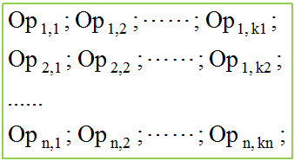
serial schedule（串行调度）
all operations of a T_{x} are performed in sequence with no interleaving with other transactions.
T₁; T₂; T₃; ......; T_{n};

Slide 35
Serializable Schedules
S is serializable if it is equivalent to a serial schedule
Transactions are isolated in a serializable schedule
A schedule is correct for any application if it is a serializable schedule of consistent transactions
The schedule : r₁(x) r₂(y) w₂(x) w₁(y)
is not serializable
serializable schedule：
r₁(x) r₂(x) w₂(y) w₁(x)

Slide 36
Serializable & Conflict Serializable
S is serializable if it is equivalent to a serial schedule
Transactions are isolated in a serializable schedule
A schedule is correct for any application if it is a serializable schedule of consistent transactions
S is conflict serializable if it is conflict equivalent to a serial schedule
'冲突可串行化' 是 '可串行化' 的一个充分条件，而非必要条件
‘冲突可串行化’调度 必定 也是一个‘可串行化’调度
一个‘可串行化’调度 并不一定 是‘冲突可串行化’的

Slide 37
1.3 Isolation Levels
Serializable & Conflict Serializable
Serialization Graph of a Schedule
Strict Schedules

Slide 38
Isolation Levels
Serializability provides a conservative definition of correctness
For a particular application there might be many acceptable non-serializable schedules
Requiring serializability might degrade performance
DBMSs offer a variety of isolation levels:
SERIALIZABLE is the most stringent
Lower levels of isolation give better performance
Might allow incorrect schedules
Might be adequate for some applications

Slide 39
Conflict Serializable
Theorem: Schedule S₁ can be derived from S₂ by a sequence of commutative interchanges if and only if conflicting operations in S₁ and S₂ are ordered in the same way
Only If: Commutative interchanges do not reorder conflicting operations
If: A sequence of commutative interchanges can be determined that takes S₁ to S₂ since conflicting operations do not have to be reordered (see text)

Slide 40
Conflict Equivalence
Definition: Two schedules, S₁ and S₂, of the same set of operations are conflict equivalent if conflicting operations are ordered in the same way in both
Or (using theorem) if one can be obtained from the other by a series of commutative interchanges

Slide 41
Conflict Equivalence
Result: A schedule is serializable if it is conflict equivalent to a serial schedule
If in S transactions T₁ and T₂ have several pairs of conflicting operations (p_{1,1} conflicts with p_{2,1} and p_{1,2} conflicts with p_{2,2}) then:
p_{1,1} < p_{2,1} and p_{1,2} < p_{2,2} (or vice versa)
in order for S to be serializable.
commutativity
conflict(1)
r₁(x) w₂(x) w₁(y) r₂(y) ≡
r₁(x) w₁(y) w₂(x) r₂(y)
conflict(1)
conflict(2)
conflict(2)

Slide 42
Conflict Equivalence and Serializability
Serializability: a conservative notion of correctness
Conflict equivalence:
a conservative technique for determining serializability
Moreover: a concurrency control that guarantees conflict equivalence to serial schedules is easily implemented

Slide 43
Serialization Graph of a Schedule S
Nodes: represent transactions
There is a directed edge from node T_{i} to node T_{j}:
if T_{i} has an operation p_{i,k} that conflicts with an operation p_{j,r} of T_{j} and p_{i,k} precedes p_{j,r} in S
Theorem: A schedule is conflict serializable if and only if its serialization graph has no cycles

Slide 44
Example
Conflict (*)
S: … p_{1,i}, …, p_{2,j}, ...
S is serializable in order
T₁ T₂ T₃ T₄ T₅ T₆ T₇
T₂
T₄
T₁
T₅
T₆
T₇
T₃
SG of schedule S
H is not serializable due
to cycle T₂ T₆ T₇ T₂
T₂
T₄
T₁
T₅
T₆
T₇
T₃
SG of schedule H

Slide 45
Serializability and Nonserializability
Consider the nonserializable schedule
r₁(x) w₂(x) r₂(y) w₁(y)
Two ways to think about it:
Because of the conflicts, the operations of T₁ and T₂ cannot be interchanged to make an equivalent serial schedule
Because T₁ read x before T₂ wrote it, T₁ must precede T₂ in any ordering, and because T₁ wrote y after T₂ read it, T₁ must follow T₂ in any ordering --- clearly an impossibility
conflict
T₁ T₂
conflict

Slide 46

Proof.
Assume there are m transactions involved, and label them T₁, T₂, . . ., T_{m}.
Because In any directed graph with no circuit there is always a vertex with no edge entering it, thus there is a vertex(or transaction T_{k}), with no edge entering it. We choose T_{k} to be T_{i}(1).

Slide 47
Proof.(cont.)
Note that since T_{i}(1) has no edge entering it, there is no conflict in H that forces some other transaction to come earlier.
Now remove this vertex, T_{i}(1), from PG(H) and all edges leaving it. Call the resulting graph PG¹(H) with no circuit.
Continue in this fashion, removing T_{i}(2) and all it's edges from PG¹(H), and so on, choosing T_{i}(3) from PG²(H), . . ., T_{i}(m) from PG^{m-1}(H).

Slide 48
总结：
并发调度：提高计算机及DBMS的性能和效率
可以充分利用计算机硬件(CPU/DISK/...)的并行处理能力，提高计算机硬件资源的利用率；
减少事务的平均响应时间，避免不必要的事务等待现象；
提高DBMS的事务吞吐量。
可串行化调度：兼顾事务处理的“性能和质量”
在一个事务的执行过程中，有可能在DB中留下“不一致”的数据；其他并发事务则可能‘访问’到这个不一致的数据
因此，不正确的并发调度可能导致错误的执行结果
冲突可串行化调度：找到可串行化调度的实现途径
“给定一个调度，然后再判断它是不是‘可串行化’” 没有实现价值！（事后诸葛亮）
采用并发控制技术，确保最终生成的调度是“冲突可串行化”！（预则立）

