Slide 1
Isolation in Relational Databases

Slide 2
Isolation in Relational Databases
Locking in Relational Databases
SQL Isolation Levels
Granular Locks
Index Locking
Multiversion Controls (MVCs)
SNAPSHOT Isolation

Slide 3
Multiple granularity locking
Lock Granularity (粒度)
Lock granularity specifies which resource is locked by a single lock attempt.
Multiple Granularity Locking (MGL-多粒度封锁)
MGL is a locking method used in database management systems (DBMS) and relational databases.
An object maybe contains other objects. For example
a dabase may have files
a file contain pages
a page contain records
When an item is accessed: DBMS locks an entity that contains the item

Slide 4
Multiple granularity locking
Lock’s granularity determined by entity’s size:
Coarse granularity (large entities locked)
Advantage: If transactions tend to access multiple items in the same entity, fewer lock requests need to be processed and less lock storage space required
Disadvantage: Concurrency is reduced since some items are unnecessarily locked
Fine granularity (small entities locked)
Advantages and disadvantages are reversed

Slide 5
Lock Granularity in Relational Database
Table locking (coarse)
Lock entire table when a row is accessed
Row (tuple) locking (fine)
Lock only the row that is accessed
Page locking (compromise)
Lock page containing accessed row

Slide 6
What’s Different About Locking in Relational Databases?
In relational databases, accesses are made to items that satisfy a predicate (for example, a SELECT statement)
What should we lock?
What is a conflict?
T₁:
...
...
SELECT SUM (balance)
FROM Accounts
WHERE name = ‘Mary’;
...
...

Slide 7
Conflicts in Relational Databases
Audit:
NewAccount:
T₁
T₂
SELECT SUM (balance)
FROM Accounts
WHERE name = ‘Mary’;
SELECT totbal
FROM Depositors
WHERE name = ‘Mary’
INSERT INTO Accounts
VALUES (‘123’,‘Mary’,100);
UPDATE Depositors
SET totbal = totbal + 100
WHERE name = ‘Mary’
p_{1,1}
p_{2,1}
p_{1,2}
p_{2,2}
Two transactions: Audit and NewAccount
Operations on Accounts and Depositors conflict
Interleaved execution is not serializable

Slide 8
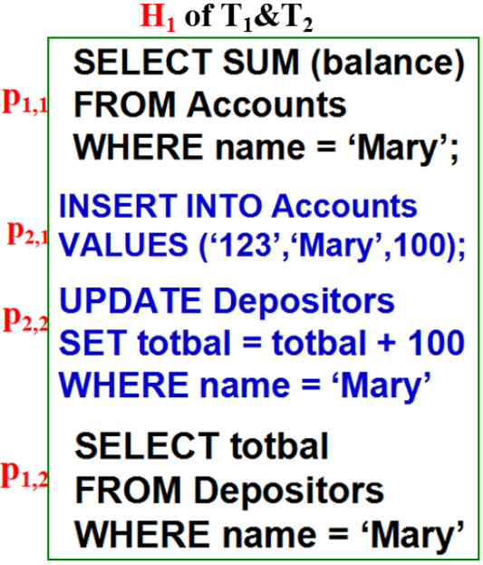
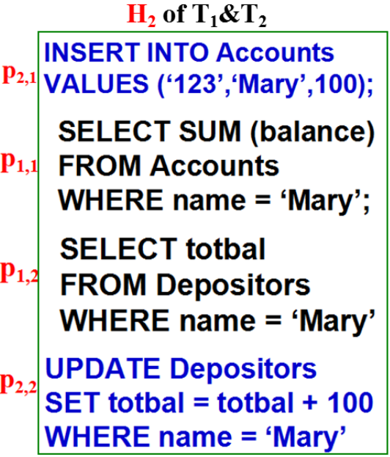
Interleaved execution
R_{1,1}(A);W_{2,1}(A);W_{2,2}(D);R_{1,2}(D);
W_{2,1}(A);R_{1,1}(A);R_{1,2}(D);W_{2,2}(D);
Interleaved execution is not conflict serializable!

Slide 9
What to Lock?
Lock tables (TL)
Execution is serializable but ...
Performance suffers because lock granularity is coarse
Lock rows (RL)
Performance improves because lock granularity is fine but ...
Execution is not serializable

Slide 10
with Table Locking
Audit:
SELECT SUM (balance)
FROM Accounts
WHERE name = ‘Mary’;
SELECT totbal
FROM Depositors
WHERE name = ‘Mary’
T₁
NewAccount:
INSERT INTO Accounts
VALUES (‘123’,‘Mary’,100);
UPDATE Depositors
SET totbal = totbal + 100
WHERE name = ‘Mary’
T₂
p_{1,1}
p_{2,1}
p_{1,2}
p_{2,2}
在采用‘Table Locking’的情况下，无论以何种方式执行，最终产生的一定是这两个事务之间的一个串行调度(S₁ or S₂)
调度S₁:
p_{1,1}; p_{1,2}; c₁; p_{2,1}; p_{2,2}; c₂;
调度S₂:
p_{2,1}; p_{2,2}; c₂; p_{1,1}; p_{1,2}; c₁;

Slide 11
Problem with Row Locking
Audit
(1) Locks and reads Mary’s rows in Accounts
NewAccount
(2) Inserts and locks new row t, in Accounts
(3) Locks and updates Mary’s row in Depositors
(4) Commits and releases all locks
Audit
(5) Locks and reads Mary’s row in Depositors
(6) Commits and releases all locks
p_{1,1}
p_{2,1}
p_{2,2}
c₂
p_{1,2}
c₁
time

Slide 12
Problem with Row Locking
SELECT SUM (balance)
FROM Accounts
WHERE name = ‘Mary’;
INSERT INTO Accounts
VALUES (‘123’,‘Mary’,100);
UPDATE Depositors
SET totbal = totbal + 100
WHERE name = ‘Mary’;
COMMIT;
SELECT totbal
FROM Depositors
WHERE name = ‘Mary’;
COMMIT;
p_{1,1}
Problem: The two SELECT statements in Audit see inconsistent data
Reason: Audit’s SELECT and NewAccount’s INSERT (on table Accounts) do not commute, but the row locks held by Audit did not delay the INSERT.
Phantom: The inserted row is referred to as a phantom.
p_{2,1}
p_{2,2}
c₂
p_{1,2}
c₁
S₃:
p_{1,1}; p_{2,1}; p_{2,2}; c₂; p_{1,2}; c₁;

Slide 13
Phantom Reads & Predicate Locks

Slide 14
Phantoms (幻像) in RL
Phantoms occur when row locking is used and
T₁ SELECTs, UPDATEs, or DELETEs using a pred. P
T₂ creates a row (using INSERT or UPDATE) satisf. P
Example:
T₁: UPDATE Table T₂: INSERT INTO Table
SET Attr = …. VALUES ( … satisfies P…)
WHERE P
在采用行级(或元组级)封锁粒度的情况下，在分别来自于事务T₁和T₂的这两条SQL语句之间不会产生锁冲突现象！
Why?

Slide 15
Phantoms in Row Locking
rows in
table R
rows in R satisfying P
(rows that can be locked)
rows satisfying
predicate P
rows satisfying P
that do not exist in R
all rows that can
possibly be in table R
(cann't be locked!!!)

Slide 16
Phantoms in RL
Question:
INSERT and UPDATE cause phantoms with row locking.
Why does DELETE not cause a similar problem with row locking?
Answer:
A row that has been read cannot be deleted because it is locked

Slide 17
Predicate Locking (PL)
TL prevents phantoms; RL does not ! BUT ......
Predicate locking also prevents phantoms
A predicate describes a set of rows, some are in a table and some are not;
In Row Locking (RL), name = ‘Mary’ is a subset of the rows satisfying name = ‘Mary’ are in Accounts
Every SQL statement has an associated predicate
When executing a statement, acquire a (read or write) lock on the associated predicate
Two predicate locks conflict if one is a write and there exists a row (not necessarily in the table) that is contained in both

Slide 18
Preventing Phantoms With PLs
Audit:
NewAccount:
SELECT SUM (balance)
FROM Accounts
WHERE name = ‘Mary’
INSERT INTO Accounts
VALUES (‘123’,‘Mary’,100)
Audit gets read lock on predicate name=‘Mary’
NewAccount requests write lock on predicate
(acctnum=‘123’ ∧ name=‘Mary’ ∧ bal=100)
Request denied since predicates overlap

Slide 19
Conflicts And Predicate Locks
Example 1:
Statements conflict since:
Predicates overlap and one is a write
There might be acc. with bal < 100 and name = ‘Mary’
Locking is conservative: there might be no rows in Accounts satisfying both predicates
SELECT SUM (balance)
FROM Accounts
WHERE name = ‘Mary’
DELETE
FROM Accounts
WHERE bal < 100

Slide 20
Conflicts And Predicate Locks
Example 2:
Statements commute since:
Predicates are disjoint.
There can be no rows (in or not in Accounts) that satisfy both predicates
No phantom involved in this (DELETE) case
SELECT SUM (balance)
FROM Accounts
WHERE name = ‘Mary’
DELETE
FROM Accounts
WHERE name = ‘John’

Slide 21
Serializability in Relational DB
Table locking
prevents phantoms and produces serializable schedules, but ...
negatively impacts performance
Row locking
does not prevent phantoms and can produce nonserializable schedules
Performance ok
Predicate locking
prevents phantoms and produces serializable schedules, but ...
too complex to implement

Slide 22
Serializability in Relational DB
What’s an implementor to do?
Later we discuss more efficient locking methods (granular locking and index locking) that prevent phantoms and produce serializable schedules

Slide 23
Isolation in Relational Databases
Locking in Relational Databases
SQL Isolation Levels
Granular Locks
Index Locking
Multiversion Controls (MVCs)
SNAPSHOT Isolation

Slide 24
Isolation Levels
SQL defines several isolation levels weaker than SERIALIZABLE that allow non-serializable schedules and hence allow more concurrency
Serializable schedules
delays
serializable
conc. control
input
s′
s
•
s′
•
weaker
conc. control
input
s
Schedules allowed
at a weaker isolation level
fewer delays

Slide 25
Isolation Levels
Schedules produced by CC operating at isolation levels lower than SERIALIZABLE Might be correct for some applications
SQL standard defines isolation levels in terms of certain anomalies they do or do not allow

Slide 26
Anomaly (异常)
We have already talked about some anomalies
Dirty Read
Dirty Write
Lost Update
Non-Repeatable Read
Phantom
Now we discuss:
Non-Repeatable Read vs. Phantom

Slide 27
Lost update & Dirty write & Blind write
A lost update or dirty write occurs when a second transaction writes a second value of a data-item on top of a first value written by a first concurrent transaction, and the first value is lost to other transactions running concurrently which need.
Lost Update:
Dirty Write:
T₁ : w(x) commit
T₂ : w(x) commit
T₁ : w(x) abort
T₂ : w(x) abort
A write w_{i}(X) is said to be 'blind write' if it is not the last action of resource X and the following action on X is a write w_{j}(X).

Slide 28

Dirty Read (脏读)
Transaction could read a database object modified by another transaction which hasn't committed (later be aborted). This is a dirty read.
Dirty Read:
T₁ has a dirty read r(x) !

Slide 29
Non-Repeatable Read (脏读)
A non-repeatable read occurs, when during the course of a transaction, a row is retrieved twice and the values within the row differ between reads.
Non-Repeatable Read:
T₁ : w(x) commit
T₂ : r(x) r(x) commit
T₂ has already seen a different value for x !

Slide 30
Anomaly: Non-Repeatable Read
T1 T2
SELECT SUM (balance)
FROM Accounts
WHERE name = ‘Mary’
UPDATE Accounts
SET balance = 1.05 * balance
WHERE name = ‘Mary’
SELECT SUM (balance)
FROM Accounts
WHERE name = ‘Mary’
does not introduce a
phantom into predicate
name=‘Mary’

Slide 31
Phantom Read (幻读)
A phantom read occurs when, in the course of a transaction, new rows are added or removed by another transaction to the records being read.
transaction T₁
transaction T₂

Slide 32
Non-Repeatable Reads and Phantoms
/* query by T₁ */
SELECT SUM (balance)
FROM Accounts
WHERE name = ‘Mary’;
/* update by T₂ */
UPDATE Accounts
SET balance = 1.05*balance
WHERE name = ‘Mary’;
/* commit by T₂ */
COMMIT;
/* query by T₁ */
SELECT SUM (balance)
FROM Accounts
WHERE name = ‘Mary’;
/* query by T₁ */
SELECT SUM (balance)
FROM Accounts
WHERE name = ‘Mary’;
/* update by T₂ */
INSERT INTO Accounts
VALUES('123', ‘Mary’, 100);
/* commit by T₂ */
COMMIT;
/* query by T₁ */
SELECT SUM (balance)
FROM Accounts
WHERE name = ‘Mary’;
With a non-repeatable read, execution of same SELECT twice yields the same set of rows, but attribute values might be different.
With a phantom read, execution of same SELECT twice yields different sets of rows. The second returns at least one row not returned by the first.

Slide 33
SQL Isolation Levels
READ UNCOMMITTED – dirty reads, non-repeatable reads, and phantoms allowed
READ COMMITTED - dirty reads not allowed, but non-repeatable reads and phantoms allowed
REPEATABLE READ – dirty reads, non-repeatable reads not allowed, but phantoms allowed
SERIALIZABLE – dirty reads, non-repeatable reads, and phantoms not allowed; all schedules must be serializable

Slide 34
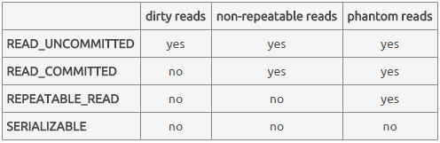
SQL Isolation Levels
Defining isolation levels in terms of anomalies leads to an ambiguous specification:
At what levels are dirty writes allowed?
Are there other anomalies that are not accounted for?
Transaction Isolation / Statement Isolation

Slide 35
Statement Isolation
In addition, statement execution must be isolated
DBMS might be executing several SQL statements (from different transactions) concurrently
The execution of statement involves the execution of a program implementing that statement’s query plan
This might be a complex program
While the execution of transactions T₁ and T₂ might not be isolated, the execution of each statement within T₁ must be isolated with respect to the execution of each statement within T₂.

Slide 36
Locking Implementation of SQL Isolation Levels
SQL standard does not say how to implement levels
Locking implementation is based on:
Entities locked: rows, predicates, …
Lock modes: read & write
Lock duration:
Short: locks acquired in order to execute a statement are released when statement completes
Long: locks acquired in order to execute a statement are held until transaction completes
Medium: something in between

Slide 37
Locking Implementation of SQL Isolation Levels
Write locks are handled identically at all isolation levels:
Long-duration predicate write locks are associated with UPDATE, DELETE, and INSERT statements
This rules out dirty writes
In practice, predicate locks are implemented with table locks or by acquiring locks on an index as well as the data
We discuss index locking later
Read locks handled differently at each level

Slide 38
Locking Implementation of SQL Isolation Levels
READ UNCOMMITTED: no read locks
Hence a transaction can read a write-locked item!
Allows dirty reads, non-repeatable reads, and phantoms
READ COMMITTED: short-duration read locks on rows returned by SELECT
Prevents dirty reads, but non-repeatable reads and phantoms are possible
REPEATABLE READ: long-duration read locks on rows returned by SELECT
Prevents dirty and non-repeatable reads, but phantoms are possible
SERIALIZABLE: long-duration read lock on predicate specified in WHERE clause
Prevents dirty reads, non-repeatable reads, and phantoms and …
Guarantees serializable schedules

Slide 39
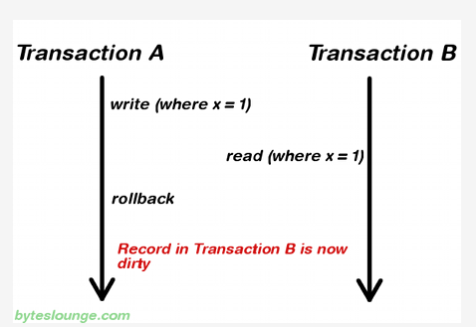
Dirty read

Slide 40

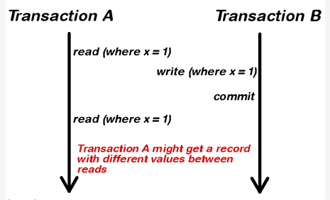
non-repeatable read

Slide 41
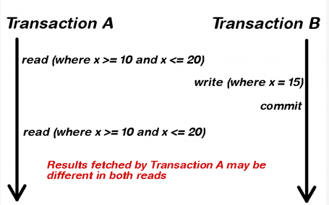
phantom read

Slide 42
Bad Things Can Happen
At every isolation level lower than SERIALIZABLE, bad things can happen
Schedules can be
Non-serializable
Specifications of transactions might not be met

Slide 43
Some Problems at READ UNCOMMITTED
Since no read locks are obtained, T₂ can read a row t, write locked by T₁
Some DBMSs allow only read-only transactions to be executed at this level
T₁: w(t) abort
T₂: r(t) w(t′) commit
T₁: w(t) w(t) commit
T₂: r(t) w(t′) commit
T₁: w(t) w(t′) commit
T₂: r(t) r(t′) commit
T₂ uses an aborted
value to update db
T₂ uses an intermediate
value to update db
T₂ does not see a
committed snapshot

Slide 44
Some Problems at READ COMMITTED
Non-repeatable reads:
Lost updates:
T₁: r(t) r(t) commit
T₂: w(t) commit
T₁: r(t) w(t) commit
T₂: r(t) w(t) commit

Slide 45
Problems at REPEATABLE READ
Phantoms:
t satisfies pred
A constraint relates rows satisfying pred and t′
Audit: r(pred) r(t′) commit
NewAccount: insert(t) update(t′) commit

Slide 46
Levels of Isolation
Levels of Isolation
Types of Locks
Write locks
Read Locks
( row )
Read Locks
(Predicates)
Problem
Read Uncommitted
No
(Read Only)
No
No
Dirty Reads
Read Committed
Yes
short-term
short-term
Lost Update
Repeatable Read
Yes
long-term
short-term
Update Anomaly
Serializable
Yes
long-term
long-term
No

Slide 47
Implications of Locking Implementation
Transactions can be assigned to different isolation levels and can run concurrently.
Since all write locks are long-duration predicate locks and SERIALIZABLE transactions have long-duration predicate read locks, SERIALIZABLE transactions are serialized with respect to all writes.
A SERIALIZABLE transaction either sees the entire effect of another transaction or no effect.
A transaction at a lower level does not see the anomalies prohibited at that level.

Slide 48
Implications of Locking Implementation
Even though all transactions are designed to be consistent,
Transactions executed at lower isolation levels can see anomalies that can cause them to write inconsistent data to the database
Transactions executed at any isolation levels can see that inconsistent data and as a result return inconsistent data to user or store additional inconsistent data in database

Slide 49
Update Locks
Some DBMS provide update locks to alleviate deadlock problem
A transaction that wants to read an item now and possibly update it later requests an update lock on the item (manual locking)
An update lock is a read lock that can be upgraded to a write lock
Often used with updatable cursors

Slide 50
Update Locks
An update lock conflicts with other update locks and with write locks, but not with read locks.
Granted mode
Requested mode read write update
read x
write x x x
update x x
Granted mode
Requested mode read write
read x
write x x
(X 代表不可以)

Slide 51
Update Locks
Schedule that causes a deadlock at CURSOR STABILITY (游标稳定性):
T₁: fetch(t) request_update(t)
T₂: fetch(t) request_update(t)
If both fetches had requested update locks, T₂’s fetch would be made to wait until T₁ had completed, avoiding the deadlock

Slide 52
Isolation in Relational Databases
Locking in Relational Databases
SQL Isolation Levels
Granular Locks
Index Locking
Multiversion Controls (MVCs)
SNAPSHOT Isolation

Slide 53
Granular Locks (粒度锁)
Transactions access data at different levels of granularity
Many DBMSs provide both fine and coarse granularity locks
DBMS attempts to automatically choose appropriate granularity
A particular application might be able to force a particular granularity

Slide 54
Granular Locks
Problem:
T₁ holds a (fine grained) lock on field F₁ in record R₁
T₂ requests a conflicting (coarse grained) lock on R₁
Lock requested by T₂
Record R₁ :
Field F₁ | Field F₂ | ……
Locked by T₁
How does the concurrency control detect the conflict
since it sees F₁ and R₁ as different items?

Slide 55
Granular Locks (GL)
Solution:
Organize locks hierarchically by containment
Require that a transaction to get a fine grained lock it
must first get a coarse grained lock on the containing item
Record R₁ :
Field F₁ | Field F₂ | ……
Hence, T₁ must:
First get a lock on R₁ Before getting a lock on F₁
When T₂ requests a conflicting lock on R₁
The conflict with T₁ is detected at R₁

Slide 56
Intention Locking
Performance improvement: if lock on parent is weak
Intention shared (IS): to get an S lock on an item, T must first get IS locks on all containing items (↑root)
Intention exclusive (IX): to get an X lock on an item, T must first get IX locks on all containing items (↑root)
Shared Intention Exclusive (SIX): Equivalent to an S lock and an IX lock on an item
Intention lock indicates transaction’s intention to
acquire conventional lock on a contained item

Slide 57
Conflict Table
T₂ Requested T₁ Granted mode
mode IS IX S X SIX
IS
IX
S
X
SIX
x
x x x
x x x
x x x x x
x x x x
Example 1: T₂ denied an IX lock (intends to update some contained items) since T₁ is reading all contained items

Slide 58
Conflict Table
T₂ Requested T₁ Granted mode
mode IS IX S X SIX
IS
IX
S
X
SIX
x
x x x
x x x
x x x x x
x x x x
Example 2: T₂ granted IS lock even though T₁ holds IX lock (since they may be accessing different subsets of contained items)

Slide 59
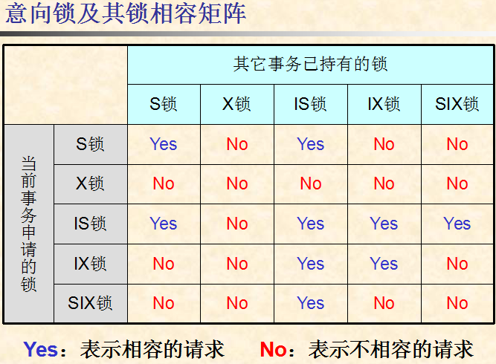

Slide 60
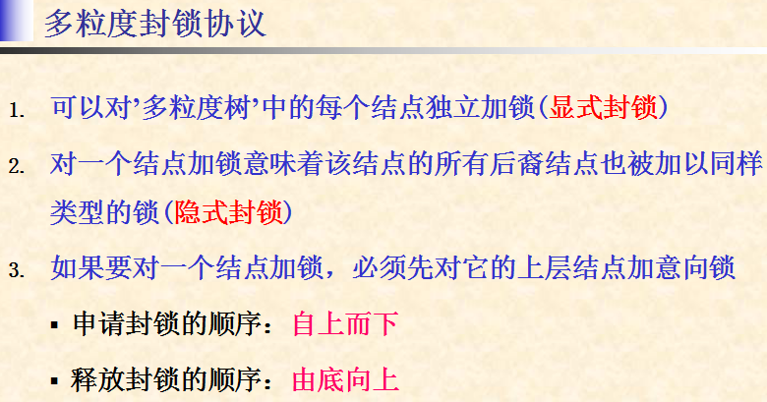

Slide 61
Isolation in Relational Databases
Locking in Relational Databases
SQL Isolation Levels
Granular Locks
Index Locking
Multiversion Controls (MVCs)
SNAPSHOT Isolation

Slide 62
Index Locking
Index Locks
Predicate Locks
Key-Range Locks

Slide 63
Preventing Phantoms
Lock entire table - this works
T₁ executes SEL(P): (where P is a predicate), obtains long-duration S lock on table
T₂ executes INS(t): requires long-duration X lock on table
Phantom prevented
Lock the predicate P - this works but entails too much overhead
Can granular locking be used?

Slide 64
封锁的选择
Lock entire table
Lock table/pages
No Appropriate Index for P
Index idx_I exists on attribute P，but no Index Locking
Index idx_I exists on attribute P，and use Index Locking

Slide 65
Lock entire table - Example
T₁: SELECT F.Name
FROM Faculty F
WHERE F.Salary > 70000
Holds: long-duration S lock on Faculty
pages of row which salary>7000
Faculty
...,75000,...
c
a b d
T₂: INSERT INTO Faculty
VALUES (…75000, …)
Requests: long-duration X lock on Faculty
inserted row
lock conflict detected on table Faculty, T₂ is waiting......

Slide 66
No Appropriate Index for P
Assume containment hierarchy is table/pages:
T₁ does SEL(P): obtains long-duration S lock on table
Since it must read every page to find rows satisfying P
T₂ requests INS(t): obtains long-duration IX lock on table and X lock on page into which t is to be inserted.
lock conflict detected (on table), hence (a potential) phantom is prevented
However other transaction can read parts of the table that are stored on pages other than the one on which t is stored
Notes:
提供‘表/页面’两级的多粒度封锁

Slide 67
No Appropriate Index for P - table / pages
T₁: SELECT F.Name
FROM Faculty F
WHERE F.Salary > 70000
Holds: long-duration S lock on Faculty
because no index can be used for salary>7000, T₁ must read every page to find rows satisfying salary>7000
pages of row which salary>7000
Faculty
...,75000,...
c
a b d
T₂: INSERT INTO Faculty
VALUES (…75000, …)
Requests: long-duration IX lock on Faculty,
计划在页面c中插入新元组，需要申请表上的IX锁和页面c上的X锁
waiting ......
lock conflict detected on table Faculty, T₂ is waiting......

Slide 68
Index I exists on attribute P but NO Index-locking
T₁ obtains long-duration IS lock on table, uses I to locate pages containing rows satisfying P, and acquires long-duration S locks on them.
T₂ obtains long-duration IX lock on table (no conflict) and X lock on page p, into which t is to be inserted.
Problem: Since p might not be locked by T₁, a phantom can result.

Slide 69
No Index Granular Locking - table / pages
T₁: SELECT F.Name
FROM Faculty F
WHERE F.Salary > 70000
unclustered
index on
Salary
Request & Holds:
IS lock on Faculty
S lock on page a, b, d
e
Faculty
c
a b d
T₂: INSERT INTO Faculty
VALUES (…75000, …)
inserted row
Request & Holds:
IX lock on Faculty,
X lock on page c
no lock conflict, but
a phantom can result. !

Slide 70
Index Locking
Solution: lock pages of the index in addition
Example: I is an unclustered B⁺ tree.
T₁ (SEL(P)) obtains:
long-duration IS lock on table,
long-duration S locks on the pages containing rows satisfying P, and
long-duration S locks on the leaf index pages containing entries satisfying P
T₂ (INS(t)) requests:
long-duration IX lock on table (granted),
long-duration X locks on the page into which t is to be inserted (might be granted), and
long-duration X lock on the leaf index page into which the index entry for t will be stored (lock conflict if t satisfies P)
The phantom is prevented!

Slide 71
Index Locking - Example
T₁: SELECT F.Name
FROM Faculty F
WHERE F.Salary > 70000
Holds: IS lock on Faculty,
S lock on a, b, d, S lock on e
unclustered
index on
Salary
e
Faculty
c
a b d
T₂: INSERT INTO Faculty
VALUES (…75000, …)
Requests: IX lock on Faculty,
X lock on c, X lock on e
inserted row
lock conflict detected on index page e, phantom is prevented !

Slide 72
Index Locking
B⁺ tree
index entries locking and key-range locking
locking index pages

Slide 73
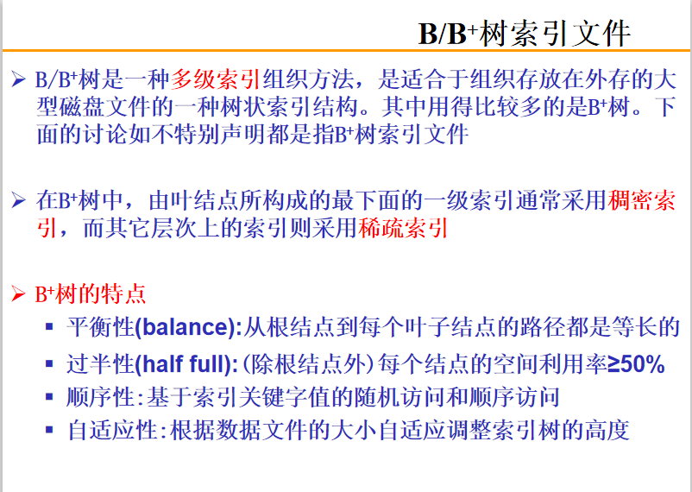

Slide 74
B⁺ tree
the order of tree (树的'阶'数)
the order of tree is the maximum number of children
N-ary B⁺-tree ( N-阶B⁺树 )
Node Type | Children Type | Min number of key value | Max number of key value
root node (the only node in the tree) | None | 1 | N − 1
root node | internal node or leaf node | 1 | N − 1
internal node | internal node or leaf node | ⎣ (N−1) / 2 ⎦ | N − 1
leaf node | None | ⎣ N / 2 ⎦ | N − 1
Notes:
备注: ⎣ x ⎦ 表示‘向下取整’，返回 ‘比x小的最大整数’； ⎡ x ⎤ 表示‘向上取整’，返回 ‘比 x 大的最小整数’
1、如果这棵树只有一个结点（the only node in the tree)，那么该结点既是根结点也是叶子结点，其中的指针不是子树指针而是关键字对应的元组指针；
2、在内部结点和叶子结点中，关键字数目的下界有所不同，主要是因为内部结点和叶子结点的分裂处理算法不一样。
3、关于‘树的阶数’的定义，有些地方指‘在一个结点中存放的关键字的最小数目’，有点地方指‘一个结点可以拥有的子结点的最小数目’（即结点中子树指针的最小数目），本文使用的是后一种定义。

Slide 75

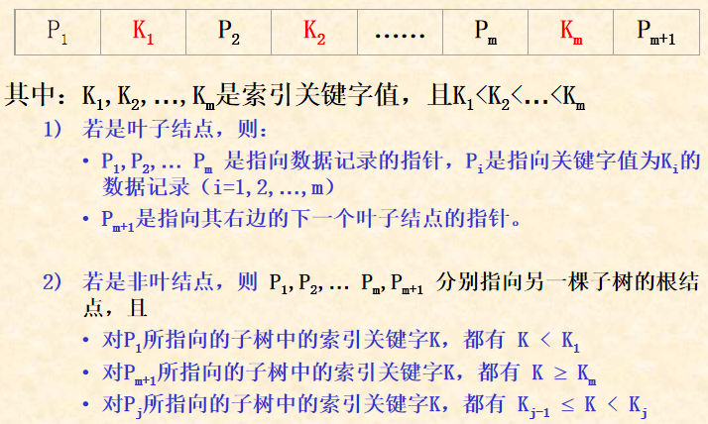
node of N-ary B⁺-tree
each node have m key values and (m+1) pointer, and K₁<K₂<…<K_{m} （1 ≤ m < N）

Slide 76
Index, Predicate & Key-Range Locks
If a WHERE clause:
refers to a predicate name = mary and if there is an index on name,
then an index lock on index entries for name = mary
is like a predicate lock on that predicate
If a WHERE clause refers to a
predicate such as 50000< salary < 70000 and if there is an index on salary,
then a key-range index lock can be used to get the
equivalent of a predicate lock on 50000<salary<70000

Slide 77
Key-Range Locking
Instead of locking index pages, index entries at the leaf level are locked (Each such lock is interpreted as a lock on a range )
Suppose the entries in the index are k₁,k₂,... and k₁<k₂<k₃<...<k_{n}
k₁ | k₂ | k₃ | ...... | k_{n}
lock on index entry | lock on key-range
k_{s} (1≤s<n) | key ∈ [ k_{s}, k_{s+1} )
k_{n} | key ≥ k_{n}
a new lock | key < k₁
Notes:
在一个含有 n 个关键字的叶子结点中，将关键字的定义域划分为 n+1 个区间 (key range)
1）设置一个虚拟的索引项 (index entry) 代表‘小于 k₁ 的所有关键字'
2）关键字 k_{s}（1≤s<n）对应的索引项代表 区间 [ k_{s}, k_{s+1} )
3）关键字 k_{n} 对应的索引项代表 ‘大于等于 k_{n} 的所有关键字'
封锁一个索引项（index entry lock）就相当于封锁其对应的索引关键字区间（key range lock）

Slide 78
Key-Range Locking (cont)
Suppose the domain of an attribute is A…Z and suppose at some time the entries in the index are
C | G | P | R | X
For example to lock the interval H<key<T, we would lock all entries from G to R because H∈[G, P) and T∈[R, X)
H
H < key < T
T
key
C
G
P
R
X

Slide 79
Key-Range Locking (cont)
Recall the index entries are:
C | G | P | R | X
For example
the interval of key | lock index entries
H < key < T | lock G, P and R
key ≥ U | lock R and X
key < E | lock [A, C) and C
key < E
H < key < T
key ≥ U
key
U
H
T
U
C
G
P
R
X

Slide 80
Key-Range Locking (cont)
To insert a new key J in the index, search index entry J and return entry G because J∈[G,P)
C | G | P | R | X
J | P | R | X
Lock G thus locking the interval [G P)
Insert J thus splitting the interval into [G J) [J P)
Lock J thus locking [J P)
Release the lock on G
Lock [G,P)
key
C
G
J
P
R
X
Lock [J,P)
Notes:
当需要在一个叶子结点中插入一个新关键字 J 对应的索引项时，其 key range locking 的处理过程如本页PPT所示。
在这里，因为需要做‘插入’操作，所以在申请 key-range 上的封锁时，所申请的锁类型应该是具有排他性的 ‘写封锁’！

Slide 81
Key-Range Locking (cont)
To insert a new key J in the index
C | G | P | R | X
Lock G thus locking the interval [G P)
Insert J thus splitting the interval into [G J) [J P)
Lock J thus locking [J P)
Release the lock on G
If a SELECT statement had a lock on G as part of a key-range, then the first step of the insert protocol could not be done
Thus phantoms are prevented and the key-range lock is equivalent to a predicate lock
Notes:
如果另外一个事务已经持有索引项G上的‘读封锁’，那么在本处理流程的第①步，当前事务在申请 G 上的‘写它锁’时就会被拒绝，因而防止了‘幻读’错误。

Slide 82
Index Locking
locking index pages
short term locks / long term locks
lock coupling
Read Locks on a B-Tree Index page
Write Locks on a B-Tree Index page

Slide 83
Locking a B⁺-Tree Index
Many operations need to access an index structure concurrently
This would be a bottleneck if conventional two-phase locking mechanisms were used
Understanding index semantics, we can develop a more efficient locking algorithm
Goal is to maintain isolation among different operations, concurrently accessing the index
The short term locks on the index are called latches
The long term locks on leaf entries we have been discussing are still obtained

Slide 84
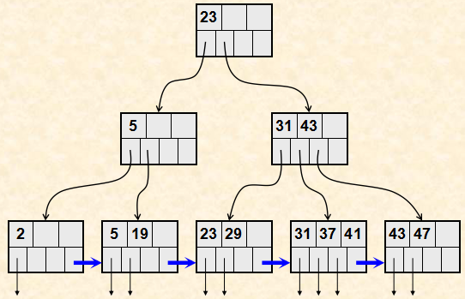
Example of B⁺-Tree Index

Slide 85
Read Locks on a B⁺-Tree Index Page
Obtain a read lock on the root, and work down the tree locking each entry as it is reached
When a new entry is locked, the lock on the previous entry (its parent) can be released
This operation will never revisit the parent
No write operation of a concurrent transaction can pass this operation as it goes down the tree
Called lock coupling or crabbing
Notes:
ReadLock 仅仅用于查询（即以‘只读’方式访问索引树的各个结点），请参考B+树上查找算法的执行流程。一般流程如下（详见下一页的流程图）
输入：随机查找关键字K
1、从根结点开始 ，自顶向下搜索到某个叶子结点；
2、在每一个结点中，根据其中保存的关键字值，将整个关键字的值域划分为若干个‘取值区间’
3、如果当前结点不是叶子结点，则判断关键字K属于哪一个取值区间，从而决定下一个要访问的索引结点（index page）。
当然，我们从当前结点（被称为’结点P'）找到的是‘下一个将要被访问的索引结点（被称为‘结点C'）的结点指针’（结点P和结点C互为‘父子’关系）
在根据找到的结点指针访问‘下一个’结点C之前，我们先要申请结点C上的ReadLock
在获得结点C上的ReadLock封锁后，当前事务就获得了对于结点C的访问权限，并且之后不需要再回溯访问其父结点P
所以，当前事务在获得子结点C上的ReadLock后，就可以立即释放其父结点P上的ReadLock
这样的封锁使用方式并不符合‘两阶段封锁’协议的要求，但适合于数据库中的 B+ 索引的访问特点
因此，为了提高效率，在B+树结点上的ReadLock的申请和释放都是这样成对出现的，这被称为‘锁耦合’（lock coupling）
4、如果当前结点是叶子结点，就搜索当前页面中是不是有关键字K。
1）如果在当前叶子结点中没有关键字K，则表明K对应的元组不存在，则以失败方式返回并释放当前叶子结点上的ReadLock; （如果是范围查找，则需要顺序扫描当前叶子结点中是否有其他符合条件的关键字，具体请参见B+树上范围查找算法）
2）如果存在，则以ReadLock方式封锁K对应的索引项（key-rangle lock），释放当前结点上的ReadLock，返回查找成功；

Slide 86
request for ReadLock (search key K)
N := root of B⁺ tree
申请结点 N 上的 ReadLock
N is a leaf node?
no
yes
在结点N中寻找关键字K对应的子结点M
在结点N中寻找关键字K
是否存在 K ?
no
申请结点M上的ReadLock
yes
释放结点N上的ReadLock
N := M
申请 K上的 ReadLock
(key-range lock for search)
lock coupling
释放结点N上的ReadLock
Notes:
给定一个关键字K，利用索引树查找其对应的元组是否存在，在索引树上的锁申请与锁释放的处理流程（详细解释请见上一页PPT的注释）

Slide 87
Write Locks on a B⁺-Tree Index
Obtain a write lock on the root, and work down the tree locking each entry as it is reached
When new entry N is locked, if that entry is not full, the locks on all its parents can be released
An insert operation might have to go back up the tree, revisiting and perhaps splitting some nodes
Even if that occurs, because N is not full, it will not have to split N and therefore will not have to go further up the tree
Thus it can release locks further up in the tree.

Slide 88
request for WriteLock (insert key K)
N := root of B⁺ tree
申请结点N上的 WriteLock
if ( 结点 N not full )
then (释放 N 的所有祖先结点上的 WriteLock)
N is a leaf node ?
no
yes
寻找N的子结点M
申请结点M上的 WriteLock
N := M
在结点N中插入关键字 K
(key-range lock for insert)
释放结点N上的 WriteLock

Slide 89
Granular and Index Locking Summary
Algorithm has property that a lock conflict that prevents phantoms will occur:
In the index, when an index is used
At the table level, when no index is used
Even if there is no index, write operations need not get an X lock on whole table, only an IX lock, which allows more concurrency

Slide 90
UPDATE Statement
An UPDATE can be treated as if it were a DELETE followed by an INSERT
If an index attribute is changed, the index entry for the tuple must be moved to a new position
The transaction must obtain write locks on both the old and new index pages

Slide 91
Lock Escalation
To avoid acquiring many fine grain locks on a table, a DBMS can set a lock escalation threshold.
If more than the threshold number of tuple (or page) locks are acquired, the DBMS automatically trades them in for a table lock but …
Beware of deadlock

Slide 92
Performance Hints
Use lowest correct isolation level
Embedding constraints in schema might permit the use of an even lower level
Constraint violation due to interleaving detected at commit time (an optimistic approach)
No user interaction after a lock has been acquired
Use indexes and denormalization to support frequently executed transactions
Avoid deadlocks by controlling the order in which locks are acquired

Slide 93
Isolation in Relational Databases
Locking in Relational Databases
SQL Isolation Levels
Granular Locks
Index Locking
Multiversion Controls (MVCs)
SNAPSHOT Isolation

Slide 94
Multiversion Controls (MVCs)
Version: a snapshot of the database containing the updates of all and only committed transactions
A multi-version DBMS maintains all versions created in the (recent) past
Major goal of a multi-version DBMS: avoid the need for read locks
w₁(x) w₂(y) c₁ w₃(x) w₂(z) c₂ ......
create version 1
(contains updates
of T₁, but not T₂)
create version 2
(contains updates of
T₁ and T₂, but not T₃)

Slide 95
Multiversion Controls

Slide 96
Read-Consistency
All DBMSs guarantee that statements are isolated:
Each statement sees state produced by the complete execution of other statements, but state might not be committed
A MVC guarantees that each statement sees a committed state:
Statement executed in a state whose value is a version
Referred to as statement-level read consistency
A MVC can also guarantee that all statements of a transaction see the same committed state:
All statements of a transaction access same version
Referred to as transaction-level read consistency

Slide 97
Read-Only MVC
Distinguishes in advance read-only (R/O) transactions from read/write (R/W) transactions.
R/W transactions use a (conventional) immediate-update, pessimistic control. Hence, transactions access the most current version of the database.
All the reads of a particular R/O transaction T_{RO} are satisfied using the most recent version that existed when T_{RO} requested its first read.

Slide 98
Read-Only MVC
Assuming R/W transactions are executed at SERIALIZABLE, all schedules are serializable:
R/W transactions are serialized in commit order.
Each R/O transaction is serialized after the transaction that created the version it read.
Equivalent serial order is not commit order.
All transactions see transaction-level read consistency.

Slide 99
Example
r₁(x) w₁(y) r₂(x) c₁ w₂(x) r₃(x) w₂(y) c₂ r₃(y) c₃
T₁ and T₂ are read/write, T₃ is read/only
T₃ sees the version produced by T₁
The equivalent serial order is T₁ T₃ T₂

Slide 100
Implementation
DBMS maintains a version counter (VC).
Incremented each time a R/W transaction commits.
The new version of a data item created by a R/W transaction is tagged with the value of VC at the time the transaction commits.
When a R/O transaction makes its 1st read request, the value of VC becomes its counter value.
Each request to read an item is satisfied by the version of the item having the largest version number less than or equal to the transaction’s counter value.

Slide 101
Multiversion Database
x
y
z
u
v1
v2
v1
v4
17
a
.223
.223
v1
38
38
v4
v2
v3
v5
22
ab
ab
v3
.24
v3
v6
123
123
v3
abf
Values read by a R/O transaction with counter value 4

Slide 102
Read-Only Multiversion Control
R/O transactions do not use read locks.
They never wait.
They never cause R/W transactions to wait.

Slide 103
Read-Consistency MVC
R/O transactions:
get transaction-level read consistency.
R/W transactions:
Write statements acquire long-duration write locks (delay other write statements)
Read statements use most recent (committed) version at time of read
Not delayed by write locks, since read locks are not requested.
Notes:
对于R/W事务
1、在执行write操作时需要申请write lock，防止两个并发事务同时修改同一个数据，避免了lost-update/dirty-wirte错误
2、在执行read操作时，读取的是当前最近版本值（该值一定是之前最后一个被提交的事务的修改结果），和当前其他正在运行的并发事务并不产生影响，因而不需要申请read lock.

Slide 104
Example
w₁(x) w₁(y) r₂(x) c₁ w₂(x) r₃(x) r₂(y) w₂(y) c₂ r₃(y) c₃
T₁ and T₂ are R/W, T₃ is R/O.
T₃ uses v1.
T₂ takes the value of x from v0, y from v1.
There is no equivalent serial order.

Slide 105
Read-Consistency MVC
Satisfies ANSI definition of READ COMMITTED isolation level, but in addition ...
Provides transaction-level read consistency for R/O transactions
No read locks: reads do not wait for writes and writes do not wait for reads
Version of READ COMMITTED supported by Oracle.

Slide 106
SNAPSHOT Isolation
Does not distinguish between R/W and R/O transactions
A transaction reads the most recent version that
existed at the time of its first read request
Guarantees transaction-level read consistency
The write sets of any two concurrently executing transactions must be disjoint
Two implementations of this specification
First Committer Wins
Locking implementation

Slide 107
First Committer Wins Implementation
Writes use deferred-update (intentions list).
T is allowed to commit only if no concurrent transaction:
committed before T, and
updated a data item that T also updated.

Slide 108
First Committer Wins
to intentions list
T₁: r(x_{n}) w(x) request_commit
T_{2:} r(x_{n}) w(x) request_commit
counter value = n
commit and create w(x_{n+1})
abort
Control is optimistic:
It can be implemented without any locks
Deadlock not possible
Validation (write set intersection) is required for R/W transactions and abort is possible
Schedules might not be serializable
Notes:
也不需要申请 write lock
当一个事务执行commit操作，需要提交对数据项 x 的修改结果时，将比较数据库中 x 的最新版本号 与 自己所读取到的版本号的大小，并根据比较结果来判断是否有其他事务提前提交了对 x 的修改结果 （已完成提交的事务生成了 x 的新版本值）

Slide 109
Locking Implementation of SNAPSHOT Isolation
Immediate update pessimistic control
Reads do not get any locks and execute as in the previous implementation

Slide 110
Locking Implementation of SNAPSHOT Isolation
A transaction T that wants to perform a write on some item I must request a write lock
If the version number of I is greater than that of T, T is aborted (first committer wins)
Otherwise, if another transaction T’ has a write lock on that item, T waits until that T’ completes
If T’ commits, T is aborted (first committer wins)
If T’ aborts, T is given the write lock and allowed to write

Slide 111
Anomalies at SNAPSHOT Isolation
Many anomalies are impossible:
Dirty read, dirty write, non-repeatable read, lost update
However, schedules might not be serializable.
Example:
Constraint a+b≥0 violated
Referred to as write skew
T₁: r(a=10) r(b=10) w(a = -5) commit
T₂: r(a=10) r(b=10) w(b = -5) commit

Slide 112
Phantoms at SNAPSHOT Isolation
Audit:
SELECT SUM (balance)
FROM Accounts
WHERE name = ‘Mary’
SELECT totbal
FROM Depositors
WHERE name = ‘Mary’
NewAccnt:
INSERT INTO Accounts
VALUES (‘123’,‘Mary’,100)
UPDATE Depositors
SET totbal = totbal + 100
WHERE name = ‘Mary’
Both transactions commit.
All reads of a transaction satisfied from the same version.
Hence Audit works correctly! why?
Notes:
答案：多版本！Audit 读取的是旧版本的数据，不是NewAccnt写入的新版本值。

Slide 113
Phantoms at SNAPSHOT Isolation
After a transaction executes SELECT, a concurrent transaction might insert a phantom
If the SELECT is repeated, the phantom will not be in the result set
Therefore, apparently, phantoms cannot occur at SNAPSHOT isolation
But …

Slide 114
Phantoms at SNAPSHOT Isolation
Non-serializable schedules due to phantoms are possible
Example: concurrent transactions each execute SEL(P) and then insert a row satisfying P
Neither sees the row inserted by the other.
The schedule is not serializable.
This would be considered a phantom if it occurred at REPEATABLE READ.
Can be considered write skew

Slide 115
Correct Execution at SNAPSHOT Isolation
Many applications execute correctly at SNAPSHOT isolation, even though schedules are not serializable
Example: reserving seats for a concert
Integrity constraint: a seat cannot be reserved by more than one person

Slide 116
Reserving Seats for a Concert
A reservation transaction checks the status of two seats and then reserves one that is free
Schedule below is non-serializable, but is correct and preserves the constraint
T₁: r(s1:Free) r(s2:Free) w(s1:Res) ......
T₂: r(s1:Free) r(s2:Free) w(s2:Res) ......
commit
commit
Alternatively, if both transactions had tried to reserve the same seat, then ...
T₁: r(s1:Free) r(s2:Free) w(s1:Res) ......
T₂: r(s1:Free) r(s2:Free) w(s1:Res) ......
abort
commit

