Slide 1
Isolation in Relational Databases (2)

Slide 2
Isolation in Relational Databases
Locking in Relational Databases
SQL Isolation Levels
Granular Locks
Index Locking
Multiversion Controls (MVCs)
SNAPSHOT Isolation

Slide 3
Isolation Levels
SQL defines several isolation levels weaker than SERIALIZABLE that allow non-serializable schedules and hence allow more concurrency
Serializable schedules
delays
serializable
conc. control
input
s′
s
•
s′
•
weaker
conc. control
input
s
Schedules allowed
at a weaker isolation level
fewer delays

Slide 4
Isolation Levels
Schedules produced by CC operating at isolation levels lower than SERIALIZABLE Might be correct for some applications
SQL standard defines isolation levels in terms of certain anomalies they do or do not allow

Slide 5
SQL Isolation Levels
Anomaly
Isolation Levels & Anomaly
Isolation Levels & Locking

Slide 6
Anomaly (异常)
We will talk about some anomalies
Lost Update
Dirty Write
Blind Write
Dirty Read
Non-Repeatable Read
Phantom Read

Slide 7
Lost update & Dirty write & Blind write
A lost update or dirty write occurs when a second transaction writes a second value of a data-item on top of a first value written by a first concurrent transaction, and the first value is lost to other transactions running concurrently which need.
A write w_{i}(X) is said to be 'blind write' if it is not the last action of resource X and the following action on X is a write w_{j}(X).
Lost Update:
Dirty Write:
T₁ : w(x) commit
T₂ : w(x) commit
T₁ : w(x) abort
T₂ : w(x) abort

Slide 8
example of Lost-Update (售票)
剩余票数 x
(初始值x=5)
Transaction 1
Transaction 2
Read (x=5);
Read (x=5);
/* 售出1张票 */
x=4
Write (x=4);
/* 售出1张票 */
x=4
Write (x=4);
Commit;
Commit;
最终的剩余票数 x=4
最终结果显然是不正确的！
其中, 一个事务的修改结果破坏了另一个事务的修改结果！

Slide 9
example of Dirty-Write
Transaction 1
初始值 x=5
Transaction 2
x=1
Write (x=1);
x=10
Write (x=10);
x=5
Abort;
x=1
Abort;
对于事务T₁而言，修改前x的前像ji值是5，放弃事务T₁需要将x的值恢复为5
对于事务T₂而言，修改前x的前像值是1（事务T₁修改后的值），放弃事务T₂需要将x的值恢复为 1
恢复处理的最终结果，数据库中的x值是错误的！

Slide 10

Dirty Read (脏读)
Transaction could read a database object modified by another transaction which hasn't committed (later be aborted). This is a dirty read.
Dirty Read:
T₁ has a dirty read r(x) !

Slide 11
example of Dirty-Read
Transaction 1
初始值 x=5
Transaction 2
x=1
Write (x=1);
Read (x=1);
y=4
Write (y=9);
Commit;
x=5
Abort;
结果 x=5
T₁ 读到的是一个错误的x值，并可能因此将一个错误的y值写入到数据库中！

Slide 12
Non-Repeatable Read (不可重读)
A non-repeatable read occurs, when during the course of a transaction, a row is retrieved twice and the values within the row differ between reads.
Non-Repeatable Read:
T₁ : w(x) commit
T₂ : r(x) r(x) commit
T₂ has already seen a different value for x !

Slide 13
Anomaly: Non-Repeatable Read
T1 T2
SELECT SUM (balance)
FROM Accounts
WHERE name = ‘Mary’
UPDATE Accounts
SET balance = 1.05 * balance
WHERE name = ‘Mary’
SELECT SUM (balance)
FROM Accounts
WHERE name = ‘Mary’
does not introduce a
phantom into predicate
name=‘Mary’

Slide 14
Phantom Read (幻读)
A phantom read occurs when, in the course of a transaction, new rows are added or removed by another transaction to the records being read.
transaction T₁
transaction T₂

Slide 15
Non-Repeatable Reads and Phantoms
/* query by T₁ */
SELECT SUM (balance)
FROM Accounts
WHERE name = ‘Mary’;
/* update by T₂ */
UPDATE Accounts
SET balance = 1.05*balance
WHERE name = ‘Mary’;
/* commit by T₂ */
COMMIT;
/* query by T₁ */
SELECT SUM (balance)
FROM Accounts
WHERE name = ‘Mary’;
/* query by T₁ */
SELECT SUM (balance)
FROM Accounts
WHERE name = ‘Mary’;
/* update by T₂ */
INSERT INTO Accounts
VALUES('123', ‘Mary’, 100);
/* commit by T₂ */
COMMIT;
/* query by T₁ */
SELECT SUM (balance)
FROM Accounts
WHERE name = ‘Mary’;
With a non-repeatable read, execution of same SELECT twice yields the same set of rows, but attribute values might be different.
With a phantom read, execution of same SELECT twice yields different sets of rows. The second returns at least one row not returned by the first.

Slide 16
SQL Isolation Levels
Anomaly
Isolation Levels & Anomaly
Isolation Levels & Locking

Slide 17
SQL Isolation Levels
READ UNCOMMITTED – dirty reads, non-repeatable reads, and phantoms allowed
READ COMMITTED - dirty reads not allowed, but non-repeatable reads and phantoms allowed
REPEATABLE READ – dirty reads, non-repeatable reads not allowed, but phantoms allowed
SERIALIZABLE – dirty reads, non-repeatable reads, and phantoms not allowed; all schedules must be serializable

Slide 18
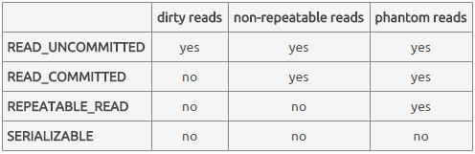
SQL Isolation Levels
Defining isolation levels in terms of anomalies leads to an ambiguous specification:
At what levels are dirty writes allowed?
Are there other anomalies that are not accounted for?
Transaction Isolation / Statement Isolation

Slide 19
Statement Isolation
In addition, statement execution must be isolated
DBMS might be executing several SQL statements (from different transactions) concurrently
The execution of statement involves the execution of a program implementing that statement’s query plan
This might be a complex program
While the execution of transactions T₁ and T₂ might not be isolated, the execution of each statement within T₁ must be isolated with respect to the execution of each statement within T₂.

Slide 20
SQL Isolation Levels
Anomaly
Isolation Levels & Anomaly
Isolation Levels & Locking

Slide 21
Immediate-Update Pessimistic Control (review)
Rule:
Do not grant a request that imposes an ordering among active transactions (delay or refuse the requesting transaction)
Grant a request that does not conflict with previously granted requests of active transactions
Result:
Each schedule S, is conflict equivalent to a serial schedule in which transactions are ordered in the order in which they commit in S (and possibly other serial schedules as well)
Reason:
When a transaction commits, none of its operations conflict with those of other active transactions. Therefore it can be ordered before all active transactions.

Slide 22
Locking Implementation of an IUPC (review)
A transaction can read a database item if it holds a read (shared) lock on the item
It can read or update the item if it holds a write (exclusive) lock
If the transaction does not already hold the required lock, a lock request is automatically made as part of the (read or write) request
All locks held by a transaction are released when Transaction completes (commits or aborts)
Delayed requests are re-examined at this time

Slide 23
Locking (review)
Request for read lock on an item is granted if:
No transaction currently holds write lock on the item
Cannot read an item written by an active transaction
Request for write lock on an item is granted if:
No transaction holds any lock on item
Cannot write item read/written by an active transaction
Transaction is delayed if request cannot be granted
Granted mode
Requested mode read write
read x
write x x
√

Slide 24
Lock Table (review)
Locking list
r
r
data item x
w
Waiting list
T_{i} holds an r lock on
x and waits for a w
lock on y
Locking list
w
data item y
r
w
Waiting list
Transaction T_{i}
L_{i}

Slide 25
Review
Two-Phase Locking Control (TPLC)
Transaction does not release a lock until it has all the locks it will ever require.
Strict Two-Phase Locking Control (STPLC)
A TPLC holding write locks until commit produces

Slide 26
Locking Implementation of SQL Isolation Levels
SQL standard does not say how to implement levels
Locking implementation is based on:
Entities locked: tables/pages, rows, predicates, …
Lock modes: read & write, ...
Lock duration:
Short: locks acquired in order to execute a statement are released when statement completes
Long: locks acquired in order to execute a statement are held until transaction completes
Medium: something in between

Slide 27
Locking Implementation of SQL Isolation Levels
Write locks are handled identically at all isolation levels:
Long-duration predicate write locks are associated with UPDATE, DELETE, and INSERT statements
This rules out dirty writes
In practice, predicate locks are implemented with table locks or by acquiring locks on an index as well as the data
We discuss index locking later
Read locks handled differently at each level

Slide 28
Locking Implementation of SQL Isolation Levels
READ UNCOMMITTED: no read locks
Hence a transaction can read a write-locked item!
Allows dirty reads, non-repeatable reads, and phantoms
READ COMMITTED: short-duration read locks on rows returned by SELECT
Prevents dirty reads, but non-repeatable reads and phantoms are possible
REPEATABLE READ: long-duration read locks on rows returned by SELECT
Prevents dirty and non-repeatable reads, but phantoms are possible
SERIALIZABLE: long-duration read lock on predicate specified in WHERE clause
Prevents dirty reads, non-repeatable reads, and phantoms and …
Guarantees serializable schedules

Slide 29
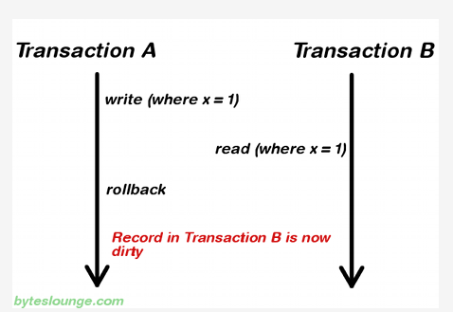
Dirty read
(for transaction B)

Slide 30

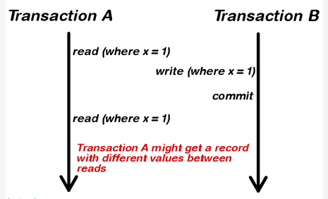
non-repeatable read
(for transaction A)

Slide 31
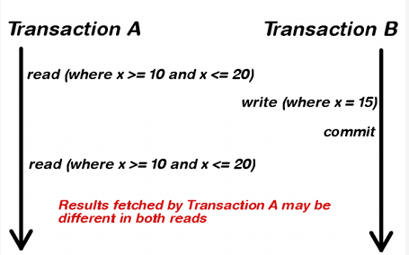
phantom read
(for transaction A)

Slide 32
Bad Things Can Happen
At every isolation level lower than SERIALIZABLE, bad things can happen
Schedules can be
Non-serializable
Specifications of transactions might not be met

Slide 33
Some Problems at READ UNCOMMITTED
Since no read locks are obtained, T₂ can read a row t, write locked by T₁
T₁: w(t) abort
T₂: r(t) w(t′) commit
T₁: w(t) w(t) commit
T₂: r(t) w(t′) commit
T₁: w(t) w(t′) commit
T₂: r(t) r(t′) commit
T₂ uses an aborted
value to update db
T₂ uses an intermediate
value to update db
T₂ does not see a
committed snapshot
Some DBMSs allow only read-only transactions to be executed at this level

Slide 34
Some Problems at READ COMMITTED
Non-repeatable reads:
Lost updates:
T₁: r(t) r(t) commit
T₂: w(t) commit
T₁: r(t) w(t) commit
T₂: r(t) w(t) commit

Slide 35
Problems at REPEATABLE READ
Phantoms:
t satisfies pred
A constraint relates rows satisfying pred and t′
Audit: r(pred) r(t′) commit
NewAccount: insert(t) update(t′) commit

Slide 36
Levels of Isolation
Levels of Isolation
Types of Locks
Write locks
Read Locks
( row )
Read Locks
(Predicates)
Problem
Read Uncommitted
No
(Read Only)
No
No
Dirty Reads
Read Committed
Yes
short-term
short-term
Lost Update
Repeatable Read
Yes
long-term
short-term
Update Anomaly
Serializable
Yes
long-term
long-term
No

Slide 37
Implications of Locking Implementation
Transactions can be assigned to different isolation levels and can run concurrently.
All write locks are long-duration predicate locks
SERIALIZABLE transactions have long-duration predicate read locks, SERIALIZABLE transactions are serialized with respect to all writes.
A SERIALIZABLE transaction either sees the entire effect of another transaction or no effect.
A transaction at a lower level does not see the anomalies prohibited at that level.

Slide 38
Implications of Locking Implementation
Even though all transactions are designed to be consistent,
Transactions executed at lower isolation levels can see anomalies that can cause them to write inconsistent data to the database
Transactions executed at any isolation levels can see that inconsistent data and as a result return inconsistent data to user or store additional inconsistent data in database

Slide 39
Update Locks
Some DBMS provide update locks to alleviate deadlock problem
A transaction that wants to read an item now and possibly update it later requests an update lock on the item (manual locking)
An update lock is a read lock that can be upgraded to a write lock
Often used with updatable cursors

Slide 40
example of deadlock without Update-Locks
 | 事务T₁ | 事务T₂ | A的封锁状态
1 | read lock₁(A); |  | ReadLock(T₁)
2 | r₁(A); |  | ReadLock(T₁)
3 |  | read lock₂(A); | ReadLock(T₁,T₂)
4 |  | r₂(A); | ReadLock(T₁,T₂)
5 | write lock₁(A); |  | ReadLock(T₁,T₂) Waiting: WriteLock(T₁)
6 | Wait… | write lock₂(A); | ReadLock(T₁,T₂) Waiting: WriteLock(T₁),WriteLock(T₂)
7 | Wait… | Wait… | ......

Slide 41
Update Locks
An update lock conflicts with other update locks and with write locks, but not with read locks.
Granted mode
Requested mode read write update
read x
write x x x
update x x
(X 代表不可以)

Slide 42
Update Locks
Schedule that causes a deadlock at CURSOR STABILITY (游标稳定性):
T₁: fetch(t) request_update(t)
T₂: fetch(t) request_update(t)
If both fetches had requested update locks, T₂’s fetch would be made to wait until T₁ had completed, avoiding the deadlock

