Slide 1
Implementing Distributed Transactions

Slide 2
Distributed Transaction
Distributed Database System & Distributed Transaction
Atomic Commit Protocol
Two-Phase Commit
Failures
Others
Global Deadlock, Global Isolation
Data Replication
Conflict Resolution
Procedural Replication

Slide 3
Distributed Transaction Distributed Database Systems
A distributed transaction accesses resource managers distributed across a network
When resource managers are DBMSs we refer to the system as a distributed database system
DBMS at Site 1
Distributed
Database
System
Application Program
Distributed
Transaction
DBMS at Site n
Notes:
一个事务在执行过程中，可以访问分布在网络上的若干个资源管理器，这样的事务被称为‘分布式事务’
如果这些资源管理器是DBMS，那么由这些可以被应用程序同时共享的DBMS所组成的系统就被称为‘分布式数据库系统’

Slide 4
Distributed Transaction Global Transaction & Subtransactions coordinator & cohorts
Operations at each site are grouped together as a subtransaction and the site is referred to as a cohort of the distributed transaction
Each subtransaction is treated as a transaction at its site
Coordinator module (part of TP monitor) supports ACID properties of distributed transaction
Transaction manager acts as coordinator

Slide 5

Distributed Database Systems & Distributed Transaction
(global ACID)
Transaction
manager
atomic commit protocol
database server machines
begin
......
commit/abort
DBMS
site 1
sub-trans.
(local ACID)
present.
services
applic.
services
distributed trans.
sub-trans.
client machines
DBMS
site n
service
invocations
(local ACID)
Notes:
每一个子事务的local ACID的实现由本地的DBMS负责。全局的分布式事务的global ACID由Transaction Manager负责。

Slide 6
ACID Properties
Each local DBMS:
Supports ACID locally for each subtransaction
Just like any other transaction that executes there
Eliminates local deadlocks.
The additional issues are:
Global atomicity: all cohorts must abort or all commit
Global deadlocks: there must be no deadlocks involving multiple sites
Global serialization: distributed transaction must be globally serializable

Slide 7
Global Atomicity
All subtransactions of a distributed transaction must commit or all must abort
An atomic commit protocol, initiated by a coordinator (the transaction manager), ensures this.
Coordinator polls cohorts to determine if they are all willing to commit
Protocol is supported in the xa interface between a transaction manager and a resource manager

Slide 8
Atomic Commit Protocol
Transaction
Manager
(coordinator)
(3) xa_reg
Resource
Manager
(cohort)
(1) tx_begin
(4) tx_commit
(5) atomic
commit
protocol
Application
program
(3) xa_reg
Resource
Manager
(cohort)
(2) access
resources
(3) xa_reg
Resource
Manager
(cohort)
Malfunctions:
Abort / Crash / Failure ?
......

Slide 9
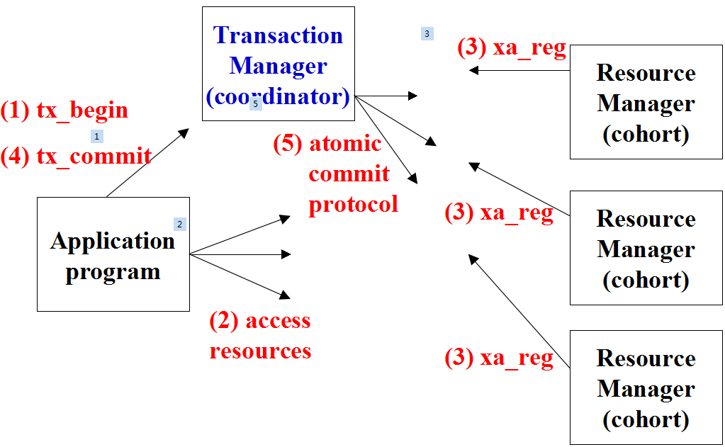
Cohort Abort
Why might a cohort abort?
Deferred evaluation of integrity constraints
Validation failure (optimistic control)
Deadlock
Crash of cohort site
Failure prevents communication with cohort site

Slide 10
Atomic Commit Protocol
Two-phase commit protocol: most commonly used atomic commit protocol.
Implemented as: an exchange of messages between the coordinator and the cohorts.
Guarantees global atomicity: even if failures should occur while the protocol is executing.

Slide 11
Atomic Commit Protocol
<transaction record> in Coordinator
Two-Phase Commit
log record & memory buffer
Two-Phase Commit (commit case)
Two-Phase Commit (abort case)
Failures and Two-Phase Commit
Timeout, Crash (Restart), Blocking

Slide 12
<transaction record> in Coordinator
与coordinator相关的消息
tx_begin, tx_commit
xa_reg, atomic commit protocol (two-phase)
与coordinator相关的日志记载 (memory / log)
transaction rec. / commit rec. / complete roc.

Slide 13
The Transaction Record
During the execution of the transaction, before the two-phase commit protocol begins:
When the application calls tx_begin to start the transaction, the coordinator creates a transaction record for the transaction in volatile memory
Each time a resource manager calls xa_reg to join the transaction as a cohort, the coordinator appends the cohort’s identity to the transaction record
trans. id
list-of-cohorts
transaction record in coordinator memory

Slide 14
Two-Phase Commit (log & buffer)
Coordinator Cohort
Coor. buffer
log buffer
trans. record
① <prepare record>
② <commit record>
③ <commit record>
④ <complete record>
Coordinator
log
Cohort
log
在数据库服务器(cohort)上，因为two-phase commit协议的要求，需要为本地子事务的提交增加一条<prepare record>日志记录。

Slide 15
Two-Phase Commit (commit case)
Application Coordinator Cohort
tx_commit
resume
- send prepare msg to
cohorts in trans. rec.
- force prepare
rec. to cohort log
phase 1
- record vote in trans. rec.
- send vote msg
waiting...
(uncertain
period)
if all vote ready, force
commit rec. to coord. log
send commit msg
- force commit
rec. to cohort log
- release locks
phase 2
when all done msgs rec’d,
force complete rec. to log
- delete trans. rec.
- send done msg
return status

Slide 16
Two-Phase Commit (abort case)
Application Coordinator Cohort
tx_commit
resume
send prepare msg to
cohorts in trans. rec.
- force prepare rec.
to cohort log
- send vote msg
record vote in trans.rec.
phase 1
uncertain
period
if any vote abort {
send abort msg to each cohorts
delete trans. rec. }
- return status
- local abort
- release locks
只要有任何一个cohort不同意提交，coordinator就会放弃整个事务（向所有cohorts发送 abort msg ）
coordinator不必等待各 cohorts 的 abort 动作的处理完成
一个分布式事务被放弃后，在Coordinator的内存及log文件中不会留下任何痕迹！

Slide 17
Two-Phase Commit -- messages
Application invokes tx_commit (application to coordinator)
Sends prepare message (coordinator to all cohorts)
Vote message (cohort to coordinator)
“ready to commit” or “aborting”
Commit or abort message (coordinator to all cohorts)
Done message (cohort to coordinator)
return status (coordinator to application)
Cohort-1
prepare msg.
tx_commit
Application
Coordinator
vote msg.
Cohort-2
commit msg.
return status
Cohort-n
done msg.
(two-phase commit)
Notes:
一个分布式事务的提交处理流程要经历6次消息传递，提交的发起和提交结果状态的返回是在应用程序和分布式事务管理器（协调者）之间的消息交互
另外4次消息交互是发生在协调者和各个参与者之间，遵循两阶段提交协议来完成一个全局分布式事务的提交

Slide 18
Two-Phase Commit -- Phase 1
2、Sends prepare message (coordin. to all cohorts)
If cohort wants to abort at any time prior to or on receipt of the message, it aborts and releases locks
If cohort wants to commit, it moves all update records to mass store by forcing a prepare record to its log
Guarantees that cohort will be able to commit (despite crashes) if coordinator decides commit (since update records are durable)
Cohort enters prepared state
Cohort sends a vote message (“ready” or “aborting”)
cannot change its mind
retains all locks if vote is “ready”
enters uncertain period (it cannot foretell final outcome)
Notes:
一个子事务可以独立地被放弃，而不必等待coord.发来prepare msg，
但当一个子事务想提交时，必须先force <prepare record>到本地的日志文件，然后等待coord.发来的prepare投票消息（收到的也有可能直接是abort msg）
如果一个子事务对prepare msg的回答是ready（同意提交），那么它必须等来coord.的最终决定（commit or abort）.

Slide 19
Two-Phase Commit -- Phase 1
Vote message (cohort to coordinator): Cohort indicates it is “ready” to commit or is “aborting”
Coordinator records vote in transaction record
If any votes are “aborting”, coordinator decides abort and deletes transaction record
If all are “ready”, coordinator decides commit, forces commit record (containing transaction record) to its log (end of phase 1)
Transaction committed when commit record is durable. Since all cohorts are in prepared state, transaction can be committed despite any failures.
Coordinator sends commit or abort message to all cohorts

Slide 20
Two-Phase Commit -- Phase 2
Commit or abort message (coordinator to all cohorts)
If commit message
cohort commits locally by forcing a commit record to its log
cohort sends done message to coordinator
If abort message, it aborts
In either case, locks are released and uncertain period ends
Done message (cohort to coordinator):
When coordinator receives a done message from each cohort,
it writes a complete record to its log and
deletes transaction record from volatile store

Slide 21
Distributing the Coordinator
A transaction manager controls resource managers in its domain
When a cohort in domain A invokes a resource manager RM_{B} in domain B:
The local transaction manager TM_{A} and remote transaction manager TM_{B} are notified
TM_{B} is a cohort of TM_{A} and a coordinator of RM_{B}
A coordinator/cohort tree results

Slide 22
Coordinator/Cohort Tree
Domain A
TM_{A}
Applic.
RM₁
RM₂
Domain B
Domain C
TM_{B}
TM_{C}
RM₃
RM₄
RM₅
invocations
protocol msgs

Slide 23
Distributing the Coordinator
The two-phase commit protocol progresses down and up the tree in each phase
When TM_{B} gets a prepare msg from TM_{A} it sends a prepare msg to each child and waits
If each child votes ready, TM_{B} sends a ready msg to TM_{A}
if not it sends an abort msg

Slide 24
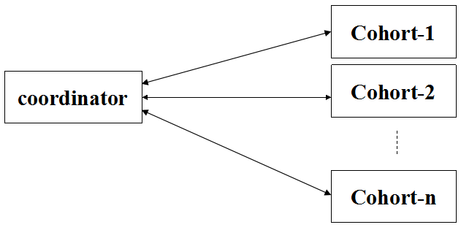
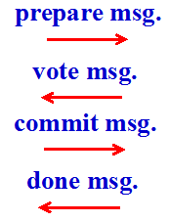
Failures and Two-Phase Commit
Timeout
Crash (Restart)
Blocking
: No response to a message
: On recovery, execute a restart protocol
: If a cohort cannot complete the protocol until some failure is repaired

Slide 25
Failures and Two-Phase Commit
A participant recognizes two failure situations.
Timeout : No response to a message. Execute a timeout protocol
Crash : On recovery, execute a restart protocol
If a cohort cannot complete the protocol until some failure is repaired, it is said to be blocked
Blocking can impact performance at the cohort site since locks cannot be released

Slide 26
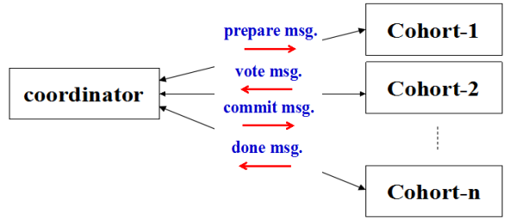
Timeout Protocol
Cohort times out waiting for prepare message
Coordinator times out waiting for vote message
Cohort (in prepared state) times out waiting for commit/abort message
Coordinator times out waiting for done message

Slide 27
Timeout Protocol
Cohort times out waiting for prepare message
Abort the subtransaction
Since the (distributed) transaction cannot commit unless cohort votes to commit, atomicity is preserved
Coordinator times out waiting for vote message
Abort the transaction
Since coordinator controls decision, it can force all cohorts to abort, preserving atomicity

Slide 28
Timeout Protocol
Cohort (in prepared state) times out waiting for commit/abort message
Cohort is blocked since it does not know coordinator’s decision
Cohort requests status from coordinator; remains blocked
Coordinator might have decided commit or abort
Cohort cannot unilaterally decide since its decision might be contrary to coordinator’s decision, violating atomicity
Locks cannot be released
Coordinator times out waiting for done message
Requests done message from delinquent cohort

Slide 29
Restart Protocol - Cohort
On restart cohort finds in its log:
begin_transaction record, but no prepare record
prepare record, but no commit record
commit record

Slide 30
Restart Protocol - Cohort
On restart cohort finds in its log:
begin_transaction record, but no prepare record:
Abort (transaction cannot have committed because cohort has not voted)
prepare record, but no commit record (cohort crashed in its uncertain period)
Does not know if transaction committed or aborted
Locks items mentioned in update records before restarting system
Requests status from coordinator and blocks until it receives an answer
commit record
Recover transaction to committed state using log

Slide 31
Restart Protocol - Coordinator
On restart:
Search log and restore to volatile memory the transaction record of each transaction for which there is a commit record, but no complete record
Commit record contains transaction record
On receiving a request from a cohort for transaction status:
If transaction record exists in volatile memory, reply based on information in transaction record
If no transaction record exists in volatile memory, reply abort
Referred to as presumed abort property

Slide 32
Presumed Abort Property
If when a cohort asks for the status of a transaction there is no transaction record in coordinator’s volatile storage
The coordinator had aborted the transaction and deleted the transaction record
The coordinator had crashed and restarted and did not find the commit record in its log
The coordinator had crashed and restarted and found a complete record for the transaction in its log
The coordinator had committed the transaction, received done messages from all cohorts and hence deleted the transaction record from volatile memory
Notes:
情况3和4不会发生。

Slide 33
Presumed Abort Property
If when a cohort asks for the status of a transaction there is no transaction record in coordinator’s volatile storage, either
The coordinator had aborted the transaction and deleted the transaction record
The coordinator had crashed and restarted and did not find the commit record in its log
It was in Phase 1 of the protocol and had not yet made a decision, or
It had previously aborted the transaction
Notes:
在提交失败的情况下，协调者向各个参与者发送ABORT消息，并不会等待各个参与者对ABORT消息的反馈就结束了该事务，故可能发上情况1

Slide 34
Presumed Abort Property
or
The coordinator had crashed and restarted and found a complete record for the transaction in its log
The coordinator had committed the transaction, received done messages from all cohorts and hence deleted the transaction record from volatile memory
The last two possibilities cannot occur
In both cases, the cohort has sent a done message and hence would not request status
Therefore, coordinator can respond abort

Slide 35
Heuristic Commit
What does a cohort do when in the blocked state and the coordinator does not respond to a request for status?
Wait until the coordinator is restarted
Give up, make a unilateral decision, and attach a fancy name to the situation.
Always abort
Always commit
Always commit certain types of transactions and always abort others
Resolve the potential loss of atomicity outside the system
Call on the phone or send email
Notes:
启发式提交：不应答情况下的处理

Slide 36
Distributed Transaction (summary)
Atomic Commit Protocol
Two-Phase Commit
Failures
timeout protocol
restart/crash protocol

Slide 37
Two-Phase Commit (commit case)
Application Coordinator Cohort
tx_commit
resume
send prepare to all Co.
if all ready {
commit rec. to log
send commit to all Co.
}
when all done {
complete rec. to log
}
return status
prepare rec. to log
return ready
commit rec. to log
return done
phase 1
blocking
blocking
phase 2
blocking

Slide 38
Two-Phase Commit (abort case)
Application Coordinator Cohort
tx_commit
resume
send prepare to all Co.
if any abort {
send abort to all Co.
}
return status
prepare rec. to log
return ready
local abort
phase 1
blocking
blocking

Slide 39
Variants/Optimizations
Read-only subtransactions need not participate in the protocol as cohorts
As soon as such a transaction receives the prepare message, it can give up its locks and exit the protocol.
Transfer of coordination

Slide 40
Transfer of Coordination
Sometimes it is not appropriate for the coordinator (in the initiator’s domain) to coordinate the commit
Perhaps the initiator’s domain is a convenience store and the bank does not trust it to perform the commit
Ability to coordinate the commit can be transferred to another domain
Linear commit
Two-phase commit without a prepared state

Slide 41
Linear Commit
Variation of two-phase commit that involves transfer of coordination
Used in a number of Internet commerce protocols
Cohorts are assumed to be connected in a linear chain
A
B
R

Slide 42
Linear Commit Protocol (1)
When leftmost cohort A is ready to commit it goes into a prepared state and sends a vote message (“ready”) to the cohort to its right B (requesting B to act as coordinator).
After receiving the vote message, if B is ready to commit, it also goes into a prepared state and sends a vote message (“ready”) to the cohort to its right C (requesting C to act as coordinator)
And so on ...
Ready?
Ready?
Ready?
A
B
• • •
R

Slide 43
Linear Commit Protocol (2)
When vote message reaches the rightmost cohort R
If R is ready to commit, it commits the entire transaction (acting as coordinator) and sends a commit message to the cohort on its left
The commit message propagates down the chain until it reaches A
When A receives the commit message it sends a done message to B that also propagates
Ready
Ready
Ready
A
B
• • •
R
commit
commit
commit
• • •
done
done
done
• • •

Slide 44
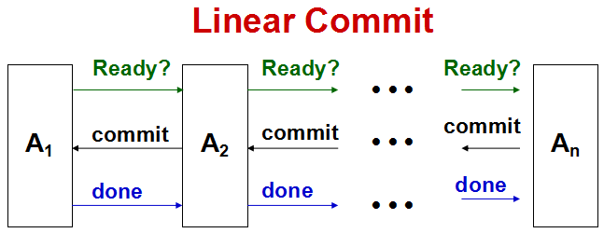
3(n-1)
messages
4n
3(n-1)
times
4
Cohort-1
prepare msg.
coordinator
vote msg.
Cohort-2
commit msg.
done msg.
Cohort-n
two-phase commit

Slide 45
Linear Commit Protocol
Requires fewer messages than conventional two-phase commit. For n cohorts:
Linear commit requires 3(n - 1) messages
Two-phase commit requires 4n messages
But:
Linear commit requires 3(n - 1) message times (messages are sent serially)
Two-phase commit requires 4 message times (messages are sent in parallel)

Slide 46
Two-Phase Commit Without a Prepared State
Assume exactly one cohort C, does not support a prepared state.
Coordinator performs Phase 1 of two-phase commit protocol with all other cohorts
If they all agree to commit, coordinator requests that C commit its subtransaction (in effect, requesting C to decide the transaction’s outcome)
C responds commit/abort, and the coordinator sends a commit/abort message to all other sites

Slide 47
Two-Phase Commit Without a Prepared State
commit request
at end of phase 1
C
coordinator
C1
C2
two-phase commit
C3

Slide 48
Others
Global Deadlock
Global Isolation
Data Replication
Conflict Resolution
Procedural Replication

Slide 49
Global Deadlock
With distributed transaction:
A deadlock might not be detectable at any one site
Subtrans T_{1A} of T₁ at site A might wait for subtrans T_{2A} of T₂, while at site B, T_{2B} waits for T_{1B}
Since concurrent execution within a transaction is possible, a transaction might progress at some site even though deadlocked
T_{2A} and T_{1B} can continue to execute for a period of time
T₁
T_{1A}
T_{1B}
T_{2A}
T_{2B}
T₂
site A
site B
waiting for

Slide 50
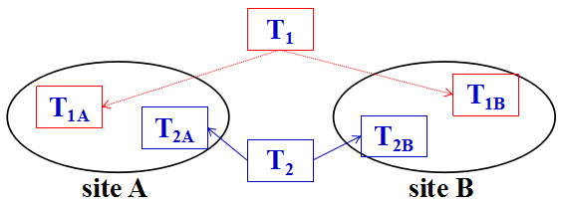
Global Deadlock
Global deadlock cannot always be resolved by:
Aborting and restarting a single subtransaction, since data might have been communicated between cohorts
T_{2A}’s computation might depend on data received from T_{2B}. Restarting T_{2B} without restarting T_{2A} will not in general work.
Notes:
全局死锁的处理不可能通过放弃或重启某个子事务来完成。

Slide 51
Global Deadlock Detection
Global deadlock detection is generally a simple extension of local deadlock detection
Check for a cycle when a cohort waits
If a cohort of T₁ is waiting for a cohort of T₂, coordinator of T₁ sends probe message to coordinator of T₂
If a cohort of T₂ is waiting for a cohort of T₃, coordinator of T₂ relays the probe to coordinator of T₃
If probe returns to coordinator of T₁ a deadlock exists
Abort a distributed transaction if the wait time of one of its cohorts exceeds some threshold
Notes:
全局死锁的两种处理方法：
（1）全局令牌（循环等待图的发现）
（2）超时检测法

Slide 52
Global Deadlock Prevention
Global deadlock prevention - use timestamps
An older transaction never waits for a younger one.
If it occurs, the younger one is aborted.

Slide 53
Global Isolation
If subtransactions at different sites run at different isolation levels, the isolation between concurrent distributed transactions cannot easily be characterized.
Suppose all subtransactions run at SERIALIZABLE. Are distributed transactions as a whole serializable?
Not necessarily
T_{1A} and T_{2A} might conflict at site A, with T_{1A} preceding T_{2A}
T_{1B} and T_{2B} might conflict at site B, with T_{2B} preceding T_{1B}.

Slide 54
Two-Phase Locking & Two-Phase Commit
Theorem: If
All sites use a strict two-phase locking protocol,
Trans. Manager uses a two-phase commit protocol,
Then
Trans are globally serializable in commit order.

Slide 55
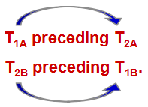
Two-Phase Locking & Two-Phase Commit (Argument)
Suppose previous situation occurred:
- At site A
* T_{2A} cannot commit until T_{1A} releases locks (2P-locking)
* T_{1A} does not release locks until T₁ commits (2P-commit)
Hence (if both commit) T₁ commits before T₂
- At site B
* Similarly (if both commit) T₂ commits before T₁
Contradiction (transactions deadlock in this case)

Slide 56
When Global Atomicity Cannot Always be Guaranteed
A site might refuse to participate
Concerned about blocking
Charges for its services
A site might not be able to participate
Does not support prepared state
Middleware used by client might not support two-phase commit
For example, ODBC
Heuristic commit

Slide 57
Spectrum of Commit Protocols
Two-phase commit
One-phase commit
When all subtransactions have completed, coordinator sends a commit message to each one
Some might commit and some might abort
Zero-phase commit
When each subtransaction has completed, it immediately commits or aborts and informs coordin.
Autocommit
When each database operation completes, it commits

Slide 58
Distributed Transaction
Data Replication
Conflict Resolution
Procedural Replication

Slide 59
Data Replication
Advantages
Improves availability: data can be accessed even though some site has failed
Can improve performance: a transaction can access the closest (perhaps local) replica
Disadvantages
More storage
Increases system complexity
Mutual consistency of replicas must be maintained
Access by concurrent transactions to different replicas can lead to incorrect results

Slide 60
Data Replication
Application Supported Replication
System Supported Replication
Replica Control

Slide 61
Application Supported Replication
Application creates replicas
If X₁ and X₂ are replicas of the same item, each transaction enforces the global constraint X₁ = X₂
Distributed DBMS is unaware that X₁ and X₂ are replicas
When accessing an item, a transaction must specify which replica it wants

Slide 62
System Supported Replication
Transaction
Request access to x
Receive requests for
access to local replicas
Request access to
remote replica of x
Replica control
Request access to local replica of x
Concurrency control
Access local replica of x
Local database

Slide 63
Replica Control
Hides replication from transaction
Knows location of all replicas
Translates transaction’s request to access an item into request to access particular replica(s)
Maintains some form of mutual consistency:
Strong: all replicas always have the same value
In every committed version of the database
Weak: all replicas eventually have the same value
Quorum: a quorum of replicas have the same value

Slide 64
Replica Control
Read One / Write All
Quorum Consensus
Primary Copy

Slide 65
1) Read One / Write All Replica Control
Satisfies a transaction’s read request using the nearest replica
Causes a transaction’s write req. to update all replicas
Synchronous case: immediately (before transaction commits)
Asynchronous case: eventually
Performance benefits result if reads occur substantially more often the writes

Slide 66
Read One / Write All Replica Control (Synchronous-Update)
Read request locks and reads most local replica
Write request locks and updates all replicas
Maintains strong mutual consistency
Atomic commit protocol guarantees that all sites commit and makes new values durable
Schedules are serializable
Writing however:
Has poor performance
Is prone to deadlock
Requires 100% availability

Slide 67
Generalizing Read One / Write All
Problem: With read one/write all, availability is worse for writers since all replicas have to be accessible
Goal: A replica control in which an item is available for all operations even though some replicas are inaccessible
This implies:
Mutual consistency is not maintained
Value of an item must be reconstructed by replica control when it is accessed

Slide 68
2) Quorum Consensus Replica Control
Replica control dynamically selects and locks a read (write) quorum of replicas when a read (or write) request is made
Read operation reads only replicas in the read quorum
Write operation writes only replicas in the write quorum
If p = |read quorum|, q = |write quorum| and n = |replica set| then algorithm decides that if:
p+q > n
(read/write conflict)
q > n/2
(write/write conflict)
Guarantees that all conflicts between operations of concurrent transactions will be detected at some site and one transaction will be forced to wait.
Serializability is maintained

Slide 69
Quorum Consensus Replica Control
if read quorum(p) + write quorum(q) <= n
lock conflict can't be detected!
write
quorum (q)
read
quorum (p)
Set of all
replicas of
an item (n)

Slide 70
Quorum Consensus Replica Control
write
quorum (q)
Set of all
replicas of
an item (n)
read
quorum (p)
Read/write conflict: p + q > n
An intersection between any read and any write quorum

Slide 71
Quorum Consensus Replica Control
write
quorum (q)
another write
quorum (q)
Set of all
replicas of
an item (n)
write/write conflict: q > n/2
An intersection between any two write quorums

Slide 72
Mutual Consistency
Problem: algorithm does not maintain mutual consistency; thus reads of replicas in a read quorum might return different values
Solution: assign a timestamp to each transaction T when it commits; clocks are synchronized between sites so that timestamps correspond to commit order
T writes: replica control associates T’s timestamp with all replicas in its write quorum
T reads: replica control returns value of replica in read quorum with largest timestamp. Since read and write quorums overlap, T gets most recent write
Schedules are serializable

Slide 73
Quorum Consensus Replica Control
Allows a tradeoff among operations on availability and cost
A small quorum implies the corresponding operation is more available and can be performed more efficiently but ...
The smaller one quorum is, the larger the other

Slide 74
Failures
Algorithm can continue to function even though some sites are inaccessible
No special steps required to recover a site after a failure occurs
Replica will have an old timestamp and hence its value will not be used
Replica’s value will be made current the next time the site is included in a write quorum

Slide 75
Read One/Write All Replica Control (Asynchronous-Update)
Problem: synchronous-update is slow since all replicas (or a quorum of replicas) must be updated before transaction commits
Solution: with asynchronous-update only some (usually one) replica is updated as part of transaction. Updates propagate after transaction commits but…
only weak mutual consistency is maintained
serializability is not guaranteed

Slide 76
Read One/Write All Replica Control (Asynchronous-Update)
Weak mutual consistency can result in non-serializable schedules
Alternate forms of asynchronous-update replication vary the degree of synchronization between replicas.
none support serializability
new
T₁: w(x_{A}) w(y_{B}) commit
T₂: r(x_{C}) r(y_{B}) commit
T_{rep_upd}: w(x_{C}) w(x_{B}) . . .
old

Slide 77
3) Primary Copy Replica Control
One copy of each item is designated primary; the other copies are secondary
A transaction (locks and) reads the nearest copy
A transaction (locks and) writes the primary copy
After a transaction commits, updates it has made to primary copies are propagated to secondary copies (asynchronous)
Writes of all transactions are serializable, reads are not

Slide 78
Primary Copy Replica Control
old
T₁: w(x_{pri}) w(y_{pri}) commit
T₂: r(x_{pri}) r(y_{B}) commit
T_{rep_upd}: w(x_{C}) w(x_{B}) w(y_{C}) w(y_{B})
new
The schedule is not serializable

Slide 79
Primary Copy Mutual Consistency
Updates of an item are propagated by:
A single (distributed) propagation transaction
Multiple propagation transactions
Periodic broadcast
Weak mutual consistency is guaranteed if:
The sequence of updates made to the primary copy of an item (by all transactions) is applied to each secondary copy of the item (in the same order).

Slide 80
Asynchronous Update OK Example
Internet Grocer: keeps replicated information about customers at two sites
Central site: where customers place orders
Warehouse site: from which deliveries are made
With synchronous update: order transactions are distributed and become a bottleneck
With asynchronous update: order transaction updates the central site immediately; update is propagated to the warehouse site later.
Provides: faster response time to customer
Warehouse site: does not need data immediately

Slide 81
Variations on Propagation
A secondary site: might declare a view of the primary, so that only the relevant part of the item is transmitted
Good for: low bandwidth connections
With a pull strategy: in contrast to a push strategy a secondary site requests that its view be updated
Good for: sites that are not continuously connected, e.g. laptops of business travelers
Notes:
部分复制

Slide 82
Asynchronous Group Replication
A transaction can: (lock and) update any replica.
Problem: Does not support weak mutual consistency.
Site A Site B Site C Site D
T₁: x := 5
propagation
T₂: x := 7
propagation
time
final value:
x_{A}=7
x_{B}=7
x_{C}=5
x_{D}=5

Slide 83
Conflicts in Group Replication
Conflict: updates are performed concurrently to the same item at different sites.
Problem: if a replica takes as its value the contents of last update message, weak mutual consistency is lost
Solution: associate unique timestamp with each update and each replica. Replica takes timestamp of most recent update that has been applied to it.
Update discarded if: its timestamp < replica timestamp
Supports: weak mutual consistency

Slide 84
Conflict Resolution
No conflict resolution strategy yields serializable schedules
e.g., timestamp algorithm: allows lost update
Conflict resolution strategies:
Most recent update wins
Update coming from highest priority site wins
User provides conflict resolution strategy
Notify the user

Slide 85
Procedural Replication
Problem: Communication costs of previous propagation strategies are high if many items are updated
Solution: Replicate stored procedure at replica sites. Invoke the procedure at each site to do the propagation

Slide 86
Summary of Distributed Transactions
The good news: If
Transactions run at SERIALIZABLE,
All sites use two-phase commit for termination and
Synchronous update replication
Then
Distrib transactions are globally atomic & serializable
The bad news: To improve performance
Applications: often do not use SERIALIZABLE
DBMSs: might not participate in two-phase commit
Replication: is generally asynchronous update
Hence:
consistent transactions: might yield incorrect results

Slide 87
TPC
TPC - Transaction Processing Performance Council
a non-profit organization founded in 1988 to define transaction processing and database benchmarks and to disseminate objective, verifiable TPC performance data to the industry.
TPC benchmarks are used in evaluating the performance of computer systems; the results are published on the TPC web site.

Slide 88
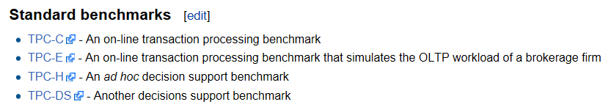
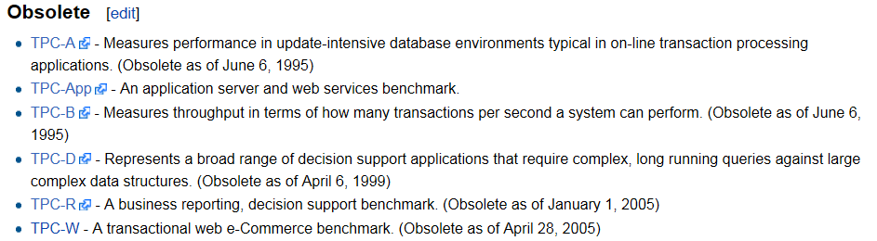

Slide 89
TPC
事务处理性能
最小代价下的响应时间以及吞吐量
估算一个TP系统性能的测试
TPC制订了3个基准(A, B, C), 每个基准定义标准的事务程序，并通过在一系列参数（如：工作负载、DB大小、响应时间保证等）条件下的吞吐量来刻划系统性能。
性能指标
最大吞吐量：每秒事务数 tps / 每分钟事务数 tpm
事务费用：(软硬件费用+5年的售后服务费) / tps

Slide 90
TPC-C Benchmark
数据库：基于批发供应商的订购应用
5种类型的事务
New-order
Payment
Order-status
Delivery
Stock-level
可测试的性能：
事务执行、访问二级Key、事务夭折等

