Slide 1
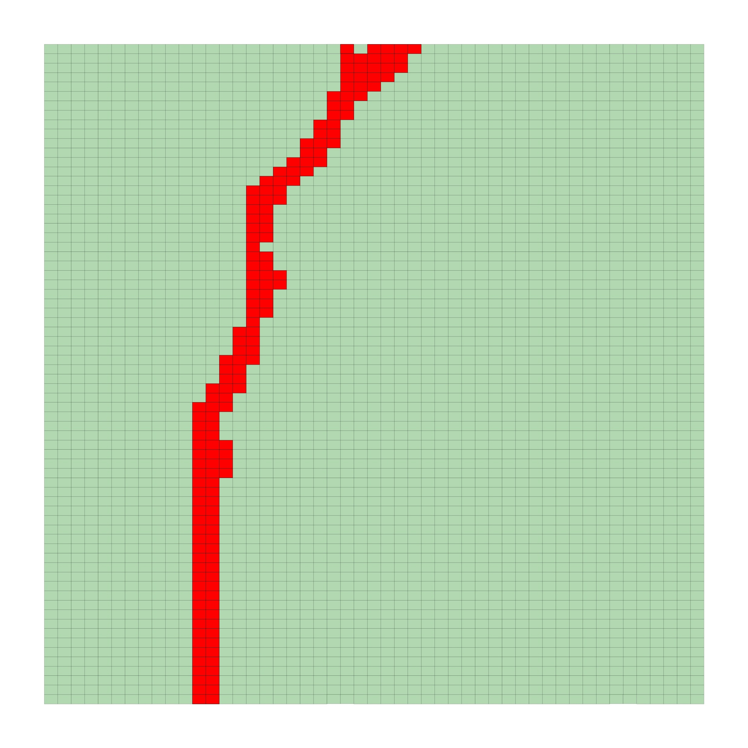
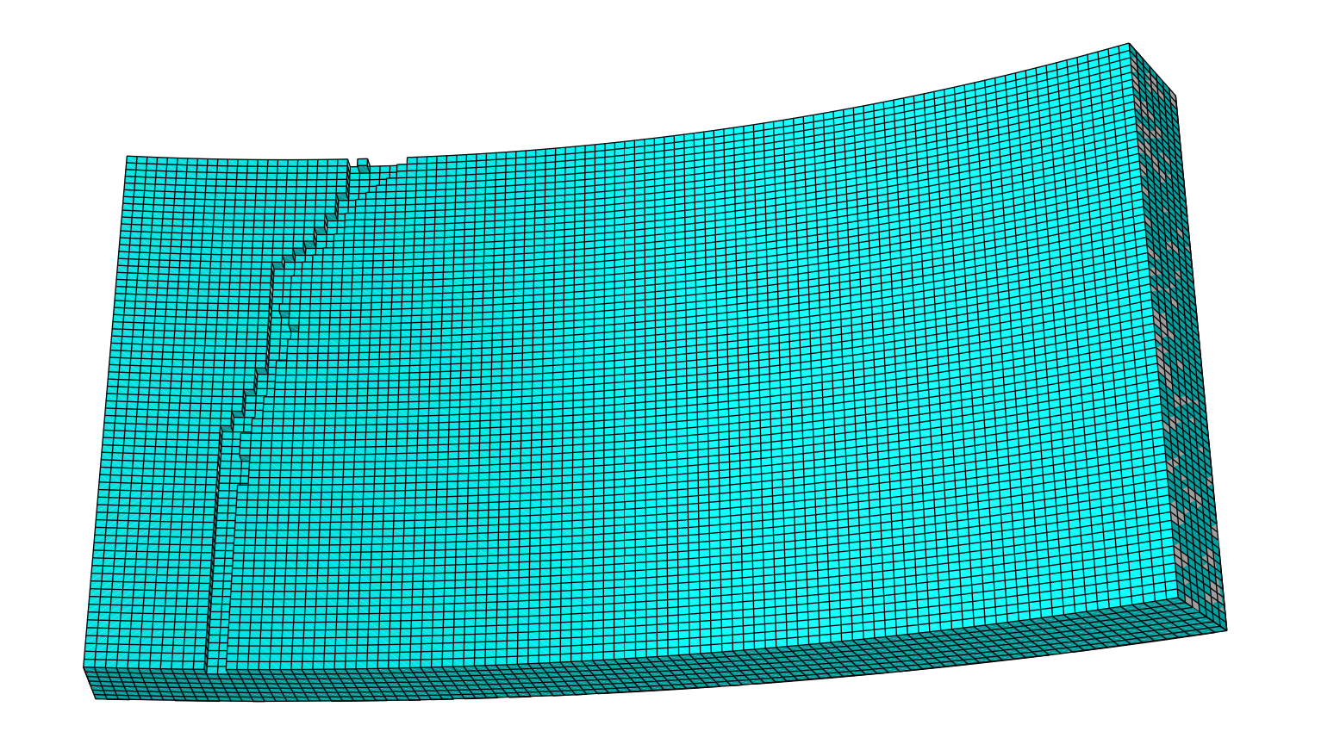
Model updating results:
(a) Crack match
(b) Updated FE model

Slide 2
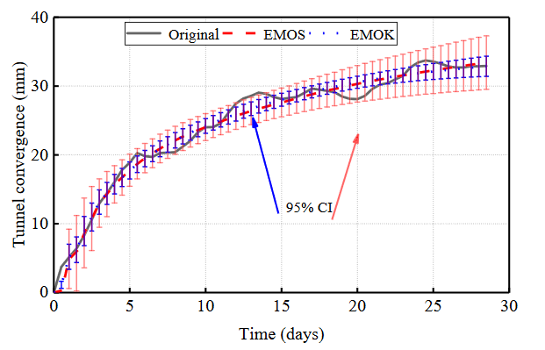
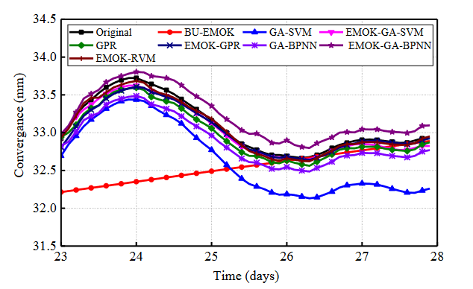
Prediction results of two empirical models:
Prediction results of the combined models:

