Slide 1




“I Have to Use My Son's QR Code to Run the Business”: Unpacking Senior Street Vendors' Challenges
in Mobile Money Collection in China
Changyang He¹, Lu He², Zhicong Lu³, and Bo Li¹
¹Hong Kong University of Science and Technology
²University of California, Irvine
³City University of Hong Kong

Slide 2
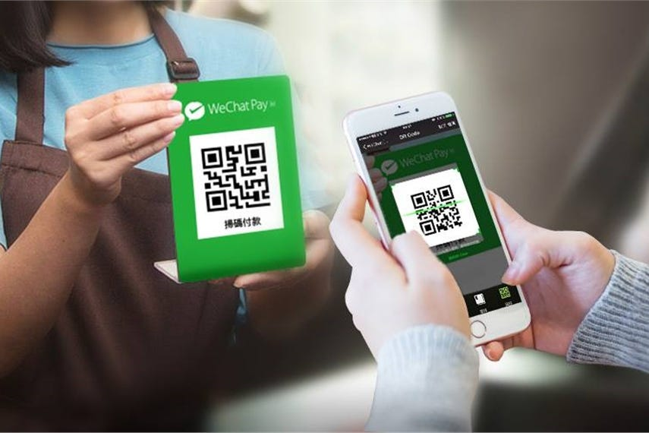
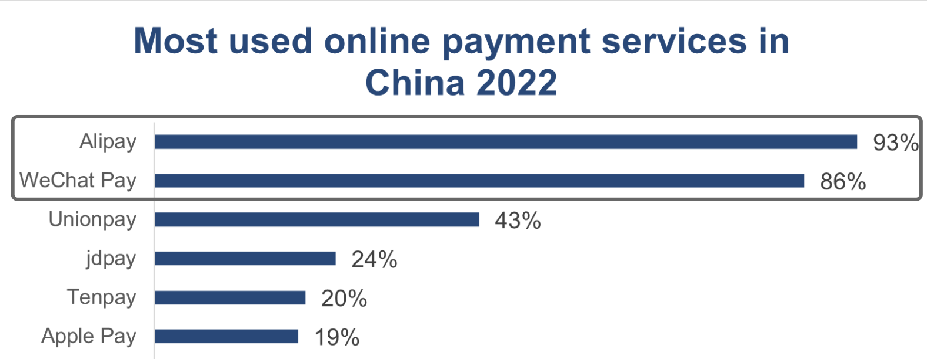
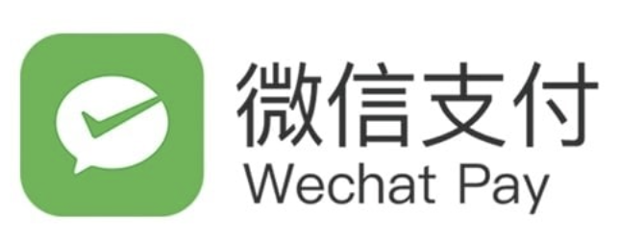

Motivation > Research Question > Method > Result > Discussion
Mobile Payment in China
Ubiquity of mobile payments in China
more than 800 million users
market > 50 trillion dollars
Homogeneity of mobile payments in China
scanning the QR code used by > 95% mobile payment users
WeChat Pay and Alipay used by > 85% mobile payment users
Changyang He · cheai@cse.ust.hk
Notes:
Mobile payment systems in China have been an infrastructural element with physical, social, and digital ubiquity.
(Cl)
By the end of 2020, the number of mobile payment users in China has reached 854 million, the market of which has exceeded 400 trillion yuan.
(Cl)
At the same time, mobile payments in China are relatively homogeneous. For the payment approach, scanning the QR code is used by more than 95% mobile payment users, while other digital payment methods such as NFC are less adopted.
(Cl)
For service providers, WeChat Pay and Alipay are two dominant mobile payment services, both of which are used by more than 85% mobile payment users.

Slide 3
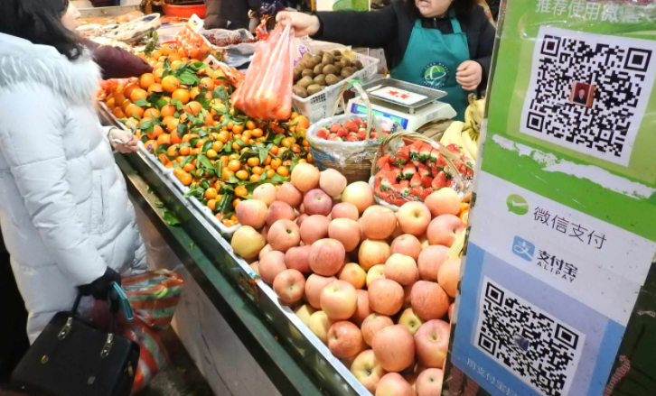
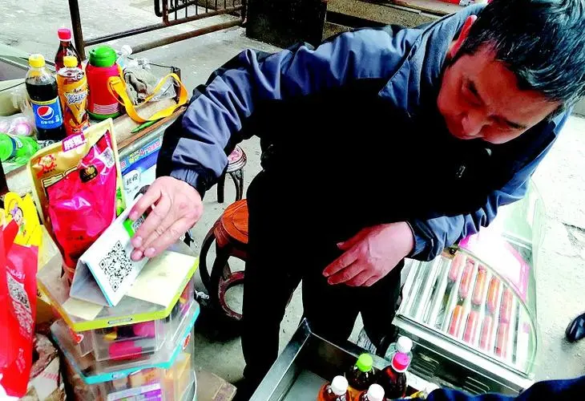
Motivation > Research Question > Method > Result > Discussion
Street Vending in China
Street vendors: people who offer goods or services for sale with a temporary static structure or mobile stall
a relatively low barrier for business
a popular type of informal economy across the Global South
The street setting brings challenges to mobile payment
uncertain and complex surroundings (e.g., poor network and light)
limit vendor-initiated money collection with electronic cash registers
Changyang He · cheai@cse.ust.hk
Notes:
Without exception, the use of mobile payment has also penetrated an important informal economy in China, namely, street vending. (CL) Street vendors are those who offer goods or services for sale with a temporary static structure or mobile stall. Like the figure above shows, a fruit seller adopts both wechat and Alipay QR code to collect money. Without the need to pay rent, street vending provides a relatively low barrier for business, especially for the low-income groups. Street vending is also common across many countries in the Global South.
(CL) Nonetheless, The street setting brings challenges to mobile payment. First, transactions typically happen under uncertain and complex surroundings. the figure below shows a vendor cleaning the QR code to enable scanning. Besides, the street setting limits the use of electronic cash registers, through which vendors could collect money by scanning customers’ QR code, which is safer for them.

Slide 4
Motivation > Research Question > Method > Result > Discussion
Challenges to Senior Street Vendors
Seniors [1] account for a large proportion of the traditional profession of street vending
Relatively low mobile payment adoption among seniors
In China, seniors had a much lower adoption rate of mobile payments (<50%) compared to the general public (~ 90%)
Senior Street Vendors vs. Senior Customers
A shaper change
essential role of mobile payments for business
challenges of senior vendors’ adoption and use of mobile payment
[1] In this work, we use “seniors” to refer to people above 50, the earliest retirement age in China.
Changyang He · cheai@cse.ust.hk
Notes:
(CL)Seniors above 50 account for a large proportion of the traditional profession of street vending.
(CL)
However, older adults had a much lower adoption rate of mobile payments compared to the general public. Some can not easily adopt it due to limited digital literacy, and some don’t want to use it due to usefulness and safety concerns.
(CL)
Unfortunately, compared to senior customers who can still choose cash in most scenarios and thus have a smoother transition to the cashless society, senior vendors face a sharper change to the ubiquity of mobile payments for everyday business. Also, vendors confront naturally distinct transaction-related challenges compared to customers, such as the change of the payment confirmation process.(CL)
(CL)There is a tension between the essential role of mobile payments for their everyday business and potential challenges in adopting and using mobile payment

Slide 5
Motivation > Research Question > Method > Result > Discussion
Research Questions
RQ1: What are the challenges of senior street vendors in adopting mobile payments for money collection?
RQ2: What strategies do senior street vendors use to adapt themselves to the cashless economy?
Changyang He · cheai@cse.ust.hk
Notes:
To have a comprehensive understanding of this problem, we propose two RQs.

Slide 6
Motivation > Research Question > Method > Result > Discussion
Method
A qualitative study
field observations on 33 senior street vendors (aged 53-72)
semi-structured interviews with 15 participants
Leverage “Moneywork” framework as an analytical lens
Pay attention to physical and social interactions (pre-, at-, and post-transaction phases) in specific contexts, instead of only focusing on the transfer of value
Changyang He · cheai@cse.ust.hk
Notes:
“physical and social interactions that users make individually and collectively in order to enable transactions”
To comprehensively investigate senior street vendors' situational challenges and strategies in mobile payment adoption, we leverage “Moneywork” framework as an analytical lens when we conducted open coding. In particular, we pay attention to physical and social interactions pre-, at-, and post-transaction phases in specific contexts, instead of only focusing on the transfer of value.

Slide 7
Motivation > Research Question > Method > Result > Discussion
Fieldwork
accept to interview
50 yuan ($8) compensation
Approaching senior street vendors in business
Get consent
1-2 hour observations
40 min - 1 hour interviews
If not, leave
If not, provide 20 yuan ($3) compensation
Location: Guangdong, China
Time: July and August 2021
Eligibility
above 50 years old (the earliest retirement age in China)
adopt any of the mobile money collection approaches for at least three months
Changyang He · cheai@cse.ust.hk
Notes:
The study took place in the field. In particular, we first approach senior street vendors in business. After getting vendors’ content, we conducted 1-2 hour non-participatory observations and took detailed notes. We then had semi-structured interviews with those accepting the interviews. Eligible participants should be above 50 years old and adopt any of the mobile money collection approaches for at least three months. we did not exclude any mobile payment adoption patterns, even in the most elementary way. For example, senior street vendors who had not mobile phones but provided printed QR codes were also included in this study.

Slide 8
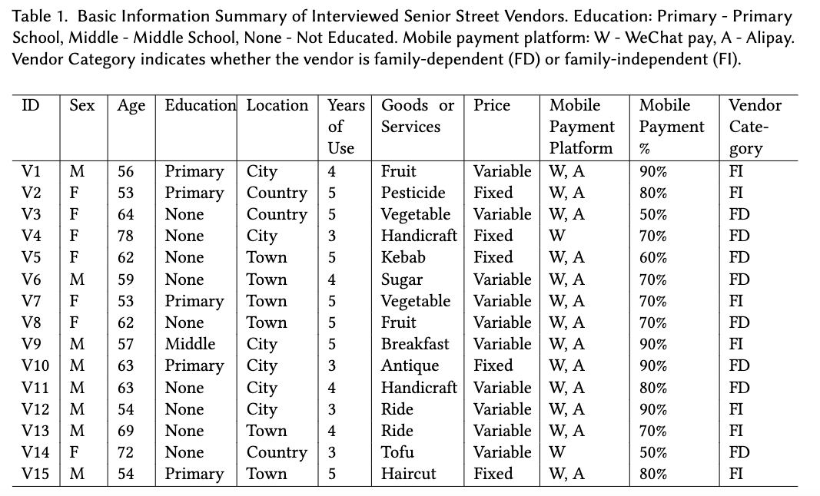
Motivation > Research Question > Method > Result > Discussion
Interviewees
7 female and 8 male
Aged 53 – 78
relatively low education level
3 - 5 year mobile payment use
> 50% daily income from mobile payment
Changyang He · cheai@cse.ust.hk
Notes:
In total, we interviewed 7 female and 8 male senior street vendors Aged from 53 to 78. They have relatively low education level in general. They have 3 - 5 year mobile payment use as of 2021, and mobile payments accounted for at least 50% of transactions for all senior street vendors, according to their own estimation.

Slide 9
Motivation > Research Question > Method > Result > Discussion
The Dilemma in Mobile Payment Adoption
Use Mobile Payment or Be Eliminated
Market-driven adoption: Passively adopting mobile payment facing the impact of cashless economy
Adopt mobile payments because of:
consumers' requests (N=7)
peer pressure (N=5)
suggestions from family (N=3)
I felt nervous when more and more people asked for WeChat Pay and Alipay. Some directly left when I said I did not have... I knew if I did not adopt them, my business would be affected. - (V2, F, 53)
Changyang He · cheai@cse.ust.hk
Notes:
First, we found that senior street vendors' mobile payment adoption in China was largely market-driven, when vendors either chose to adopt mobile payment, or got excluded by the increasingly cashless society. Passively adopting mobile payment facing the impact of cashless economy, instead of recognizing its benefits to use, was the common characteristic of senior vendors' motivations of mobile payment adoption.Specifically, vendors adopt mobile payments mainly due to consumers' requests, peer pressure, or suggestions from family. For example, V2 reported that ...

Slide 10
Motivation > Research Question > Method > Result > Discussion
The Dilemma in Mobile Payment Adoption
Use Mobile Payment or Be Eliminated
family-dependent use: rely on family's accounts, devices or QR codes to run their everyday business
the current family-independent (FI) vendors: request the family's short-term help in installation, set-up and onboarding
family-dependent (FD) vendors: directly request QR codes from family members for daily business and rely on family's long-term support
I never got educated and I am illiterate. It is impossible for me to use smartphones, let alone set up mobile payments. I only hold a dumbphone to contact my family, after my eldest son told me how to dial... But no one takes cash now. The only choice for me is to use my son's QR code. - (V4, F, 78, FD)
Changyang He · cheai@cse.ust.hk
Notes:
As such, family-dependent use, relying on family's accounts, devices or QR codes to run their everyday business, was the solution for many senior vendors.Some vendors request the family's short-term help in installation, set-up and onboarding, and become family-independent after learning the mobile payment use. Instead, some vendors had relatively low digital literacy, and had to directly request QR codes from family members for daily business and rely on family's long-term support.For example, V4, a 78 years old vendor noted, “”

Slide 11
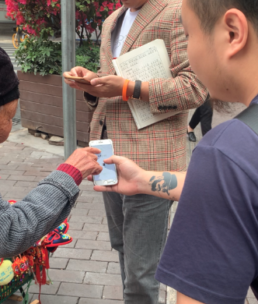

Motivation > Research Question > Method > Result > Discussion
Unexpected Difficulties of Different Confirmation Approaches
Visual-based Confirmation
the pop-up notification on their own devices?
no time and no available hands; no access for FD vendors
visually checking the payment information from customers
Difficulties
limited time due to social considerations
additional labor for FD vendor: payment information from customers as the only proof
I just take a glance (to check the payment proof). If you spend a long time checking, it seems that you distrust your customers and that makes your customers embarrassed - (V7, F, 53, FI)
Changyang He · cheai@cse.ust.hk
Notes:
Second, we identified unexpected difficulties for different payment confirmation approaches during transaction.
First, we found that vendors rarely relied on the pop-up notification on their own devices, because they have no time and no available hands to check phone messages in the busy and multitasking business, and FD vendors don’t have access to the signal. Therefore, visually checking the payment information from customers is the common choice.
However, they had to check in a limited time due to social considerations. As V7 described,” If you spend a long time checking, it seems that you distrust your customers and that makes your customers embarrassed”.
More importantly, FD vendor had to have additional labor in this step, as the payment information from customers as the only proof. Like this figure shows, V4 had to check the payment number and receiver who is actually her child very carefully to avoid mistakes or fraud.

Slide 12
Motivation > Research Question > Method > Result > Discussion
Unexpected Difficulties of Different Confirmation Approaches
Audio-based Confirmation: sound signal confirmation from the device (“WeChat Pay/Alipay receiving xx yuan”)
relied on more in street vending (“could free my hands and eyes”)
Difficulties
noisy circumstances in the street (especially for those with degraded hearing)
use external loudspeakers as a remedial strategy
the traffic was very noisy and my hearing was not so good, so I could not always hear the sound (of payment proof) clearly - (V1, M, 56, FI)
Changyang He · cheai@cse.ust.hk
Notes:
Also, vendors reported that sound signal confirmation from the device is relied on more in street vending, because it could free their hands and eyes in the busy business. However, noisy circumstances in the street become obstacles, and using external loudspeakers connected through Bluetooth become a remedial strategy.

Slide 13
Motivation > Research Question > Method > Result > Discussion
Payment Fraud
Signal-based Fraud
Fake screenshots of payment proof
e.g., proof of another payment that was appropriated
Fake sounds of payment proof
e.g., creating the sound signal using customers’ own devices
Interaction-based Fraud
Invalid half-done proof before entering the password
Excuses for leaving to pay (e.g., poor network)
Changyang He · cheai@cse.ust.hk
Notes:
Besides, vendors also face different types of mobile payment-based fraud. Nearly all of them have encountered fake screenshots of payment proof, such as screenshots of another payment that was appropriated. Some also found fake sounds of payment proof when some customers create the sound signal using their own devices.
Notably, they not only met Fraud with faked signals, but also fraud occurring from interactions. For example, some customers showed Invalid half-done proof before entering the password, and some customers found excuses for leaving to pay such as poor network.
To cope with the fraud, vendors had to balance the trust and risk of fraud, such as carefully checking non-regular customers.
The fraud also become incentives to motivate vendors evolve from FD use to FI use for mixed-method rather than relying on only customers’ proof
.

Slide 14
Motivation > Research Question > Method > Result > Discussion
The Lost Money Freedom: When income flows into family's wallet
inability or inconveniences to freely collect, withdraw or spend the money they earned
Additional labor
digital money in the family's wallet
disposable cash
comparing and verifying each transaction, summing up income, communicating with family, withdrawing money from the bank…
My son runs a business, too. This QR code is used for both his and my business. It is hard to distinguish between his income and mine... I record transactions in this notebook. In the beginning, we checked my income on his smartphone every day, but that was too troublesome. Now I only tell him how much I earn every month, and he gives me the money in cash when he visits me.- (V14, F, 72, FD)
Changyang He · cheai@cse.ust.hk
Notes:
When using the family's account to collect digital money was adopted as senior street vendors' last choice to avoid being divided, most of their daily income flowed into the family's wallet, instead of becoming their own disposable money. It brought a less visible yet critical challenge to these family-dependent vendors: the lost ``money freedom’’, which referred to the inability or inconveniences of vendors to freely collect, withdraw or spend the money they earned.
First, to transfer digital money in the family's wallet to disposable cash, vendors have to go through a complex social and monetary process including comparing and verifying each transaction, summing up income, communicating with family and withdrawing money from the bank. For instance, V14 said “My son runs a business, too. This QR code is used for both his and my business. It is hard to distinguish between his income and mine... I record transactions in this notebook. In the beginning, we checked my income on his smartphone every day, but that was too troublesome. ”

Slide 15
Motivation > Research Question > Method > Result > Discussion
The Lost Money Freedom: When income flows into family's wallet
disadvantaged economic status caused by lost money freedom
I only request the cash for daily cost, which is definitely much lower than my earnings in his wallet. The remaining income is left to support his small family. However, I think he regards it as a matter of course gradually and sometimes he is reluctant to give me the money... I feel really upset when the fact is that I support him, but it seems that he gives me the money. - (V3, F, 64, FD)
transparency of business
When my wife checks the phone, she knows how much I earn and when I do the business. Just kidding, sometimes I feel I am under surveillance...- (V11, M, 63, FD)
Solution: requesting cash when possible, and not advertising mobile payments
Changyang He · cheai@cse.ust.hk
Notes:
It was notable that such a compensatory measure for lost money freedom naturally put senior street vendors at a disadvantaged position. For example, V3 said that “I feel really upset when the fact is that I support him, but it seems that he gives me the money”.
Besides, the lost money freedom also led to senior street vendors' concerns about business privacy. V11 complained that “When my wife checks the phone, she knows how much I earn and when I do the business. Just kidding, sometimes I feel I am under surveillance”.
Therefore, some vendors don’t explicitly show the QR code till the customers requested, as ask for cash when possible.

Slide 16
Motivation > Research Question > Method > Result > Discussion
Discussion
Contextual Vulnerabilities for Senior Street Vendors in a Cashless Economy
sociotechnical context: lagging behind the cashless society
situational context: situational impairments under complex physical configurations
interpersonal context: vendor-customer and vendor-family interactional asymmetry
Family as a Cushion against Technology Impact
family's support provides a dynamic and lasting cushion to prevent senior adults from being eliminated in technological innovations of payment methods
the tension between intermediated mobile payment use and financial autonomy
Yue Deng · ydengbi@cse.ust.hk
Notes:
The findings uncovered rich nuances of challenges in mobile money collection beyond a binary view of ``inclusion'' or ``exclusion”.
Based on the findings, we delve into the Contextual Vulnerabilities for Senior Street Vendors in a Cashless Economy, such as how vendors lagged behind the cashless society under the sociotechnical context, and how vendors faced vendor-customer and vendor-family interactional asymmetry under the interpersonal context
This work also shed light on how family's support provides a dynamic and lasting cushion to prevent senior adults from being eliminated in technological innovations of payment methods, and raised concerns about the the tension between intermediated mobile payment use and financial autonomy
.

Slide 17
Motivation > Research Question > Method > Result > Discussion
Design Implications
Family-friendly Design: Balancing Intermediated Mobile Payment Use and Financial Autonomy
“sub-account” system to support dependants' financial management
remote connections for dumbphones to enable vendors to receive payment signals
Supporting Hybrid Confirmation
auxiliary device incorporating visible screens and loudspeakers
failed payment warning in addition to successful payment notification
Yue Deng · ydengbi@cse.ust.hk
Notes:
We .

Slide 18
Thanks for listening!
Summary:
We unpack the challenges of senior street vendors facing the ubiquity of mobile payment, and emphasize the significance to understand contextual vulnerabilities of underrepresented groups in different transactional stages.
We reveal the varied strategies of senior street vendors to conduct mobile money collection, which necessitate considerations for heterogeneity in HCI4D and support for non-users.
We discover how family serves as a cushion for older adults against the rapid shift to a cashless society in China, and raise implications for family-friendly design in response to the technology impact.
Changyang He¹ (On the job market!), Lu He², Zhicong Lu³, and Bo Li¹
¹Hong Kong University of Science and Technology
²University of California, Irvine
³City University of Hong Kong

Slide 19
Motivation > Research Question > Method > Result > Discussion
Challenges to Senior Street Vendors
Senior Street Vendors vs. Senior Customers
A shaper change
Compared to senior customers who can still choose cash in most scenarios and thus have a smoother transition to the cashless society, senior vendors face a sharper change to the ubiquity of mobile payments for everyday business
Distinct challenges
vendors confront naturally distinct transaction-related challenges compared to customers, such as novel mobile payment-based frauds and alteration of the payment confirmation process
Changyang He · cheai@cse.ust.hk

Slide 20
Motivation > Research Question > Method > Result > Discussion
Data Collection
Observation
non-participatory observation
pay attention to confirmation period
detailed notes
guide some impromptu interview questions
Semi-Structured Interviews
adoption of mobile payment
interaction with customers
(pre-, at-, and post-transaction)
fraud and countermeasures
positive and negative experiences
Changyang He · cheai@cse.ust.hk
Notes:
Objective: get a preliminary understanding of the transactional interactions and the possible challenges for senior street vendors

Slide 21
Motivation > Research Question > Method > Result > Discussion
Data Analysis
generating initial codes => open coding
cover transactional interactions across different stages of Moneywork
examples: “fake screenshot of payment proof”, “concerns on business privacy”
validating credibility => meetings, comparisons and discussions
Developing high-level themes => affinity diagramming
Examples: “the lost money freedom”
organize the high-level themes into pre-, at-, and post-transaction phases
Changyang He · cheai@cse.ust.hk
Notes:
Objective: get a preliminary understanding of the transactional interactions and the possible challenges for senior street vendors

