Slide 1
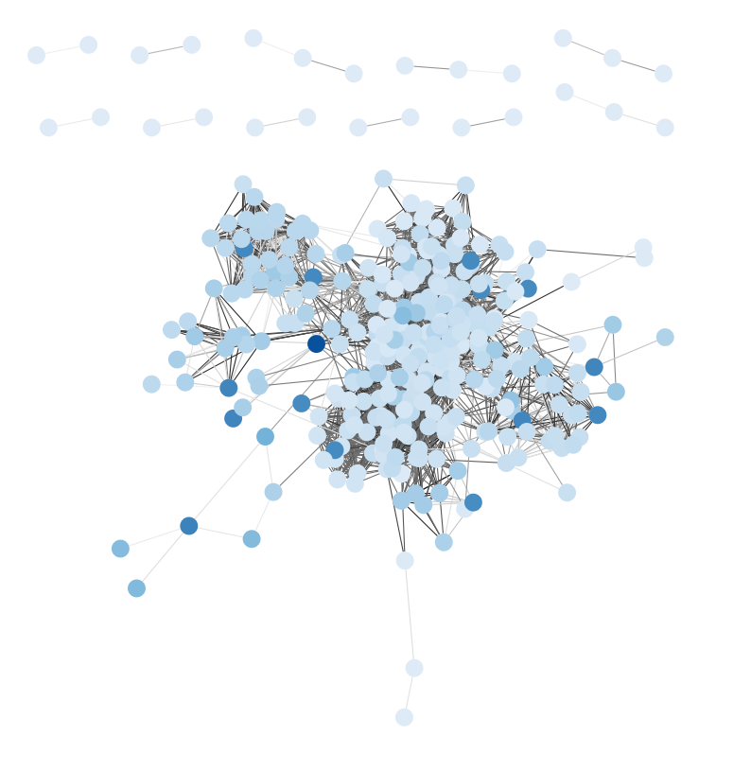
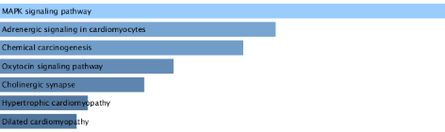
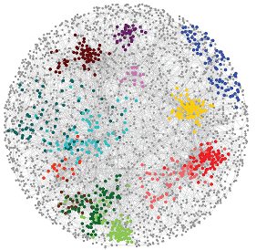
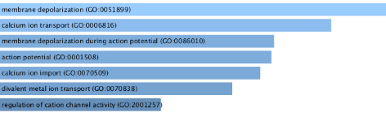
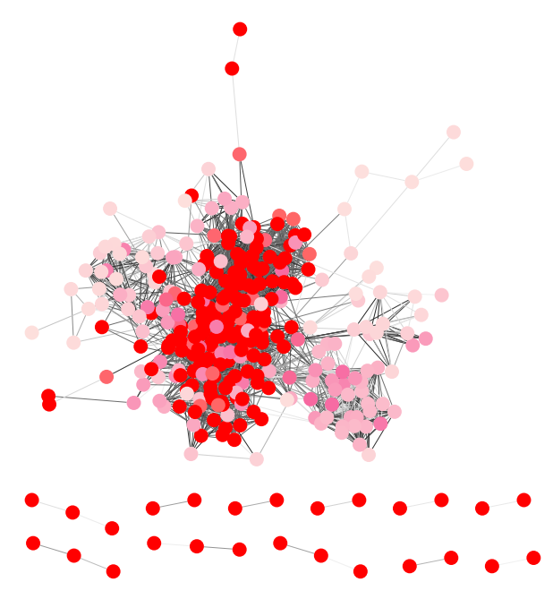
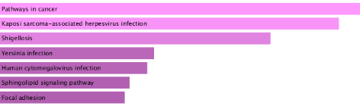
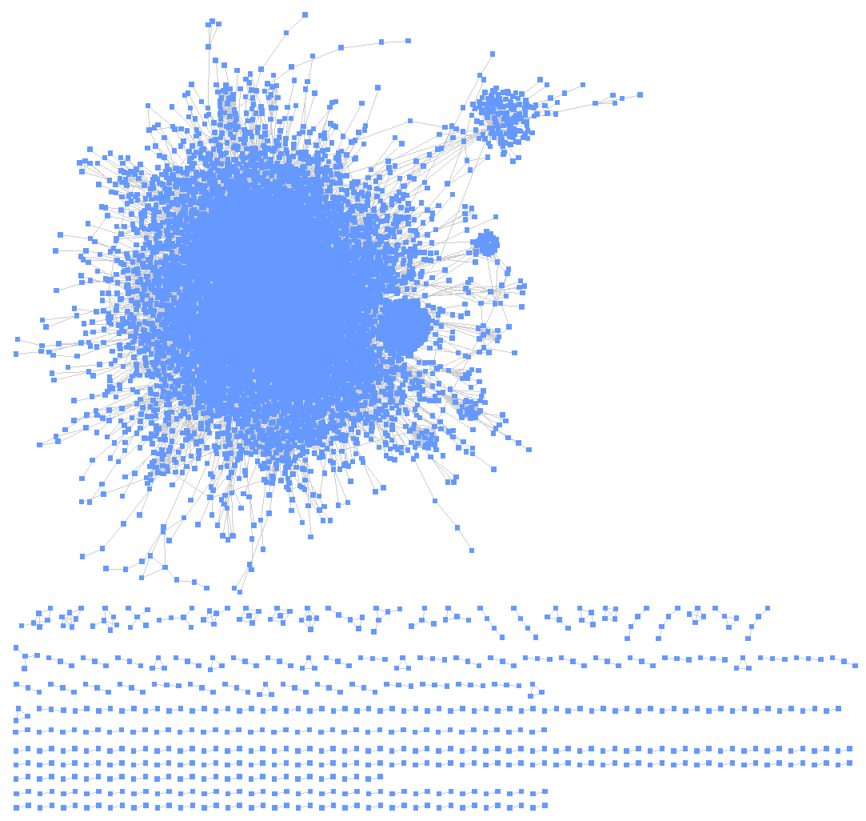
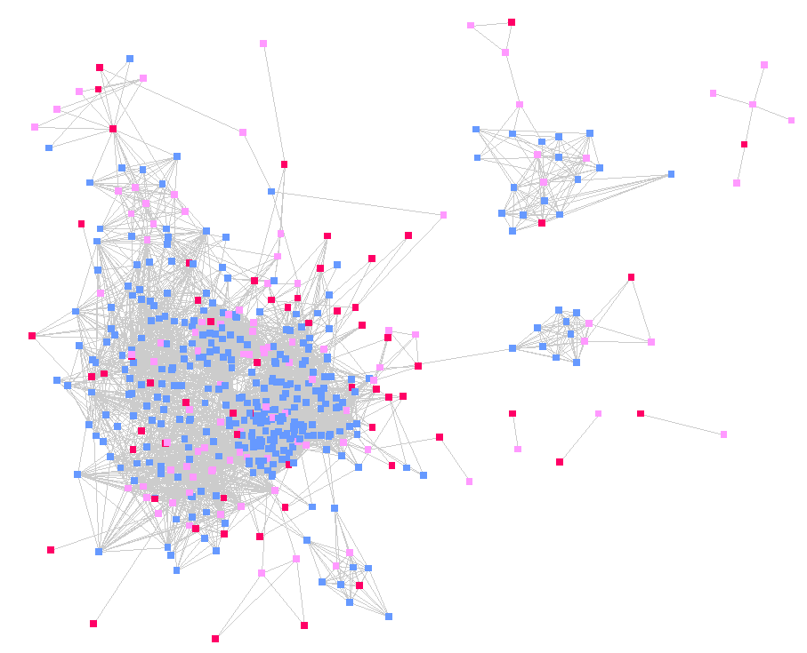
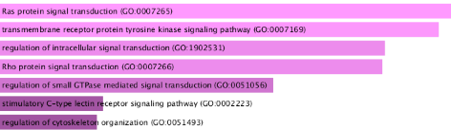
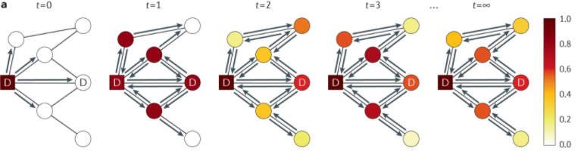
Network analysis to predict the influence of Lin28a deficiency
Chang Yun Cho
Recently, numerous bioinformatic techniques have been proposed for genetic analysis using network, based on random walks, information diffusion and electrical resistance.
Network propagation is a state-of-the-art-method using random walk with restart algorithm to interpret individual gene-level perturbations at the network-level associations (Cowen, et al., 2017).
Deficient of Lin28 results in developmental defects and tumorigenesis was reported (Zhu et al., 2010).
Identification of DEGs (|log₂FC|≥1)
RNA-seq siLuc, siLin28a (filter >=30)
Down regulated
Up regulated
Obtain Protein-Protein Interaction Network (PPI) from public database (StringDB).
Extract sub-PPI network with edge score.
DEGs as seeds, propagate information through network iteratively.
Analyze highly scored non-seed genes (EnrichR).
Results
Motivation
Workflow
Down regulated
KEGG Pathway
GO Biological Process
Up regulated
A NETWORK OF INTERACTIONS BETWEEN THOUSANDS OF GENES
KEGG Pathway
GO Biological Process
Result shows MAPK signaling KEGG Pathway (down regulated) and Pathways in cancer KEGG Pathway (up regulated) are influenced by siLin28a.
PPI network contains comprehensive functional association.
Other pathways and GO biological process need to be checked.
Discussion

