Slide 1
Git & GitHub
How to get started with GIT and work with GIT Remote Repo
( https://www3.ntu.edu.sg/home/ehchua/programming/howto/Git_HowTo.html )

Slide 2
Table of Contents
1. Introduction
2. Setting Up Git
3. Git Basics 4. Tagging
5. Branching/Merging 6. Collaboration

Slide 3
1. VCS (Version Control System)
A VCS serves as a Repository (or repo) of program codes, including all the historical revisions.
It records changes to files at so-called ”commits” in a log so that you can recall any file at any commit point.

Slide 4
VCS
Why VCS?
The Repository serves as the backup (in case of code changes or disk crash).
It is a living archive of all historical revisions. It lets you revert back to a specific version, if the need arises.
It facilitates collaboration between team members, and serves as a project management tool.
more...

Slide 5

VCS
Centralized VCS(e.g., CVS, Subversion)
a single server that contains all the versioned files.
a number of clients that check out files from that central place.
If that server goes down, then nobody can collaborate

Slide 6
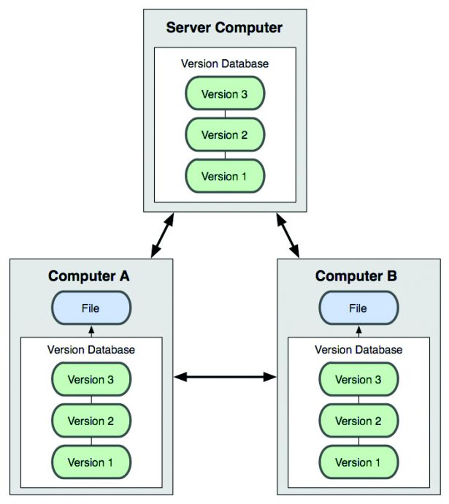
VCS
Distributed VCS(e.g., git)
each user has a full copy of the database

Slide 7
Git
Initially designed and developed by Linus Torvalds, in 2005, to support the development of the Linux kernel
Distributed Version Control System (DVCS)
Mother site for Git: http://git-scm.com.

Slide 8
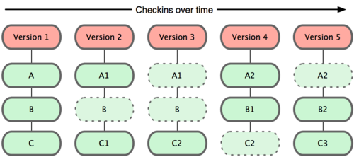
Git
Commit Snapshots (git)
Every time you commit, Git takes a snapshot and stores a reference to that snapshot
If files have not changed, Git doesn’t store the file again --just a link to the previous identical file it has already stored

Slide 9
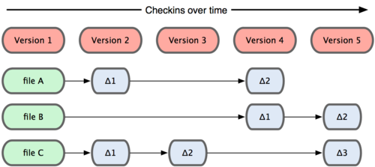
Git
Commit Deltas(CVS, Subversion)
These systems think of the information as a set of files and the changes(deltas) made to each file over time
Merges can be slow to carry out

Slide 10
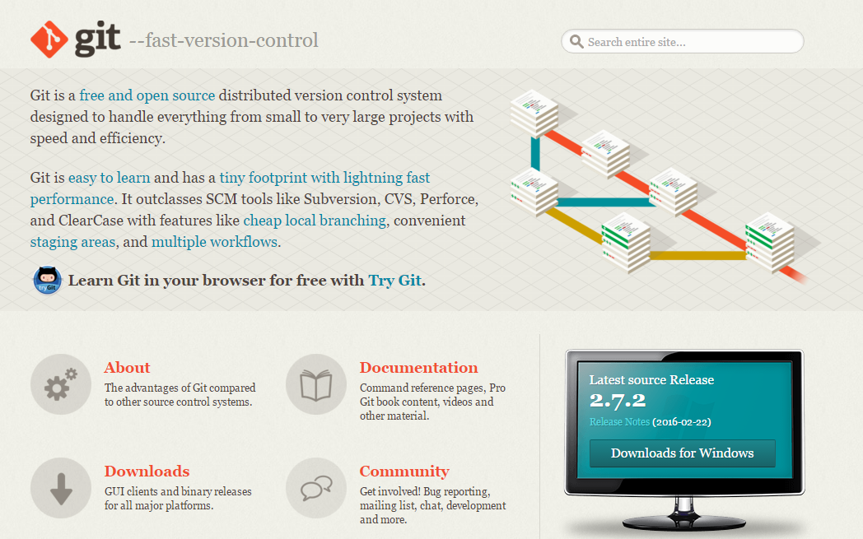
2. Setting Up Git
http://git-scm.com

Slide 11

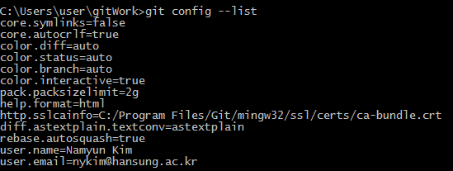
Setting Up Git
Customize Git
issue “git config” command
// Set up your username and email (to be used in labeling your commits)
// to list the settings

Slide 12
Setting Up Git
Customize Git
if you want to set the editor only for git

Slide 13
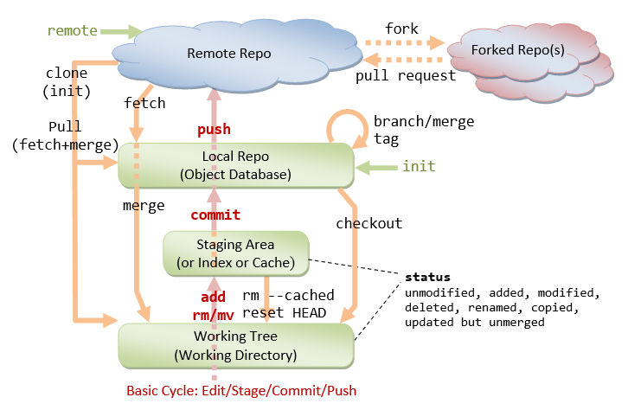
3. Git Basics

Slide 14
Git Commands
// command form
$ git <command> <arguments>
// commmonly-used commands
init, clone, config: for starting a Git-managed project.
add, mv, rm: for staging file changes.
commit, rebase, reset, tag:
status, log, diff, grep, show: show status
checkout, branch, merge, push, fetch, pull

Slide 15
3.1 Getting Stared with Local Repo
There are 2 ways to start a Git-managed project
Starting your own project
Cloning an existing project from a GIT host (github, bitbucket)

Slide 16
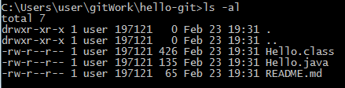
1) Setup the Working Directory
hello-git project
// Hello.java
public class Hello {
public static void main(String[] args) {
System.out.println("Hello, world from GIT!");
}
}
//README.md
This is a README file for the Hello-world project.

Slide 17
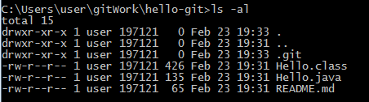
2) Initialize a new git repo (git init)
initialize a git repository on current folder
Run "git init" at the project root directory
A hidden sub-directory called ".git" will be created

Slide 18
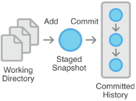
Basic Work Cycle
Edit/Stage/Commit
You MODIFY files in your working directory.
You STAGE the files, adding snapshots of them to your staging area.
You do a COMMIT, which takes the files as they are in the staging area and stores that snapshot permanently to your git directory.
Staging
Area
Working
Directory
Local
Repository

Slide 19
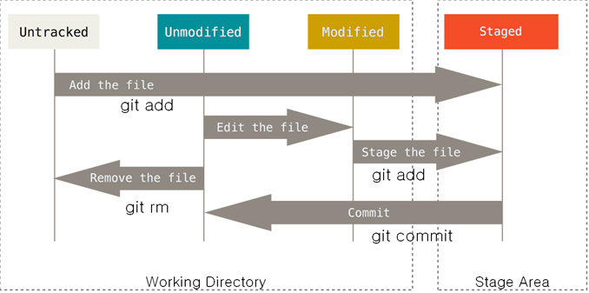
Lifecycle of the status of files
tracked
New file
The files in the working tree are either untracked or tracked.
Git uses two steps to commit file changes:
"git add <file>" to stage file changes into the staging area, and
"git commit" to commit ALL the file changes in the staging area to the local repo.

Slide 20
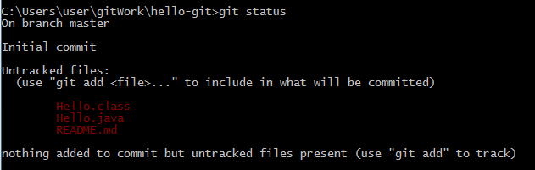
3) Staging File Changes for Tracking (git add)
Issue a "git status" command to show the status of the files
To stage a new file for tracking, use "git add <file>" command.

Slide 21
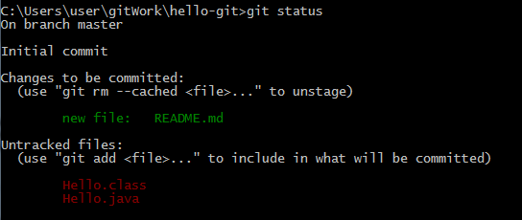
Staging File Changes for Tracking
When a new file is added, it is staged (or indexed, or cached)
in the staging area but NOT yet committed.

Slide 22
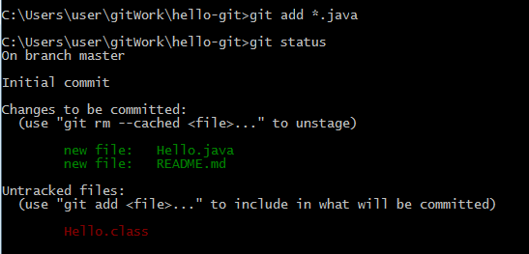
Staging File Changes for Tracking
You can use wildcard * in the filename.
You can also use "git add ."
to add all the files in the current directory (and all sub-directories).
Use “git rm --cached <file> to unstage

Slide 23

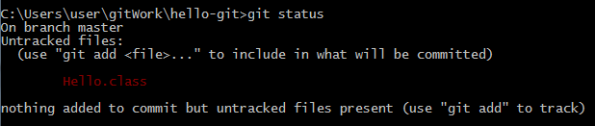
4) Committing File Changes (git commit)
The "git commit" command commits ALL the file changes in the staging area.
Use a -m option to provide a message for the commit.

Slide 24
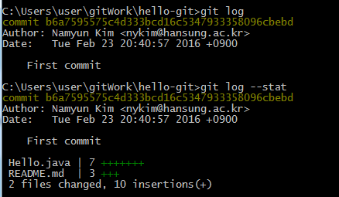
5) Viewing the Commit Data (git log)
You can use "git log" to list the commit data
Each commit is identified by a 40-hex-digit SHA-1 hash code.
But we typically use the first 7 hex digits

Slide 25
6) File Status (git status)
In Git, changes for a tracked file could be:
unstaged (in Working Tree)
staged (in Staging Area or Index or Cache)
committed (in local repo object database)

Slide 26
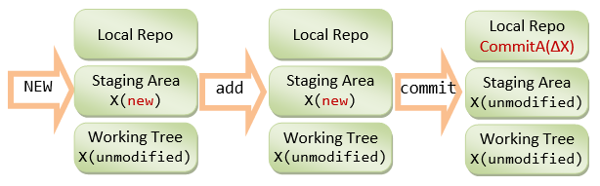
File Status(git status)
X (new)
When a new file is created in the working tree,
it is marked as new in working tree and shown as an untracked file.
When the file change is staged,
it is marked as new (added) in the staging area,
and unmodified in working tree.
When the file change is committed,
it is marked as unmodified in both the working tree and staging area.

Slide 27
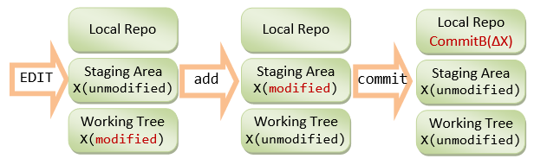
File Status(git status)
When a committed file is modified,
it is marked as modified in the working tree and unmodified in the staging area.
When the file change is staged,
it is marked as modified in the staging area and unmodified in the working tree.
When the file change is committed,
it is marked as unmodified in both the working tree and staging area.

Slide 28
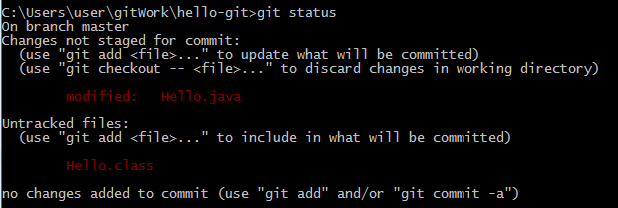
File Status(git status)
//hello.java
public class Hello {
public static void main(String[] args) {
System.out.println("Hello, world from GIT!");
System.out.println("Changes after First commit!");
}
}

Slide 29
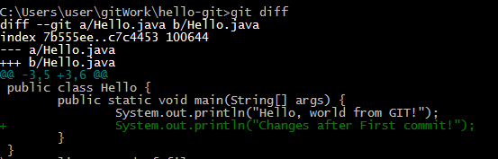
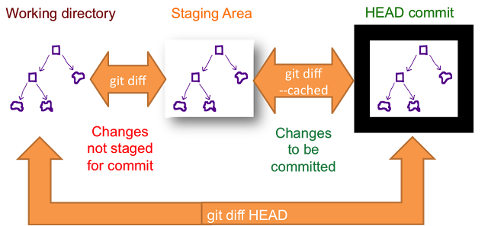
7) Compare Files (git diff)
"git diff" command
show the file changes in the working tree
1
2
3
The older version is marked as --- and new one as +++.
Each chunk of changes is delimited by
"@@ -<old-line-number>,<number-of-lines>
+<new-line-number>,<number-of-lines> @@".
Added lines are marked as + and deleted as -.

Slide 30
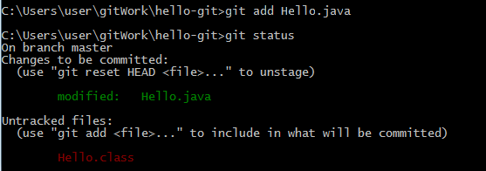
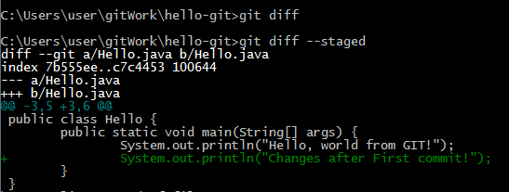
Compare Files
Issuing an "git diff" to show the unstaged changes results in empty output.
You can inspect the staged change (in the staging area)
via "git diff --staged( or cached)" command

Slide 31
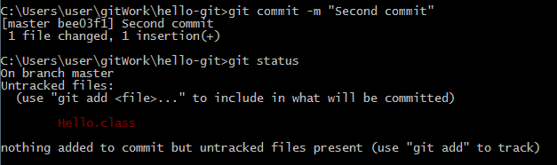
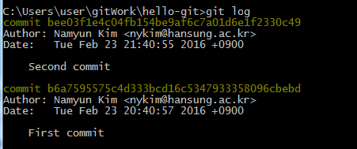
More “git log”
Issue "git log" to list all the commits:

Slide 32
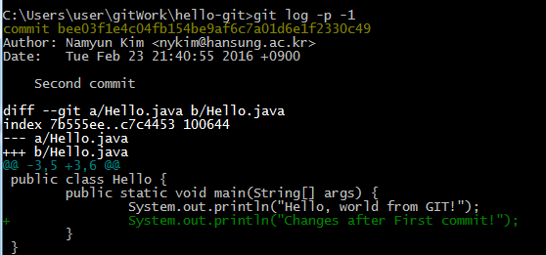
More “git log”
Check the patches for the latest commit via "git log -p -1",
with option -n to limit to the last n commit:

Slide 33
8) The .gitignore File
To ignore files from being tracked and remove them from the untracked file list
create a ".gitignore" file in your project directory, which list the files to be ignored
.class, .o, .exe …
# .gitignore
# Java class files
*.class
# Executable files
*.exe
# Object and archive files
# Can use regular expression, e.g., [oa] matches either o or a
*.[oa]
# temp sub-directory (ended with a directory separator)
temp/

Slide 34
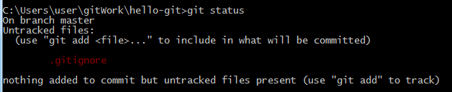
The .gitignore File
"Hello.class" is not shown in "Untracked files".

Slide 35
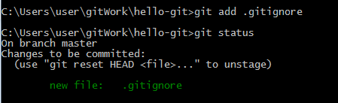
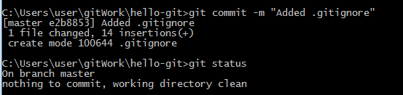
The .gitignore File
track and commit the .gitignore file.

Slide 36
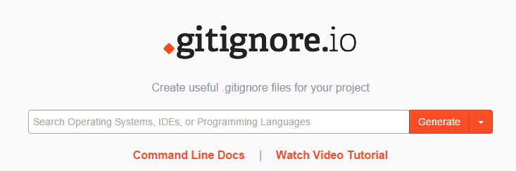
Generating ‘.gitignore’ File
https://www.gitignore.io/

Slide 37
Lab 1
New, Edit/Stage/Commit Cycle
installing git - http://git-scm.com
git init
git add, git commit
git status/git log
.gitingore

Slide 38
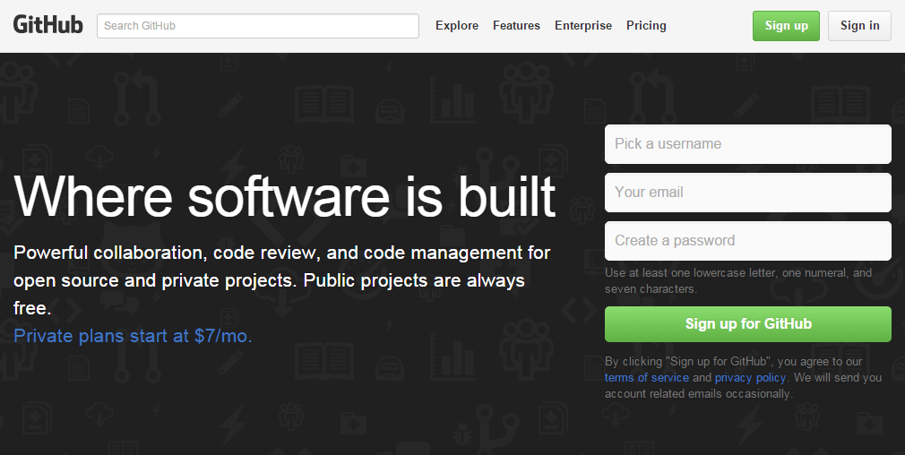
3.2 Setting up Remote Repo
Sign up for a GIT host, such as Github (https://github.com)

Slide 39
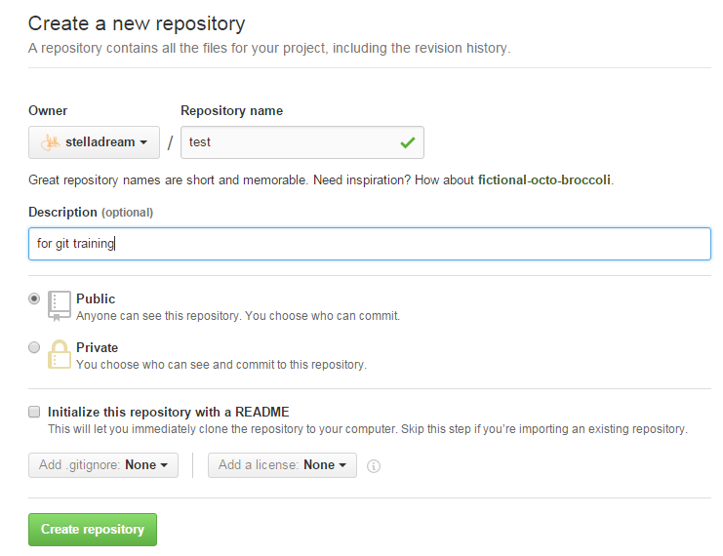
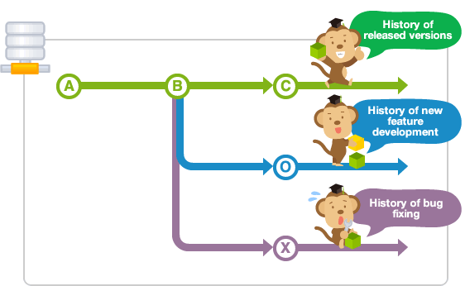
1) Create a new remote repo
repo
Mater branch
Devel branch
Hotfix branch

Slide 40

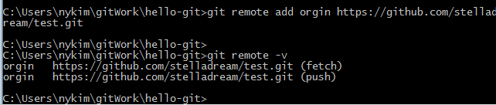
2) Create a new connection to a remote repository (git remote add)
"git remote add <remote-repo-name> <remote-url>"
the URL of a remote repo, copy it
1
2
We shall name our remote repo as "origin“
Now, we can manage the remote connection,
using a simple name instead of the complex URL
To remove, git remote rm origin

Slide 41
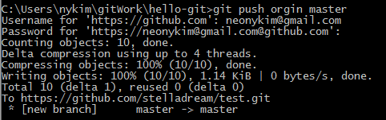
3) Push the specified branch to <remote> (git push)
git push <remote-repo> <local-branch-name>
By convention, the main branch of our local repo is called "master"
local repo/master branch -> remote repo(origin)/master branch

Slide 42
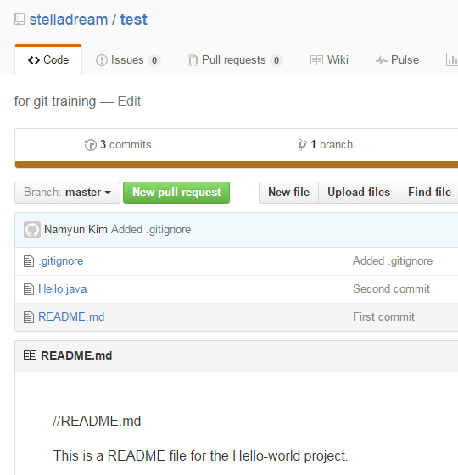
Push the specified branch to remote repo
Remote
repo
branch

Slide 43
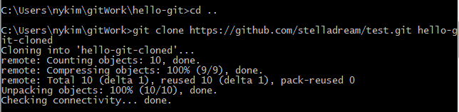
3.3 Cloning a repository into a new directory (git clone)
$ git clone <remote-repo-url> <working-directory>
Clone our remote repo "test" into
a new working directory called "hello-git-cloned"

Slide 44
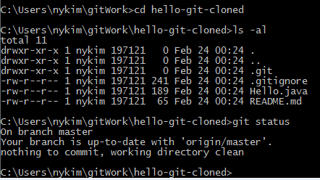
Cloning a repository into a new directory

Slide 45
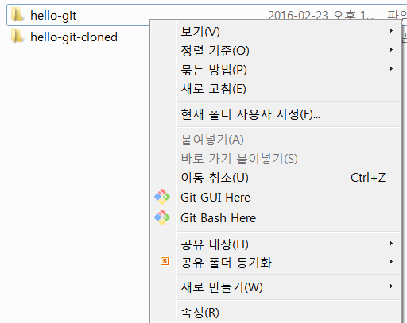
3.4 Git GUI Tools
Right-click on the project folder and choose "Git Gui"

Slide 46
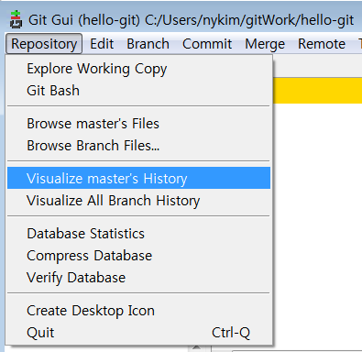
Git GUI Tools

Slide 47
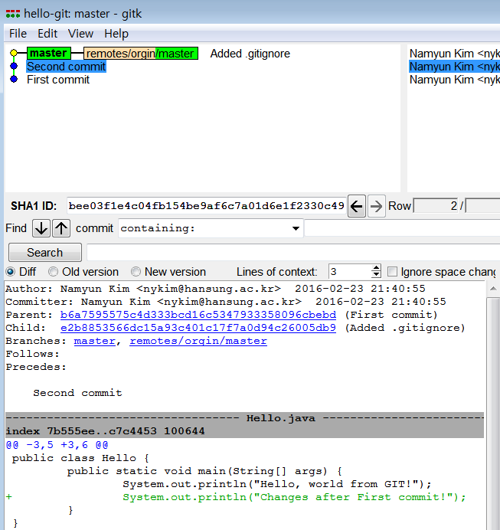

Slide 48
3.5 Summary of Basic Cycle (Edit/Stage/Commit/Push)
// Edit (Create, Modified, Rename, Delete) files,
// which produces "unstaged" file changes.
// Stage file changes, which produces "Staged" file changes
$ git add <file> // for new and modified files
$ git rm <file> // for deleted files
$ git mv <old-file-name> <new-file-name> // for renamed file
// Commit (ALL staged file changes)
$ git commit -m <message>
// Push
$ git push <remote-repo-name> <local-branch-name>

Slide 49
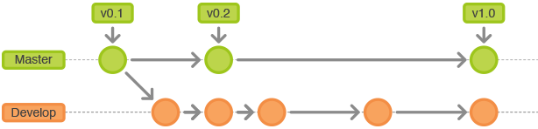
4. Tagging (git tag)
Tag (or label) can be used to tag a specific commit as being important, for example, to mark a particular release.
I recommend that you commit your code and push it to the remote repo as often as needed (e.g., daily), to BACKUP your code.
When you code reaches a stable point (in turn of functionality), create a tag to mark the commit.

Slide 50

Tagging
Creating an Annotated Tag
$ git tag –a <tag-name> -m <message>
Listing Tags
$ git tag
Git database contains the tagger name,
email, date and a tagging message
create an annotated tag at the latest commit

Slide 51
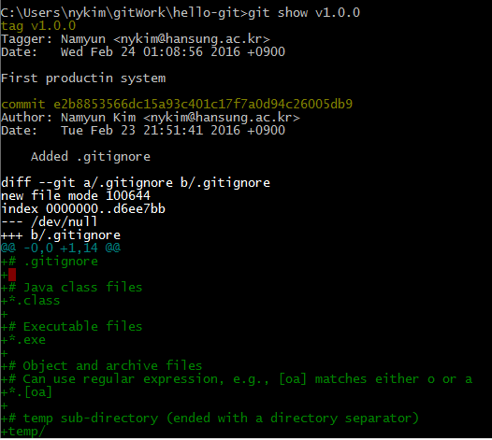
Tagging

Slide 52
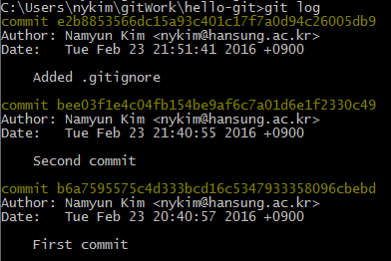
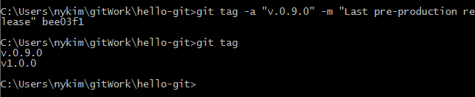
Tagging
Create a tag for an earlier commit

Slide 53
Lab 2: remote repo
Alice
Create github account
Create remote repo
Push a local branch to remote repo
(git remote add, git push)
Bob
clone remote repo to working directory

